Slide 1

Malnutrition

Slide 2
Outline
Why diagnose Malnutrition
Pediatric Malnutrition Criteria
Adult Malnutrition Criteria
Case Studies
Malnutrition PES Statements

Slide 3
Why Diagnose Malnutrition?
Developmental, Physical, Functional Outcomes:
  Decreased IQ
  Developmental delays
  Loss of LBM
  Decreased lung function
  Stunting
  Increased infections, decreased immune function
  Delayed wound healing
  Increased morbidity
  Increased LOS, cost, readmission rates
Need for consistency and improvement in nutrition assessments from all disciplines
  Variable terminology: FTT, underweight, poor weight gain, undernutrition
  Variable methods of assessment

Slide 4
Difficult to determine:
Prevalence of Malnutrition in Hospitals
• 30-50% of patients are malnourished upon hospital admission¹
• A 2011 Johns Hopkins study showed that 53% of patients are malnourished²
• 38% of patients with normal nutrition status experience decline during hospitalization³
Prevalence ranges for 15-60%
Many definitions of malnutrition
Not Malnourished
Up to 50% Malnourished
Correia and Campos. Nutrition 2003; 19:823-825
Somanchi. JPEN 2011; 35: 209-216
Braunschweig et al. JADA 2000; 100: 1316-1322

Slide 5

Consequences of Unrecognized Malnutrition
Increased morbidity and mortality
Decreased quality of life
Increased frequency of hospital admissions and readmissions
Increased muscle loss/functional loss
  45% of patients who had fallen in an acute care setting were malnourished
Impaired wound healing
  2x more likely to develop pressure ulcer
Increased healthcare costs

Slide 6
Pediatric Malnutrition

Slide 7
Pediatric Malnutrition
Ages 30 days (CGA) through 17 years
Classifications:
  Acute (≤3 months) vs Chronic (>3 months)
  Illness (disease or trauma related) vs Non-illness-related (environmental, social, behavioral)
  Mild, Moderate or Severe malnutrition
You will learn about assessing and diagnosing neonatal malnutrition in a future education, it is not addressed in this module
Notes:
At this time there is not criteria for diagnosing malnutrition in neonates or premature infants
You should always use clinical judgment when diagnosing malnutrition

Slide 8
Primary Indicators for Pediatric Malnutrition
Single data point available for diagnosis
Primary Indicators | Mild Malnutrition | Moderate Malnutrition | Severe Malnutrition
Weight for length z score | -1 to -1.9 z score | -2 to -2.9 z score | -3 or less z score
BMI for age z score | -1 to -1.9 z score | -2 to -2.9 z score | -3 or less z score
Length/height for age z score | No data | No data | -3 or less z score
Mid-upper arm circumference (6-59 months) | -1 to -1.9 z score | -2 to -2.9 z score | -3 or less z score
Notes:
Can make diagnosis when only single point available:
Weight for Length z-score
BMI for Age z-score
Length/Height for age z-score
MUAC z-score

Slide 9
Primary Indicators for Pediatric Malnutrition
≥ 2 data points available for diagnosis (indicate a change over a period of time)
Primary Indicators | Mild Malnutrition | Moderate Malnutrition | Severe Malnutrition
Weight gain velocity (< 2 y of age) | < 75% of the norm for expected weight gain | < 50% of the norm for expected weight gain | < 25% of the norm for expected weight gain
Weight loss (2 to 20 y of age) | 5% usual body weight | 7.5% usual body weight | 10% usual body weight
Deceleration in weight for length/height z score | Decline of 1 z score | Decline of 2 z score | Decline of 3 z score
Inadequate nutrient intake | 51% to 75% estimated energy/protein intake | 26% to 50% estimated energy/protein intake | ≤ 25% estimated energy/protein intake
Notes:
2 or more data points needed when using these criteria because they indicate a change over a period of time:
Weight gain velocity
Weight loss
Decline in weight for length/BMI z-score
Inadequate nutrient intake

Slide 10
Supporting the Data
NFPE
  Subjective
  Functional status, ability to perform daily tasks
Fluid accumulation
  Can be impacted by inflammatory processes (condition-dependent)
  Use to substantiate weight changes
Lab values
  Not currently recommended for use as malnutrition diagnostic markers

Slide 11
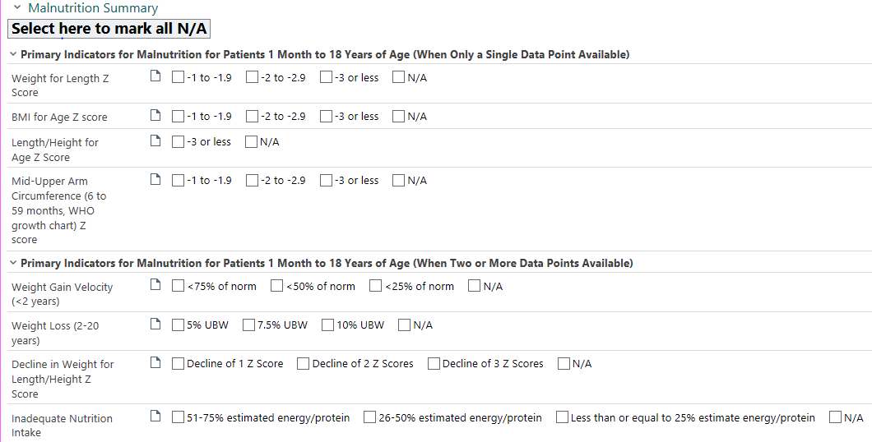
Documentation
Complete the “Malnutrition Summary” in the Navigator or Flowsheet
  You must click something for every indicator, even if it is N/A

Slide 12
PES statements
Malnutrition Classification:
  Acute (<3mo) vs chronic (>3mo)
  Illness vs Non-illness-related (environmental, social, behavioral)
  Mild, moderate or severe malnutrition
“Related to”:
  Etiology, such as inadequate intake
“As evidenced by”:
  Malnutrition assessment above.
    Z-scores
    Growth velocity
    Nutrition-related findings

Slide 13
Case Study 1
12 year old Male in GI clinic
PMH: Anoxic brain injury at birth, CP, developmental delay.
Receives 100% of nutrition through G-tube.
Cared for by grandma. Grandma was diagnosed with cancer 2 years ago.
Attended visits every 6 months since his GT was placed, but has not been to clinic for over 2 years.

Slide 14
Case Study 1
Criteria | Mild | Moderate | Severe
Wt-for-lt z-score | -1 to -1.9 | -2 to -2.9 | -3 to -3.9
BMI for age z-score | -1 to -1.9 | -2 to -2.9 | -3 to -3.9
Length/Ht for Age z-score |  |  | -3 or less
MUAC z-score | -1 to -1.9 | -2 to -2.9 | -3 to -3.9
Weight gain velocity (<2 yrs) | <75% of norm | <50% of norm | <25% of norm
Weight loss (2-20 yrs) | 5% UBW | 7.5% UBW | 10% UBW
Decline in Wt for Lt/Ht z-score | Decline of 1 z-score | Decline of 2 z-scores | Decline of 3 z-scores
Inadequate nutrition intake | 51-75% estimated energy/pro needs | 26-50% estimated energy/pro needs | < 25% estimated energy/pro needs
Anthropometrics:
Height: 133 cm (z-score: -2.23)
Weight: 23 kg (z-score: -3.69)
BMI: 13 (z-score: -3.6)
MUAC: 165 cm (<3rd percentile)
Anthro history: Last visit 3/23/2017
Height: 121 cm (z-score: -2.71)
Weight: 22.6 kg (z-score: -2.35)
BMI: 15.4 kg/m² (z-score: -0.69)
Feedings:
4 cans Pediasure + 16 oz water daily (42 kcal/kg)

Slide 15
Case Study 1
Does pt meet criteria for malnutrition? Yes No
Etiology: Acute Chronic
Illness: Illness related Non-illness related
Severity: Mild Moderate Severe
Criteria | Mild | Moderate | Severe
Wt-for-lt z-score | -1 to -1.9 | -2 to -2.9 | -3 to -3.9
BMI for age z-score | -1 to -1.9 | -2 to -2.9 | -3 to -3.9
Length/Ht for Age z-score |  |  | -3 or less
MUAC z-score | -1 to -1.9 | -2 to -2.9 | -3 to -3.9
Weight gain velocity (<2 yrs) | <75% of norm | <50% of norm | <25% of norm
Weight loss (2-20 yrs) | 5% UBW | 7.5% UBW | 10% UBW
Decline in Wt for Lt/Ht z-score | Decline of 1 z-score | Decline of 2 z-scores | Decline of 3 z-scores
Inadequate nutrition intake | 51-75% estimated energy/pro needs | 26-50% estimated energy/pro needs | < 25% estimated energy/pro needs

Slide 16
Case Study 1
Criteria | Mild | Moderate | Severe | N/A
Wt-for-lt z-score | -1 to -1.9 | -2 to -2.9 | -3 to -3.9 | x
BMI for age z-score | -1 to -1.9 | -2 to -2.9 | -3 to -3.9
Length/Ht for Age z-score |  |  | -3 or less | x
MUAC z-score | -1 to -1.9 | -2 to -2.9 | -3 to -3.9 | x
Weight gain velocity (<2 yrs) | <75% of norm | <50% of norm | <25% of norm | x
Weight loss (2-20 yrs) | 5% UBW | 7.5% UBW | 10% UBW | x
Decline in Wt for Lt/Ht z-score | Decline of 1 z-score | Decline of 2 z-scores | Decline of 3 z-scores
Inadequate nutrition intake | 51-75% estimated energy/pro needs | 26-50% estimated energy/pro needs | < 25% estimated energy/pro needs | x
Does pt meet criteria for malnutrition? Yes No
Etiology: Acute Chronic
Illness: Illness related Non-illness related
Severity: Mild Moderate Severe

Slide 17
PES Statement
Malnutrition summary table includes criteria:
  BMI z-score <-3
  Decline of 2 z-scores

Slide 18
Adult Malnutrition

Slide 19
Adult Malnutrition
Ages 18 years and over
Adult Malnutrition is Etiology Based
  Acute injury, illness or inflammation (<3 months)
  Chronic illness, or inflammation
  Non-inflammatory
Moderate or Severe Malnutrition

Slide 20
Acute Injury/Inflammation Etiologies
Severe inflammation, <3 months
Severe sepsis/septic shock
Systemic inflammatory response syndrome (SIRS)
Adult respiratory distress syndrome (ARDS)
Severe burns
Multi-organ system failure
Trauma/multi-trauma
Major abdominal surgery
Closed head injury
Severe acute pancreatitis

Slide 21
Chronic Illness/Inflammation Etiologies
Mild-moderate inflammation
Cardiovascular disease/ Congestive heart failure
Cirrhosis / Hepatitis
Chronic kidney disease/ Chronic pancreatitis
Chronic obstructive pulmonary disease (COPD)
Cystic fibrosis
Inflammatory bowel disease
Celiac disease
Organ failure/transplant (kidney, liver, heart, lung, or gut)
Hematologic malignancies/Neuromuscular disease
Rheumatoid arthritis/ Dementia/ Solid tumor
Chronic wounds, pressure ulcers
Sarcopenic obesity

Slide 22
Non-inflammatory etiologies
Pure chronic starvation
Anorexia nervosa
Dysphagia*
Depression
Lack of resources
Prolonged ileus*
Bowel obstruction*
  *= only if unrelated to inflammatory illness such as malignancy or solid tumor

Slide 23
Adult Moderate Malnutrition
ICD-10 Code: E44 Moderate protein-calorie malnutrition | Moderate Malnutrition in the context of Acute Illness/injury | Moderate Malnutrition in the context of Chronic Illness | Moderate Malnutrition in the context of Non-Inflammatory Condition
Weight loss- is evaluated in light of other clinical findings including hydration. Weight change over time is reported as a percentage of weight loss from baseline | Weight loss 1-2% in 1 week 5% in 1 month 7.5% in 3 months | Weight loss 5% in 1 month 7.5% in 3 months 10% in 6 months 20% in 12 months | Weight loss 5% in 1 month 7.5% in 3 months 10% in 6 months 20% in 12 months
Intake- RD obtains diet history and estimates energy needs. Suboptimal intake is determined as a % of estimated needs over time | Energy Intake <75% of estimated energy requirement for >7 days | Energy Intake <75% of estimated energy requirement for ≥1 month | Energy Intake <75% of estimated energy requirements for ≥3 months
Physical Assessment (Body Fat)- loss of subcutaneous fat (i.e. orbital, triceps, fat overlying ribcage). | Body fat Mild depletion | Body fat Mild depletion | Body fat Mild depletion
Physical Assessment (Muscle Mass) – loss of muscle (i.e. wasting of the temples, clavicles, shoulders, interosseous muscles, scapula, thigh and calf) | Muscle Mass Mild depletion | Muscle Mass Mild depletion | Muscle Mass Mild depletion
Physical Assessment (Fluid Accumulation) – general or local fluid accumulation (i.e. extremity or vulvar/scrotal edema, ascites) | Fluid Accumulation Mild | Fluid Accumulation Mild | Fluid Accumulation Mild
Functional Assessment (Grip Strength) | Reduced Grip Strength: N/A | Reduced Grip Strength: N/A | Reduced Grip Strength: N/A
Notes:
Discuss ICD code and reinforce that non factor in regards to documentation

Slide 24
Adult Severe Malnutrition
ICD- 10 Code: E43 Unspecified severe protein calorie malnutrition | Severe Malnutrition in the context of Acute Illness/Injury | Severe Malnutrition in the context of Chronic Illness | Severe Malnutrition in the context of Non-inflammatory condition
Weight loss- is evaluated in light of other clinical findings including hydration. Weight change over time is reported as a percentage of weight loss from baseline | Weight loss >2% in 1 week >5% in 1 month >7.5% in 3 months | Weight loss >5% in 1 month >7.5% in 3 months >10% in 6 months >20% in 12 months | Weight loss >5% in 1 month >7.5% in 3 months >10% in 6 months >20% in 12 months
Intake- RD obtains diet history and estimates energy needs. Suboptimal intake is determined as a % of estimated needs over time | Energy Intake ≤50% of estimated energy requirement for ≥5 days | Energy Intake ≤75% of estimated energy requirement for ≥1 month | Energy Intake ≤50% of estimated energy requirement for ≥1 month
Physical Assessment (Body Fat)- loss of subcutaneous fat (i.e. orbital, triceps, fat overlying ribcage). | Body Fat Moderate depletion | Body Fat Severe depletion | Body Fat Severe depletion
Physical Assessment (Muscle Mass) – loss of muscle (i.e. wasting of the temples, clavicles, shoulders, interosseous muscles, scapula, thigh and calf) | Muscle Mass Moderate depletion | Muscle Mass Severe depletion | Muscle Mass Severe depletion
Physical Assessment (Fluid Accumulation) – general or local fluid accumulation (i.e. extremity or vulvar/scrotal edema, ascites) | Fluid Accumulation Moderate to Severe | Fluid Accumulation Severe | Fluid Accumulation Severe
Functional Assessment (Grip Strength) – Consult informative standards supplied by the manufacturer of measurement device. | Reduced Grip Strength Measurably reduced | Reduced Grip Strength Measurably reduced | Reduced Grip Strength Measurably reduced
ICD-10 Code: E44.1- The Academy and ASPEN experts agree that it is not possible to distinguish mild malnutrition from normal nutritional status and therefore did not develop definitions or criteria for mild malnutrition at this time.
Notes:
Chronic/non –inflammatory takes longer to develop

Slide 25
Deciding Between Moderate and Severe
Need at least 2 criteria to identify malnutrition
If a patient meets one moderate and one severe criteria, diagnose with moderate malnutrition.
If a patient meets one moderate or more and two or more severe criteria, diagnose with moderate or severe malnutrition using clinical judgment.

Slide 26
Nutrition Focused Physical Exam in the Adult Patient
Same “landmarks” as pediatric patients
Additional context given for assessing obese adults
Micronutrient exam is similar
NFPE findings will likely determine moderate vs severe

Slide 27
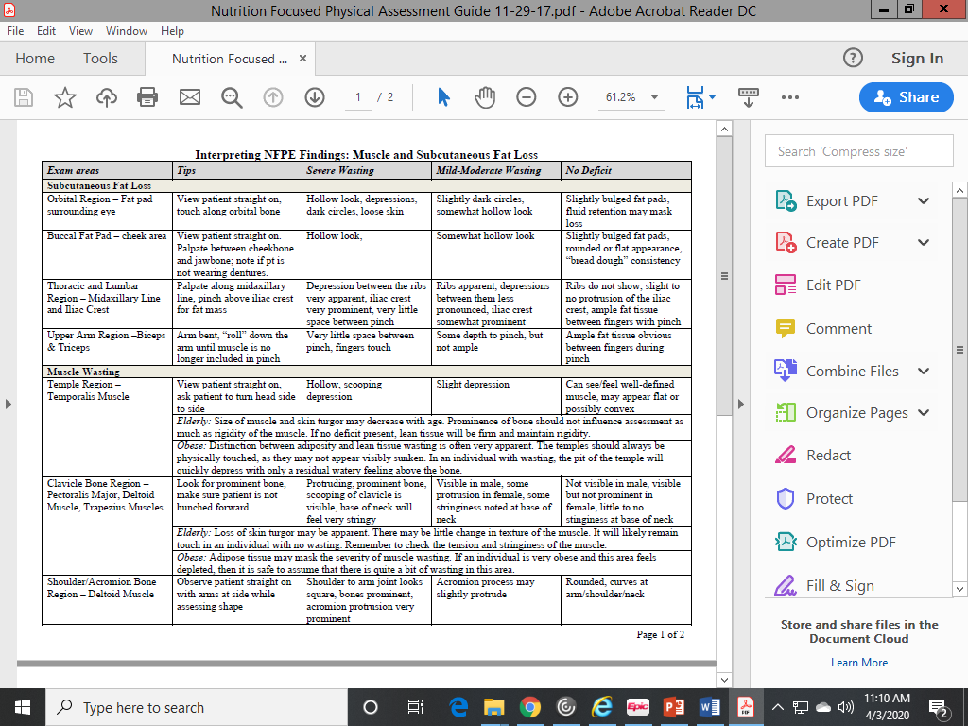

Slide 28
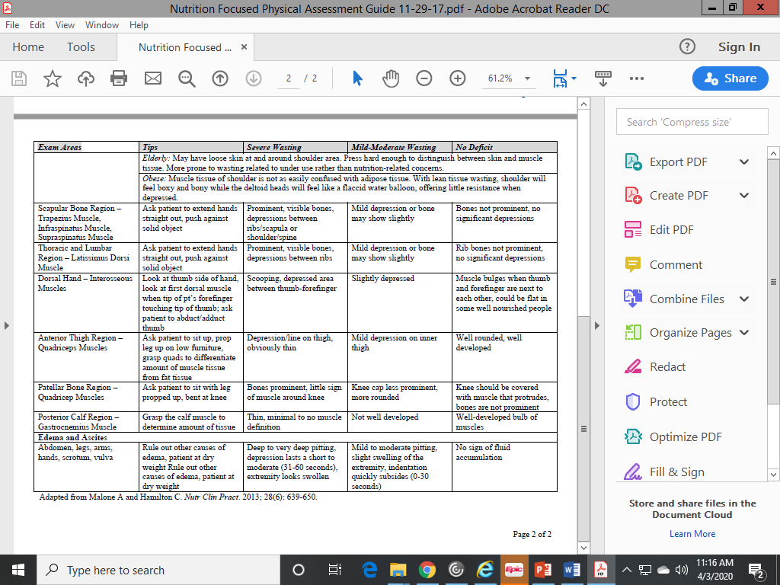

Slide 29
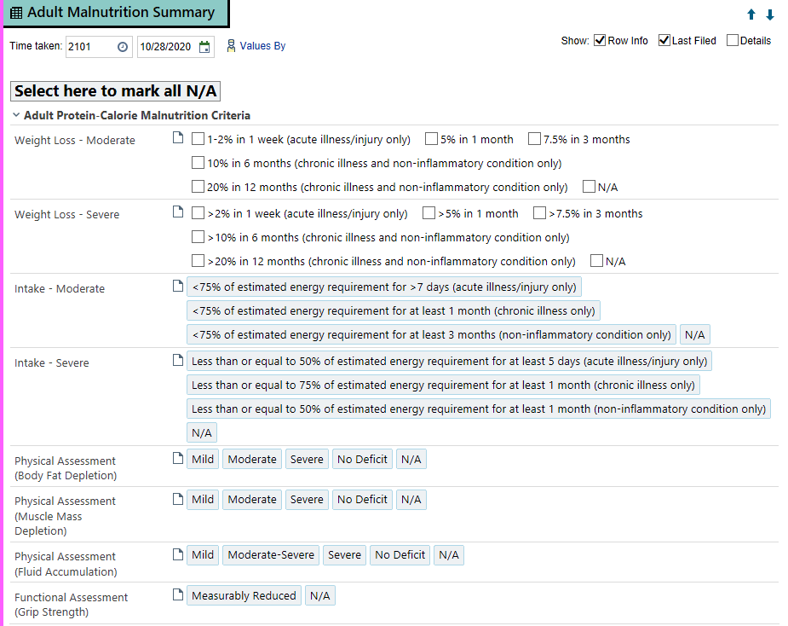
Documentation of Malnutrition
Adult Malnutrition Summary
  Click “Select here to mark all N/A” if no criteria applies
  All rows must have documentation just like in pediatric malnutrition

Slide 30
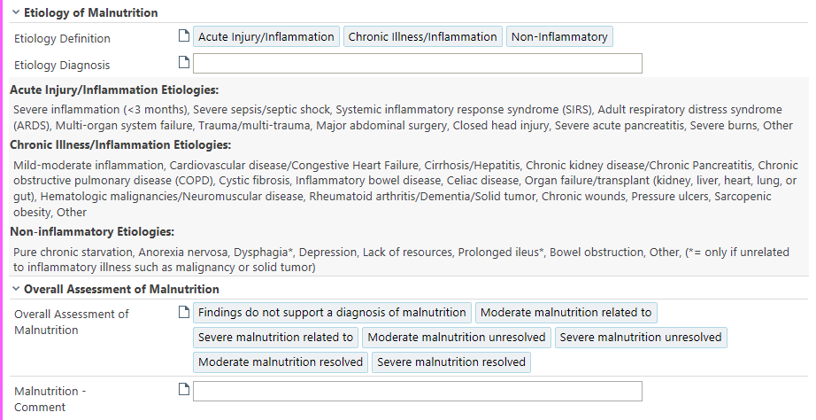
Adult Malnutrition Summary-Etiology
Notes:
Add in your etiology diagnosis here

Slide 31
Documentation of PES Statement
Etiology
  Choose one of the 3 options
  Enter “Etiology Diagnosis” in free text box
Overall Assessment of Malnutrition
  Choose option that fits with your assessment
  If no malnutrition document “Findings do not support a diagnosis of malnutrition”
Malnutrition - Comment
  Free text for rational (optional)
  If included, end with “and” for New and Unresolved PES statement to minimize need for editing
  Include rational for Resolved PES statement
    The word “and” will automatically populate in your note

Slide 32
Case Study 2
C.M. is a 22 year old female who presents with a partial bowel obstruction in the setting of Crohn’s disease. She reports a difficult time eating and vomiting with oral intake
Assessment:
Height: 162.1 cm UBW: 84.7 kg (3 months ago) Current weight: 76.2 kg (-10%)
NFPE:
Depressions and hollow look noted at orbital
Bones prominent at shoulder and scooping of clavicle is visible
No edema
HGS 17.9 kg right hand (-2.12 SD)
Additional comments: energy intake meets <70% of estimated needs over the past 2 months.

Slide 33
Case Study 2
Questions to consider:
  Etiology: Chronic, acute, or non-inflammatory?
  Malnutrition Severity: Moderate or Severe?
    Indicators:
      Weight loss
      Energy intake
      NFPE
      HGS

Slide 34
Moderate vs Severe Malnutrition
ICD-10 Code: E44 Moderate protein-calorie malnutrition | Moderate Malnutrition in the context of Chronic Illness
Weight loss- is evaluated in light of other clinical findings including hydration. Weight change over time is reported as a percentage of weight loss from baseline | Weight loss 5% in 1 month 7.5% in 3 months 10% in 6 months 20% in 12 months
Intake- RD obtains diet history and estimates energy needs. Suboptimal intake is determined as a % of estimated needs over time | Energy Intake <75% of estimated energy requirement for ≥1 month
Physical Assessment (Body Fat)- loss of subcutaneous fat (i.e. orbital, triceps, fat overlying ribcage). | Body fat Mild depletion
Physical Assessment (Muscle Mass) – loss of muscle (i.e. wasting of the temples, clavicles, shoulders, interosseous muscles, scapula, thigh and calf) | Muscle Mass Mild depletion
Physical Assessment (Fluid Accumulation) – general or local fluid accumulation (i.e. extremity or vulvar/scrotal edema, ascites) | Fluid Accumulation Mild
Functional Assessment (Grip Strength) | Reduced Grip Strength: N/A
ICD- 10 Code: E43 Unspecified severe protein calorie malnutrition | Severe Malnutrition in the context of Chronic Illness
Weight loss- is evaluated in light of other clinical findings including hydration. Weight change over time is reported as a percentage of weight loss from baseline | Weight loss >5% in 1 month >7.5% in 3 months >10% in 6 months >20% in 12 months
Intake- RD obtains diet history and estimates energy needs. Suboptimal intake is determined as a % of estimated needs over time | Energy Intake ≤75% of estimated energy requirement for ≥1 month
Physical Assessment (Body Fat)- loss of subcutaneous fat (i.e. orbital, triceps, fat overlying ribcage). | Body Fat Severe depletion
Physical Assessment (Muscle Mass) – loss of muscle (i.e. wasting of the temples, clavicles, shoulders, interosseous muscles, scapula, thigh and calf) | Muscle Mass Severe depletion
Physical Assessment (Fluid Accumulation) – general or local fluid accumulation (i.e. extremity or vulvar/scrotal edema, ascites) | Fluid Accumulation Severe
Functional Assessment (Grip Strength) – Consult informative standards supplied by the manufacturer of measurement device. | Reduced Grip Strength Measurably reduced

Slide 35
Moderate vs Severe Malnutrition
ICD-10 Code: E44 Moderate protein-calorie malnutrition | Moderate Malnutrition in the context of Chronic Illness
Weight loss- is evaluated in light of other clinical findings including hydration. Weight change over time is reported as a percentage of weight loss from baseline | Weight loss 5% in 1 month 7.5% in 3 months 10% in 6 months 20% in 12 months
Intake- RD obtains diet history and estimates energy needs. Suboptimal intake is determined as a % of estimated needs over time | Energy Intake <75% of estimated energy requirement for ≥1 month
Physical Assessment (Body Fat)- loss of subcutaneous fat (i.e. orbital, triceps, fat overlying ribcage). | Body fat Mild depletion
Physical Assessment (Muscle Mass) – loss of muscle (i.e. wasting of the temples, clavicles, shoulders, interosseous muscles, scapula, thigh and calf) | Muscle Mass Mild depletion
Physical Assessment (Fluid Accumulation) – general or local fluid accumulation (i.e. extremity or vulvar/scrotal edema, ascites) | Fluid Accumulation Mild
Functional Assessment (Grip Strength) | Reduced Grip Strength: N/A
ICD- 10 Code: E43 Unspecified severe protein calorie malnutrition | Severe Malnutrition in the context of Chronic Illness
Weight loss- is evaluated in light of other clinical findings including hydration. Weight change over time is reported as a percentage of weight loss from baseline | Weight loss >5% in 1 month >7.5% in 3 months >10% in 6 months >20% in 12 months
Intake- RD obtains diet history and estimates energy needs. Suboptimal intake is determined as a % of estimated needs over time | Energy Intake ≤75% of estimated energy requirement for ≥1 month
Physical Assessment (Body Fat)- loss of subcutaneous fat (i.e. orbital, triceps, fat overlying ribcage). | Body Fat Severe depletion
Physical Assessment (Muscle Mass) – loss of muscle (i.e. wasting of the temples, clavicles, shoulders, interosseous muscles, scapula, thigh and calf) | Muscle Mass Severe depletion
Physical Assessment (Fluid Accumulation) – general or local fluid accumulation (i.e. extremity or vulvar/scrotal edema, ascites) | Fluid Accumulation Severe
Functional Assessment (Grip Strength) – Consult informative standards supplied by the manufacturer of measurement device. | Reduced Grip Strength Measurably reduced
ICD-10 Code: E44.1- The Academy and ASPEN experts agree that it is not possible to distinguish mild malnutrition from normal nutritional status and therefore did not develop definitions or criteria for mild malnutrition at this time.
Notes:
Weight loss: 10% over 3 months (severe)
Energy intake: <70% of estimated needs over the past 2 months (moderate or severe)
NFPE: muscle mass and body fat both severe depletion (severe)
HGS: measurably reduced (severe)

Slide 36
Case Study 2
Is this patient’s malnutrition Chronic, Acute, or Non-inflammatory?
  Chronic due to Chron’s
Is the malnutrition Moderate or Severe?
  Severe due to:
    Weight loss: 10% over 3 months (severe)
    Energy intake: <70% of estimated needs over the past 2 months (moderate or severe)
    NFPE: muscle mass and body fat both severe depletion (severe)
    HGS: measurably reduced (severe)

Slide 37

Case Study 2
PES Statement
Malnutrition summary table includes information regarding the criteria:
    10% weight loss over 3 months and intake less than 70% of estimated energy needs.

Slide 38
Case Study 3
KP is a 21 year female who has been inpatient x 8 days with 15%TBSA burn. She is receiving NJ feedings. PMH significant for obesity and HTN.
Assessment:
Ht: 157.6 cm Wt: (2/2/20): 84 kg Wt (2/10/20): 80.6 kg (-4%)
NFPE:
Orbital: slightly dark circles, somewhat hollow look
Upper arm: ample fat tissue
Clavicle and acromion: rounded curves at arm/shoulder/neck
Additional comments:
Pt has been NPO frequently for wound care. Over the admission, she has only been receiving ~70% of prescribed tube feeding.

Slide 39
Moderate vs Severe Malnutrition
ICD-10 Code: E44 Moderate protein-calorie malnutrition | Moderate Malnutrition in the context of Acute Illness/injury
Weight loss- is evaluated in light of other clinical findings including hydration. Weight change over time is reported as a percentage of weight loss from baseline | Weight loss 1-2% in 1 week 5% in 1 month 7.5% in 3 months
Intake- RD obtains diet history and estimates energy needs. Suboptimal intake is determined as a % of estimated needs over time | Energy Intake <75% of estimated energy requirement for >7 days
Physical Assessment (Body Fat)- loss of subcutaneous fat (i.e. orbital, triceps, fat overlying ribcage). | Body fat Mild depletion
Physical Assessment (Muscle Mass) – loss of muscle (i.e. wasting of the temples, clavicles, shoulders, interosseous muscles, scapula, thigh and calf) | Muscle Mass Mild depletion
Physical Assessment (Fluid Accumulation) – general or local fluid accumulation (i.e. extremity or vulvar/scrotal edema, ascites) | Fluid Accumulation Mild
Functional Assessment (Grip Strength) | Reduced Grip Strength: N/A
ICD- 10 Code: E43 Unspecified severe protein calorie malnutrition | Severe Malnutrition in the context of Acute Illness/Injury
Weight loss- is evaluated in light of other clinical findings including hydration. Weight change over time is reported as a percentage of weight loss from baseline | Weight loss >2% in 1 week >5% in 1 month >7.5% in 3 months
Intake- RD obtains diet history and estimates energy needs. Suboptimal intake is determined as a % of estimated needs over time | Energy Intake ≤50% of estimated energy requirement for ≥5 days
Physical Assessment (Body Fat)- loss of subcutaneous fat (i.e. orbital, triceps, fat overlying ribcage). | Body Fat Moderate depletion
Physical Assessment (Muscle Mass) – loss of muscle (i.e. wasting of the temples, clavicles, shoulders, interosseous muscles, scapula, thigh and calf) | Muscle Mass Moderate depletion
Physical Assessment (Fluid Accumulation) – general or local fluid accumulation (i.e. extremity or vulvar/scrotal edema, ascites) | Fluid Accumulation Moderate to Severe
Functional Assessment (Grip Strength) – Consult informative standards supplied by the manufacturer of measurement device. | Reduced Grip Strength Measurably reduced

Slide 40
Discussion
Chronic, acute or non-inflammatory?
  Acute due to severe inflammation (burn), <3 months
Moderate or severe?
  Moderate due to:
  Weight loss: 4% (meets >2% in 1 week= severe)
  Intake: <75% needs >7 days (moderate)
  NFPE: body fat mild depletion (moderate)
Notes:
Discuss findings and how clinical judgment can be used to diagnose malnutrition or not

Slide 41

Case Study 3
PES Statement
Malnutrition Summary Table includes information regarding the criteria:
    significant weight loss of 4% in 1 week and depletion of fat mass

Slide 42
Collaboration with Providers
Talk with your provider partners about your diagnosis as you normally would regarding your malnutrition findings in all areas (Hospital and Ambulatory encounters)
Hospital Encounters:
  Your diagnosis will pull into providers documentation to assist them with diagnosis malnutrition
  The provider must include it in their diagnosis in order for it be recognized as a current problem for billing and coding

Slide 43
Diagnostic Criteria: Key Differences between adult and pediatric criteria
Adult
Only moderate and severe malnutrition diagnoses
Must meet 2 or more criteria for diagnosis
NFPE can be used as diagnostic criteria
Hand-grip can be used as criteria to diagnose severe malnutrition
  To classify as measurably reduced, HGS must be more than 2 standard deviations below the mean
Pediatric
Can have mild, moderate, or severe malnutrition
Can be diagnosed with 1 met criteria
NFPE cannot be used as diagnostic criteria, but will support diagnosis
Hand-grip is not a diagnostic criteria
Notes:
ICD-10 Code: E44.1- The Academy and ASPEN experts agree that it is not possible to distinguish mild malnutrition from normal nutritional status and therefore did not develop definitions or criteria for mild malnutrition at this time

Slide 44
Please write down any questions you have

