Slide 1

Nutrition Focused Physical Exam

Slide 2
Outline
Review of Nutrition Focused Physical Exam (NFPE)
    Requirements to complete competency
  Review of Mid-upper Arm Circumference (MUAC)
    Demonstration to complete competency
Review of Hand Grip Strength
  Demonstration to complete competency

Slide 3
Nutrition Focused Physical Exam (NFPE)

Slide 4
NFPE in Practice
Frequency
    Inpatient: Initial assessment + every 7 day re-assessment
    Outpatient: Every visit
Minimum NFPE requirement
    Measure MUAC in all patients ≥ 6 months corrected age
      If you aren’t able to obtain, it is required to document reason for “unable to obtain” using options noted in the Clinical Nutrition Navigator
    Minimum of 2 NFPE components

Slide 5
NFPE Techniques
Inspection
  Observation:
    Movement, color, shape, size, edema, affect, behavior
Palpation
  Tactile Examination
    Texture, size, tenderness, temperature, edema
Advanced Techniques
  Percussion
  Auscultation

Slide 6
Tools
Follow isolation and contact rules
Primary Tools:
  Eyes
  Hands
  Gloves
Secondary tools
  Penlight
  Tongue Depressor

Slide 7
Getting Started
Prepare your script
  What is it you are going to say?
  Explain your process
  Explain why you are doing the exam
In the Room…
  Wash Hands & Ensure Privacy
  Explanation of what you are doing
  Position Patient
  Begin with general survey of patient
    1st impression

Slide 8
Subcutaneous Fat Loss
Subjective assessment of fat stores
Look for defined muscular outlines
Bony Prominences
Loose or hanging skin
Minimal space between fingers when pinching

Slide 9
Sites: Subcutaneous Fat Loss
Orbital Fat Pads
Inspect for fat loss under eyes
Look for dark circles and loose skin
Triceps
Bend arm to 90° (goal post arms)
Pinch fat roll between fingers
Ribs
Mid-axillary line, look for separation between ribs
Buccal Fat
Examine below cheek bone for hollow or sunken appearance
Grasp fat stores above the iliac crest

Slide 10
Muscle Wasting
Bilateral when possible
Inspect and palpate for:
  Volume (bulk) and tone
  Muscle atrophy- flat or concave
  Prominent bones

Slide 11
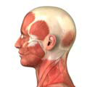
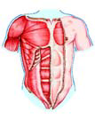
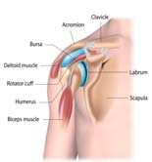
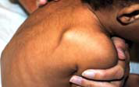
Sites: Muscle Wasting: Upper Body
Temporalis
Thinning muscle of temporal bone
Palpate with scooping motion
Deltoid
Arms at side, grasp muscle at shoulder
Squared vs round shoulder
Scapula
(Trapezius/Lat Dorsi)
Prominent scapula/protruding
Clavicle (Pectoralis)
Observe for prominence of clavicle
Palpate muscle under clavicle
Observe prominent acromion process
Ask pt to chew
Well rounded back
“deep drop off” from scapula

Slide 12
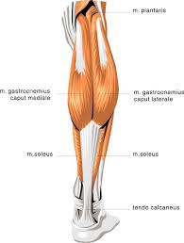
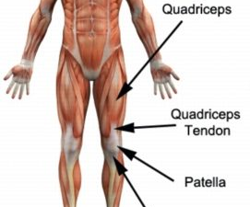
Sites: Muscle Wasting Lower Body
Quadriceps
Seated, leg propped
Squeeze quadriceps
Knees
Seated position, leg propped
Calf
Foot planted firmly on floor
Quadriceps should be larger than knee cap
Look for depressions between muscles
Muscle or bone more prominent?
Grasp calf muscle to determine tone
Should feel “bulb” muscle at calf

Slide 13
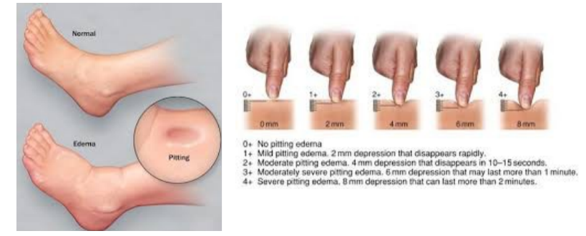
Sites: Edema
Do you ever notice fluid accumulation around your child’s ankles or in the lower part of your legs?
Do your child’s eyes appear puffy?
Do you notice any swelling or fluid in child’s stomach?

Slide 14
NFPE & Micronutrients
Micronutrient Deficiency
  Primary or secondary deficiency
Is there a medical reason for a deficiency?
  Medications, medical diagnosis
Is Inflammation Present?
  An elevation in inflammatory markers may warrant delay in checking for nutrient levels
  Markers: CRP, SED rate, WBC

Slide 15
Hair and Eyes
Hair
Seborrheic Dermatitis | B6, biotin, Zinc
Hair Lightening | Selenium
Hair Loss | Protein/energy deficiency, anemia (iron)
Lanugo | Protein energy deficiency
Hirsutism | Obesity, Cushing, PCOS
Follicular Hyperkeratosis | Vitamin A or C
Dull, lack luster hair | Protein/energy deficiency
Eyes
Night blindness | Vitamin A deficiency
Conjunctival Xerosis (dry eye) | Vitamin A, Zinc deficiency
Icterus | Vitamin A toxicity
Pale Conjunctiva | Anemia (Fe, B12, Folate) or Copper deficiency
Bitot’s spots | Vitamin A deficiency
Notes:
Clinical interpretation of NFPE findings- could be possible nutrient related causes but there are also non-nutrient related causes

Slide 16
Sites:
Micronutrients: Hair
Have you noticed any change in the texture of your child’s hair?
Does your child’s hair appear thinner?
Is there more hair in the brush or on the pillow?
Is the hair easily pluckable?
Has there been any color changes or noticeable patches of color?

Slide 17
Site:
Micronutrients: Eyes
Have you noticed any changes in your child’s vision? Difficulty with seeing at night?
Eyes water excessively or dry eye?
C/o of pain in or around the eyes?
Have you noticed any scaling around eye lids?

Slide 18
Site:
Oral Exam
Findings | Possible Deficiency
Angular stomatitis or cheilitis (swollen red patches in the corners of the mouth) | Riboflavin, niacin, iron, vitamin B6, vitamin B12
Purplish/magenta tongue | Riboflavin
Smooth, beefy red tongue | Vitamin B12, niacin
Glossitis (swollen/inflamed tongue) | Riboflavin, niacin, vitamin B6, vitamin B12, folate, severe iron deficiency
Pale tongue | Vitamin B12, folate, iron
Gingivitis, bleeding gums | Vitamin C, niacin, folate, zinc, severe vitamin D deficiency

Slide 19
Site:
Mouth & oral exam
Have you noticed any difficulty with chewing or swallowing?
Is you child complain of pain when eating or inside his or her mouth?
Have you noticed any broken teeth?
Does your child have any sores in his/her mouth or a history of mouth sores?

Slide 20
Site:
Nails
Findings | Possible Deficiency
Koilonychia (spoon‐shaped, concave) | Iron, anemia
Leukoncyia (white nail bed) | Hypoalbuminemia
Beau’s lines (transverse ridges, horizontal grooves) | Severe zinc deficiency, hypercalcemia
Pale Nail Bed | Anemia, Iron, B6, B12, folate
Brittle, soft, dry, weak or thin, split easily | Magnesium, severe malnutrition, vitamin A and selenium toxicity
Central ridges | Iron, folate
Splinter hemorrhage | Vitamin C

Slide 21
Site:
Nails
Have you noticed any changes in your child’s nails?
Are they breaking easily or appear more brittle?

Slide 22
Site:
Skin
Findings | Possible Deficiency
Poor wound healing, pressure ulcers | Zinc, Vitamin C
Follicular hyperkeratosis | Vitamin A or vitamin C
Seborrheic dermatitis | Biotin, vitamin B6, zinc, riboflavin, essential fatty acids, vitamin A excess or deficiency
Petechiae | Vitamin C, Vitamin K
Xerosis (abnormal dryness) | Vitamin A, essential fatty acids
Pallor | Iron, vitamin B12, folate, anemia
Purpura (red, non-blanching spots) | Purpura Vitamin C, vitamin K, excessive vitamin E
Eczema | Riboflavin, zinc
Notes:
Once again, could also have non-nutrition related causes as well

Slide 23
Documenting Physical Exam Findings
Document Physical Exam findings (minimum of 2 areas) in Physical Exam section of CN Navigator
Document any micronutrient findings/risks (if you have them) in Micronutrient Exam section of CN Navigator
  Any deficiency diagnosis must be in coordination with a medical provider
Both of these sections will pull into the Malnutrition section of your Progress Note

Slide 24
NFPE Competency Steps
You will need to complete a full NFPE for each patient category listed on your 90 day competency sheet
Goal to complete NFPE on patients of all ages and each unit of the hospital.

Slide 25
Mid-upper arm circumference (MUAC)

Slide 26
MUAC measurement
Why measure MUAC?
  MUAC is sensitive to changes in fat and muscle
  Especially useful in patients with fluid imbalance
When to perform:
  Every 7 days while patients are admitted to the hospital
  Every outpatient encounter
Who to perform on:
  All patients over 6 months of age when you can get an accurate measurement

Slide 27
Which data set do I use?
In patients 6-59 months:
  Measure the left arm
  Use WHO data from Peditools.org to get a z-score
    Right arm if left is not available for 12 to 60 months (5 years)
      Addo Data
In patients 5 years (60 months) – 20 years:
  Measure the right arm
  Addo Data automatically populates in Epic
In patients >20 years
  Measure the right arm
  Use the Frisancho data in your resource binder

Slide 28
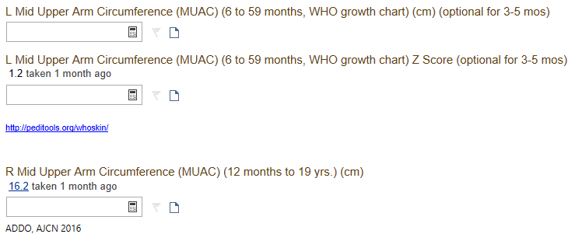
Documenting MUAC Measurement
Epic filters by age and offers the options available
Example: 23 month-old (2 data sets available)

Slide 29
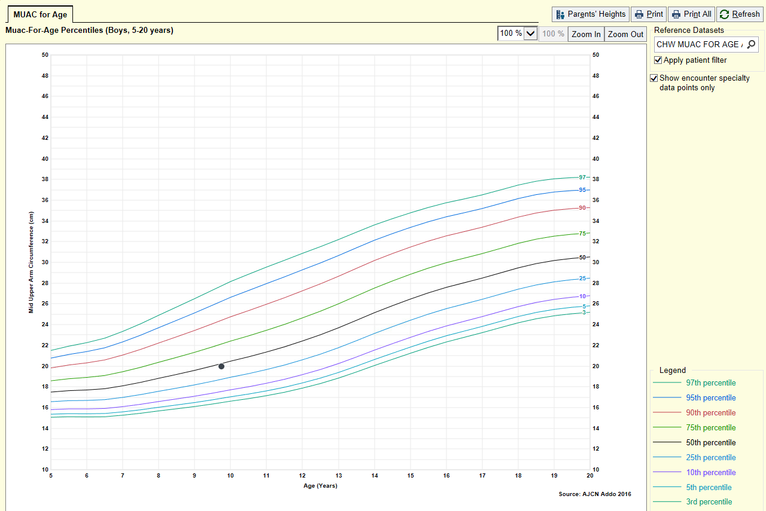
Addo Data is a Growth Chart in Epic

Slide 30

Z score automatically populates
Hover in growth chart for data points
Pulls into progress notes
  Previous example – 9 year-old boy
    MUAC Measurement of 20 cm

Slide 31
Can I use MUAC to diagnose malnutrition?
Yes, but only in patients 6-60 months
Only validated for WHO z-score data available for that age group

Slide 32
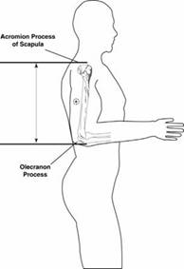
Measuring MUAC
Make sure patient is in an upright position
Arm should be bent at 90 degree angle
  Measuring point half way between the olecranon process of the ulna and the acromion process of the scapula
Once you identify the half way point, instruct them to let the arm hang at the side
Take 3 measurements, average

Slide 33
What if I can’t get a good measurement, or can’t use the correct arm?
Use your clinical judgment
  If you feel like it is still valuable/useful, do the measurement and make a note of the limitation in the comments
  You can also decide not to do it at that visit and indicate the reason in the navigator

Slide 34
MUAC References
Frisancho AR. New Norms of Upper Limb Fat and Muscle Areas for Assessment of Nutritional Status. Am. J Clinical Nutrition, 1981 (34): pg 2540-2545
Frisancho AR, D.P. Tracer. Standards of Arm Muscle by Stature for the assessment of Nutritional Status in Children. American Journal of physical anthropology. 1987 (73) pg: 459-465
M. de Onis, R. Yip,2 & Z. Mei The development of MUAC-for-age reference data recommended by a WHO Expert Committee
WHO child growth standards and the identification of severe acute malnutrition in infants and children. World Health Organization, United Nations Children's Fund
The development of a MUAC-for-height reference, including a comparison to other nutritional status screening indicators. Bull World Health Organ. 1997; 75(4): 333–341.
Anthropometric Reference Data for Children and Adults: United States, 2007–2010
Addo OY. Reference ranges for midupper arm circumference, upper arm muscle area, and upper arm fat area in US children and adolescents aged 1-20y. Am J Clinical Nutrition, 2017; 105(1):111-120.

Slide 35
Hand Grip Strength (HGS) Measurements

Slide 36
HGS Expectations
HGS is another tool for your toolbox
Use when you feel like it is beneficial for you and your patient
There is no HGS “requirement”, use your clinical judgment

Slide 37
Why HGS?
HGS responds earlier to both nutritional deprivation and nutritional repletion than other body composition parameters²
Although muscle loss can be assessed with NFPE, it does not appear to be the only factor responsible for muscle dysfunction³

Slide 38
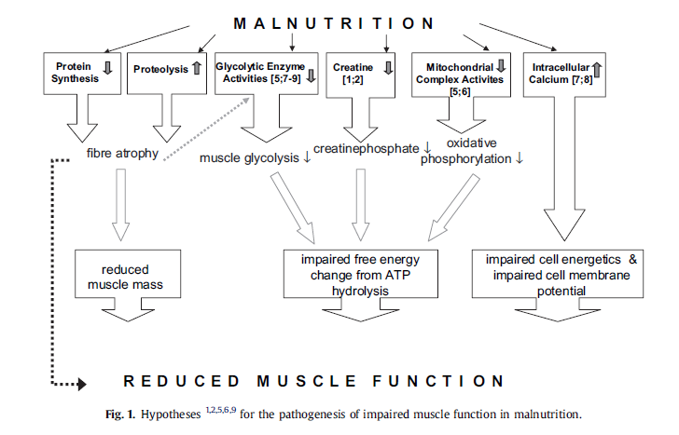
Why HGS?
Norman, K., et al. (2011). Hand grip strength: Outcome predictor and marker of nutritional status. Clinical Nutrition, 30, 135-142

Slide 39
When to Use HGS?
If you are concerned a patient has decreased muscle strength and functionality due to poor nutrition
When you want an additional indicator to support your nutrition assessment
If your patient is normal weight/overweight but you suspect they may have muscle loss
If you are assessing malnutrition in an adult patient

Slide 40
MUAC vs. HGS in Obese Patients
Review of the research
  MUAC
    Able to identify obesity but unable to differentiate between muscle and fat stores¹
    Increased level of difficulty in obtaining measurement
  HGS
    Absolute HGS is not significantly different between obese and lean subjects³
    Muscle strength changes can be seen before changes in weight or BMI occur³

Slide 41
Case Examples Using HGS at CW
HGS ≥1SD below the mean:
Overweight feeding team patient with a very low protein diet
NEW Kids patient with low activity and a refined CHO diet
Type 2 diabetes patient with weight loss to a normal BMI and an elevated HbA1C
Inpatient oncology patient with AML and malnutrition admitted for 26 days and on TPN

Slide 42
How Does HGS Impact Nutrition Intervention?
As with other indicators of malnutrition:
  HGS provides evidence of possible suboptimal nutrition
  Highlights need for adequate calorie and protein intake and using critical care guidelines when appropriate
  Understand HGS may be an early sign of malnutrition in populations it may otherwise be missed e.g. obesity

Slide 43
Benefits of using HGS
Rapid takes <2 minutes to perform three measurements
Cost-effective
Non-invasive
Objective
High test and re-test reliability
High inter-rater reliability
Reacts quickly to changes in nutrition status

Slide 44
Limitations of HGS
Consistency in technique is critical – posture, arm side or handle position can alter grip strength
HGS is an indicator of upper limb strength only and cannot replace other measures of strength

Slide 45
Populations
HGS has been tested in children as young as 4 years old, normative values exist for males/females aged 6-75+
Exclusion criteria:
  Wearing a cast, most of hand covered in bandages
  Surgery on hand or wrists in last 3 months

Slide 46
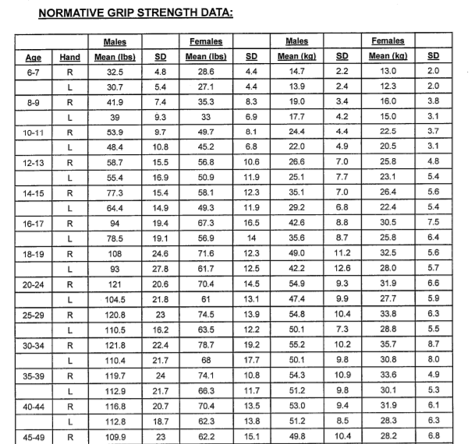
Normative Data
Can be found in the dynamometer case

Slide 47
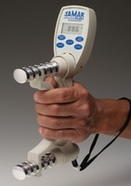
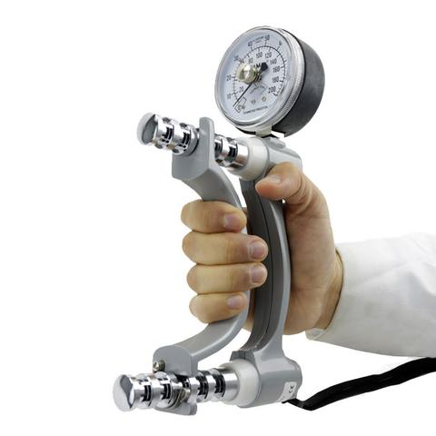
Jamar Dynamometer
Adjusts to 5 grip positions
Use the wrist strap to prevent it from falling on the floor if accidentally dropped
Needs to be calibrated annually minimally
  Should be recalibrated if dropped
CW has two types:
  Jamar Plus Digital Dynamometer
  Jamar Hydraulic Hand Dynamometer

Slide 48
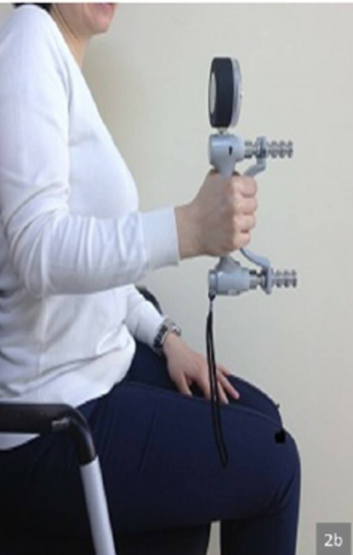
Proper Patient Positioning
Body position
  Patient should be sitting on a bed or chair, ideally feet flat on the ground
  Arms at their side and shoulders neutrally rotated
  Elbow flexed at 90º and wrist neutrally positioned
Hand position
  Use dominant hand when possible
    Document if using non-dominant hand
  Index finger should be at 90º angle on the handle when looking at it from above
    If the four finger nails dig into the palm, the rungs are too close
    If it feels as if the hand may slip off the handle when squeezing, the rungs are too far
She should be using the wrist strap!

Slide 49
Measuring HGS
Ensure the instrument is clean before using
Demonstrate how to use the dynamometer
Ask patient to squeeze the instrument for 3 seconds, provide encouragement
  “You can do it, squeeze as hard as you can”
Repeat for 3 contractions with 20 seconds between each test
Calculate the mean

Slide 50
HGS Tips and Tricks
Write down the measurements as you go
Be sure to use the correct unit (kg or lbs) when documenting in Epic
Remember to note the hand used
Dynamometers are currently located on the Milwaukee campus, Fox Valley and many satellite clinics
  Ask your fellow colleagues where they are located in your area

Slide 51
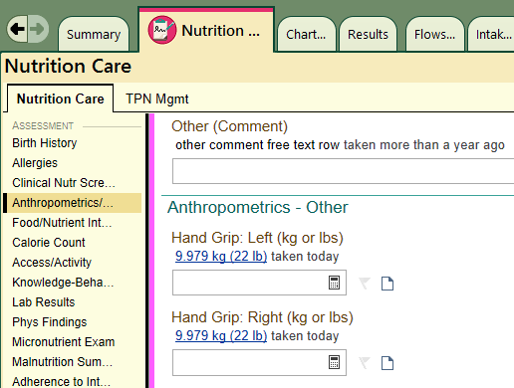
Documenting HGS
Example: You have a 6 year old male patient with a mean HGS of 22 pounds
Normative Data for a 6 year old male HGS mean = 32.5 lb +/- 4.8 SD
Take normative data minus patient data divided by standard deviation
32.5 – 22 = 10.5 lbs from mean ÷ 4.8 = -2.1 SD from mean

Slide 52
Video Resource
https://www.youtube.com/watch?v=jFf7eotFxjo
If you would like to look at how to perform a HGS with a patient again here is a video link

Slide 53
References
1. Chaput JP, Katzmarzyk PT, Barnes JD , Fogelholm M, Hu G, Kuriyan R (2017). Mid-upper arm circumference as a screening tool for identifying children with obesity: a 12-country study. Pediatric obesity, 12 (6), 439-445.
2. Flood, A., et al. (2013). The use of hand grip strength as a predictor of nutrition status in hospital patients. Clinical Nutrition.
3. Norman, K., et al. (2011). Hand grip strength: Outcome predictor and marker of nutritional status. Clinical Nutrition, 30, 135-142

