Slide 1
Parenteral Nutrition: Access, Ordering and Monitoring

Slide 2
Outline
Access
PN Monitoring
Ordering

Slide 3
Access

Slide 4
Definitions
Vascular access is defined at the position of the catheter tip
Types:
Peripheral venous access
Central venous access
Tip in the superior vena cava or at the junction of the superior vena cava and the right atrium

Slide 5
Peripheral Venous Access
Short duration
Typically <10 days
PN formulas need to be <900 mOsm/L
Larger fluid volumes needed for stability
Difficult to meet nutrition needs
Dextrose 12.5% or less required (50 mOsm/%)
AA main contributor of osmolality (100 mOsm/%)
Peripheral Venous Thrombophlebitis
Typically site needs to be rotated often to prevent this
Lower risk of catheter-related infections

Slide 6
Central Venous Catheter (CVC)
Also known as a central line or central venous access device (CVAD), inserted into a vein of the central vascular system
Indications:
Long-term use (i.e. TPN, antibiotics, chemotherapy)
Administration of large volumes quickly
Ability to administer hyptertonic solutions (>600mOsm/L)
Types:
Non-tunneled catheters: Subclavian / Jugular / Femoral lines
Peripherally Inserted Central Catheters (PICCs)
Tunneled catheters: Hickmans / Broviacs / Groshongs / Small bore
Implanted ports

Slide 7
Types of CVCs
Non-Tunneled CVC
Subclavian, jugular, femoral lines
Easily dislodged, not recommended for home TPN
Higher infection risk
Tunneled CVC
Hickmans, Broviacs, Groshongs, Small bore
Requires surgical or fluoroscopic insertion
Good for long-term, home TPN
Theoretically, decreases risk of infection
Peripherally Inserted Central Catheters (PICCs)
Inserted into basilica, cephalic, or brachial veins and ends in superior vena cava
Limited activity, easy to remove, preferred for neonates
Implanted ports
Umbilical venous catheters

Slide 8
Routine Cares for
CW has best practice bundles in place
Lock Solutions
Antimicrobial lock therapy
Used to prevent and treat central line-associated bloodstream infections (CLABSI)
Types: Ethanol, antibiotic
Consists of instilling the solution into the catheter hub for a specific period of time
Heparin lock therapy
Used to prevent catheter occlusion and/or thrombosis
Filters
0.2 micron without IVFE
1.2 micron for 3-in-1 PN and all IVFE infused separately

Slide 9
Additional questions for the group
How much detail into decision for which VAD to use?
How much (if any) detail in cares of VADs, such as hospital bundle sets, site care, set changes, flushing etc?

Slide 10

PN Monitoring
Notes:
Next we will discuss lab monitoring of patients on parenteral nutrition.

Slide 11
Inpatient
Lab monitoring will vary depending on unit/service
Home TPN patients admitted
May follow home lab schedule unless change in intake/output, electrolyte abnormalities, or clinical situation indicates more frequent monitoring
Parameter | Initial | Follow-Up
BMP/CMP | Daily | 1-2 x/week
Magnesium | Daily | 1-2x/week
Phosphorus | Daily | 1-2x/week
Triglycerides | Once at goal lipids | 1-2x/week
Ionized Calcium | If low albumin/serum Calcium not reliable
CBC differetial/platelets | Daily to weekly | Every 1-4 wk
Notes:
Inpatient lab monitoring varies dependent on the unit or service the patient is on. Here is a general example of TPN lab monitoring inpatient.
When Home TPN patients are admitted to the hospital, they can follow their previous home lab schedule unless changes in medical status warrant more frequent monitoring.

Slide 12
Outpatient
Discharge planning
Include all disciplines (inpt and outpt RD, RPh, ICM, outpt RN)
Outpatient pharmacy
Common variations include shortages, 3:1 vs 2:1, multivitamin, trace element mixtures
Patient to be discussed at weekly TPN Rounds shortly before being discharged home on PN
Notes:
When it has been determined that a patient will go home on TPN, it’s helpful to start the discharge planning process as early as possible and include all of these disciplines to ensure best and safest care.
Closer to discharge, conversations with the outpatient Home TPN pharmacy are helpful in determining any variations that will be required based on what is available at the home pharmacy. Common changes include running 3 in 1 TPN instead of 2 in 1 TPN, shortages of TPN components, and what kinds of multi vitamin infusion and trace element mixtures they have available.
There are many benefits to running 3 in 1 TPN, especially on an outpatient basis, so this is a common variant we discuss with outpatient pharmacies. Benefits include aseptic compounding, less risk of contamination during administration, more convenient storage, and fewer supplies needed in the home.

Slide 13
Outpatient
Suggested initial outpatient lab monitoring schedule:
Weekly x 4
Every other week x 4
Monthly x 4
Every 3 months
Notes:
In the outpatient setting, patients follow this lab monitoring schedule, starting with weekly labs for 4 weeks, then transitioning to every other week labs for 4 more draws, stretching out to monthly labs for 4 draws, and then eventually drawing labs only every 3 months indefinitely.
Lab draws can vary from this schedule based on clinical judgement. This is typically a decision made in outpatient TPN rounds with the team including the GI doctor, GI nurse, and primary outpatient dietitian.

Slide 14
Outpatient
Patient discharged on Home PN
Has been on stable PN in the hospital with no major recent or anticipated changes in EN or PN
Q week X 4 CBC w/ auto differential, CMP (Albumin, Alk Phos, Total Bili, Ca, Cr, Glucose, Total Protein, AST, ALT, BUN, Na, K, Cl, CO₂,) PO₄, Mg, Triglycerides
No
Yes
Q 2 weeks X 4 CBC w/ auto differential, CMP (Albumin, Alk Phos, Total Bili, Ca, Cr, Glucose, Total Protein, AST, ALT, BUN, Na, K, Cl, CO₂,) PO₄, Mg, Triglycerides
Notes:
Here is a decision tree on when to draw TPN labs for a patient newly going home on TPN. Most often, patients new to TPN are discharged home with weekly labs.

Slide 15
Outpatient
Patient already on PN but goes home after re-hospitalization
Individualize future lab draws
Either/or
Return to original lab schedule
Choose a new lab schedule
Either/or
Repeat all labs
Do only labs of concern
Notes:
Here is a decision tree of whether or not to adjust the lab monitoring schedule after a home TPN patient has been readmitted and then discharged from the hospital. Typically, an individualized plan for future labs is discussed based on the patient’s medical status and hospital course.

Slide 16
Outpatient Micronutrient Labs
Additional Micronutrient Labs obtained starting 3 months after hospital discharge OR 3 months after PN initiation for long term hospitalized PN patients (PN Micronutrient Lab Panel)
Labs | Initial 3 month | q 6 months | Annually
Trace Elements (Cu, Se, Zn) | X | X
Fat Soluble Vitamins (Vit A, 25OH-hydroxy D, Vitamin E, PT) | X | X
Carnitine (infant under 1 year) | X | X
Iron Studies (Serum Iron, TIBC, Ferritin) | X | X (q 3 months if 100% PN dependent)
RBC Folate, Vitamin B12 + MMA | X | X
Homocysteine (only in short bowel, pseudoobstruction or other concern for limited absorption) | X | X
TSH/Free T4 | X | X
DEXA Scan |  |  | X
Notes:
Here is a table of additional labs that are drawn on long term TPN patients to ensure they are meeting their micronutrient needs. These should be obtained either 3 months after hospital discharge or 3 months after PN initiation in the hospital if they are still admitted. This is referred to as the PN Micronutrient Lab Panel in Epic.
You will see in the table that after the initial draw, these continue to be monitored every 6 months. The one exception is the DEXA scan which is only done annually.

Slide 17
Additional Lab Considerations
Essential Fatty Acid Deficiency
Triene:tetraene ratio
Cessation
After PN is discontinued, determine with medical team what, if any, labs need to be drawn due to risks based on medical diagnoses
Notes:
There may be additional labs that need to be monitored for home TPN patients. Here are a few examples.
Based on the type and volume of lipid being administered, a patient may be at risk for Essential Fatty Acid Deficiency. If this concern exists, a triene to tetraene ratio can be drawn.
When a patient’s TPN is discontinued, the medical team should discuss which, if any, labs should be drawn due to the patient’s risk for deficiency based on their medical status and conditions.

Slide 18
Order Writing
Notes:
Here, we will cover the basics of TPN Order Writing:

Slide 19
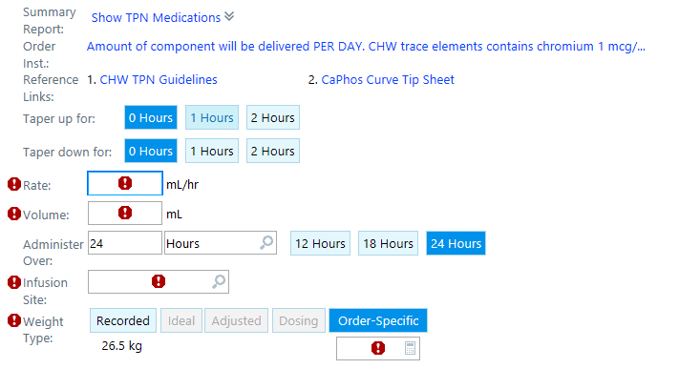
Inpatient TPN Order
Notes:
Here is an example of what a Pediatric TPN order looks like at Children’s Wisconsin. Not all sections need to be filled in. However, note the red exclamation points which are “hard stops”, meaning the order cannot be pended or signed until these have been filled it.

Slide 20
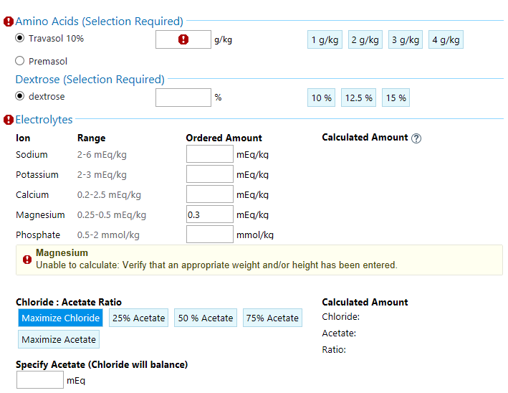
Inpatient TPN Order
Notes:
As shown here, the suggested dosing of electrolytes, calcium, phosphorus, magnesium is listed next to the component. For acetate and chloride, there are suggestions. If you want an amount of acetate that is not listed as a click button choice-you will have to calculate the amount by hand.

Slide 21
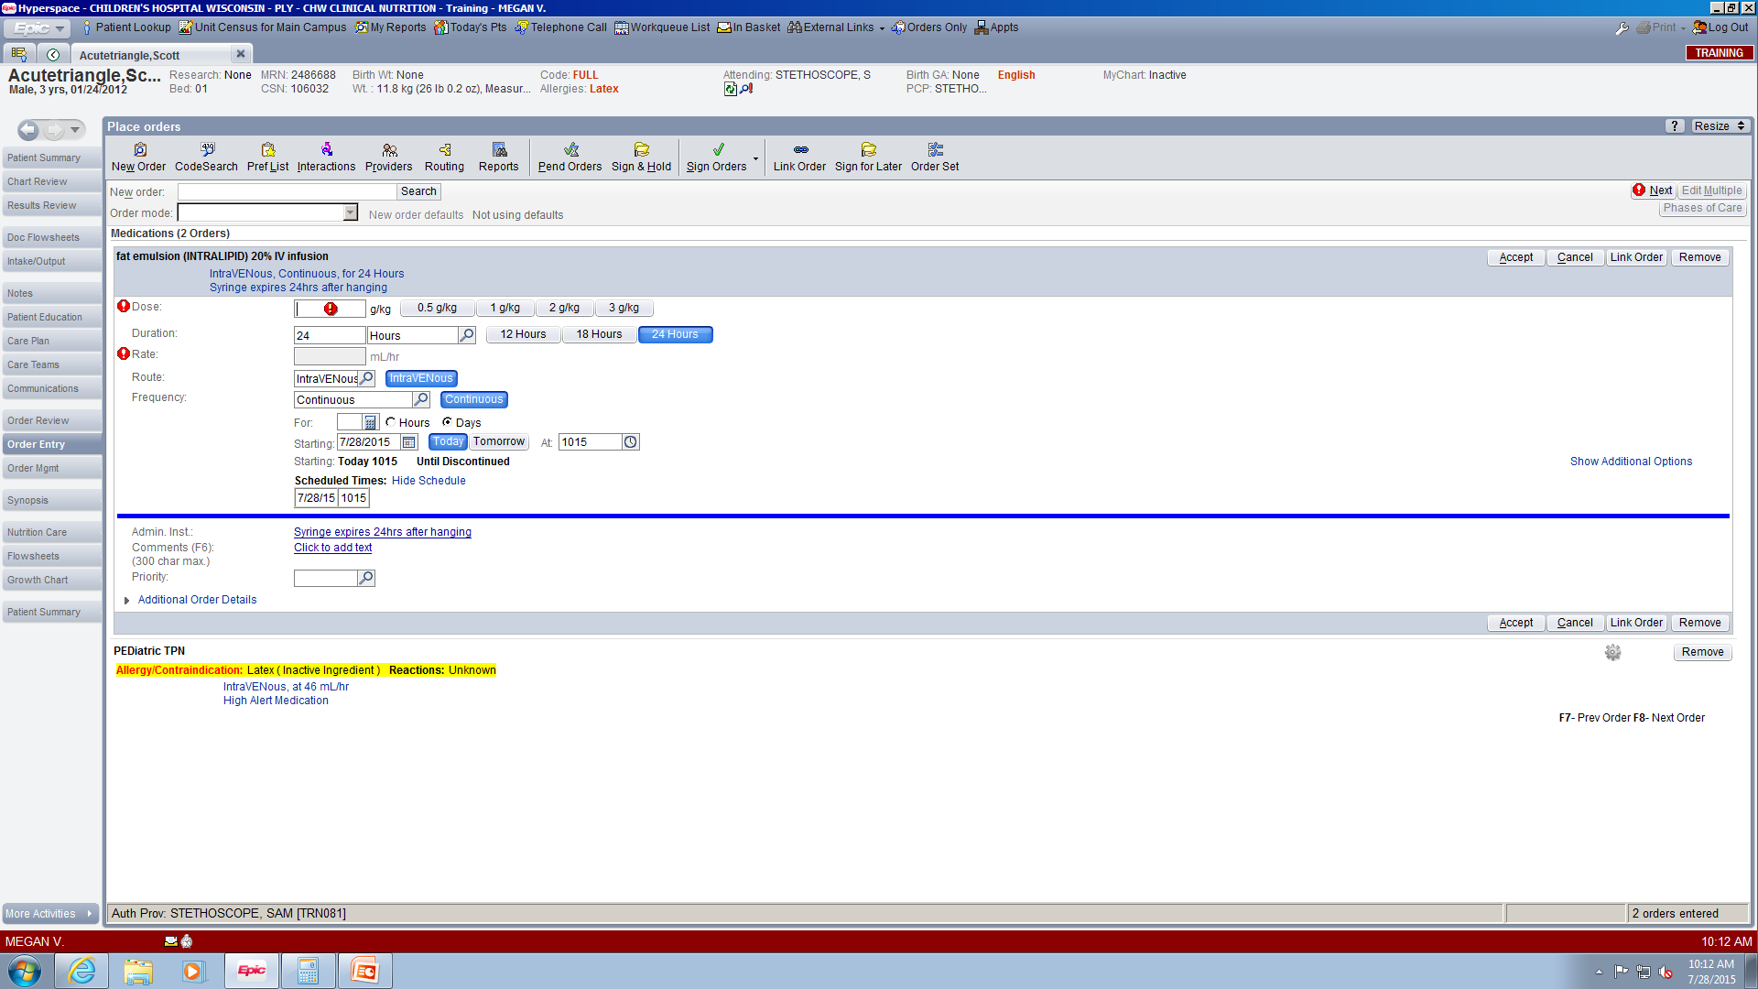
Inpatient Lipid Order
Notes:
PN at Children’s is administered as a 2 in 1, so lipids need to be ordered separately. Here is an example of what an order for Intralipid looks like. Note you have to choose a dose, ordered in grams per kilogram, and a rate ordered in milliliters per hour. A duration of 24 hours is the order default but can be changed as needed.

Slide 22
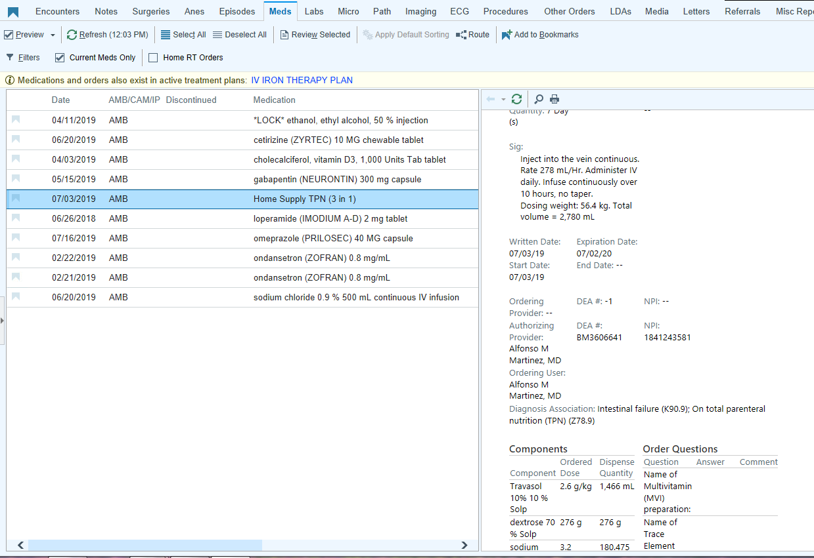
Home TPN Order
Notes:
Home TPN is a separate order in Epic, titled “Home Supply TPN 3 in 1”. Here is a screenshot of how this order shows up in a patient’s medication list.

Slide 23
Resources
Learning Home Documents
Home Supply TPN
TPN Documentation Note
Notes:
We will not cover ordering Home Supply TPN in this training module. However, if this is a task that will be assigned to you in your work assignment, you can use the Epic Learning Home titled Home Supply TPN as a resource.

