Slide 1

Preceptor Training

Slide 2
Objectives
Understand the importance of precepting
Types of learners
Providing feedback
Communicating, listening and managing time

Slide 3
What is a preceptor?
Catalyst for clinical excellence
Demonstrates how to provide the best and safest care
Helps to socially and culturally acclimate new learners
Notes:
Connect.chw.org

Slide 4
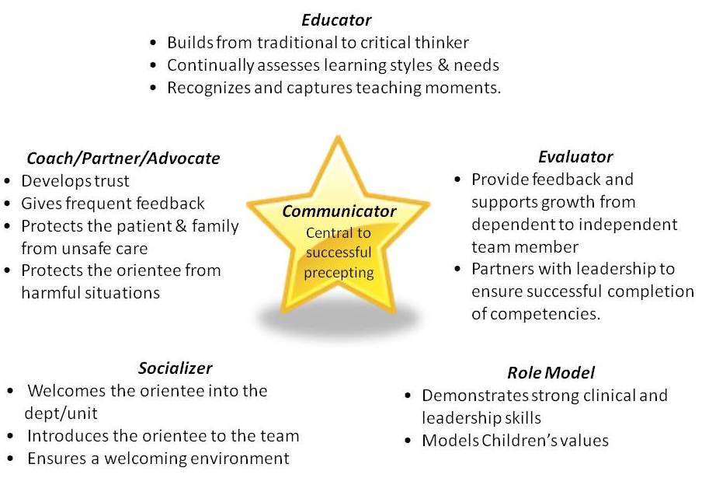

Slide 5
Importance of Precepting
As a preceptor, you may support the development of:
  Students
  New graduates from school
  New employees that come with a lot or limited experience
  Colleagues transitioning to a new specialty area

Slide 6
Importance of Precepting
Improve knowledge through facilitation
  Implement techniques that help adults learn
  Use various strategies to increase knowledge successfully
  Use:
    Thoughtful questioning
    Encourage feedback
  Avoid:
    Giving away all of the answers
    Only letting learners observe and “absorb” knowledge
For all learners, it is important to identify the expectations for orientation
Notes:
https://www.cdrcampus.com/course/view.php?id=131&page=1545

Slide 7
Successful Preceptors
Are organized and focused
Value preceptor-learner interactions
Are dynamic and enthusiastic
Relate well to learners
Use an analytical approach
Are competent and confident
Model professional behavior
Notes:
How do we accomplish all of these goals?
Through understanding how adults learn
*Goal setting?
In order to define goals clearly for both the preceptor and preceptee, they should be written. By putting the goals in writing, you create structure and improve the success of the precepting process.¹ Written goals give the preceptee a specific focus for growth and will assist in evaluation.
When writing goals, remember that they should be specific, concrete, and realistic.^{2,3} After determining the goals, you will need to break each down into smaller, more manageable performance outcome statements. The best goals are:
Developed collaboratively with the preceptee
Written with specific performance outcomes
Use self evaluation on a weekly basis
Use daily performance evaluation to keep written goals on track
Many facilities document goal achievement with facility checklists and competencies, so writing the goal is essential in order to track progress.

Slide 8
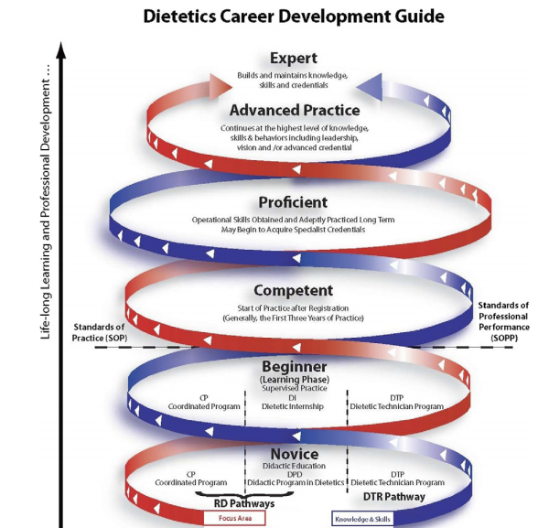
Notes:
This guide allows practitioners to self- assess their own level of expertise , regardless of where one is on the career development guide there is a need for lifelong learning and professional development. AS a preceptor you can facilitate lifelong learning and development.

Slide 9
Adult Learning

Slide 10
Adult Learning
Types of learners
Learning tips
Barriers to learning
Assessing learning

Slide 11
Notes:
The more involved a learner is in the process, the more they will remember!

Slide 12
Types of Learning
Type | Traits | Ways to support
Visual | Prefer body language and facial expressions to understand Think in pictures and create mental images to remember Prefer learning environments without visual obstructions | Use visual displays including diagrams, illustrations, slides, videos, flipcharts and hand-outs Allow for note taking to absorb the information May understand better by reading the chart vs listening on rounds
Auditory | Learn best with verbal lectures, discussions, talking things through and listening to what others have to say Interpret the underlying meanings of speech through listening to tone of voice, pitch, speed and other nuances Find it easy to instruct patients and move them toward behavior change | Encourage roll playing and practicing aloud
Kinesthetic or tactile | Learn best through a hands-on approach They have the ability to control body movements and handle objects skillfully. By interacting with the space, they remember and process information | May find it hard to sit still for long periods and may become distracted by their need for activity and exploration Will learn better from practicing skills that they want to develop

Slide 13
Learning Tips
Learning Tips
Use Multiple Methods
Be Flexible
Integrate new ideas with existing knowledge
Promote self esteem
Make it practical and problem centered
Notes:
Learning Tips
Examples:
Visual learner: utilizing a pamphlet/teaching sheet
Auditory learner: face-to-face time
Kinesthetic leaner: measure portions of food
How to do it
Make it practical and problem centered
Give overviews, summaries, examples to link theory to practice
Offer suggestions for problems they may encounter when applying new info
Promote self esteem
Provide low-risk activities in small group settings
Build success incrementally
Help establish productive routines
Integrate new ideas with existing knowledge
Recall what they already know from prior experiences to relate new topics
Share your agenda and assumptions, ask for their input. Adjust timing for topics as needed.
Identify what the learner would like to know about the topic.
Build in flexibility/options within your plan so you can shift to address needs
Be prepared that you may need to help unlearn old habits or confront inaccurate beliefs
Be flexible
Provide a quality, well organized experience that uses time effectively
Avoid jargon
Affirm their knowledge, contributions and successes
Teach learners to use forethought in selecting words and examples to avoid creating stereotypes and negative perceptions

Slide 14
Assessment of Learning
Use open-ended questions to gain understanding of learning as much as possible
  Build upon questions to improve their critical thinking:
    Diagnose: "What is your interpretation of the data?"
    Decide: "What interventions do you suggest?"
    Hypothesize: "What would you do differently if this patient had diabetes?"
    Challenge: "What leads you to that conclusion?"
    Summarize: "What are the key issues that might hinder the patient's compliance?"
Notes:
This helps to develop critical thinking

Slide 15
Problem Solving Barriers to Learning

Slide 16
Organization & Time Management
Use a daily planner and/or large calendar
Expect the learner to note rotations, due dates, schedule, and other important information.
Provide a detailed weekly or daily schedule
  Schedule daily or weekly meetings with the student to track progress
Discuss how to prioritize talks and give opportunities to practice

Slide 17
Knowledge deficits
Help identify the specific deficit
  Ask what they found difficult about the competency and why
Suggest resources or additional activities to improve skill or knowledge
  Examples: additional readings, role playing
Review any action plan to assess if deficit is improved

Slide 18
Difficulty learning a new skill
Provide safe learning experiences to practice the new skill
  Example:
    If having difficulty providing nutrition education in a group setting role playing may help.
    Try presenting in front of a small group that he/she feels comfortable with first
Give specific feedback on weak areas and continue to practice this new skill whenever possible until confident

Slide 19
Too dependent
Determine the reason for dependence
  Not enough practice/training/knowledge?
Provide opportunities to practice skills early; observation is important in the beginning but do not wait too long to encourage skill building
  Start by giving small, safe tasks to perform at first to increase confidence
Give positive feedback and encouragement
Schedule specific times during the day to meet for discussion and feedback

Slide 20
Feeling stressed out/overwhelmed
Encourage stress management activities
  Deep breathing, relaxation, meditation
Help identify sources of stress and suggest ways to manage them
Relay your own internship experiences
Give encouragement
  Refer them to counseling resources, if needed

Slide 21
Case Study

Slide 22
Case: Questioning in a Clinical Situation
Your learner asks, “Should this patient be advanced from a step 1 to a step 2 diet for dysphagia?”
What response should you avoid in this situation?
What would be a reasonable way to respond?
Notes:
Have learner write down responses on worksheet

Slide 23
Case: Questioning in a Clinical Situation
Your learner asks, “Should this patient be advanced from a step 1 to a step 2 diet for dysphagia?”
Avoid answering with “Yes” or “No”
Instead respond by asking questions to help critical thinking, problem solving, and discover the answer through their questioning
What are some questions you could ask this learner?
Notes:
This helps show the preceptors thought process and decision making process too. Take a moment to write down your ideas for other questions you could ask.

Slide 24
Case: Example Questions
How has the patient been tolerating the dysphagia 1 diet to this point?
What are the differences between the medical nutrition therapy provided in dysphagia 1 and 2?
What are the indications that the patient is ready to advance?
If advancing is warranted, how would you recommend advancing?
If the patient is advanced, what factors should be monitored?
Notes:
All of these questions will lead to more understanding of what the learner is thinking and where there might be gaps in their knowledge

Slide 25
Case: Questioning in a Clinical Situation
If the suggested plan is appropriate:
  Reinforce learning and help develop self-confidence by confirming that the use of the steps in the nutrition care process as well as the decision-making processes are sound
If the learner does not understand the patient’s condition and needs or has failed to consider all of the important factors:
  Provide more information and teaching about both the process and the principles of nutrition care

Slide 26
Precepting Strategies

Slide 27
One Minute Preceptor
A framework around which preceptor-learner conversations can be built
Contains five microskills to accomplish when discussing a case with a learner
Typically takes about ten minutes to accomplish, but can be helpful in many disciplines and especially when very busy
Notes:
Sometimes we do not have a lot of time between patients to go through a case in as much detail as we would like. This strategy is one way to help the learner in smaller amounts of time.

Slide 28
One Minute Preceptor: Skills
Skill | Questions to ask
#1: Ask the learner what they think is happening | What do you think is going on with this patient? Based on the patient’s history, are there any particular parts of the assessment that you should focus on? Do you feel there are social concerns with this patient?
#2: Probe for reasoning and/or supporting evidence | What were the major findings that lead you to this decision? What else did you consider? What other information might you need? How do you know that these problems are this patient’s priorities?
#3: Teach important principles | When you see this, always consider… Your reasoning that this patient will need instruction on portion sizes is appropriate Patients may tell you what they think you want to hear, be sure to ask clarifying questions.
#4: Provide positive, constructive feedback | Your organization of this information was logical and easy to follow. You actively listened to the patient and allowed them to open up to you.
#5: Correct mistakes in reasoning | This patient’s nausea and pain with swallowing are more likely due to the chemotherapy than their surgery. Next time, try or consider…
Notes:
Video?

Slide 29
Improving Critical Thinking
6 Steps to Effective Thinking and Problem Solving: IDEALS
Identify the problem | What is the question we are facing?
Define the context | What are the facts and circumstances that frame the problem?
Enumerate choices | What are our most plausible 3 or 4 options?
Analyze options | What is our best course of action, all things considered?
List reasons explicitly | Let’s be clear. Why are we making this particular choice?
Self-correct | Let’s look again, what did we miss?
Notes:
Can also look at types of question’s asked
Source: www.insightassessment.com/teachtips.html

Slide 30
Learner Feedback

Slide 31
Importance of Providing Feedback
Key aspect of clinical education experience
Necessary for the development of the learners skills
Allows preceptor to establish the role as a resource for learning
Helps learner identify their strengths and weaknesses and develop ways to improve

Slide 32
Providing Feedback
Giving and receiving feedback is a learned skill
Prepare your learner ahead of time and let them know that you will be providing feedback frequently
  Ask your learner how they prefer to receive feedback and try to take this into consideration
  Also let your learner know when to expect it, how, where, and by whom feedback will be given, and what they will be expected to do next
Example: You ask for edits to a teaching sheet
  Give clear expectations-
    The teaching sheet will be assessed within a week by three staff members
    Inform them if they will be expected to make corrections or modifications based upon the feedback given
Notes:
X,y,z method?
Setting the stage for and giving valuable feedback helps strengthen the preceptor-learner relationship. The learners come to know that you will be upfront with them and that you want them to develop appropriate and professional techniques.

Slide 33
Providing Feedback
Encourage reflection and self-assessment
  It is best for learners to assess their own strengths and weaknesses before hearing/receiving other people's views
Find someplace private to provide feedback
Speak in the first person
  Example: “I think you included too few details in your explanation of how to mix formula.”
Give feedback in a timely fashion
  When able, give feedback immediately
Notes:
It encourages them to think seriously about how they are doing
It is also good practice to honestly assess strengths and weaknesses
As a preceptor they rely on you to tell them if their impressions are accurate
Give feedback immediately: We all know how easy it is when we are always on the run to let other commitments prevent us from giving feedback promptly. However, research shows that students learn best if feedback is specific and given soon after the assignment is completed

Slide 34
Providing Feedback
Give feedback in a descriptive manner rather than judgmental and be specific
  Example: “I think you could have given the patient more suggestions for creating meals that they enjoy by spending more time asking open ended questions about what they like to eat.”
  Instead of “You were wrong to give that patient your suggestions.”
Avoid sending mixed messages
  Example: If you provide the feedback "good job," you must not later present a list of things that were not done well
    Causes learners to become confused, frustrated, and discouraged

Slide 35
Providing Feedback
Take one thing at a time
  Focus on what is most important to improve upon first
Provide feedback on a routine basis
  It becomes easier and helps improve progress
Make sure the feedback has been clearly understood
  Ask the learner to tell you what their understanding of the feedback is
Be honest in all of your feedback
Notes:
Take one thing at a time: students are not likely to be able to work on improving in lots of ways all at the same time. So help them focus on what you think is the most important consideration first.
Provide feedback on a routine basis. The more often you provide meaningful feedback, the easier it becomes and the more likely the student is to learn and progress.
Make sure the feedback has been clearly understood. Ask the student to repeat in their own words what they understood you to say.

Slide 36
The 4 E’s of Constructive Feedback
E | Example
Engage | Prepare for feedback, ask how, where and what- not why. Do not give feedback unless there is a constructive outcome you wish to achieve When giving feedback on the spot, frame it in the terms of the behavior/situation you want to improve or acknowledge. Ex: “You instructed the patient very effectively because you did not overload him with information” or if the trainees thoughts are not well-organized when giving a diet instruction, explain they must develop a logical outline to use to guide the instruction.
Empathize when providing feedback | Incorporate active listening and focus on facts and feeling Determine the best time and place to convey the message Move to a private area if on the spot feedback is needed
Educate for improvement | Describe the behavior, its impact, and explain how to improve. Focus on the situation or behavior rather than their personality Be objective and provide examples to help clarify your intent. Ex: if the trainee did not consider all of the pertinent information in a nutrition assessment, describe how they should have approached gathering and analyzing information, what could happen as a result of basing the assessment on incomplete information, and how to approach the next assessment.
Enlist a response using probing Q’s | Ask probing questions and be sure to listen and summarize. Establish mutual goals, accountability, and schedule time for follow-ups.
Notes:
As a preceptor, always be fair and ethical in providing feedback to students. Make sure formative feedback given throughout a rotation is consistent with the final or summative evaluation. A student who received very positive formative assessments will be confused and discouraged if the final or summative evaluation is highly critical.

Slide 37
Case: Providing Feedback
Your learner provides education to a family on increasing protein in the diet. When they are done with the education they forget to ask the family what questions they have and leave the clinic room.
What feedback would you provide and how?
Notes:
Write down your feedback on your worksheet

Slide 38
Working with a Learner: Beginning to End

Slide 39
Communication
Discuss goals, competencies, and learning objectives for the rotation
Assess learning in relation to the planned experience and learning objectives
Establish a set time for 1:1 sessions and review of daily learning activities and progress
Provide clear expectations for when self-directed learning and guided learning should occur
Provide information on how the learner should communicate with you
Notes:
As with the program director, the preceptor must communicate with students from the onset of their experience. Initially, when meeting with students a preceptor must communicate clearly to the student the goals and expectations of their planned rotation or experience. When goals and expectations are clear, the student will be better prepared to focus their learning efforts and learning experiences where they matter most. This process is easily facilitated during the student orientation process as part of the planned experience.

Slide 40
Communication
Effective communicators
  Possess and demonstrate broad knowledge
  Explain the basis for actions and decisions
  Answers learner questions clearly and precisely
  Are open to conflicting ideas and opinions
  Connect information to broader concepts
  Communicates clear goals and expectations
  Captures the attention of the learners

Slide 41
Co-Precepting Communication
Co-precepting is common
  Shared weeks or full weeks and then transition
  Helps lighten the load for each preceptor
Providing regular handoff and communication to co-preceptor is important
  Allows learner to continue to develop their skills sequentially
  Decreases duplications
  Work together to decide how learner evaluations will be completed
Utilize the learner to ensure goals are met
  “What is your goal for your day?”
Notes:
Discuss what works best with your co-preceptor. Handoff via voalte, email, weekly, after each day? This will depend on the preferences of the preceptors so work together.
*add as part of the recording details on what to provide as handoff preceptor to preceptor and how to use the learner as a way to provide handoff and continue to push the learner forward.

Slide 42
Observation of the Learner
Early in the process of precepting, explain the purpose of your observations
  Inform how, when, where, and why observations will take place
  Share a checklist or other assessment guide at the beginning
  Notify the patients that you will be observing
    This can be done by either the learner or the preceptor
  Conduct the observation without interrupting
  Quickly jot notes about what was observed
  Provide specific feedback to the student as soon after the observed encounter as possible

Slide 43
Listening
Practice active listening
Listening fully and avoid thinking about what you want to say next
Active listening requires that you listen intently and really focus on what the other person is saying
Use reflections throughout your conversation
Show empathy while listening
  Empathic listening gets inside another person’s frame of reference, like putting yourself in someone else’s shoes
Notes:
Like reflective listening in MI

Slide 44
Listening Tips
Apply the non-verbal clues to communicate interest
  Make eye contact, nod your head, lean in, and relax
Re-state what was said either in the same words or summarize
  be sure to capture the essence of what is being said
If you don’t understand what is being said, ask for clarification

Slide 45
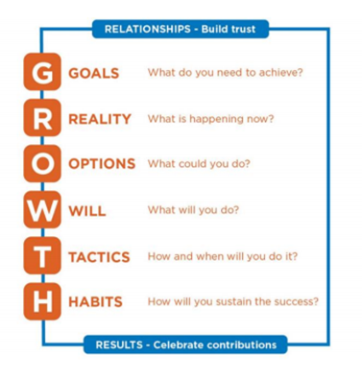
Coaching
Help identify where there are gaps in practice and develop a plan
Lead the learner to discover where they have growth opportunities

Slide 46
Coaching
Example:
  Preceptor: Now that you have been in orientation for a month, what do you think you still need to work on?
  Learner: I think I am pretty good at calculating the nutrition prescription and determining the diagnosis, but I am still having problems determining the correct intervention. I get confused.
  Preceptor: I have noticed that as well. Let’s look at some of the reasons you are getting confused and find ways to increase your knowledge.
Notes:
Add a video?

Slide 47
Managing Time
Ways to be an efficient preceptor:
  Thoroughly orient the learner
  Discuss daily tasks and expectations for supervised practice experiences
  Use planning tools such as prioritized “To Do” lists
  Set time expectations for tasks
  Accomplishing multiple purposes with single real-world activities
  Each day debrief and then plan for the next session
Notes:
Set mini-goals to help a student experience a sense of accomplishment. Preceptor and student interactions may be more productive if they are short and happen frequently.

Slide 48
Managing time
Precepting takes up a lot of your time
Please ask for help! We are all a giant team!
  See if the learner wants to shadow any other areas
    If going to an entirely different area reach out to supervisor
  If you are swamped, talk to your supervisor
  Use the self-learning modules
  Use intern projects
    Have intern pick something that interests them at the start of their rotation
  Co-precepting
  Reach out to AP of education for additional support and adjustment

Slide 49
Setting Realistic Expectations
Setting realistic goals is essential
  If goals are too difficult, learners will become frustrated
  If too easy they may become bored or disengaged
When setting goals, build upon the present skill level

Slide 50
Reassessing Goals and Expectations
Goals and expectations should be reassessed to determine progress and make adjustments
  Place reassessment points into the orientation plan
Consider a weekly progress agenda
  Review established expectations
  Discuss observations of clinical practice
  Give feedback on observations over the past week
  Have a discussion using questioning/case scenarios
  Plan goals for the upcoming week.

Slide 51
Supervised Practice
Learners need more supervision in the beginning
As skills are learned they will gain more autonomy
Make sure you give enough support to allow the learner to feel:
  They will not be allowed to fail
  Will be protected from making mistakes
  Build confidence

Slide 52
Summary
Precepting is important for the learning and development of future and new dietitians
There are many types of learners and it is beneficial to use many learning techniques
Successful precepting takes communication, encouragement, and feedback

Slide 54
References
Curry, KR. Multicultural competence in dietetics and nutrition. J Am Diet Assoc. 100:1142-1143, 2000.
Department of Nursing, Sonoma State University; N425 Preceptor Handbook, December 6, 2005.
Harden RM and Crosby JR. An extended summary of Association for Medical Education in Europe Medical Education Guide No. 20, Medical Teacher 22(4): 334-347. (http:/www.amee.org)
Lacey K, Pritchett E. Nutrition Care Process and Model: ADA adopts road map to quality care and outcomes management. J Am Diet Assoc. 2003;103:1061-1072.
Lee JE, Ryan-Wenger N.J Pediatr Health Care. The "Think Aloud" seminar for teaching clinical reasoning: a case study of a child with pharyngitis. 1997 May-Jun;11(3):101-10.
Nutrition Diagnosis and Intervention: Standardized Language for the Nutrition Care Process. Chicago, Il: The American Dietetic Association, 2007.
Oermann MH. A Study of Preceptor Roles in Clinical Teaching, Nursing Connections 1996 Winter; 9(4):57-64.
Shojania KG, Duncan BW, McDonald KM, Wachter RM. Making Health Care Safer: A Critical Analysis of Patient Safety Practices. Evidence Report/Technology Assessment No.43 (Prepared by the University of California at San Fransico-Stanford Evidence-based Practice Center under Contract No. 290-97-0013). Rockville, MD: Agency for Healthcare Research and Quality; 2001. Report No.:AHRQ. Publication No. 01-E058.
Sonoma State University Nursing Preceptor Handbook, Sonoma State University Nursing Department, 12/6/05
The Effective Preceptor. Monograph by MAHEC Office of Regional Primary Care Education, Asheville, North Carolina, www.oucom.ohiou.edu, accessed 4/24/07.
Writing Group of the Nutrition Care Process/Standardized Language Committee. Nutrition Care Process and Model Part I: 2008 Update. J Am Diet Assoc. 2008;108: 1113-1117.
Writing Group of the Nutrition Care Process/Standardized Language Committee. Nutrition Care Process Part II: Using the International Dietetics and Nutrition Terminology to Document the Nutrition Care Process. J Am Diet Assoc. 2008;108:1287-1293.
Lazarus, J. Journal of Midwifery & Women’s Health. “Precepting 101:Teaching Strategies and Tips for Successful Preceptors. 2016.https://onlinelibrary.wiley.com/doi/epdf/10.1111/jmwh.12520

