Slide 1
Protection Officer Briefing Alternative Train Orders
March 2022
Presented by UGL REGIONAL LINX

Slide 2
Agenda
Alternative Train Order
Background
Special Orders
Work Train Orders
Next Steps
CLICK TO EDIT HEADING

Slide 3
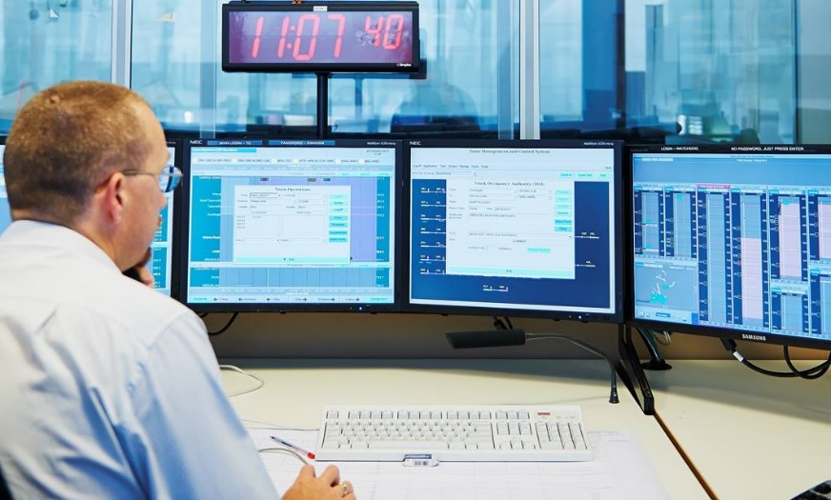
Background
Rail Traffic is issued with Train Order to occupy track
The GPS Watchdog tracks rail traffic movements using GPS
A Train Order permits travel in one direction only
Work Trains are not issued an authority to occupy and enter the limits of a track occupancy authority
Relies on the Protection Officer to protect the work train
Unauthorised rail traffic movements will generate alarms in the control centre.
CLICK TO EDIT HEADING

Slide 4
Background
Train Order Limitations in other Networks
System limitations and operational restrictions associated with Mishap Orders (Train must fail in the correct location)
May result in unnecessary Out of Authority alarms
Mishap Order process is inflexible and requires the recovery process to be known in advance of order issue
Some operational scenarios cannot be supported be the system, resulting in use of administrative controls (SPAs)
CLICK TO EDIT HEADING

Slide 5
Background
Train Order Limitations in other Networks
Train working within a TOA as per CNWT-314 (Work Trains) generates Out of Authority alarms on the GPS Watchdog
Work train is reliant on Protection Officer to provide protection
Departure of Work Trains from worksites can be complex and inefficient
CLICK TO EDIT HEADING

Slide 6
ALTERNATIVE TRAIN ORDERS Special Orders

Slide 7
ATO - Special Orders
Objectives
Special Orders are bidirectional authorities
Work on track authorities CANNOT be issued until Special orders are fulfilled
Can be used degraded recovery purposes or planned train working
Improves engineering controls system locking and GPS Watchdog monitoring
Provides greater operational flexibility without position constraints
Existing Rail Traffic protection rules and procedures apply

Slide 8
ATO - Special Orders
Process
Issued to FAILED or ASSITING train
Uses existing system controls to reserve track
Follows existing process to establish a Train Order
Drivers records details of planned movement on FORM CNRF 009
Limits defined by NCO and recorded by Driver on FORM CNRF 009
Allows for all necessary bi-directional movements on a single authority

Slide 9
ATO - Special Orders
Cancellation Alternative Train Orders may be cancelled if:
Vehicle Movements have not commenced or are not completed
Vehicle(s) are stationary
All Affected workers are told of the cancellation

Slide 10
ATO - Special Orders
Fulfillment Alternative Train Orders may be Fulfilled if:
Vehicle Movements are completed
Vehicle(s) are stationary
All Affected workers are told of the cancellation

Slide 11
ALTERNATIVE TRAIN ORDER Work Train Order

Slide 12
ATO - Special Orders
Objectives
Provide work trains a valid authority to occupy a TOA
Follows existing process to establish a Train Order
Supplementary code applied for work train order overlapping TOA
Limit of Work Train will be the same as TOA once entering the TOA limits
WTO constitutes joint occupancy with the TOA
Train will be issued a Work Train Order
Work Train is piloted into the TOA and within the worksite
Train is protected even if the TOA is fulfilled

Slide 13
ATO - Special Orders
Process
Driver contacts Protection Officer and agree on arrangements
Protection Officer provides driver supplementary code
Driver provides supplementary code to NCO
NCO issue Work Train Oder
Work Train is piloted into the TOA and within the worksite
Limits of WTO same as TOA once entering as defined in special instruction on form CNRF 009
Train is protected

Slide 14
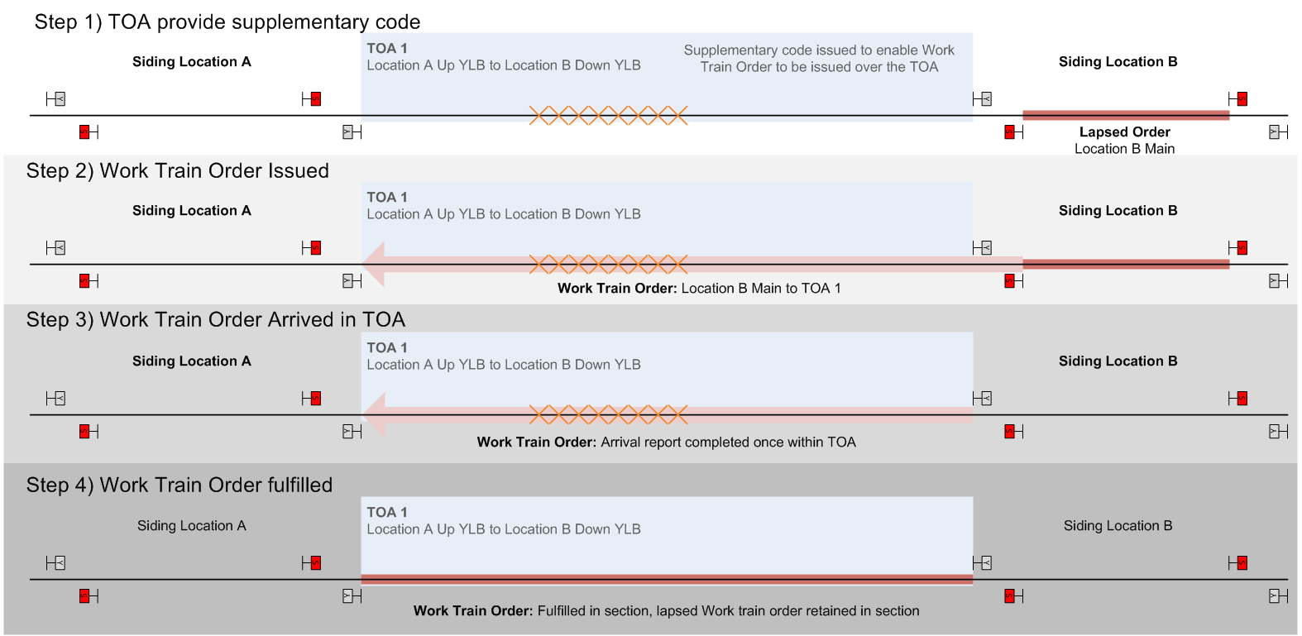
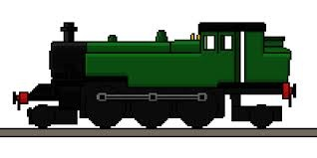
ATO - Work Train Orders

Slide 15
ATO - Work Train Orders
Fulfillment Work Train Orders may be Fulfilled if:
Vehicle Movements are completed
Vehicle(s) are stationary
All Affected workers are told of the cancellation
The TOA may be fulfilled with the train still within the limits as it is protected at all times by the system and its own Authority

Slide 16
ALTERNATIVE TRAIN ORDER Piloting

Slide 17
ATO - Piloting
Piloting Rail Traffic Work trains must be piloted into and within the worksite
The work train does not require a pilot, or piloting when the work train has passed clear of the worksite and is not returning

Slide 18
ALTERNATIVE TRAIN ORDER Further Reading

Slide 19
ATO - Work Train Orders
Further reading CNWT 304 Track Occupancy Authority CNSY 508 Alternative Train Order CNPR 701 Using a Track Occupancy Authority CNPR 710 Piloting Rail Traffic

Slide 20
ATO - Work Train Orders
Next Steps Ensure you have a thorough understanding of this presentation, and all applicable rules and procedures.
Next Step: Complete the Assessment via the RIW eLearning portal

Slide 21
THANK YOU

