Slide 1
UGLRL – Siding Protection
March 2022
Presented by UGL REGIONAL LINX

Slide 2
Agenda
CNWT 309 Siding Protection
Background
Siding Protection
Network Rules and Procedures
Next Steps
CLICK TO EDIT HEADING

Slide 3
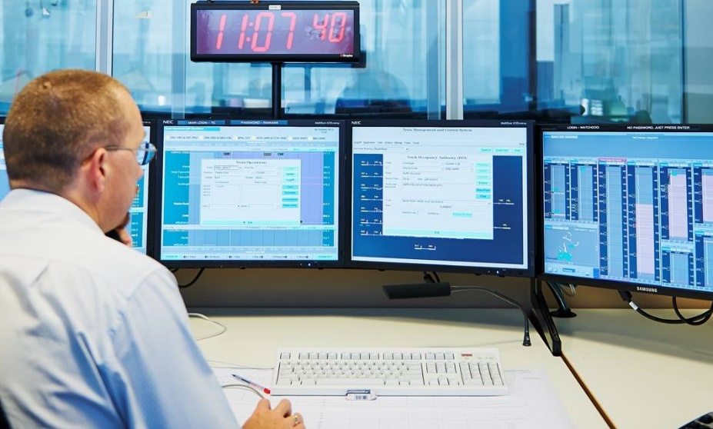
Background
Network Rule - CNWT 300 Planning Work in the Rail Corridor:
Provides guidance for planning track work and assessing the work for safety
Provides guidance for working in Attended and Unattended locations, which is outdated
Does not specify the type of work that may be performed
Does not specify the minimum protection requirements
CLICK TO EDIT HEADING

Slide 4
SIDING PROTECTION

Slide 5
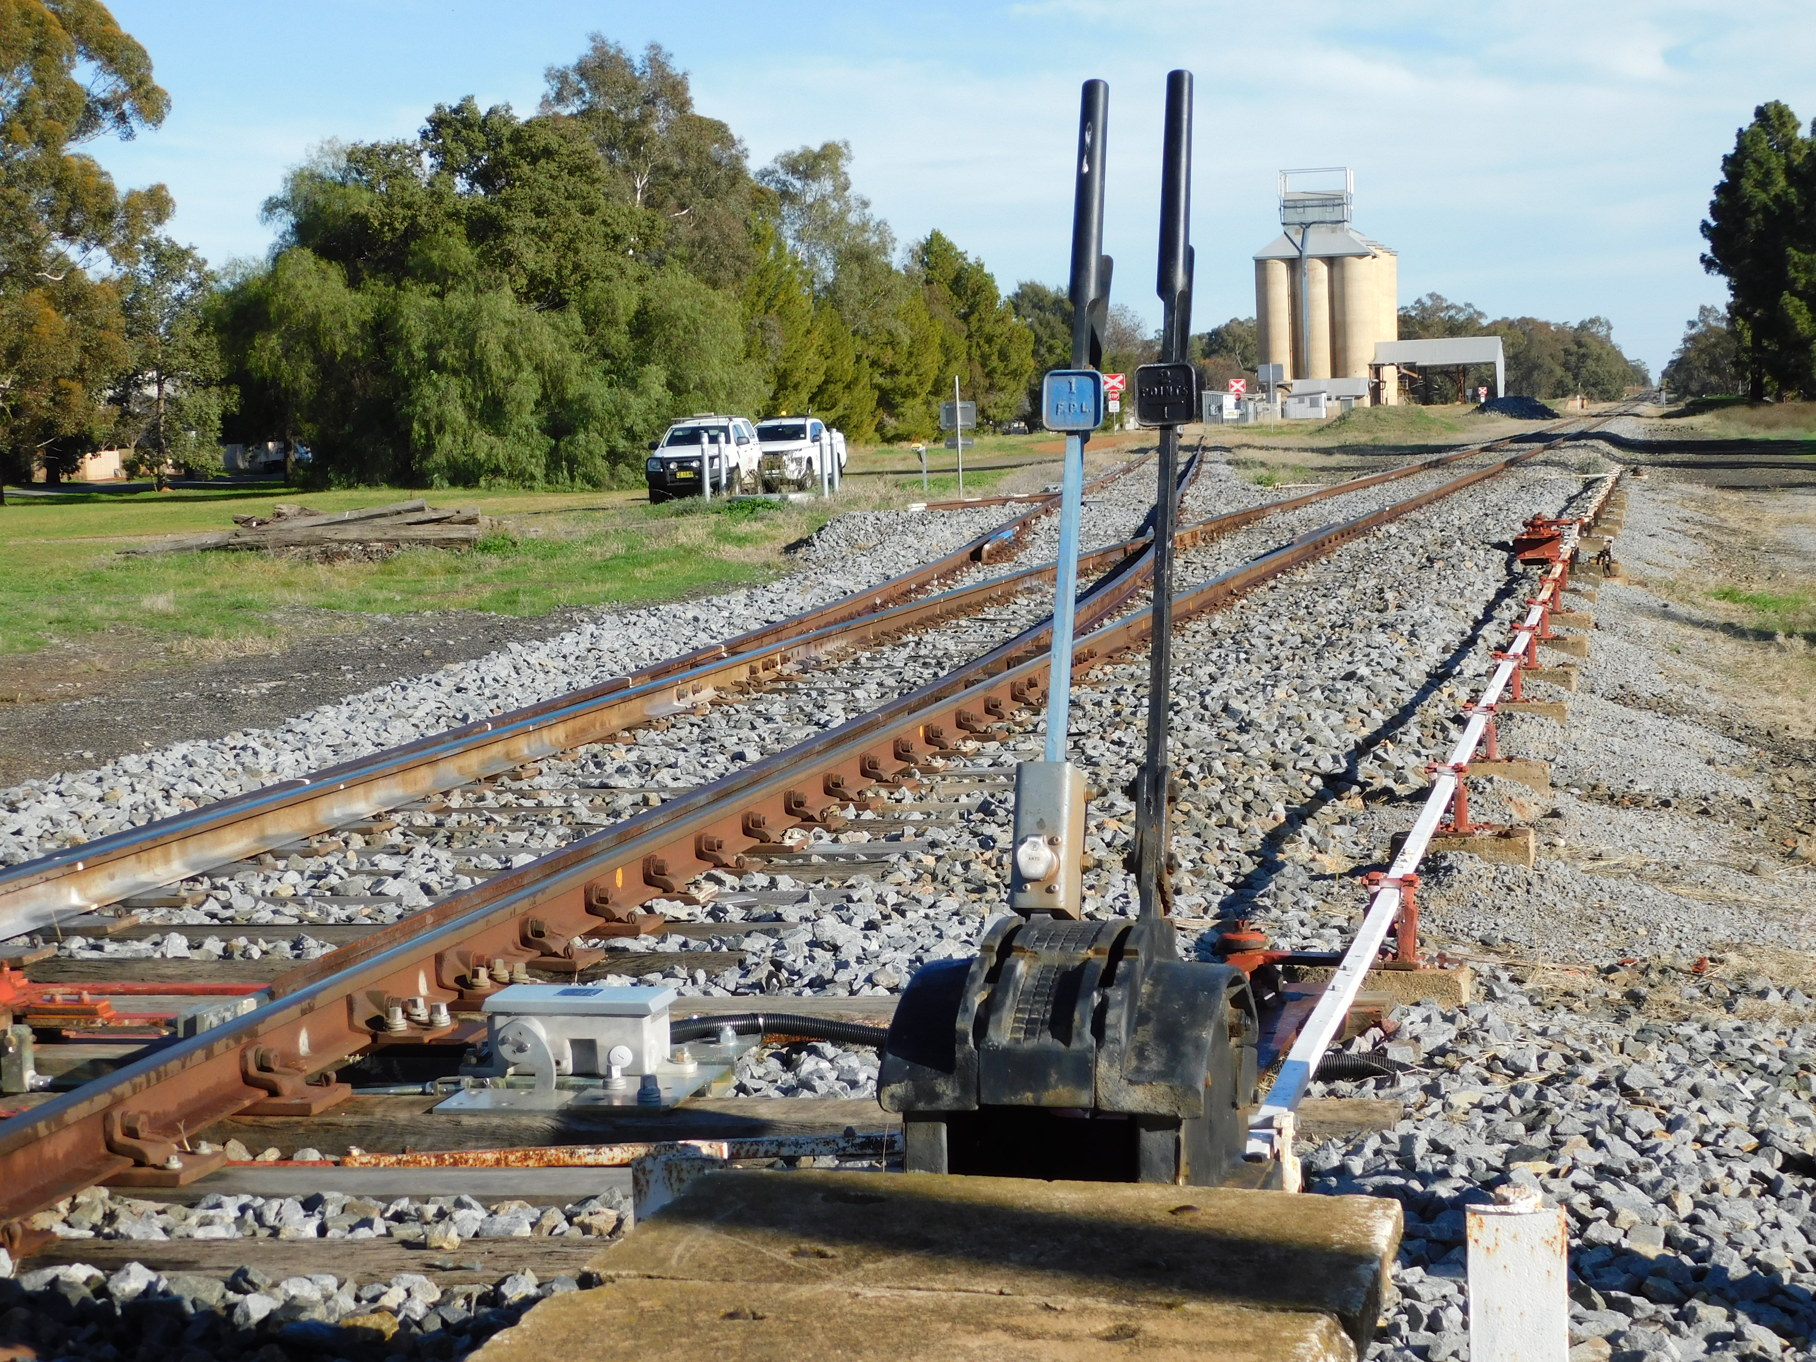
Siding Protection
General
Authorises exclusive occupancy of track between nominated locations for work on track activities on sidings
This occupancy may include rail vehicles secured against movement
Siding Protection must only be authorised by the Network Control Officer
The Protection Officer and the Network Control Officer must apply protection for Siding Protection
Siding Protection may be used by a single worker, in which case, that worker is also the Protection Officer
The limits of Siding Protection must be defined as being between nominated locations such as siding clearance points, manual points or stop blocks
Siding Protection may be used for any work activity.

Slide 6
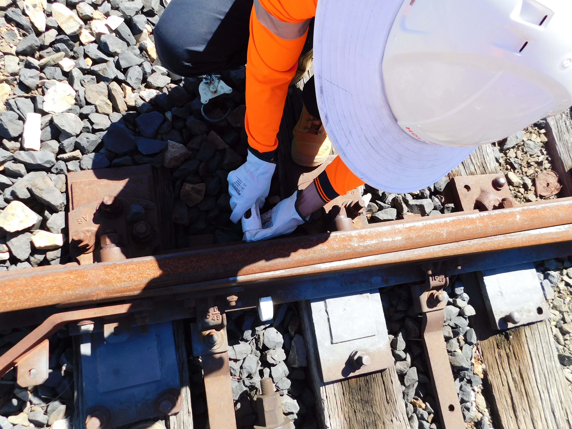
Siding Protection
Minimum Mandatory Protection Arrangements
Siding Protection must employ at least two of the Protection Officer protection methods and one of the Network Control Officer protection methods to protect each limit of the work area.
Protection provided by the Protection Officer
Points clipped and locked to prevent rail traffic access to the worksite
Red flag/light placed in the four foot at the Siding Protection limits (only to be used with Points clipped and locked or Stop block or Derail device)
An adjoining work on track authority that prevents unauthorised rail traffic access to the Siding Protection limits
Red flag/light placed in the four foot and three Railway Track Signals placed at the Siding Protection limits
Stop block placed on the line as advertised in SAFE Notice or Country Network Local Appendix
Derail device as advertised in SAFE Notice or Country Network Local Appendix
Hand signaller/s
Protection provided by the Network Control Officer
Electric ground frame release blocked in normal position
Signal block
Points block
Track block
Note placed in the Network Control Officer Diary or on the Train Control Diagram

Slide 7
Siding Protection
Objectives of CNWT 309
define mandatory minimum requirements for protecting worksites in sidings
define the type of work that may be performed using Siding Protection
instruct how the limits of Siding Protection are defined
provide instruction for using, requesting, authorising, fulfilling and recording Siding Protection.
CLICK TO EDIT HEADING

Slide 8
Siding Protection
Process - Requesting, Authorising and Protecting
Protection Officer must:
complete planning and worksite protection documents
contact the NCO and advise the location, track, protection methods and finish time
clip and lock points where practicable
advise and make arrangements with rail traffic crews in the area
apply 2 forms of protection to protect each SP limit
Network Control Officer must:
only authorise SP in their area of control
apply protection for the worksite
confirm the protection arrangements with the Protection Officer before work commences
CLICK TO EDIT HEADING

Slide 9
Siding Protection
Process - Ending Siding Protection
Protection Officer must advise the NCO when:
work is complete, equipment is clear, track is available for use and
Rail Traffic Crews have been advised.
Network Control Officer:
confirm the ending of Siding Protection with the Protection Officer, and
remove blocks associated with the Siding Protection, and
record the ending of Siding Protection.
CLICK TO EDIT HEADING

Slide 10
Siding Protection
Process
In train order territory WOT authorities will be issued for “running lines” rather than “train order lines” with the exception of main and loop at crossing locations
At crossing locations the portion of track between clearance points on the main will still be known as “main” and the portion of track between clearance points on the loop will still be known as “loop”
At terminal locations such as Hillston/Boree Creek etc, the portion of track from the end train order sign to the stop block is the running line with any roads diverging from that being sidings.
CLICK TO EDIT HEADING

Slide 11
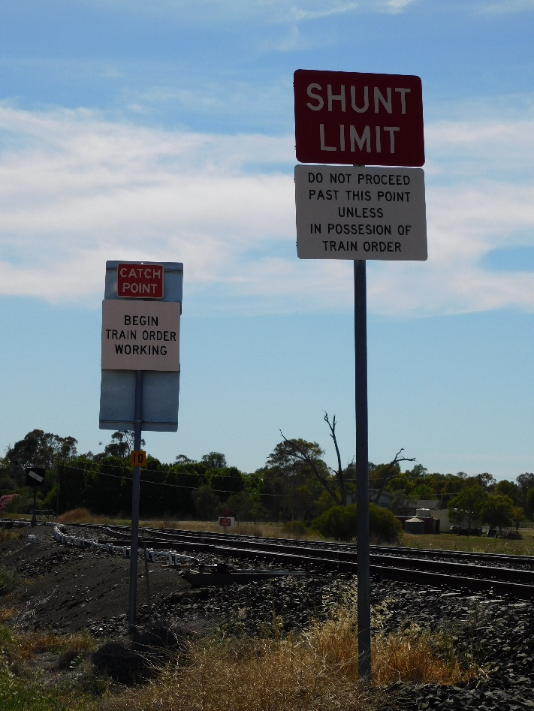
Siding Protection
Ending Siding Protection
The Protection Officer must advise the Network Control Officer when:
work is completed, and
workers and their equipment are clear of the danger zone, and
the track is available for use or has been booked out of use, and
Protection Officer protection methods have been removed, and
points that were secured are available for use, and
Rail Traffic Crew of rail traffic in the area have been advised.
The Network Control Officer must:
confirm the ending of Siding Protection with the Protection Officer, and
remove blocks associated with the Siding Protection, and
record the ending of Siding Protection.

Slide 12
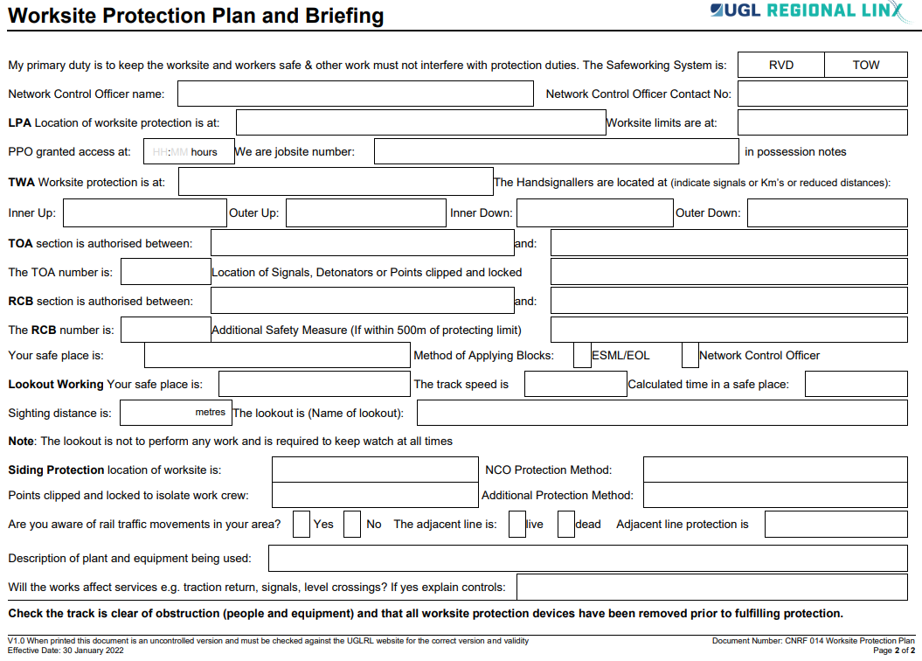
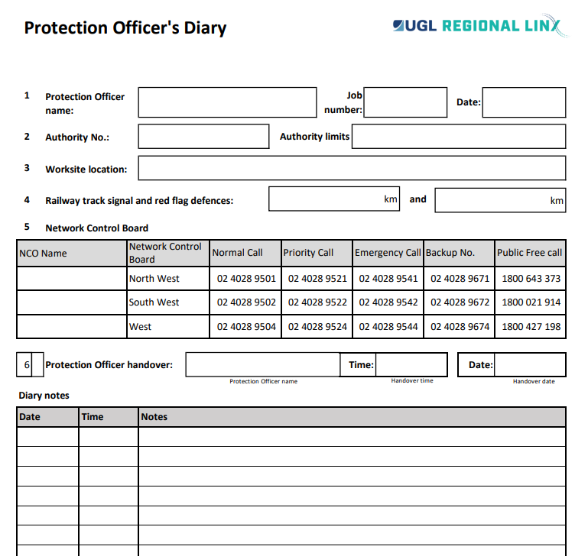
Worksite Protection Plan and Briefing Recording Siding Protection
Ensure all relevant details are entered in to the Worksite Protection Plan (CNRF 014)
And recorded in your PO Diary

Slide 13
Further Reading

Slide 14
Siding Protection
Further reading CNWT 309 Siding Protection CNPR 706 Using Siding Protection CNPR 707 Clipping Points

Slide 15
Siding Protection
Next Steps Ensure you have a thorough understanding of this presentation, and all applicable rules and procedures.
You are now ready to complete the Assessment via the RIW eLearning portal

Slide 16
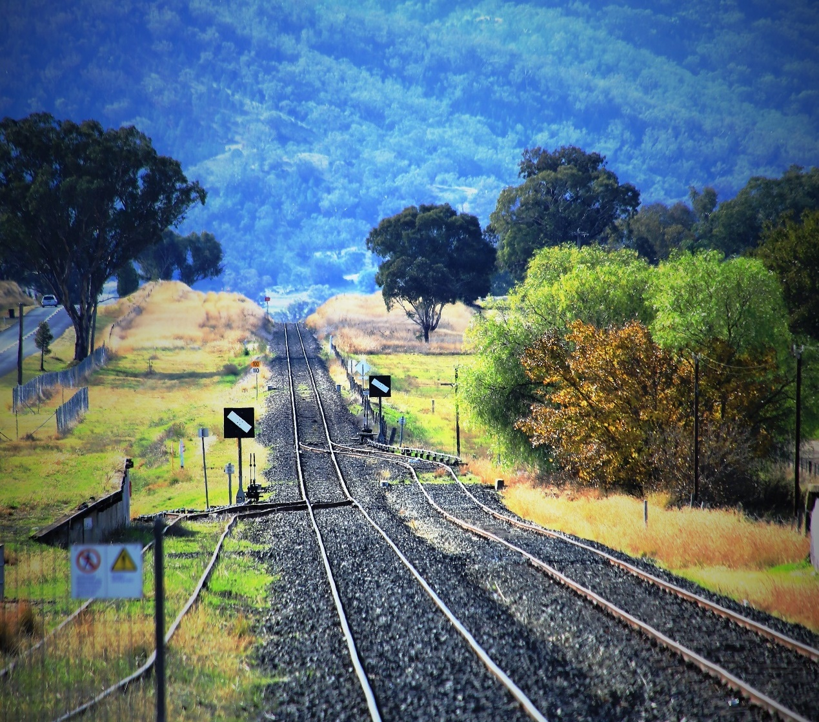
THANK YOU

