Slide 1
iPas MP Portal Using Excel to Enter Price Information
Process:
Export to Excel
Populate Bid Information in Excel
Import from Excel
May 30th,2023

Slide 2
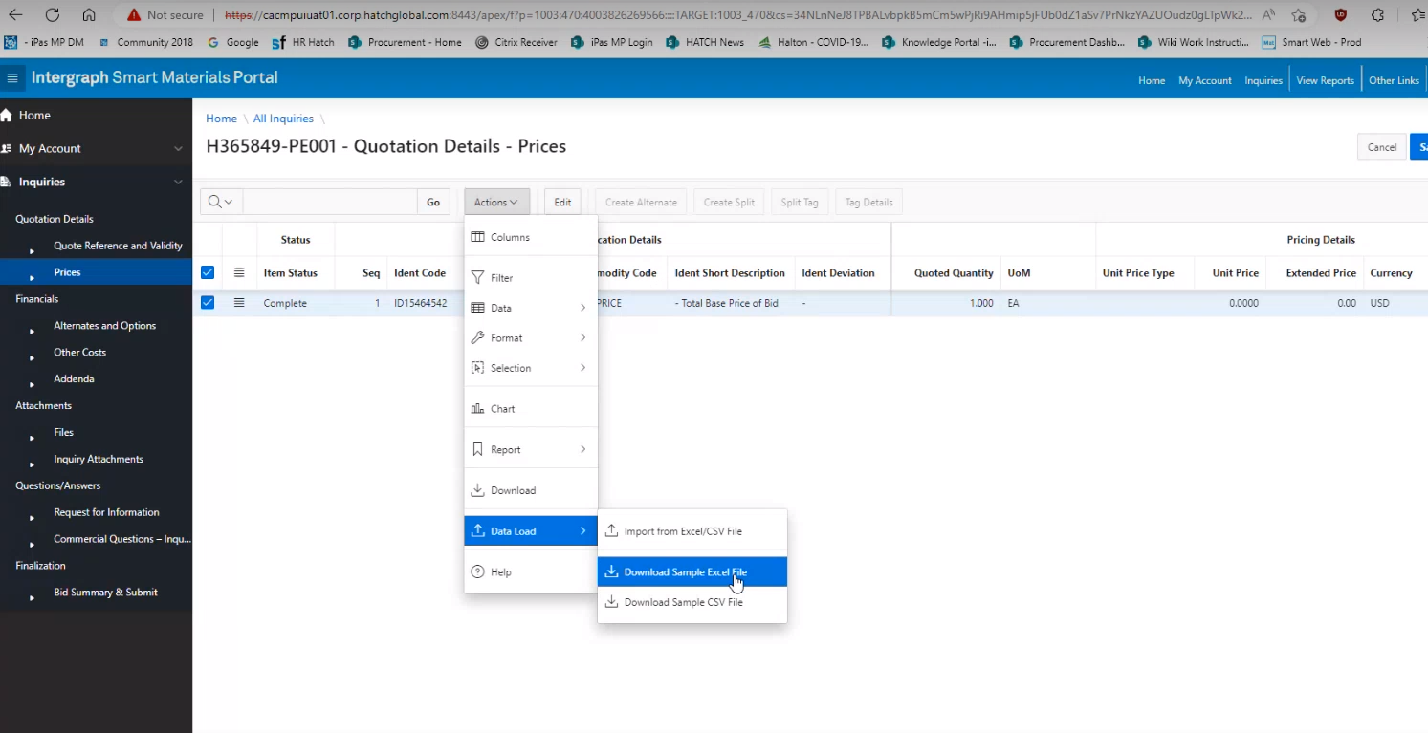
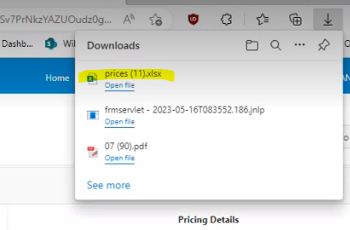
Export to Excel
Under the Price Tab
Click on the Action Button
Open Data Load
Click on Download Sample Excel File
Save as file type .xlsx
The file will download according to your own computer configuration. This is an illustration of Windows download.
1
3
2

Slide 3
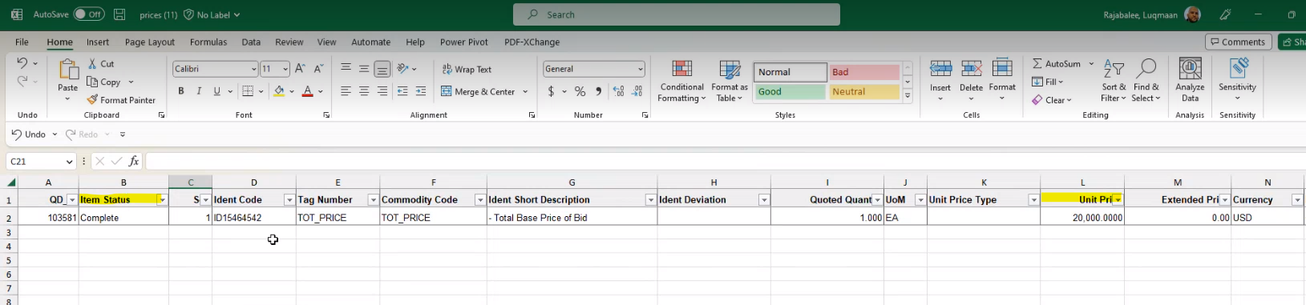
Complete Information in Excel
Item Status:
By default value will be In Process.
Change it to Complete after entering prices or No Bid if you will not bid on this line item
Unit Price:
Enter Price per unit. (Extended price will calculate)
Save the file as .xlsx file type
IMPORTANT:
Do not:
Alter the Excel format
Add lines
Modify values in Column A or other columns

Slide 4
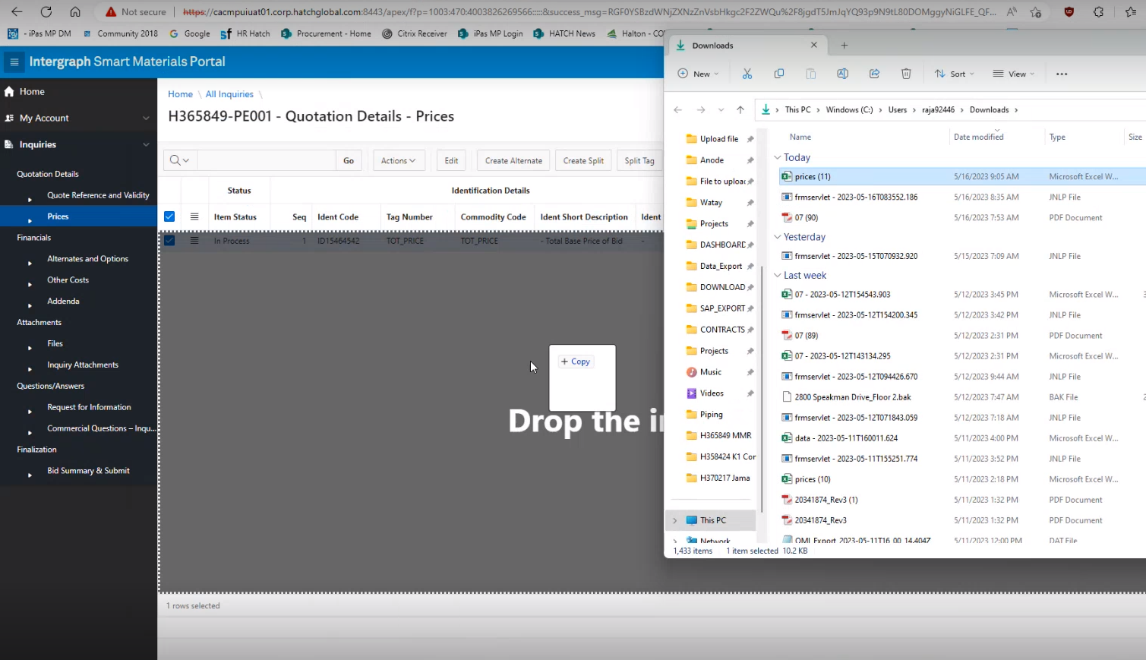
Import Excel File
Drag & Drop file over the Pricing Tab Page
Data will appear in the table
Save.
Complete all other information per instructions before submitting the bid.

