Slide 1
The Office of the Controller Presents
Disbursement Voucher (DV) Processing

Slide 2
Today’s Topics
Preparing the DV
  Payment Reason Codes
  Selecting the Vendor and Address
  Choosing a Payment Method
    Completion of Wire Tab
  Special Handling
  Route Log
  Ad hoc routing
DV Action Buttons
Researching Payment Status

Slide 3
Document Overview Tab
Description
Organization Document Number
Explanation
Secured Field

Slide 4
Aren’t They All The Same?
Descriptions and Business Purpose
Document Overview Tab – cont.
Description – this is a required field and shows up on the operating statement.
Explanation – this can be used to describe the business purpose or give more detail than the description.
Line Description – this will overwrite the required description and show up on the operating statement
Check Stub Text – this is for items that will print on the check stub/remittance advice

Slide 5
Document Overview Tab – cont.
Organization Document Number – can be used by the department for anything they want. It is not secure.
Secured Field – can be used by the department to store information they wish to remain secure, such as APID or SSN.

Slide 6
Payment Information Tab
Payee ID
Payment Reason Code
Address
Amount
Due Date
Payment Method
Special Handling
Check Stub Text

Slide 7
Payment Reason Code
Payment Information Tab – cont.
Must choose before entering vendor – only certain vendors will show up depending in the payment reason code.
  SP or Employee Vendors will not show up unless you are using E, I or F as the payment reason codes
Payment Reason Code listing can be found in Section 75 of the Manual of Business Procedures.
The correct payment reason code is important as this is how the DVs are assigned to auditors. The wrong one will cause a delay in processing.

Slide 8
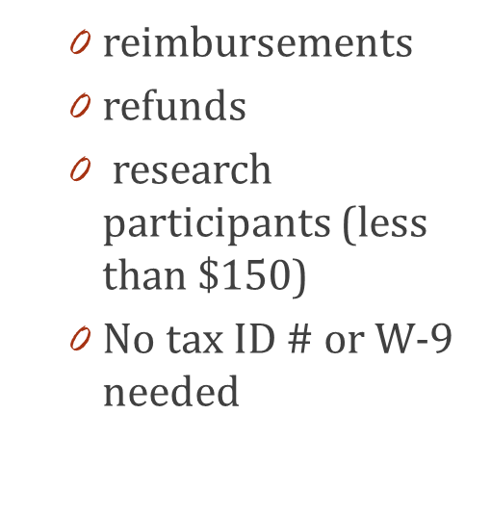
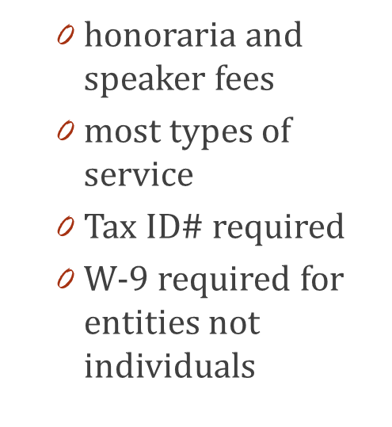
Using the Correct Vendor Type
Vendor Mix Ups
Payment Information Tab – cont.
SP Vendor
DV Vendor
Employee Vendors – only for refunds and reimbursement, choose correctly!

Slide 9
Choose the Right Vendor!
Payment Information Tab – cont.
Use the look-up tool to find the vendor
  The TIN is the most accurate way to find the vendor
  Verify details such as remit address
Copy vendor ID for ad hoc routing to an employee

Slide 10
Choose the Correct Address!
Payment Information Tab – cont.
Review your invoice and make sure you select the correct remit address.
  Choosing incorrectly can cause a delay, or the payment never reaching the correct destination.

Slide 11
Amount
Payment Information Tab – cont.
Enter the amount to be paid in the Check Amount field.
  This should match the amount due on the invoice. If it does not an explanation will be required in the Notes section.
  If you are paying via wire in a foreign currency, you will enter the foreign currency amount and the DV will be converted to USD upon processing.

Slide 12
Due Date
Payment Information Tab – cont.
Do NOT change this date
  This field defaults to the date of initiation.
  It facilitates the date that a check will be cut. Changing it can make your payment late.

Slide 13
Payment Method – Very Important!
*The payment method selected cannot be changed later*
Payment Information Tab – cont.
P – Check/ACH
  This is the default unless the vendor is set up with MSU’s Paymode-X or E-payables programs. Employees using direct deposit will default to this method.
W – Wire Transfer
  A wire should be processed when you are making a payment to any country other than the US or Canada. The Wire Tab will need to be completed when choosing this option (see later slides).
PX – ACH BOA
  Will default to this if vendor is enrolled in MSU’s Paymode-X program.
CC – EPAY BOA
  Will default to this if vendor is enrolled in MSU’s E-Payables program.

Slide 14
Wire Tab Requirements
The charge for a wire is $25
Payment Information Tab – cont.
Required information on the tab has a “*”.
Choose the currency that the DV is stated in.
Enter wire banking information obtained from the vendor.
  Wire banking information is required to be attached to the vendor record for individuals and can be either attached in the Notes section or on the vendor record for entities.
Payee Payment Details – this is basically check stub text for a wire.
Complete the Accounting Line for the $25 charge.

Slide 15
Special Handling Tab
The charge for special handling service is $15
Payment Information Tab – cont.
Special Handling is used when you are asking for:
The payment to be rushed
  This means the e-doc must be fully approved by all outside departments (FO, Purchasing, CGA) and in our action list by 10am for a check to be processed on our next scheduled check run (currently Tuesday and Thursday), or a wire to be processed same day.
  Put “RUSH” in both the Special Handling Name and Special Handling Address 1 fields.

Slide 16
Special Handling Tab
Payment Information Tab – cont.
Special Handling is used when you are asking for:
The check to be mailed somewhere other than the address printed on the check
  We currently do not allow hold for pickup so many units have the checks mailed to their campus address
  Put “MAIL TO” in the Special Handling Name field
  Add the alternative mailing address in the rest of the applicable fields

Slide 17
Special Handling Tab
Payment Information Tab – cont.
Special Handling is used when you are asking for:
The check to be mailed with attachments
  Put “ADD ATTACHMENTS” in both the Special Handling Name and Special Handling Address 1 fields.
  Add a note instructing which attachments to mail with the check

Slide 18
Special Handling Tab
Payment Information Tab – cont.
Other items regarding Special Handling
You do not need to send Accounting an email if you checked the Special Handling box – we will automatically be notified
There are no hold for pickup options at this time
The $15 fee is to cover the cost of manually pulling that check from a stack of hundreds and facilitating special treatment of it
If you forget to check the Special Handling Box and require it after the fact, there is a separate process to follow
Do NOT check the box if this is for an employee direct deposit – as it will generate a check instead – follow the separate process.

Slide 19
Special Handling Tab
What do you do if you forget to check the box or if your special handling request is for an employee direct deposit?
Payment Information Tab – cont.
Add a note to the e-doc stating what your special handling request is (RUSH, MAIL TO, ATTACHMENTS or DIRECT DEPOSIT) and what departmental account you would like the $15 fee charged to (this cannot be a RC account)
Send an e-mail to accounting@ctlr.msu.edu with the exact same information as in #1 above. The e-mail must be received, and the edoc must be fully approved, by 10am to be considered for same day service.

Slide 20
Check Stub Text
Payment Information Tab – cont.
This will print on the check stub and should be used to help the recipient identify the payment. Do not copy the explanation or business purpose. Typically, an invoice or contract number is appropriate.

Slide 21
Accounting Lines Tab
The Accounting Line entered is used to charge the expense to the operating statement/general ledger
More than one account can be added
The amount totals must add up to the check amount and cannot be negative
Remember entering anything in the Line Description field will overwrite the document Description field
Don’t forget to hit the add button

Slide 22
Accounting Lines Tab
Accounting Lines Tab – cont.
Required information is noted with a “*”
We will audit for appropriate object code and change if necessary
Other items (sub-account/object, project, etc.) are for your use.
FO can change these items before approving.

Slide 23
Nonresident Alien Tax Tab
When a DV payment is being made to a foreign vendor or a U.S citizen with a foreign address, the DV routes to a group of Tax Managers in the Accounting Office
They make determinations as to whether the payment is reportable and/or needs to have taxes withheld, then complete the tab and approve as Tax Manager.

Slide 24
Notes and Attachments Tax Tab
Supporting documentation needs to be provided that agrees to the payment amount.
Invoice or appropriately signed contract
Paid receipts and reimbursement worksheet for reimbursements
Cash receipts or edoc number for refunds
Wire info for entities – can be on vendor record instead.
Any other attachments required by policy
Any other notes or information that may be helpful
A note does not get seen until we open the edoc unless you use the “Read Notes” function.

Slide 25
General Ledger Pending Entries Tab
Once you have saved your document, you can review this tab to see the entries that will be posted to the operating statement/general ledger once the document is final.

Slide 26
Route Log Tab
Where does it go?
Automatic Routing
FO – there may be other routing depending on your unit.
Over $25K – College/MAU level approval
Tax Manager (Accounting)
CGA – for any RC accounts
Audit (Accounting)
Over $10K (Accounting)
Disbursement Method Reviewer (Accounting for wire processing)
Ad hoc routing – see next slide

Slide 27
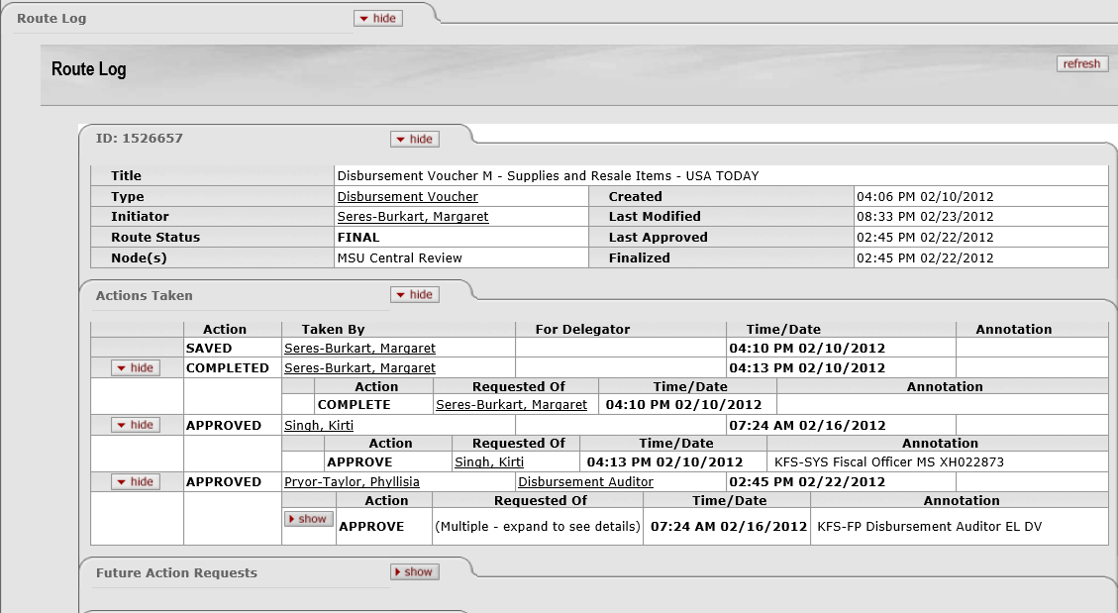
Basic Routing - example

Slide 28
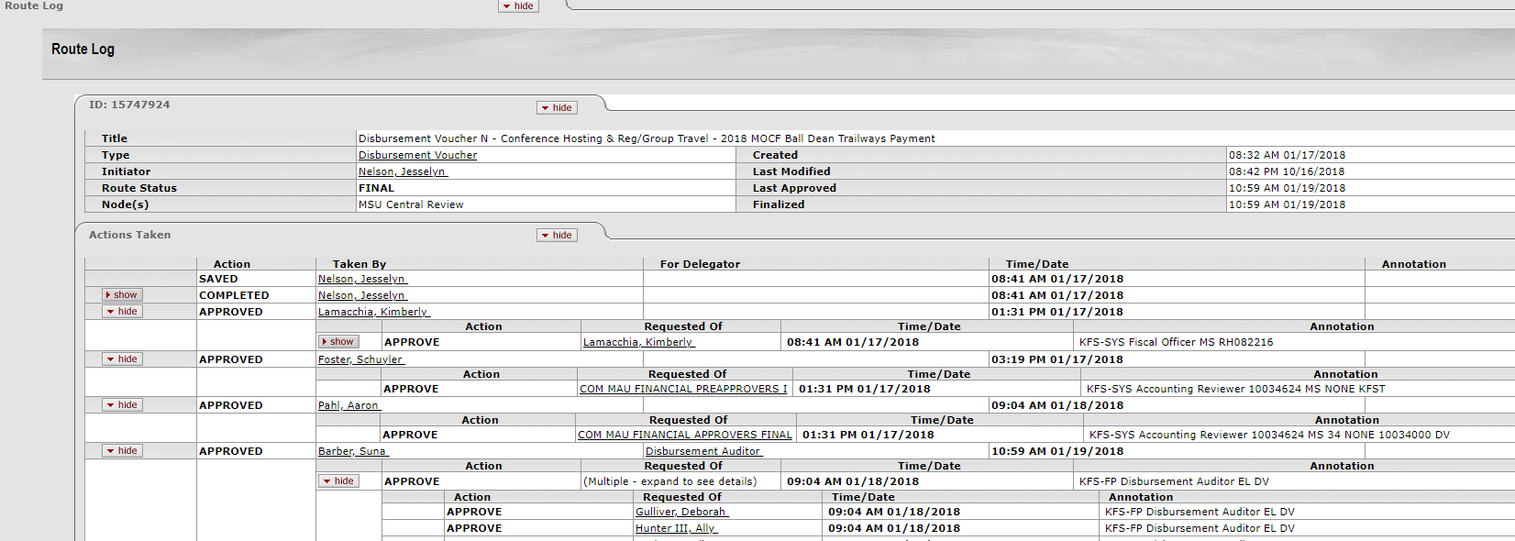
Organization Review Routing - example

Slide 29
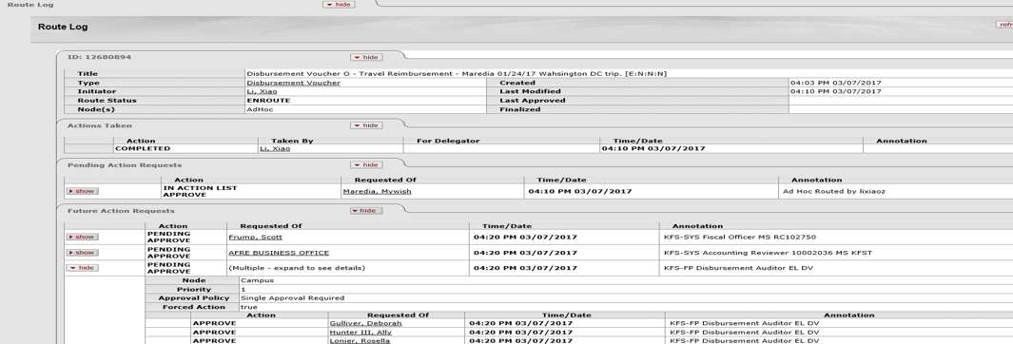
Enroute Document – example

Slide 30
Ad Hoc Recipients Tab
Required - employee reimbursement DVs must be ad hoc routed for verification and approval of expenditures.
  If the MSU employee is the e-doc initiator – no ad hoc needed unless also FO
  Students, on-call, temporary or faculty no pay employees – no ad hoc needed
  If the MSU traveler is a regular employee – the e-doc must be ad hoc’d to them for approval. No further routing will occur until approved.
  Optional – options are FYI, acknowledge or approve

Slide 31
Action Buttons
Submit – this starts the DV along its route log and approval path
Save – used when you have started a DV and need further information to finish it but don’t want to lose your work. Allows you to see the General Ledger Pending Entries and the Route Log
Close – closes the DV. If it has not been saved it will no longer exist.
Cancel – can only be used before you submit. If it wasn’t saved, it will no longer exist, otherwise status will be cancelled.
Copy – allows you to copy a DV. Items replicated are:
  Description, Amount, Check Stub Text, Accounting Line

Slide 32
Pre-Disbursement Processor Status Tab
Was the Payment Sent?
View this tab to research payment information
  Extracted shows date DV was final
  Pre-Extraction means no check/ACH has been processed yet or wire is the payment method
  Click on “disbursement info” box for details regarding the payment
    Disbursement Date is date of check/ACH
    Disbursement Number is the check (starts with a 2) or ACH (starts with a 3) number
    Contact accounting@ctlr.msu.edu if you need us to check with the bank to see if a check has been cashed.

Slide 33
Other Items
Depending on volume, it may take 7-10 business days for a DV to be approved and processed, Although 3-4 days is more common.
Common disapprovals include:
  Incorrect amount – does not match supporting documentation. The amount cannot be changed after the DV is submitted.
  Incorrect payment method – a wire needs to be processed for payments going to countries other than the US or Canada. The payment method cannot be changed after the DV is submitted
  Address doesn’t match. It can only be changed if the correct address has been added to the vendor
  Noncompliance with MSU policy

Slide 34


