Slide 1
Payments to Non – U.S. Citizens and International Vendors
Hosted by:
Lee Hunter
Office of the Controller - Accounting
hunteri@msu.edu

Slide 2
Class Agenda
Introduction
Identifying Nonresident Aliens
Differences in payments to NRA’s
Visa Types
Documents – alphabet and number soup
Taxation & Tax Treaties
Manual of Business Procedures Section 77

Slide 3
Nonresident Alien (NRA) Definition
A “nonresident alien” or NRA is a citizen of another country who has not been granted permanent residency in the U.S. Such individuals are temporarily present in the U.S. and their ability to receive payment is often controlled by their visa status.

Slide 4
What an NRA is…
Person or entity (business)
Resident or organized outside of the U.S.
An NRA is not…
Puerto Rican Citizen
Resident Alien
Naturalized U.S. Citizen
Note: A Puerto Rican company is an NRA.

Slide 5
Differences in Payments to a NRA
W-8BEN or W-8BEN-E forms
NRAPSC
Paperwork, paperwork, paperwork
Why? Why? Why?
  American Competitiveness and Workforce Improvement Act 1998 (ACWIA) - NRA cannot displace a U.S. worker, except in certain conditions

Slide 6
Source Rules for Income
If the income is: | Then source is determined by:
Services & Honoraria | Where the services are performed
Rents | Where the property is located
Royalties – Patents, Copyrights, Software Licenses | Where the property is used/income generated
U.S. source is subject to tax withholding

Slide 7
Vendors
If only reimbursing an NRA - set up an SP vendor
  Entities do not get reimbursed – they provide a service
If paying for services, honorarium, royalty - set up a DV vendor
The W-8BEN (for individuals) or the W-8BEN-E (for entities) must be attached to the vendor document

Slide 8
Payments to an Entity
W-8BEN-E form
NRAPSC
Tax accordingly
Wire payments – required for most foreign countries other than Canada. Wire information can be attached to DV or vendor record.

Slide 9
W-8BEN-E
Entities only
  Treaty section for services, royalties & copyrights, and rental - either a U.S. tax ID or a foreign tax ID is required
No faxes
Must check certification box
Attach to vendor e-doc
MSU W-8BEN-E Simplified Instructions

Slide 10
NRAPSC
Complete legibly
Be sure to provide location of services
Secure all required signatures

Slide 11
Payments to an Individual
Determine Visa Type
Obtain Required Paperwork
Tax accordingly
Wire payments - required for most foreign countries other than Canada. Wire information cannot be attached to DV. Add to vendor record for security purposes.

Slide 12
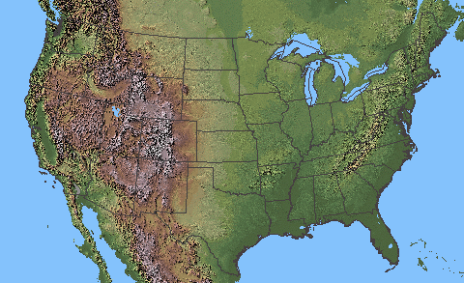
Before coming to the U.S.
When inviting international visitors, please be aware of the following:
  Office for International Students and Scholars (OISS) https://oiss.isp.msu.edu
  The visitor’s visa type – super important in case the visa type does not allow payments.

Slide 13
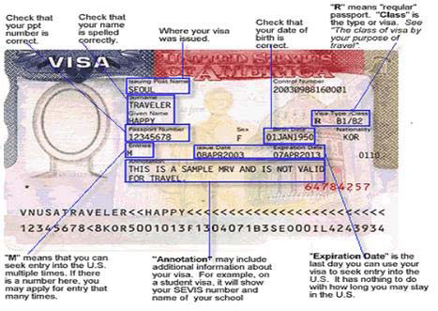
Visa: Entry into the U.S.
A document showing that a person is authorized to enter the territory for which it was issued, subject to permission of an immigration official at the time of actual entry.

Slide 14
Visa Types
Type of visa limits how, or whether, someone can be paid
If considering payment to someone in a visa status other than B1/B2, ESTA (Visa Waiver), or J1, please contact Accounting
  B1/VWB – visitors for business
  B2/VWT – visitors for tourism
    B1/B2/VW – cannot work in the U.S but may receive honorarium
  J1 – exchange visitor (Short-term scholar, researcher, specialist, some students)
  F1 – students (heavily restricted – contact Accounting)

Slide 15
Visa Waiver
A program of the U.S. Government which allows citizens of specific countries to travel to the U.S. for tourism or business for up to 90 days without having to obtain a visa.
Andorra | Finland | Japan | New Zealand | Spain
Australia | France | Latvia | Norway | Sweden
Austria | Germany | Liechtenstein | Portugal | Switzerland
Belgium | Greece | Lithuania | San Marino | Taiwan
Brunei | Hungary | Luxembourg | Singapore | United Kingdom
Czech Republic | Iceland | Malta | Slovakia
Denmark | Ireland | Monaco | Slovenia
Estonia | Italy | the Netherlands | South Korea | (not a complete list)

Slide 16
Documents – alphabet and number soup
B1/B2/VW visa types
  W-8BEN attached to vendor record
  USCIS I-94 or Substitute (Canada only)
  MSU B1/B2/VWB Certification
  NRAPSC
  8233 treaty claim (must have U.S. TIN)
Keep this one!

Slide 17
W-8BEN
Individuals only
Treaty section for rent, royalties/copyrights (others use 8233)
No faxes
Attach to vendor e-doc

Slide 18

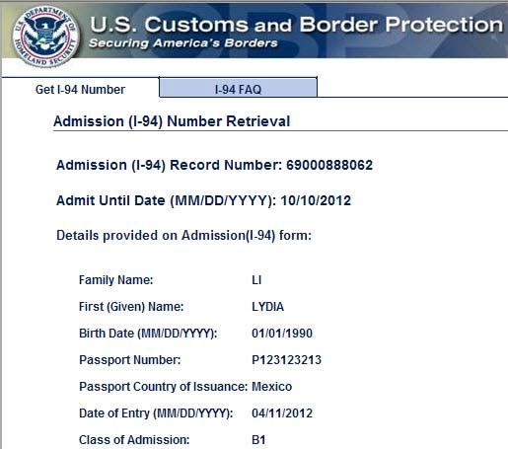
I-94 Stamp (stamped into passport or visa)
Verifies that individual entered the U.S. legally
Notes visa type, and date of U.S. entry
Electronic version available at https://i94.cbp.dhs.gov/home

Slide 19
9-5-6 Rule for B1/B2 and Visa Waiver
The payment relates to service is considered to be usual academic activity (teaching, research, or public service)
The international visitor was at Michigan State University for no more than 9 days.
The international visitor has received similar payment from no more than 5 institutions or organizations during the previous 6 month period

Slide 20
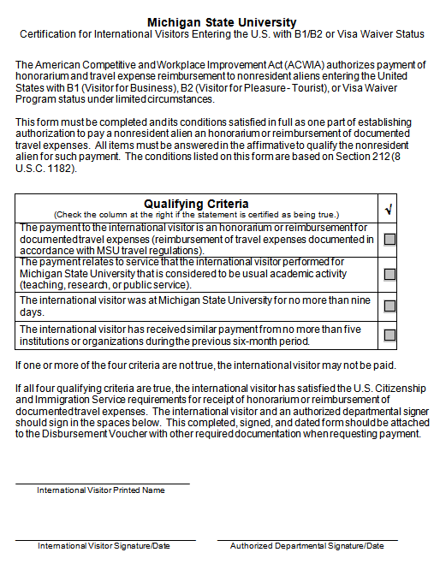
Certification for
B1/B2 and Visa Waiver

Slide 21
NRAPSC
Complete legibly
Be sure to provide location of services
Secure all required signatures

Slide 22
8233 Tax Treaty Claim
Tax treaty claim for services – rents, royalties/copyrights claimed on W-8BEN
8233 for services and honoraria
  U.S. Tax ID required
  Compete Part II lines 11,12 and 14
  Sign
  Original form must be submitted to Accounting. It is mailed to the IRS and we must wait 10 business days before releasing payment

Slide 23
Documents – alphabet and number soup
J1 visa type
  W-8BEN attached to vendor record
  USCIS I-94
  NRAPSC
  8233 treaty claim (must have U.S. TIN)-frequently unavailable due to “fixed base” clause
  DS2019
  Responsible Officer Statement
Keep this one!

Slide 24
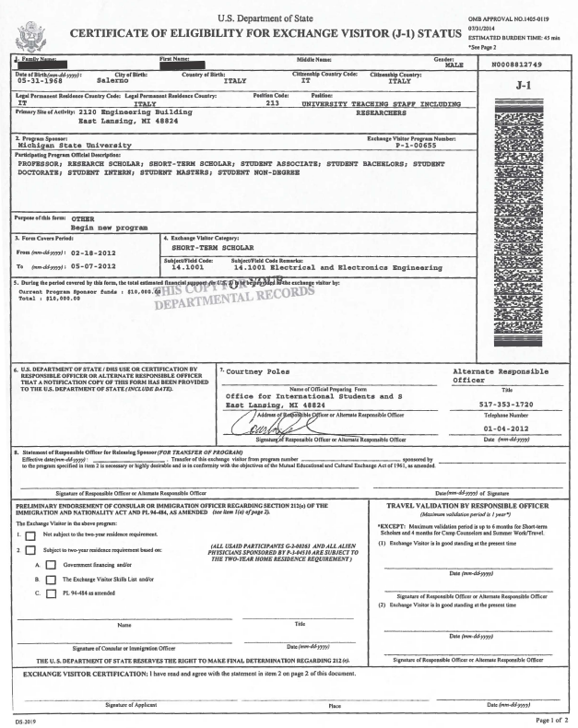
Sample Form DS-2019

Slide 25
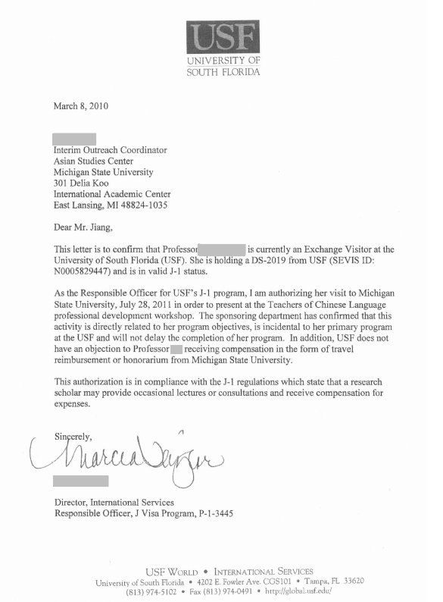
Sample RO Letter

Slide 26
Documents – alphabet and number soup
F1 visa type – call Accounting!
  W-8BEN attached to vendor record
  USCIS I-94
  NRAPSC
  8233 treaty claim (must have U.S. TIN)
  INS I-20
  Designated School Officer Statement
  Employment Authorization Card (EAD)

Slide 27
Royalties/Copyrights
Subject to tax withholding based on where the property is used
Property used in the U.S. is subject to tax withholding
  Industrial and patent royalties arising from U.S. sources
  Copyrighted materials used in U.S. publishing
  Software licenses
Tax treaty may apply (treaty benefits claimed on W-8BEN or W-8BEN-E, not Form 8233)

Slide 28
Taxation
A payment is subject to NRA tax withholding if it is from sources within the U.S., and it is:
  Fixed, determinable, annual, or periodical (FDAP) income (services, honoraria, royalties, rentals)
  NRA taxes must be withheld from the payment, not just reported, unlike U.S citizen payments where payments are reported on a 1099 or W-2.

Slide 29
Tax Treaties
Without a treaty, the tax rate is: 30% Federal plus 4.25% State = 34.25%
With a treaty, the rate for service payments is reduced to 0%, and the rate for other payments varies.
A unit may choose to ask that the payment be grossed up if they wish to pay the taxes for the vendor. For a $500 payment:
$500 / .6575 = $760.45 charged to unit

Slide 30
Tax Treaties continued…
Individuals claim a tax treaty benefit on form:
  8233 – for services and honoraria – U.S. tax ID required
  W-8BEN – for royalties & copyrights, and rentals – either a foreign tax ID or U.S. tax ID required
Businesses claim a tax treaty benefit on form:
  W-8BEN-E – for services, royalties & copyrights, and rental - either a U.S. tax ID or a foreign tax ID is required
Keep this one!

Slide 31
Contact information
Lauren Knoch, Accounting Office
kaiserl3@msu.edu
Manual of Business Procedures Section 77 https://controller.msu.edu/manual-of-business-procedures/section-77

