Slide 1


MICAH QN
Strategy Group #2
February 2026

Slide 2

Members
Strategy Group 2 Data Management and Analysis
Member | Critical Access Hospital
Nicholson, Kena, RN | Schoolcraft Memorial Hospital
Bentley, Jennifer, RN, BSN | Munson Healthcare Manistee Hospital
Bissonette, Christine, RN | Kalkaska Memorial Health Center
Bucholtz, Emily | McLaren Thumb & McLaren Caro
Duke, Jennifer, MT (ASCP), MBA | MiMichigan Standish
Harbuck-Valley, Julia RN, BSN | Scheurer Health
Walsh, Katie | Aspire Health
Johnson, Kristi, MSN | Paul Oliver Memorial Hospital
Lovern, Cory MSN, RN | UP Health Systems - Bell
Miedema, Kathy RN, BSN | Beacon Allegan Hospital
Harris, Rebecca | McKenzie Health System
Stimson, Jeffrey MHA | Munson Charlevoix
Tillery, Tisha | Harbor Beach Community Hospital
Truemner, Alicia, LPTA | Scheurer Health
Notes:
I wanted to start off by recognizing the members of Strategy Group 2.

Slide 3
Strategy Group #2 – Data Management and Analysis
Purpose:
Develop a process to measure quality standards by creating a shared benchmarking database that collects data, highlights best practices, and guides each CAH in implementing targeted process improvements.
Why:
To equip CAHs with the tools to drive data-informed change, strengthen accountability, and improve health outcomes in rural communities.

Slide 4
Where We Have Been / Key Accomplishments
MBQIP Focused Webinars
October 2024
Education Hour Feedback
1 Educational Webinar - 2026
The Changing Landscape of Quality Measurement and Reporting
16 participants (9 survey completions 100% satisfied), 40 website views.
May 2025
Hybrid Hospital Wide Readmission
29 participants (4 surveys complete @ 100% satisfied) 6 requests for recorded session and presentation.
November 2025 coming 11/13
eCQM Update: The Future is Digital
26 Participants
3 Survey Responses
3 satisfied (100%)

Slide 5
Where We Have Been / Key Accomplishments
MBQIP Focused Measures
Monitoring OP-22 (LWBS) CY 2024
Michigan CAH Quality Dashboard
Located on the MCRH Website - Michigan CAH Quality Dashboard
Increased reporting by 5% pts
Increased CAH meeting National Benchmark by 12% pts
Safe use of Opioids CY 2024
Increased reporting by 12 % pts
Increased performance by 1%
CAH Infrastructure and Assessment CY 2024
100% participation
Updated Quarterly

Slide 6
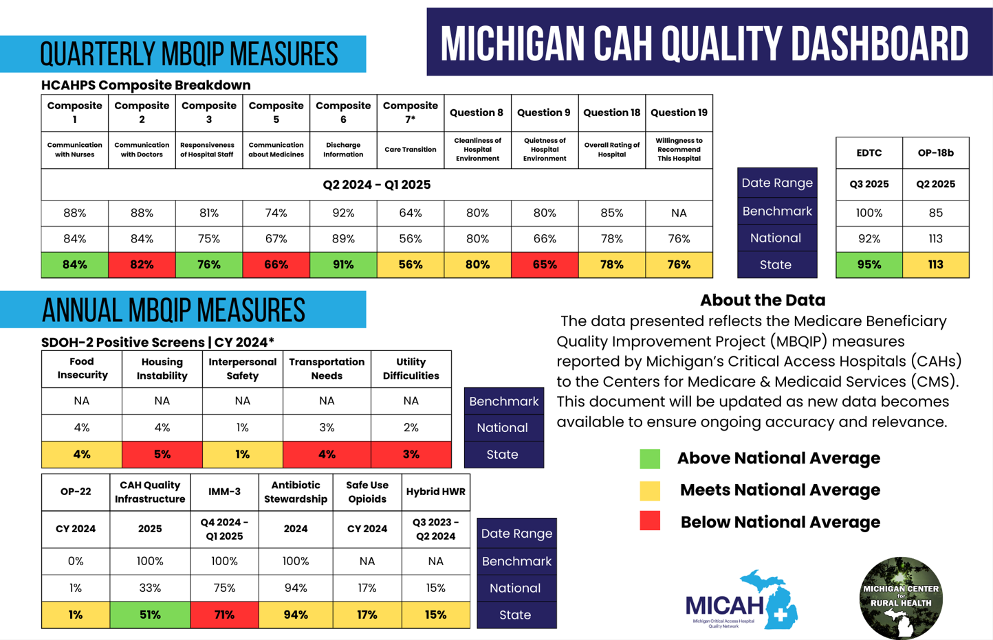
Notes:
This report will continue to reflect retired measures until they fall off the FMT reports received by MCRH

Slide 7
Moving Forward and Next Steps
Increase peer sharing at each quarterly meeting
Score cards/Stoplight reports/Dashboards
Performance Improvement Projects
Best Practices
MBQIP Quarterly Calls
Subject Matter Experts
Peer Led
Educational Webinars
NHSN
Share feedback quarterly
Participants, Surveys, Satisfaction
MCRH Access
Real time data

Slide 8
MICAH QN
Quality Data Review
February 2026 Meeting

Slide 9
MICAH QN Data Quality Reporting
This presentation is meant to provide data in a meaningful way to the MICAH QN. The data measures and compares quality standards and identifies gaps as they relate to the Medicare Beneficiary Quality Improvement Program (MBQIP).
The data provides information that demonstrates the high-quality services provided by Michigan’s Critical Access Hospitals. It identifies opportunities for change that lead to continued improvement in the health status of the population we serve.
Objectives:
  Why Participate in MBQIP
  2025 MBQIP Measure Review
  Data release dates
  Submission Deadlines
  New Data Review
  HCAHPS Measure Review
  Resources
Notes:
This data presented today will allow us to compare quality standards and identify gaps and opportunities for change that lead to continued improvement.

Slide 10
Why Participate in MBQIP?
Reflects a commitment to patient-centered care by using validated data to improve patient outcomes.
Assists in identifying trends and provides an opportunity that directly benefits rural patients with safer and more effective care.
Allows CAHs to meet quality benchmarks through best practices and resources.
Aligns priorities with peer sharing and subject matter experts from the MICAH QN.
Reaffirms commitment to providing a sustainable, high-quality healthcare model that prioritizes Michigan’s rural communities using rural-relevant measures.
Aligns with CMS Priorities.
Goals
Improve the quality of care provided in CAHs by increasing quality data reporting by CAHs and driving quality improvement activities based on the data.
MICAH QN and MBQIP Alignment
The MICAH QN supports and recommends full participation in the MBQIP Program.
Vision Statement - MICAH QN will be known as the statewide and national leader in the measurement of healthcare quality for Critical Access Hospitals (CAHs).
Notes:
MBQIP participation supports a patient-centered approach by using data to drive improvement and enhance outcomes for patients. Through these measures, hospitals can evaluate their own data and compare performance with other CAHs, identifying opportunities for improvement. It also fosters collaboration across Michigan’s CAHs through the MICAH Quality Network encouraging hospitals to partner on quality initiatives, share best practices, and implement proven strategies. Aligned with CMS priorities, this work enables CAHs to meet quality benchmarks, strengthens care delivery. The goal is to increase quality reporting and drive meaningful improvements in patient care.

Slide 11
MBQIP Quality Reporting 2026
(9 Measures)
Global Measures:
CAH Quality Infrastructure Assessment Annual
Patient Safety
Healthcare Personnel Influenza Immunization Annual
Antibiotic Stewardship Annual
Safe Use of Opioids (required eCQM measure) Annual
Patient Experience
HCAHPS Quarterly
Care Coordination
Hybrid All Cause Readmissions Annual
Emergency Department
Emergency Department Transfer Communication (EDTC) Quarterly
OP-18 Time from Arrival to Departure Quarterly
OP-22 Left without Being Seen Annual

Slide 12
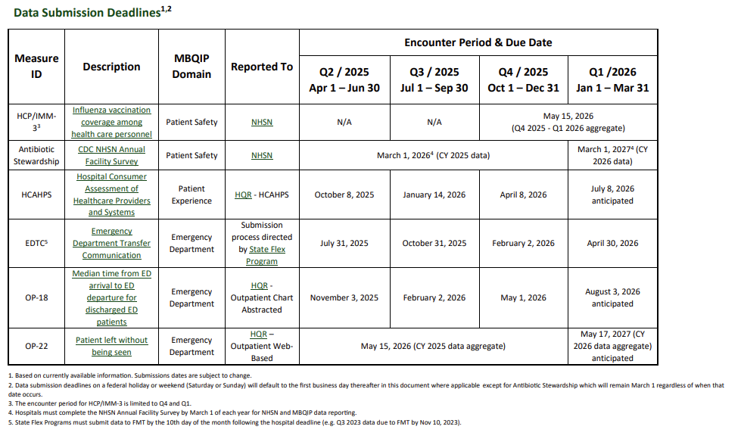
MBQIP Submission Deadlines
3 Quarterly Measures
Notes:
The submission deadlines posted here are a reminder of the dates the measures are due and where they are reported to.

Slide 13
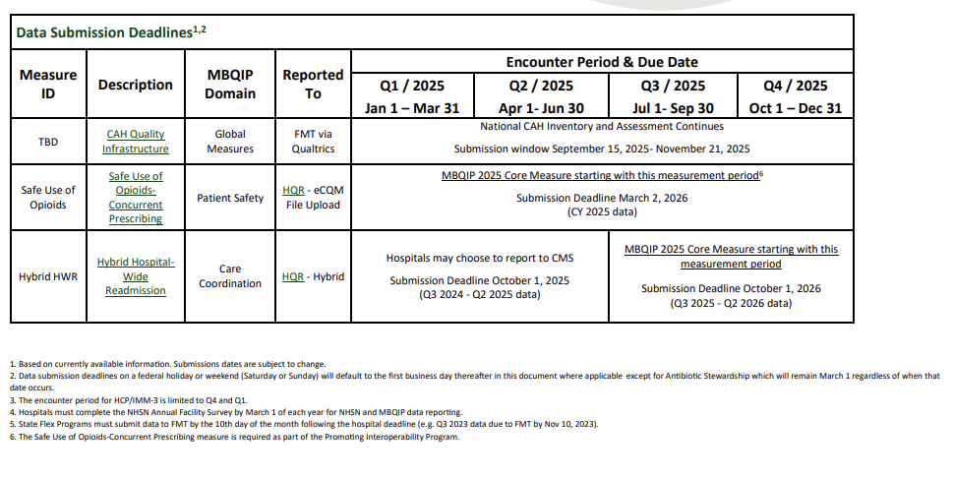
MBQIP Submission Deadlines

Slide 14
Critical Access Hospital by State
Notes:
The slide show all of the states and the number of CAH hospitals and how many times they have been listed in the top 10 for their 2025 data. This looks specifically at HCAHPS measures and OP 18b for Q1 reporting. I will go back and include EDTC

Slide 15


MBQIP Data Report
Updates
OP18b – Q2 2025
HCAHPS – Q1-Q4 2024
EDTC – Q3 2025 & Q4 2025
Notes:
Today we will go over the most currently quality data

Slide 16


OP 18B

Slide 17
OP 18B- Q2 2025
OP - 18B | State by Performance |  |  |  |  | State Current Quarter |  |  |  | National Current Quarter |  |  | Benchmark
Emergency Department – Quarterly Measure | Q3 2024 | Q4 2024 | Q1 2025 | Q2 2025 |  | # CAH Reporting | Median Time | 90th percentile |  | #CAH Reporting | Median Time |  | Median Time
Median Time from ED Arrival to ED Departure for Discharged ED Patients | 123 min | 114 min | 117 min | 113 min |  | 35 | 113 min | 89 min |  | 1217 | 113 min |  | 85 min
Number of Patients (N) | 2947 | 3179 | 3197 | 3161
Number CAH Reporting | 32/35 | 32/35 | 35/35 | 35/35
Reporting Percentage | 91% | 91% | 100% | 100%
CAH Above State Median | 47% | 49% | 54% | 46%
CAH Lower than State Median | 50% | 51% | 45% | 54%
National Benchmark | 3% | 14% | 11% | 9%
Take aways.
* State Median Time Increased by 4 minutes
* State Measure Participation remined at 100% participation
* Increase in CAH meeting the State Median of 113 minutes
* Decrease in CAH meeting the National Benchmark of 85 minutes
Notes:
The value for OP-18b is median time – the median number of minutes from ED arrival to departure among discharged ED patients who meet
certain criteria (a lower value indicates better performance). OP-18b is reported quarterly. The benchmark for OP-18b is set at the national
90th percentile of CAHs with MOUs during 2023
State Submission Performance remained at 100% participation. We had 19 critical access hospitals below the state mean of 113 minutes and 3 meeting the national benchmark (90%) of 85 minutes or less.

Slide 18
OP 18B - Q1 2025
Above State Median State Median 113 minutes National Median 113 minutes Benchmark 85
Notes:
State and National Median are the same and are reflected by the orange line

Slide 19
OP 18B- Q1 2025
National Comparison
Top 10
Notes:
Take Aways:19 States Preformed better on OP18B for Q2 2025 placing MI at the 20th spot over all.

Slide 20
HCAHPS Q2 2024-Q1 2025

Slide 21
HCAHPS 12 Month Rolling Data Summary Star Comparison
N= 13 N=14 N = 13 N= 13
Notes:
This slide is comparing the rolling data for calendar year

Slide 22
HCAHPS Q4 2023-Q3 2024
CAH receiving Summary Star Rating (13)
Critical Access Hospital | Summary Star Rating | Number of Surveys | Responsed Rate
TRINITY HEALTH SHELBY | 5 | 130 | 36
UP BELL HOSPITAL | 5 | 107 | 23
MYMICHIGAN MEDICAL CENTER GLADWIN | 5 | 115 | 38
COREWELL HEALTH GERBER MEMORIAL | 5 | 345 | 23
MUNSON HEATHCARE CHARLEVOIX HOSPITAL | 4 | 279 | 27
U OF M SPARROW CLINTON HOSPITAL | 4 | 289 | 41
U OF M SPARROW EATON HOSPITAL | 4 | 259 | 36
U OF M SPARROW IONIA HOSPITAL | 4 | 208 | 32
BRONSON LAKEVIEW HOSPITAL | 4 | 225 | 29
OSF ST FRANCIS HOSPITAL AND MEDICAL GROUP | 4 | 285 | 28
COREWELL HEALTH PENNOCK | 4 | 290 | 28
MCLAREN THUMB REGION | 4 | 115 | 24
ASPIRUS IRONWOOD HOSPITAL | 3 | 110 | 21

Slide 23
HCAHPS Q4 2023-Q3 2024
CAH with under 100 reported surveys (15)
Critical Access Hospital | Summary Star Rating | Number of Surveys | Responsed Rate
ASPIRE HILLS & DALES GENERAL HOSPITAL |  | 92 | 33
SCHOOLCRAFT MEMORIAL HOSPITAL |  | 84 | 41
HELEN NEWBERRY JOY HOSPITAL |  | 84 | 34
ASPIRUS KEWEENAW HOSPITAL AND CLINICS |  | 83 | 20
BARAGA COUNTY MEMORIAL HOSPITAL |  | 78 | 34
ASPIRE MARLETTE REGIONAL HOSPITAL |  | 73 | 29
EATON RAPIDS MEDICAL CENTER |  | 70 | 32
SCHEURER HOSPITAL |  | 56 | 50
MACKINAC STRAITS HOSPITAL AND HEALTH CENTER |  | 52 | 34
ASPIRUS IRON RIVER HOSPITAL & CLINICS, INC |  | 41 | 23
COREWELL HEALTH REED CITY HOSPITAL |  | 31 | 23
MCKENZIE HEALTH SYSTEM |  | 23 | 21
MUNISING MEMORIAL HOSPITAL |  | 21 | 38
HARBOR BEACH COMMUNITY HOSPITAL |  | 12 | 48
MCLAREN CARO REGION |  | 12 | 44

Slide 24
HCAHPS Q4 2023-Q3 2024
CAH with No Surveys Submitted (7)
Critical Access Hospital | Summary Star Rating | Number of Surveys | Responsed Rate
MUNSON HEALTHCARE PAUL OLIVER MEMORIAL HOSPITAL |  | Did Not Report
KALKASKA MEMORIAL HEALTH CENTER |  | Did Not Report
MY MICHIGAN STANDISH COMMUNITY HOSPITAL |  | Did Not Report
ASPIRE DECKERVILLE COMMUNITY HOSPITAL |  | Did Not Report
SHERIDAN COMMUNITY HOSPITAL |  | Did Not Report
BEACON DOWAGIAC HOSPITAL |  | Did Not Report
BEACON ALLEGAN HOSPITAL |  | Did Not Report

Slide 25
HCAHPS Rolling Data Comparison Rolling
Notes:
HCAHPS scores provide direct feedback from patients about their experiences with care. By reviewing quarterly rolling data, you can identify trends, gaps, or declines in service quality, allowing them to make targeted improvements to enhance patient experience and care delivery.

Slide 26
HCAHPS Rolling Data
National Comparison Rolling Q2 2024 – Q1 2025
Notes:
The Average Mixed Mode response rate is 32% with the 90th percentile at 43%
National response rate in 25%
MI ranks 6th in the Nation.

Slide 27
HCAHPS Composite Questions
  Composite Topics:
  Composite 1
    Nurse Communication – Questions 1, 2,3
  Composite 2
    Doctor Communication – Questions 5,6,7
  Composite 5
    Communication about medications – Questions 13,14
  Composite 6
    Discharge Information – Questions 16, 17
  Individual Topics:
  Cleanliness of hospital environment – Question 8
  Quietness of hospital environment – Question 9
  Global Topics:
  Hospital rating – Question 18
  Willingness to recommend hospital – Question 19
Notes:
As a reminder these are the composites and the questions that correlate with them.

Slide 28
HCAHPS Q1 2024-Q4 2024
National Averages vs MI CAH State Data
Notes:
The state results indicate an area where the MI CAHs are above the National Average for Composite 6 – Discharge Information
The next slide is a deeper dive into each individual composite and allows us to look at the percentages of who is meeting the national averages and benchmarks.

Slide 29
HCAHPS Q4 2023-Q3 2024
Composite Analysis
Benchmark | 88% | 88% | 74% | 80% | 80% | 92% | 85% | NA
National Avg | 84% | 82% | 67% | 80% | 66% | 89% | 78% | 76%
Notes:
This slide is an assessment of the composites and how we are doing on each one. I took each score and determined who was and was not meeting the national average as well and the benchmark.
Area of Opportunity for individual CAH’s
Improvement - Composite 2 (Doctor Communication) where 54% of MI CAH do not meet the National Average of 82%. Compared to 46% last rolling quarter.
Of note we took a small sampling from SG2 2025 survey results to see if any of the new questions stood out as opportunities.
New Question: During this hospital stay, how often were you able to get the rest you needed?
Average Score – 51%
Old Question: During this hospital stay, how often was the area around your room quiet at night?
Average Score – 64%
I will keep these two questions top of mind when I receive reports from FTM at the beginning of the year.

Slide 30
HCAHPS National Comparison
Composite 1
Top 10 - AL, TN, LA, MA, WV, KY, AK, MS, PA, SC (91% - 86%)
MI 26th – 84%
Composite 2
Doctor Communication
Top 10 AL, SC, LA, MS, TN, TX, AK, KS, KY, MA (92% - 87%)
MI 36th -82%
Nurse Communication

Slide 31
HCAHPS National Comparison
Composite 5
Top 10 – MA, SC, AK, LA, AL, AR, MS, WV, FL, KY (74% - 69%)
MI 31st – 66%
Composite 6
Discharge Information
Top 10 – MA, SC, AL, MI, TN, WV, IA, IL, IN, LA (92% - 90%)
MI 4TH – 91%
Communication about Medicine
Question 8
Cleanliness of Hospital Environment
Top 10 –AL, LA, WV, TX, AK, MS, NH, PA, IL, KS (91% - 82%)
MI 26th – 80%

Slide 32
HCAHPS National Comparison
Question 9
Top 10 - SC, AL, LA, MS, TN, GA, MN, ND, TX, NE (80% - 71%)
MI 28th – 65%
Question 18
Hospital Rating
Top 10 – LA, TN, NE, SC, UT, IA, KS, MS, TX, AL (84% - 80%)
MI 26th – 78%
Quietness of Hospital Environment
Question 19
Willingness to Recommend Hospital
Top 10 - MA, AL, LA, MA, SC, TN, UT, HI, KS, NE (86% - 79%)
MI 21nd – 76%

Slide 33

EDTC Q3 2025

Slide 34
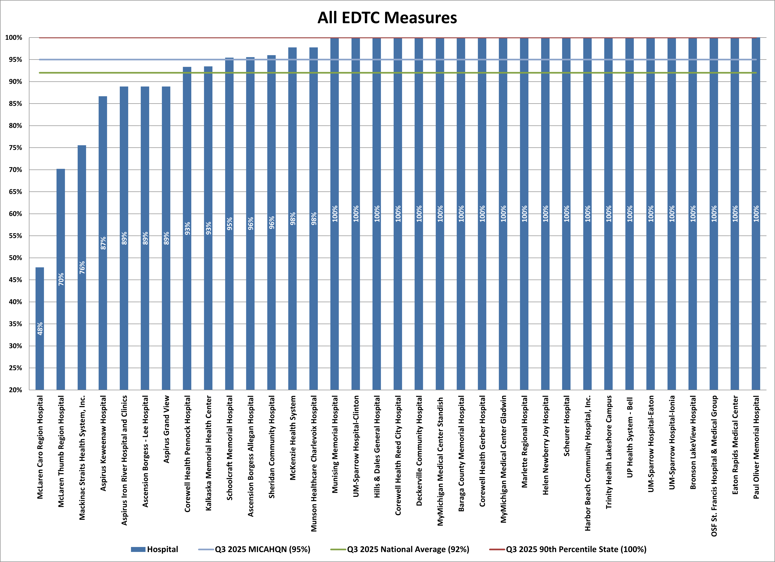
MI EDTC Q3 2025 – National Data Q3 2025

Slide 35
EDTC Q4 2025

Slide 36
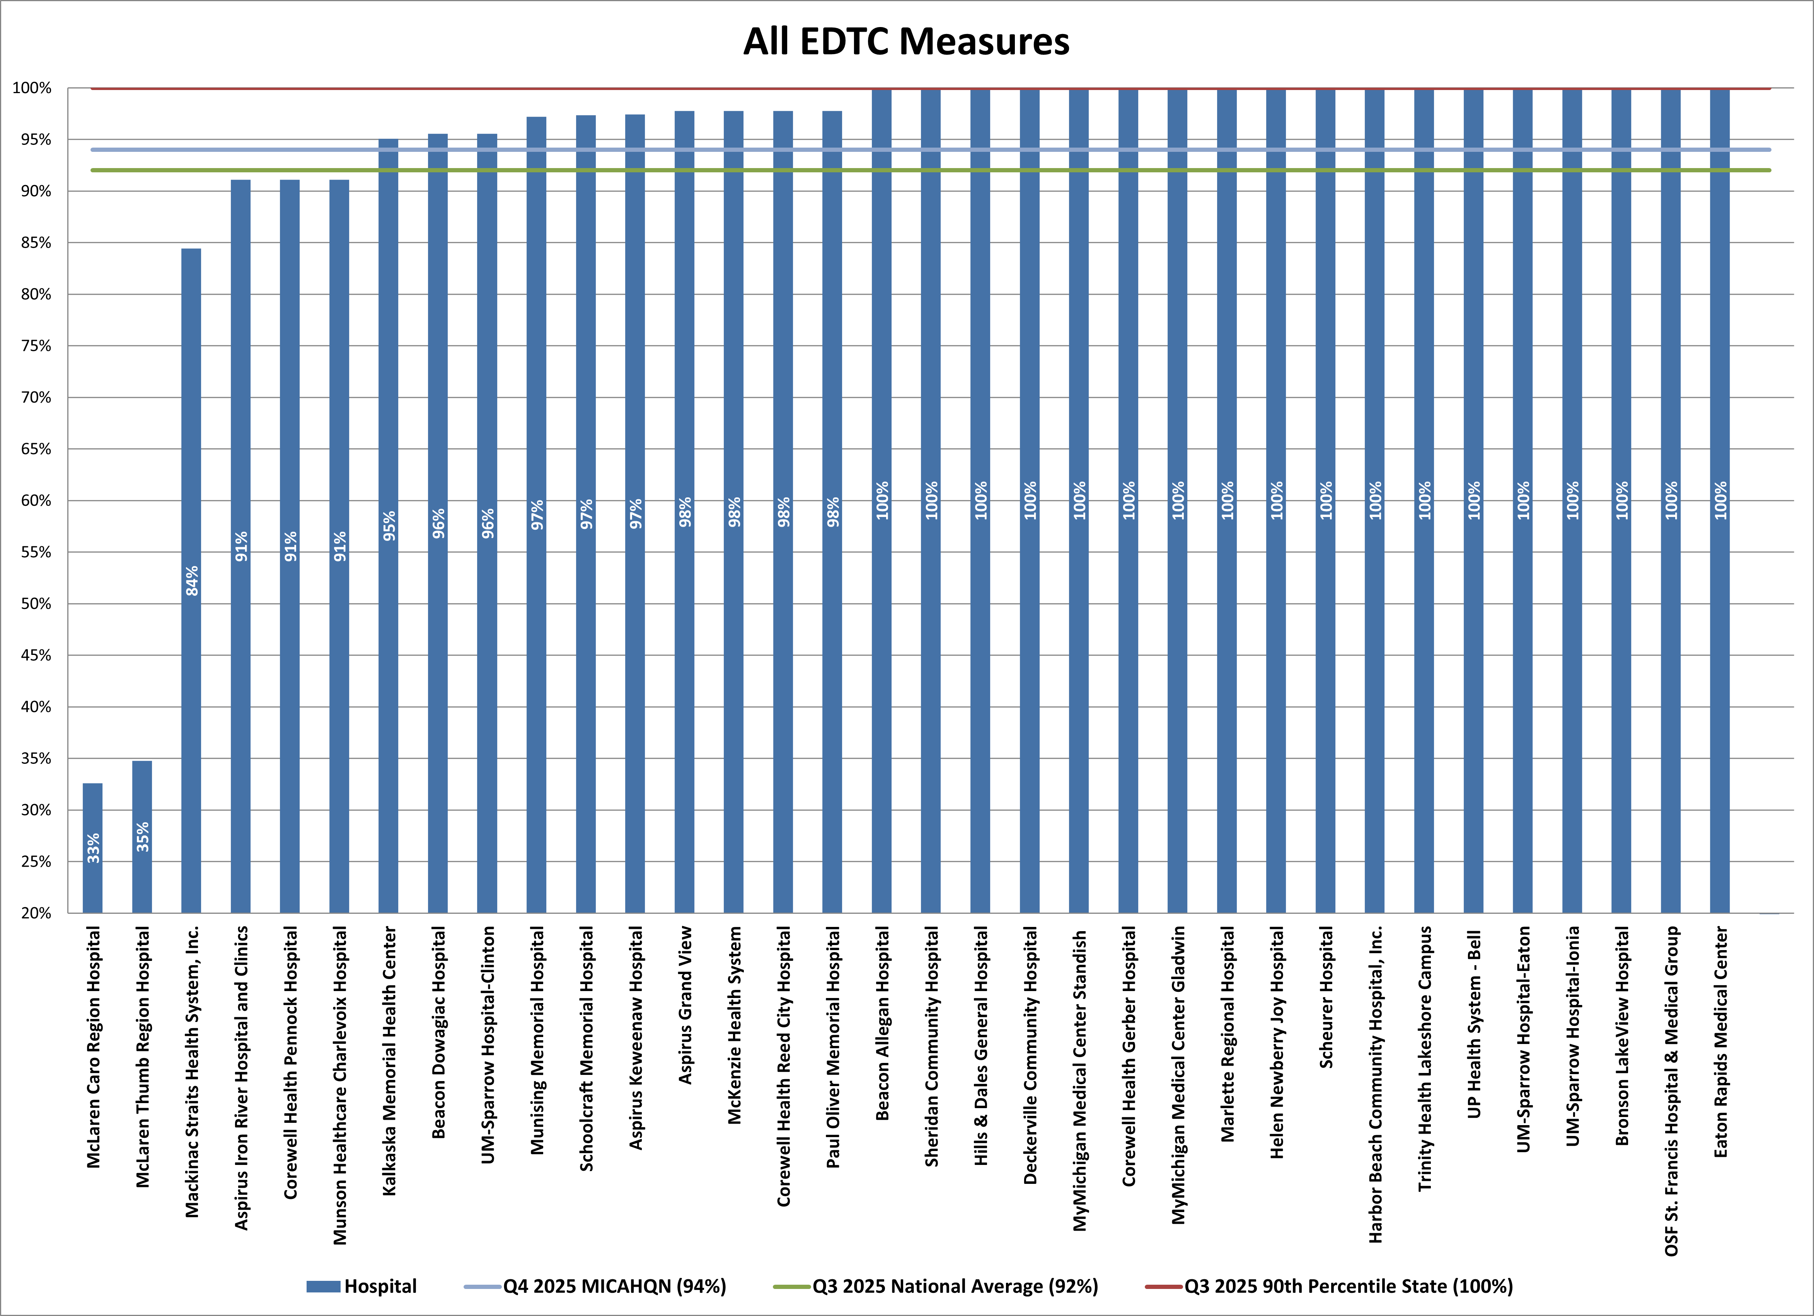
MI EDTC Q4 2025 – National Data Q3 2025

Slide 37
Up Coming Due Dates
March 1, 2026 – Annual Measure
Antibiotic Stewardship CY 2025 is due March 1, 2026. Submission is through the NHSN Secure Portal. Antibiotic Stewardship Resources
March 2, 2026 – Annual Measure
Safe Use of Opioids- Concurrent Prescribing CY 2025 encounters is due March 2, 2025. Specifications CMS eCQM ID CMS506v6. Submission is through the HQR Secure Portal. This measure is a MBQIP and an eCQM measure.
April 8, 2026 – Quarterly Measure
HCAHPS – Reporting Hospital Consumer Assessment of Healthcare Providers and Systems (HCAHPS) Q4 2025 encounters (10/1/25-12/31/25) is due April 8, 2026. Submission is through the HQR Secure Portal-Vendor. Quality Assurance Guidelines V.18.0.
April 30, 2026 – Quarterly Measure
Emergency Department Transfer Communication (EDTC) Q1 2026 encounters (01/01/2026- 3/31/2026) is due April 30, 2026. Connect with Crystal Barter @ barthcry@msu.edu for submission process details.
May 1, 2026 – Quarterly Measure
Reporting Median time from ED arrival to ED departure (OP-18) Q4 2025, October 1 – December 31 is due May, 1, 2026 . Submission is through the HQR Secure Portal-Outpatient.
May 15, 2026 – Annual Measure
Patient left without being seen (OP-22) CY 2025 data is due May 15, 2025. Submission is through the HQR via HARP log in.

Slide 38
Up Coming Webinars
MDHHS Stoke and STEMI Update
February 26, 2026, 12-1pm
Contact Amanda St. Martin for Webinar Invite
NHSN 2026 Patient Safety Component Annual Training Series
Training Week 1 – March 17 and March 19
Training Week 2 – March 24 and March 26
Training Week 3 – March 31 and April 2
Training Week 4 – April 7
MDHHS State Plan on Aging
March 24, 2026, 12-1pm
Contact Amanda St. Martin for Webinar Invite

Slide 39
Annual Measures

Slide 40
Hybrid HWR – Q3 2023- Q2 2024

Slide 41
Hybrid HWR
HWR | State by Performance |  |  | State Current Quarter |  |  | National Current Quarter |  |  | Benchmark
Hybrid HWR | Q3 2022 - Q2 2023 | Q3 2023 - Q2 2024 |  | # CAH Reporting | Current Year % |  | #CAH Reporting | Current Year % |  | 90th Percentile
Hybrid Hospital Wide Readmissions | 13% | 15% |  | 14 | 15% |  | 551 | 15% |  | NA
Number of Patients (N) | 780 | 1628
Number CAH Reporting | 7/35 | 14/35
Reporting Percentage | 20% | 40%
CAH Above State % | 100% | 43%
CAH At or Below State % | 0% | 57%
National Benchmark | NA | NA
Take aways.
* State Measure Participation increased by 20% points
* Increase in HWR by 2% pts
Notes:
2024 reporting was still an optional/practice year. This measure will be a required measure during the next reporting cycle. Great improvement year over year.

Slide 42
Hybrid HWR
Q3 -2023 – Q2 2024
Above State % State 15% National 15%
Notes:
State and National Median are the same and are reflected by the orange line

Slide 43
Hybrid HWR – Q3 2023- Q2 2024
National Comparison
Top 10
Notes:
Take Aways:31 States Preformed better on HWR for Q1 2025 placing MI at the 32nd spot overall. This measure will not be taken into consideration when reviewing the Top in for MBQIP reporting and performance in 2026

Slide 44
OP 22
Calendar Year 2024

Slide 45
OP 22 CY 2024
OP - 22 | State by Performance |  |  |  |  | State Current Quarter |  |  |  | National Current Quarter |  |  | Benchmark
Emergency Department – Annual Measure | CY 2021 | CY 2022 | CY 2023 | CY 2024 |  | # CAH Reporting | CAH Overall Rate | 90th percentile |  | #CAH Reporting | Median Time |  | 90th Percentile
Patient Left Without Being Seen | 2% | 2% | 1% | 1% |  | 31 | 1% | 0% |  | 1081 | 1% |  | 0%
Number of Patients (N) | 222.272 | 251,055 | 294,436 | 315,913
Number CAH Reporting | 23/36 | 29/36 | 29/36 | 30/35
Reporting Percentage | 62% | 78% | 81% | 86%
CAH Above State Performance | 3% | 2% | 19% | 14%
CAH Meeting State Performance | 72% | 75% | 33% | 71%
National Benchmark | 25% | 22% | 22% | 34%
Take aways.
* State Performance remainded the same
* State Measure Participation increased to 86% participation
* Increase in CAH meeting the State Performance
* Increase in CAH meeting the National Benchmark
Notes:
State Submission Performance increased to 86% participation. We had 18 critical access hospitals below the state performance of 1% or below and 10 meeting the national benchmark (90%) 0%

Slide 46

OP 22 CY 2024
+ Did not report measure
Notes:
Percentage are based are rounded to the nearest number and will reflect the score on your individual reports.

Slide 47
OP 22 CY 2024
National Comparison
Top 10
Notes:
. Take Aways: 27 States Preformed better on OP22 for CY 2024 with Arizona, Indiana, Mass, Missouri, Nevada and New York

Slide 48
IMM-3
Q4 2024 – Q1 2025

Slide 49
IMM-3 Q4 2024 – Q1 2025
IMM-3 | State by Performance |  |  |  |  | State Current Quarter |  |  |  | National Current Quarter |  |  | Benchmark
Healthcare Provider Influenza Vaccinations | Q4 2021-Q1 2022 | Q4 2022- Q1 2023 | Q4 2023- Q1 2024 | Q4 2024 - Q1 2025 |  | # CAH Reporting | % | 90th percentile |  | #CAH Reporting | % |  | 90th Percentile
Healthcare Provider Influenza Vaccinations | 82% | 75% | 75% | 71% |  | 35 | 71% | 94% |  | 1289 | 75% |  | 100%
 |  |  |  |  |  | 0
Number of Patients (N)
Number CAH Reporting | 27/36 | 33/36 | 33/35 | 35/35
Reporting Percentage | 75% | 92% | 94% | 100%
CAH Above State Performance | 39% | 44% | 46% | 51%
CAH Lower than State Performance | 36% | 47% | 49% | 49%
National Benchmark | 0% | 0% | 0% | 0%
Take aways.
* State Performance increased by 4%
* State Measure Participation increased to 100% participation
* State Above State Performance increased by 5%
Notes:
State Submission Performance increased to 100% participation. We had 16 critical access hospitals above the state performance of 71% and 0 meeting the national benchmark (90%) 100%

Slide 50
IMM-3 Q4 2024 – Q1 2025
Below State Rate State Rate 71% National Rate 75% Benchmark 100%

Slide 51
IMM-3 Q4 2024 – Q1 2025
National Comparison
Top 10
Notes:
. Take Aways: 30 States Preformed better on IMM-3 for CY 2024 New York, Ohio and Washington

Slide 52
Safe Use of Opioids
Calendar Year 2024

Slide 53
Safe Use of Opioids
Notes:
Safe use of Opioids is a new annual MBQIP measure that is also a required eCQM measure.
State Submission Performance increased to 83% participation. We had 13 critical access hospitals above the state performance of 17%

Slide 54
Safe Use of Opioids
*CAH had a 0 denominator and/or low volume exemption for all 4 quarters but is still considered reporting
+ Did Not Report the measure
Notes:
State and National Current year are both 17%

Slide 55
Safe use of Opioids
National Comparison
Notes:
Take Aways: 22 States Preformed better on Safe Use of Opioids for CY 2024

Slide 56
Antibiotic Stewardship
Calendar Year 2024

Slide 57
Antibiotic Stewardship
Abx Stewardship | State by Performance |  |  |  |  | State Current Year |  |  |  | National Current Year |  |  | Benchmark
 | CY 2021 | CY 2022 | CY 2023 | CY 2024 |  | # CAH Reporting | % | 90th percentile |  | #CAH Reporting | % |  | 90th Percentile
Antibiotic Stewardship Measure - All Measures Met | 93% | 94% | 91% | 94% |  | 33 | 94% |  |  | 1298 | 94% |  | 100%
Number CAH Reporting | 32/37 | 34/36 | 33/35 | 33/35
Reporting Percentage | 86% | 94% | 94% | 94%
All Elements Met | 93% | 94% | 91% | 94%
Leadership | 93% | 94% | 94% | 97%
Accountability | 97% | 97% | 94% | 100%
Drug Expertise | 100% | 100% | 94% | 100%
Action | 100% | 100% | 100% | 100%
Tracking | 97% | 97% | 100% | 100%
Reporting | 100% | 100% | 100% | 97%
Education | 100% | 1000% | 100% | 100%
Take aways.
* State Performance increased 3% from 2023
* CAH meeting all 7 Elements increase 8%
* State Measure Participation remained the same at 94%
* Saw improvement in Element Participation with 3 Elements
* Saw a decrease of reporting of 1 Element
Notes:
Increase with Leadership, Accountability, Drug Expertise,
Decrease with Reporting

Slide 58
Antibiotic Stewardship
State Rate 94% National Rate 94% Benchmark 100%
+ Did Not Report the measure
Notes:
State and National are the same percentage

Slide 59
Antibiotic Stewardship
National Comparison
Notes:
26 States preformed better with meeting all 7 elements

Slide 60
Supplemental Data

Slide 61
MBQIP Resources
MBQIP Quality Measure Resources
MBQIP 2025 Information Guide
MBQIP Quality Reporting Guide
MBQIP Submission Deadlines
MBQIP Measures -
This entire webpage is a good resource to review
Webpage Data abstraction tools
How to upload a Population and Sampling File
How to submit HCHE and SDOH data
How to submit Hybrid Measures and View Outcomes
CAH Quality Infrastructure
MBQIP All Measure Document
MBQIP Navigator
MBQIP Educational Videos
2024
October - The Changing Landscape of Quality Measurement and Reporting
The Changing Landscape of Quality Measurement and Reporting - Presentation
  Video
March - MBQIP Q&A
MBQIP Q&A - Presentation
  Video
January - The Future of MBQIP - Are You Ready?
The Future of MBQIP - Are You Ready? - Presentation
  Video
2025
May – Hybrid Hospital Wide All Cause Readmission
Please reach out to Amanda St. Martin @ amanda.saintmartin@affiliate.msu.edu for the video and power point

Slide 62

MBQIP Resource
MBQIP Navigator
Key Features and Benefits:
• Comprehensive guidance for all MBQIP core measure reporting
• Seamless navigation across all four reporting mechanisms
• Step-by-step setup and submission instructions
• Reporting worksheet for Flex programs and hospitals
• Central hub linking to essential MBQIP resources and tools
Notes:
The MBQIP Navigator is a powerful guide designed to streamline the MBQIP reporting process for hospitals.
This guide is intended to help Flex Coordinators, CAH staff and others involved with the MBQIP program understand the measure reporting process. For each reporting channel, information is included on how to register for the site, which measures are reported to the site and how to submit those measures to the site.

Slide 63
MBQIP Quality Reporting 2026
Notes:
MBQIP Measure Reports from the Flex Monitoring Team are released quarterly. The summary table shows the release timing as well as which MBQIP measures will be updated in the first, second, third and fourth MBQIP Measure reports each year.

Slide 64
MBQIP Quality Reporting 2026

Slide 65
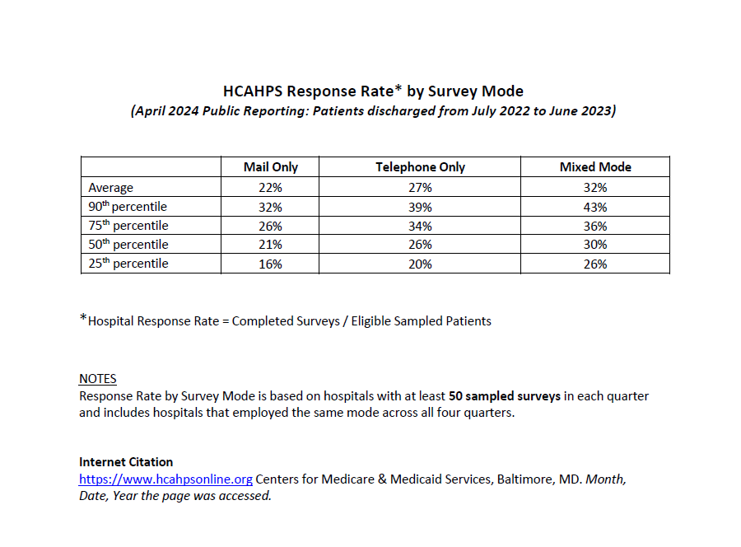
HCAHPS Response Rate By Survey Mode
Notes:
These percentiles allow a hospital to compare its own response rate, which can be found on the Care Compare Web site (https://www.medicare.gov/care-compare/?providerType=Hospital) under “Patient Survey Rating,” to other hospitals that employ the same mode.
Hospitals whose response rate falls below the 50th percentile should consider taking steps to improve

