Slide 1
Michigan Systems of Care Update

Slide 2
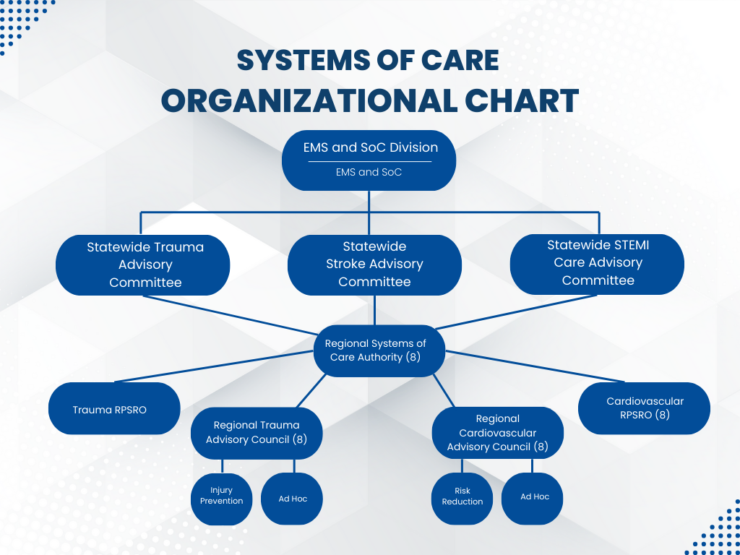

Slide 3
Systems of Care Pillars
Michigan Systems of Care utilizes six pillars as the building blocks for regional work.
Each region completes an application and workplan every 3 years outlining the objectives they will work on under each pillar.
The following slides discuss pillars and highlight the stroke and STEMI objectives built into the upcoming regional workplans.

Slide 4
Injury Prevention/Risk Reduction
Injury Prevention/Risk Reduction - The Regional Systems of Care Authority (RSoCA), in cooperation with other agencies and organizations, uses analytical tools to monitor the performance of population-based (regional) injury prevention programs.
Each regional service line is responsible for monitoring, assessing, and evaluating its regional system to improve trauma, Stroke, and STEMI care, reduce death and disability, surveillance of injury, and implementation of injury prevention and risk reduction activities.
Objective 1.2 - The RSoCA has developed, implemented and updated a written injury prevention plan. The injury prevention plan is data driven and targeted programs are developed based upon high injury risk areas. Specific goals with measurable objectives are incorporated into the regional injury prevention plan.
The plan reflects the State of Michigan Trauma System Injury Prevention Plan (2021).
The plan will address RSoCA integration with national programs and program evaluation.

Slide 5

Communication and Infrastructure
Communication - The RSoCA is supported by a coordinated communication system linking and integrating hospitals, life support agencies, the EMS system and the RSoCA.
Infrastructure - The regional infrastructure consists of membership, governance, medical oversight, policies, procedures and protocols that support the regional trauma system.

Slide 6

Continuum of Care and Education
Continuum of Care - supports the integration of rehabilitation as applicable into the RSoCA and that these resources are made available to all populations requiring those resources.
Education - The RSoCA ensures a competent workforce through trauma, stroke and STEMI education.

Slide 7
Performance Improvement
Performance Improvement - The RSoCA, including subcommittees, use system data to evaluate system performance and regularly reviews system performance reports to develop regional policy.
Objective 5.5 - An assessment of the needs of the general medical community, including physicians, nurses, pre-hospital care providers, and others, concerning trauma, stroke, and STEMI system information, has been conducted.

Slide 8
System Integration Status
Project Timelines and Priorities for 2025–2026
March 4th meeting to ready stroke and STEMI for regional advisory council applications, meetings and the 2027 regional application.
Process for facility designation being developed
The regions are working on the SOC Authority application.
This document is used by the Regions to organize the structure (which is Administrative Rule driven) and has been amended to include stroke and STEMI

Slide 9
Project Timelines and Priorities for 2025–2026
Completing the trauma registry migration by September 2026.
Data collection for stroke and STEMI has been deferred due to a longer than anticipated conversion to a new vendor product.
We initially thought the registry would be the first element of the system in place for stroke and STEMI, but despite some setbacks productive discussions are ongoing with AHA GWTG.
Start quarterly regional meetings for Stroke and STEMI partners
Finalize designation process for accredited stroke facilities

Slide 10

Meetings, Conferences, and Other Opportunities for Engagement
Michigan Systems of Care Conference
Program Building Educational Opportunities
Risk Reduction and Injury Prevention Initiatives

Slide 11
Stroke and STEMI Coordinators
Christine Laking
Region 1, 2N, 2S, & 3
STEMI Coordinator
Mark Ladetto
Region 1, 2N, 2S, & 3
Stroke Coordinator
Elizabeth Baty
Region 5, 6, 7, & 8
STEMI Coordinator
Penny Stevens
Region 5, 6, 7, & 8
Stroke Coordinator

