Slide 1


The Michigan Rural EMS Quality Improvement Survey
May 2019
Andrea Abbas MS NRP
EMS Programs Manager

Slide 2
The Michigan Center for Rural Health developed this Rural EMS QI Survey in collaboration with the Bureau of EMS, Trauma and Preparedness.
We wish to thank all who took the time to answer the survey.

Slide 3
The Purpose of The Michigan Rural EMS QI Survey, The Why
To better understand and identify quality improvement opportunities for rural EMS agencies in Michigan.
Foster future education and resources focused on rural EMS quality improvement and data reporting.
Utilize the data collected to fund EMS QI resources that fit the needs of rural Michigan EMS agencies.

Slide 4
Surveys Went to All Licensed Michigan Rural EMS Professionals.
386 responses were captured. We were able to generate responses from all medical control authority regions in Michigan.
The respondents consisted of EMS professionals from all licensure levels.
The participants worked in varying EMS roles in the community. There was representation from clinical, administrative, managerial, and educator roles.

Slide 6

Definition of Rural, Small Urban and Urban
Rural Community: population less than 9,999 and > 25 miles from a population center
  72% of participants
Small Urban: population less than 9,999 within 25 miles of a population center OR a population > 10,000 and > 25 miles from a population center
  17% of participants
Urban: all others
  11% of participants

Slide 7
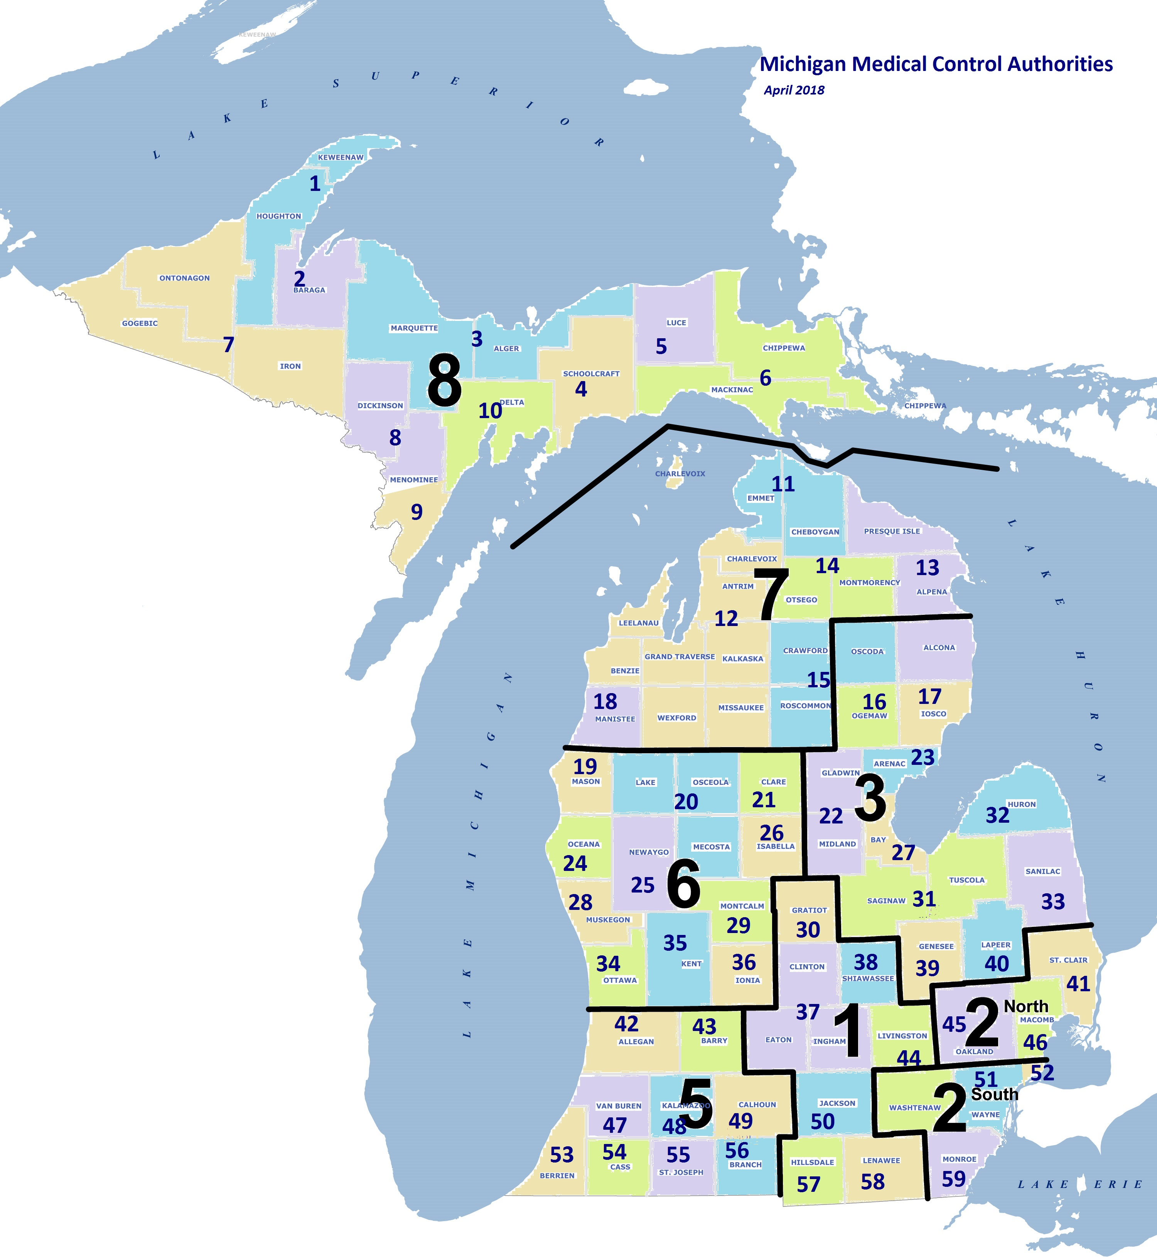
Michigan Trauma Regions and Medical Control Authorities
Response Number

Slide 8
Trend Summary:
Most participant agencies complete > 1000 calls annually
Those agencies that completed < 1000 calls annually were as a majority rural.

Slide 12

Data Trend Summary: EMS Clinical Documentation Training and ePCR Submission
Roughly 50% of rural EMS professionals reported receiving sufficient EMS clinical documentation training.
Roughly 30% of rural EMS professionals were provided EMS clinical documentation training but reported it insufficient, while 18% were not provided any training.
The data shows ePCR timeline submission criteria is more relaxed in rural EMS communities.
Clinical documentation training and ePCR submission requirements impact billing and reimbursement as well as clinical documentation quality.

Slide 15

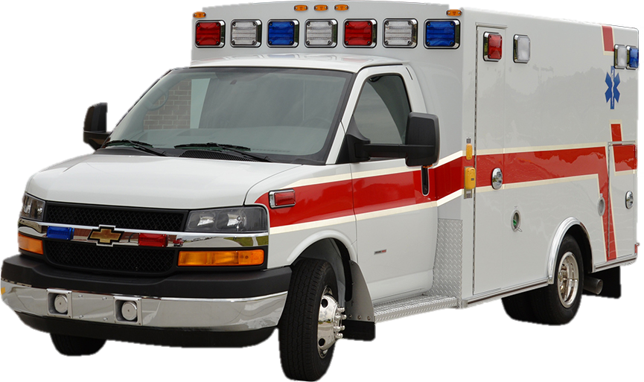
Data Trend Summary: EMS Agency and Hospital Clinical Feedback
According to the survey, clinical feedback is not provided to a majority of the rural EMS providers surveyed.
Providing clinical feedback to EMS providers fosters a learning environment impacting clinical quality improvement.

Slide 18
3rd Ride Training Program Offered

Slide 20


New Employee Orientation and Field Training Trend Summary
58% of rural EMS participants reported having a new employee orientation program. While 42% reported not having a program.
44% of rural EMS participants reported having a structured field training manual while 56% reported not having this resource.
Orientation Manual

Slide 21
New Employee Orientation and Field Training Trend Summary
There were many disparities with EMS agency field training third ride structure. Programs ranged from structured to volunteer. The involvement of the field training officer was highly variable. 23% of rural EMS participants reported not offering field training program third rides.
The criteria reported for agency Field Training Officer positions was highly variable. Position pay stipends, promotional requirements, and position training varied. 41% of rural EMS professionals reported not offering field training officer positions.

Slide 23
Data Trend Summary
Awareness around MCA Clinical Quality Improvement initiatives was highly variable.
Statistically there were multiple MCA regions where survey participants reported a lack of awareness about CQI initiatives.

Slide 24
Data Trend Summary
The responses varied by MCA region. Many participants indicated familiarity with their medical director.
This data could be skewed by current vacancies for an MCA medical director or a relatively new Medical Director.

Slide 27

Next Steps
The data gathered will be used to direct EMS clinical improvement and sustainability initiatives through the Michigan Center for Rural Health in the state of Michigan. Additionally, to guide state level research initiatives.
We plan to use the information gathered in our survey to appropriately deploy resources to rural Michigan EMS agencies.

