Slide 1
Accessing and Using SPLS Data for Review Processes
February 15, 2024

Slide 2
Agenda
Transition from SIRS to SPLS
A few SPLS basics
Direct Access to SPLS data
Using SPLS data for review processes
Questions and Discussion

Slide 3
Transition from SIRS to SPLS
The transition from SIRS to the SPLS was initiated because of an aging IT system and because of longstanding reports to the Provost’s office about biases and subjective use of SIRS results for evaluative purposes.
If this was simply a switch to a new IT system, it would be much easier.
This transition at MSU is largely about culture change, which is within the broader context of a national effort to transform the way that teaching is evaluated.

Slide 4
Beth McMurtrie | February 6, 2024 The Chronicle of Higher Education

Slide 5
Transition from SIRS to SPLS
The aim is to implement a research informed approach to gathering and using student feedback –in conjunction with other indicators– to enhance the quality of teaching at MSU.
The purpose of the SPLS is to collect feedback from students in all courses to
provide instructors, graduate teaching assistants, and teaching units with feedback on their instructional practices;
contribute to instructor retention, promotion, tenure, and salary decisions; and
provide students with information to guide decision-making related to course selection (only available to students after two years of data have been collected).

Slide 6
SPLS basics: the shift from SIRS to SPLS
SIRS was administered in courses with end dates of June 15, 2023 and earlier.
The SPLS started with courses ending June 16, 2023 and later.
The SPLS system does not retain historical SIRS data.
SIRS data will remain available until the IT system permanently fails. Any SIRS data that has not already been downloaded and saved should be downloaded right away.
SPLS data is stored in the MSU data warehouse so that it can be retained if/when the university shifts to a different IT system or vendor.

Slide 7
SPLS basics: University-level questions
Level of Interest. At the time of enrollment, my level of interest in this course was:
Responses are used for statistical analysis (discriminant validity)
Responses are not reported to instructors, department chairs, or deans
Workload. Compared to other courses of equal credit, the workload for this course was:
The purpose of this question is to provide students with information to guide decision-making related to course selection
Responses are reported to instructors and will be reported to students in the future
Responses are not reported to department chairs or deans and are not intended for evaluative purposes

Slide 8
SPLS basics: University-level questions
Expectations. I understood what was expected of me in this course:
Organization. Overall, the course was well organized:
Atmosphere. The instructor created an atmosphere that supported my learning:
“Instructor” questions name the Faculty Member and/or Graduate Assistants in Campus Solutions
Expanded understanding. The course expanded my understanding of the subject matter:
Demonstrate understanding. Course assignments and/or tests provided opportunities for me to demonstrate an understanding of the course material:
Interest increased. My interest in the subject has increased because of this course:

Slide 9
SPLS basics: Open-ended questions
In addition to rude and mean-spirited comments, the clearest evidence of bias by respondents, especially related to gender and race, is in qualitative comments.
There tends to be a low response rate in comparison to Likert scale responses within the same survey.
Comments are difficult to aggregate as they may be contradictory and not reliable.
Instructors, supervisors, and review committees are highly susceptible to biases such as novelty bias and negativity bias.
And when comments are anomalous or do not correlate with quantitative item means, they often get disproportionate consideration by reviewers.
The SPLE Policy does not permit open-ended questions among the university-level questions.

Slide 10
SPLS basics: Open-ended questions
The SPLE Policy does not prevent colleges or departments from using open-ended questions. Those who choose to use them are strongly encouraged to also establish a protocol for managing rude responses and ensure that they understand what the research says about open-ended questions.
Responses to open-ended questions are included in instructor reports because, if they are used at all, they may be useful for course improvement. But they are not included in college or department reports or dashboards as they are not appropriate for evaluative purposes.

Slide 11
Direct Access to SPLS Data
Instructors and graduate teaching assistants have direct access to their SPLS data and can submit that information along with other annual review/RPT/evaluation packet materials.
In addition to the downloadable PDF reports emailed to instructors after the end of the term, instructors will soon have access to the SPLS Instructor Dashboard. This provides quick and easy access to all SPLS reports in one place. Data are viewable in static and dynamic forms.
Deans and Dept Chairs/School Directors have direct access to SPLS data for their respective teaching units, which includes teaching-unit level data all the way down to individual course-section-instructor level data.
The access currently available allows for annual review and RPT processes to move forward.
Compiling a spreadsheet of instructor-by-instructor mean scores is not feasible in the SPLS system and is not an appropriate use of student perception survey data. Approaches like this often do not account for important contextual variables or consider other evidence related to teaching quality, which can perpetuate biases and inequities.

Slide 12
Direct Access to SPLS Data
Direct access to data is not available for support staff.
Some departments had support staff download SIRS reports or data and add them to annual review and RPT packets.
The onus is on instructors to submit SPLS information in their packets. This ensures that -instructors have viewed SPLS feedback at least once -they have an opportunity to add narrative to help evaluators understand contextual variables -they can package student feedback alongside other evidence of teaching quality, such as a teaching portfolio, peer observation, teaching narrative, syllabi and other course materials, and/or student artifacts.

Slide 13
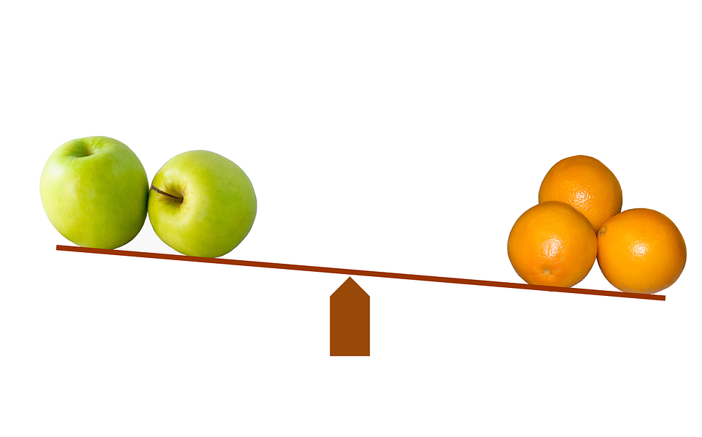
Using SPLS data for review processes
The research on student perceptions of learning suggests that feedback is highly context specific. Students perceive that they learn better in small classes and that is reflected in survey results. Other context-specific attributes include degree level, discipline, and type of course (e.g., lecture, lab, seminar).
Comparisons between instructors is rarely a one-to-one comparison.
Instructors are encouraged to contextualize student feedback when including it in annual review and RPT processes. For example, highlight and describe the potential implications of class size, type of course, and nature of the course content.

Slide 14
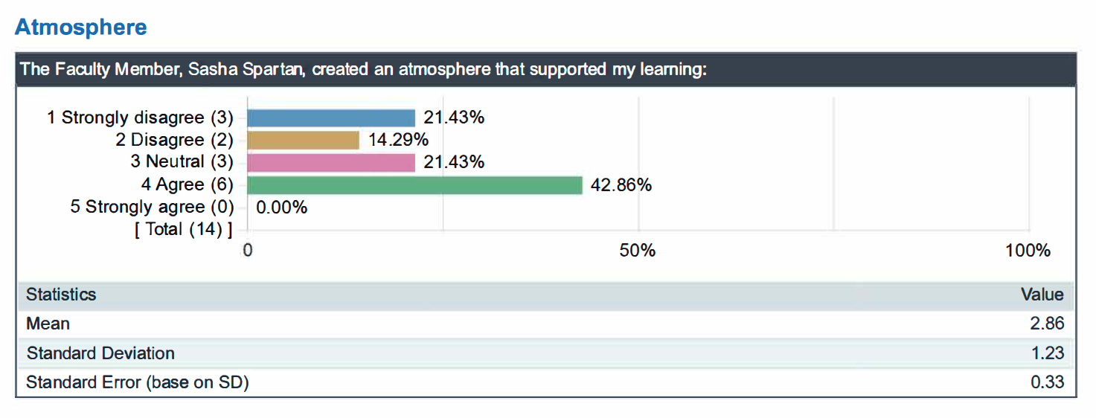
Using SPLS data for review processes
In many respects, it is not necessary to compare instructor mean scores to department, college, or university mean scores. Feedback such as this suggests that the instructor could enhance the quality of the learning experience by focusing on the learning atmosphere. Some evaluators might immediately look for more information in student comments but pairing this feedback with other evidence of teaching such as a teaching narrative or syllabi and other course materials.

Slide 15
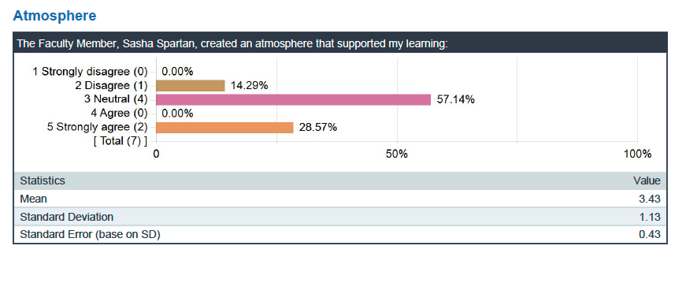

Slide 16
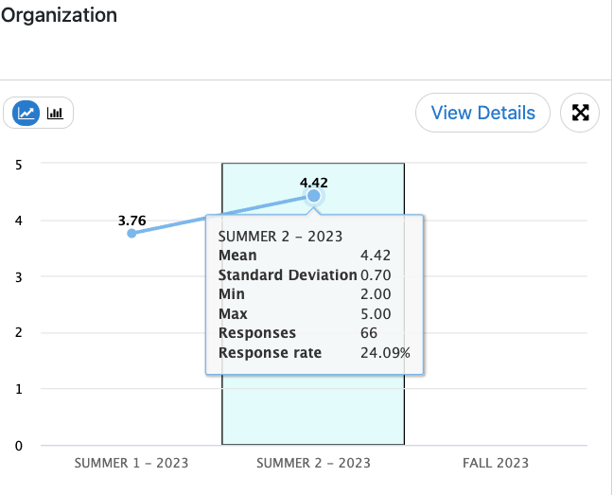
Using SPLS data for review processes
There is tremendous value in seeing feedback over time.

Slide 17
Using SPLS data for review processes
First, watch the Introduction to the SPLS Administrator Dashboard and Reports and review the SPLS Administrator Dashboard User Guide. Both are linked on the Administrators page of the SPLS website (spls.msu.edu).
Useful Materials
Instructor submitted narrative
Instructor submitted reports
Department or course-level mean score report
SPLS Administrator Dashboard > filtered by instructor

Slide 18
Notes:
The initial screen shows mean scores by calendar year

Slide 19
Notes:
Click on the year field, select Terms, and choose the Term of interest
Now this shows mean scores over time for the department

Slide 22
Notes:
This shows the mean scores for selected courses over time

Slide 23
Instructor submitted report
and
Instructor submitted narrative

Slide 24
Notes:
Now Filter by Instructor

Slide 25
Notes:
This shows one Instructor’s SPLS feedback over time

Slide 26
Notes:
Response rates over time for department

Slide 27
Notes:
Response rates over time for selected courses

Slide 28
Questions and Conversation
Website
The website (spls.msu.edu) is continuing to expand, especially FAQ sections
Contact
Your first point of contact is your office of the dean or the SPLS Liaison for your college
Office Hours
SPLS Office Hours by Zoom are open to everyone
Access the link on the SPLS website homepage
Tuesdays at 10:00am

