Slide 1



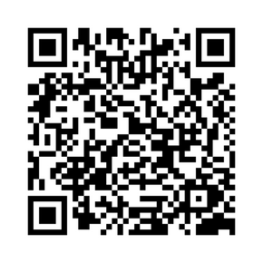


YOU ARE NOT ALONE
IF YOU’RE A VETERAN, SERVICE MEMBER, OR HAVE A LOVED ONE IN CRISIS:
Text: 838255
Chat: VeteransCrisisLine.net/Chat
AVAILABLE 24/7, 365 DAYS A YEAR
ALL CALLS ARE COMPLETELY CONFIDENTIAL
Family members and friends who are concerned about a veteran are also encouraged to call-
even if they are not veterans themselves
Calls, texts, and chats have resulted in more than 1.6 million referalls to VA Suicide Prevention Coordinators &
more than 398,000 dispatches of emergency services

