Slide 1
Interventional Rehab of
Radicular and Axial Pain
Treatments and Efficacy of Therapy
Andy Cooper, MSIV

Slide 2
Case:
23 yo male with lumbar pain radiating to his right leg above the knee for several months, described as constant
Pt describes vague generalized weakness in his upper leg
Pain rating at rest is 7-8/10 at rest, but at times goes to 10/10
Patient is normally very active, but has not been able to participate in athletics such as competitive basketball, softball, tennis, soccer, and golf.

Slide 3
Exam
Pt is found to have diminished patellar reflex on the right side with appreciable decrease in strength of his knee extensors.
Tenderness to palpation noted in the paraspinal muscles of the lumbar spine
No changes in sensation noted
What would you do?

Slide 4
Impression/Plan
Pt is determined to have a L4 radiculopathy
After confirming with MRI, the patient is sent for L4/L5 laminectomy
Following recovery from surgery, the pt is able to return to his active lifestyle for a period of approximately 8 months before axial pain returns and he has to reduce his activity level again.

Slide 5
Statistics
Estimated that 80% of all people will have an episode of back pain in their lifetime.
50% of all Americans have an annual episode of back pain
Back pain is the second most common reason for visits to the doctor
Estimated that Americans spend
$50 billion each year on care for these symptoms

Slide 6
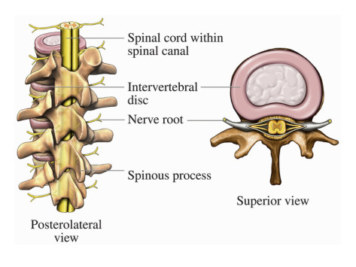
Normal Anatomy
Illustration of the Anatomy of the Human Spine, Featuring the Middle Thoracic Vertebrae and Spine by Nucleus Medical Art

Slide 7
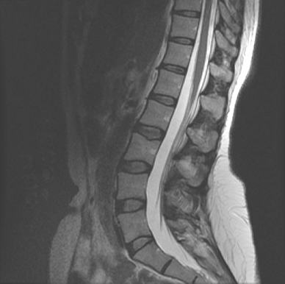
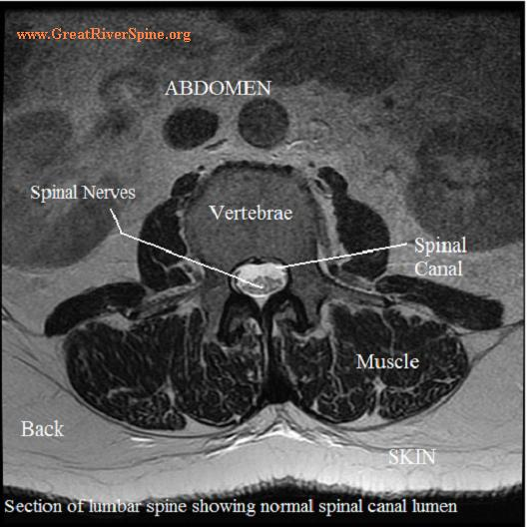
MRI views

Slide 8
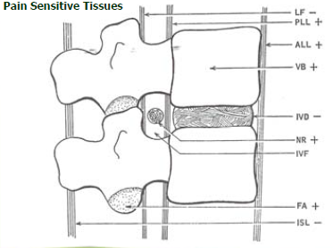

Slide 9
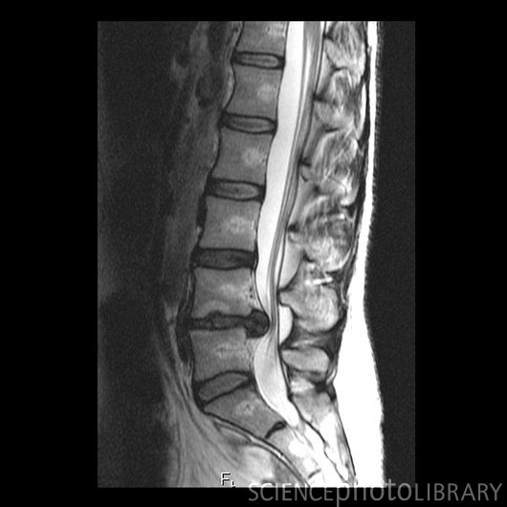
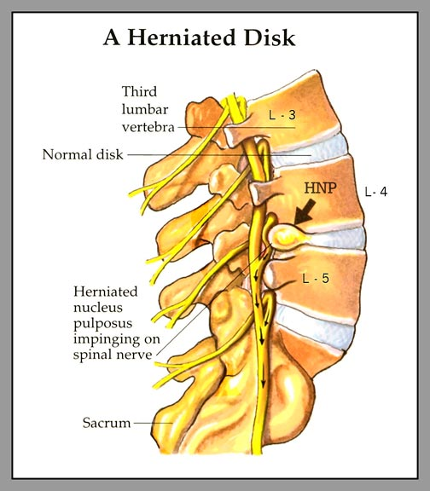
Pathology
It is believed that PLA2 activity from herniated discs is up to 10,000 x greater than from any other human source.
Other immunohistochemical substances found at the site of herniation include:
  NO
  PGE2
  IL-6
Hypothesis: glucocorticoids interrupt the inflammatory cascade and inhibit nocioception

Slide 10
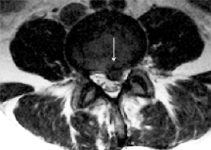

Slide 11
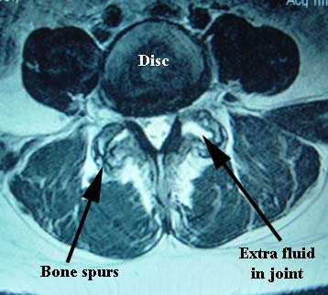
Image courtesy of Dr Mark Wolgn, http://www.drwolgin.com/Pages/facetarthrosis.aspx

Slide 12
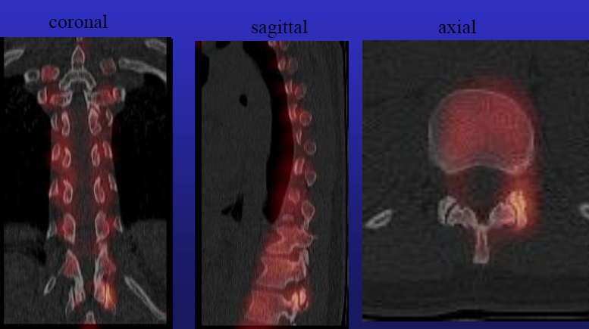
Fire Scan
Imaging technique that combines SPECT with CT to better localize possible cause of axial back pain, not effective for radicular pain
Images courtesy of Dr Stuart Willick, University of Utah PM&R

Slide 13
Options
First the proper diagnosis must be made
  Radiculopathy vs Facet Arthropathy vs Stenosis vs Referred
If radicular…
  The most conservative therapy or combinations of therapy should always be considered initially.
  Options may include but are not limited to…
Physical Therapy | OMT
Exercise Regimen | Home Stretches
Steroid Injection | Surgical Correction

Slide 14
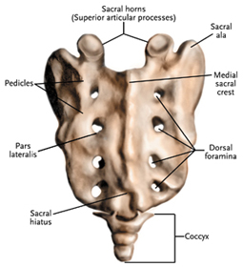
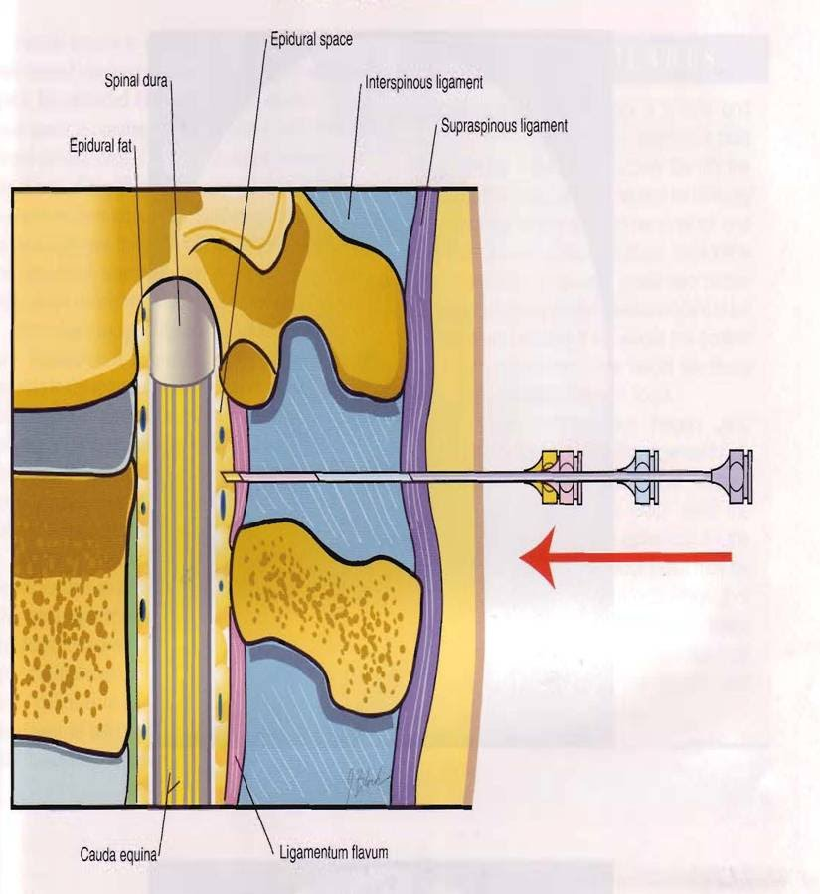
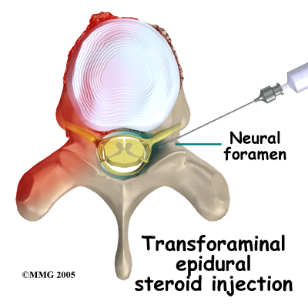
SEI Techniques
Caudal Approach
  Entry through the sacral hiatus
  Catheter is placed proximal to the lesion
Interlaminar
  Needle is inserted paraspinally
  Ligamentum Flavum
Transforaminal
  Needle is inserted more laterally
  Allows for approximation to specific nerve roots
Images courtesy: concordortho.com and health-fts.blogspot.com

Slide 15
Efficacy
The efficacy of ESIs has generally been in question for years.
The issue with RCTs is that the definition of “effective” has never been established
Many previous studies have been quite small not to mention that almost none of them use the same parameters for testing and qualification

Slide 16
Cochrane Review
Because of these factors, The Cochrane Review of Epidural Injections states:
Based on these results, the review authors concluded that there is no strong evidence for or against the use of any type of injections therapy for individuals with subacute or chronic low back pain.
Keep in mind that they too were unable to find enough comparable data to get any objective findings

Slide 17
The Studies
Riew and colleagues (2000) - TFESI
    55 pts (28 in treatment, 27 in control grps)
    Unilateral radicular pain c radiographic confirmation HNP or stenosis
    All subjects were considered surgical candidates by self and surgeon
    Double blinded (surgeon and patient)
    Bupivicane alone vs bupivicane with betamethasone
    Follow up at 13-28 months post-injection
  67% of the control group went on to have surgery
  29% of the treatment group was able to avoid surgery
    Statistically significant (P<.004)

Slide 18
Riew and colleagues (2006) – TFESI follow up
  29 pts in the original study had not received surgery at the conclusion of the study
    9 in control grp
    20 in treatment grp (8 of which were lost to follow up)
  At the five year follow up:
    8/9 control grp had avoided surgery
    9/12 treatment grp had avoided surgery
    All pts lost to follow up were in treatment grp, therefore we have no way of measuring there contribution to a statistical significance.
    With data as is, there is no sign of long term benefits

Slide 19
Karppinen and colleagues (2001)
    160 pts (80 in treatment, 80 in control grps)
    Unilateral leg pain > back pain for 3-28 weeks
    Double blinded (surgeon and patient)
    Saline vs methylprednisolone and bupivicane - single injection
    Outcome measures included were standardized using 6 separate measures including cost of treatment and PE maneuvers
  Follow up was provided at regular intervals:
    Immediate: 61% reduction in treatment grp, 44% in control
    2 weeks: improvements in all measures in both groups
    3 months: control>treatment in reduction of back pain
    6 months: : control>treatment in reduction of back and leg pain
    1 year: both groups showed improvement overall, no difference
  TFESI seemed to have short-term effect but did not last past 3 months

Slide 20
Karppinen and colleagues –sub-group analysis
    Used the same 160 pts, but broke them into subgroups including contained HNP vs disc extrusions
  Results:
    Contained HNPs showed significant improvement at 2 & 4 weeks postinjection compared to the control grp
    No such results found with disc extrusions
    Analysis also showed that contained HNPs were also less likely to go on to surgical intervention, used less days of sick leave at 3-6 months, and the cost of treatment was significantly lower as early as 4 weeks and as far out as 1 year
  ESI appear to be more harmful in extrusions while overall beneficial in contained HNPs

Slide 21
Ng and colleagues (2005)
    86 pts (43 in treatment, 43 in control grps)
    Unilateral radicular pain from HNP or foraminal stenosis
    Double blinded (surgeon and patient)
    Bupivicane only vs methylprednisolone and bupivicane - single injection
    Outcomes assessed at 6 & 12 weeks
  Study found improvement in both groups with no statistically significant difference
  However, when analyzing the duration of symptoms Ng found that the shorter the duration of symptoms, the better the outcomes of the injection in both groups.

Slide 22
Ghahreman and colleagues (2010)
    150 pts
    3 treatment grps: TFI c triamcinolone, bupivicane, or saline
    There was also a control grp with that received IM saline or steroid
    Pain c SLR, imaging confirmed
    If no relief with initial injection, each pt was allowed a total of 3
    Success measured by at least 50% relief for >1 month
  Results: (success rate)
Treatment | TFESI: 54% | Saline: 19% | Anesthetic: 7%
Control | Steroid: 21% | Saline: 13%

Slide 23
Battle of Approaches
Ackerman and Ahmad (2007)
    90 pts (30 designated to each approach)
    No “control” group, each pt received injection of triamcinolone and saline in their designated fashion
    Each subject had L5-S1 herniation c EMG confirmed S1 radiculopathy
    Up to 3 injections at two week intervals were allowed until adequate relief of pain was achieved
  Average required injections :
    TF: 1.5
    IL: 2.2
    Caudal: 2.5
  Bottom Line: greater ventral flow = greater relief

Slide 24
Candido and colleagues (2008)
    57 pts (no true control again – TFESI vs ILESI)
    Both groups received identical injections of methylprednisolone, lidocaine, and saline
  If the findings of Ackerman and Ahmad are accurate, then by ensuring adequate ventral flow, pts should have greater relief of symptoms.
  ILESI approach was altered to a more parasagital approach, allowing for greater ventral flow
  Researchers found there to be equal relief between TF and IL grps
  Key finding was a decrease in total exposure to radiation (avg of 28.96 sec of fluoroscopy time in IL vs 46.25 in TF)

Slide 25
Imaging
Use of fluoroscopy in TFESI is standard of care
Not so in IL and caudal approaches
HOWEVER, without imaging, inaccurate needle placement has been found in…
  35-53% of caudal approaches
  17-30% of IL approaches
    (numbers vary according to individual trials)

Slide 26
Complications
No matter our view of injections, we must agree there is significant risk of complications
Transient:
  Headache*
  Impaired glucose control
  Insomnia
  HTN
  Vasovagal reaction
  Nausea
  Increase of pain
More Serious:
  Infection
  Hypersensitivity
  Hematoma
  Intravascular injection of medication
  Neural trauma
  Subdural injection
  Air embolism
  Disc injection

Slide 27
In Summary
Although there is a plethora of trials, lack of standardization has left us guessing
However, we can see evidence for…
  Use of fluoroscopy gives us a greater chance of approximating the steroid to the lesion
  Earlier treatment leads to greater chance of relief
  Approximation is key to optimal relief
  For this reason, TFESI may be considered the choice approach, while caudal may be the least effective
  We cannot clump all back pain into one category, we can’t even clump all radicular pain into one category
  Proper diagnosis is the key

Slide 28
References:
Ackermann WE, Ahmad M. The efficacy of lumbar epidural steroid injections in patients with lumbar disc herniation. Anesth Analg 2007;104:1217–22.
Candido KD, Raghavendra MS, Chinthagada M, et al. A prospective evaluation of iodinated contrast flow patterns with fluoroscopically guided lumbar epidural steroid injections: the lateral parasagittal interlaminar epidural approach versus the transforaminal epidural approach. Anesth Analg 2008;106(2):638–44.
Ghahreman A, Ferch R, Bogduk N. The efficacy of transforaminal injection of steroids for the treatment of lumbar radicular pain. Pain Med 2010;11:1149–68.
Karppinen J, Malmivaara A, Kurunlahti M, et al. Periradicular infiltration for sciatica: a randomized controlled trial. Spine 2001;26:1059–67.
Karppinen J, Ohinmaa A, Malmivaara A, et al. Cost effectiveness of periradicular infiltration for sciatica: subgroup analysis of a randomized controlled trial. Spine 2001;26(23):2587–95.
Ng L, Chaudhary N, Sell P. The efficacy of corticosteroids in periradicular infiltration for chronic radicular pain: a randomized, double blind, controlled trial. Spine 2005;30:857–62.
Riew KD, Yin Y, Gilula L, et al. The effect of nerve-root injections on the need for operative treatment of lumbar radicular pain. A prospective, randomized, controlled, double-blind study. J Bone Joint Surg Am 2000;82-A:1589–93.
Riew KD, Park JB, Cho YS, et al. Nerve root blocks in the treatment of lumbar radicular pain. A minimum five-year follow-up. J Bone Joint Surg Am 2006; 88(8):1722–5.

Slide 29
More References:
Riew KD, Yin Y, Gilula L, et al. The effect of nerve-root injections on the need for operative treatment of lumbar radicular pain. A prospective, randomized, controlled, double-blind study. J Bone Joint Surg Am 2000;82-A:1589–93.
Riew KD, Park JB, Cho YS, et al. Nerve root blocks in the treatment of lumbar radicular pain. A minimum five-year follow-up. J Bone Joint Surg Am 2006; 88(8):1722–5.
Rho ME & Tang CT, “The Efficacy of Lumbar Epidural Steroid Injections: Transforaminal, Interlaminar, and Caudal Approaches”, Phys Med Rehabil Clin N Am. [2011, 22(1):139-148], doi: 10.1016/j.pmr.2010.10.006
Saal JS, Franson RC, Dobrow R, et al. High levels of inflammatory phospholipase A2 activity in lumbar disc herniation. Spine (Phila Pa 1976) 1990;15(7):674–8.
Staal JB, de Bie R, de Vet HCW, Hildebrandt J, Nelemans P. Injection therapy for subacute and chronic low-back pain. Cochrane Database of Systematic Reviews 2008, Issue 3. Art. No.: CD001824. DOI: 10.1002/14651858.CD001824.pub3
Stout A,“Epidural steroid injections for low back pain”, Phys Med Rehabil Clin N Am. 2010 Nov;21(4):825-34. doi: 10.1016/j.pmr.2010.08.001

