Slide 1
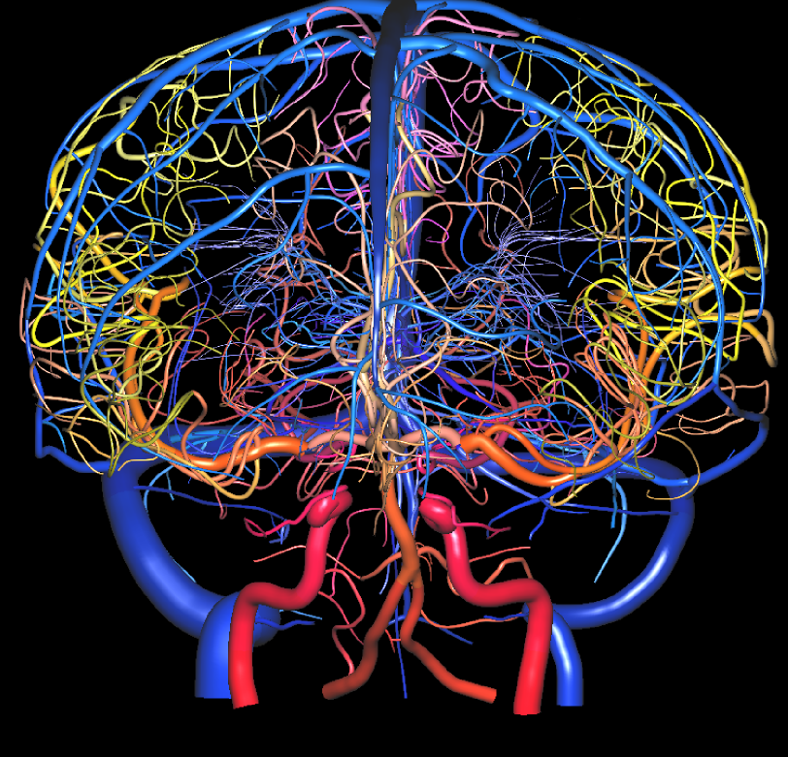
Wallenberg syndrome
Jason Samona MS4 MSUCOM

Slide 2
One condition… Many names
WALLENBERG SYNDROME = POSTERIOR INFERIOR CEREBELLAR ARTERY SYNDROME = LATERAL MEDULLARY SYNDROME
one of the most commonly recognized brain stem infarct related neurological condition
  Arterial hypertension = main risk factor (52%)
commonly caused by lesions (most commonly strokes) to intracranial vasculature → injury to the lateral part of the medulla (“brain stem stroke”) → tissue ischemia and necrosis
  VERTEBRAL ARTERY > PICA (POSTERIOR INFERIOR CEREBELLAR ARTERY) > SUPERIOR MIDDLE AND INFERIOR MEDULLARY ARTERIES

Slide 3
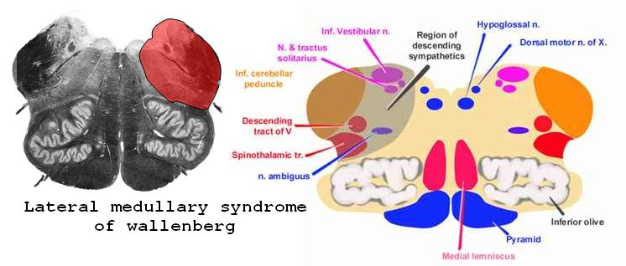
CAUSES
  Less common causes
    Mechanical Trauma to the vertebral artery in the neck,
    Vertebral Arteritis (inflammation of the walls of the arteries)
    Metastatic Cancer
    Hematoma
    Aneurysm of associated vasculature esp. the vertebral artery
    Herpetic Brainstem Encephalitis
    Head Injury
    ArterioVenous Malformations (AVMs)
    Multiple Sclerosis
    Varicella Infection
    Brainstem Tuberculoma (a rare form of TB)

Slide 4
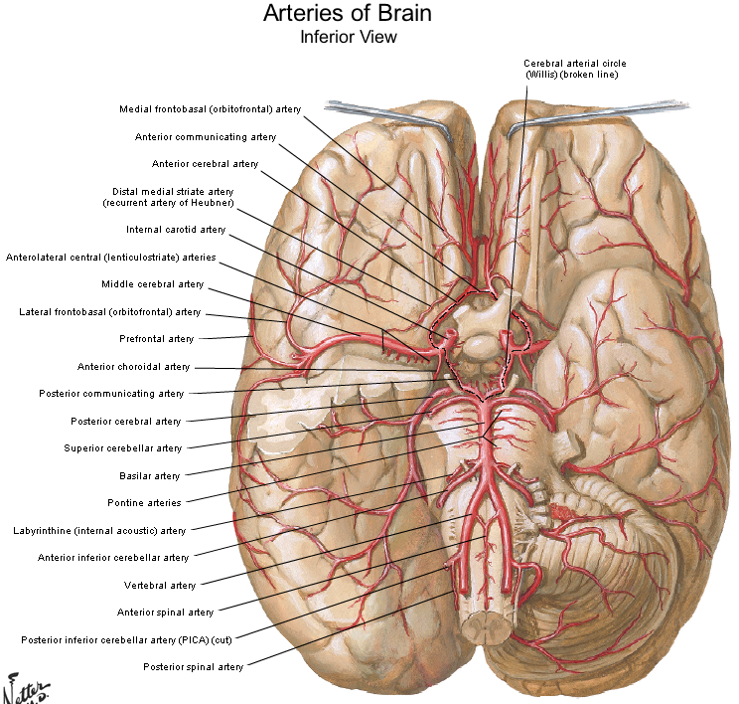

Slide 5
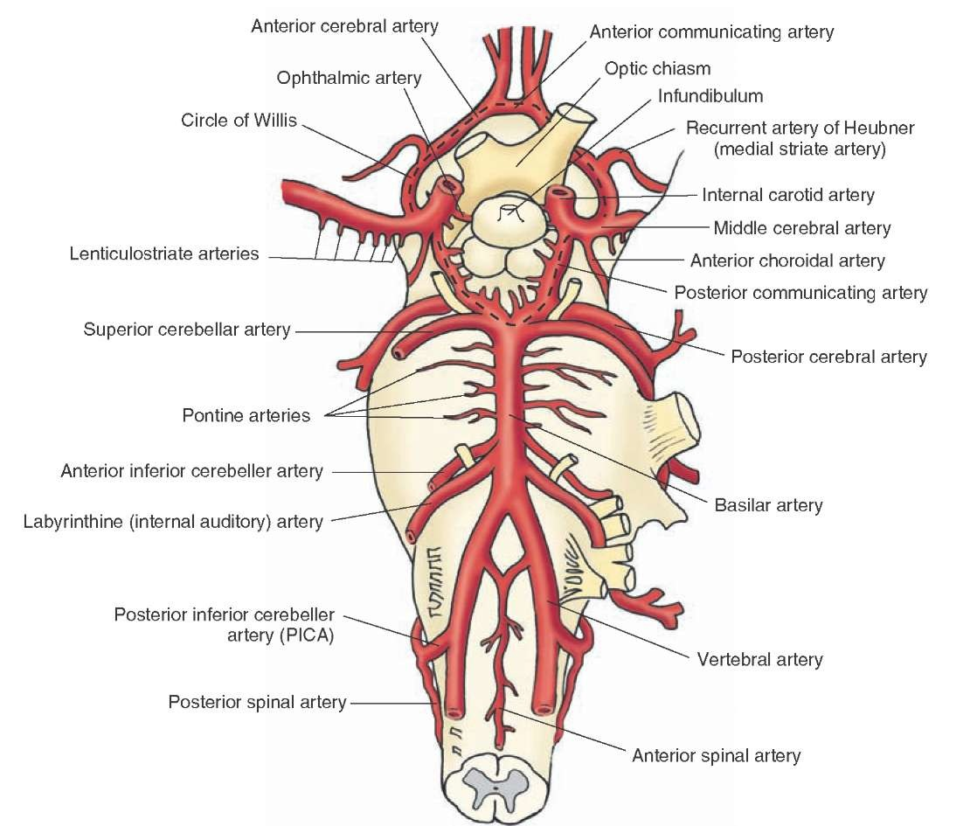

Slide 6
CLINICAL FINDINGS
  different clinical findings / presentations, depend on the site of the lesion, whether rostral, caudal or medial
There was a progressive form of onset in most cases
Case Review : 25 patients with a diagnosis of the disease…
  predominance = middle aged men presenting at 55.06 years of age (range 30- 78)
  Most common symptom = dysphonia > dysphagia > etc…
  Most common finding on physical examination =ataxic gait (24/25 patients)
  MR was positive in 22 of the 23 cases in which this was done… therefore, identified with modern neuro-imaging techniques!
  Most cases, prognosis = good
  Most common sequela = ataxia
Case Review : 33 consecutive patients w/ lateral medullary syndrome evaluated by the Stroke Center b/t 1983 and 1989
  most frequent symptoms at onset
    Ataxia (70%)
    numbness either of the ipsilateral face or of the contralateral body (64%)
    vertigo (51 %),
    Dysphagia or dysphonia (51%)

Slide 7
CLINICAL FINDINGS
  Overall…. Common Symptoms
    ocular symptoms (diplopia or blurred vision) - 33%
    Horner's syndrome - 91 %
    ipsilateral ataxia - 85%
    contralateral hypoalgesia -85%
    Nystagmus (61%)
    facial weakness (42%)
    Conclusions. —The triad of Horner's syndrome, ipsilateral ataxia, and contralateral hypoalgesia will clinically identify patients with lateral medullary infarction. Facial weakness and ocular symptoms are frequent and do not necessarily imply that the infarction extends beyond the lateral medulla
  Imaging Results
    Head CT was abnormal only when a cerebellar infarction was present (three cases)
      Cerebellar infarcts only infrequently accompany lateral medullary syndrome, suggesting that most of the posterior inferior cerebellar artery territory is spared, despite the high frequency of vertebral artery occlusion
    MRI, obtained in 22 cases, was normal in two; a lateral medullary infarction alone was present in 12, and a lesion extending beyond the lateral medulla was found in eight.
    No correlation was noted between facial weakness or ocular symptoms and infarction extending beyond the lateral medullary region.
    Vertebral artery disease was confirmed by vascular imaging or insonation studies in 73% of patients.

Slide 8
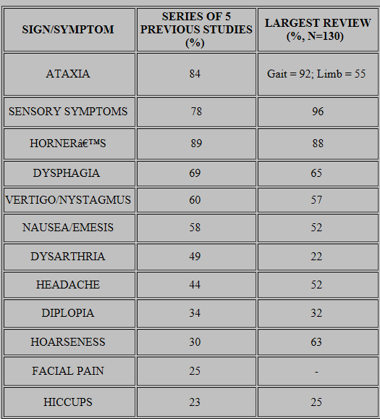
CLINICAL FINDINGS
DYSFUNCTION | EFFECTS
VESTIBULAR NUCLEI | vestibular system: nausea/ vomiting vertigo, nystagmus
INFERIOR CEREBELLAR PEDUNCLE | Ipsilateral cerebellar signs including limb and gait ataxia, dysmetria (past pointing), dysdiadokokinesia
CENTRAL TEGMENTAL TRACT | palatal myoclonus
LATERAL SPINOTHALAMIC TRACT | contralateral deficits in pain and temperature sensation from body (limbs and torso)
SPINAL TRIGEMINAL NUCLEUS & TRACT | Ipsilateral loss of pain, and temperature sensation from face
NUCLEUS AMBIGUUS - (WHICH AFFECTS VAGUS NERVE AND GLOSSOPHARYNGEAL NERVE - LOCALIZING LESION (ALL OTHER DEFICITS ARE PRESENT IN LATERAL PONTINE SYNDROME AS WELL) | Ipsilateral laryngeal, pharyngeal, and palatal hemiparalysis: dysphagia, hoarseness, diminished gag reflex (efferent limb - CN.X)
DESCENDING SYMPATHETIC FIBERS | Ipsilateral Horner's syndrome (ptosis, miosis, & anhydrosis)
DORSOLATERAL MIDDLE MEDULLA, ADJACENT TO RETICULAR FORMATION | Hiccups

Slide 9
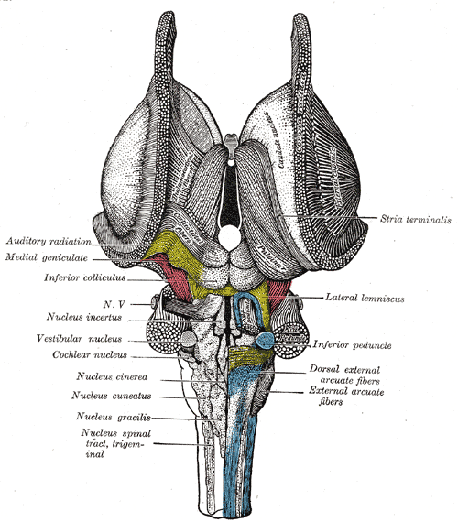
VESTIBULAR NUCLEI & SYSTEM
4 subnuclei; at the floor of the fourth ventricle make the “vestibular nuclei”
Role of the Vestibular System = contributes to
  sense of spatial orientation
  provides the leading contribution about movement and sense of balance for the sensory system
The vestibular system, with the cochlea (a part of the auditory system), make up the labyrinth of the inner ear, which is situated in the vestibulum in the inner ear
movements consist of rotations and translations, and vestibular system comprises two components:
  Semicircular canal system → indicate rotational movements
  Otoliths → indicate linear accelerations
The vestibular system sends signals primarily to the neural structures that control
  eye movements - the vestibulo-ocular reflex which is required for clear vision
  The muscles that keep humans upright and balanced
VESTIBULAR NUCLEI & SYSTEM | Location
medial vestibular nucleus (dorsal or chief vestibular nucleus) | medulla (floor of fourth ventricle)
lateral vestibular nucleus or nucleus of Deiters | medulla (upper)
inferior vestibular nucleus | medulla (lower)
superior vestibular nucleus | pons

Slide 10

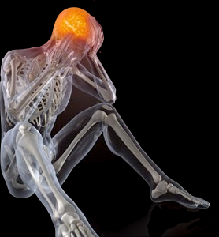
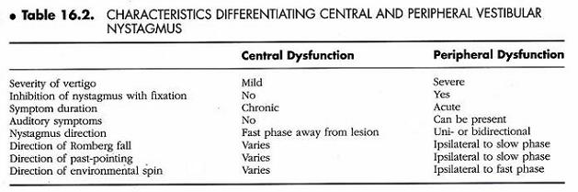
VERTIGO
a subtype of dizziness
feeling of motion when one is stationary
a feeling that you or your surroundings are moving BUT THERE IS NO ACTUAL MOVEMENT, the individual is stationary
The patient may feel as though they are spinning, whirling, falling, or tilting, and they may have trouble walking or standing, which can be seen when the patent loses their balance and falls
severe vertigo may cause the patient to feel very nauseated or vomit

Slide 11
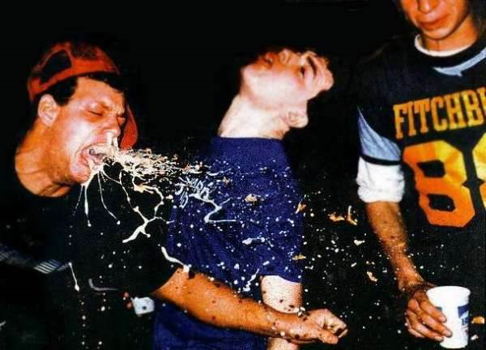
NAUSEA / VOMITING

Slide 12
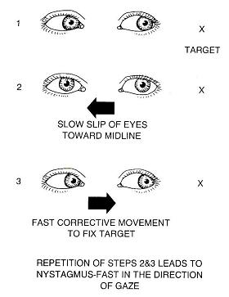

NYSTAGMUS
fast periodic rhythmic ocular oscillation of the eyes
  Side to side (horizontal nystagmus)
  Up and down (vertical nystagmus)
  Rotary (rotary or torsional nystagmus)
oscillations may be sinusoidal ….
  approximately equal amplitude and velocity (pendular nystagmus)
    Or
  with a slow initiating phase and a fast corrective phase (jerk nystagmus) = MORE COMMON
Causes of Nystagmus
  PRESENT AT BIRTH
    infantile nystagmus syndrome (INS)
    congenital diseases of the eye
  ACQUIRED NYSTAGMUS
    drugs or medication- can impair the labyrinth's function
      The most common cause of acquired nystagmus is certain
      Phenytoin (Dilantin) - an antiseizure medication
      excessive alcohol
      any sedating medicine
    Head injury from motor vehicle accidents
    Inner ear disorders such as labyrinthitis or Meniere's disease
    Stroke
    Thiamine or vitamin B12 deficiency
  diseases of the brain (ex multiple sclerosis or brain tumors) …if the areas controlling eye movements are damaged

Slide 13
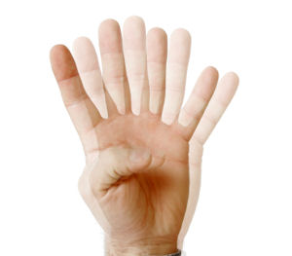
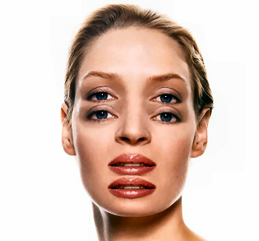
DIPLOPIA
diplopia is derived from 2 Greek words:
  Diplous = double
  Ops = eye
  Diplopia = double vision
mechanism of diplopia were investigated in 31 patients with Wallenberg's syndrome resulting from acute dorsolateral medullary infarction.
  Diplopia was found in 10 of 31 patients (32%),
    5 patients reporting vertical diplopia alone
    5 reporting vertical and horizontal diplopia.
    in Wallenberg's syndrome, diplopia is considered to be caused by a lesion involving the otolith-ocular system
      Vertical diplopia
        due to a lesion involving the vestibular nucleus
        the affected eye becomes deviated inferiorly
      horizontal diplopia
        may require involvement of the medial longitudinal fasciculus (MLF), which produces skew deviation in mirror image

Slide 14
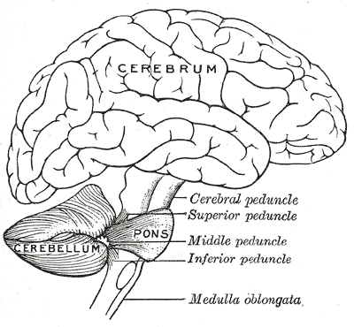
INFERIOR CEREBELLAR PEDUNCLE
Ipsilateral cerebellar signs including
  limb and gait ataxia
  dysmetria (past pointing)
  dysdiadocokinesia

Slide 15
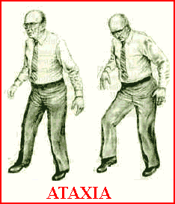
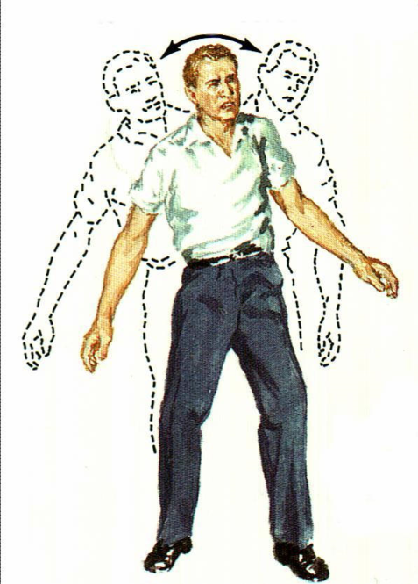
ATAXIA
“Ataxia", comes from the Greek word, " a taxis" = "without order or incoordination“ ……………….ATAXIA MEANS WITHOUT COORDINATION.
may affect the…...
  coordination
  fingers, hands, arms, legs, body
    a lack of muscle coordination during voluntary movements, such as walking or picking up objects
  Difficulty with fine-motor tasks ( ex. eating, writing or buttoning clothing)
  Speech → Slurred speech
  eye movements
  ability to swallow → difficulty swallowing
  Gait → Unsteady walk and a tendency to stumble
cerebellum = a region of the brain which participates in the control of muscle coordination
  Persistent ataxia usually results from damage to the cerebellum
  Ataxia can develop over time or come on suddenly, depending on the cause
conditions that may cause ataxia, include
  alcohol abuse
  stroke, tumor
  cerebral palsy
  multiple sclerosis
  inheritance a defective genes that may cause one of many ataxia variants
Treatment
  depends on the underlying cause
  Adaptive devices
    ex. walkers or canes
  physical therapy
  occupational therapy
  speech therapy

Slide 16
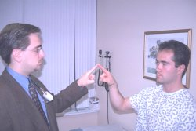
DYSMETRIA (PAST POINTING)
a type of ataxia
The term dysmetria broken down, means …. … DIFFICULT TO MEASURE
a condition in which there is a lack of coordination due to the improper measuring of distance in muscular acts, in which there is an inability to judge distance or scale → leading to a patient over or underestimate distance with the eyes, hands, or legs.
  Exemplified by the undershoot or overshoot of position with the hand, arm, leg, or eye, with an intended target
    Hypermetria = overshooting the intended position
    Hypometria = undershooting the intended position
Damage to the cerebellum or to any of the pathways leading into or out of it, can lead to dysmetria
  cerebellum is the portion of the brain responsible for motor coordination
often it is associated with other cognitive disorders of the cerebellum, this can include…. symptoms such as
  language impairment
  Issues with memory
  Issues with reasoning
may be displayed / characterized, by the inability to perform rapid tapping movements or other coordinated movements of the extremities
  Diagnosing dysmetria can begin with simple tests such as…….. The hand-to-nose test =
    the physician holds a finger up in front of the patient, the patient is asked to touch the physician's finger, and then his or her own nose, several times
    There other similar tests that can be used to examine coordinated movement of the arms and legs.
  Imaging modalities can be used to identify lesions and give more concrete support for a definite diagnosis
dysmetria is a symptom which is caused be a certain lesion, therefore in cases where there are uncurable lesions such as with permanent brain damage secondary to infarctions, a complete cure is not possible
  BUT……. the condition can be managed via
    medications …..such as Isoniazid and Clonazepam.
    experimental treatments include …..cannabis
    rehearsal by eye movement = this is where the patient is trained to practice movements with the eye before attempting physical movement
    Deep brain stimulation (DBS)

Slide 17

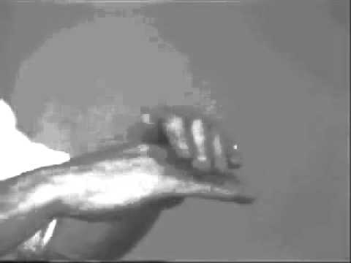
DYSDIADOCOKINESIA
dysdiadochokinesia = “bad,” “receive,” and “movement.”
difficulty to execute quick/ rapid alternating movements
often due to lesions on the cerebellum’s posterior lobe, therefore making it difficult to activate or deactivate antagonizing muscle groups
  the affected muscles can weaken and they may also tire more easily, therefore the patient can seem uncoordinated and clumsy = ATAXIA
  cerebellum coordination is needed in performing alternating movements steadily and quickly
a key sign of many cerebral disorders, including multiple sclerosis
You can lead to diagnose the condition by asking the patient to perform a series of simple movements, such as….
  turning a door knob
  screwing in a lightbulb
  Have the patient rub their shin with the opposite heel
  winding a watch
  moving the tongue quickly from one side of the mouth to the other
  … if the patient has dysdiadochokinesia … they will be UNable to execute these tasks steadily or quickly, and maybe not at all

Slide 18
CENTRAL TEGMENTAL TRACT
The central tegmental tract includes
  ascending axonal fibers …
    arise from rostral nucleus solitarius → terminate in the thalamus’ ventral posteromedial nucleus (VPM)
  descending axonal fibers …
    arise from parvocellular red nucleus→ project to inferior olivary nucleus
Lesions in this area → palatal myoclonus

Slide 19
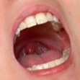
PALATAL MYOCLONUS
Rapid spasm (contraction) of the muscles at the roof of the mouth
Can be displayed as rhythmic involuntary jerky movements of the
  soft palate of the throat
  sometimes other muscles related to the throat can experience this also
patients often complain of …..
  CLICKING sensation in the ear
  POPPING sensation in the ear

Slide 20
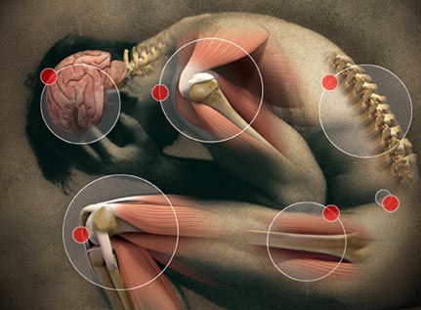

SENSORY
LATERAL SPINOTHALAMIC TRACT
  contralateral deficits in pain and temperature sensation from body (limbs and torso)
SPINAL TRIGEMINAL NUCLEUS & TRACT
  ipsilateral loss of pain, and temperature sensation from face

Slide 21
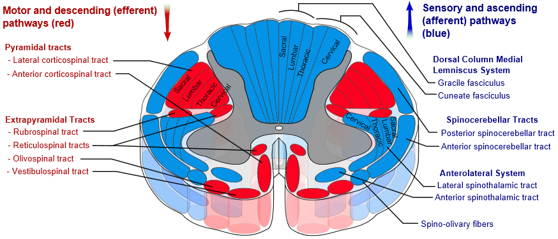
LATERAL SPINOTHALAMIC TRACT
Anterolateral system aka secondary sensory fasciculus aka spinal lemniscus
  = bundle of sensory axons ascending through white matter of the spinal cord, transmitting sensory information to the brain
  Anterior/ ventral spinothalamic tract
  lateral spinothalamic tract aka lateral spinothalamic fasciculus
    Part of the anterolateral system
    pain and temperature sensory information → thalamus
    composed of … secondary sensory neurons which have already synapsed with the primary sensory neurons of the peripheral nervous system in the dorsal horn of the spinal grey matter =
      primarily of fast-conducting, sparsely-myelinated Aδ axons
      slow-conducting, unmyelinated C axons

Slide 22
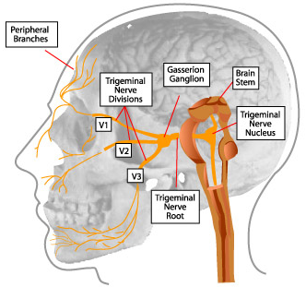
SPINAL TRIGEMINAL NUCLEUS
& TRACT
a nucleus in the medulla
receives information from the ipsilateral face, regarding..
  DEEP/CRUDE TOUCH
  PAIN
  TEMPERATURE
  …convey by the Cranial Nerves…
    CN 5 TRIGEMINAL
    CN 7 FACIAL
    CN 9 GLOSSOPHARYNGEAL
    CN 10 VAGUS
projects to the (VPM) Ventral Posterior Medial nucleus in the dorsal thalamus

Slide 23
NUCLEUS AMBIGUUS → AFFECTS VAGUS NERVE & GLOSSOPHARYNGEAL NERVE →
ipsilateral laryngeal, pharyngeal, and palatal hemiparalysis →
  Dysphagia
  Dysarthria
  Hoarseness
  Diminished gag reflex (efferent limb - CN.X)

Slide 24
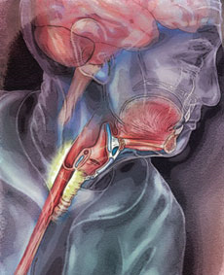
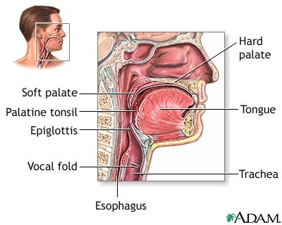
DYSPHAGIA
Dysphagia = dys (bad or disordered) and phago ("eat“)
difficulty in swallowing, it may be …
  a sensation that suggests difficulty in the passage of solids or liquids or BOTH, from the mouth to the stomach
  a lack of pharyngeal sensation
  other difficulties associated with swallowing
  Oropharyngeal dysphagia = difficulty moving food from your mouth, into your upper esophagus
  Esophageal dysphagia (most common subtype) = difficulty moving food through your esophagus to your stomach
Dysphagia is NOT…..
  Odynophagia = painful swallowing
  Globus= the sensation of a lump in the throat
SIGNS & SYMPTOMS
  Some patients have limited awareness of their dysphagia secondary to their debility → high risk of PULMONARY ASPIRATION AND THEREFORE ASPIRATION PNEUMONIA
  FREQUENT/ RECURRENT PNEUMONIA
  DEHYDRATION & MALNUTRITION
  RENAL FAILURE
  DIFFICULTY WITH CONTROLLING …. FOOD OR SALIVA IN THE MOUTH
  INABILITY TO SWALLOW SOLID FOOD → described by patient as
    Food 'becoming stuck' or 'held up' before it either passes into the stomach or becomes regurgitated
    food is "sticking" in your throat or chest
  GURGLY OR WET VOICE AFTER SWALLOWING
  INITIATING A SWALLOW
  COUGHING, CHOKING, NASAL REGURGITATION
  SORE THROAT
  WEAK VOICE
  UNEXPLAINED WEIGHT LOSS
  BELCHING

Slide 25
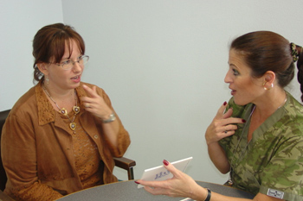
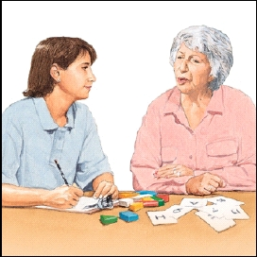
DYSARTHRIA
= a MOTOR speech disorder, therefore….The MUSCLES of the mouth, face, and respiratory system may become dysfunctional (ex. weak, or do not move at all after a neurological lesion)
  type & severity depend on ... which area of the nervous system is affected & to what extent!
Possible causes
  Stroke
  head injury
  cerebral palsy
  muscular dystrophy
SIGNS & SYMPTOMS
  Speech is…. "SLURRED," SOFT, PATIENT IS BARELY ABLE TO WHISPER
  ABNORMAL RATE when speaking
    SLOW rate of speech
      OR
    RAPID rate with "MUMBLING"
  ABNORMAL RHYTHM when speaking
  Limited movement at the tongue, lip, and jaw
  Changes in quality of the voice…
    "nasal" or "stuffy"
    Hoarseness or Breathiness
  Drooling or poor control of saliva
  Chewing and / or swallowing difficulty may also be noted….. DYSPHAGIA !!!!

Slide 26
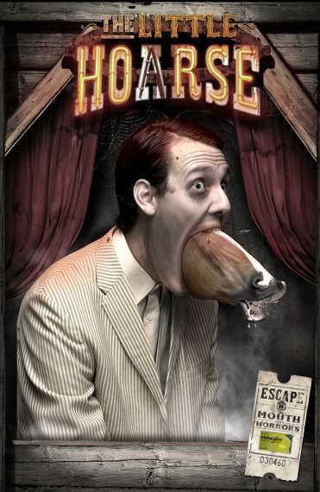
HOARSENESS
difficulty …
  producing sound when speaking
  changing voice pitch or quality
patient’s voice may be described as…..
  weak, breathy, raspy, strained, scratchy, husky, changes in volume or pitch, etc..
associated with disorders in the vocal folds (= sound-producing region) of the “voice box”/ larynx
While…
  breathing → vocal folds remain apart
  speaking or singing → vocal folds come together … air leaves the lungs → vocal folds vibrate → sound is produced
    … issues that effect the vocal cords ability or configuration when coming together can therefore effect the sound quality the patient makes…. such as with weakness to the muscles of the larynx due to a stroke → HOARSENESS

Slide 27
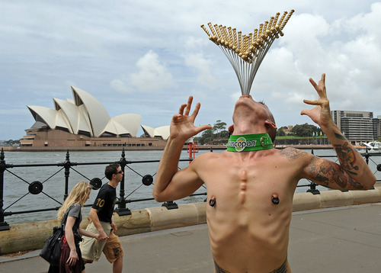
  DIMINISHED GAG REFLEX (EFFERENT LIMB - CN.X)
PHARYNGEAL REFLEX aka GAG REFLEX aka LARYNGEAL SPASM
  = reflex contraction = brisk & brief elevation of soft palate w/ bilateral contraction of pharyngeal muscles elicited via stimulating the
    posterior region of the throat
    roof of the mouth
    back of the tongue
    Peri-tonsilar region
  This reflex prevents objects from entering the throat , unless they are part of normal swallowing, therefore it prevents choking
  a simple gag may enlarge to retching or vomiting in some individuals
REFLEX ARC of the GAG REFLEX =
  SENSORY CN IX Glossopharyngeal nerve (posterior pharyngeal wall) and/or CN V Trigeminal nerve (soft palate) → MOTOR CN X Vagus nerve → GAG Reflex!

Slide 28
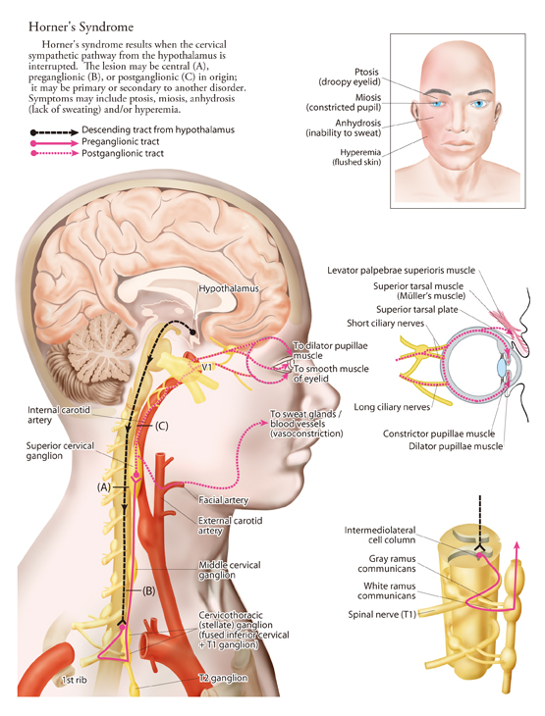
DESCENDING SYMPATHETIC FIBERS
Horner’s Syndrome

Slide 29

DORSOLATERAL MIDDLE MEDULLA, ADJACENT TO RETICULAR FORMATION
Infrequently a result of lateral medullary infarction such as seen in Wallenberg’s Syndrome and is poorly understood
importance may be underestimated
If persistent…they may lead to….
  Exhaustion
  Distress
  Aspiration
EXAMPLE STUDY
  Objective: evaluate the relation b/t lesional loci of lateral medullary infarction vs hiccups
  Methods: 51 pt.’s with Wallenberg’s Syndrome were investigated via MRI…. 7/ 51 patients developed hiccups!
  Results:
    ALL of the patients with hiccups had MIDDLE LEVEL LATERAL MEDULLARY LESIONS
    ALL patients with lateral medullary infarction presenting with hiccups also had
      Nausea/ Vomiting
      Dysphagia
      Vertigo & Dizziness
  Conclusions: MIDDLE LEVEL and DORSOLATERAL lesion locations IN LATERAL MEDULLARY INFARCTION frequently induce hiccups

Slide 30


TREATMENT
Tx VIA…. = RELIEF OF SYMPTOMS & ACTIVE REHABILITATION
Rehabilitation → helps those recover their activities of daily living and cope with neurologic loss that can be psychologically devastating
Stroke rehab should start as soon as possible after a stroke
  The sooner you begin stroke rehabilitation = more likely the patient may be able to regain lost abilities / skills
  first priority is stabilize the medical condition, life-threatening conditions should addressed first
  measures should be taken to
    prevent another stroke
    limit any stroke-related complications
  …….. once these steps have been taken → stroke rehabilitation should be started during the acute hospital stay
duration of your stroke rehabilitation depends on
  PATIENT RECOVERY
  SEVERITY OF SYMPTOMS
  RESPONSIVENESS TO THERAPY
  RELATED COMPLICATIONS
  ..….. some stroke survivors recover quickly BUT most stroke survivors need some form of stroke rehabilitation long term, possibly months or years, after their stroke
  the stroke rehabilitation plan will change during the recovery as the patient relearns skills and their needs change

Slide 31
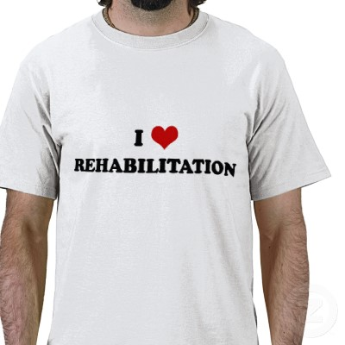
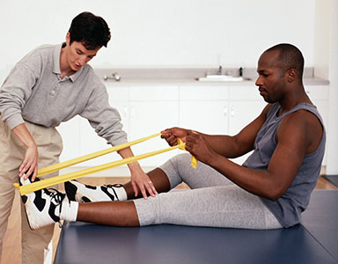
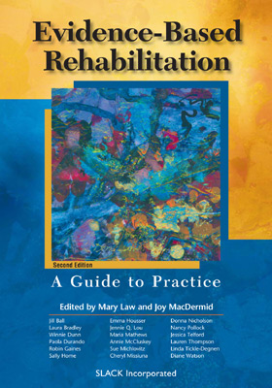
Overall treatment goals with Wallenberg’s Syndrome
  Can be caused by possible irreversible damage to parts of the brain secondary to infarction, therefore the syndrome itself cannot be treated directly except by usual means of treating a stroke, which Wallenberg syndrome is ammendable to depending on the cause.
  The degree of recovery is highly dependent upon the specific case and the amount of damage the brain stem suffered
  Some Wallenberg syndrome victims will continue to battle the condition for years after the initial insult
  The nature of the condition & brain damage that accompanies it, means there are NO guarantees in terms of outcomes with rehabilitation, therefore it is important to maintain close relationships with your patient and help them through the recovery process in any way possible

Slide 32
Rehabilitation Settings
  HOSPITAL
    stroke rehabilitation usually begins while the patient is still in the hospital
  Inpatient rehabilitation (“IPR”) units
    free-standing or part of a larger hospital or clinic
    Some patients may stay for extended periods of time as part of intensive rehabilitation regimes
  Outpatient units
    often part of a hospital or clinic
    the patient spends several hours a day in this location, but the patient returns home each night
  Skilled nursing facilities
    Some facilities specialize in rehabilitation, but others offer less intense therapy options
    some patients can leave the hospital to go directly to nursing homes and bypass the rehabilitation facility all together
  Home-based programs
    therapy may be done in the patient’s home
    PROs = greater flexibility for the patient to receive care, for example when an individual finds it difficult to travel or find transportation to rehab facilities
    CONs = will not have access to specialized rehab equipment in the patient’s home & NOT EVERYONE IS ELIGIBLE! Insurance companies strictly control who qualifies for this home therapy

Slide 33
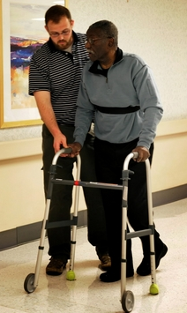
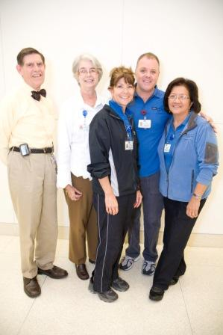
REHAB TEAM =
  Physicians
    physical medicine and rehabilitation (physiatrists) - guide care and prevent complications
    Tx of symptoms, ex. managing bowel and bladder complications of stroke
    feeding tube inserted through the mouth or gastrostomy can be necessary if impaired swallowing
      understand if there is risk for aspiration pneumonia in some patients
      Wallenberg syndrome patients frequently experience difficulty with oral motor control and swallowing
    medication can reduce pain
      chronic neuropathic pain associated with the syndrome can be treated with anti-epileptics (such as gabapentin)
      Opioid analgesics are frequently prescribed to patients with Wallenberg’s
    neuroradiologist or vascular neurologists
      cerebral angiogram is typically required to evaluate for surgical recanalization
    interminable, violent hiccups
      the most unique and difficult to treat symptoms that occurs with Wallenberg syndrome
      hiccups can be so severe patients commonly struggle to … Eat, Sleep, carry conversations
        hiccups severity is correlated to the severity of stroke blockage
        can last for weeks
        very few successful medications exist to mediate this issue
    Commonly Long term treatments
      generally involves antiplatelet and statin regimen for the rest of the patients life → minimize the risk of another stroke
      warfarin is used if atrial fibrillation is present
      medications to suppress high blood pressure
  Rehabilitation nurses
    Specialized nurses with experience dealing with rehabilitation cases, and know the limitations of patient in the rehab floor and are able to properly care for and look after the patient
  Psychologists
    assess the patients level of thinking skills
    work with the patient to ensure mental and emotional health concerns are addressed
    depressed mood & withdrawal from society can be seen in patients following the initial neurologic insult

Slide 34
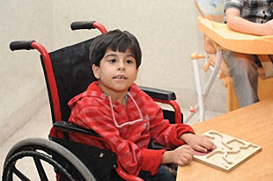

  Therapeutic recreation specialists
    help patients resume activities and roles enjoyed before the insult, ex … hobbies
  Physical therapists
    help the patient relearn physical tasks, ex. walking, keeping balance, etc
  Occupational therapists
    help the patient relearn functional hand and arm use for daily skills, ex..
      bathing, tying shoes, buttoning clothes
      address safety issues in the home via suggestions on making certain changes to the patients’ home
      help with cognitive organizational tasks
  Speech & Language Pathologists
    help the patient with
      language skills
      ability to swallow
      teach how to use compensatory tools to address problems with memory and thinking
      patients suffering from Wallenberg syndrome can make a nearly complete recovery in regards to speech deficits in many cases
  Dietitians
  Social workers
    help the patient
      With financial issues $$$
      arrange new living arrangements after the hospital visit
      identify community resources that may support your recovery
  Vocational counselors
    help the patient address return-to-work issues
some individuals will always have residual symptoms due to the severity of the lesion which caused the syndrome! Therefore some treatments will have varied success
  ex…. 2 patients may present with the same initial symptoms after a stroke, but months later one patient may fully recover while the other is still severely handicapped

Slide 35
END OF PRESENTATION. THANK YOU

