Slide 1
Urban Immersion Fellowship
Information Session
Friday March 8, 2024

Slide 2
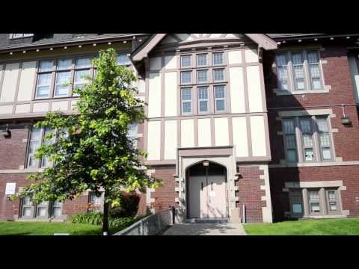
The Urban Immersion Fellowship: What to Expect

Slide 3
Why?
There are close to 17,000 public school districts in the United States.
A quarter of all elementary & secondary students go to school in just over 200 of our large urban districts.
These districts are responsible for educating close to 40% of our country’s students living in poverty, and over 40% of students of color.
Regardless of school location, close to 20% of U.S. children live in poverty.
Profound Implications for
Educator Readiness and Effectiveness

Slide 4
Purpose
Provide teacher candidates with a quality experience for “authentic” engagement with urban context learners.
Transform future urban educators thinking about the possibilities and promise for urban children and families.
Provide a “highly effective” future talent pool of urban educators.

Slide 5
Fellowship Dispositions
Professional Maturity, Initiative & Flexibility
Acknowledge, Respect & Embrace cross-cultural differences.
Recognize existing structures of Power, Privilege & Oppression.
Willingness to Engage, Connect & Learn.

Slide 6
What? When?
Paid IN-PERSON summer opportunity in support of Detroit Public Schools Community District (DPSCD) or community agency summer programming, to provide learning support for the enrichment and acceleration of Detroit students.
Stipend payment of $4000 for completion. (You will be paid as an MSU Student Employee)
TENTATIVE PROGRAM DATES:
June 18th - August 2nd, 2024

Slide 7



PARTNERS

Slide 8
Typical Fellowship Schedule
Week 1 & 2
Professional Development/Training
Monday – Friday 8:00 AM – 4:00 PM
Week 3-6
Placement
Monday – Thursday 7:30 AM – 12:30 PM

Slide 9
Application
Any Current Freshman, Sophomore, Junior, or Senior pursuing Teacher Preparation Program at MSU (UECP/GECP Preferential consideration)
Writing sample describing commitment to urban education
Recommendation from MSU education faculty or other professional.
Online Application
  Available:
  Wednesday, March 27, 2024
  https://education.msu.edu/urban-immersion-fellowship/
  DEADLINE:
  Wednesday, March 27, 2024
  @ 5:00 PM DON’T DELAY!!
  Feedback starting week of
  April 1st

Slide 10
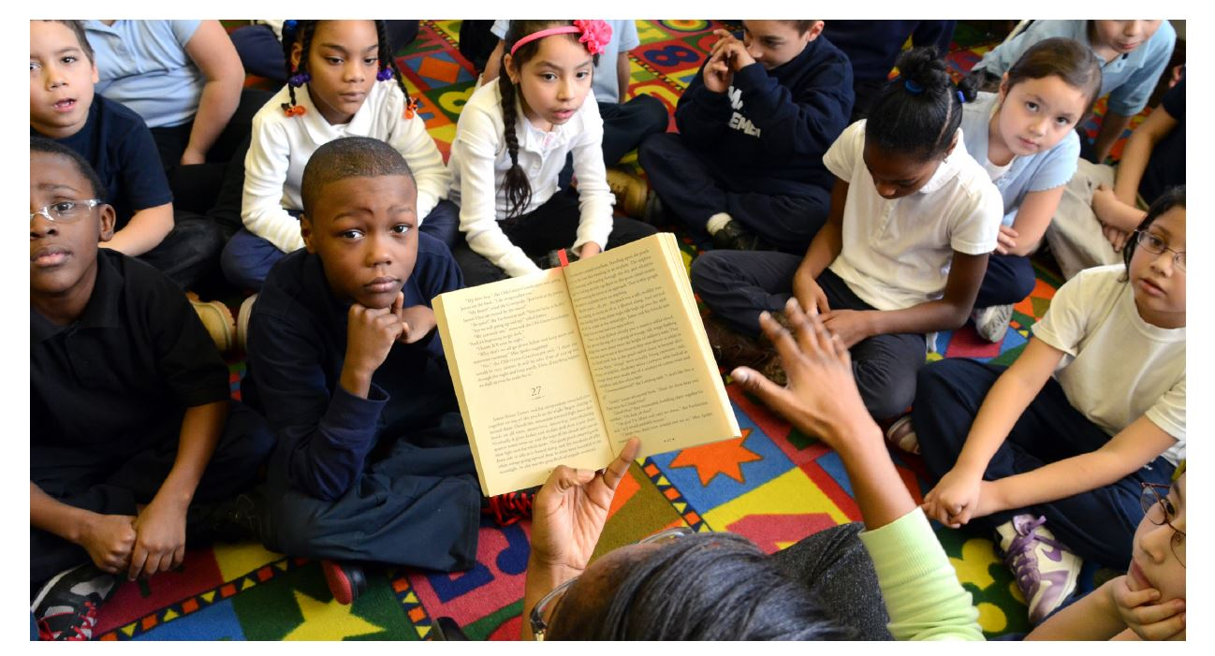
Questions?

Slide 11
CONTACT
Terry Flennaugh, Ph.D.
Associate Dean, College of Education
Michigan State University
flennaug@msu.edu

