Slide 1
Approaching low back pain in adults
Anand Navarasala
MSUCOM OMS IV
9/17/12

Slide 2
Introduction
Second most common symptom for clinician visit
Classification based on duration
Acute (less than 4 weeks)
Subacute (4-12 weeks)
Chronic (greater than 12 weeks)
Total costs exceeds 100 billion per year for job related disability costs in USA
Disabling in many ways by interfering with quality of life and activity level
Notes:
- Patients will typically get better in the first month with improvement in their pain and level of disability.
- The five percent of people with back pain that do not get better are the ones that comprise 75% of the total cost.
- In up to 85 percent of the patients that come to the clinician for back pain don’t get a definitive diagnosis
- Although many patients initially present with back pain over 90% do not return to the clinic after 3 months to seek care
- Higher expectations for recovery help patients recover faster and with better functional improvement

Slide 3
Objectives
Risk Factors
Terminology
History
Physical examination
Differential diagnosis
Imaging
Pharmacotherapy
Non surgical interventional techniques
Additional therapy
Summary

Slide 4
Risk factors
Smoking
Obesity
Older age
Sedentary lifestyle
Occupational tasks or hazards
Psychosocial factors i.e. level of education, job dissatisfaction, somatization disorder, anxiety, depression
Notes:
- Type of work is a large factor in which physically strenuous work, sedentary, and psychologically stressful work largely contribute to the population affected by back pain.
- Coexisting conditions can exacerbate back pain and stress can manifest itself as back pain the same way a headache can
- Chronic low back pain has strong psychosocial variables and many patients with this condition have poor overall health status, coexisting psychiatric illnesses, and coping behavior which is maladaptive including drug use and alcohol

Slide 5
Terminology in back pain
Spondylosis
Spondylolisthesis with grades I-IV
Spondylolysis
Spinal stenosis
Radiculopathy
Sciatica
Cauda equina syndrome
Lordosis/kyphosis/scoliosis
Piriformis syndrome
Notes:
Spondylosis – Arthritis of the spine, characterized by discspace narrowing and/or arthritic changes in the facet joints
Spondylolisthesis – Slippage with anterior displacement of a vertebrae on top of the one beneath it
Spondylolysis – Fracture in pars interarticularis
Radiculopathy – impairment of a nerve root resulting in pain, numbness, tingling, or muscle weakness to the corresponding root distribution

Slide 6
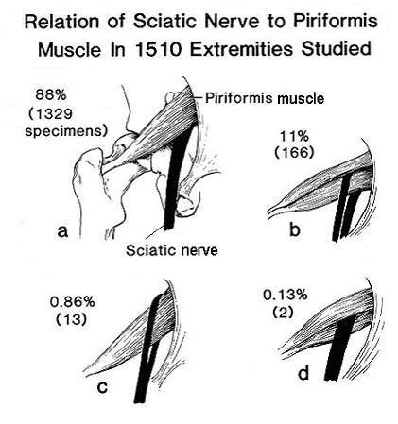
Sciatic nerve anatomical variation
Based on the anatomy of the sciatic nerve
True condition may not actually exist
EMG/NCS can be diagnostic to determine etiology of sciatica

Slide 7
History of pain
History should establish reason for pain
Systemic disease/neurological compromise?
Psychological stressors?
PPQRSTA especially important in regards to activity eliciting pain, associated symptoms
History of medical/family conditions such as cancer or neuropathic pain disorders
Notes:
- Clues for underlying systemic diagnosis
- History of cancer, age greater than 50, unexplained weight loss
- Duration of pain over one month, Nighttime pain, Unresponsiveness to previous therapy

Slide 8
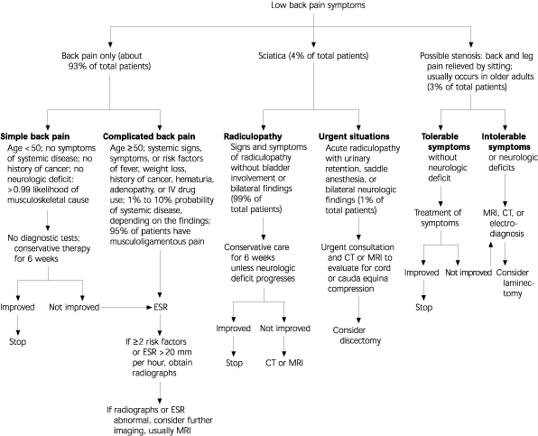

Slide 9
Physical Examination
Inspection of back and posture
Range of motion/ facet loading
Palpation of spine and adjacent musculoskeletal structures
Straight leg raise w/ leg symptoms
Neurological assessment L5 and S1 roots
Evaluation for malignancy (i.e. weight loss or acanthosis nigricans)
Peripheral pulses for vascular claudication

Slide 10
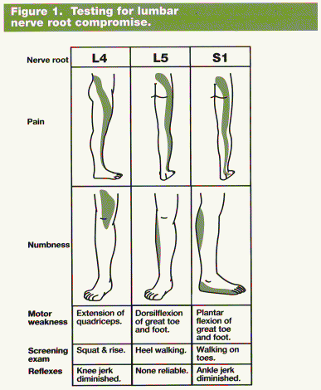
Neurological assessment
Reflex assessment, weakness in nerve root muscle, as well as screening examinations can be helpful in pinpointing location of pathology

Slide 11
Differential Diagnosis
Non-mechanical
Neoplastic
Infection
Inflammatory arthritis
Paget’s disease of bone
Visceral disease
Pelvic organs
Renal disease
AAA
GI disease

Slide 12
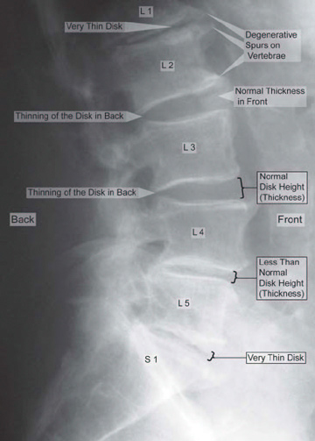
Imaging
Imaging not necessary in first 4-6 weeks in majority of cases
Unless progressive deficits apparent
Acute low back pain typically resolves but “red flags” warrant immediate imaging

Slide 13
“Red flags” according to ACR
Recent trauma, or milder trauma age >50
Unexplained weight loss/fever
Immunosuppression/history of cancer
IV drug use active or history
Osteoporosis or history of long term steroid use
Age >70
Disabling or focal neurologic deficits
>6 week duration of symptoms

Slide 14
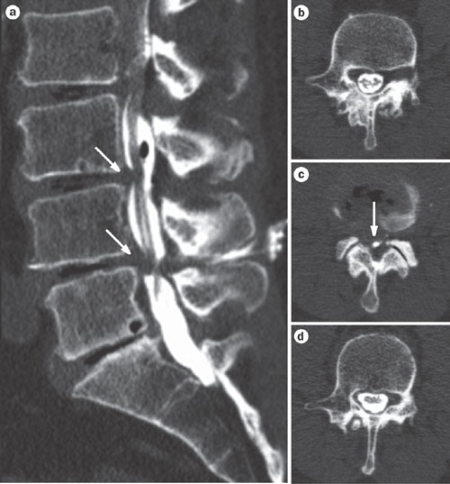
CT/MRI scanning
More sensitive in detecting infection, cancer, herniation, stenosis
Use in patient past subacute pain period of >12 weeks
MRI>CT due to better visualization of soft tissue

Slide 15
Overuse of imaging is a problem
From 1994-2005 MRI images of lumbar spine increased by 4x
Patients often push physician to get imaging even when not indicated
Increased number of MRI machines→ More unnecessary scans
“the mindset that more testing means better care must be abandoned in favor of a more evidence- based approach”

Slide 16
When a referral is indicated
Neurosurgery/Orthopedist
Cauda equina syndrome
Suspected spinal cord compression
Progressive or severe neurological deficit
Neurologist/Physiatrist
Persistent neuromotor deficits >6 weeks
Sensory deficit, loss of reflexes, or sciatica that is non resolving w/ favorable psychosocial circumstances

Slide 17
Pharmacotherapy
According to the ACP either acetaminophen or NSAIDs are first line for acute low back pain
NSAIDs for 2-4 weeks in patient w/o risk i.e. GI
Ibuprofen 200-800mg QID
Naproxen 250-500mg BID
Acetaminophen - less side effects but not as efficacious at relieving pain
Use in older patients and minimize use in liver compromised patient

Slide 18
Pharmacotherapy cont.
Centrally-acting skeletal muscle relaxants
Cyclobenzaprine (Flexeril) is first line
Combination therapy with NSAIDS provide most effective symptom relief
Side effects include sedation and dizziness
Opioids
Used in chronic low back pain patients
Side effects include sedation, confusion, nausea, and constipation
Abuse potential in long term so provide as needed dosing

Slide 19
Nonsurgical interventional tx
Corticosteroid Injections
Medication injected epidural either translaminar, transforaminal, or caudal approach
3 injection series w/ 1 month minimum between
Local or trigger point injection
Nerve blocks diagnostic and therapeutic
Radiofrequency ablation
Notes:
Corticosteroid injections were found to be effective in many trials compared to placebo water injections. The adverse effects of the injections included dural puncture, infection, and bleeding but this is more a complication of operator error in preparation. Some other symptoms at much less frequency include headache and nausea but these symptoms were relieved within a day after the procedure.
Trigger point injections – TPI in studies involving injection into iliac crest region and iliolumbar ligaments were poor quality and did not warrant their use for chronic or acute low back pain. Their use is rather indicated in myofascial pain syndrome which is related to fibromyalgia.
Facet joint injection and medial branch block – There are miminal trials investigating facet joint injections but those that were existent showed no difference in pain relief from facet joint injection vs placebo.

Slide 20
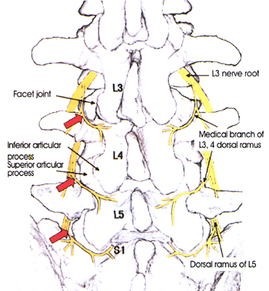
Video of pain clinic approach
http://www.youtube.com/watch?v=2jv-SIaPZj8
http://www.youtube.com/watch?v=2x9f3pVQZyQ&feature=related

Slide 21
Non surgical treatment cont.
Chemonucleolysis
Use of chymopapain
Risks – allergic reactions, hemorrhage, neurologic complications and is no longer used in U.S. since 2003
Botulinum toxin A
Paravertebral injection into muscle
Preliminary results are promising but further research is warranted for long term use

Slide 22
Exercise and physical modalities
Exercise – return to ambulation ASAP!
Spinal manipulation
OMT may be beneficial opposed to chiropractor due to intensity of maneuvers
2 treatments per week for no longer than 10 weeks
Massage and yoga
Acupuncture
Cold and wet heat
Patient education is key
Giving the tools to maximize function leads to a more favorable prognosis and return to activity

Slide 23
Summary
The multifactorial nature of this illness warrants an initial thorough investigation of history and symptoms
Preliminary evidence in non surgical intervention requires further investigation
Using a therapeutic lifestyle change for symptoms is most beneficial and results in better long term outcomes
Spending time to educate patients leads to better outcomes and belief in treatment modality

Slide 24
Case #1
37 y/o male presents to the office with 4 day history of pain in buttocks and thighs. He admits the pain is better at rest and worse when he walks or exerts himself. Pt admits impotence. He has Hx. Of smoking, poor diet, and family history of MI.
PE: Pertinent findings include decreased femoral pulses.

Slide 25
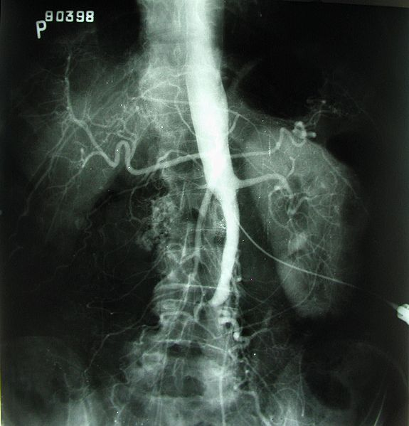
Imaging was obtained
What does he have?
A. Cauda Equina syndrome
B. Piriformis syndrome
C. Spinal Stenosis
D. Vascular claudication
E. Spondylolisthesis

Slide 26
Case #2
72 y/o male presents with 3 day history of low back pain after slipping on a wet floor at Kroger. He admits that he has numbness down his right leg. He admits he has been unable to urinate as well after the incident but has a history of BPH and takes medication which helps with sx.
PE: L4 Reflexes 1+ on both legs and Dorsiflexion of both feet 3/5 strength

Slide 27
What should we do next?
A. Consult Orthopedic spine/ Neurosurgery
B. Obtain X-ray
C. Obtain CT/MRI
D. Give him a script for Vicodin
E. Tell him to walk it off
F. Both A and C

Slide 28
References
UpToDate
Subacute and chronic low back pain: Nonsurgical interventional treatment
Treatment of acute low back pain
Diagnostic testing for low back pain
Approach to the diagnosis and evaluation of low back pain in adults
Diagnostic imaging for low back pain: Advice for High-value health care from the American college of physicians. ACP best practice advice 2011.

