Slide 1
Mirror Therapy for Phantom Limb Pain
Craig Thom
OMS IV
November 9, 2012

Slide 2
What is a Phantom Limb?
“The sensation that an amputated or missing limb (or even an organ, like the appendix) is still attached to the body.” (3) (4)

Slide 3
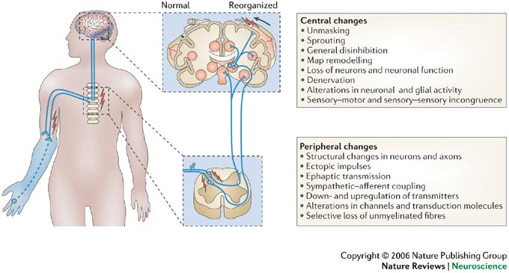
Possible Mechanisms (7)

Slide 4
UptoDate 2011 says:
“True phantom limb pain is a complex, poorly understood pain syndrome that is described as burning, aching or electric-type pain in the amputated limb. The diagnosis of phantom pain should only be made after other causes of stump pain have been eliminated including ischemia, infection, neuroma and pressure-related wounds.” (5)

Slide 5
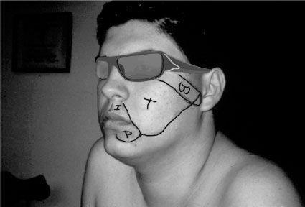
Ramachandran’s First Inspiration
(6)

Slide 6
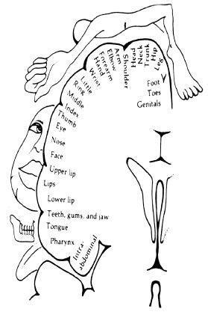
(6)

Slide 7
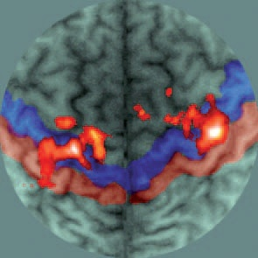
Telescoping in the Phantom Limb: Imagined movement and executed movement (7)
EM
IM
Notes:
Functional MRI

Slide 8
History of Treatment (7)
Until the late 1980s phantom pain was generally attributed either to neuromas at severed nerve endings or to a psychological disturbance.
Surgeons sometimes performed a second amputation in extreme cases which increased the pain, not touching the original phantom pain but adding a new “phantom stump” pain.
More radical treatments included cutting the sensory nerves leading to the spinal cord or removing the part of the thalamus that receives sensory signals from the body.

Slide 9
Nothing is really helping! (2006)
“Several studies, including large surveys of amputees, have shown that most currently available treatments for phantom limb pain, which include:
Analgesic medication
Antidepressant medication
Stimulation,
are ineffective
and…

Slide 10
….fail to consider the mechanisms that underlie production of the pain. On the basis of the findings on CNS plasticity related to phantom pain, experimental methods that affect neuroplasticity as well as memory formation and maintenance might positively influence phantom limb pain.” (7)

Slide 11
Clinical Significance
Phantom limb pain occurs in at least 90% of limb amputees at Walter Reed.
2011 saw a new one year high for military amputations- 240 soldiers lost one or more limbs
Improved body armor saves soldiers who would have died in previous wars
Amputation from other non-traumatic causes may or may not result in phantom pain. (2)

Slide 12
Walter Reed Army Medical Center Study (1)
22 Amputees
Randomly assigned to one of three groups:
Experimental
Sham Mirror
Mental Imagery
15 minutes of therapy per day for 4 weeks

Slide 13
Link to Video
http://www.youtube.com/watch?v=YL_6OMPywnQ&playnext=1&list=PL4BF6852C61FAB2E9&feature=results_video

Slide 14
Mirror Therapy
Watch the mirror image of the intact limb
Move the phantom limb
Repeat 15 minutes per day for 8 weeks (1)

Slide 15
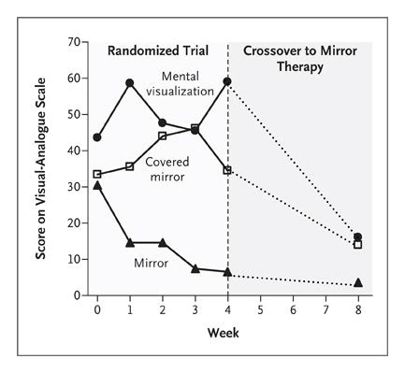
Study Results at Walter Reed reported in the NEJM, 2007

Slide 16
Other Studies
A randomized clinically controlled trial reported in the European Journal of Pain (EJP) in 2007 reports that Mirror Therapy is no more effective than other methods for treating phantom limb pain (8)
Contradicts the Walter Reed study!
Really?
No.
Notes:
The EJP study gave the experimental group a one time therapeutic experience of doing 10 different movements 10 times. They did say that participants reported being able to move their phantom limbs more freely

Slide 17
Other Treatments
Myoelectric prostheses
Acupuncture (9)
Graded Motor Imagery (which may incorporate mirror therapy) and Sensory Discrimination Training
On the horizon- virtual reality goggles that function like the mirror to provide the experience of moving the phantom limb

Slide 18
Conclusion, Part I
The Walter Reed Army Hospital Study makes it clear that the therapy is effective
Why have there been no big follow up studies?
Small, spread out patient population
No money to be made, no pharmaceutical research to be done or drugs to be sold,
No apparatus to build or market.

Slide 19
Conclusion, Part II
Who can support the use of this inexpensive, easy to administer treatment?
You!

Slide 20
References
Chan, Brenda. “Mirror Therapy for Phantom Limb Pain”, New England Journal Medicine; Volume 357:2206-2207; November 22, 2007
“DoD says amputations reached wartime high”, Armytimes (online) Volume 5:38:44 EDT; March 14, 2012
www.mayoclinic.com/health/phantom-pain/DS00444/DSECTION=treatments-and-drugs
Ramachandran, VS; Hirstein, William. ”The perception of phantom limbs”. Brain, Volume 121: 1603-1630; 1998
Lkalapatapu, Venkat, MD. “Lower extremity amputation”, Uptodate, June 1, 2012
Ramachandran, VS. The Tell-Tale Brain, WW Norton & Co, New York, 2011
Flor, Herta. “Phantom Limb Pain: a Case of Maladaptive CNS Plasticity?” Nature, Volume 7: 873-880; November 2006.
Brodie , Eric E. ”Analgesia through the looking-glass: A randomized controlled trial investigating the effect of viewing a ‘virtual’ limb upon phantom limb pain, sensation, and movement”, European Journal of Pain, Volume 11, Issue 4, Pages 428-436; May 2007
Hao, Jason Jishun, DOM, MTCM, MBA. “The Treatment of Phantom Limb Pain by Scalp Acupuncture”; Acupuncture Today, Volume 7, Number 9; September 2006.

