Slide 1
LYMPHEDEMA
AN OLD PROBLEM WITH A NEW LOOK
Margaret Fankhauser, DO

Slide 2
HISTORY OF LYMPH VESSEL SYSTEM
Hippocrates (460-377 BC) – “Vessels which can carry white blood”.
Aristotel (384-322 BC) – “Structure which contains colorless fluid”.
The physicians of Alexandarian Schoor (Egypt) mark these vessels as “ductus lactei” (“milky duct”) found in humans and animals. They also described the “white blood in the abdomen”, later named chylus.
In 1622 Gaspare Asselli found in dog “2 white cords” between the abdome and thorax – later named thoracic ducts

Slide 3
HISTORY OF LYMPH VESSEL SYSTEM
In 1651 Jean Pecquet – chylus vessels, cisterna chyli and thoracic ducts in human cadaver.
In 1692 Anton Nuen introduced method for studying the lymph vessels through injection with quicksilver.
In 1850’s Sappey described lymph vessels in the various tissues including the face using quicksilver injection.
After 1920 many publications clarified the role of the lymph vessel system in pathophysiology in human diseases.

Slide 4
Lymphatics -- Anatomy
Peripherally, the lymphatic vessels do not communicate with the blood vessels.
The lymph empties into the bloodstream at the junction of the jugular and subclavian vein (bilaterally).
The endothelium of the lymphatic vessels at these points of junction is continuous with that of the veins.
Structure of lymphatic system:
  Capillary plexuses
  Collecting lymphatic vessels
  Lymphatic trunks
  Cisterna chyli
  Thoracic duct

Slide 5
HISTOLOGY -- ANATOMY
Lymphatic channels have numerous valves and are slightly distended at these sites.
Lymphatics with a diameter of more than 0.2 mm usually have a thin muscular media.
Lymphatics have a larger cross-sectional area than do capillaries.
Lymphatics lack a true basement membrane.
Lymphatics do not serve (nails, cornea) cartilage, bone, epithelial tissue and tissues of the central nervous system.

Slide 6
EDEMA
Excess of interstitial fluid in the tissues
Can result from any of the factors that control movement of water between the vascular compartment and the tissue spaces:
Not a disease, but rather the manifestation of altered physiological function and can occur in healthy and sick individuals.

Slide 7
CAUSES OF EDEMA
Increased Capillary Pressure
Arteriolar dilation
  Allergic response (e.g., hives)
  Inflammation
Venous obstruction
  Hepatic obstruction
  Heart failure
  Thrombophlebitis
Increased vascular volume
  Heart failure
  Increased levels of adrenocortical hormones
  Premenstrual sodium retention
  Pregnancy
  Environmental heat stress
Effects of gravity
  Prolonged standing

Slide 8
CAUSES OF EDEMA
Decreased Colloidal Osmotic Pressure
Decreased production of plasma proteins
  Liver disease
  Starvation of severe protein deficiency
Increased loss of plasma proteins
  Protein-losing kidney diseases
  Extensive burns
Increased Capillary Permeability
Inflammation
Immune responses
Neoplastic disease
Tissue injury and burns
Obstruction of Lymphatic Flow
Infection or disease of the lymphatic structures
Surgical removal of lymph nodes/scaring from radiation

Slide 9
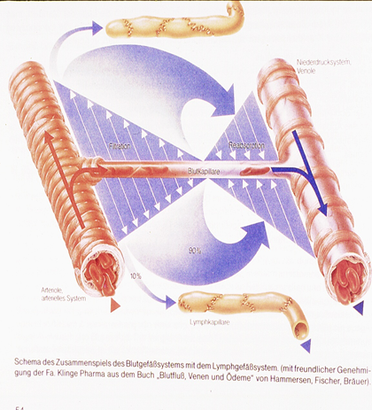
PATHOPHYSIOLOGY
DURING SYSTOLE, FLUID LEAVES THE ARTERIOLES AND ENTERS THE INTERSTITIAL SPACES. 90 PERCENT RETURNS TO THE VENOUS SYSTEM 10 PERCENT RETURNS THROUGH THE LYMPHATIC SYSTEM

Slide 10
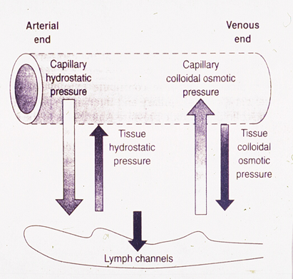
PATHOPHYSIOLOGY
INCREASED FILTRATION THEORY
  HIGH PROTEIN LOADS IN THE TISSUE CAUSES AN OSMOTIC GRADIENT TO PULL FLUIDS INTO TISSUES
  CAPILLARY VASODILITATION OR INCREASED PRESSURE CAUSES INCREASED PRESSURE GRADIENT FOR FILTRATION
  MAY PRODUCE MORE THAN THE LYMPHATIC SYSTEM CAN HANDLE

Slide 11
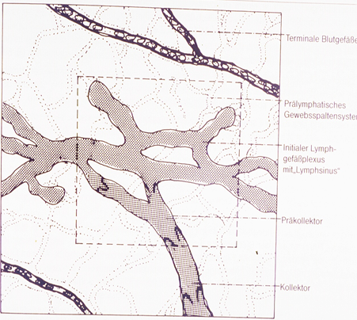
PATHOPHYSIOLOGY
THE LYMPHATIC SYSTEM HAS A SINGLE CELL WALL WITH VERY FEW MUSCULAR CELLS COMPARED TO THE VASCULAR SYSTEM

Slide 12
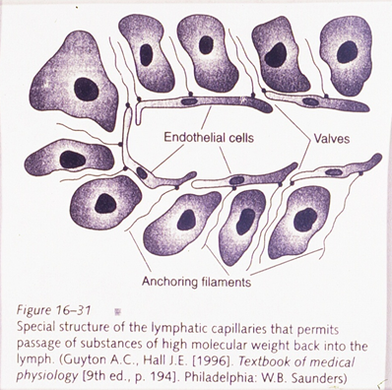
PATHOPHYSIOLOGY
SPECIAL STRUCTURE OF THE LYMPHATIC VESSELS PERMITS LARGE MOLECULES TO ENTER FOR RETURN TO THE VASCULAR SYSTEM

Slide 13
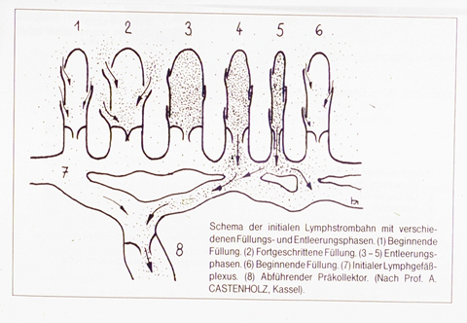
PATHOPHYSIOLOGY
DURING SYSTOLE, THE ARTERIOLE EXPANDS CAUSING PRESSURE ON THE PRECOLLECTOR LYMPHATICS CAUSING EMPTYING
DURING DIASTOLE, THE ARTERIOLE CONTRACTS PULLING THE PRECOLLECTOR LYMPHATICS OPEN FOR FILLING
M Foldi pg34-36

Slide 14
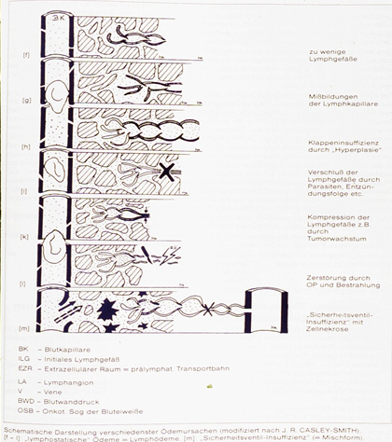
PATHOPHYSIOLOGY
PRIMARY LYMPHEDEMA IS AN INSUFFICIENT NUMBER OF COLLECTING VESSELS.
IT IS UNCLEAR IF THE PROBLEM IS PRESENT AT BIRTH IN ALL CASES OR IF IT CAN DEVELP OVER TIME AS A RESULT OF HYPOPLASIA DURING GROWTH
LYMPHEDEMA CAN BE PRESENT IN INFANCY, MILROY’S, CAN FIRST SHOW UP AT PUBERTY, LYMPHEDEMA PRAECOX OR LATER IN LIFE, LYMPHEDEMA TARDA
Mortimer pg 2798

Slide 15
PATHOPHYSIOLOGY
HIGH VOLUME INSUFFICIENCY
  VESSEL HYPERTROPHY ANGIOGENESIS
    INCREASED SURFACE FOR FILTRATION
  VESSEL DILATION
    INCREASED PRESSURE FILTRATION
    S Mortimer pg 2800

Slide 16
PATHOPHYSIOLOGY
#1 CAUSE OF LYMPHEDEMA IS A MISSMATCH BETWEEN THE AMOUNT OF FLUID AND THE CAPACITY OF THE LYMPHATIC SYSTEM
  NORMAL SYSTEM AND EXCESSIVE FLUIDS
  MINIMALLY LOW NUMBER OF LYMPH CHANNELS THAT USUALLY HANDLE THE FLUID LOAD BUT COMPENSATORY MECHANISMS FAIL
  PRIMARY LYMPHEDEMA AGENESIS OR MALFORMATION
  DAMAGED VESSELS

Slide 17
PATHOPHYSIOLOGY
SECONDARY LYMPHEDEMA
TRAUMA TO LYMPHATIC SYSTEM
  SURGERY
  RADIATION THERAPY
  INFECTION
  INJURY
INCREASED FLUIDS
CHANGE IN AIR PRESSURE – PLANE FLIGHT

Slide 18
PATHOPHYSIOLOGY
VALVULAR INCOMPETENCE OCCURS IN THE LYMPHATIC SYSTEM JUST AS IT DOES IN THE VENOUS SYSTEM WHEN THERE IS TOO MUCH FLUID CAUSING DISTENSION OF THE VESSELS
M Foldi pg 38

Slide 19
PATHOPHYSIOLOGY
LYMPH VESSEL WALL INFILTATION WITH HIGH VOLUME
INFILTRATION OF SURROUNDING CONNECTIVE TISSUE
LYMPHATIC WALL INSUFFICIENCY
PROLONGED EXPOSURE TO EXTRAVISATE ACTIVATES PROLIFERATION OF CONNECTIVE TISSUE AND HYPEREMIA

Slide 20
PATHOPHYSIOLOGY
ORGANIZATION OF PROTEIN AS FIBROUS TISSUE WITHIN CONNECTIVE TISSUE
BRAWNY EDEMA

Slide 21
DIAGNOSIS
RAPIDLY DEVELOPING EDEMA IS MORE LIKELY TO BE RELATED TO CARDIAC OR VASCULAR DISEASE
TUMOR INFILTRATION OF LYMPH NODES RARELY CAUSES EDEMA UNLESS THERE HAS BEEN PRIOR SURGERY OR RADIATION OF THE AREA
POST SURGICAL EDEMA IS USUALLY SLOW TO DEVELOP IF IT IS DUE TO LYMPATIC CHANGES BUT RAPID IF DUE TO VASCULAR OCCLUSION OR NARROWING

Slide 22
DIAGNOSIS
PHYSICAL EXAM
  LE
    COMPARISON FOR ASSYMETRY
    SKIN CHANGES – EPIDERMAL , DERMAL, LESIONS, DISCOLORATION
    TENDERNESS, CORDS, PROMINENT VEINS
    PITTING – LEVEL, SEVERITY ON 4 POINT SCALE

Slide 23
DIAGNOSIS
BLOOD WORK
  COMPREHENSIVE CHEMISTRY PANEL
  URINALYSIS
  LIVER FUNCTION TESTS
  ALBUMIN
  THYROID STIMULATING HORMONE
EKG
CHEST XRAY
CHO, SHAUN

Slide 24
DIAGNOSIS
LYMPHSCINTIGRAPHY
  INJECTION OF SMALL AMOUNT OF NUCLEAR SUBSTANCE BETWEEN DIGITS SUBCUTANEOUSLY
  SCANS TAKEN AT 15 MIN, 30MIN, 1-2 HOURS
  SHOWS WHERE LYMPHATIC OBSTRUCTION IS AND IF ANY PATHWAYS ARE OPEN

Slide 25
DIAGNOSIS
VENOUS DOPPLERS
  ASK FOR EVALUATION OF VALVULAR COMPETENCE

Slide 26
TREATMENT
INCREASING KNOWLEDGE RECENT ADVANCES WITH GENOMICS
MEDICAL APPROACHES
SURGICAL ADVANCES
PHYSICAL APPROACHES

Slide 27
TREATMENT
THE EARLIER TREATMENT IS BEGUN, NO MATTER WHICH FORM, THE BETTER THE RESULTS
IF THERE IS LYMPHANGITIS, WARM ERYTHEMATOUS SKIN, TREAT FIRST FOR CHRONIC INFECTION BEFORE ANY DRAINAGE TECHNIQUES
USUALLY STAPH EPI AND SENSATIVE TO AMOXICILLIN 2 GRAMS PER DAY CONTINUOUS INFUSION IV FOR 1 MONTH OR LEVOQUIN PO 2-3 WEEKS
HEAL ALL OPEN ULCERS

Slide 28
TREATMENT
MEDICATIONS
COUMARIN –
  ATTRACTS MACROPHAGES
  HELPS BREAKDOWN PROTEINS IN THE INTERSTITIAL SPACES DECREASING THE OSMOTIC DIFFUSION
GROWTH FACTOR
  STIMULATES THE GROWTH OF VASCULAR STRUCTURES

Slide 29
TREATMENT
SURGERY
  DEBULKING PROCEDURES
  SUBFASCIAL DRAINAGE
  SURFACE LYMPHANGECTOMY

Slide 30
TREATMENT
MICROSURGERY
  CONSIDER WHEN MEDICAL AND PHYSICAL THERAPY HAVE NOT SUCCEEDED
  RECURRENT LYMPHANGITIS
  INTRACTABLE PAIN
  WORSENING LIMB FUNCTION

Slide 31
TREATMENT
LYMPHATICOVENOUS SHUNT
  TECHNIQUES HAVE IMPROVED
  WORKS BEST IF DONE BEFORE FIBROTIC CHANGES HAVE OCCURRED
  BEST RESULTS WITH MULTIPLE ANASTEMOSES
  NEED TO MAKE CERTAIN THAT VEIN VALVES ARE COMPETENT

Slide 32
TREATMENT
PHYSICAL APPROACHES
PNEUMATIC PRESSURE PUMPS
  SINGLE VALVE AND CIRCUMFERENCIAL PRESSURE
  MULTIPLE VALVES AND COMPRESSION BEGINNING DISTAL MOVING PROXIMAL
REDISTRIBUTE FLUIDS
DAMAGE LYMPH VESSELS

Slide 33
TREATMENT
MODALITIES OF MLD
  MASSAGE
  WRAPPING
  EXERCISE
  COMPRESSION GARMENTS

Slide 34
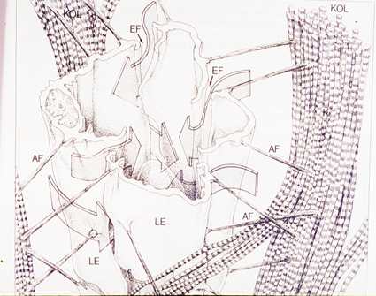
TREATMENT
MANUAL LYMPHEDEMA DRAINAGE
  PRESSURE OF THE HAND PUSHES AGAINST THE ELASTIC CONNECTIVE TISSUE AND PASSIVELY OPENS THE VALVES ALLOWING VESSELS NEARBY TO FILL WITH FLUID
  IMPROVES THE ABILITYOF VESSEL TO CONTRACT (STARLINGS LAW).

Slide 35
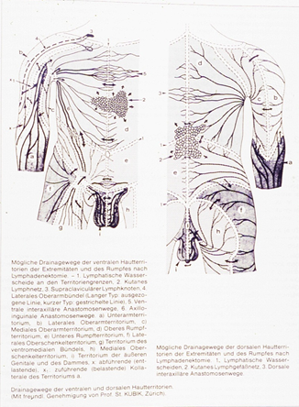
TREATMENT
INSOLUBLE PARTICLES MOVE WITH THE LYMPH FLUIDS SO THEY CAN BE UTILIZED
IT IS IMPORTANT TO BEGIN MASSAGE THERAPY BEFORE THE PROTEIN RICH FLUIDS ORGANIZE
WITH MASSAGE, THERE IS AN INCREASE IN LEUKOCYTE AND LYMPHOCYTE COUNTS IN LYMPH FLUIDS
GOAL IS TO USE VESSELS AVAILABE AND OPEN SMALLER VESSES TO TAKE ON THELOAD

Slide 36
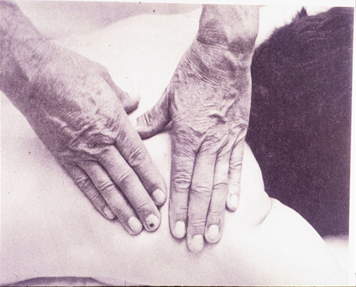
TREATMENT
MANUAL LYMPHEDEMA DRAINAGE
  PASSIVE TECHNIQUE PROVIDED BY A CERTIFIED THERAPIST
  GOAL IS TO MOVE FLUID INTO THE PRELYMPHATIC CHANNELS
  ALTERNATING PRESSURE OF THE MASSAGING HAND SUPPORTS THE FILLING AND EMPTYING OF LYMPHATIC CAPILLARIES

Slide 37
TREATMENT
WRAPPINGS
  SHORT STRETCH BANDAGES
    INCREASED COMPRESSION DURING MUSCLE ACTIVITY AND LESS WITH REST
    LESS DISPLACEMENT WITH ACTIVITY
    SEVERAL LAYERS DISTALLY AND FEWER PROXIMALLY
    LEFT ON FOR 24 HOURS

Slide 38
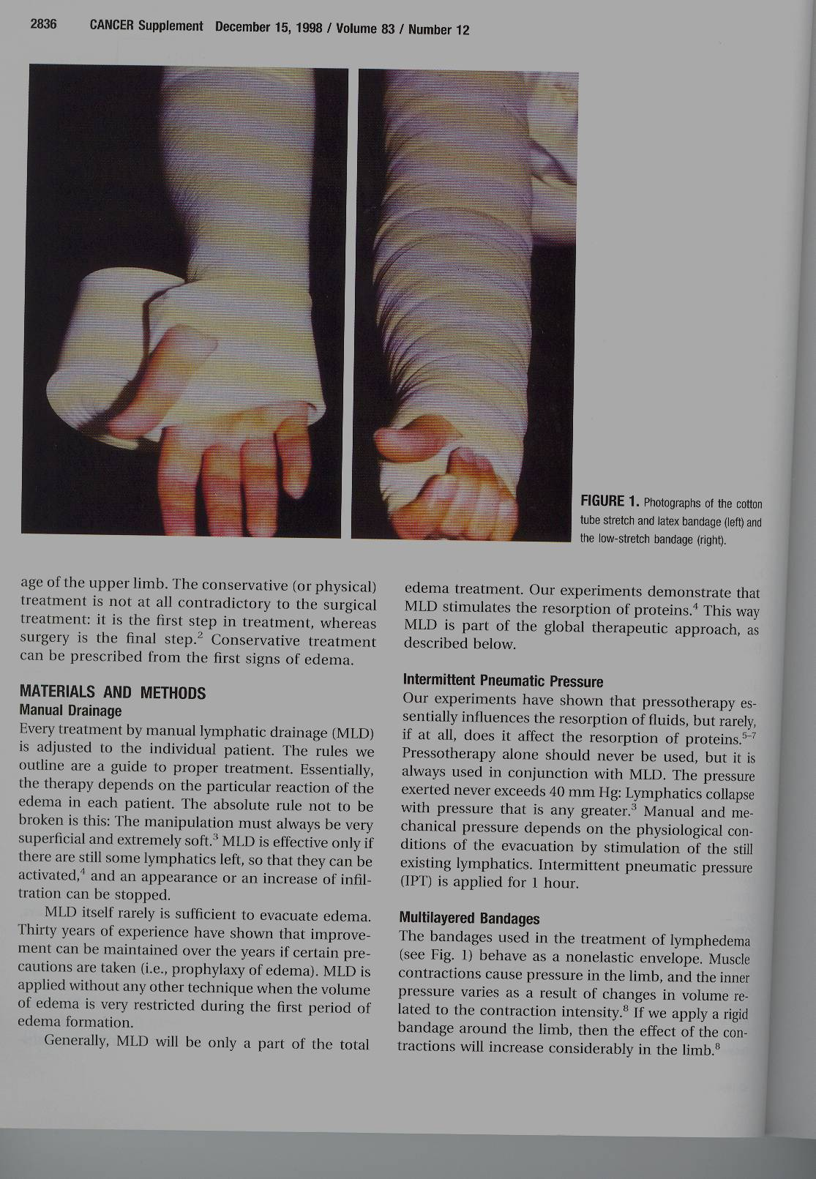
TREATMENT
BANDAGING

Slide 39
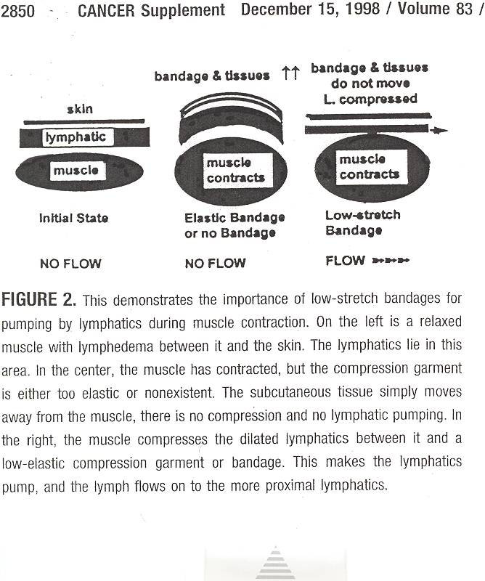
TREATMENT

Slide 40
TREATMENT
EXERCISES
  AROM
    ALL MUSCLES OF THE INVOLVED EXTREMITY
    CHEST WALL AND ABDOMEN MOVEMENT

Slide 41
TREATMENT
COMPRESSION GARMENTS
  MEASURED BY CERTIFIED THERAPIST
  CHECK FITTING
  USE RUBBER GLOVES TO DON GARMENTS

Slide 42
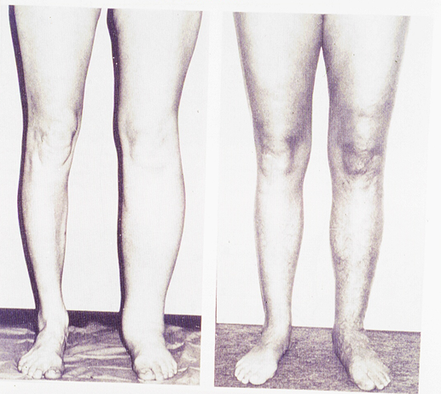
PRE AND POST TREATMENT

Slide 43
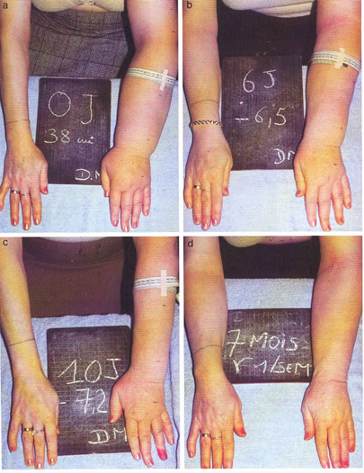
TREATMENT
RESULTS

Slide 44
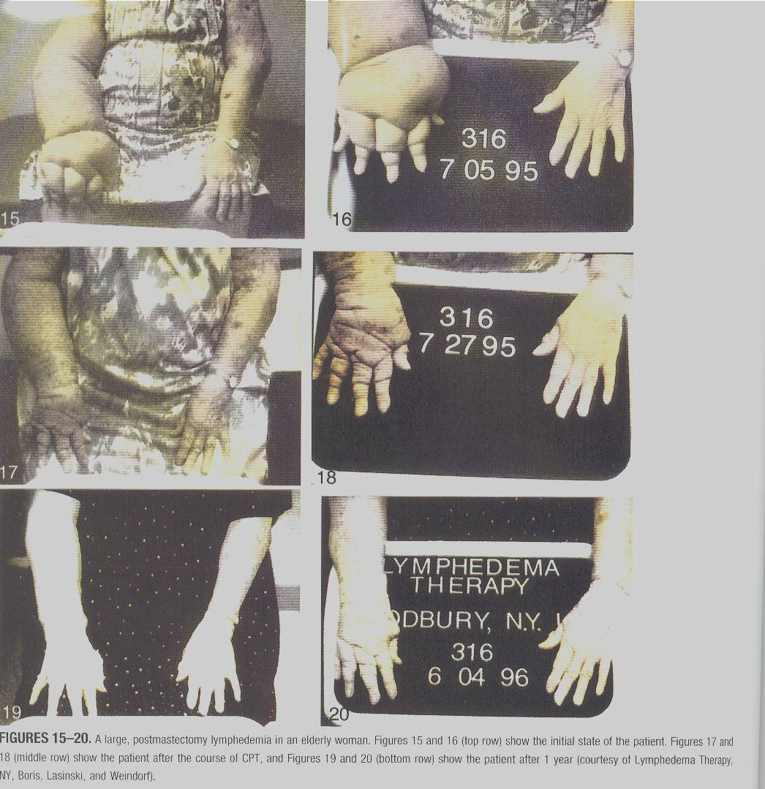
17 YEARS OF EDEMA IMPROVED WITH CPT AND IT LASTS

Slide 45
DIAGNOSIS
RULE OUT COMMON CAUSES OF EDEMA THAT REQUIRE OTHER MEDICAL TREATMENT
  CHF
  NEPHROTIC SYNDROME
  HEPATIC DISEASE
  POOR PROTEIN NUTRITION
  HYPOTHYROIDISM
  PULMONARY DISEASE
  OBSTRUCTIVE TUMORS
  CHO, SHAUN

Slide 46


