Slide 1
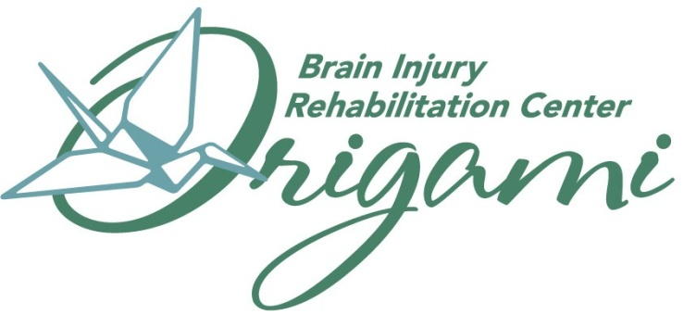
Let’s Talk About It –
Social Communication Skill
Re-training post TBI
Linda C. Wells, MA, CCC-SLP, CBIS
Danielle Pyle, MS, CCC-SLP, CBIS

Slide 2
Another “silent epidemic”
“Humans are social beings. We live within a broad spectrum of social relationships and roles, which draw on a diverse set of cognitive processes that may be disrupted due to varying degrees by brain dysfunction. Impairments in social functioning are among the most devastating consequences of brain dysfunction, including traumatic brain injury (TBI). Such deficits can place enormous strain on interpersonal relationships and severely limit one’s ability to function independently in society.”
(Driscoll, D. M, dal Monte, O. & Grafman, J. (2011))
Notes:
The CDC refers to brain injury as the “silent epidemic”
However an area of brain injury that is often silent within itself until social demands are placed upon a survivor are the social communication skill impairments they may encounter

Slide 3
Fred
TBI-survivor
Supported work environment
Takes sarcasm personally
Constantly involves others to verify
Cursing
Elevated speech volume
Aggressive
Memory lapses with heightened emotion
Job in jeopardy
Loss of friends
Heart of gold
Notes:
What is the connection between his TBI, social behaviors, and communication?

Slide 4
Cognitive-Communicative Disorders after TBI
Linguistic
Nonlinguistic
Expressive Language:
Spoken
Written
Nonverbal
Gestures
Facial expressions
Receptive Language:
Auditory
Printed
Nonverbal
Attention
Information processing
Memory
Reasoning
Problem solving
Executive functions
Self-awareness, self-inhibiting, self-monitoring, self-evaluation, flexible thinking
Coelho, DeRuyter, & Stein (1996).
Notes:
Cognitive-communicative disorders can result from impairment in linguistic or nonlinguistic cognitive functions

Slide 5
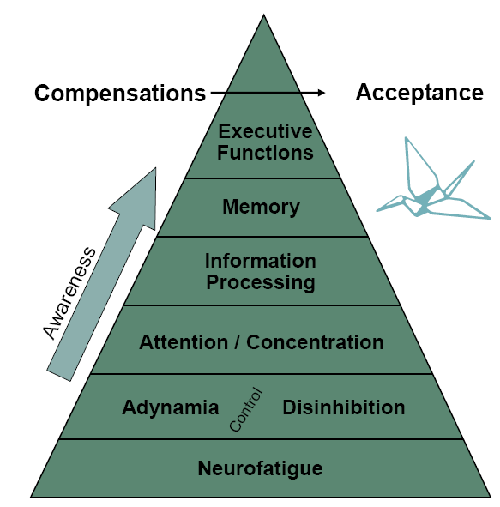
What problems occur after a TBI?
Notes:
Hierarchy of cognitive functions; Pyramid builds on another- a problem at a lower level affects every level above it

Slide 6
How do these impact communication?
Neurofatigue
poor engagement in conversation
disconnect due to overstimulation
Adynamia/Disinhibition
flat affect
lack of eye contact
↓ variation in speech prosody
↓ topic initiation
↓ topic maintenance
emotional flooding (giddiness, tears, etc.)
Notes:
Neurofatigue- mental fatigue which usually comes on after prolonged cognitive stimulation
Adynamia- low mental energy or apparent lack of will
Disinhibition- Inability to control impulsive behavior & emotions.

Slide 7
How do these impact communication?
Attention/Concentration
difficulties switching topics
topic perseveration
distractibility
attending to nonverbal cues
Information Processing
may need repetition
slowed speed of comprehension
↑ time to respond
processing nonverbal cues
Notes:
Attention: the ability to focus on an external activity or internal thought
Information processing: taking environmental stimulation in through the 5 senses, interpreting it, and responding to it appropriately based on past experiences

Slide 8
How do these impact communication?
Memory
difficulty recalling others’ personal info (name, age, occupation)
may ask for repetition
difficulty recalling details from a previous conversation
Executive Functioning
difficulty with any of the following:
sequencing events in a convo
social reasoning
using and understanding sarcasm/humor
thought organization
figurative language
judgment
Notes:
Memory: taking in new information, holding on to the information, and recalling the information when needed
Executive functions: the ability to reason, plan, problem solve, make inferences and accurately evaluate results of actions and decisions

Slide 9
Summary
Cognitive-linguistic deficits
Communication skills
Social behavior

Slide 10
International Classification of Functioning, Disability, & Health (ICF)
Impairment
Handicap
Disability

Slide 11
Impairment
Disability
Handicap
Abnormality in physical or mental function
Ex: speech, language, cognitive, hearing impairments
Limitation in performance of an activity because of impairment
Ex: communication problems in everyday life activities
Social consequences of an impairment or disability
Ex: isolation, joblessness, dependency, role changes

Slide 12
Difficulties with social communication may result in:
Social isolation
Difficulty maintaining healthy relationships
Difficulty reintegrating into society
Difficulty maintaining employment
“impairments in social communicative abilities can disrupt the ability to successfully maintain relationships and employment”
(Ylvisaker et al., 2001)
“after 10-15 years post-severe-head-injury, loss of social contact was the most disabling handicap in daily life.”
(Thomsen, I., 1984)
Notes:
What is the best way to address social communication deficits and prevent these detrimental effects in therapy? Deciding whether to do this in individual or group settings. Individual vs. group

Slide 13
Group Therapy Research
Growth of group treatment steadily over last 20 years.
Generalization of functional skills
Stimuli/response difficult to generalize
Adjunct to individual treatment
Psychosocial adjustment and family counseling
Anecdotal reports without empirical data
Aphasia groups from the 50-60’s
Notes:
But, does group therapy work? EBP?

Slide 14
Research cont.. The Efficacy of Group Therapy
28 participants
2 groups
DT no significant change
Completion of intake and pre-treatment testing
IT significant improvement following completion
Maintained 1 month post
Assessments
Shortened Porch Index of Communication Abilities (SPICA)
Western Aphasia Battery – Aphasia Quotient (WAP-AQ)
Communicative Abilities in Daily Living (CADL)
5 hours/week
2 sessions/week
Group Treatment verses Social Contact is Responsible for Improvements.
Elman, Bernstein-Ellis1999
Notes:
Aphasia group

Slide 15
Research cont.. Group Therapy Conference, CA
California State University, Hayward
Insights into rationale for group treatment
Discipline wide model for group treatment
Group therapy widely utilized across disorders
Stuttering
Laryngectomy
Aphasia
Articulation disorders
Avent, J., Graham, M., Peppart, R . 2004
Notes:
Lit review

Slide 16
Group Therapy, CA cont..
6 core components to group therapy
Stable membership
Interdependent group relationships (interaction and feedback)
Focus on communication skills
Psychosocial support
Treatment accountability with documentation of goals/outcomes
Natural context
Notes:
Important areas - comon

Slide 17
Group Therapy CA Cont..
Considerable differences among groups
Setting
Collaborative treatment disciplines
Definition of functional communication; curriculum vs. basic needs
Group composition
Influence of delivery factors regarding group effectiveness
Notes:
LOTS of variability

Slide 18
Research cont.. Rocky Mountain Regional Brain Injury System
Replicable treatment program
Self developed workbook
Social Skills and TBI: A workbook for Group Treatment
12 weeks
3 groups
Control; Immediate Treatment; Delayed Treatment
882 potential participants
Kahlberg, Cusick, et al. 2007

Slide 19
Rocky Mountain cont..
TBI external force
D/C from TBI program
At least 1 year post TBI
18-65 years old
At or above Rancho VI
Receptive/Expressive skills 5 or above on FIM at D/C
Recall of day to day events
Social communication Impairment ID.
Behavioral concerns
Medical issues decreasing tolerance for attendance
Diagnosis of psychiatric/psychologic disorder prior to TBI
Current Hx of ETOH/ substance abuse
Significant motor disorder
Not English speaking
Not living in community
Inclusion Criteria
Exclusion Criteria

Slide 20
Rocky Mountain cont..
60 participants actually enrolled
4 groups
14 – 16 each group
Staggered schedule over 9 months
Randomized
Receiving treatment
Deferred 3 months
No treatment
Moderate/Severe TBI
Initial GCS

Slide 21
Rocky Mountain cont..
Immediate treatment
90 minute sessions once a week
Room setting
Baseline and post program testing
Delayed testing 3, 6, 9 months following completion of program
Deferred treatment
Baseline testing
No intervention 12 weeks
Re-tested immediately before treatment began

Slide 22
Rocky Mountain cont.. Assessments
Profile of Functional Impairment in Communication (PFIC)
Craig Handicap Assessment and Reporting Techniques – Short Term (CHRT-SF)
Community Integration Questionnaire (CIQ)
Satisfaction With Life Scale (SWLS)
Notes:
Impairment, Disability, and Handicap measures

Slide 23
Rocky Mountain cont.. Topics
Overview – learning skills of good communication
Self assessment and setting goals
Presenting self and starting conversations
Developing conversation strategies and using feedback
Being assertive and solving problems
Practice in community

Slide 24
Rocky Mountain Topics cont..
Developing social confidence through positive self talk.
Setting and respecting social boundaries
Video taping and problem solving
Video review and feedback
Conflict resolution
Closure and celebration

Slide 25
Rocky Mountain cont.. Within session format
Review of homework
Introduction to topic
Guided discussion
Small group practice
Problem solving and feedback
Assignment of homework
Structured break mid-session

Slide 26
Rocky Mountain cont.. Results
Improvement in ability to participate actively and appropriately in conversations
Increased awareness and pleasure with communication abilities
6 months post reported increased satisfaction with life
Continued improvement at 9 months
Client 10 years post demonstrated improvement
Deferred treatment group demonstrated no significant changes despite being encouraged to maintain social contacts through deferment period
Group therapy verses social contact is responsible for treatment effects

Slide 27
Rocky Mountain cont.. Weaknesses
Two group leaders with over 10 years each of experience making replication questionable
Participants with higher education and less diversity than general TBI population statistically.
Women only comprised 15% of the study.

Slide 28
What we have done:
We knew there was a need
Team member referrals vs. inclusion criteria
Obtained physician prescriptions and funding approval
Wanted a curriculum with a beginning and an ending
Small group size to promote open communication
Measurement tool
Adaptation of Profile of Functional Impairment in Communication (PFIC)

Slide 29
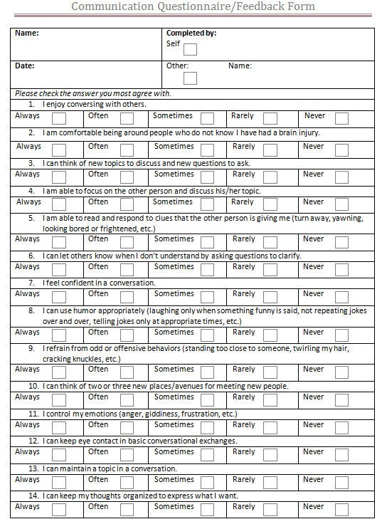
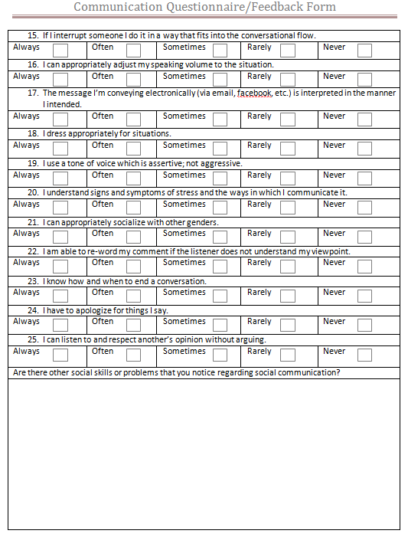
Communication questionnaire

Slide 30
Thoughts of development
Awareness
Metacognitive approach
Education
TBI related deficits (cognitive-communicative)
Impact of deficits on functional interactions
Social cognition
Importance of social communication skills
Strategies
Compensatory
Environmental
Communication partner training
Notes:
EBP from the world of communication disorders
Integrating TBI knowledge and principles with communication disorders
Several research-based principles in development

Slide 31
Development of Goals
Focus area of Rehab Summary Report: Maximize involvement with social contacts
Participation measures from the Mayo-Portland Adaptability Inventory-4 (MPAI-4)
Long term goals:
1. Client will improve awareness of social-communication skills through self-rating on Social Communication feedback form in a minimum of 3 areas.
2. Client will demonstrate improvement in overall social-communication skills through others' rating with the Social Communication feedback form in a minimum of 3 rating areas.

Slide 32
Short Term Goals
1. Client will demonstrate ability to monitor and correct impulsiveness in group conversations.
2. Client will demonstrate thought organization abilities to express concise conveyance of message.

Slide 33
Short Term Goals cont…
3. Client will identify and monitor appropriate social pragmatic skills in both verbal and nonverbal communication.
4. Client will demonstrate the ability to apply strategies in social situations within a functional setting.
Report on these in daily documentation at first, sixth and final sessions.

Slide 34
Group Topics
1. Introduction
2. Interviewing and approaching novel people
3. Pragmatics: Verbal and nonverbal comm.
4. Written communication
5. Humor
6. Sexuality
7. Stress management

Slide 35
Group Topics cont…
8. Aggressive vs. Assertive communication styles
9. Multiple viewpoints
10. Self-concept map and videotaping
11. Group outing and questionnaire
12. Review videotape/wrap-up

Slide 36
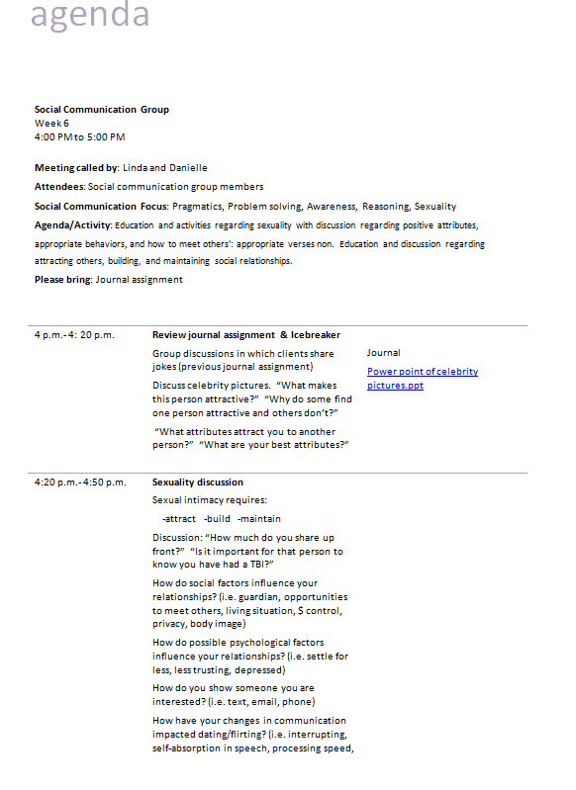
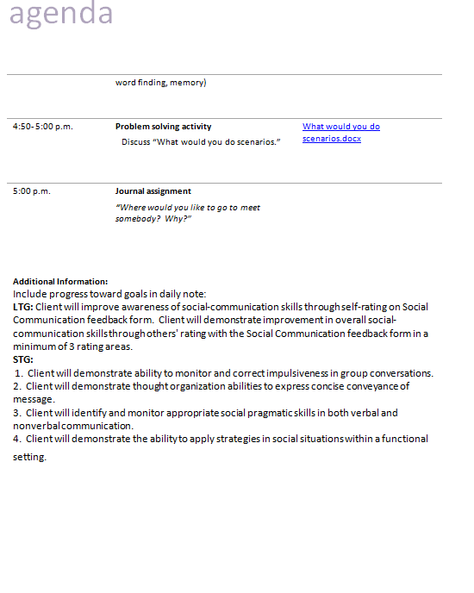
Sample agenda

Slide 37
Assessment
Client completion during session
Other’s assessment to return
Family member, staff, co-worker, etc.
Refusal
Confusion
Poor follow-through
Defensiveness
Discomfort
Disclosure of info.
Poor acceptance
Initial and Week 11
Client Observations

Slide 38
Preliminary Data Fall 2010 Communication Effectiveness
Notes:
So, what did we do with all that information?
Client verses other’s perception, initiation of course.
What is their awareness level?

Slide 39
Preliminary Data Fall 2010
Self Assessment
Beginning and at 11 week comparison
5 of 8 participants completed both questionnaires.
Assessment by Other
Beginning and at 11 week comparison. 2 of 8 participants returned others’ assessment questionnaires.

Slide 40
Preliminary Data cont.. Winter 2010-11 Communication Effectiveness
Notes:
Client verses other’s perception, initiation of course.
What is their awareness level?

Slide 41
Preliminary Data cont.. Winter 2010-11
Self Assessment
At beginning and at 11 weeks of course. 2 of 6 completed both assessment questionnaires.
Others’ Assessment
At beginning and at 11 weeks of course. 2 of 6 returned both assessment questionnaires

Slide 42
Preliminary Data Spring 2011 Communication Effectiveness
Notes:
Client verses other’s perception, initiation of course.
What is their awareness level?

Slide 43
Limitations
Rating scales on perception of abilities
Unprecipitated discharges
Limited research
Limited community venues to practice functional skills
Age range
Pre-morbid psycho-social history

Slide 44
Future goals
Functional outcome measure post-treatment evaluations:
6 months; 1 year
Identify additional measurement tool related to disability and handicap measure
Inclusion criteria for group participation
Reassess need for longer session duration
60 min. vs. 90 min.

Slide 45
What we’ve learned
Adjust depth of discussion and education depending on group needs
Functional outing discussion
Impact of awareness level
Impact of trust
Social skills are very personal

Slide 46
The group continues to evolve…
Importance of flexibility to meet needs
Standardization vs. individualization
Discontinuation of structured homework/journals
Presentation vs. outing
Expansion of length of treatment

Slide 47

Questions?
Linda C. Wells, MA, CCC-SLP, CBIS
Linda.wells@origamirehab.org
Danielle Pyle, MS, CCC-SLP, CBIS
Danielle.pyle@origamirehab.org

Slide 48
References
Avent, J., Graham, M., Peppart, R. Group treatment across disorders. Neurophysiology and Neurogenic Speech and Language Disorders, 23:2, 2004.
Dahlberg, C., Cusick, C., Hawley, L., Newman, J., Morey, C., Harrison-Felix, C., & Whiteneck, G., Treatment efficacy of social communication skills training after traumatic brain injury: A randomized treatment and deferred treatment controlled trial. Archives of Physical Medicine and Rehabilitation, 88:12, 1561- 1573, 2007.
Driscoll, D, Dal Monte, O, & Grafman, J. A need for improved training interventions for the remediation of impairments in social functioning following brain injury. Journal of Neurotrauma, 2011: 28.2.
Elman, R. and Bernstain-Ellis, E. The efficacy of group communication treatment in adults with chronic aphasia. Journal of Speech, Language, and Hearing Research. 42, 411-419, 1999.
Thomsen, I. Late outcome of very severe blunt head trauma: A 10-15 year second follow-up. Journal of Neurology, Neurosurgery, and Psychiatry, 1984; 47:260-268.
Ylvisaker, M., Todis, B., Glang, A., Urbanczyk, B., Franklin, C., DePompei, R., Feeney, T., Maxwell, N.M., Pearson, S., & Tyler, J.S. (2001). Educating students with TBI: Themes and recommendations. Journal of Head Trauma Rehabilitation, 16, 76- 93.

