Slide 1
Grand Rounds
John Tegtmeier, DO
12/17/12

Slide 2
Presentation of Case: D.S.
HPI:
36 y/o male presented to McLaren ED on 11/25/12 with c/o severe HA and nausea. A CT brain suggested possible infarction and an MRI was recommended. Pt refused MRI because he did not want to remove his metal bracelet. A follow-up MRI was scheduled for 11/27/12 which the pt had performed. Around 6:00 am on Wednesday 11/28/12 he awoke from sleep with a severe HA, nausea, dizziness, and burning on the left side of face. Pt reported that he fell while in the bathroom. His mother found him and called EMS. He was initially taken to McLaren but then transferred to Sparrow after the MRI results were reviewed. Initial NIHSS was 4.

Slide 3
Presentation of Case: D.S
ROS: + hiccups, blurred vision, diplopia, heartburn, nausea, vomiting, and HA
PMH: htn, hyperlipidemia
PSH: adenoidectomy
Medications: Lovastatin, diphenhydramine, ASA
Allergies: doxycycline, latex
Social Hx: Married, has 3 children. Self employed (catering business). Nonsmoker, social alcohol use.
Family Hx: Mother-HTN (controlled with medication); Father-uncontrolled HTN; Brother-HTN

Slide 4
Physical examination
General: alert, orientated, pleasant but often frustrated by his current circumstances
Speech: spontaneous, fluent, no dysarthria
Cognition:
Short term/long term memory intact
Able to add coins
Able to recite days of week forward and backward.
Insight: intact
HEENT: left ptosis and miosis
Coordination: dysmetria with left finger nose finger and left heel to shin test. RAM- dysdiadochokinesis on left.

Slide 5
Physical examination
Muscle Strength R L
Sh Add 5 5
Sh Abd 5 5
EF 5 5
EE 5 5
WE 5 5
FDI 5 5
HF 5 5
KE 5 5
ADF 5 5
Toe Flexion 5 5
Reflexes R L
Biceps 2+ 2+
Triceps 2+ 2+
Brachioradialis 2+ 2+
Patellar 2+ 2+
Achilles 2+ 2+
Babinski: Equivocal bilaterally
Clonus: 3 beats on left, 1 beat on right
Sensory Exam:
Thermoanalgesia left face and right UE/LE
Decreased pinprick on left face and right UE/LE

Slide 6
Differential??

Slide 7
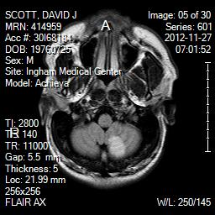
MRI Brain

Slide 8
Imaging
CT Brain (11/28/12): subacute, nonhemorrhagic infarct, left cerebellar hemisphere.
CTA Neck/Brain (11/28/12): area of low density seen in the left cerebellum consistent with a cerebellar infarct. The left posterior inferior cerebellar artery (PICA) is occluded.
TEE (12/4/12): small PFO, suggesting right to left shunt.

Slide 9
Lateral Medullary Syndrome
AKA: Wallenberg syndrome, Syndrome of PICA
Historical perspective
Adolf Wallenberg (German neurologist) described the clinical manifestations in 1895, autopsy in 1901 revealed occlusion of PICA
Earliest description was by Dr Gaspard Vieusseux of Geneva in 1919
Described his own stroke to the Royal Society of Medicine and Surgery of London
He mentioned that the hiccups could be cured by “taking up a morning cigarette.”

Slide 10
Lateral Medullary Syndrome
Pathogenesis:
occlusion of vertebral artery, PICA, or superior/middle/ inferior medullary artery
infarction of dorsolateral medulla posterior to the olivary nucleus
Causes:
thrombosis, embolism, syphilitis arteritis, fibromuscular dysplasia, arterial dissection (spontaneous, trauma)
Incidence:
2.5% of cerebral infarctions, most common brainstem CVA

Slide 11
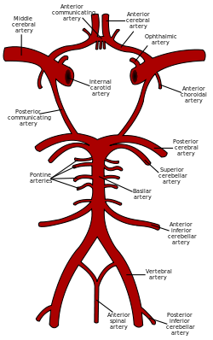
Vasculature

Slide 12
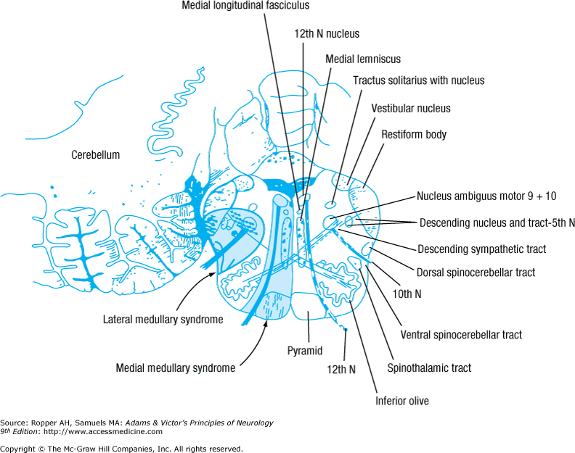
Anatomy

Slide 13
Symptoms | Structure affected
Pain, numbness, impaired sensation ipsilateral face | Spinal nucleus of trigeminal nerve
Ataxia of limbs | Spinocerebellar tract, Olivocerebellar
Vertigo, nausea, vomiting | Vestibular nuclei
Diplopia | Vestibular nuclei, MLF
Descending sympathetic tract | Horner syndrome (miosis, ptosis, anhydrosis)
Autonomic symptoms (hypotension, tachycardia, respiratory failure | See Article*

Slide 14
Symptoms | Structure affected
Loss of taste | Nucleus and tractus solitarius
Hoarseness, paralysis of vocal cord, ipsilateral paralysis of palate/vocal cord | Nucleus ambiguus (efferent fibers of CN IX, X)
Pain, numbness, impaired thermal sense of contralateral body | Spinothalamic tract
Dysphagia | Nucleus ambiguus, Nucleus solitarius, and Dorsal motor nucleus of the vagus nerve

Slide 15
Risk factors
Hypertension
DMII
Atrial fibrillation
CAD
PVD
Alcohol
Drugs
Tobacco
Migraine
Coagulopathies

Slide 16
Physical examination
HEENT
ptosis, miosis, nystagmus
dysarthria
ipsilateral loss of taste
oculomotor disorders
internuclear ophthalmoplegia, nystagmus
Neuro
ipsilateral loss of pain/temperature in the face
contralateral loss of pain/temperature in the body
ataxia of ipsilateral limbs

Slide 17
PATIENT PRESENTATION

Slide 18
Spinothalamic tract
Pain sensations
Temperature changes
Non-discriminative light touch

Slide 19
Spinothalamic Tract
Neuron I
Cell bodies in the dorsal root ganglia enter spinal cord and ascend one or more segments in Lissauer’s tract and synapse in the dorsal horn of the spinal cord
Neuron II
From dorsal horn, the fibers decussate in the anterior white commissure of the spinal cord and ascends on the contralateral side as the lateral spinothalamic tract with termination in the ventral posterolateral (VPL) nucleus of the thalamus
Neuron III
From the VPL nucleus (thalamus) the fibers ascend as part of the posterior limb of the internal capsule to the cerebral cortex (primary somatosensory cortex)

Slide 21
Horner’s Syndrome
Lesion of the sympathetic pathway:
(1) Central portion: posterior hypothalamus through brainstem to the upper spinal cord (C8–T2)
(2) Preganglionic portion: exits the spinal cord and synapses in the superior cervical ganglion
(3) Postganglionic portion: superior cervical ganglion (fibers travel with the carotid plexus, ophthalmic division (V1) of the trigeminal nerve, nasociliary branch of V1) to the dilator muscle and tarsal muscle.
Dilator muscle paresis causes miosis.
Tarsal muscle paresis produces ptosis.

Slide 22
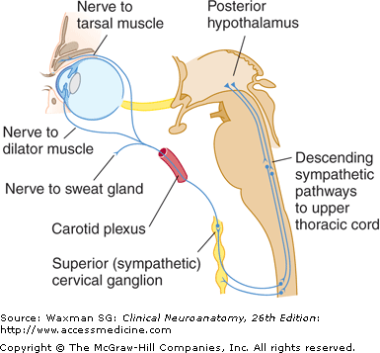
Horner’s syndrome

Slide 23
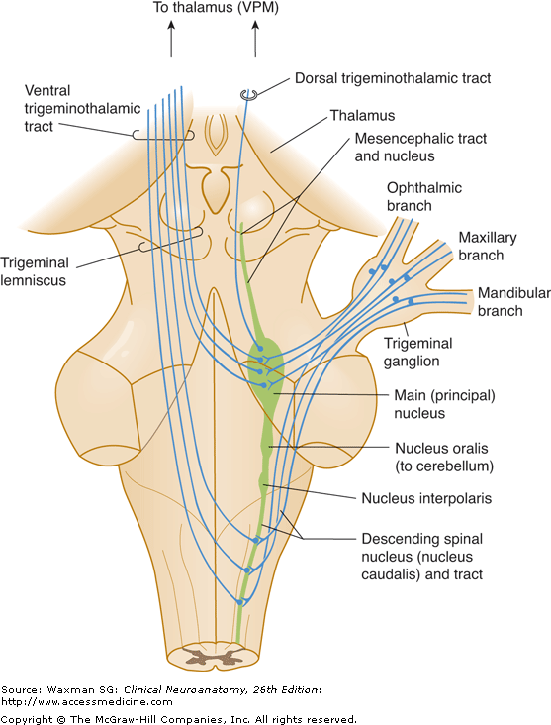
Trigeminal nucleus

Slide 24
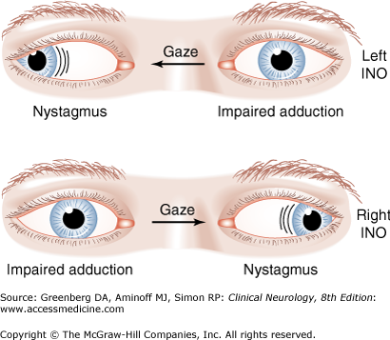
Medial longitudinal fasciculus

Slide 25
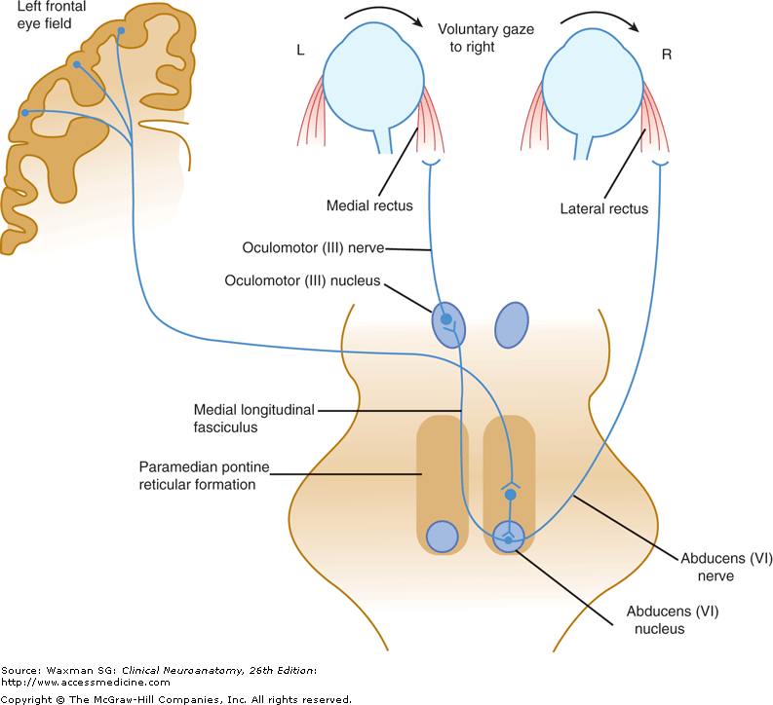
Medial Longitudinal Fasciculus

Slide 26
Imaging
MRI
Preferred over CT for identifying brain stem infarctions because lack of bony artifacts, high spatial resolution, and sharp contrast between normal tissue and lesion.
Series of 33 patients (Arch Neuro 1993 Jun; 50(6):609)
CT imaging: 91% had normal posterior fossa, 9% had abnormal posterior fossa
MRI: 91% had abnormal posterior fossa, 9% had normal posterior fossa
MRA
Useful for identifying the blood vessel involved
Duplex doppler
Noninvasive means of detecting vertebral artery disease

Slide 27
Treatment
tPA-administered within 3 hr from onset of stroke symptoms
Prevention of recurrence: antiplatelet, statin therapy, anti-hypertensives
PT, OT, SLP (especially for dysphagia)
Dysphagia: compensatory techniques, percutaneous endoscopic gastrostomy (PEG)
Neuropsychology
*See Article*

Slide 28
Prognosis
14% of serious events reported within first 2 weeks following lateral medullary infarction
Based on cohort study (Neurology 1991 Feb; 41Pt1)):244
43 patients (mean age 64) were identified with LM infarction from population-based stroke registry 1982-1988
Extension of stroke occurred in 2 patients
Death occurred in 4 patients (nocturnal apnea(2), myocardial infarction (2))
Overall:
most patients with lateral medullary syndrome can be discharged (after rehabilitation) home with recovery of independent ambulation

Slide 29
References
Baugh, C. Brown, D., Nadel, E. (2009). “Horner’s syndrome, Hoarseness, and Unsteady gait.” The Journal of Emergency Medicine. 36:176-180.
Braddom, R.L., and Buschbacher, R.M. “The Stroke Syndromes." Physical medicine and rehabilitation. 4th ed. Philadelphia: Saunders, 2011. 341-343. Print.
Chafetz, M. D., Frideman, A. L., Kevorkian, G., & Levy, J. K. (1996). The cerebellum and cognitive function: Implications for rehabilitation. Arch Phys Med Rehabilitation, 77.
Chiti-Batelli, S. and Delap, T. (2001). “Lateral Medullary Infarct Presenting as Acute Dysphagia”. Acta Otolaryngol, 121: 419-430.
Gofton, T.E., Segal, O.R., Skanes, A.C., Fraser, J.A., Hyson H.C.. (2009). Lateral Medullary Syndrome Prsenting with Ataxia and Bradycardia. Can.J.Neurological Sciences. 36:390-392.
Goldman B. Chapter 164. Vertigo and Dizziness. In: Tintinalli JE, Stapczynski JS, Cline DM, Ma OJ, Cydulka RK, Meckler GD, eds. Tintinalli's Emergency Medicine: A Comprehensive Study Guide. 7th ed. New York: McGraw-Hill; 2011. http://www.accessmedicine.com/content.aspx?aID=6365845. Accessed December 15, 2012.
Martino, R., Terrault, N., Ezerzer, F., Mikulis, D. (2001). “Dysphagia with Lateral Medullary Syndrome.” Gastroenterology. 121: 420-426
Ropper, A., Samuels, M. Adams. “Stroke Syndromes.” Victor’s Principles of Neurology. 9th edition. The McGraw Hill Companies, 2009.
Waxman SG. Chapter 7. The Brain Stem and Cerebellum. In: Waxman SG, ed. Clinical Neuroanatomy. 26th ed. New York: McGraw-Hill; 2010. http://www.accessmedicine.com/content.aspx?aID=5272329. Accessed December 15, 2012.

