Slide 1
FDM
FASCIAL DISTORTION MODEL
Timothy J. Zielicke, OMS IV

Slide 2
CASE STUDY (Mr. G)
55 yo male present to family medicine outpatient clinic with 8 month hx of 8/10 sharp, non-radiating right knee pain medial, lateral and inferior to the patella. No specific injury at onset.
He had seen multiple providers without resolution. He was now scheduled for a orthopedic surgery consult.

Slide 3
On PE he had obvious difficulty ambulating. Knee flexion ~60 degrees with pain. No sensory deficit, strength impairment (although limited by pain) or ligamentous instability. Patellar and achilles relfexes were 2+. X-rays showed mild age appropriate joint degeneration
I performed 4 FDM treatments which took about 10 minutes.
Post treatment evaluation: Pain: 0/10, Knee flexion full ROM (130-140 degrees) able to ambulate normally without pain. At 6 month follow up pain hadn’t returned and he was ambulating normally. He cancelled his appointment with the orthopedic surgeon.

Slide 4
History of FDM
Steven Typaldos, D.O. (1957-2006)
Family medicine trained, worked as ER physician
FDM developed in early 1990’s
Manual written 1997-2002

Slide 5
Diagnosis based on:
-subjective complaints
-mechanism of injury
-objective findings (especially palpation)
-body language

Slide 6
Types of distortions (6 types)
Triggerband (TB)
Herniated Triggerpoint (HTP)
Continuum Distortion (CD)
Folding Distortion
Cylinder Distortion
Tectonic Fixation

Slide 7
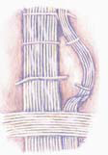
TRIGGERBANDS
-most common
-twisted or wrinkled fascial fibers
-burning or pulling pain
-Body Language: sweeping motion with their fingers
think of a Ziploc® bag that has become unzipped
TREATMENT: Untwist the twisted fibers and iron out the wrinkle

Slide 8
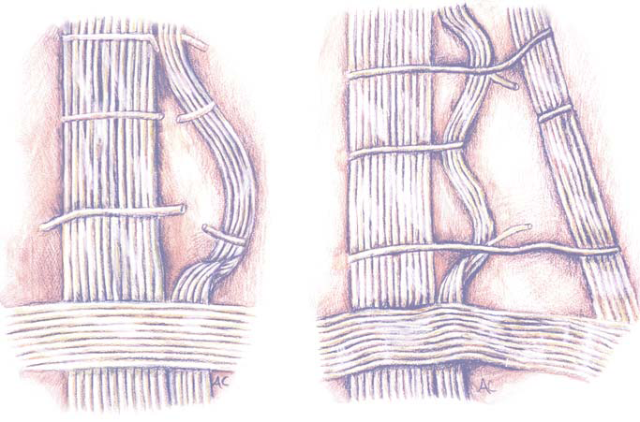
ACUTE CHRONIC

Slide 9
Body language
Direction of triggerband (affected fibers run parallel to sweeping motion of fingers)
• Extent of pathway involved (the more sweeping the motion, the farther along the pathway fibers have separated)
• The deeper the triggerband is anatomically – the more firmly the person pushes into the fascia with his/her fingers

Slide 10
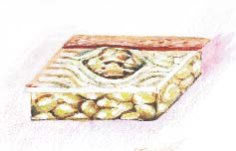
HERNIATED TRIGGERPOINTS
Rarely found in the extremities, HTP’s feel like spongy marbles, and are almond-sized or smaller fascial herniations.
Body language: pushing fingers, thumb or knuckles into protruding tisssue
TREATMENT: Push protruding tissue below fascial plane

Slide 11

CONTINUUM DISTORTIONS
Think of these distortions as tiny injuries of the bone ligament transition zone.
Body language: Point with one finger to spot of pain
TREATMENT: Force osseous components in the transition zone to shift back into the bone

Slide 12
ligametous –osseus- distorted

Slide 13
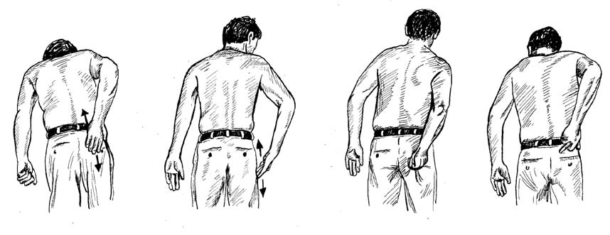
What’s the distortion?
Triggerband Triggerband HTP CD

Slide 14
Sprained Ankle: 26 Year Old Woman
Chief Complaint: Left ankle pain x 3 days
History: Ms. L. is a medical student whose ankle buckled outward as she played flag football. There was immediate pain and swelling. At the Emergency Department an x-ray was taken (interpreted as negative), a Ace wrap was applied, and she was put on crutches. The following day Ms. L was told by her physician to stay off the ankle and if not better to see an orthopedist.
Body Language: Points to the lateral aspect of the ankle with one finger to show source
of pain, but also indicates with a sweeping motion that there is a pulling discomfort from the heel down along the lateral foot.
Physical Exam:
Lateral malleolar swelling and ecchymosis
No point tenderness
Unable to bear weight
Dorsiflexion = 1/4 with stepping
Diminished eversion and inversion
Orthopedic Diagnosis: Ankle sprain

Slide 15
FDM Diagnosis:
1. Continuum ankle sprain
2. Triggerband foot sprain
Discussion:
This ankle/foot sprain combination is best treated in this order:
1. Anterior ankle continuum distortion
2. Lateral ankle continuum distortions
3. Lateral foot triggerbands
Ms. S. was treated and was immediately able to bear weight, stand on her toes, and to walk without a limp without crutches.

Slide 16
Adverse effects
Pain during treatment
Bruising

Slide 17
Uses
Sports medicine
Musculoskeletal injuries
        Acute
        Chronic
Chronic Pain/Fibromyalgia

Slide 18
Resources
Typaldos, D.O., Stephen. FDM. Clinical and Theoretical Application of the Fascial Distortion Model Within the Practice of Medicine and Surgery. 4th. Bangor, Maine: Typaldos Publishing Company, 2002. 269.

