Slide 1
Michigan State University
Psychology PhD Program
Cognition & Cognitive Neuroscience
Information Session

Slide 2
Session Agenda
Welcome & Introductions
Information about the program and MSU
Guidelines for applying
Q&A time

Slide 3
Who are we
The Psychology Department consists of (approximately) fifty faculty members, 25-30 department and research staff members, and 60-75 graduate students during any given year.
Our shared mission is to train the next generation of scientists, leaders, and professionals to advance knowledge and promote individual and societal well-being.
Goals
  Provide world-class scientific training
  Transcend traditional disciplinary boundaries
  Translate scientific knowledge into action
Values
  scientific integrity, methodological rigor, production of high quality and impactful work, curiosity, teamwork and collaboration, inclusiveness, and respect for others’ viewpoints.
  Commitment
  To understanding psychological processes in an increasingly diverse society, and to training all graduate students to learn about multiple diverse populations
Notes:
Provide world-class scientific training: Students are trained to become outstanding scientists and thinkers through active and sustained scholarship.
Transcend traditional disciplinary boundaries: Students are encouraged to develop multidisciplinary expertise through collaborative engagement and debate.
Translate scientific knowledge into action: Students are trained to use scientific knowledge to generate solutions to individual and societal challenges.

Slide 4
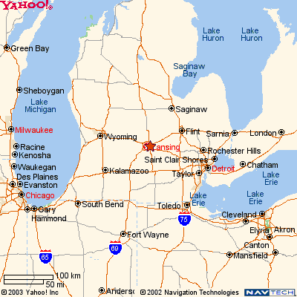
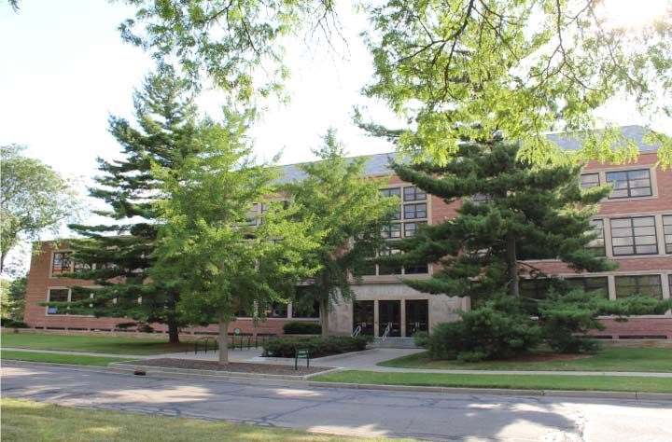
Where are we
Notes:
In chat will provide links to campus virtual tours:
video tours of campus.
Also will share links to things in the community:
City of East Lansing opens in new window: Everything about East Lansing from events and attractions to city government can be found here!
City of Lansing opens in new window: Lansing’s official website. Get information from the mayor’s office, city council, the city clerk’s office, and stay updated on events happening throughout the City of Lansing.
Lansing Visitors Bureau: opens in new window Great site for visitors and even residents who would like to see what’s going on in the area! Lists of things to do, nightlife, shopping, group tours, and more. This site will also help you find hotels in the area if you or someone you know is coming for a visit.
State News opens in new window: The State News is the student-run newspaper of Michigan State University. Can be accessed for free in campus and local buildings and online.
City Pulse opens in new window: An “alternative” newspaper that features arts & culture, local events and news. Can be accessed for free online and in select buildings on campus and in the community.
Pure Michigan opens in new window: Pure Michigan is a great place to find fun adventures, shopping and tourist destinations all right here within the State of Michigan.

Slide 5
How are we organized?
Behavioral Neuroscience (BNS)
Clinical Science (CS)
Cognition and Cognitive Neuroscience (CCN)
Ecological/Community Psychology (ECO)
Organizational Psychology (ORG)
Social/Personality Psychology (S/P)
Notes:
You will have a primary home within Cognition & Cognitive Neuroscience area, but it is important to note that you are a graduate student within the Department of Psychology. Although the work you do to attain your MA and PhD degrees will focus on cognition and cognitive neuroscience, the degrees themselves are degrees in Psychology ultimately conferred by Michigan State University.

Slide 6
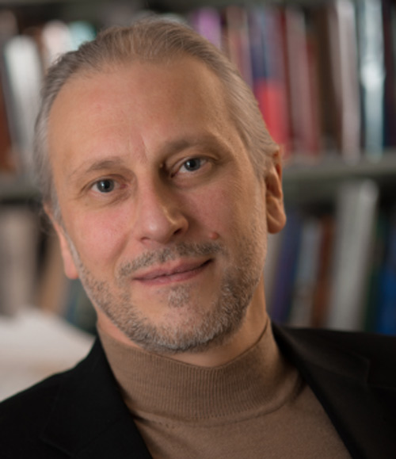
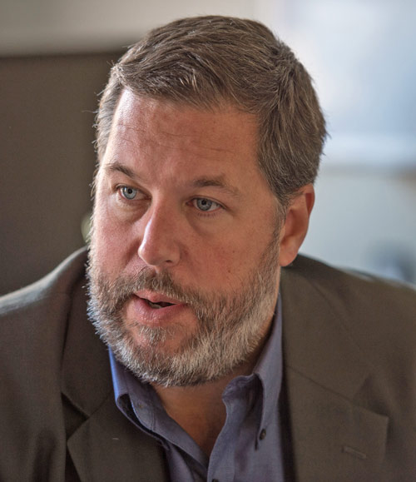
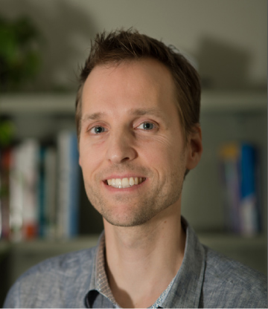
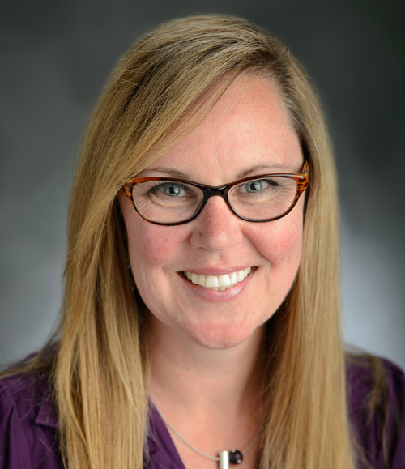
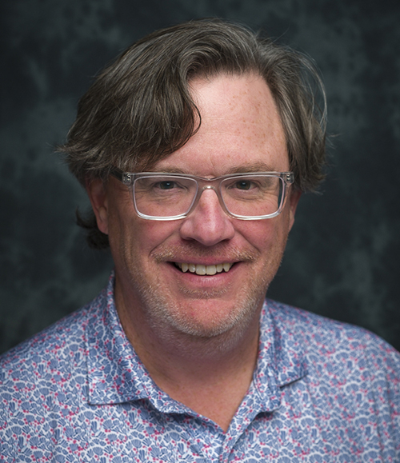
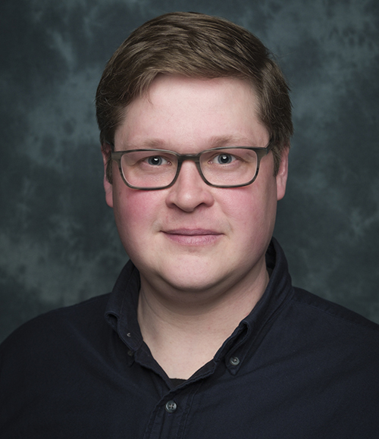
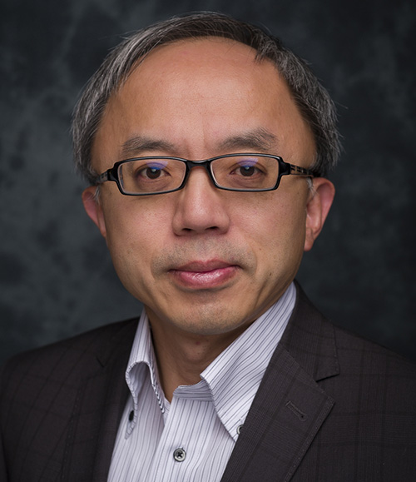
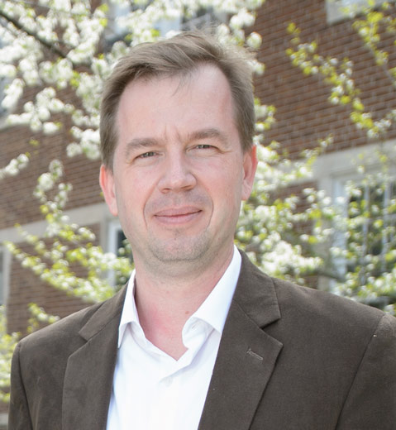

9 CCN core faculty with research labs
Erik Altmann
Mark Becker
Jan Brascamp
Kimberly Fenn
Zach Hambrick
Altmann lab
Perception and Attention lab
Visual Neuroscience lab
Sleep and Learning lab
Expertise lab
Karl Healey
Taosheng Liu
Devin McAuley
Susan Ravizza
Computational Basis of
Cognitive Control lab
Neuroimaging of Perception
and Attention lab
Timing, Attention, and
Perception lab
Cognitive Control Neurolab

Slide 7
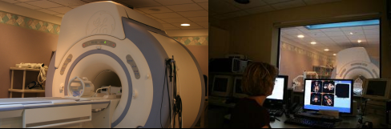
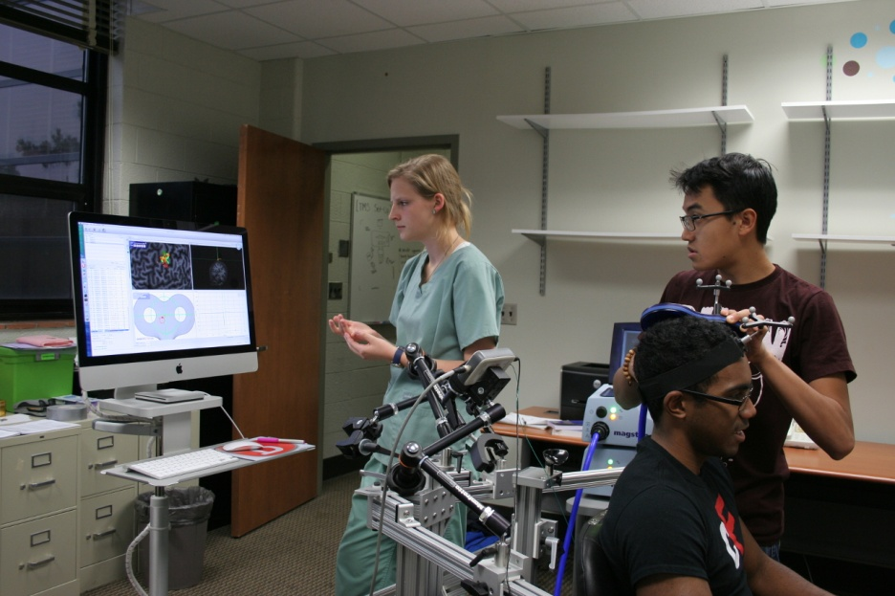
Facilities & Technology
fMRI
EEG/ERP
Eye tracking
Sleep lab
Transcranial Magnetic Stimulation
Motion tracking
Broad range of behavioral methods

Slide 8
Structure of CCN program
Funding model: typically 5 years including summer
  Research Assistantship (RA) or Teaching Assistantship (TA)
Course work
  Minimum four courses, 2 quantitative + 2 content
  A range of courses to choose from
    Sensation & Perception, Attention, Memory, Expertise, Basic/Higher cognition, Systems Neuroscience, Cognitive Neuroscience
    Technical – fMRI, programming, advanced statistical methods
    Courses outside psychology (Statistics, Computer Science, Linguistics, Communicative Sciences & Disorders, Kinesiology, CMSE)

Slide 9
Structure of CCN program (cont’d)
Key milestones
  First year project
  Second year project (Master’s)
  Comprehensive exam (breadth + depth)
  Dissertation proposal
  Dissertation completion
Annual review and feedback
  Structured feedback

Slide 10
Related formal and informal training opportunities.
Cognitive Science Program
  Graduate specialization
  Cognitive Science Forum
  Distinguished Speakers
Other talk series on campus: NSP, CS, EEBB, Linguistics
Notes:
EEBB: ecology, evolutionary biology and behavior

Slide 11
Selection of CCN Alums
Dr. Alex Burgoyne – Postdoc, Georgia Tech
Dr. Carolyn Kroger – Postdoc, University of Michigan
Dr. Katelyn Conn – US Army research
Dr. Jonathan Hakun – Assistant Prof, Penn State U
Dr. Peter Kvam – Assistant Prof, Florida State U
Dr. Stella Qian – Postdoc, Aston University, UK
Dr. Michelle Stepan – Assistant Prof, U of Pittsburgh

Slide 12


Slide 13

How will I spend my time?
2-3 courses each semester of first year
Actively engage in research from the start
Informal training through seminars, research lab meetings, workshops
Master’s thesis completed in first several years; dissertation typically within 5 years
Notes:
One important piece of information is that we do not offer terminal masters degrees, and we do not offer an online PhD program for any of the 6 programs in our department. Students enter the program with the intent of earning their PhD, and earn a Masters along the way. You might also already have a masters degree from elsewhere and enter into the PhD program.
The graduate program is individualized to allow you, working with your Guidance Committee, to shape a program of study that is broad in scope yet consistent with your specific interests. The expectation for our program is that all MA and PhD requirements can be completed in a 5-year period.

Slide 14

What stands out about this graduate program?
Available resources
  Funding, professional development, student organizations
Student involvement in publications/presentations/awards
Success of alums

Slide 15
What kind of applicant are we looking for?
PhD is a research degree
Research skills
Fit with faculty research interests
Analytic and writing skills

Slide 16
What should I include in my application?
Required scores
  GPA
  Optional
  GRE
Recommendations
  Who to ask? When to ask?
Personal Statements
  What makes you stand out?
  What will you do with this degree?
  Interviews
  Some but not all areas do interviews as a second stage

Slide 17

Personal Statement Elements
Relevant background about you
Your experiences
The skills you gained from these experiences
Your specific strengths
Your goals
Your interests
Who you want to work with
  Review department website and faculty webpages and CVs to help determine this!

Slide 18
How to apply
https://admissions.msu.edu/apply/graduate-students
https://psychology.msu.edu/_assets/pdfs/grads-prospective/gradapplicationguidance.pdf

Slide 19
Things to consider as you apply
Give yourself plenty of time to collect materials and work with the online portal
Use the online portal for queries about application status
Initial contact is via the online portal, followed by outreach to you from admissions chairs and sometimes other faculty members
Recognize that the decision-making process takes time and is iterative (is conducted in stages)

Slide 20
Timeline for applications
Applications Due
Applications Reviewed
Fellowship offers; candidate interviews
Initial offers and waitlist offers
Acceptances

