Slide 1




MSU Clinical Science Area
Dr. Alytia Levendosky
(Chair of Admissions)
Welcome!

Slide 2
Behavioral Neuroscience (BNS)
Clinical Science (CS)
Cognition and Cognitive Neuroscience (CCN)
Ecological/Community Psychology (ECO)
Organizational Psychology (ORG)
Social/Personality Psychology (S/P)

Slide 3
Overview of MSU Clinical Science
z
Our program is designed to educate and train students who will become culturally responsive clinical scientists deeply involved in the generation and dissemination of knowledge in settings in which research and/or evaluation are an integral part of professional services
Core approaches
Developmental psychopathology
Multiple levels of analysis
Cultural responsivity
Core scientific areas
Individual differences across social contexts
Social and biological bases of behavior
Treatment development & implementation across settings
APA and PCSAS
accredited
6 years including internship

Slide 4

MSU Clinical Science Research
Prenatal Stress Lab
Dr. Levendosky
Clinical Psychophysiology Lab
Dr. Moser
Autism Research Lab
Dr. Ingersoll
Klump Lab
Dr. Klump
Clinical Neuroscience Lab
Dr. Thakkar
Accessing Community Treatments (ACT) Lab
Dr. Drahota
ARISE Research Lab
Dr. Burnette
Risk, Resilience, and Recovery Lab
Dr. Cowan
Burt Lab
Dr. Burt
Notes:
Prenatal Stress Lab focuses on understanding the mechanisms through which intimate partner violence is transmitted across generations, including psychological and physiological mechanisms for this transmission, as well as how intimate partner violence and other stressors, affect the development of emotion regulation in children.
Clinical Psychophysiology Lab aims to better understand the interplay between emotion, cognition, and behavior as it relates to anxiety and depression, using a wide variety of experimental designs and measures involving self-report questionnaires, behavioral tasks, and physiology.
Autism Research Lab focuses on the development, dissemination, and implementation of evidence-based, community-viable interventions for children on the autism spectrum and their families, with the goal of improving meaningful outcomes.
Klump Lab studies the etiology of eating disorders, including anorexia nervosa, bulimia nervosa, binge-eating disorder, and subthreshold variations of these disorders, including an understanding developmental differences in risk factors across adolescence and adulthood, with a particular focus on the role of genetic factors and gonadal hormones in programming and activating risk across development
Burt Lab focuses on understanding the etiology of aggressive and rule-breaking behaviors across the lifespan, including the role of environmental influences both as main effects and also as moderators of genetic influences, and developing methodological innovations in behavioral and molecular genetics studies
MSU Twins Registry is made up of thousands of twins and their families from throughout the state of Michigan and facilitates Dr. Klump and Dr. Burt’s research.
Clinical Neuroscience Lab aims to understand the biological basis of psychotic disorders using translational methods to examine the basic building blocks of impaired cognition, disrupted social abilities, and the core disturbances in the sense of self purported to characterize psychosis.
The ACT Lab conducts research to reduce the research-to-practice gap that is experienced by individuals who are in need of mental, behavioral, and physical health services.
ARISE lab investigates the social, cultural, and environmental factors that influence ​how people feel about their bodies and eat.
Risk, Resilience, & Recovery Lab uses a person-centered approach that integrates lifespan development, personality, resilience, well-being, and self-understanding to form a holistic view of individuals with serious mental illness. We particularly apply this approach to the development of psychotic disorders in adolescence and emerging adulthood, with an emphasis on improving prediction, prevention, and recovery.

Slide 5
MSU Clinical Science Research
Autism Research Lab
Dr. Brooke Ingersoll
Clinical Neuroscience Lab
Dr. Katy Thakkar
Accessing Community Treatments (ACT) Lab
Dr. Amy Drahota
Risk, Resilience, and Recovery Lab
Dr. Raffles Cowan
Notes:
Autism Research Lab focuses on the development, dissemination, and implementation of evidence-based, community-viable interventions for children on the autism spectrum and their families, with the goal of improving meaningful outcomes.
Clinical Neuroscience Lab aims to understand the biological basis of psychotic disorders using translational methods to examine the basic building blocks of impaired cognition, disrupted social abilities, and the core disturbances in the sense of self purported to characterize psychosis.
The ACT Lab conducts research to reduce the research-to-practice gap that is experienced by individuals who are in need of mental, behavioral, and physical health services.
Risk, Resilience, & Recovery Lab uses a person-centered approach that integrates lifespan development, personality, resilience, well-being, and self-understanding to form a holistic view of individuals with serious mental illness. We particularly apply this approach to the development of psychotic disorders in adolescence and emerging adulthood, with an emphasis on improving prediction, prevention, and recovery.

Slide 6
MSU Clinical Science Program:
Program Elements
Coursework: Fairly prescriptive in first 2 years with core CS courses and then flexible to tailor your own training foci
MA thesis: short proposal; article length final product
Clinical work: Starts in year 2 and continues; Individual Development Plan
Cognate and comprehensive exam: Find your niche area and organize around it
Dissertation
Internship: 100% match rate for ~15 years
Program Initiatives: Community Outreach and Engagement Committee; Graduate Student Council; Grant Seminar

Slide 7
MSU Clinical Science Program:
Funding, advising, outcomes
Funding
Funding guaranteed for 4 years; but dept has understanding that we will guarantee the funding for 5 years
Typically funded in summer too
Advisor-Advisee Relationship
Apprenticeship model
Encouraged to work across labs
Collaborative program, department and university more broadly
Graduates
Majority involved in research in some capacity – Psychology Dept, Academic Medical School, Research Institutes
Others in clinical or policy careers – Clinicians in academic medical centers, clinics, private practice, etc.

Slide 8
What makes a strong applicant?
Research skills
Fit with faculty research interests
Analytic and writing skills
PhD is a research degree
https://mitch.web.unc.edu/wp-content/uploads/sites/4922/2017/02/MitchGradSchoolAdvice.pdf#page=21.09
Notes:
ALTERNATIVE IS NEXT SLIDE

Slide 9
How to apply
https://admissions.msu.edu/apply/graduate-students
https://psychology.msu.edu/_assets/pdfs/grads-prospective/gradapplicationguidance.pdf
https://grad.msu.edu/admissions/apply/international-applicants
Recent shifts in U.S. immigration policy may have a significant impact on international students. Information about some of these policy changes is available at: https://oiss.isp.msu.edu/immigration1/immigration-alerts/new-dhs-rule-end-duration-status/.

Slide 10
Timeline for applications
Applications Due
Applications Reviewed
Fellowship offers; initial zoom interviews
In person interviews, initial offers and waitlist offers
Acceptances
https://psychology.msu.edu/index.html

Slide 11
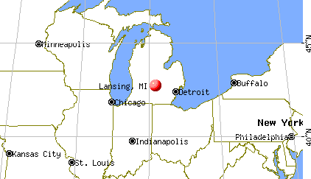
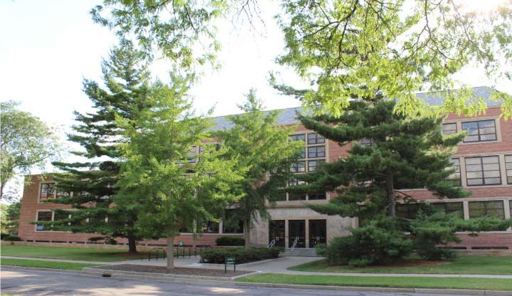
MSU Clinical Science:
A look at East Lansing
Cheap to live
Relatively easy living – minimal traffic
Sports city – if you like sports
Wharton Center – great venue, Broadway plays, etc.
Breslin center – music and big acts venue
Ever increasing culinary options
Summer Arts Festival
Detroit / Grand Rapids
The Great Lakes and Upper Peninsula!
Hiking and natural green spaces

Slide 12
MSU Clinical Science:
Questions?

Slide 13
MSU Clinical Science:
Lab Zooms!
Raffles Cowan
Amy Drahota
Brooke Ingersoll
Katy Thakkar

