Slide 1
State of Michigan Tax Return
Tax Year 2024
This seminar is ONLY for international students and scholars who lived and earned money in ONLY the State of Michigan during 2024. If you lived/work in Michigan and another state, you cannot use this presentation.
This seminar is provided for informational purposes only. Your circumstances may be different. We have drafted this to inform nonresident aliens on their filing obligations. Contact a tax professional if you have additional questions.

Slide 2
Documents Needed to Complete Michigan Tax Return
Federal Form 1040NR (competed in Sprintax software)
All income year end statements you used to complete your 1040NR (examples are W-2, 1099-NEC, 1042-S, etc.)
Any tax document that reported Michigan withholding.
Michigan Forms we will cover in this seminar:
Michigan 1040
Michigan Schedule 1
Michigan Schedule NR
Michigan Schedule W

Slide 3
Form MI-1040
Line 1 - Enter your name and United States address
Line 2 - Enter your Social Security Number or ITIN
Line 3 - Leave blank unless you are filing jointly
Line 4 - Enter “10000” “Nonresident” for School District Code

Slide 4
Line 5 and 6
Line 5 asks if you want $3 of the tax you pay to go to a fund for politicians to run for office. This does not change your tax bill. It merely takes $3 of what they have collected from you and places it into this fund.
Line 6 is skipped because you are not a farmer, fishermen, or seafarer.

Slide 5
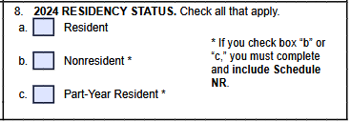
Filing Status & Residency Status
Line 7
Select the same status as you used on your federal form.
If you are married, this is most likely
“married filing separately. ”
Line 8 - Check “Nonresident” box

Slide 6
MI-1040 page 1, continued
Line 9. Exemptions
Enter the number of people you are claiming on your return. Most international students can only enter 1 in box 9a.
Multiply line 9a by $5,600
Enter the same amount that is on line 9a in box 9f
Notes:
Not sure about line 9

Slide 7
Michigan 1040 page 1, continued
Line 10. Adjusted Gross Income - You will need to look at the federal tax return Form 1040NR
In the federal return - Form 1040-NR (look in upper left corner of the form to confirm form number), then copy the amount from line 11 from your federal 1040NR to line 10 on your Michigan tax return.

Slide 8
MI-1040 page 1, continued
Line 11 – Enter 0, because these do not apply to you.
Line 12 - Add together the numbers in line 10 and line 11

Slide 9
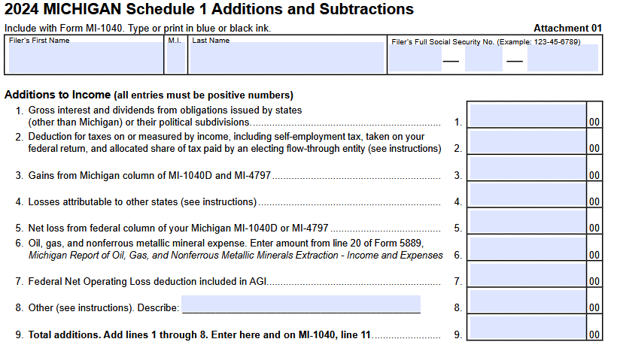
SWITCH FORMS to Schedule 1
Switch forms to calculate what amount(s) may be excluded from Michigan taxation. Continue to next slide.

Slide 10
Schedule 1 – Additions and Subtractions
Schedule 1 can apply to a taxpayer’s situation for several reasons.
The first situation is if you received a state of Michigan or city of East Lansing refund during calendar year 2024.
The second situation is if you received a scholarship, grant, or award received during calendar year 2024.
We will discuss each of these situations on the next few slides.
! If you earned income in more than one U.S. state in 2024, your Schedule 1 will be different so please do not use this presentation to complete your return – it will not complete your return correctly. !

Slide 11
Instructions for Schedule 1
These instructions are for anyone completing the Schedule 1
Put your name and social security number or ITIN on the top of both pages
Lines 1-12 on page 1 – Skip because these do not apply to you

Slide 12
Schedule 1 Line 13 Part 1: Overview
Scholarship, Grant, or Award
The state of Michigan does not tax scholarship, grants, or awards received by nonresidents. Because Michigan does not tax those, we need to make sure those amounts are excluded from Michigan taxation. The next slide will explain how to do this.

Slide 13
Schedule 1 Line 13 Part 2: Do you have a treaty benefit that covers scholarships, grants, or awards?
The next step is to determine if your scholarship was already excluded from tax.
Some treaties exclude scholarships, grants, and awards from federal taxation.
If your scholarships, grants, and awards was already excluded from tax at the federal level, you do not need to list the amount on the Michigan Schedule 1 and you can skip the next slide.
To determine if your scholarship, grant, or award was excluded from federal tax, review your 1040NR that was completed in Sprintax. Sprintax would have informed you of this treaty benefit and you would have accepted it. You can check Schedule OI line L1 to see what benefits you received.
If your scholarship, grant, and award, was taxed by the federal government, you need to list the amount of your scholarships, grants, and awards on line 13. Please see the next slide for further instruction.

Slide 14
Schedule 1 Line 13 Part 3: Listing the amount of your scholarship, grant, or award
To exclude your scholarship, grant, or award, list the total amount of these items on line 13 of the Schedule 1.
For the explanation write “Nonresident scholarship.”

Slide 15
Schedule 1 Line 16: Michigan and/or City income tax refund- Part 1: Finding the Amount
If you received a refund from the state of Michigan or city of East Lansing or Lansing, that refund amount(s) needs to be list on line 16 of the Schedule 1.
There are several ways for you to find your refund(s) amount(s).
You can find the amount of your Michigan refund by looking your 2023 MI-1040 form.
You can find the amount of your city of East Lansing by looking at your 2023 EL-1040 form
You can find the amount of your city of Lansing by looking at your 2023 L-1040 form
You may have received the form 1099-G “postcard” indicating a state of Michigan or City of East Lansing or Lansing refund last year. If so, it should have “2024” on it.
You can check your bank account to see the refund amount(s) deposited.

Slide 16
Schedule 1 Line 16 : Michigan and/or City income tax refund- Part 2: Finding the Amount
Once you have the amount(s) of your refund, list the total amount on line 16 of the Schedule 1.

Slide 17
Schedule 1
Lines 17-28 – Skip
Line 29 - Copy the number from line 13 and 16
Line 30 - Skip
Line 31 - Copy the number from line 29 and then switch back to the main form (MI-1040)

Slide 18
SWITCH FORMS back to MI-1040 page 1
Line 13
You will need to look at your Schedule 1 line 31 and transfer that number to line 13 here
Line 14 - Subtract line 13 from line 12 (line 12 minus line 13). If line 13 is larger than line 12, enter 0 (zero)
Notes:
Line 15?

Slide 19
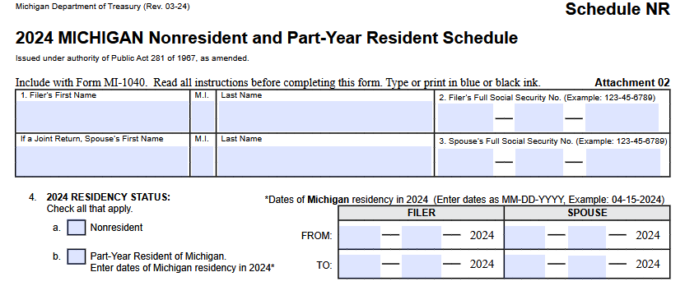
SWITCH FORMS to Schedule NR

Slide 20
Schedule NR
Line 1
Fill in your name
Line 2
Fill in your Social Security number or ITIN
Line 3
Skip, unless you are filing jointly
Line 4
Select nonresident, even if you moved into Michigan during the year. If you are a federal nonresident, you are a Michigan nonresident for tax purposes

Slide 21
Schedule NR, continued
Line 5 – If you had wages, enter your total wages into Column A and Column B
Lines 6-10 – Skip

Slide 22
Schedule NR, continued
This form is to demonstrate to the state how much of that $5,600 of personal exemption you should receive. If you lived in Michigan all year, you should receive the full exemption amount. You will also use Schedule NR to show that the scholarship income is not attributable to Michigan.
Line 11 – If your scholarship income was taxed at the federal level, list your scholarship income in column A and C. If your scholarship was not taxed at the federal level or you did not receive a scholarship, grant, or award, leave this line blank.
Line 12 – Add all amounts in lines 5-11.
Line 12, Column A = total amounts from lines 5-11 in column A
Line 12, Column B = total amounts from lines 5-11 in column B
Line 12, Column C = total amounts from lines 5-11 in column C

Slide 23
Schedule NR, continued
Line 13 – Skip
Line 14 - Copy the numbers from line 12
Line 15 - Copy the number from line 9f of your MI-1040

Slide 24
Schedule NR, continued
! Please note that the below instructions regarding lines 16 – 18 do not match the instructions on the MI-1040. Please follow our instructions provided below as it is the only way we have found to list your scholarship, grant, or award as non-taxable with the state of Michigan !
Line 16 - Enter the number from line 5, column B
Line 17 - Enter the number from line 11, column A
Line 18 - Enter “100”
Line 19 - Copy the number from line 15

Slide 25
SWITCH FORMS to MI-1040 page 1
Line 15 - Copy the number from line 19 of your Schedule NR
Line 16 - Subtract line 15 from line 14 (line 14 minus line 15). If line 15 is larger than line 14, enter 0 (zero).
Line 17 - Multiply the number in line 16 by 4.25% (0.0425)

Slide 26
MI-1040 page 2
Enter your Social Security Number or ITIN on the top of page 2
Lines 18 and 19 – Skip because they do not apply to nonresident aliens
Line 20 - Copy in the number from line 17
Line 21 and 22 - Skip

Slide 27
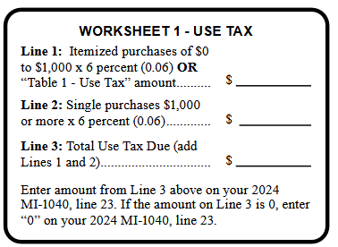
MI-1040 page 2
Line 23 Use Tax Use tax is a tax on purchases you made outside of Michigan, but then brought that property into Michigan either by shipping or personal carry. You must add up all purchases you made (online or outside of the state) but did not pay Michigan sales tax on. Then multiply that number by 6% and enter that amount on Line 23. You can use an alternate calculation based on your income, which is in the instructions for MI Form 1040. The Instructions also have “Worksheet 1” (pictured here) to help you with the calculation. The worksheet does not need to be included with your return. You can use the one on this page.

Slide 28
MI-1040 page 2, continued
Line 24 - Add together lines 20 through 23 and enter the total in line 24.
Lines 25-29 – Skip because these do not apply to nonresident aliens

Slide 29
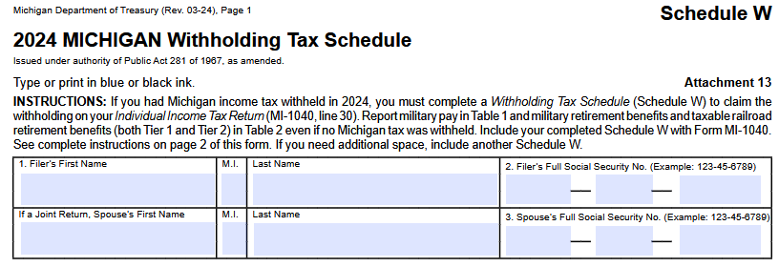
SWITCH FORMS to Schedule W

Slide 30
Schedule W
Line 1 - Enter your Name
Line 2 - Enter your Social Security Number or ITIN
Line 3 - Skip, unless you are filing jointly

Slide 31
Schedule W - Table 1 – W-2’s
Transfer all information from your W-2s into Table 1
For each of your W-2’s, you will enter the following information into one line of the Table 1:
Column A - Check the “filer” box (you will only check the box for your spouse’s W2s if you are filing jointly)
Column B – Enter your employer’s EIN (box b on your W2)
Column C – your employers name (box c on your W2)
Column D - your wages (box 1 from your W2)
Column E – Michigan income tax withheld (box 17 from you W2)

Slide 32
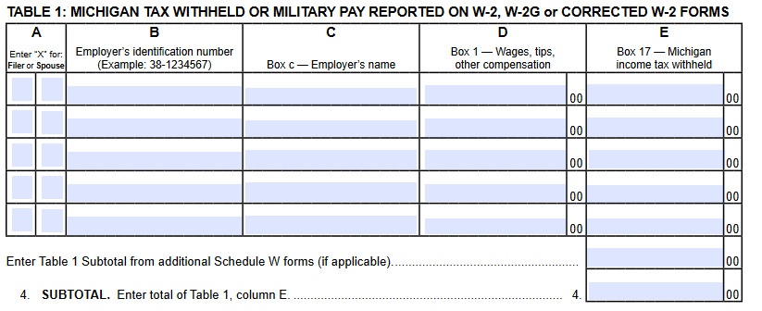
Schedule W – Table 1
Line 4 - Add together everything from Table 1, column E

Slide 33
Schedule W – Table 2
Enter your information from your 1042-S (if applicable) in table 2
Column A – Check “filer” (you will only enter your Spouses W2s if you are filing jointly)
Column B – Payer’s EIN or TIN (line 12a of 1042-S)
Column C – Payer’s Name (line 12d of 1042-S)
Column D - Taxable pension distribution, misc. income (box 2 of 1042-S)
Column E – Michigan tax withheld (box 17a of 1042-S)

Slide 34
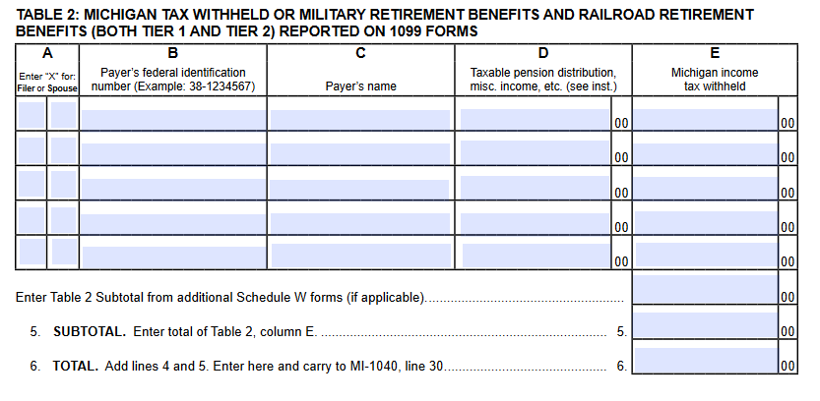
Schedule W, continued
Line 5 - Add together everything from Table 2, column E
Line 6 - Add together line 4 and line 5
Carry over amount to MI-1040, line 30

Slide 35
SWITCH FORMS back to MI-1040, page 2
Line 30 - Enter the amount from line 6 of your Schedule W on line 30
Line 31 and 32 - Skip
Line 33 – Enter the amount that is on line 30 above.

Slide 36
MI-1040 page 3
Enter your Social Security Number or ITIN on the top of page 3
Lines 34 and 35 (You will fill in ONE of either line 34 OR 35)
If line 24 is larger than line 33, subtract line 33 from line 24 (line 24 minus line 33) and put that number in the box on line 34
If line 33 is larger than line 24, subtract line 24 from line 33 (line 33 minus line 24) and put that number in the box on line 35
Line 36 – Skip
Line 37 - If you have a number in line 35, copy it to line 37

Slide 37
Direct Deposit
If you have a number in line 34, you owe additional tax. See next slide for payment instructions.
If you have a number in line 37, you are receiving a refund. You can receive this by direct deposit or check
If you are receiving a refund and want the state to deposit it directly into your bank account, enter your information
DOUBLE CHECK THAT YOU ENTERED THE CORRECT INFORMATION
Neither the state nor your financial intuition will confirm your information
If you enter the wrong information, it will be VERY DIFFICULT OR IMPOSSIBLE TO FIX

Slide 38
How to pay State of Michigan
Payments can be made using Michigan’s e-Payments service by direct debit (e-Check) from your checking or saving account, or by using a credit or debit card.
Visit www.Michigan.gov/iit to make your payment electronically.
To be able to make an e-Payment you must:
Have filed your 2023 Michigan Individual Tax Return before December 2024, and
Use the same zip code from your 2023 Michigan Individual Income Tax Return.
Paying by debit card will result in a flat fee of $3.95.
Paying by credit card will result in a convenience fee of 2.3% of the total payment amount.
Payments can also be mailed. Make your check payable to:
State of Michigan
Print the last four digits of your Social Security Number or ITIN and “2024 income tax” on the front of your check.

Slide 39
When You Are Finished Filing due date: April 15, 2025
Sign your return.
If you filed jointly, each spouse must sign the return.
Attachments - Forms to send for State of Michigan income tax returns
MI-1040
Schedule W
Schedule 1
Schedule NR
Copy of your Federal 1040NR form
Where to mail?
Are you receiving a refund or have zero due/zero refund?
Michigan Department of Treasury
Lansing, MI 48956
Do you owe additional tax?
Michigan Department of Treasury
Lansing, MI 48929
Before you mail your return to the State of Michigan, be sure to make a copy for your records.

