Slide 1
Sprintax Federal Tax Return Walk-Through 2024
Alvin L. Storrs Low-Income Taxpayer Clinic
Email: taxclinic@law.msu.edu
Phone: 517-432-6880
This seminar is provided for informational purposes only. Your circumstances may be different. We have drafted this to inform nonresident aliens on their filing obligations. Contact a tax professional if you have additional questions.

Slide 2
Step 1: Go to https://taxprep.sprintax.com/mi-state-uni
This should be the page that appears when you click the link above. Once you are here, click on the “Get Started” button

Slide 3
Step 2: Create a sprintax account
Once you have clicked the “Get Started” button, a screen will pop up for you to create a Sprintax account. Fill out your legal first name, legal last name, phone number, email, and create a password. Please make note of the email and password you use and keep it somewhere safe because that is the information you will use to login and access your tax forms.
Make sure you check both boxes before hitting the “Create Account” button.

Slide 4
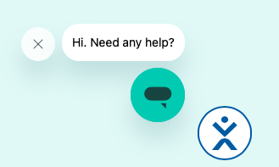
Live chat with Sprintax
This bubble appears on each page and if clicked on will open a chat with an AI bot. We have found that this bot is not very helpful and does not always provide correct information. If you would like to get help from Sprintax, we instead recommend emailing them at hello@sprintax.com. If you are unsure or need further assistance, you can contact the Tax Clinic, however, responses from the Tax Clinic will take 3-5 business days.

Slide 5
Step 3: Select your visa type
Once you have clicked the “Create Account” button, your next screen will ask you to select your VISA type. Click the white box that says, “Please select visa type” and select the VISA you currently hold from the provided list.

Slide 6
Step 4: Make sure you have the necessary documents
Once you have selected your current VISA, you will be brought to this screen, which lists the documents you will need before you proceed with filling out the tax forms. Make sure these items are near you because you will need to input information from these documents into Sprintax.
Documents you will need:
Passport
US entry and exit dates for current and all past visits to the US
Income forms – such as: W2, 1042-S and/or 1099
VISA/Immigration status information: DS-2019 or I-20
Social Security Number (SSN) or Individual Taxpayer Identification Number (ITIN)
Once you have these documents, click “Get Started”

Slide 7
Step 4 continued
Once you click “Get Started” this screen will pop up, please read the box and contact your institution or employer if you do not have the listed forms and believe that you should have received them.
Once you have confirmed you have the forms needed to move forward with filing, click the “I Understand” button

Slide 8
Step 5: Select tax year
After you click “I Understand” the next screen will ask you to select which tax year you need a return prepared for. You will need to select 2024 and then scroll down to click the arrow to proceed to the next screen. This walk-through only addresses tax year 2024. If you need more information on filing returns for previous tax years or need to amend a return from a previous tax year, please visit https://taxclinic.law.msu.edu/International-Students-and-Scholars for more information.

Slide 9
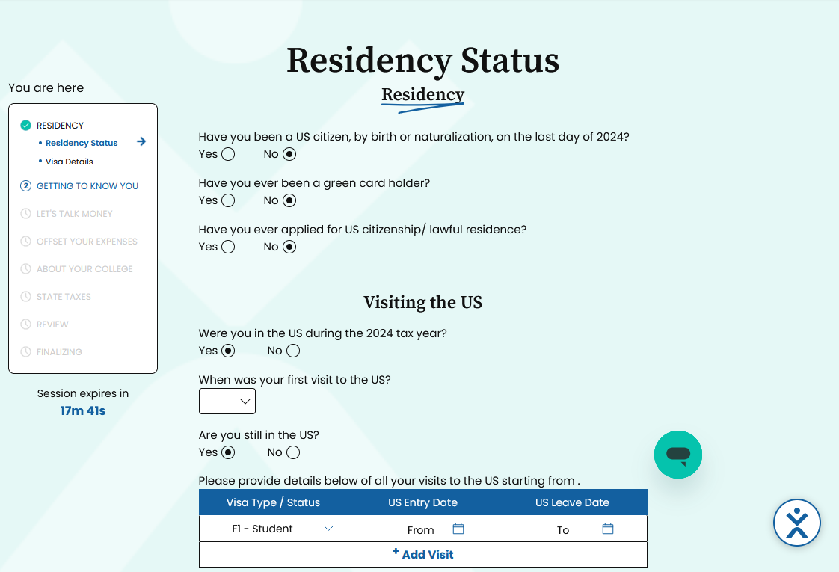
Step 6: Determine your residency status
Once you have clicked the arrow after selecting 2024, you will be directed to answer some questions regarding your residency in the United States which will determine your residency status that is required for you to file the appropriate tax documents.
For the visits, please put dates for any time that you were physically present in the United States at any point. For multiple visits, click the “Add Visit” tab so that another line will show up for you to add other dates.
After you have completed this information, scroll down and click the arrow to move to the next page.

Slide 10
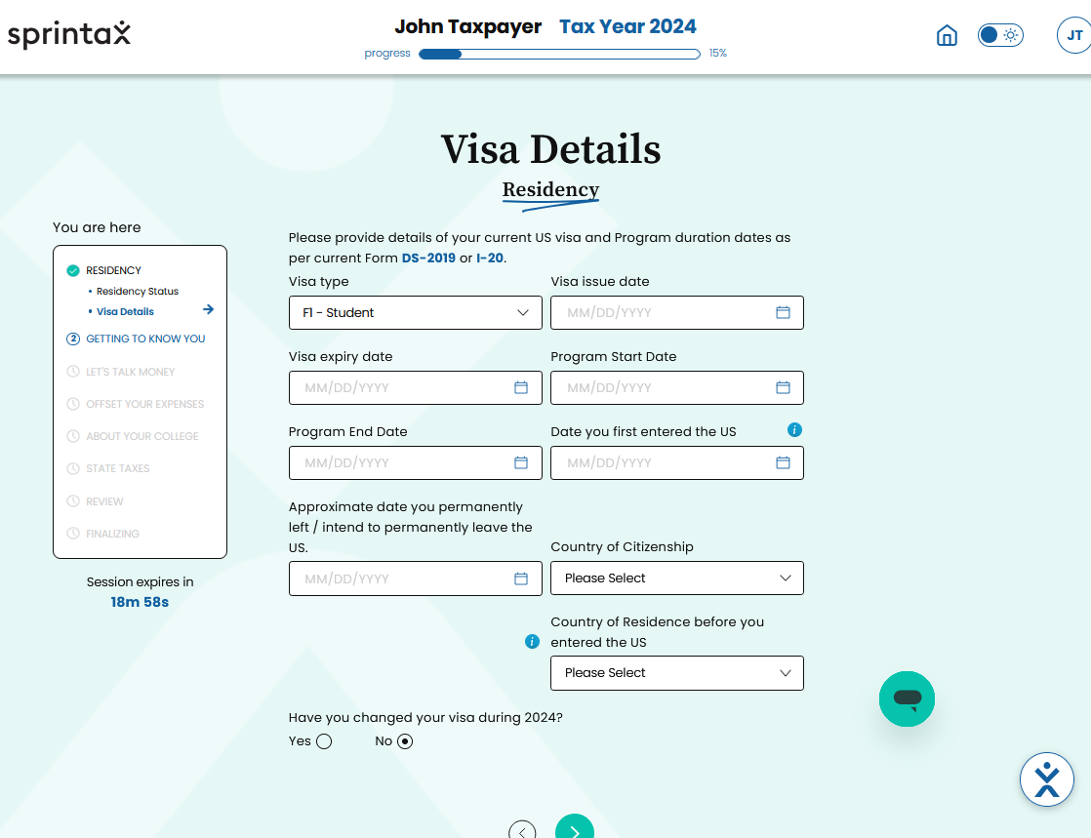
Step 7: complete VISA details
After you have clicked on the arrow, you will be asked to enter information regarding your VISA. Please fill out the information and click the arrow at the bottom once completed.
Please verify that the VISA type in the “Visa type” box on this page matches the VISA type you previously selected. This box automatically is filled out with the VISA you selected from the drop-down menu in step 3. If it is incorrect, please return to step 3 and select the correct VISA you currently hold.

Slide 11
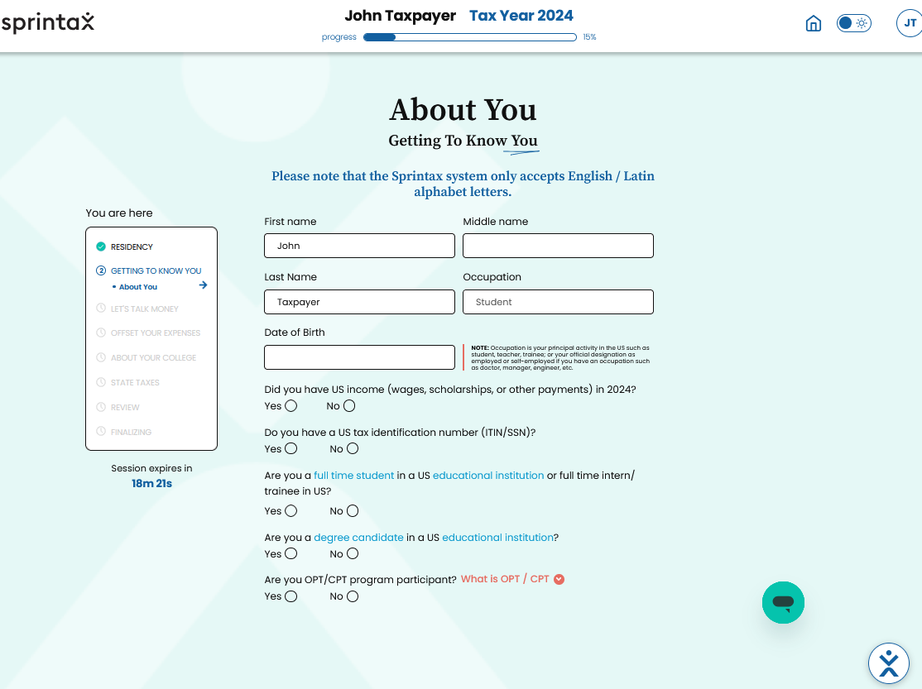
Step 8: Entering information about you
After you have completed information about your VISA details, you will need to fill out some questions regarding you personally. Once you have entered all the information, scroll down and click the arrow to continue.
If you do not have a Social Security Number (SSN) or Individual Taxpayer Identification Number (ITIN), select no. You will then be asked if you would like to have an ITIN application created for you for $19.95. If you want to pay to have Sprintax complete the application, that’s fine. If you do not want to pay, the Tax Clinic may be able to assist you in completing the application. Contact the Tax Clinic at taxclinic@law.msu.edu and we can advise on the requirements of the ITIN and how to apply. PLEASE NOTE: You cannot file your taxes without having an SSN or ITIN. However, Sprintax will let you select no on both of these and still take you all the way through your filing. DO NOT FILE YOUR FORMS WITH A SSN or ITIN listed, or attaching the ITIN application

Slide 12
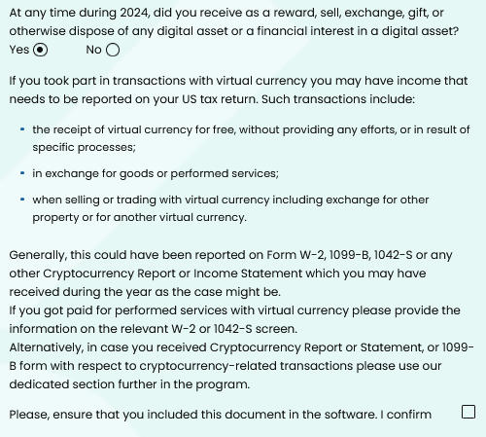
Step 8 Continued
At the bottom of the page, you will see a question that asks whether at any point in 2024 you received as a reward, sold, exchanged, gifted, or otherwise disposed of any digital assets or a financial interest in a digital asset. Digital assets can be crypto currency but also many other types (Bitcoin, Ethereum, Dogecoin, etc.) and if you have or had any form of digital asset in 2024, you need to select yes to report this because the government is now keeping track of digital assets for tax purposes. If you check yes, you will be required to check another box confirming that you have included the necessary tax document in this software. Later on, you will select and upload different tax documents and you will need to make sure the tax document regarding this asset is included in your filing.

Slide 13
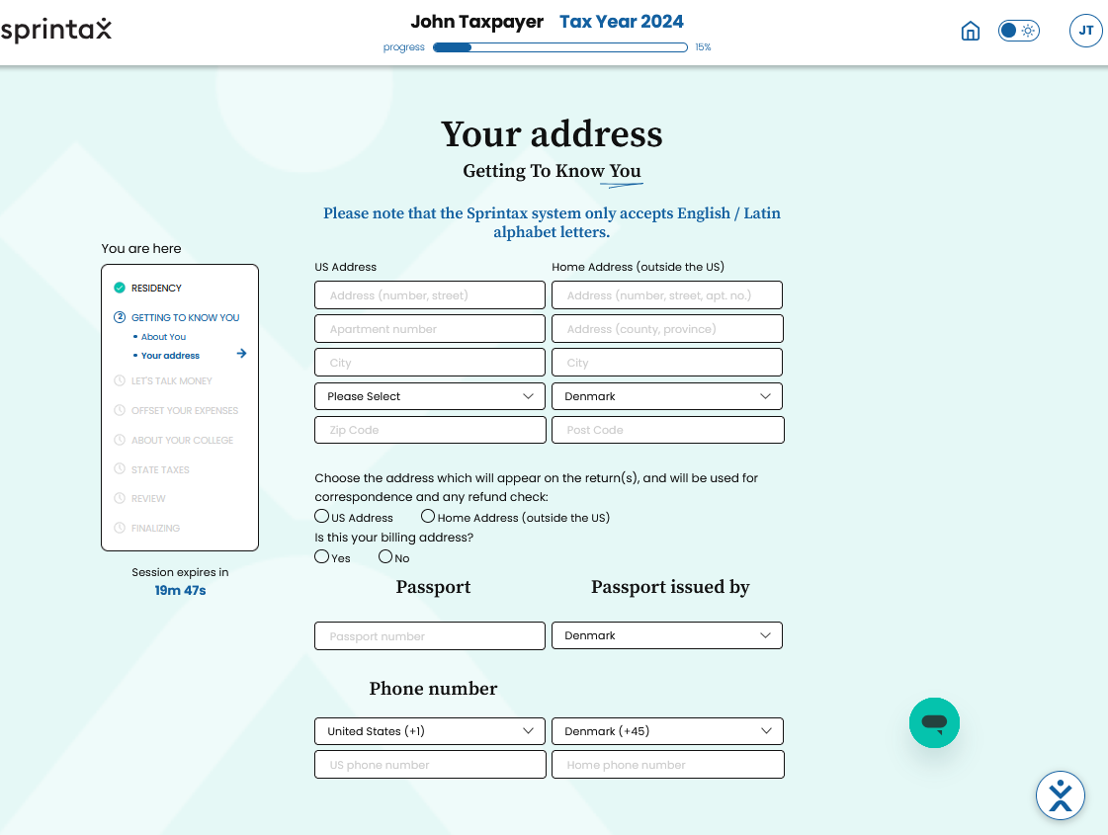
Step 9: Providing both of your Addresses
Once you have clicked the arrow you will next be asked to provide both your address here in the United States (US Address side) as well as your international address (Home Address side). Please fill out both addresses and then select below which address you would like your refund to be sent and where any other important tax related documents will be mailed to.
Scroll down and then enter your passport number and select from the drop-down menu what country issued your passport. Then you should enter your phone number that you use here in the United States as well as a phone number you use outside of the United States.
Once you have completed filling out this information, click the arrow to move to the next page.

Slide 14
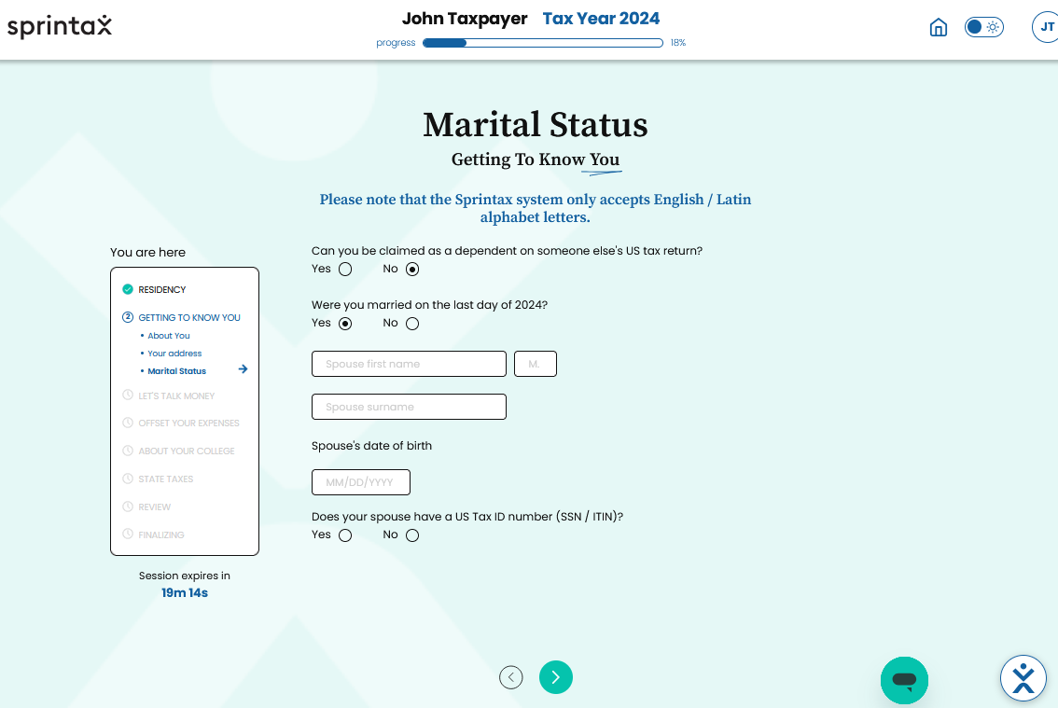
Step 10: Marital Status
Once you have clicked the arrow you will be then be asked about questions to determine your marital status. Check yes or no on the questions. The second question is asking if by the date of December 31, 2024, you were married. If you were, check yes and then you will be asked to fill out your spouse’s name, spouse’s date of birth, and SSN or ITIN if they have one. If you have a valid and legal marriage in your home country, you are considered to be married in the US.

Slide 15
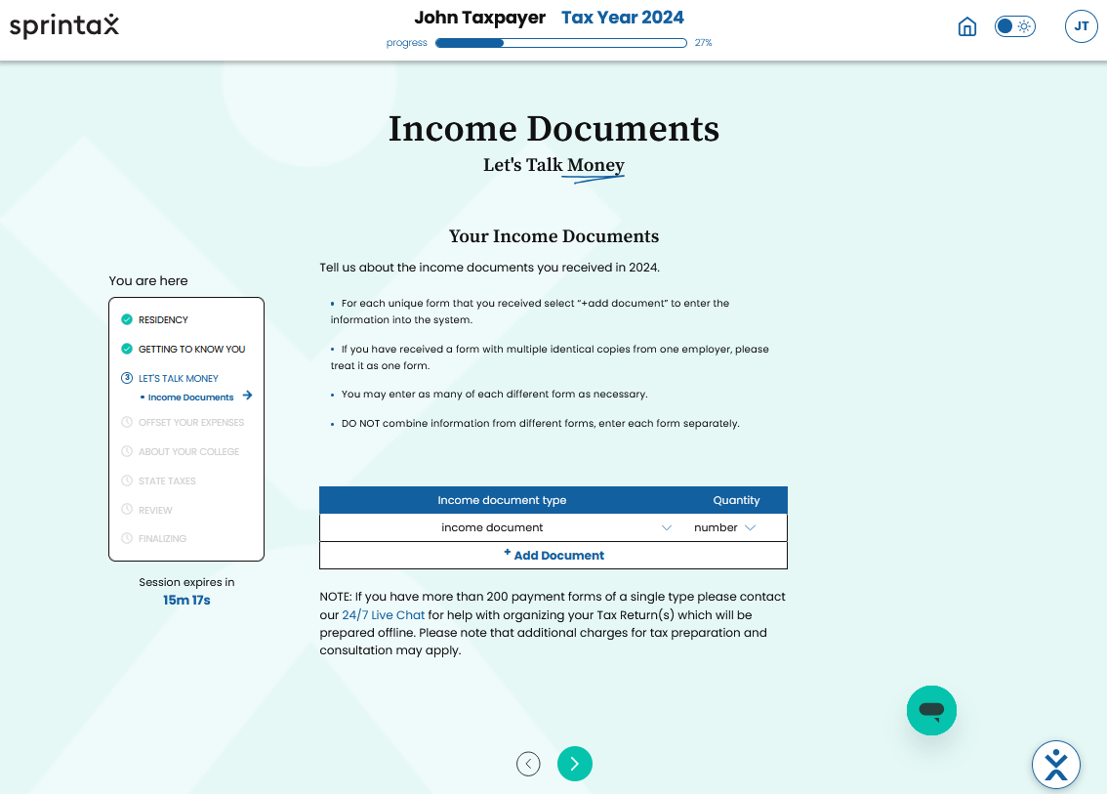
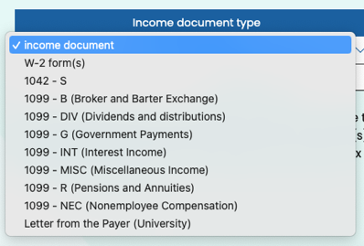
Step 11: Listing income documents
After you have clicked the arrow on the previous page, you will now be asked to list your income documents and how many of each document you have. Click the drop-down menu and select the type of income document and then select the quantity in the number drop-down next to it. For example, if you have two different W2s, you will select W2 and then under quantity select 2. Click the “ + Add Document” banner and repeat this process until you have listed all income documents on this page. You may not have all the documents listed and that is okay as they are not all required, just list the ones you do have. If you are unsure whether you should have a certain document, please see our website for more information on the documents: https://taxclinic.law.msu.edu/International-Students-and-Scholars

Slide 16
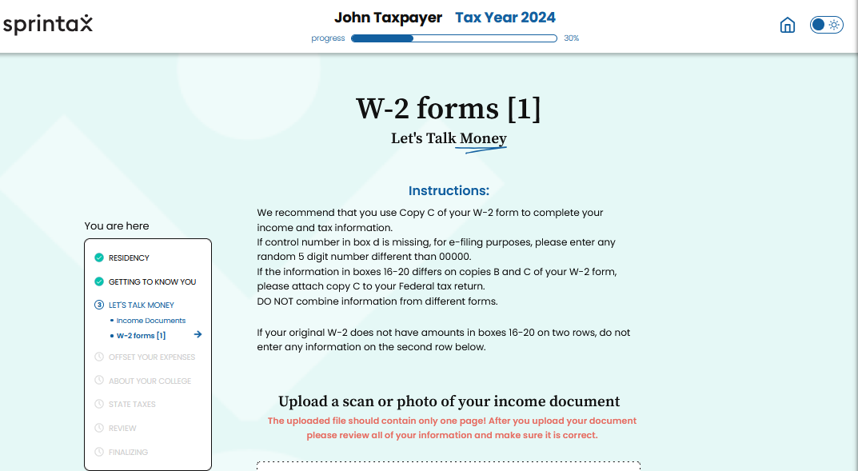
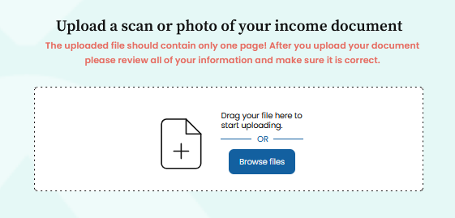
Step 12: Entering information from your W2 Form(s)
Once you click the arrow, you will now begin the process of entering the information from your income documents into the system. First up will be your W2(s) (if you have a W2) and you need to start by reading the instructions listed at the top of this page.
After you have read the instructions, you will be prompted to upload your W2. However, we do not recommend that you upload the document because it will auto-complete the form (and we have found that it does it incorrectly sometimes). If you do choose to upload the W2 and it auto-completes the form below, please go line by line and verify that all information is in the correct box and word for word what is on your W2.

Slide 17
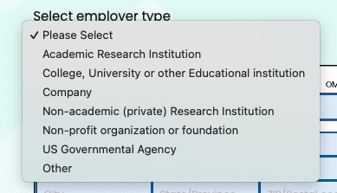
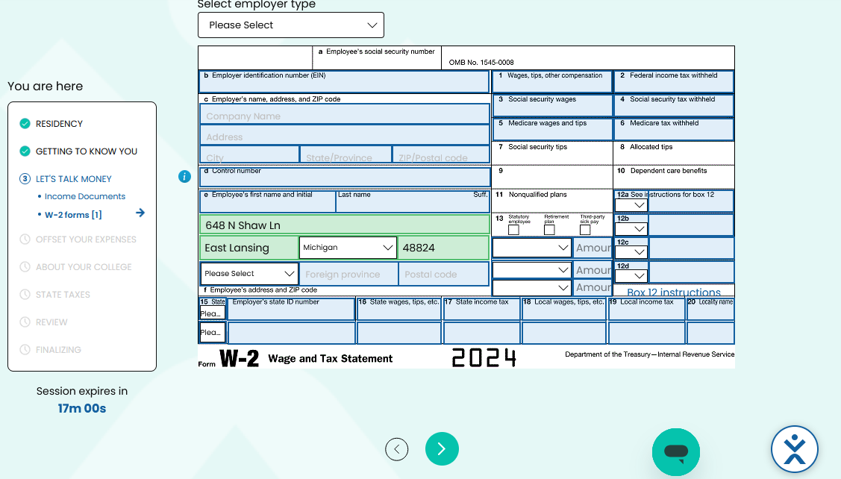
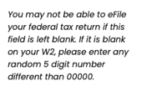
Step 12 Continued
Scroll down and you will see a template of a W2 that allows you to type in each box. First, click the drop-down menu that says, “Select employer type” and pick the title that best matches the category your employer would fall under. Then, you will need to go through and manually enter all the information from your W2 into the matching boxes.
This is your employer’s EIN
Box D. Control Number
Your W2 may not have a number listed here, and that is okay. Your filing will be complete without it. If your W-2 form does not have one, Sprintax cannot e-file your return – you will need to print off the return and mail it in. If you have one, enter it as it is listed on your W2. If you do not have one, please type in a random 5-digit number that is not 00000.

Slide 18
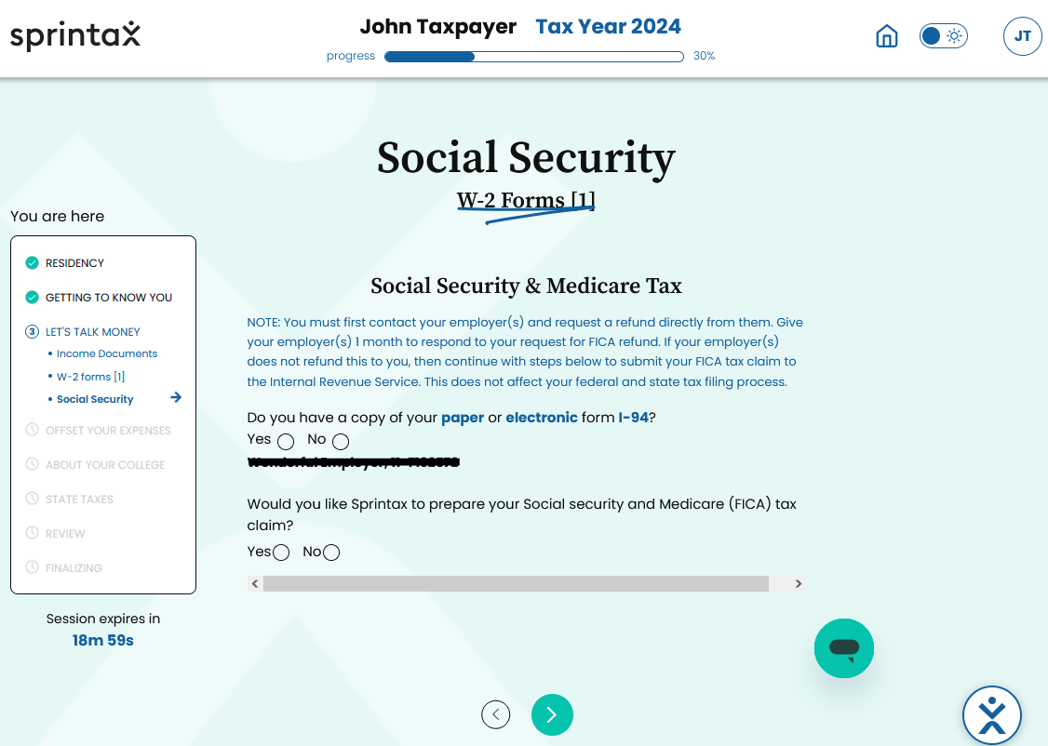
Step 13: Social Security & Medicare tax
Once you complete your W2, if you have it, you will click the arrow and be directed to a page about Social Security & Medicare taxes. You will answer the two questions below. For the second question, if you select yes, you will be prompted to answer other questions. If your employer is MSU, you should be able to call Payroll and get a FICA refund directly from them. If your employer is not MSU, you can contact the Tax Clinic and we should be able to assist you in getting a FICA refund for free. We are unsure if Sprintax charges a separate fee to prepare a FICA claim so if you select yes to them preparing a claim, there may be additional costs you will have to pay.
Where this black bar is, the name of your employer and their EIN number, verify that it matches what is listed on your W2.

Slide 19
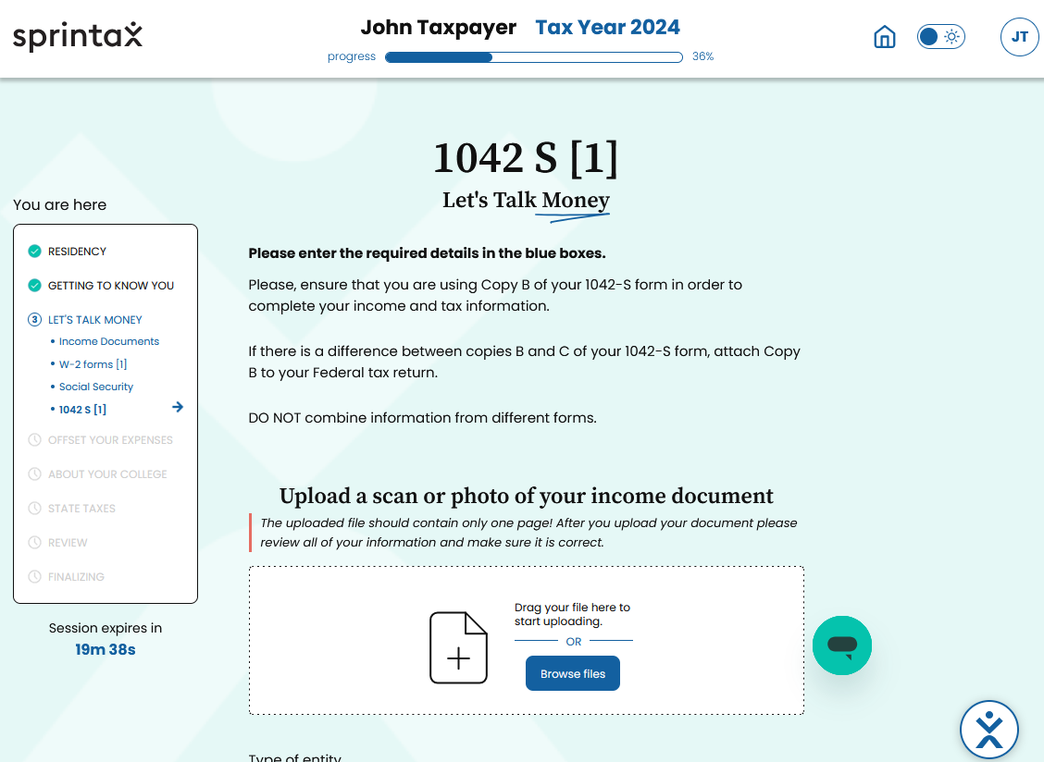
Step 14: Entering information from your 1042-S
After you have completed entering W2 information (if you have one), you will click the arrow and move to your next income document. If you have a 1042-S, this will be the next form you are prompted to enter into the system. First, read the directions at the top regarding how to properly enter your 1042-S information. As with the W2, you can upload the document, however, we recommend you complete the form below yourself by manually typing the information into each box. If you do choose to upload, make sure what is automatically filled in matches every box on your actual 1042-S.

Slide 20
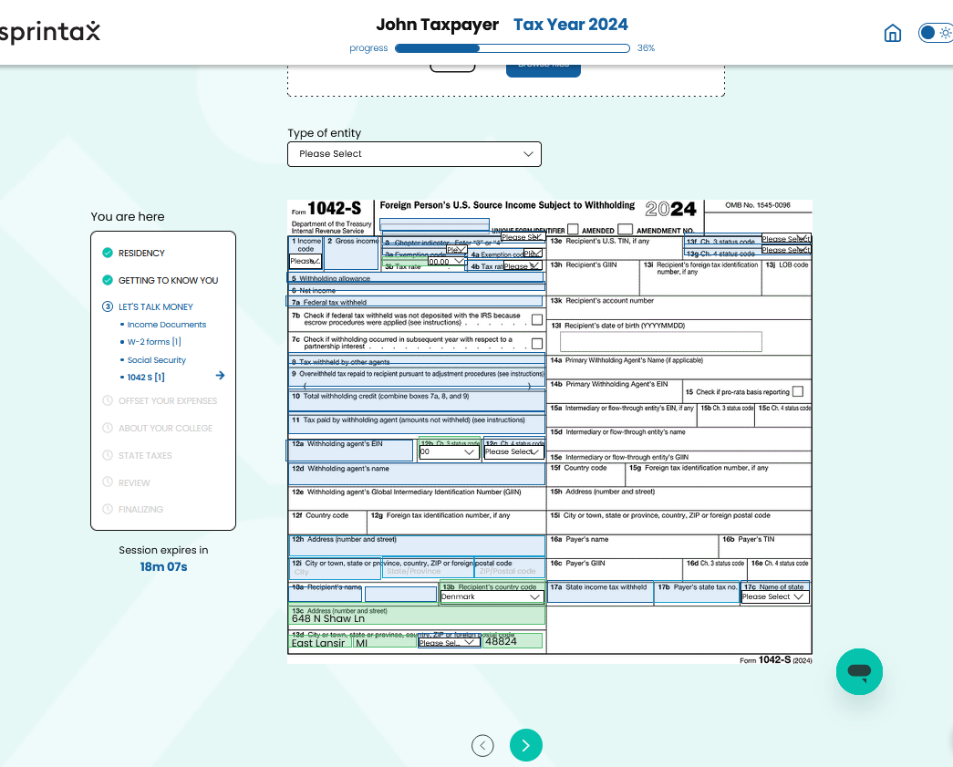
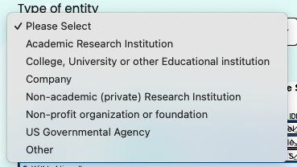
Step 14 continued
Scroll down until you see the screen below. Start by selecting the category of entity that best matches your employer. If your employer is MSU, you will select “College, University, or other Educational Institution.” Then you will need to go through each blue box and enter the information from your 1042-S. Once you have verified that all blue boxes have been completed and match what is on your 1042-S, click the arrow at the bottom to move on.

Slide 21
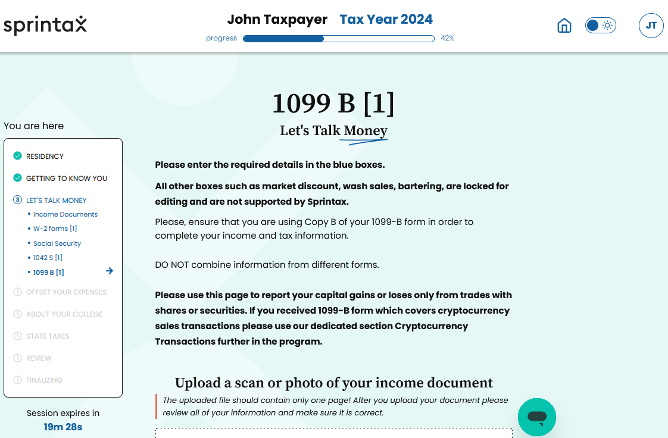
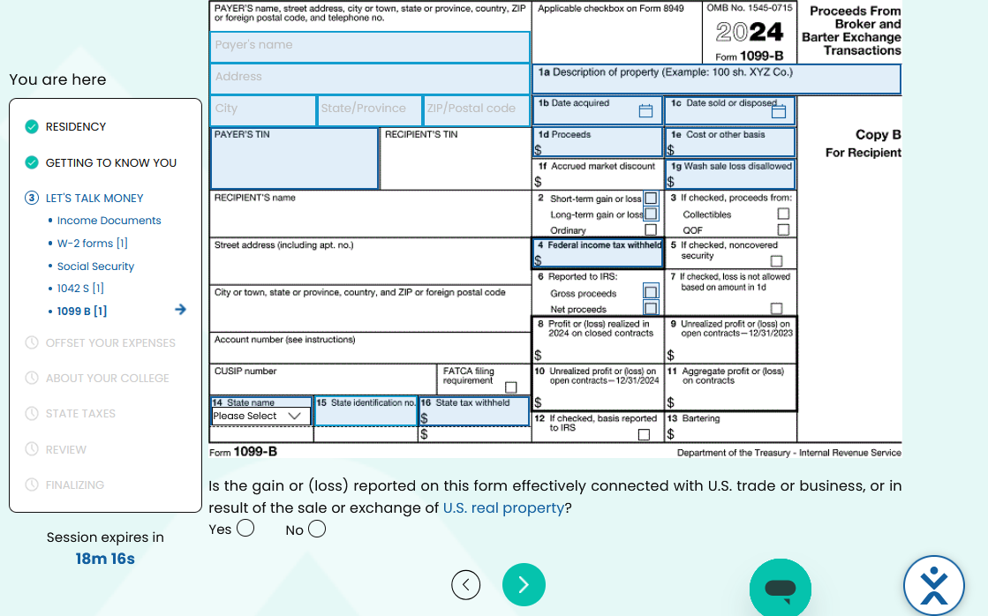
Step 15: Entering information from your 1099-B
If you have included a 1099-B in your list of income documents, you will fill out and complete that information here. Please read the top directions carefully because a depending on what your 1099-B is related to can impact if you enter that information now or later. If you do decide to upload a digital copy, make sure that all lines it auto-completes are accurate. We recommend you manually enter the information in all the blue boxes and verify that they accurately match what is on your 1099-B.
Once you have completed filling out the 1099-B, you will select yes on the question below the 1099-B.

Slide 22
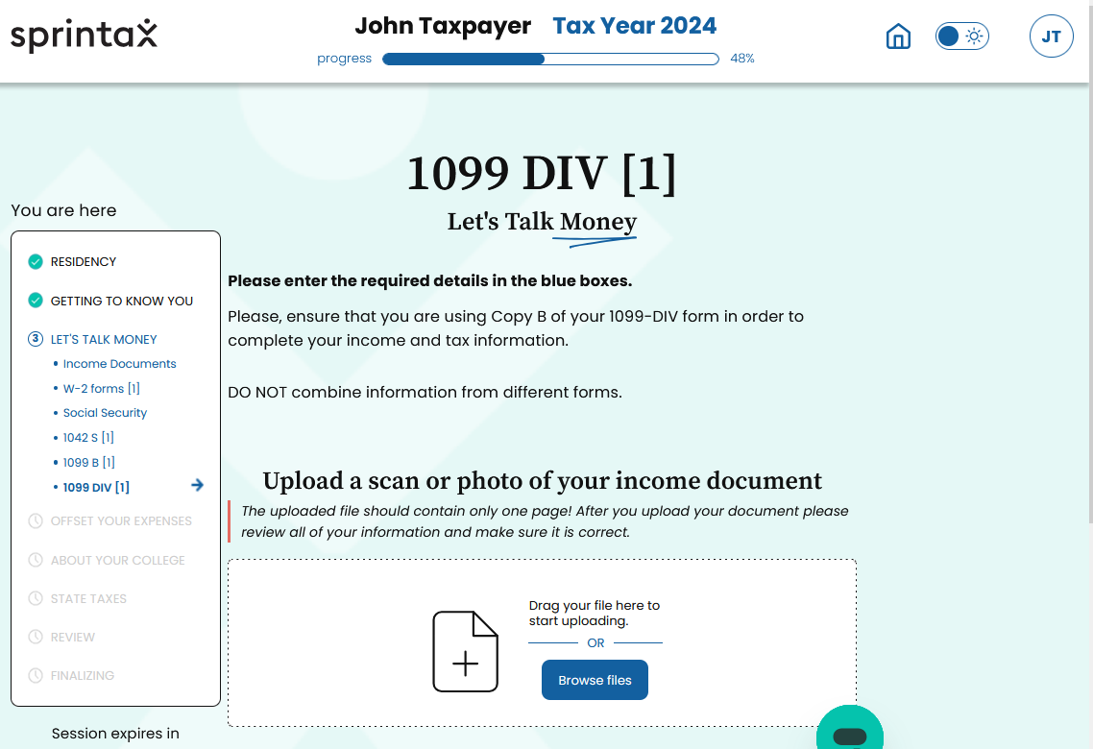
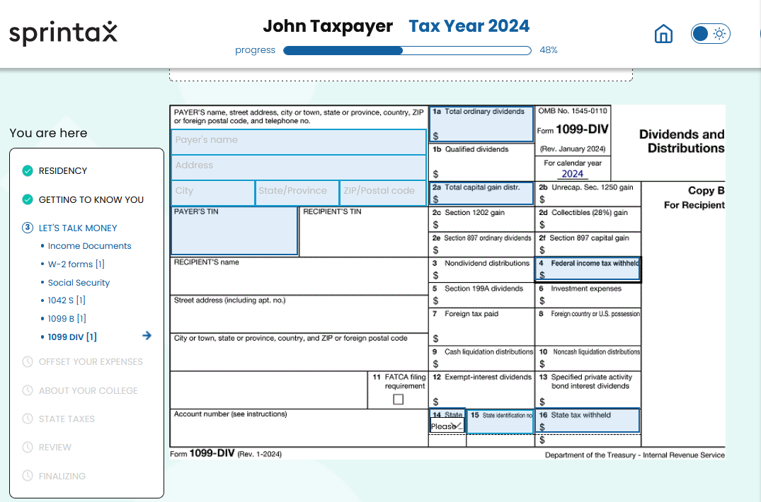
Step 16: Entering information from your 1099-DIV
Next, if you have a 1099-DIV, you will be asked to provide that information. As previously mentioned, you can upload a digital version of the form, but this is not always accurate. If you do upload, please verify line by line that all information is correct and as it is stated on your 1099-DIV. Otherwise, if you manually type in the information as we would recommend doing, scroll to the bottom and fill out all the blue boxes and verify it is all accurate before clicking the arrow to move to the next form.

Slide 23
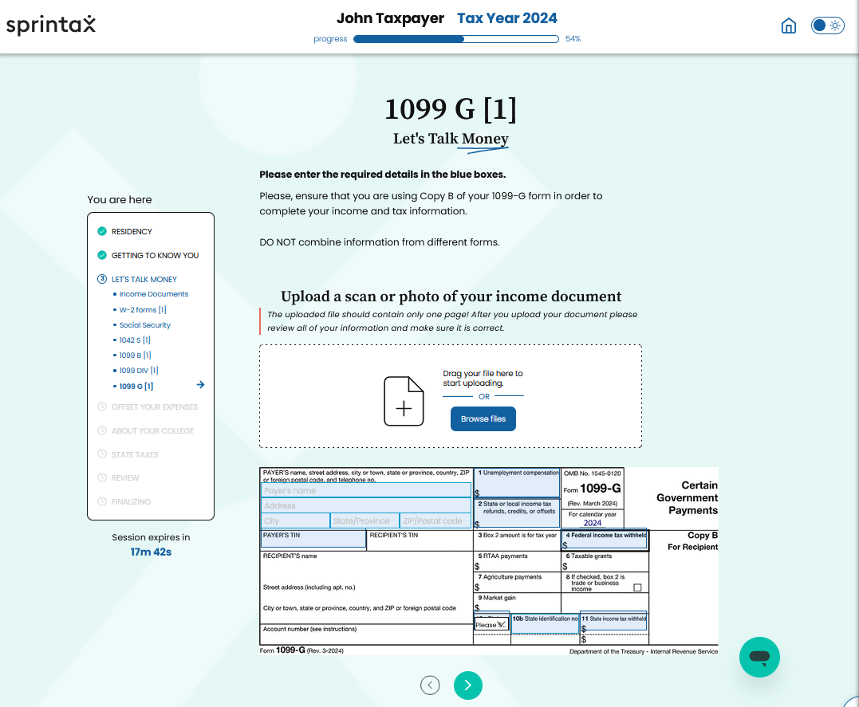
Step 17: Entering Information from your 1099-G
Next, if you listed that you had a 1099-G, you will be asked to provide the information from that form. You can upload, but we recommend that you manually enter all information in the blue boxes below. If you do upload, please verify that all information is accurate by checking every box with your 1099-G. If you manually enter the information, please complete the blue boxes and verify all information is accurate before hitting the arrow to move on to the next page.
Your 1099-G may look different than the sample provided, please see the next slide if that is the case for an example of another version of the 1099-G.

Slide 24
Step 17 Continued
This is your employer’s EIN
2024
This is your refund amount that you will put in box 2
2023

Slide 25
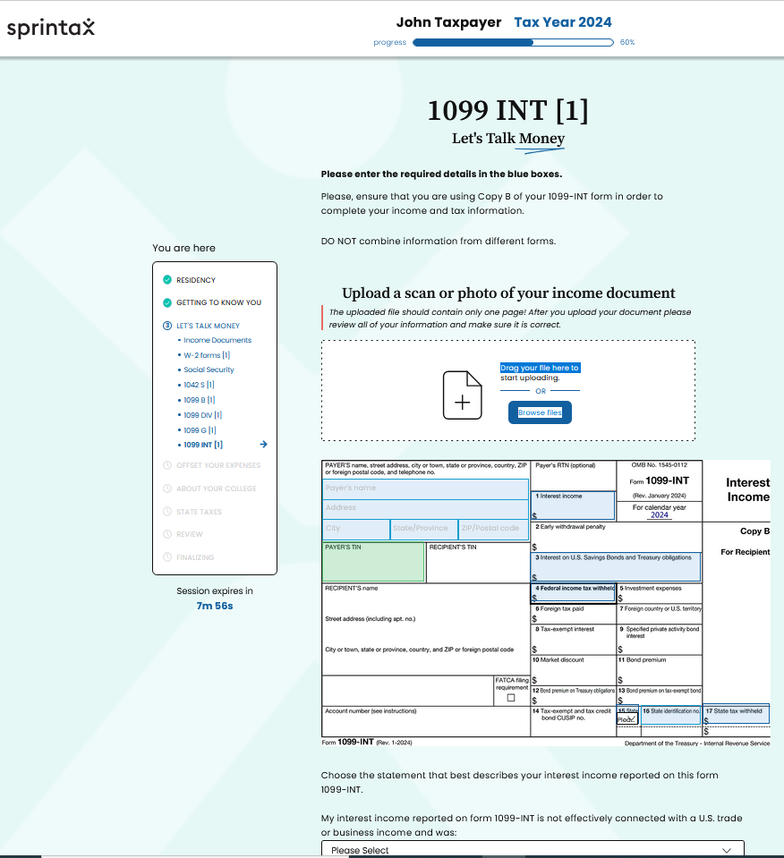
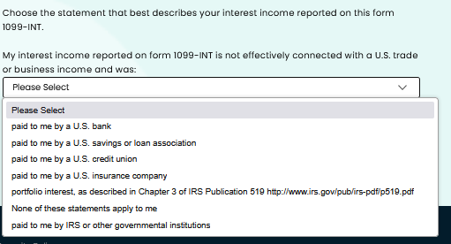
Step 18: Entering information from your 1099-INT
Once you have clicked the arrow on the previous page, you will now be prompted to fill out you 1099-INT, if you listed that in your income documents. This is another document you can upload but we recommend that you manually enter all the information as uploading does not always auto-complete the form properly. If you do upload, be sure to verify all boxes with information to make sure they are accurate. If you are manually entering the information, please make sure to enter the information in the appropriate blue boxes and verify it is accurate before clicking the arrow to continue.

Slide 26
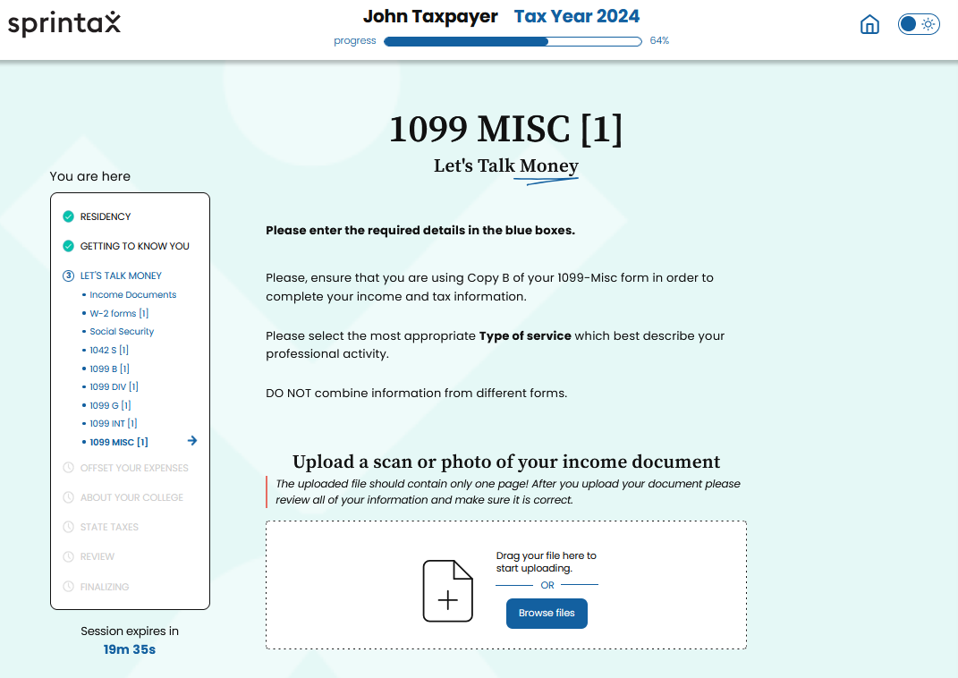
Step 19: entering information from your 1099-MISC
Next, if you listed that you have a 1099-MISC, you will need to enter that information here. Once again, you can upload but we strongly recommend that you manually type the information in below because the information sometimes does not automatically transfer correctly. If you do upload, please go line by line and check that all information is entered and accurate. If you plan to manually enter the information, scroll down and go to the next slide to see where you should enter that information.

Slide 27
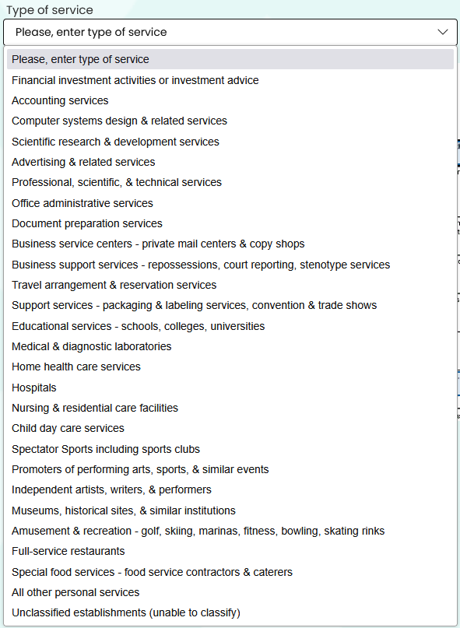
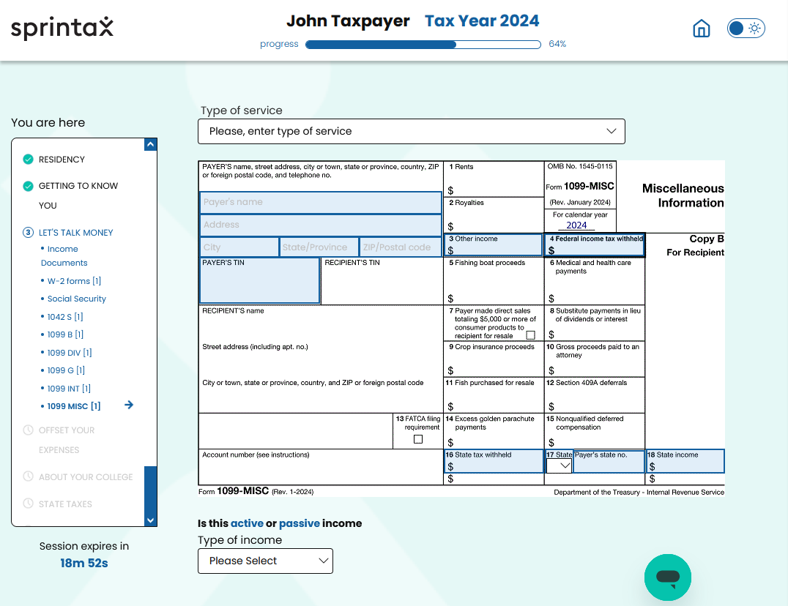
Step 19 Continued
To manually enter the information from you 1099-MISC, you will start by selecting the type of service that most closely matches where the income reported on this form comes from. After you have selected the service type, you will need to complete the blue boxes below and verify they are accurate. Once you have completed entering all the information, you will need to scroll down and answer a question before you can move on. See the next slide, for more information on that question.

Slide 28
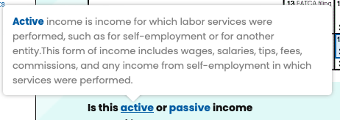
Step 19 Continued
After you have entered all the information from your 1099-MISC, you need to scroll down and select whether the income listed on this form is either active or passive income. Listed below are the definitions of “active income” and “passive income,” please read them carefully and select the type of income from the drop down menu based on how closely your income on the 1099-MISC matches one of these definitions.

Slide 29
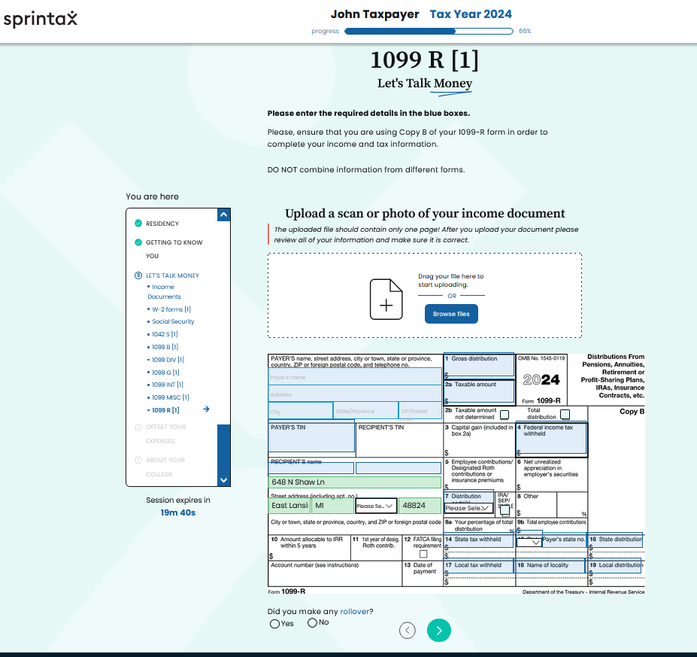
Step 20: Entering information from your 1099-R
Next, if you listed a 1099-R, you will be asked to enter information from that form. This form also allows you to upload a digital file, but we recommend that you manually enter the information because the information is not always accurate when uploading the document. If you do upload the document, please check every box and verify the information is accurate and what is stated on your form. If you manually enter the information, please scroll down and type the information on your 1099-R into the blue boxes and verify everything you entered is accurate.
Lastly, you will need to select either yes or no on whether you made any rollover in 2024. Rollover is defined as moving funds from one retirement account to another.

Slide 30
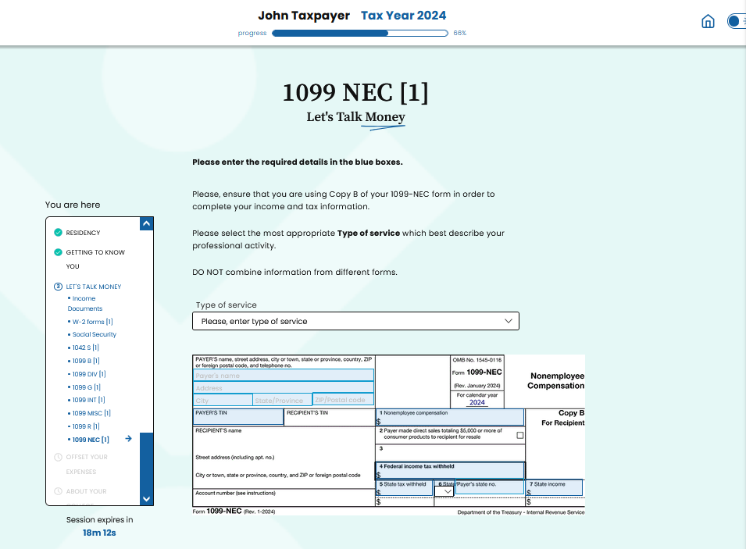
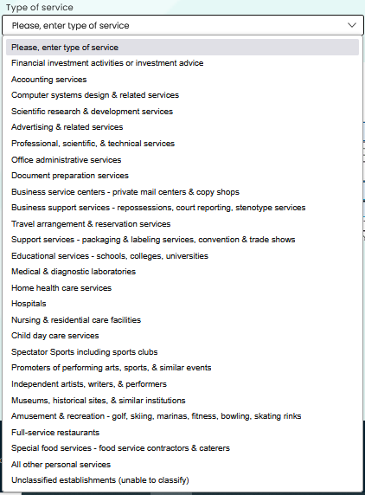
Step 21: entering information from your 1099-NEC
If you listed that you had a 1099-NEC, you will be asked to enter the information at this point. First, you will select the type of service from the drop-down menu that best matches the income listed on this document. Then you must manually enter the enter from you 1099-NEC by filling in the blue boxes below. Once you have verified the information is accurate, you can click the arrow to move on.

Slide 31
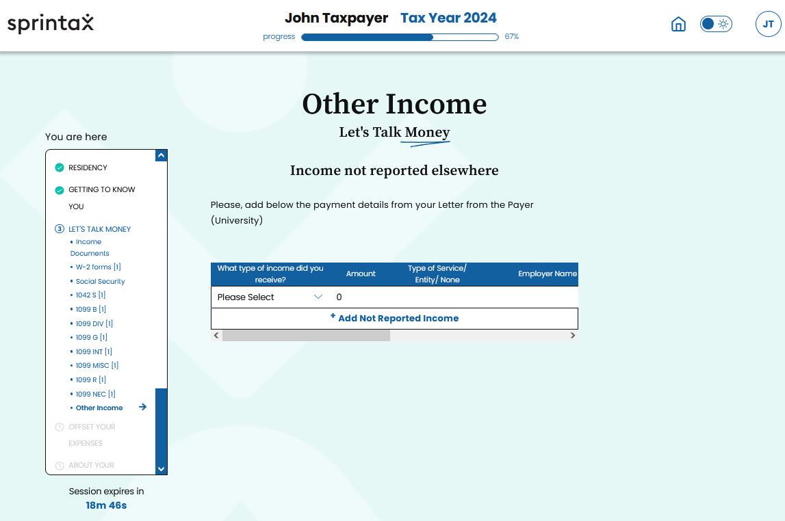
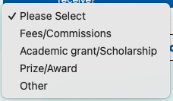
Step 22: entering information from your letter from the payer (University)
If you have any other income not reported elsewhere, you will select a Letter from the Payer (University) and enter that information here. You will start by selecting the type of income from the drop-down menu. Then you will type the amount you received below amount. You will likely then need to scroll over to the right so that you can enter the employer’s name, employer’s EIN, state abbreviation, and locality name.

Slide 32
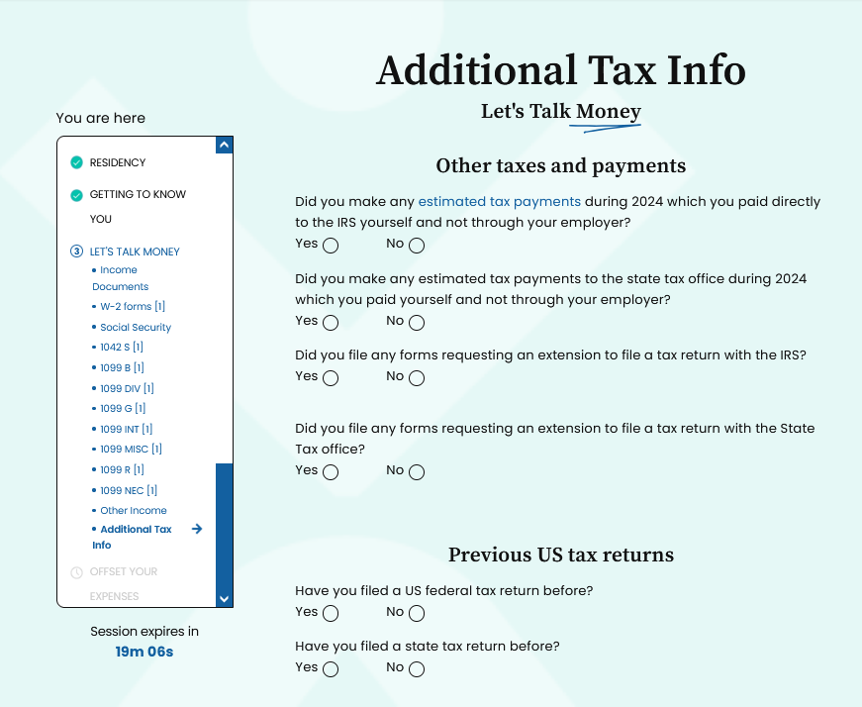
Step 23: additional tax information
Now that you have completed entering all your income documents, you will need to answer some additional questions. These questions deal with if you have made payments to the IRS or a state in 2024 as well as if you previously filed federal and/or state taxes.
Please see the next couple of slides for a break down of these questions.

Slide 33
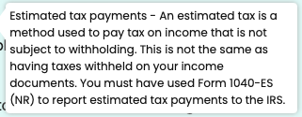
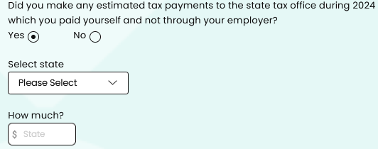
Step 23 continued
The first question is whether you made any estimated tax payments during 2024 that you directly paid to the IRS. Please see the above box for the definition of estimated tax payments. If you answer yes, you will be asked to enter the amount you paid. If you did not, click no and move to the next question.
You will next be asked in you made any estimated tax payments during 2024 that you paid directly to the state tax office. If you did, click yes and then enter the state you paid the tax to and how much you paid. If you did not make any direct payments, click no and then move on to the next question.

Slide 34
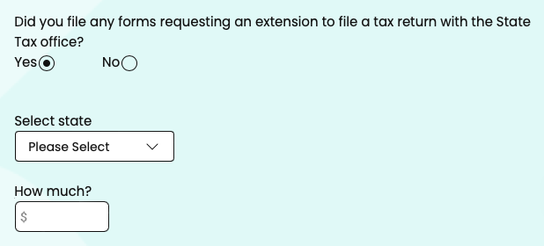
Step 23 continued
The next question you need to answer is if you have filed any forms requesting an extension to file a tax return with the IRS. If you have, click yes, and then it will ask if you paid any amount when you submitted that form and if you did, how much you paid. If you did not file an extension form with the IRS, click no and move to the next question.
Then you will be asked if you have filed any forms requesting an extension with the state tax office. If you click yes, you will be asked to provide which state and the amount you paid, if you paid anything when filing the extension. If you did not file an extension with the state, click no and move on to the next question.

Slide 35
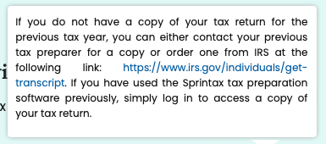
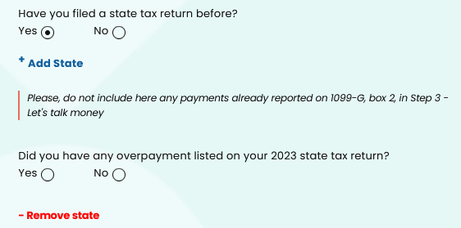
Step 23 Continued
Next, you will need to answer questions about any previous tax returns you have filed. The first is whether you have filed a US federal tax return before. If you click yes, you will need to select the most recent previous tax year you filed a federal tax return and what type of return you filed. If you are not sure what return type you filed most recently, please see the box above about how to get a copy. If you have not, click no and move on to the next question.
Then you will need to answer whether you have filed a state tax return previously. If you have, click yes and you will need to add what state you filed a return in. Then you will need to answer if you had an overpayment listed on your 2023 state tax return. If you have not filed a state tax return for the previous year, then you will click no and move on to the next page.

Slide 36
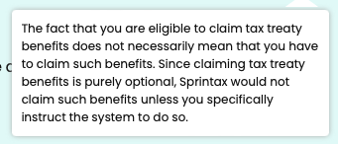
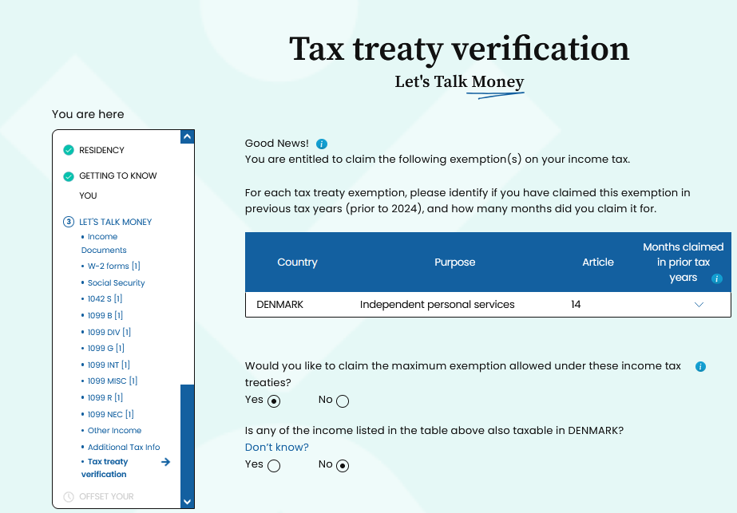
Step 24: Tax Treaty Verification
This next step involves tax treaty information. Depending on the country you are a resident of, there may be tax benefits you can claim if your country has a tax treaty with the United States. The United States does not have a tax treaty with every country so this screen may not appear at all when you are filing, you will just proceed with the rest of the filing. However, if your country and the United States have a tax treaty, those benefits will be displayed here. Please verify that the country listed below is the country you are a resident of.
Even if you have treaty benefits, you are not required to take them. It is important that before you select yes on the question asking if you want to claim the maximum exemption, that you review your country’s treaty benefits and decide whether to take them in part or whole. There can be restrictions associated with treaty benefits, such as having to repay the benefits if you stay over your expected visit, so please read the listed benefits carefully. If you have questions about your treaty benefits, you can contact the Tax Clinic.

Slide 37
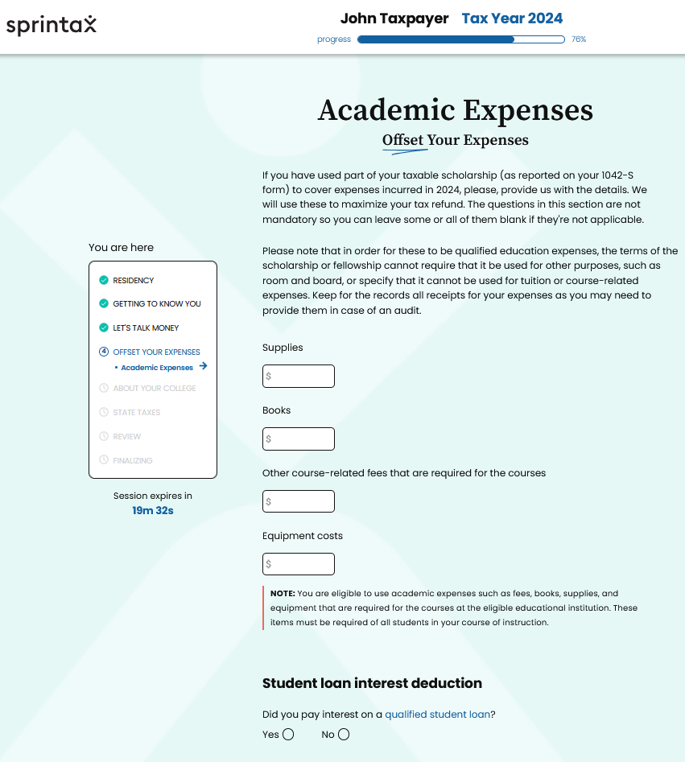
Step 25: Academic expenses
Next, if you have scholarship funds that you have listed, you are going to be asked to provide information on whether you used those scholarship funds on academic expenses in 2024. These questions are not mandatory and can be left blank as the instructions explain, but they are beneficial because they can decrease your tax liability. Please read the instructions before entering dollar amounts for each expense to make sure that what you are listing is an expense that is allowed to be claimed. If you choose to provide this information, fill out the boxes that apply with the amounts and then click the arrow to move on. If you do not want to provide this information, you can leave all the boxes blank and just click the arrow to move on to other parts of the return.

Slide 38
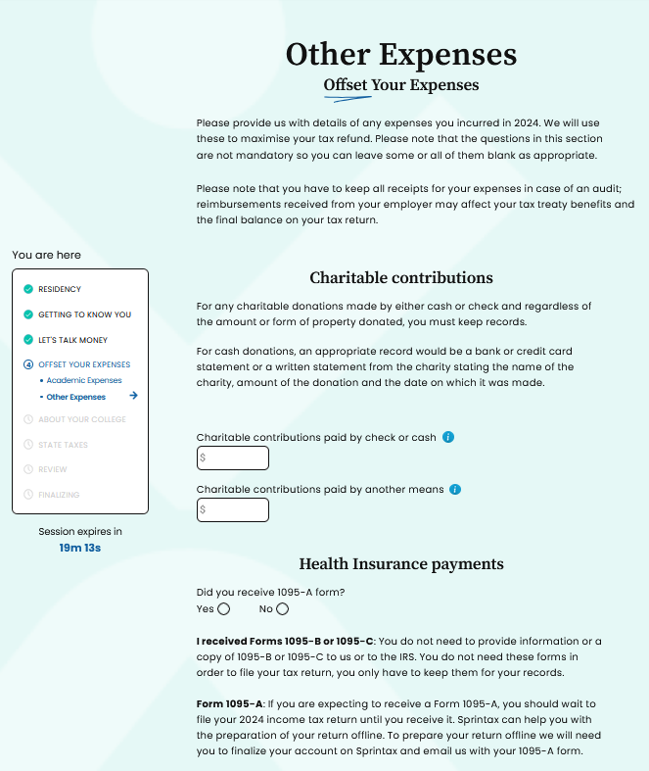
Step 26: Other Expenses
The next step is regarding charitable contributions and health insurance payments. Please read all instructions on this page as there are important instructions regarding the reporting of these other expenses. These other expenses are not required, you may elect to complete this portion or leave it blank and move on.
Charitable Contributions
Once you have read all the instructions, you can enter any charitable contributions you made in 2024. You will then be asked if you received a 1095-A form.
Health Insurance Payments
If you received a 1095-B or 1095-C form, you will not need to use that to file your taxes but you should keep it for your records. If you received a 1095-A, you will need to follow the instructions listed to get in contact with Sprintax so they can help you file correctly. Once you have completed these questions if you chose to, you will click the arrow and move on to the next page.

Slide 39
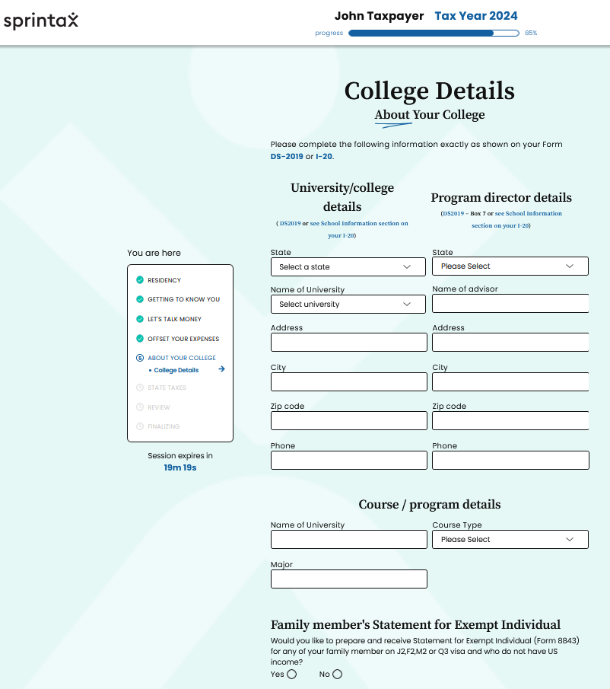
Step 27: College details
Next, you will be asked about your university’s information. You will need to fill this portion out exactly how it is stated on either your DS-2019 or I-20. You will need to provide the state your university is in, the name of the university, university’s complete address, and phone number. You will also need to provide your program director’s details such as the state they are located in, their name, complete address of the director’s office on campus, and their phone number.
Once you have provided information about your university/college and program director, you will be asked to provide details on your course/program. You will need to enter the name of your university, your course type (Bachelors, Masters, Doctorate, or Other), and your major.

Slide 40
Step 27 continued
IMPORTANT: If your spouse and/or dependents were present in the US in 2024 on an F or J visa, they must file Form 8843. This is the case even if they did not have any income. Sprintax charges an extra fee for the additional Forms 8843. The Clinic recommends that you do not use Sprintax for this as it is a relatively simple form and that you complete the form separately.
We have links to the form and all previous years’ forms on our website. Once completed, you should mail each Form 8843 for your spouse/dependents in a separate envelope, i.e., do NOT include it with you tax return.
Please see this link for Form 8843 as well as instructions on how to complete Form 8843: https://www.irs.gov/pub/irs-pdf/f8843.pdf
If you have any questions regarding how to complete a Form 8843 for your spouse or dependent, please contact the Tax Clinic and we will assist you.

Slide 41
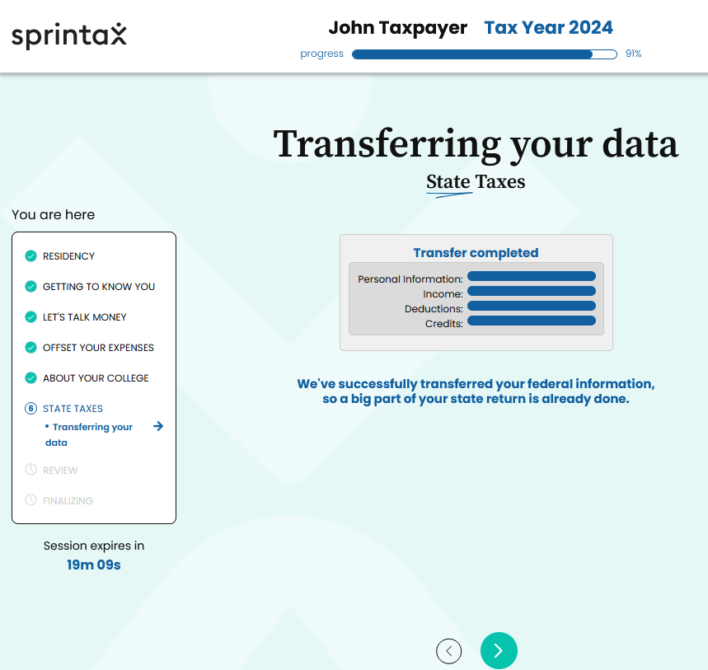
Step 28: Transferring your date for State Taxes
Next, if you selected to add on and pay the additional fee for Sprintax to file your state tax, this will be the screen you will see. Wait for it to say transfer complete and then click the arrow at the bottom to continue. If you did not select to pay the additional fee for Sprintax to prepare your state taxes, you will not see this screen and will move to the next step in filing.

Slide 42
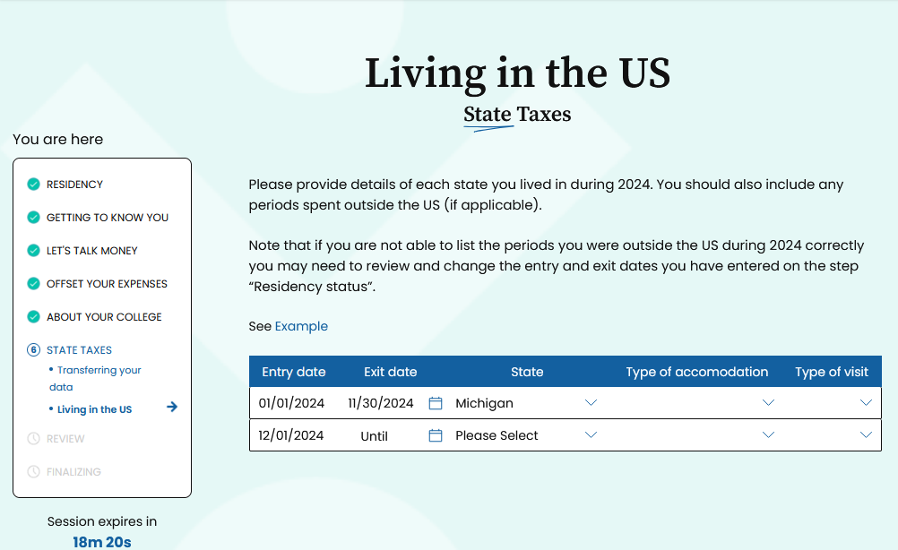
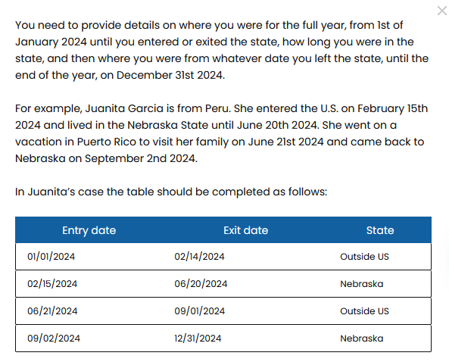
Step 29: time Living in the united states
Next, you will need to enter details regarding what state you have lived in during 2024 as well as periods of time that you spent outside the United States. Look at the example to better understand how you will need to fill out the chart. Once you have done that, complete the table with entry dates, exit dates, state you lived in or if you were outside the US, the type of accommodation you lived in during that period, and type of visit it was.

Slide 43
Step 30: State residency determination
You will then be asked questions regarding your state residency. You may have questions regarding a different state here. If that is the case, answer the questions accordingly and to the best of your knowledge.
For Michigan, if you have selected that you are married, it will ask you if your spouse has filed state taxes in Michigan for 2024. If they have, you will select yes and then be asked to provide whether they filed as married filing jointly or married filing separately. Most nonresidents cannot file joint tax returns so if your spouse selected married filing jointly for their tax return and is a nonresident, please contact the Tax Clinic for help.

Slide 44
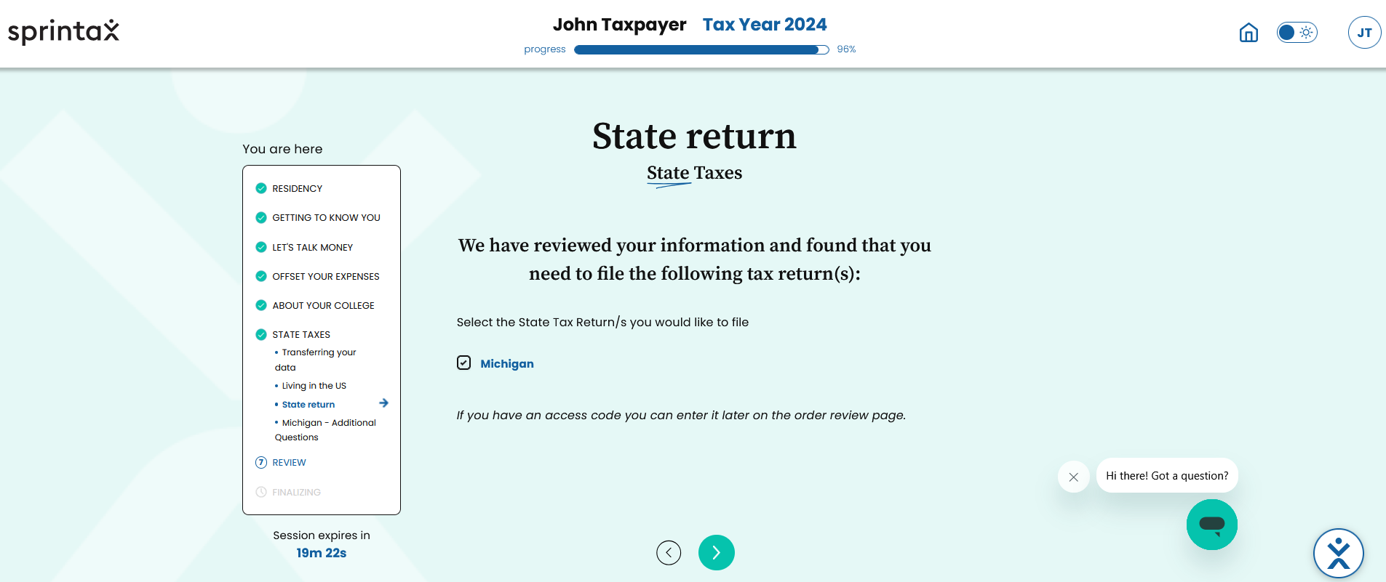
Step 31: State Return
Then you will be asked about your state return and provide you with a list of states you will need to file a state return based on the information you have provided previously. The code provided by MSU is only for a federal tax return, not state. If you want to use Sprintax to file your state return, you will have to pay additional money to do so. To proceed with Sprintax filing state taxes and paying the additional fee associated with it, you can click the box next to the state(s) you want to file and proceed by clicking the arrow. If you would prefer not to pay the additional fee, the Tax Clinic’s website has a tutorial for free to help you complete your Michigan return.

Slide 45
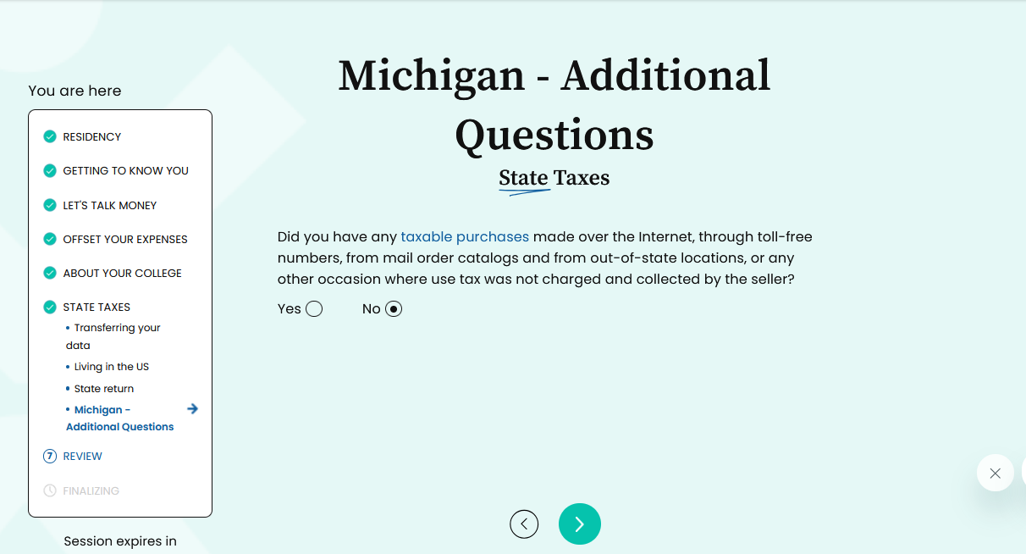
Step 32: Additional Michigan questions for state taxes
If you elect to file Michigan state taxes through Sprintax for an additional cost, you will be asked about taxable purchases you made during 2024. If you click yes, you will see two other questions pop up regarding the taxable purchases. Please answer these questions before clicking the arrow and moving on.

Slide 46
Step 33: Summary
Now you will review a summary of the numbers associated with your filing. First, you will be asked if a VITA Volunteer has helped you in preparing your tax return. You will select no since you are preparing this yourself. After answering that question, you will scroll down and review the numbers for your federal filing to start, and you should verify that all information looks correct. If it is not, you will have to go back to that point in Sprintax and make edits. You will then click the arrow at the bottom of the page and repeat this process of review for the state tax filing if you selected to have Sprintax file your state taxes for an extra fee.

Slide 47
Step 34: Final Confirmation
After you have reviewed your federal return summary and possibly your state return summary, you will click the arrow to continue, and this notice will pop up. Please read it carefully and verify that all the information you have provided is correct and that you have included all income documents. Once you have done so, you will click the yes button which will take you to the page where you will enter your code.

Slide 48
Step 35: Federal Tax review you are owed a refund
Once you have confirmed your information is correct, you will receive a screen that either states you are due a refund or that you owe federal tax. If you owe money, please see the next slide for information on that. If you are owed a refund, you will choose whether you want the refund to be transferred to a United States bank account, mailed a check, or put as a credit towards next year’s tax.
If you choose to transfer to a bank account, you will need to enter banking information. You will need to verify this very carefully because if the banking information is incorrect, you will lose your refund and be likely unable to get it back. If you choose to have a check mailed, please make sure the address provided is accurate (keep in mind it has to be mailed to a US address). If you will not be at that address for a while after filing your taxes, we recommend that you select the option to transfer to a US bank account instead. Do not select the option to apply the credit towards next year’s taxes.

Slide 49
Step 35: Federal Tax review – you owe money
After you confirm, you may get a screen instead that says you owe money. Below the amount you owe, there are two options for paying the amount you owe to the IRS, either by check/money order or using a credit or debit card. For either option you click, you will be alerted that instructions to pay your tax will be in your completed packet at the end of this filing. Please read those instructions carefully. If you cannot afford to pay the full balance, pay as much as possible and then contact the Tax Clinic for other payment options.

Slide 50
Step 36: State Tax Review
If you elected to have Sprintax file your state taxes, the next screen will be a review of your state tax and what steps you want to take whether you get a state refund or you owe more state tax. The options below will all be the same as you chose before for your federal taxes so you can make your decision and then fill out the required information and proceed to the next step. Remember, do not select the credit towards next year’s tax option under refund.

Slide 51
Step 37: Post-Filing support
The next screen you will see is regarding post-filing support. This is not included in the code you have received from MSU, and you would need to decide whether you want to purchase this package additionally for a separate fee. Please read the top portion about what this is and if you had any other questions, use the live chat feature with Sprintax. While we cannot guarantee it, the Tax Clinic may be able to assist you with any notice the IRS or state may send you if we have availability. If you do not want to pay the additional fees listed, you will check the box at the bottom that says you will handle your own post-filing communication. If you do decide to pay the additional fees and have this post-filing support, select the option you would like to purchase for the additional fee. It is not required for you to file your taxes. Once you have decided on this additional service, you will click the arrow to continue.

Slide 52
Step 38: Sprintax forms
After the post-filing support, there will be another option for an additional service to purchase. This page is referencing a Form W4 which is needed for starting a new job in the United States, and it is not required to file your 2024 tax return. If you would like to purchase this additional option, you can do so but it is not required to file your taxes. If you would like to purchase this additional service for a fee, you can click the button that says, “Get taxed correctly.” If you do not want to purchase this for an additional fee, click the underlined words below the button that say, “Proceed without Sprintax Forms.” The words will then be circled once you click on them, and you can click the arrow to continue on to the next page. MSU Tax Clinic can assist MSU students and scholars who have questions when starting. a new job,

Slide 53
Step 39: Review and entering code
Now you are at the step of reviewing the pricing of the additional items and then entering your code MSU provided for your federal return. Please enter the unique code emailed to you in the white box where it says access code and then hit validate. Once you click validate after entering the code, the federal price will be taken off and you will just have the remaining balance of additional services you may have elected. If you did not add any additional services and you just have your federal filing, your amount should equal $0 after entering the code.

Slide 54
Step 40: payment
After you have reviewed the charges for the different services and entered your code provided by MSU, you will see this screen. You will verify the amount is either $0 for only a federal return or whatever dollar amount your additional services cost. You will click checkout to continue to the next step.

Slide 55
Step 41: checkout
Once you have clicked ”Checkout” on the previous screen, you will see this screen appear. If you only selected a federal filing and entered the code, you will see you owe $0 and you will hit complete order. If you selected additional options in Sprintax, you will see a balance that you will need to pay in order to access the forms needed for filing. You will click ”Complete order” and be redirected to your filing in Sprintax. After you have clicked “Complete order” you should also receive an email from Sprintax saying that your 2024 return is now complete. You have not filed at this point and still have remaining steps to file your taxes!

Slide 56
Step 42: Download files
Now you need to download your tax return for filing. First, you need to confirm your SSN or ITIN on the forms listed on this page. You will then scroll down and click the “Download” button under Federal Tax Return. You should save this document to your computer and keep it for your records. Read all the instructions provided in the PDF version of your tax forms once you have downloaded it. You should read through the entire return and make sure everything looks accurate prior to taking any further steps.

Slide 57
Step 43: Printing and Signing your return
Once you have saved a digital copy of your return to your computer for your records, you will need to print out a physical copy of your return. Once you have reviewed the return that you have printed out, you will need to sign your return in pen, and it must be a blue or black pen (we recommend blue pen for signatures). You also need to make sure you write the date next to your signatures. Once you have signed the documents, you will need to mail the documents to the address provided in your Federal Tax Return that you downloaded from Sprintax. Please see the next slide for more information on mailing your tax return.

Slide 58
Step 44: Mailing your return
Once you have printed and signed your forms, you will need to put them in the mail as early as possible but must be postmarked at the latest on April 15, 2025.
You will mail your documents to the address provided in the instructions that are included when you download your documents from Sprintax. If you would like clarification or more information regarding the address, please see the MSU Tax Clinic’s website at https://taxclinic.law.msu.edu/International-Students-and-Scholars
To mail your tax return, you can use the United States Postal Service, UPS, or Fedex, and we recommend that you mail your documents with tracking, that way you can know that they did in fact arrive. Please keep mailing information in your records as well.
Please keep in mind that if you used Sprintax to complete your state return, you will need to mail your State Tax Return to a different address than where you will mail your Federal Return and they will need to be in separate envelopes. Please see your Sprintax instructions for more information regarding where to send your State Return.

