Slide 1

Floating Offshore Wind Turbines
Notes:
Introduce NYPA and yourself, get to know students.

Slide 2
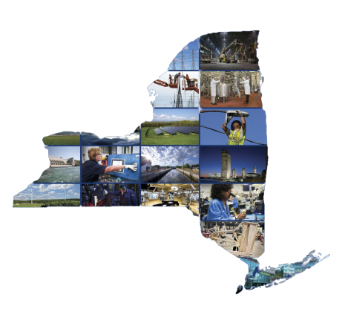
Who and What is
New York Power Authority?
Notes:
<Narrative> NYPA is the largest state-owned power facility in the nation, with 16 generating facilities in New York State producing approximately 5826 MWs of electricity. They are a national leader in promoting energy efficiency, the development of clean energy technologies and electric vehicles.
Their energy services projects can be found throughout New York State, saving money and megawatts while helping reduce greenhouse gas emissions. Over 80% of NYPA’s electricity is produced through hydroelectric power.
Recently, NYPA has become involved in another type of renewable energy, wind. Once the wind turbine produces electricity, it has to be distributed throughout NYS through transmission lines.
NYPA will be building these transmission lines that will connect the wind turbines, located offshore, to communities on shore.
Why is this important?
The Climate Leadership and Community Protection Act (CLCPA) is legislation that addresses the climate crisis and sets ambitious goals for NYS to achieve, such as having zero-emission electricity by 2040 and an 85% reduction in greenhouse gas emissions by 2050, which will be achieved by using renewables such as hydropower, wind, and solar. NYS goal is to add 9000 MW of Wind energy by 2035!!

Slide 3
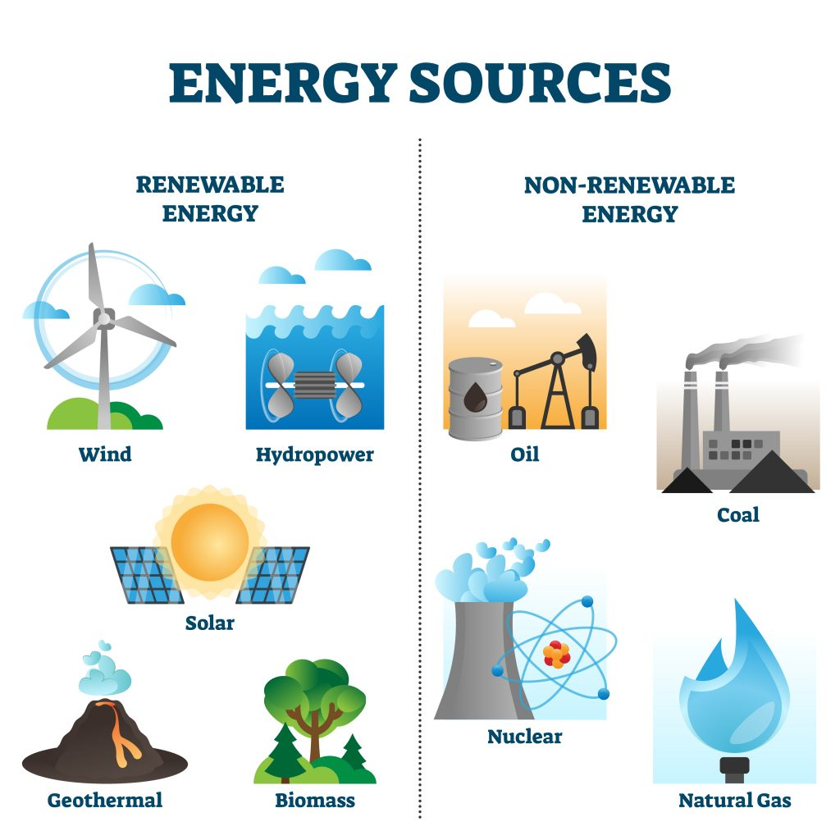
What are
Renewable
Energy Sources?
Why are they important?
Notes:
<Narrative> Ask students the answer questions on the screen. Students will have a variety of answers. Validate their responses and focus on renewable sources. There are 3 major categories for electricity generation - fossil fuels (coal, natural gas, and petroleum), nuclear energy, and renewable energy sources.
Today we are going to focus on learning more about one specific renewable Wind Energy. Our goal is to use what we learn today to do a hands-on activity soon.

Slide 4

Notes:
<Narrative> How does wind energy work? Let’s watch a video about a young boy and his mom talking about wind turbines. Ask students What did you learn from this video?
<Teacher Notes> Check for understanding before moving on to the next slide by asking students to share facts about wind turbines that they learned from the video.
<Video Credit> Video- Energy Basic 1:37

Slide 5
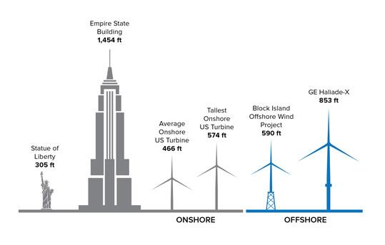
The Size of Wind Turbines
Notes:
<Narrative> Wind Turbines are used throughout New York, both on land and close to the shore. Based on their location they use different foundational structures. If they are on land or shallow waters, they are fixed foundation turbines. Wind turbines built far offshore or in deeper water are referred to as Offshore Floating Wind Turbines.
Can you think of why offshore floating wind turbines are a better idea than those on land or in shallow waters?
Ask students for answers, Validate student answers and make sure the following points have been mentioned:
reduce visibility from the shore
less impact on marine life and the fishing industry
the impact on birds and the environment is less
helps by not competing for land
results in lower construction costs
higher and steadier wind
There is nothing blocking or slowing the wind down on the ocean, which allows for stronger, more reliable wind conditions. Therefore they allow for more opportunities for the wind turbines to capture the potential energy.
<Picture credit>
https://www.nyserda.ny.gov/-/media/Project/Nyserda/Images/Programs/Offshore-Wind/1-2_Turbine-Size_539x344.jpg

Slide 6
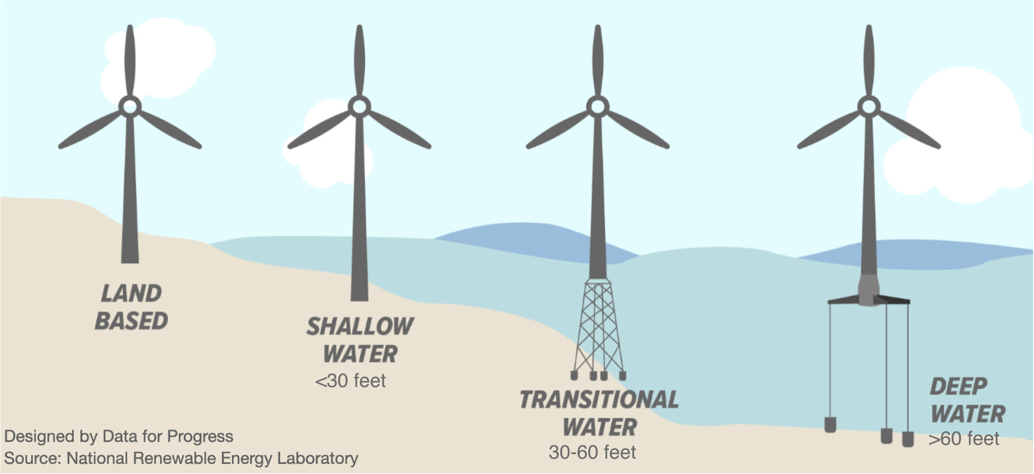
Types of Wind Turbines
Notes:
<Narrative> As we just learned wind turbines are complex and big machines with a lot of moving parts. In addition to the mechanics of the turbines, the turbines need to be built to withstand all sorts of weather and other natural forces. Wind Turbines are used throughout New York, both on land and close to the shore. based on their location they use different foundational structures.
If they are on land or shallow waters, they are fixed foundation turbines. Wind turbines built far offshore or in deeper water are referred to as Offshore Floating Wind Turbines. Over the last decade there has been a push to build wind turbines offshore - far offshore in deep waters.
Why do you think there is a push for offshore wind turbines?
Take a look at this image, what do you notice about the foundations?
Wind turbines on land or in shallow water are fixed into grounds
Wind turbines in medium depth water have a structure that is fixed into the ground
Wind turbine in deep water are floating with anchors
<Teacher Note> Students will give various answers, validate answers and point out the tan in land, and the blue is water and the structures that are holding each up. Show how the deep water turbine base is in floating in the water.
If they are on land or shallow waters, they are fixed foundation turbines. Wind turbines built far offshore or in deeper water are referred to as Offshore Floating Wind Turbines. Over the last decade there has been a push to build wind turbines offshore - far offshore in deep waters.
Take a look at this image, what do you notice about the foundations?
Wind turbines on land or in shallow water are fixed into grounds
Wind turbines in medium depth water have a structure that is fixed into the ground
Wind turbine in deep water are floating with anchors
<Teacher Note> Students will give various answers, validate answers and point out the tan in land, and the blue is water and the structures that are holding each up. Show how the deep water turbine base is in floating in the water.

Slide 7
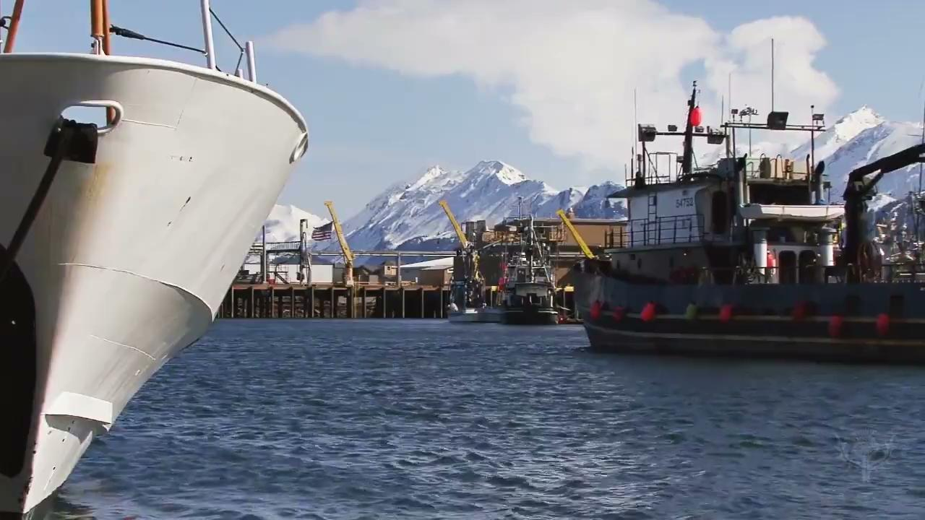
Why things float or sink?
Notes:
<Narrative> How can such huge structures float and not “fall to one side or the other or sink.” Let’s watch this short video to learn more. After the video ask students what did you learn about what things float?
<Teacher Note> There are two important forces: gravity and buoyancy that make it possible for the floating turbine to stay vertical.
Gravity is a force pulling together all matter (which is anything you can physically touch). The more matter, the more gravity. Gravity is the force pulling you down.
Buoyancy is the upward force that keeps things afloat in liquids. Water exerts a force on the contacting surface of the board. Buoyancy is the force pushing you up.
<Video credit> Discover why an object will float or sink 1:49 min of video

Slide 8
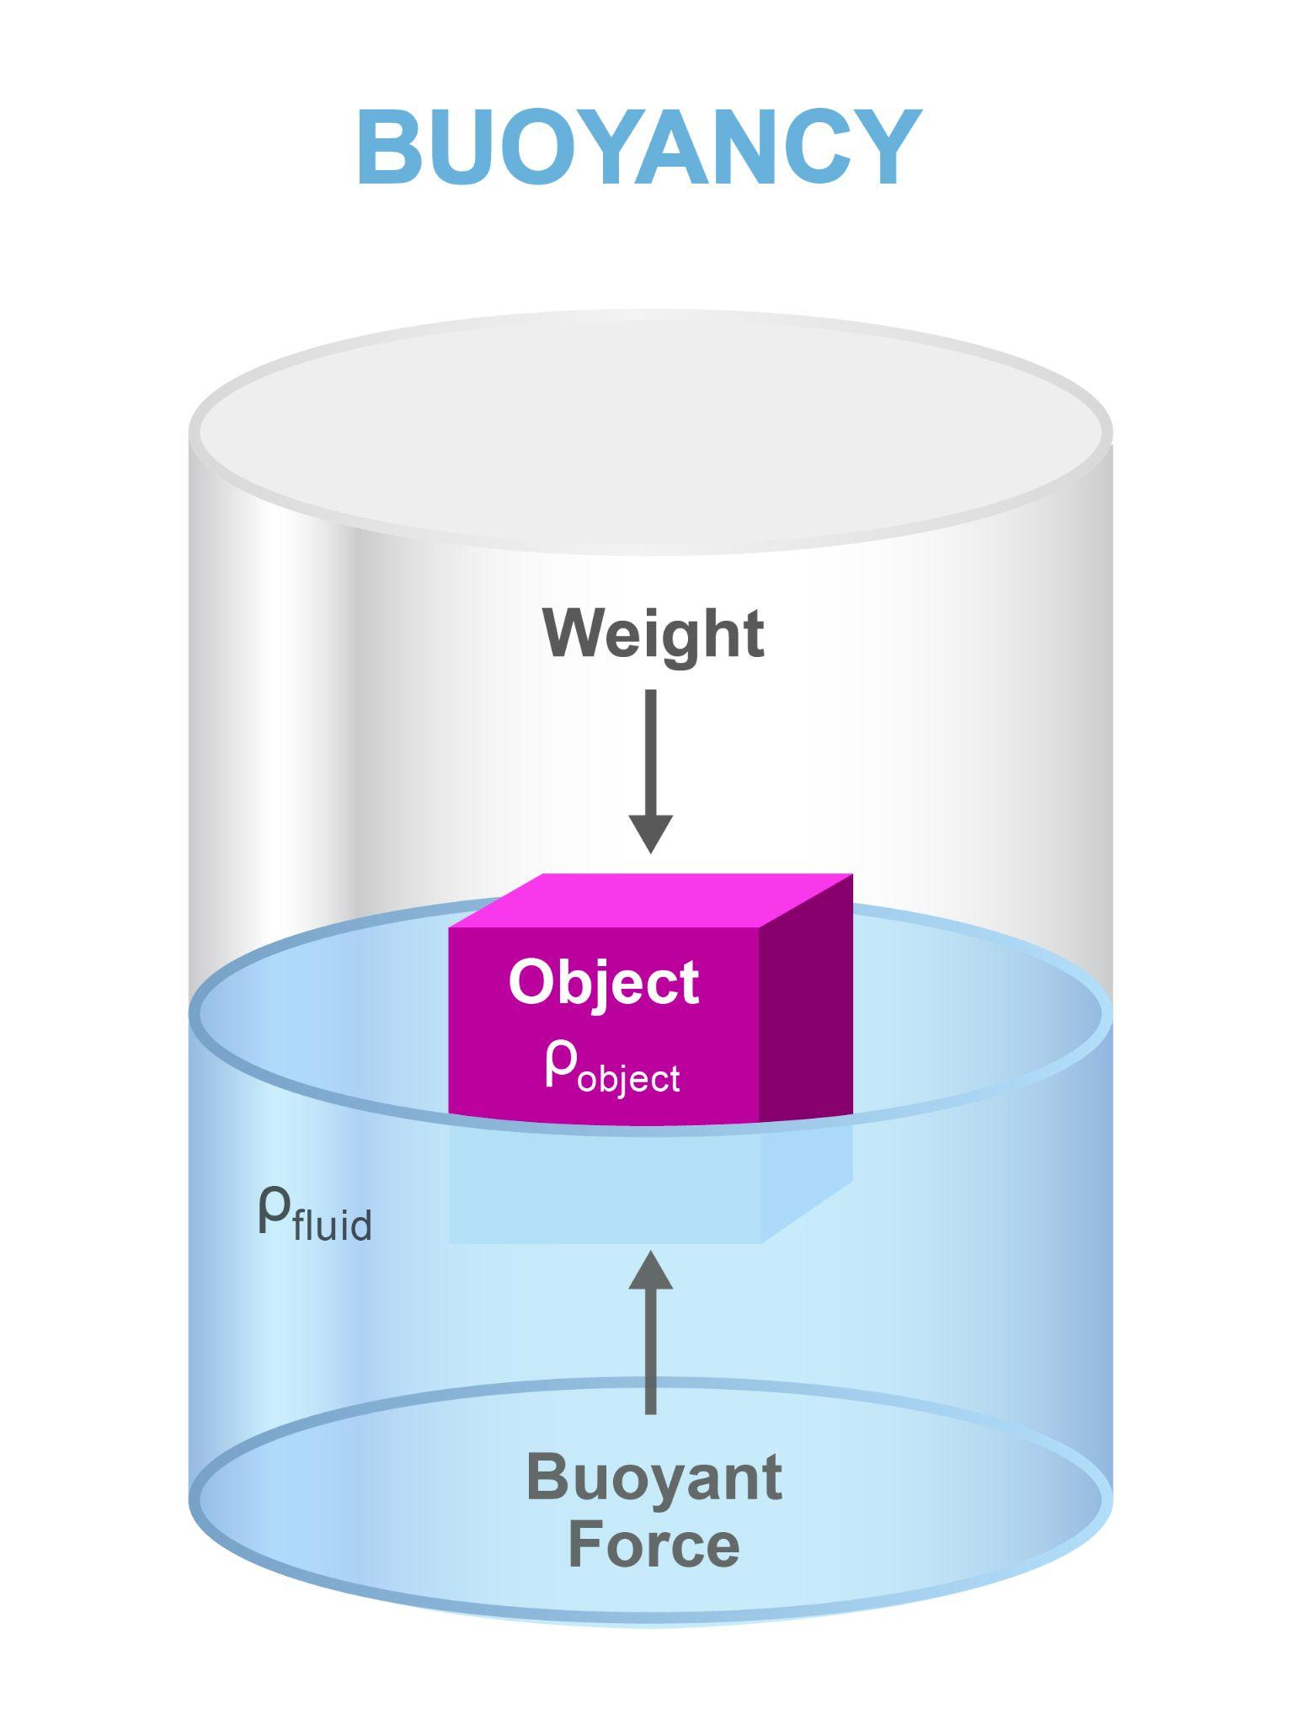
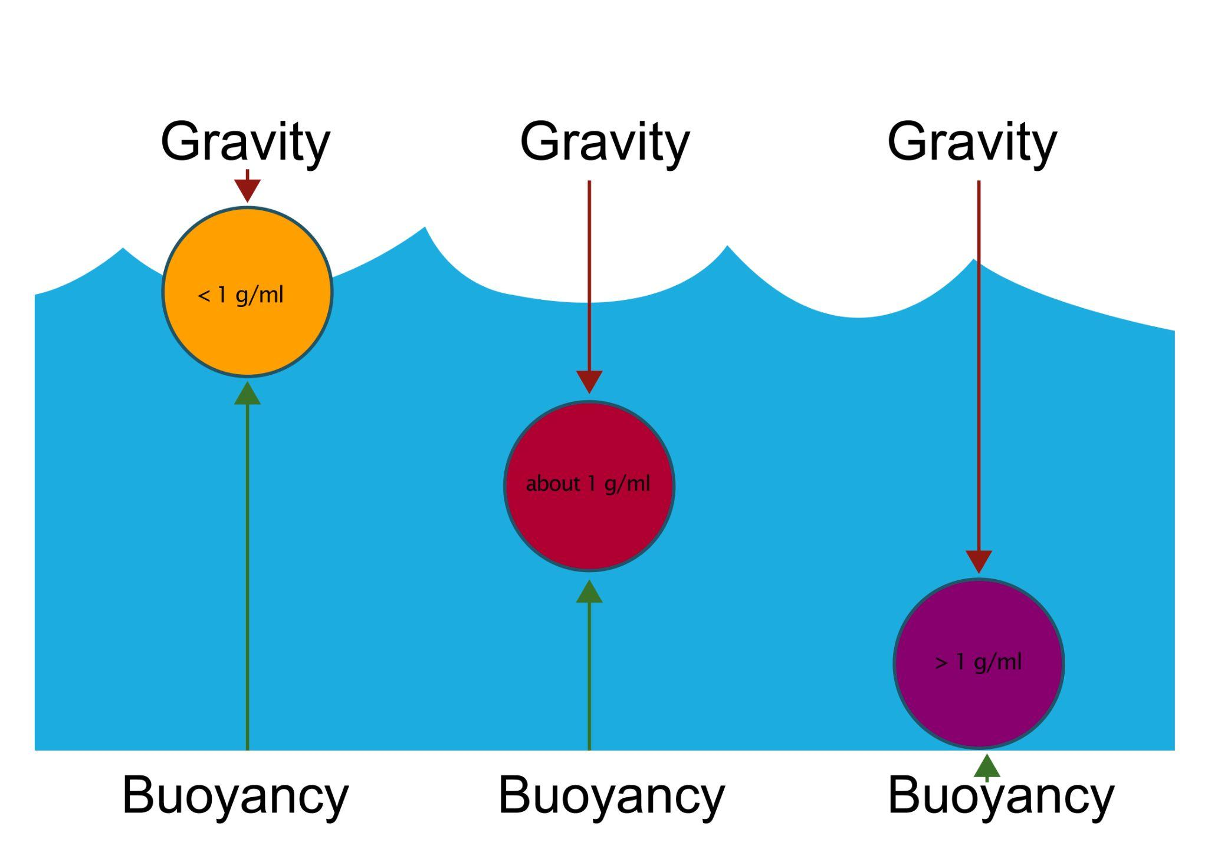
Buoyancy and Center of Gravity Demonstration
Notes:
<Narrative> Let’s discuss what makes things float or sink or stay in between. I have 3 test tubes that I will use to demonstrate positive, negative, and neutral buoyancy and gravity in action.
<Teacher Demonstration> Demonstrate positive, negative, and neutral buoyancy using the labeled test tubes provided and a bucket of water. Focus on showing students about buoyancy and how having a lower center of gravity creates balance and stability.
The empty test tube labeled Positive Buoyancy will float.
The filled test tube labeled Negative Buoyancy will sink.
The test tube filled half way, is labeled Neutral Buoyancy and will float vertically.
Teacher NOTE With so many variables continually knocking the turbine out of its equilibrium there needs to be a way that the foundation is able to continually correct itself and not tip over. Returning to equilibrium may be referred to as a restorative force (pulling it back into place) versus a destructive force (when pushed to a certain angle the object tips/falls over).
<Narrative>
Positive buoyancy is created when there is less gravity pushing down and more buoyancy pushing up
Negative buoyancy is created when there is more gravity than buoyancy
Neutral buoyancy which enables something to neither completely float or completely sink. This happens when there is an equal amount of buoyancy and gravity.
Ask students: What do they notice about the different test tubes, what makes one float, one sink and one stay in the middle?
<Teacher Note> Don’t tell the students how this is connected to wind turbines. They will explore these concepts as they build their floating wind turbines.

Slide 9
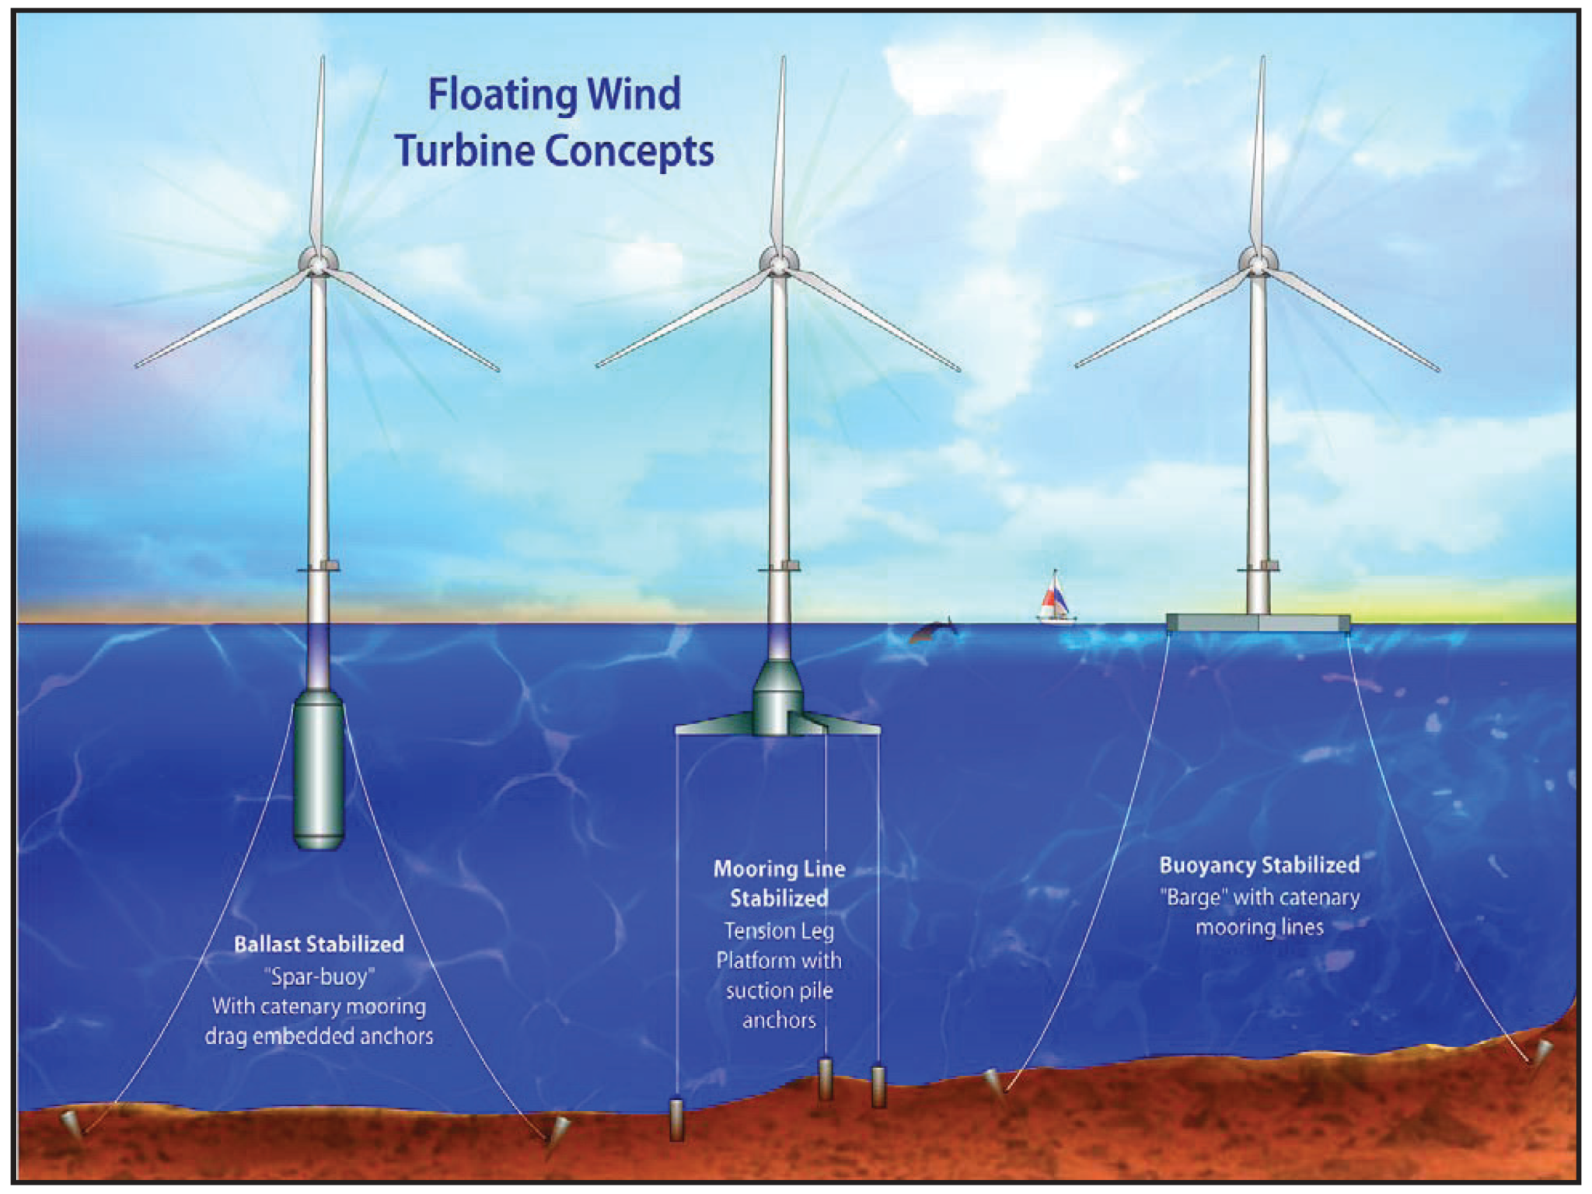
Structural Engineers, it is your turn!
Construct a stable floating foundation
for a Floating Offshore Wind Turbine
The floating foundation needs to take up the least amount of surface area as possible and guarantee stability and balance at all times.
What do we need to be thinking about?
How do we create neutral buoyancy?
Will the foundation be able maintain balance from the waves and the wind?
Notes:
<Narrative> You are now NYPA Engineers working on constructing an offshore floating wind turbine - focusing on creating a stable floating foundation. Construct a stable floating foundation for a floating offshore wind turbine. Your floating foundation needs to take up the least amount of surface area on the water as possible and guarantee stability and balance of a wind turbine above the water at all times. Working with your team, you have a set of materials you can use: test tubes, weights, masking tape to build your floating foundation. Then balance the wind turbine on top of the floating foundation and make it permanent using double sided tape. As you plan out your build ask yourselves:
What do you need to be thinking about when you are building a floating foundation?
Creating neutral buoyancy so the test tubes can float
Foundation stability and balance, while having the smallest possible footprint.
<Teacher Notes> Group students into groups of three or four depending on the total number of students. Each group will have their own materials kit and share buckets of water. Student handout guides tell students exactly what to do in building the structure - feel free to work through the test tube part together. Even if you build the structure together, the students still need to figure out how many marbles in each tube will be needed to make the test tubes stable and vertical in the water. State how much time they will have and give them a signal when there is 5 minutes left. Circulating around the room while students work. Encourage students to test and then modify one part at a time.
Walk around throughout the activity. Try not to “give the answer” to questions but rephrase the questions so they do the “thinking.”
Examples of pointed questions, you might ask:
Why is the turbine not stable? Or standing upright?
What adjustments have you made? What adjustment might you try?
What role do the marbles play? How do they contribute to the buoyancy of the wind turbine?
Examples of general questions, you might ask:
What do you think will happen if we change this variable?
How do you think this will affect the outcome of the experiment?
What do you predict will happen next?
What do you think will happen if we do this differently?
How can we test your prediction?

Slide 10
Share & Reflect!
What was challenging about building your floating offshore turbine?
What advice would you share with other students building floating wind turbines?
Notes:
<Teacher Note> Allocate at least 10 minutes. Make sure to leave enough time at the end for students to reflect and discuss. This is when the real learning happens. The structures that the students built should be floating in containers at this time.
If a group didn’t finish, that is OKAY. Focus on the reflection and process. Remind students that engineers do not always succeed and most learning happens when things do not work out the way they want.
<Narrative> Before having students reflect on the questions have groups share their builds.
Ask students these reflection questions:
What was challenging about building your floating offshore turbine?
Possible student answers: unable to keep it from tipping, not enough marbles.
What advice would you share with other students building floating wind turbines?
Possible student answers: use more marbles/weights, experiment and record the information.

Slide 11
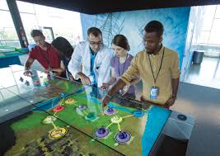
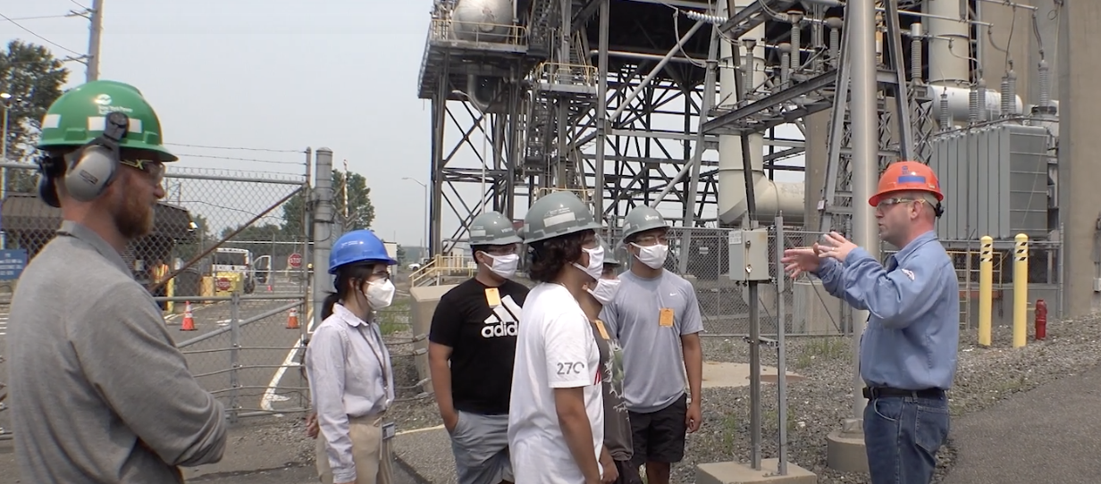
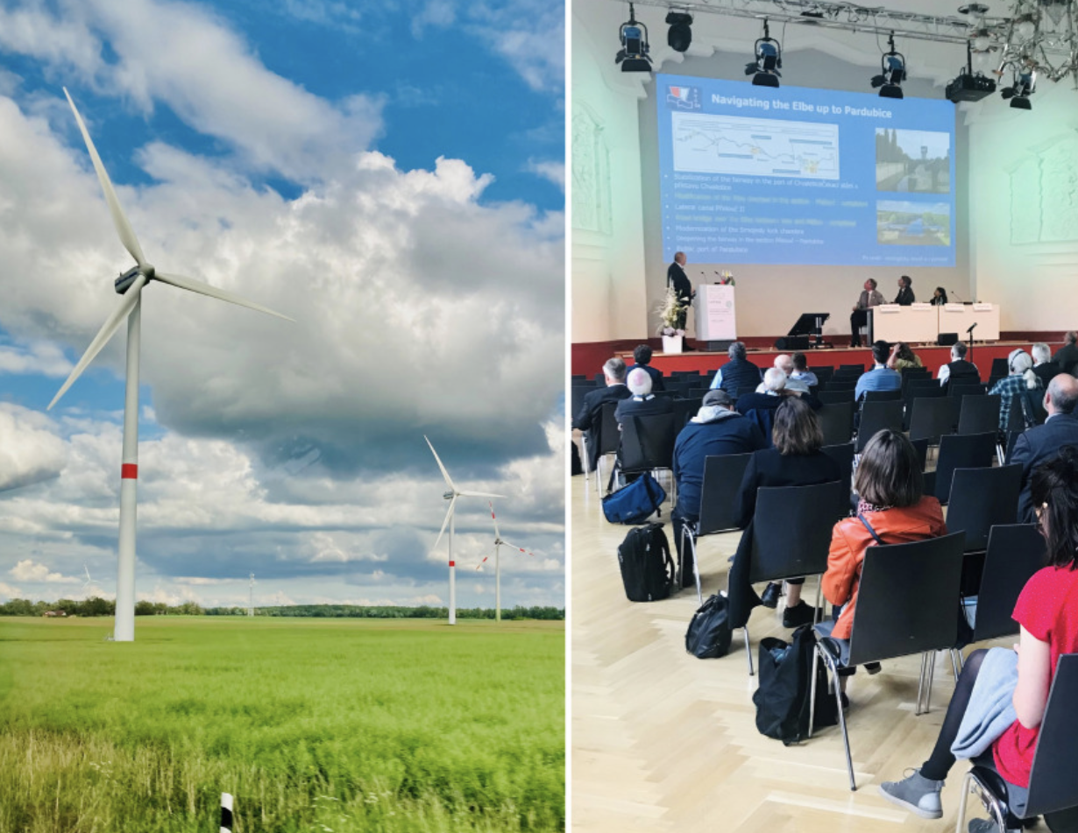
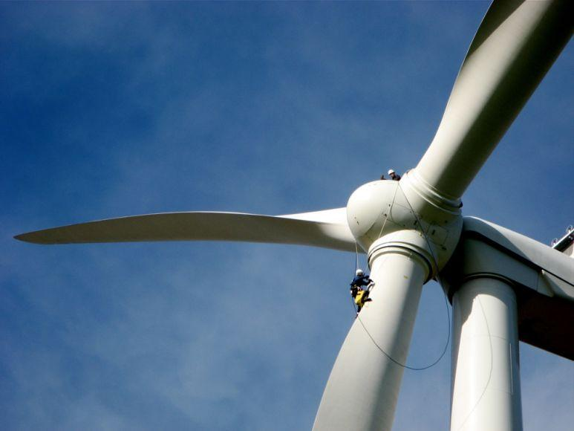
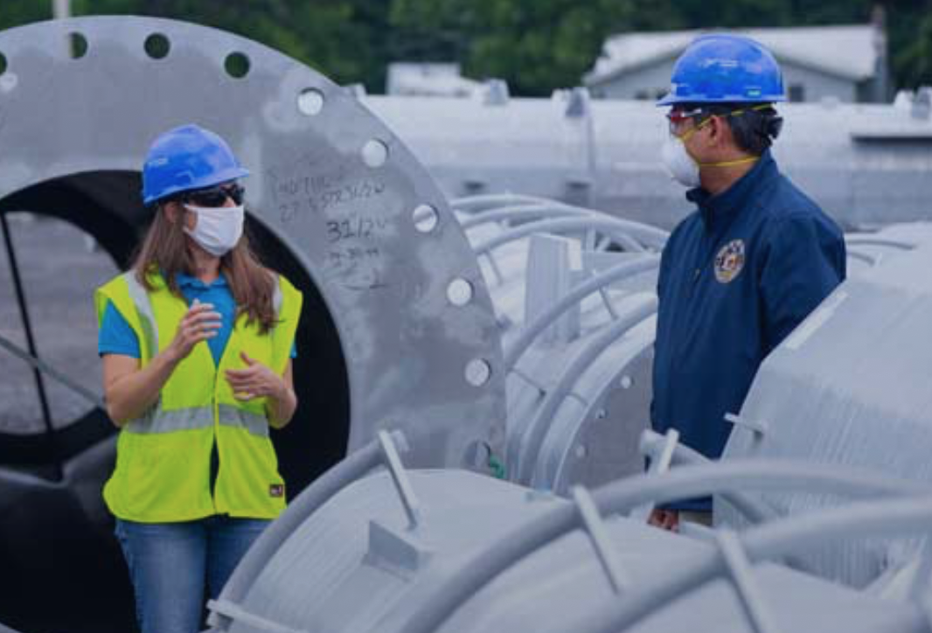
You are the engineers of the future!
What careers do you think you could have with NYPA in the future?
What problems do you want to solve?
Notes:
Today you were NYPA engineers, You helped us explore the feasibility of offshore wind turbine farms. Offshore wind has opened the door to many new careers, and NYPA renewable and non-renewable energy to solve a problem and transmit electricity to a city building. NYPA has thousands of electricians, engineers and others that keep all of our lights on day to day. Everyday the citizens of New York State use more and more electricity in different ways, we need your great minds to keep the lights on and design solutions for our communities now and in the future.
What careers do you think you could have with NYPA in the future?
What problems do you want to solve?
THANK YOU!!
We really enjoyed being with you today, If you have questions, we can answer them as we wrap up our time together today.

