Slide 1
Electricity Basics
What is electricity?

Slide 2

Who and What is
New York Power Authority?
Notes:
Introduce NYPA and yourself, get to know students.

Slide 3
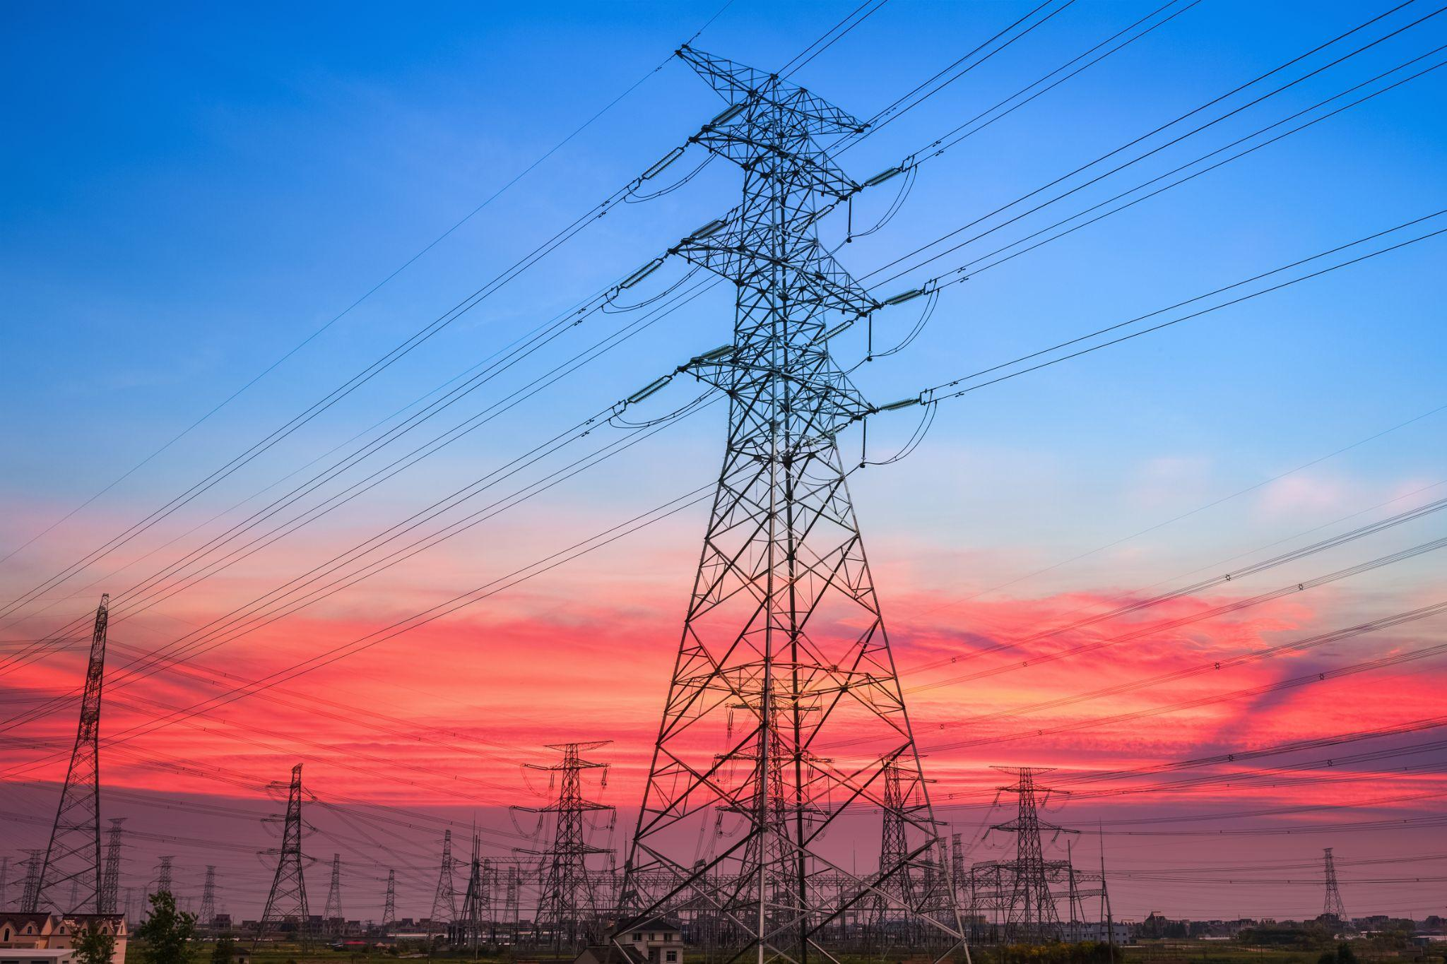
Think of 3 things
that you could not live without
that use electricity?
1
2
3
Notes:
Ask students to share out some things that use electricity that they use everyday. Expand their minds with suggestions for other things they are not mentioning.
Lights, cell phone, computer, TV, gaming systems, air conditioning, oven, microwave, laundry, traffic lights, signs, cars, refrigerator, alarm clocks, bumper cars, trains, subways, buses…

Slide 4
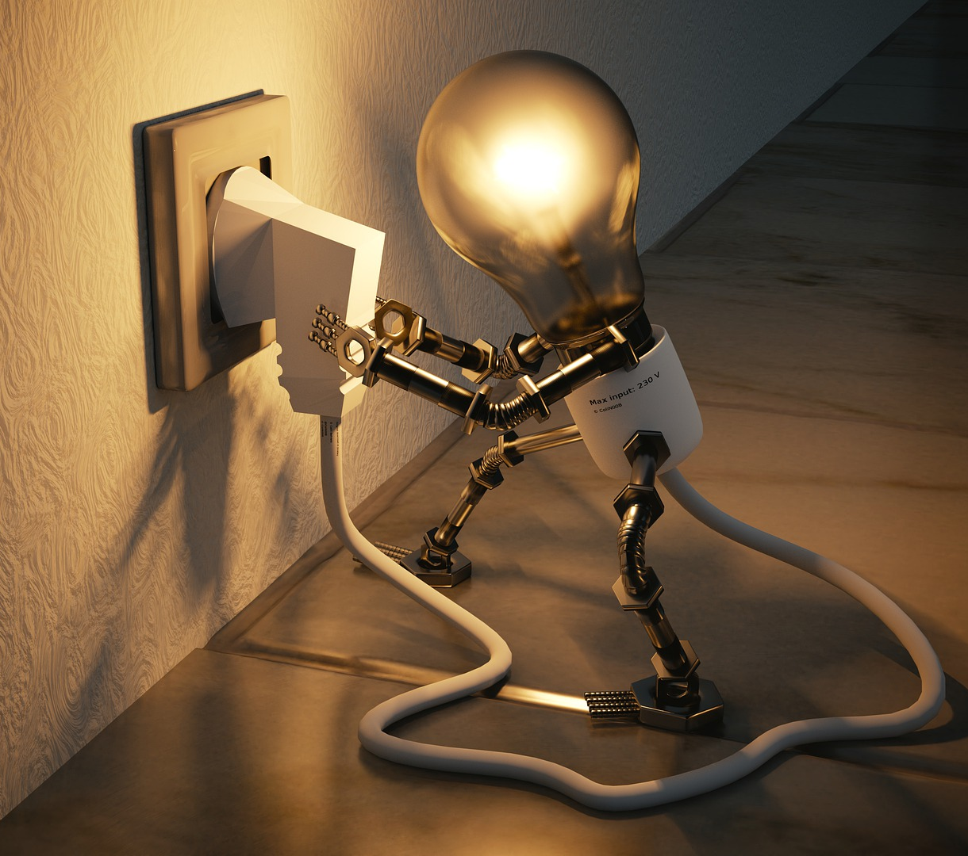
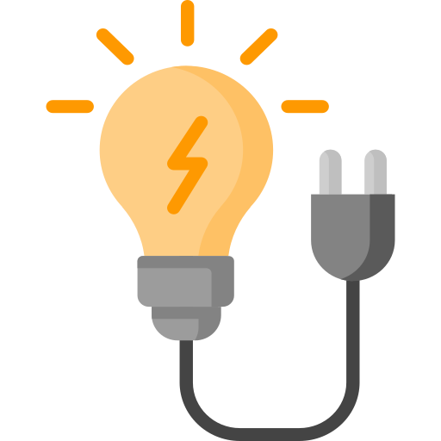
What is electricity?
Electricity is the flow of tiny particles called electrons moving through a circuit.
Notes:
Electricity is the flow of electrical energy. Electricity is when tiny subatomic particles called electrons can flow through a circuit. Electricity energy is when tiny particles called electrons are moving through a circuit.

Slide 5
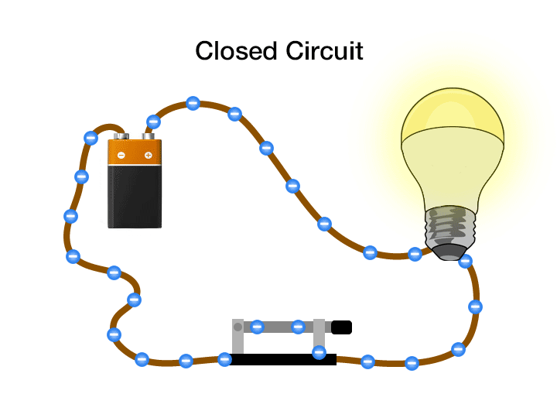
What is electricity?
Electricity is the flow of tiny particles called electrons moving through a circuit.
Notes:
Electricity is when tiny particles called electrons can flow through a circuit. Electricity is the flow of electrical energy. Electricity energy is when tiny particles called electrons are moving through a circuit.
A simple circuit is made up of four parts: a load - the lightbulb, the power source - battery, the switch and the path or wires. A closed circuit is a when the path of electricity can flow from the power source through the path to the load back to the power source.
We do things to control electrons in a circuit all day long, we turn on a light switch and make a closed circuit so the electrons can flow to the lights. We plug in our phones to charge and we make a closed circuit for electrons to flow to the battery of the phone.

Slide 6

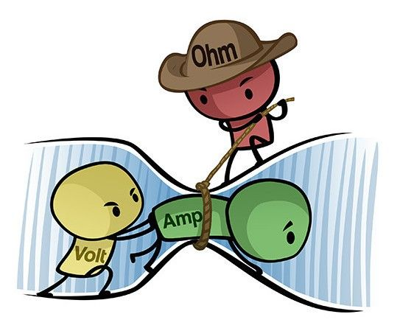
Ohm’s Law
The pressure is called volts. The voltage pushes electrons.
Current is the amount of electrons are called amps.
The opposition to the electrical flow is resistance.
Power
(Watts)
Current X Voltage
Voltage
Current X Resistance
Electricity is measured by the amount of pressure moving through a circuit and the amount of electrons in the circuit.
Notes:
Electric circuits have pressure & flow
Voltage is the pressure, the higher the voltage the more electrons are pushed to move.
The number of electrons flowing through the circuit are called amps. It is the amount of electrons in the circuit. The more amps the more electrons.
The opposition to the flow of electricity is resistance or ohms.
When you combine volts and current you get watts or the measure of power. 100 watt light bulb takes 100 watts of power.
Ohm’s law may be easier to understand with an analogy. Current flowing through a wire is like water flowing through a hose. Increasing voltage with a higher-volt battery increases the current. This is like opening the tap wider so more water flows through the hose. Increasing resistance reduces the current. This is like stepping on the hose so less water can flow through it.
Greater voltage results in more current and greater resistance results in less current. In other words by doubling the voltage across a circuit the current will also double. However if the resistance is doubled the current will fall by half.

Slide 7

New York Skyline lights are turned off.
Let’s build a circuit to turn them back on.
Activity 1
Notes:
Let’s make our own circuits! We have a dilemma and NYPA needs your help. The NYC skyline seems to have lost all power and we need your help to build the circuitry that makes it light up the night sky. Before we can fix the NYC Skyline let’s go over some basics to make sure we have what we need to resolve this issue and do it safely. We are going to use the materials in our kit to build a circuit to turn the city lights back on.

Slide 8
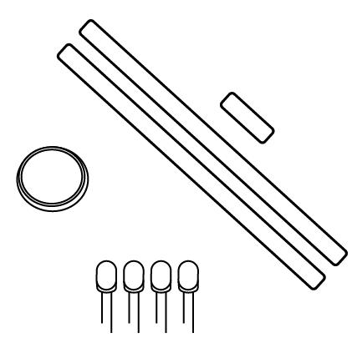
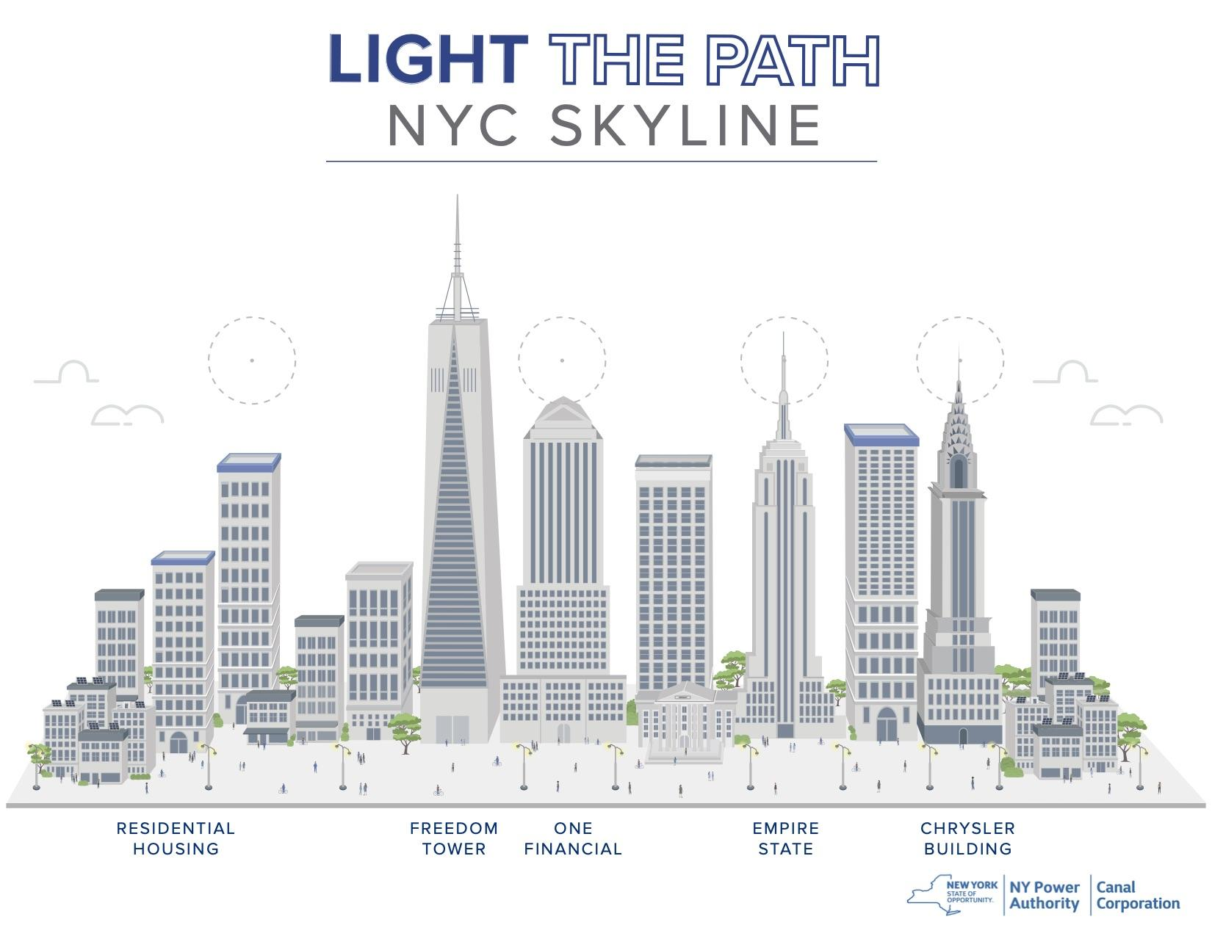
ACTIVITY 1
New York City Skyline
MATERIALS
Notes:
These are the materials in your bag. Your student guide will tell you all of the instructions. Follow along step by step.

Slide 9
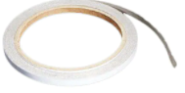
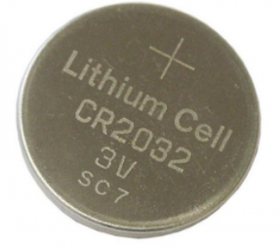
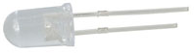
Maker Tape
PATH
Battery
POWER SOURCE
LED light
LOAD
Notes:
Show Materials in Kit: These are the materials in your bag. Your student guide will tell you all of the instructions...
Maker Tape is the path for the circuit, it conducts electricity and is sticky once you pull off the white paper. Use your thumb to roll the tape towards you to stick on your thumb.
LED is the light. Notice the LED has a shorter leg and longer leg. The shorter leg is negative and the longer leg is positive. Electrons only flow in one direction in these light emitting diodes. The shorter leg always needs to be on the same side of the circuit as the negative side of the battery. And the longer or positive side needs to be connected to the positive (+) side of the battery.
Battery is the power source - the battery has a + on the positive side

Slide 10
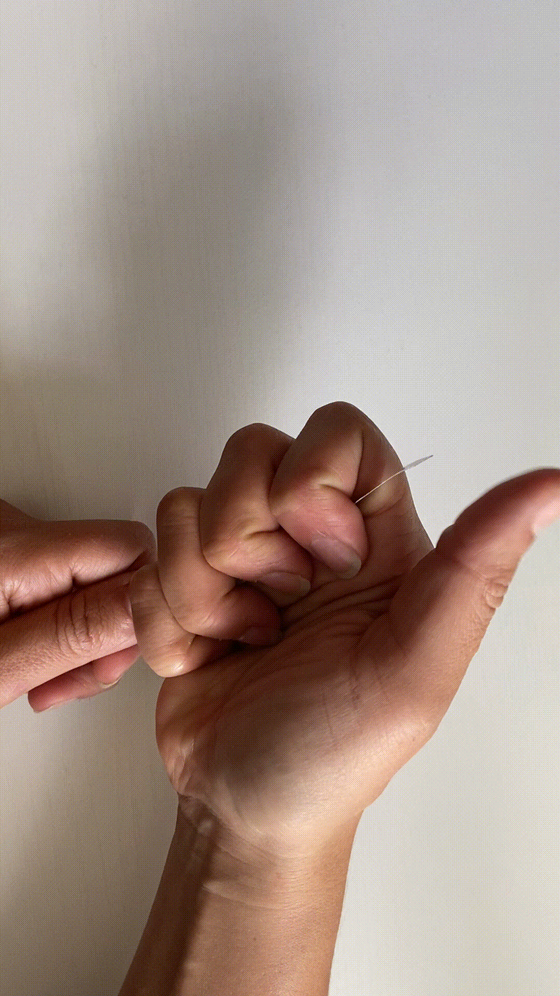

How to peel Maker Tape
Notes:
​​Hold the gold side of the Maker Tape facing your thumb and roll your thumb over the top of the Maker Tape and down. The sticky side of the tape will catch on your thumb.

Slide 11

Safety
Do not put electrical
components in your mouth.
Always have a load
in the circuit.
Never run the path directly from the battery, back to the battery.
If anything get hots,
call over the teacher.
Notes:
Review Safety Notes

Slide 12
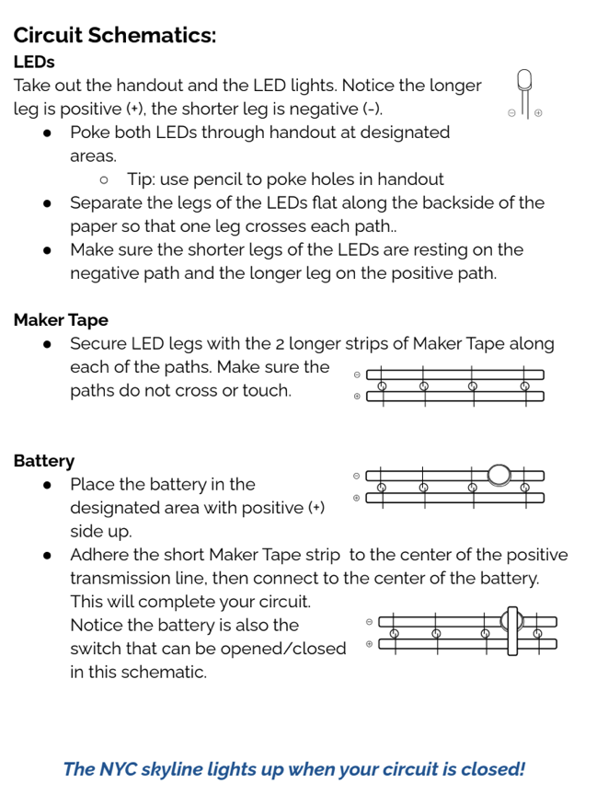
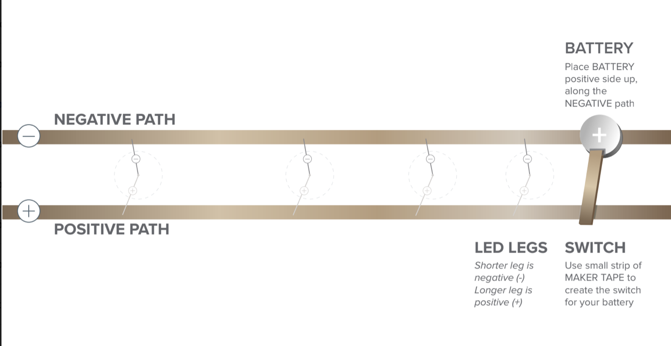
Let’s Build
Notes:
LEDs
Take out the handout and the LED lights. Notice the longer leg is positive (+), the shorter leg is negative (-).
Poke both LEDs through handout at designated areas.
Tip: use pencil to poke holes in handout
Separate the legs of the LEDs flat along the backside of the paper so that one leg crosses each path..
Make sure the shorter legs of the LEDs are resting on the negative path and the longer leg on the positive path.
Maker Tape
Secure LED legs with the 2 longer strips of Maker Tape along each of the paths. Make sure the paths do not cross or touch.
Battery
Place the battery in the designated area with positive (+) side up.
Adhere the short Maker Tape strip to the center of the positive transmission line, then connect to the center of the battery. This will complete your circuit. Notice the battery is also the switch that can be opened/closed in this schematic.

Slide 13

Notes:
Yay! We have light the New York Skyline. You are going to be great electrical engineers that NYPA needs. Have student clean up their workspace

Slide 14

WONDER TIME
Notes:
Slide to be used to transition from building mode to reflection time.

Slide 15
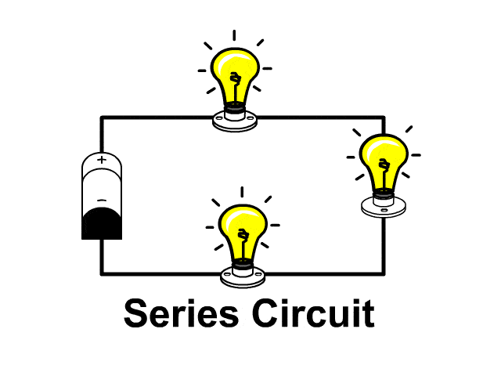
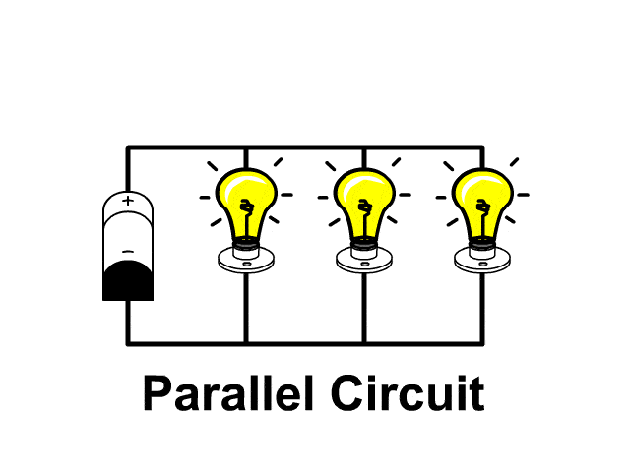
What is a circuit?
Notes:
What type of circuit did you create today?
A simple circuit is made up of four parts: a load - the lightbulb, the power source - battery, the switch and the path or wires.
A series circuit is when the path of electricity can flow from the power source through the path to the load back to the power source. If there are multiple load points along the path, and disruption occurs, power will be lost to all load points along the circuit. If one light bulb is broken or taken out, all of the lights will shut off.
In a parallel circuit, the electricity has multiple paths to travel to the various load points within the circuit. If a disruption occurs within one path, it will not disrupt the flow of electricity to the others. If one light bulb is broken or taken out, all of the other lights will stay on!
We do things to control electrons in a circuit all day long, we turn on a light switch and make a closed circuit so the electrons can flow to the lights. We plug in our phones to charge and we make a closed circuit for electrons to flow to the battery of the phone.

Slide 16
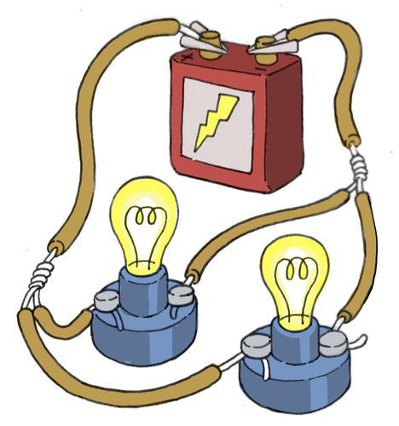
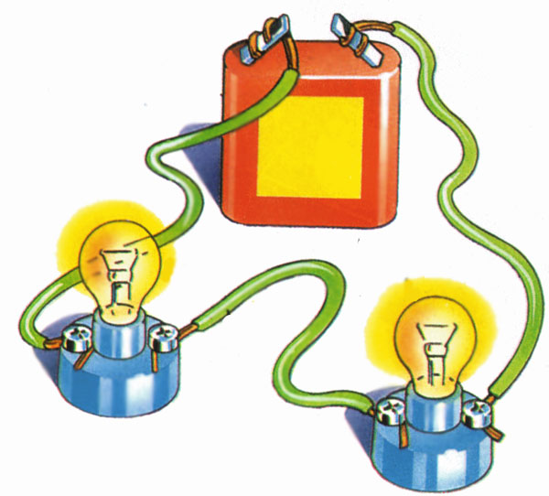
What is the difference between a series and parallel circuit?
Notes:
Series circuit - all of the lightbulbs are on one path
Parallel circuit - all the lightbulbs are on separate paths.
Which type of circuit did you create today?
Parallel
What are the basic components of a circuit?
Power source - battery, outlet, solar panel, generator
Load - light bulb, motor
Path - maker tape, wires, metal, water, humans

Slide 17
What does Ohm’s Law help us do?
Notes:
Ohms law helps us to understand the components of our circuitry. Helps keep us safe by telling us what load we can use and what resistance we need. We can use Ohm’s law to control the amount of current in a circuit, adding resistors to reduce the current flow and taking them away to increase the amount of current.

Slide 18
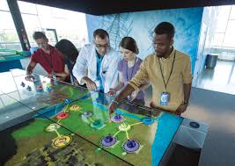
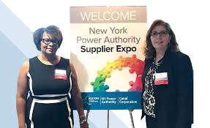
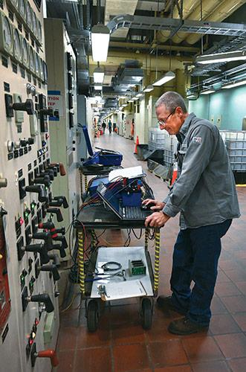
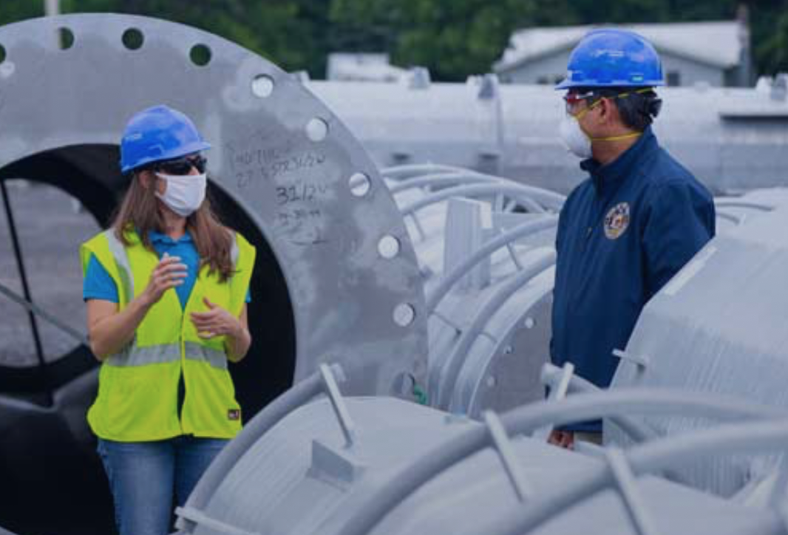
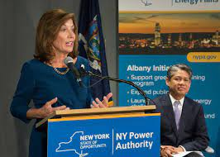
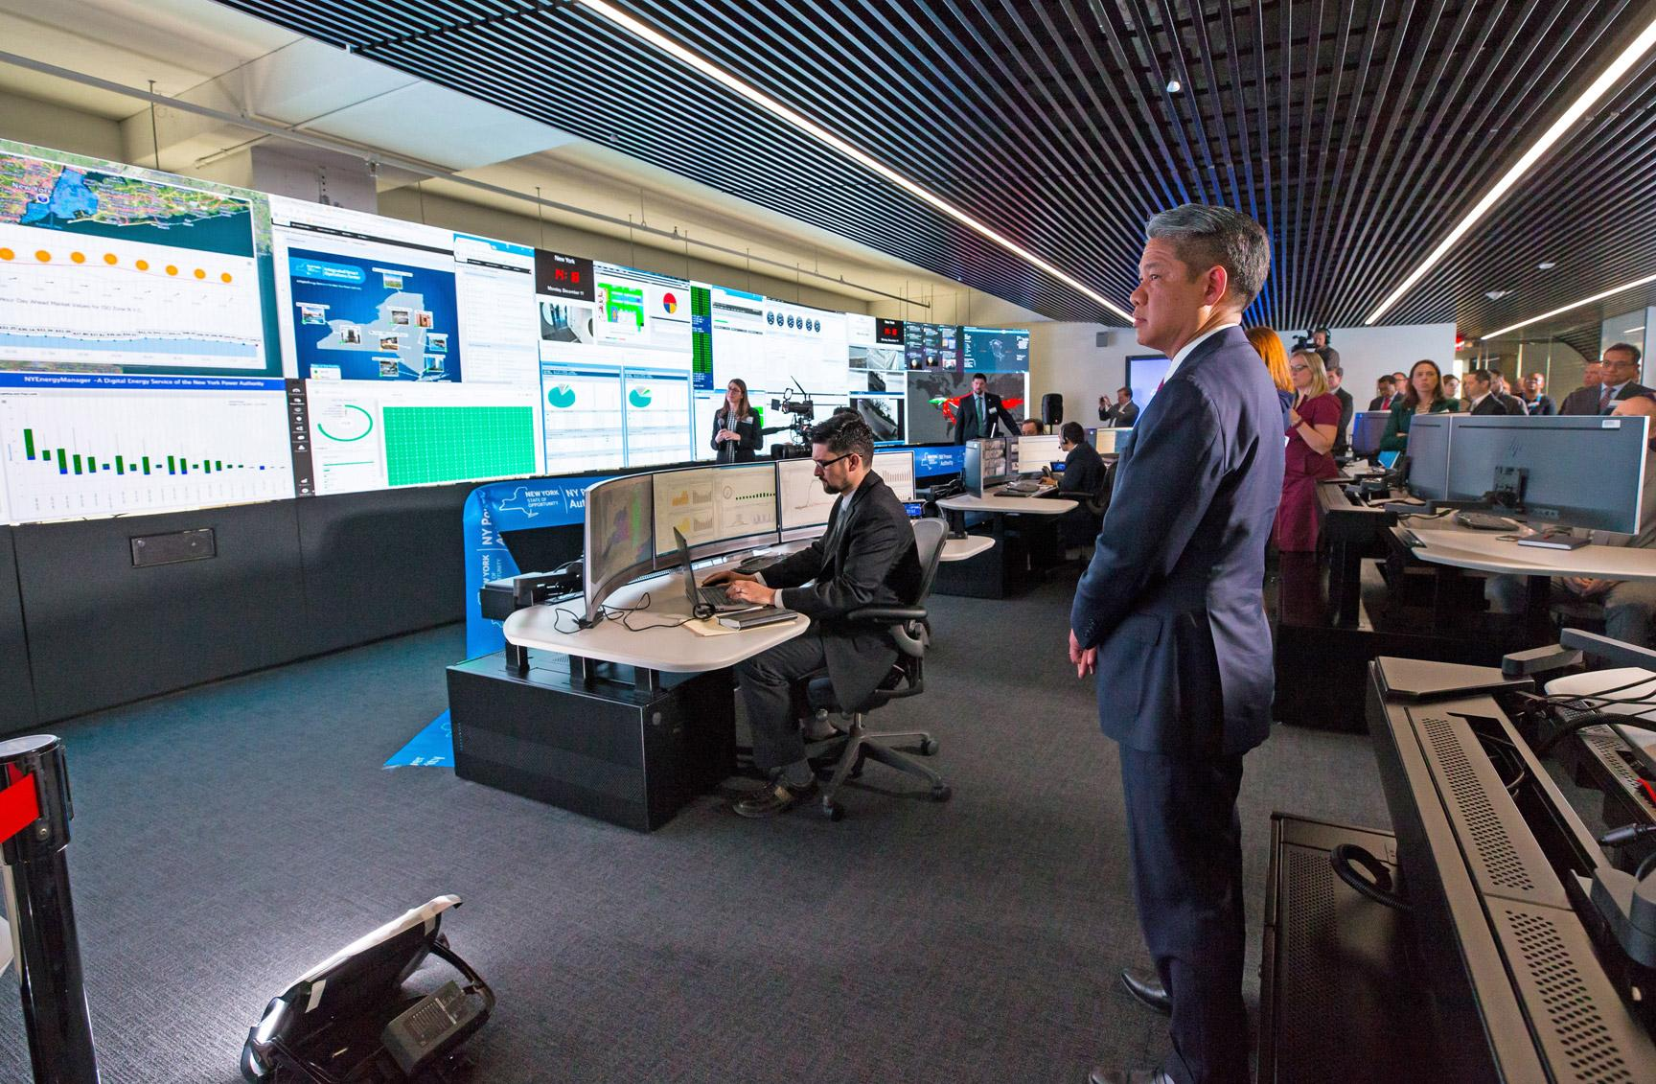
What careers do you think you could have with NYPA in the future?
What problems do you want to solve?
Notes:
Today you were NYPA engineers, you helped us to use both renewable and non-renewable energy to solve a problem and transmit electricity to a city building. NYPA has thousands of electricians, engineers and others that keep all of our lights on day to day. Everyday the citizens of New York State use more and more electricity in different ways, we need your great minds to keep the lights on and design solutions for our communities now and in the future. What careers do you think you could have with NYPA in the future? What problems do you want to solve?
We really enjoyed being with you today, if you have questions, we can answer them as we wrap up our time together today.

