Slide 1
Charging Zero Emission Vehicles in the Community

Slide 2
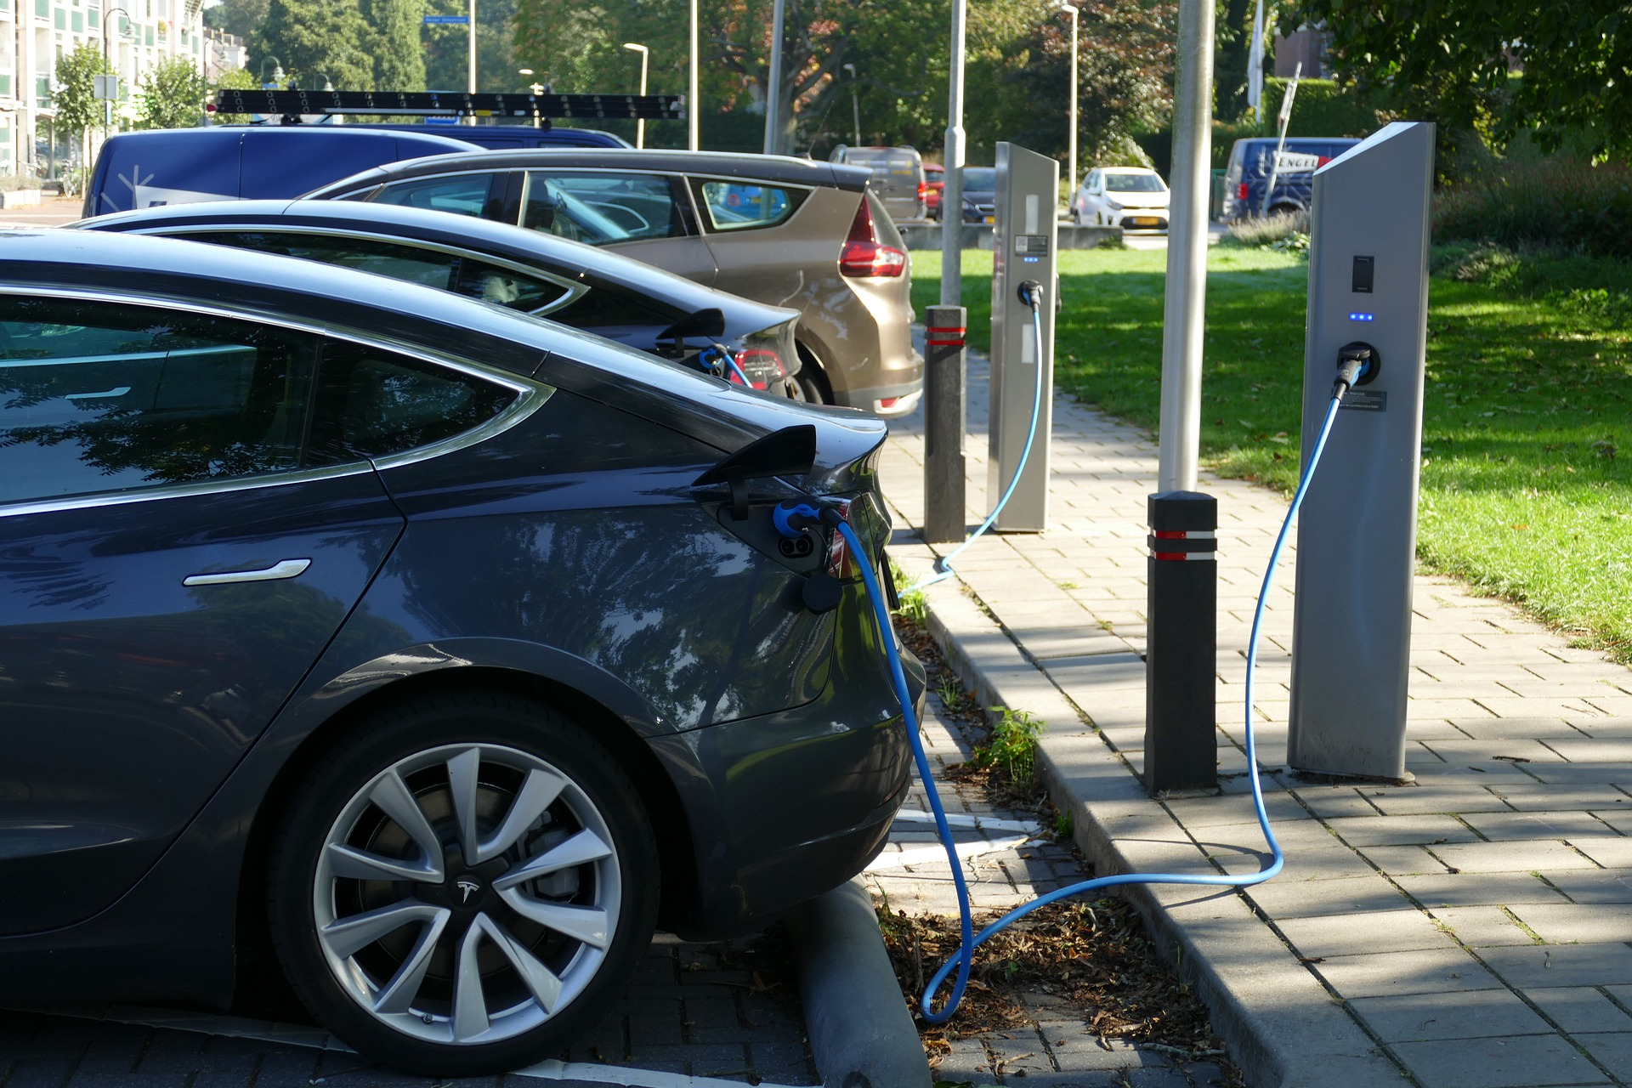
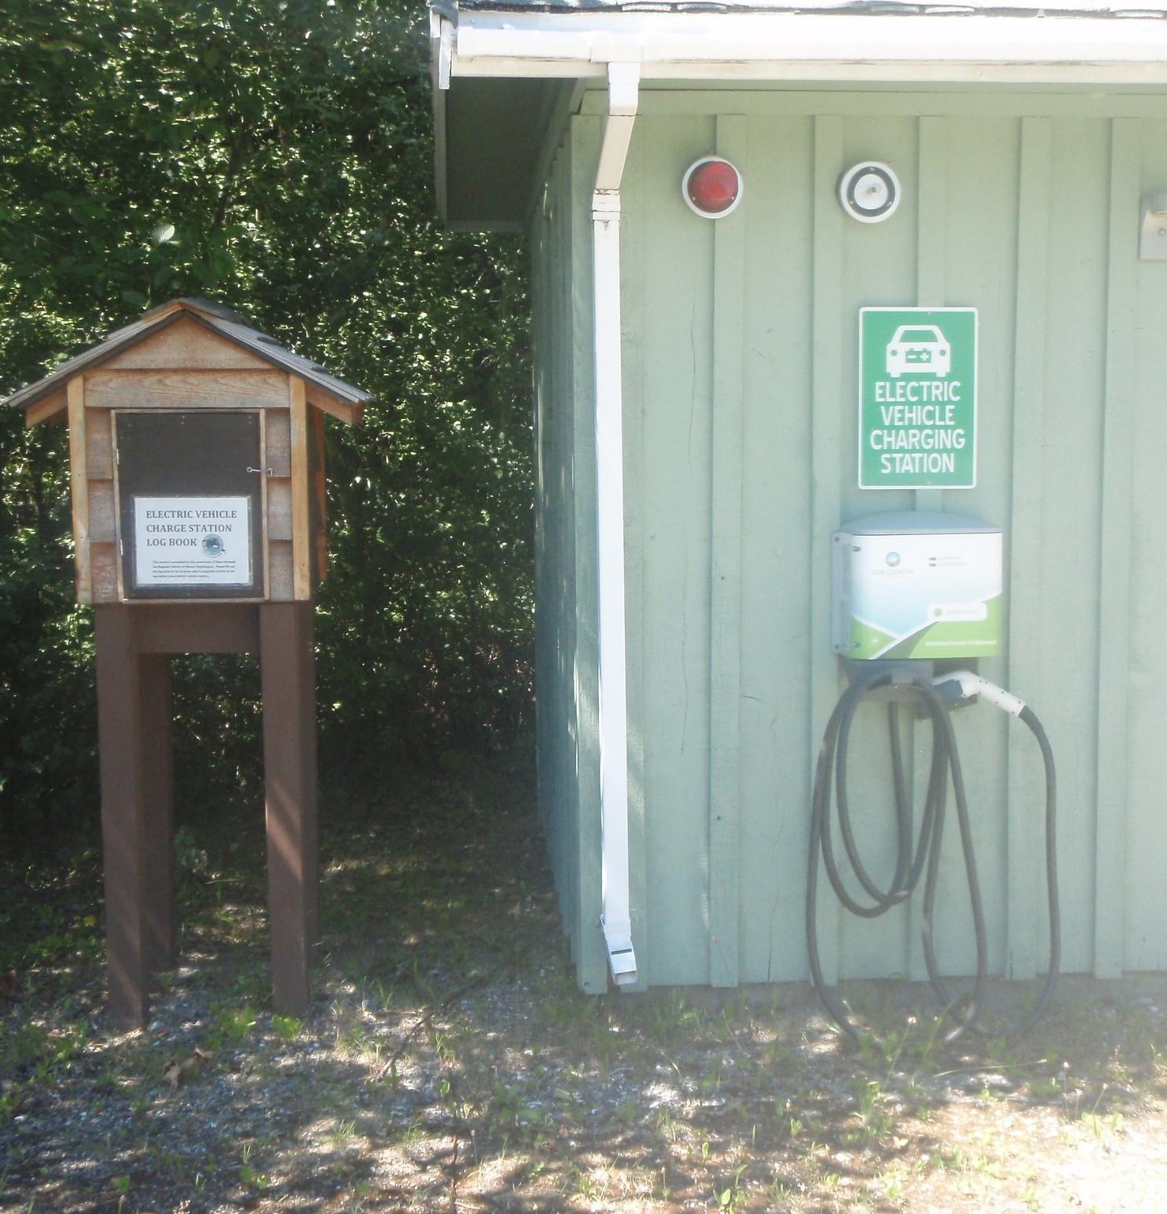
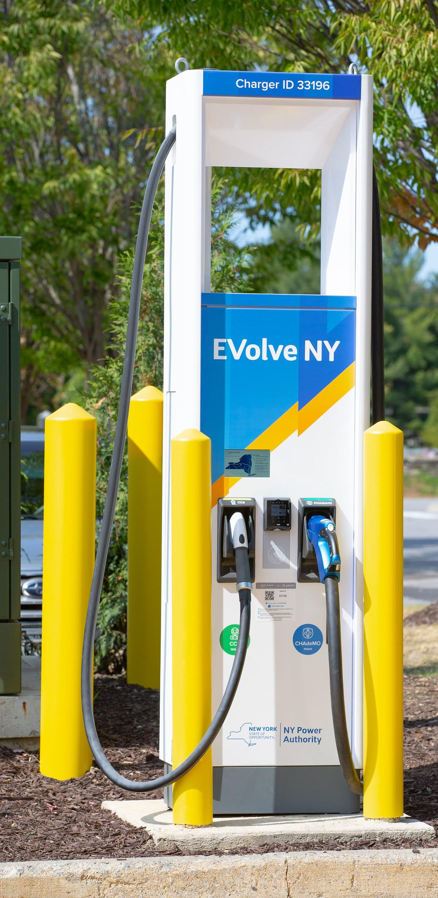
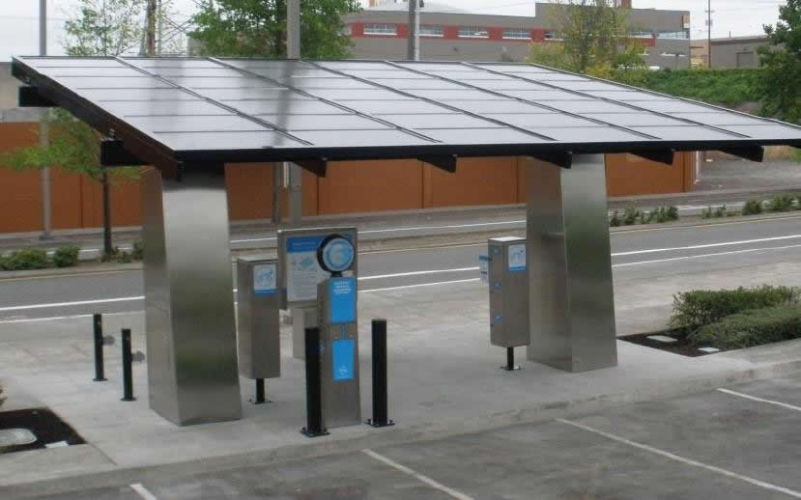
Charging an Electric Vehicle Battery
Notes:
Electric Vehicles are really cool! The run on only electricity and that electricity is stored in a big battery onboard the car. The battery has to be charged, storing energy to be used as the car is driven. When the battery becomes depleted, it needs to be recharged. Just like you do with your cell phone or laptop. When home plugging the car into a regular outlet works but it can take a long time, because the battery is about 400 times bigger than the one in your phone. NYPA is working on building a network of rapid chargers around New York State so that you can quickly recharge your car anywhere while you are on the go. Today you are going to design a charging station for an electric car!

Slide 3

Safety
Do not put electrical components in your mouth.
Always have a load in the circuit.
Never run the path directly from the battery, back to the battery.
If anything get hots, call over the teacher.
Notes:
Do not handout any materials until safety slide has been reviewed with students.
Review the safety notes with students
Do not put electrical components in your mouth.
Always have a load in the circuit.
Never run a path directly from the battery, back to the battery.
If anything gets hot, call over the teacher.

Slide 4
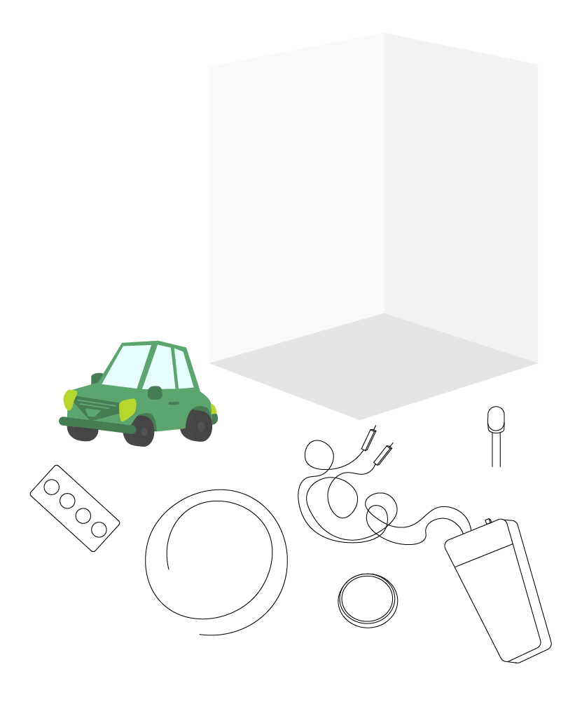
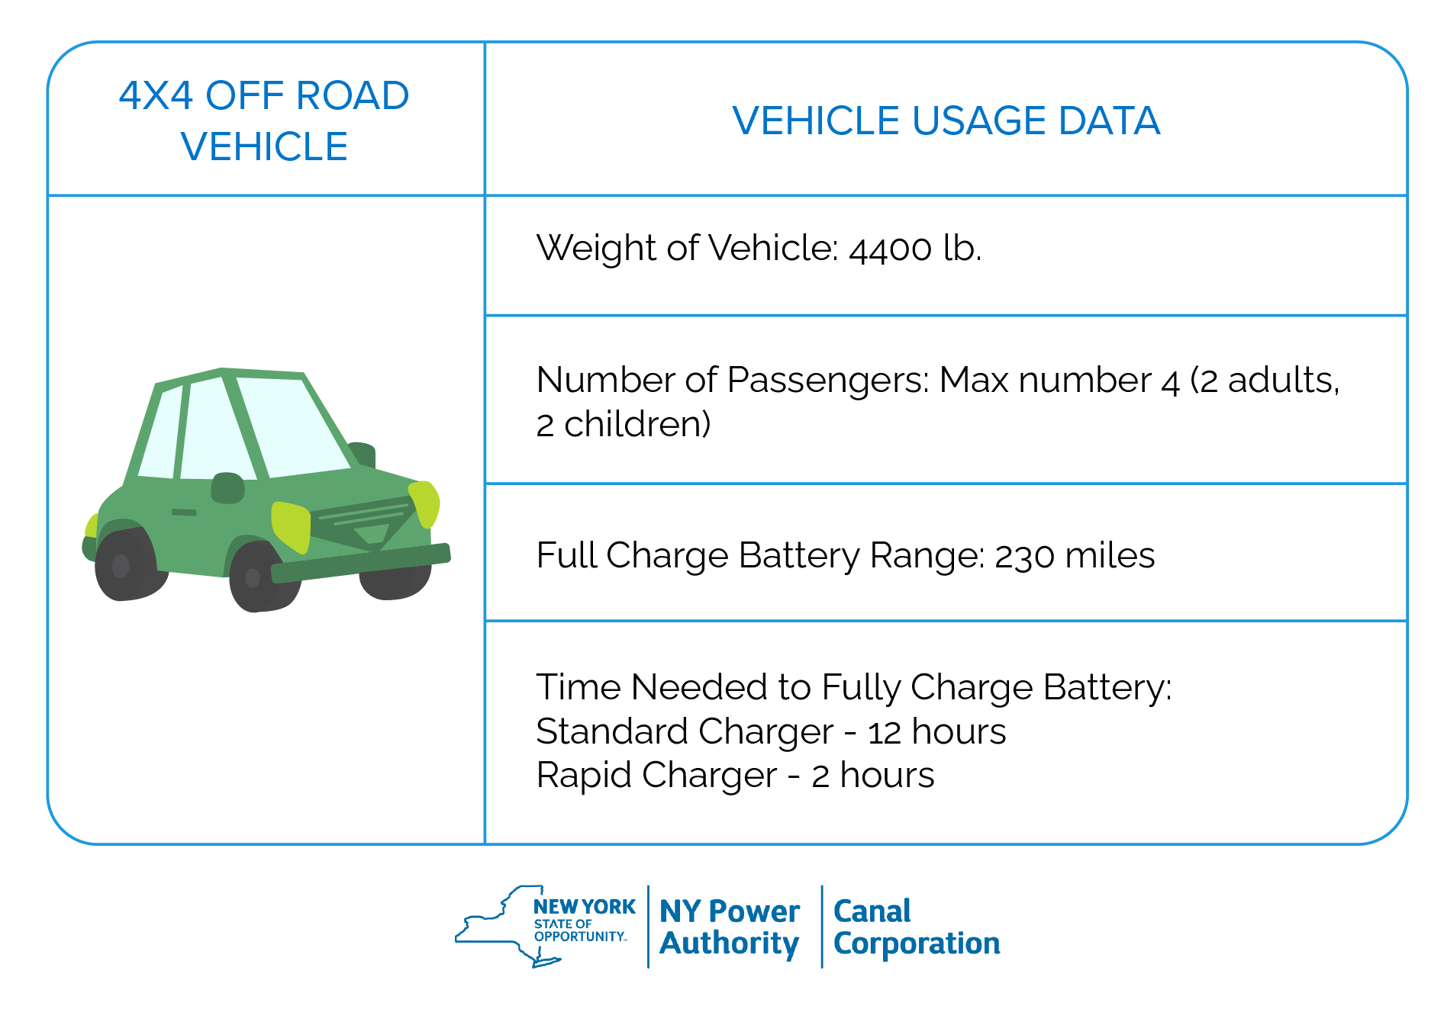
ZEV Charging Station
Notes:
You are going to use the design thinking process to build the best possible solution for your vehicle charging station. In the activity bag there is a vehicle and a story card about the people who drive that vehicle. Take out your story card and read the card to yourself.

Slide 5

Guiding Questions
What is important for the person charging the vehicle?
What else would be nearby the charging station?
Where would the charging station be located?
What type of power source would work for this type of charging station?
What type of charger will the charging station use? Rapid or Standard? Why?
Notes:
You are going to build a charging station that is best fit for the people in your story. You will simulate charging the vehicle by putting an LED on the vehicle and building a circuit on the cardboard display. You will color the scene around the charging station to tell the whole story of how this charging station will work and benefit people in the story.
You will use your design journal to help you brainstorm and plan the charging station. Let’s answer these questions together for your vehicle and scene. Have students answer each question for their specific vehicle and scenario.
Teacher Note: Based on the group dynamics and skill level you may want to have them fill out the journal, turn and talk with a neighbor, or work through them as a group.

Slide 6

Brainstorm
IDEA 1
IDEA 2
IDEA 3
IDEA 4
Notes:
Brainstorm at least 4 different ideas what the charging station could look like and what it needs based on the guiding questions and scenario on the card. Once you have at least 4 different ideas select your best brainstorm that best meets the needs of people in their task card story.

Slide 7
Sketch
Include the answers to the guiding questions.
Scenario
Location
Vehicle
Notes:
Draw out a final sketch with all the details of the charging station. Include where the circuits are going to go (look at the prototype section for help), the setting around the charger, the type of power source, where the people will be and what they will be doing and any other details necessary.

Slide 8
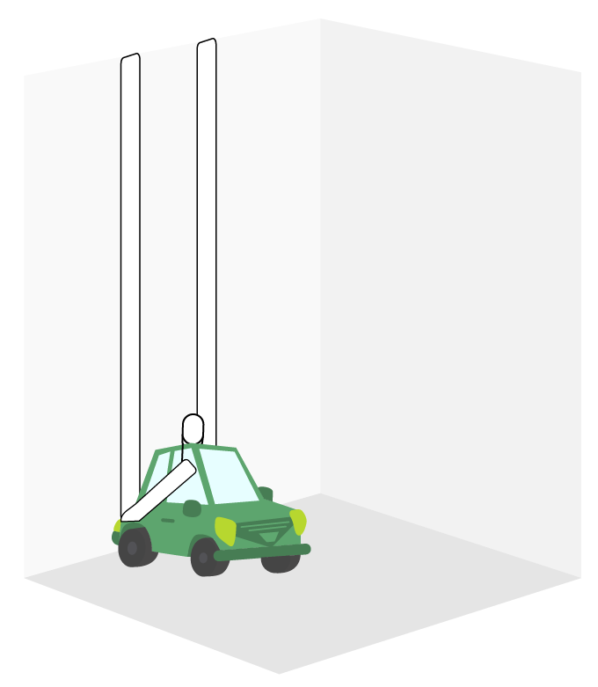
Prototype
Notes:
Construction note: Students can sit the LED on the top of the car so that the legs are pointing out from the back of the car. So that when you back the car into the charging station the legs of the LEDs make contact with the Maker Tape on the wall. Students should use a piece of masking tape to hold the LED onto the car.

Slide 9
Design Journal Questions
TESTING
REAL WORLD APPLICATION
REFLECTING
Notes:
Have students respond to some of the testing and reflecting questions in their design journal. Allow students to share what they created and the story connected to it.

Slide 10

WONDER TIME
Notes:
Slide to be used to transition from building mode to reflection time.

Slide 11
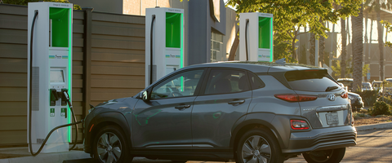
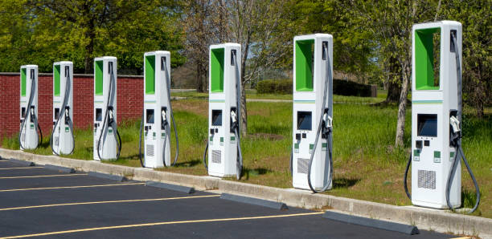
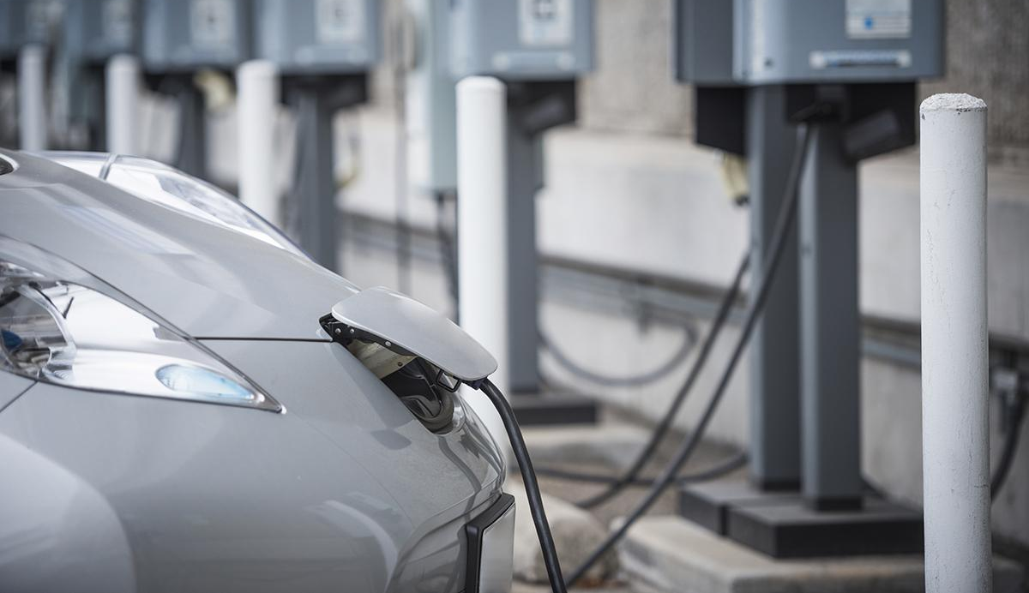
Notes:
Vehicle charging does not happen instantly; it takes some time to fill up the battery with a full charge. Around New York State Evolve NY and NYPA are building a network of 800 fast charging stations. In these stations you will pull up, plug in your car and wait possibly no more than 15 - 30 minutes to charge your vehicle and get on with your day! These charging stations are built at places like rest stops or outside of shopping malls, hotels, and parking garages.

Slide 12
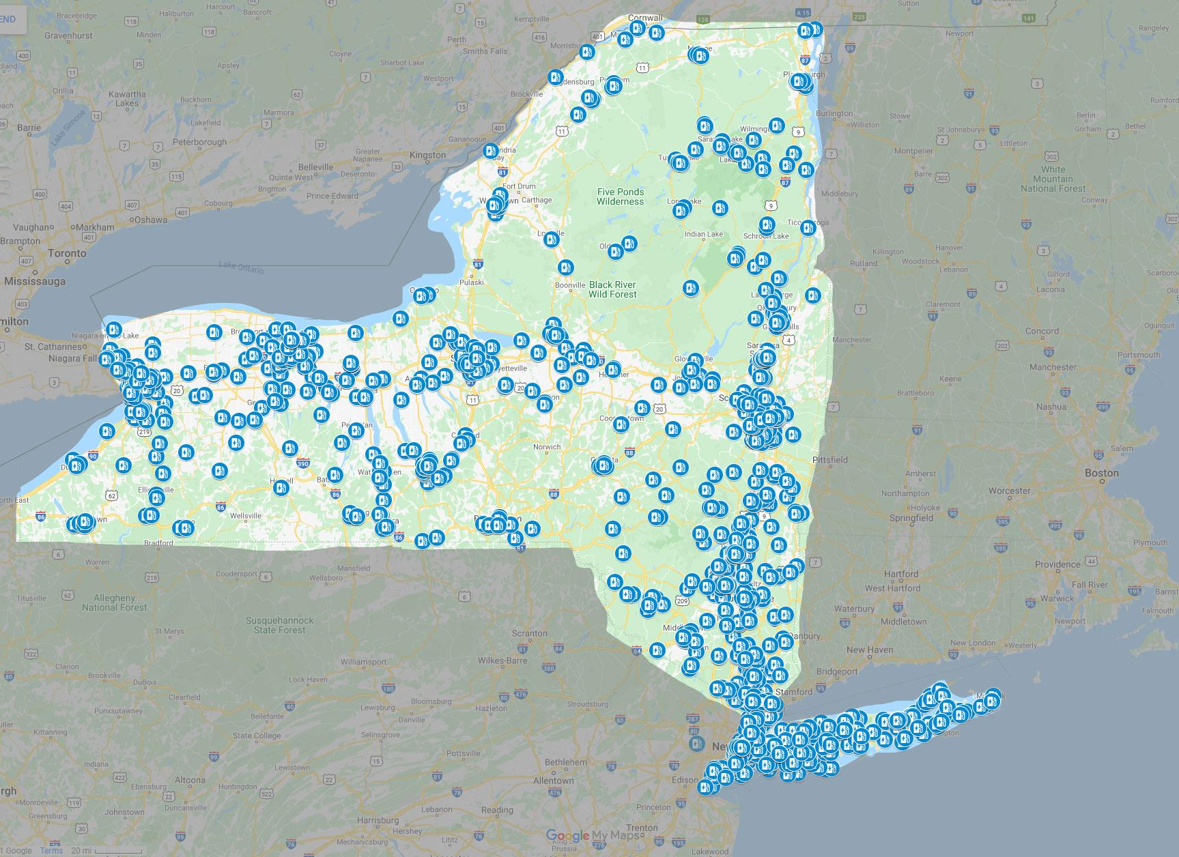
Notes:
Here is a map of current charging stations in the state.

Slide 13
HOW WOULD THE INFRASTRUCTURE
OF THE STATE CHANGE WITH ADDITIONAL CHARGING STATIONS ADDED AROUND
THE STATE OF NY?
Notes:
Answer:
There would be no gas stations and there would be charging stations everywhere. The neighborhood would be quieter (reduced noise pollution), the air will be cleaner - due to reduced air pollution. Overall healthier, happier people.
Today you were NYPA designers, planners and environmentalists, thinking about how Zero Emission Vehicles can solve some of our climate change problems. As more and more citizens of New York State buy Zero Emission Vehicles, we need your great minds and kind hearts to build a culture of where everyone makes eco friendly decisions to populate a healthier state. How can you go home and make an impact now and what problems do you want to work on with NYPA to solve in the future?

