Slide 1
Electricity Basics
WHAT IS ELECTRICITY?

Slide 2

Who and What is
New York Power Authority?
Notes:
Introduce NYPA and yourself, get to know students.

Slide 3
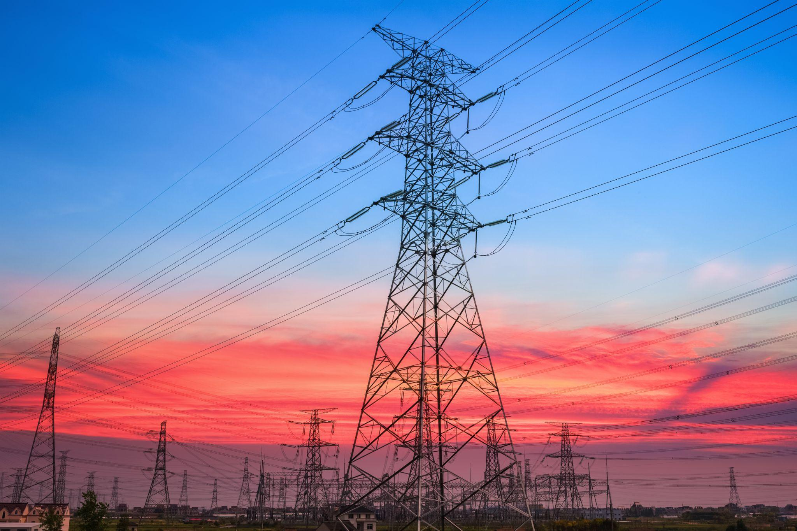
Think of 3 things
that you could not live without that use electricity?
1
2
3
Notes:
Ask students to share out some things that use electricity that they use everyday. Expand their minds with suggestions for other things they are not mentioning.
Lights, cell phone, computer, TV, gaming systems, air conditioning, oven, microwave, laundry, traffic lights, signs, cars, refrigerator, alarm clocks, bumper cars, trains, subways, buses…

Slide 4
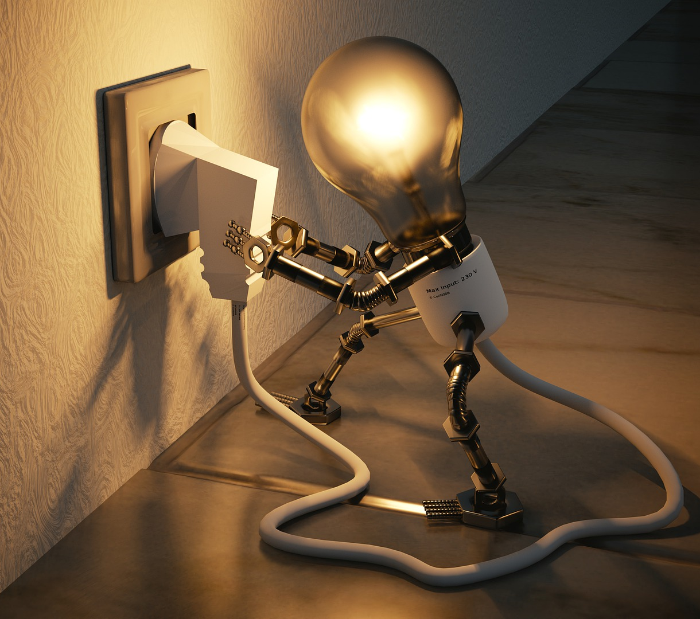
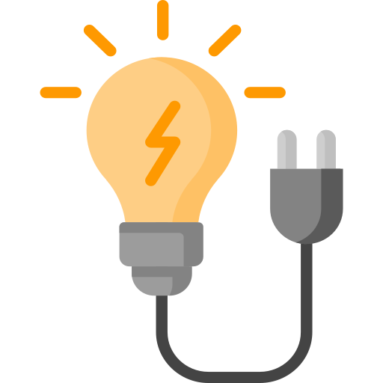
What is electricity?
Electricity is the flow of tiny particles called electrons moving through a circuit.
Notes:
Electricity is when tiny particles called electrons can flow through a circuit. Electricity is the flow of electrical energy. Electricity energy is when tiny particles called electrons are moving through a circuit.

Slide 5
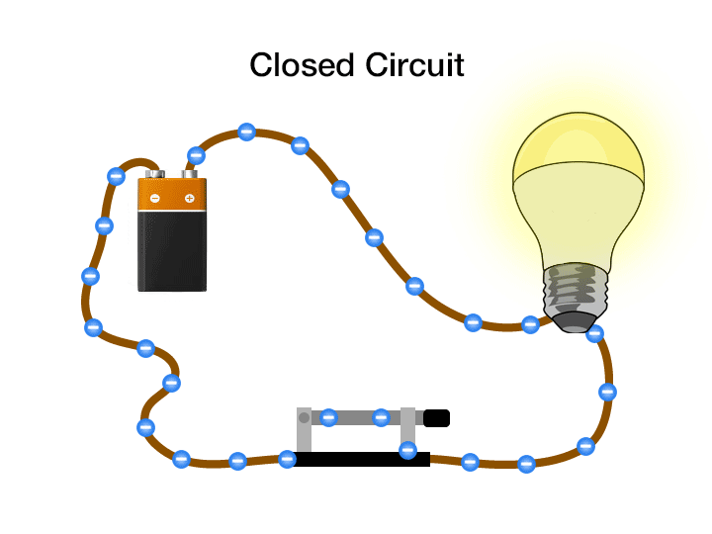
What is electricity?
Electricity is the flow of tiny particles called electrons moving through a circuit.
Notes:
Electricity is when tiny particles called electrons can flow through a circuit. Electricity is the flow of electrical energy. Electricity energy is when tiny particles called electrons are moving through a circuit.
A simple circuit is made up of four parts: a load - the lightbulb, the power source - battery, the switch and the path or wires. A closed circuit is a when the path of electricity can flow from the power source through the path to the load back to the power source.
We do things to control electrons in a circuit all day long, we turn on a light switch and make a closed circuit so the electrons can flow to the lights. We plug in our phones to charge and we make a closed circuit for electrons to flow to the battery of the phone.

Slide 6
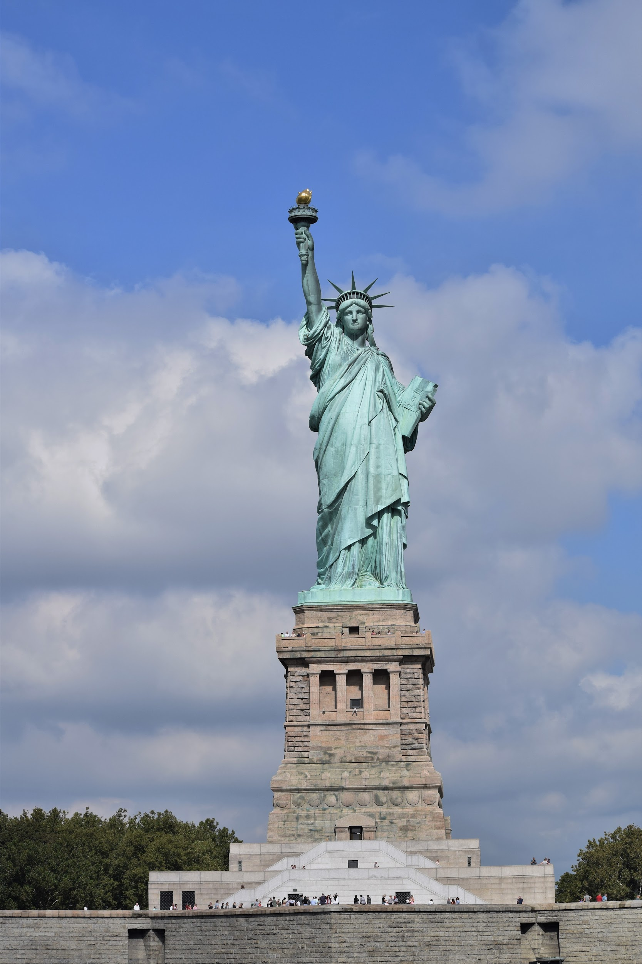
Lady Liberty’s torch turned off.
Let’s build a circuit to turn it back on.
Notes:
Let’s make our own circuits! We have a dilemma and NYPA needs your help. Lady Liberty’s Torch seems to have lost all power and we need your help to build the circuitry that makes it light up the night sky. Before we can fix Lady Liberty, let’s go over some basics to make sure we have what we need to resolve this issue and do it safely. We are going to use the materials in our kit to build a circuit to turn the torch back on for Lady Liberty.

Slide 7

Safety
Do not put electrical
components in your mouth.
Always have a load in the circuit.
Never run the path directly from the battery, back to the battery.
If anything get hots, call over the teacher.
Notes:
Quickly review safety notes

Slide 8

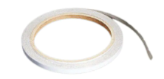
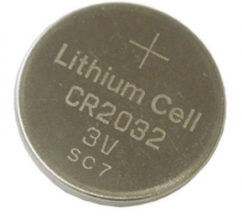
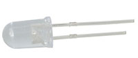
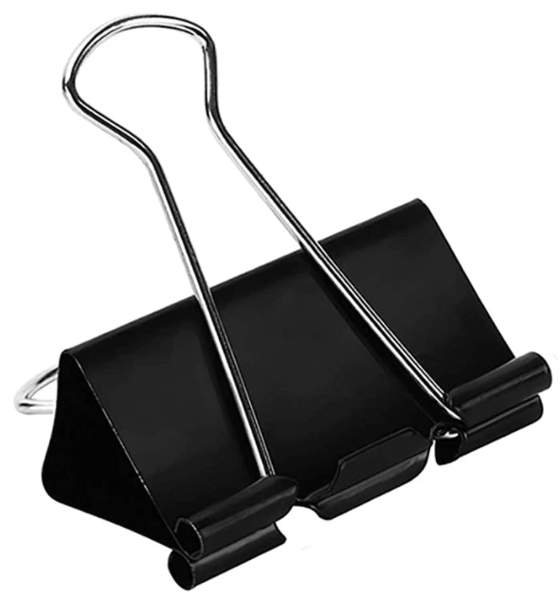
Maker Tape
PATH
Battery
POWER SOURCE
LED light
LOAD
Binder Clip
SWITCH
Activity 1 Lady Liberty Materials
Notes:
Show Materials in Kit: These are the materials in your bag. Your student guide will tell you all of the instructions...
Maker Tape is the path for the circuit, it conducts electricity and is sticky once you pull off the white paper. Use your thumb to roll the tape towards you to stick on your thumb.
LED is the light. Notice the LED has a shorter leg and longer leg. The shorter leg is negative and the longer leg is positive. Electrons only flow in one direction in these light emitting diodes. The shorter leg always needs to be on the same side of the circuit as the negative side of the battery. And the longer or positive side needs to be connected to the positive (+) side of the battery.
Battery is the power source - the battery has a + on the positive side
Binder clip is all metal and acts like a switch.

Slide 9
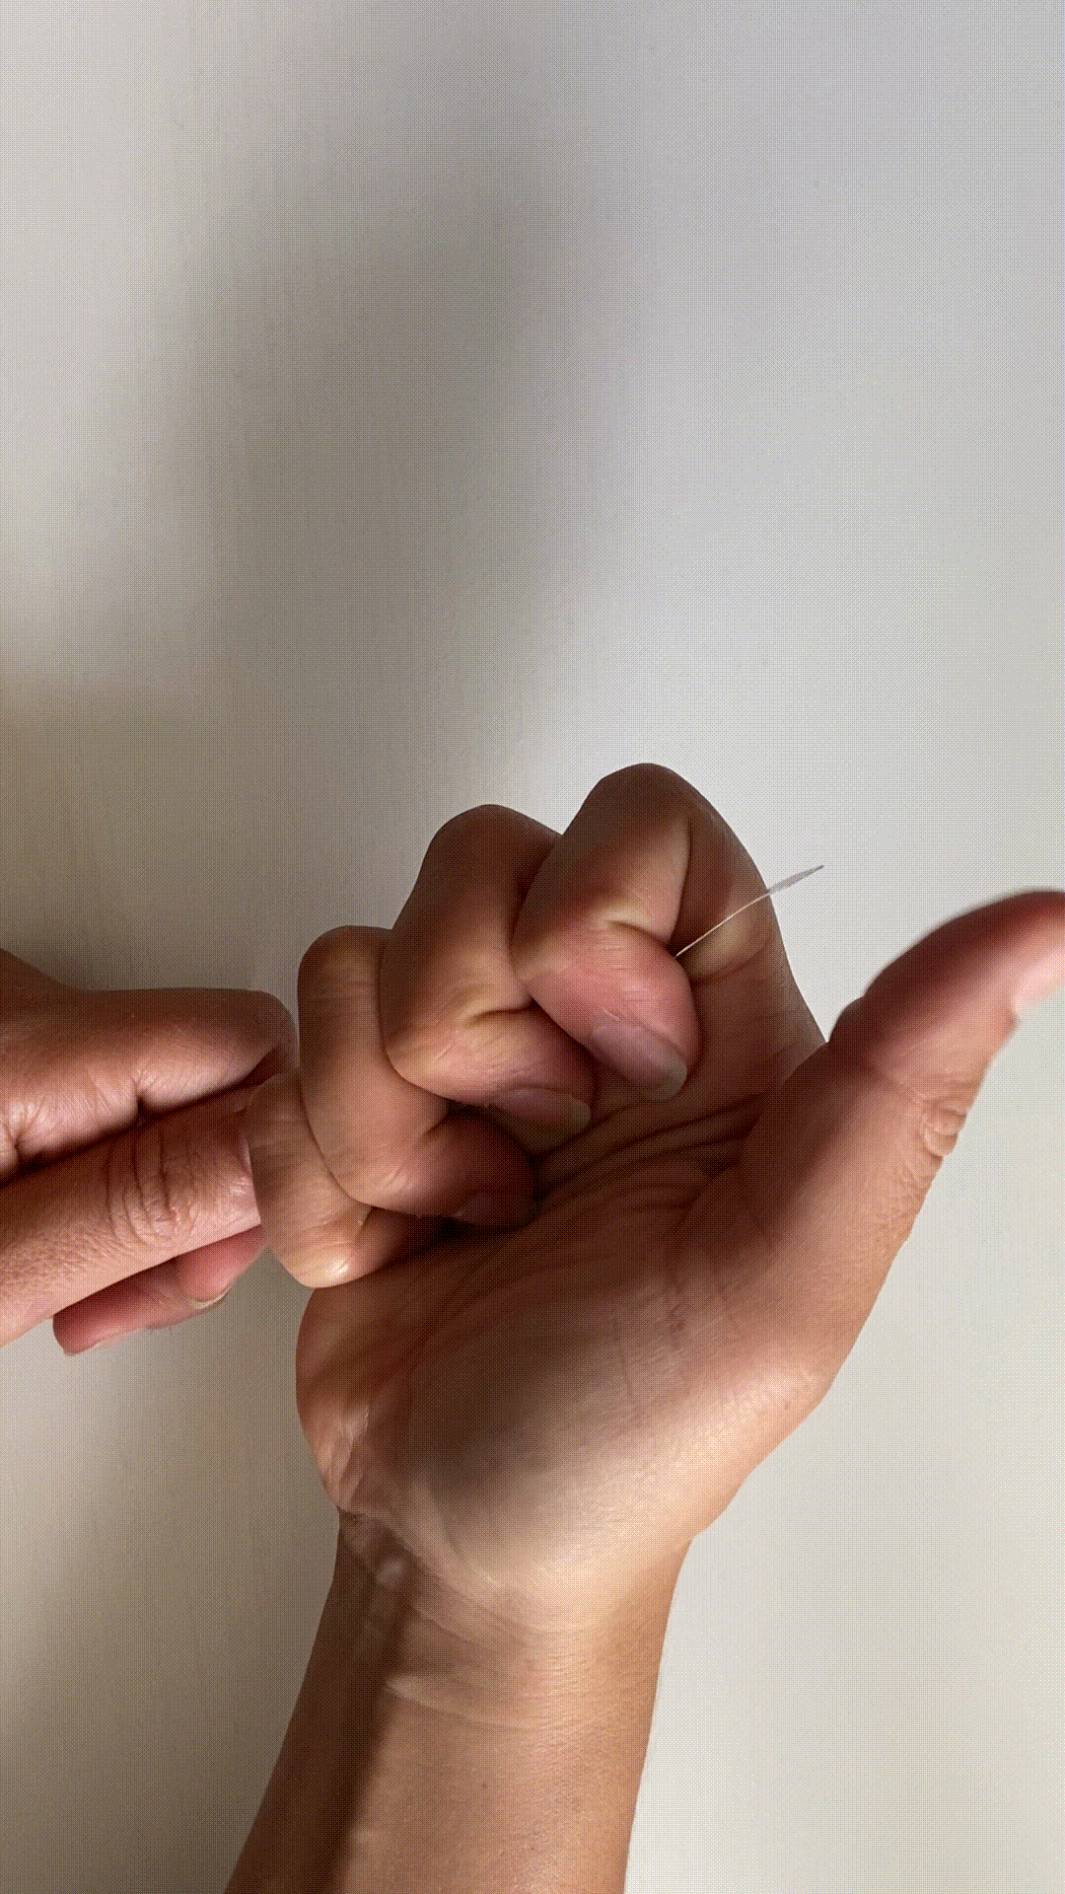

How to peel Maker Tape
Notes:
​​Hold the gold side of the Maker Tape facing your thumb and roll your thumb over the top of the Maker Tape and down. The sticky side of the tape will catch on your thumb.

Slide 10
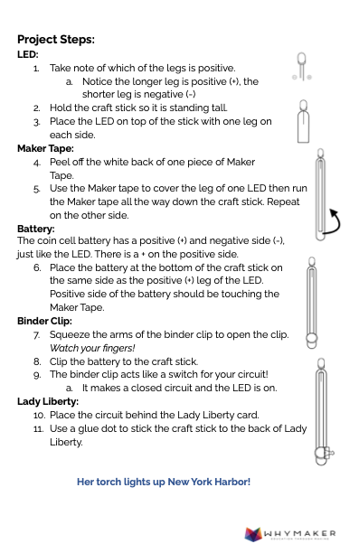
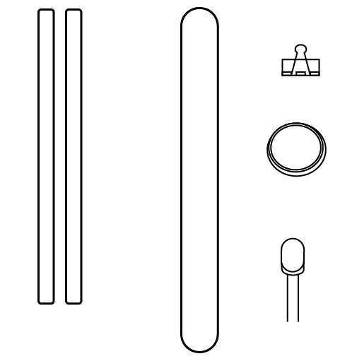
Let’s Build!
Notes:
Students building circuit following student guide.

Slide 11
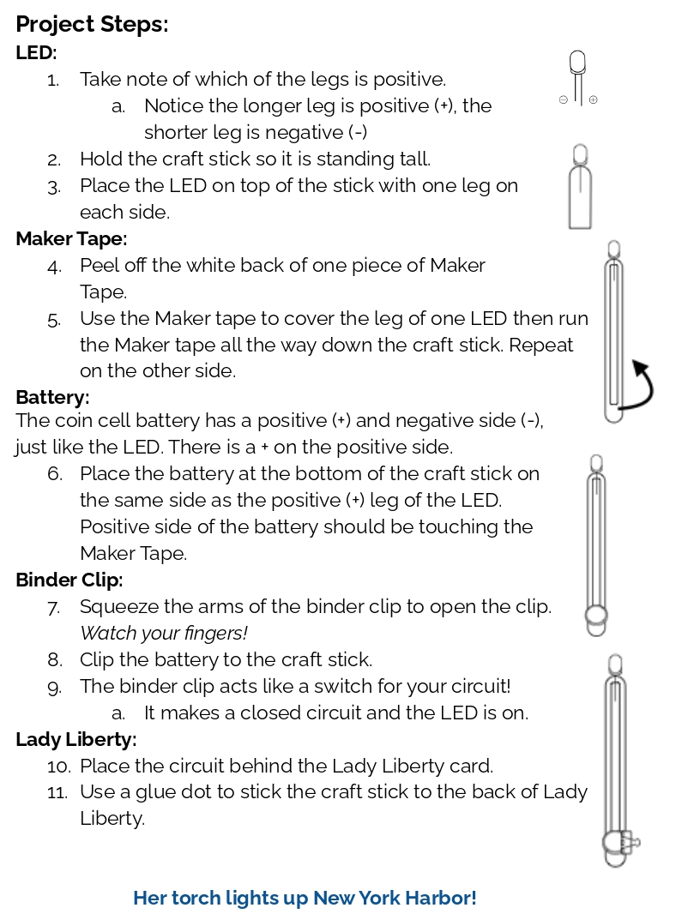
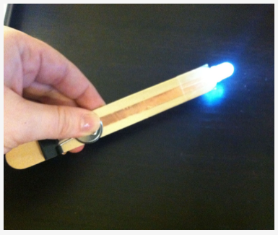
Let’s Build!
Notes:
Teacher should summarize each step of the project card - all verbiage included above is as stated on the student card - you do not need to read it verbatim.
“Let’s look at the Project Steps, the first is the LED.”
Teacher can walk through the information for each section - supporting the students
When discussing Maker Tape, students can try rubbing or twisting the end of the tape to
loosen the paper from the back of the tape
Student Guide Instructions:
LED:
1. Take note of which of the legs is positive.
a. Notice the longer leg is positive (+), the shorter leg is negative (-)
2. Hold the craft stick so it is standing tall.
3. Place the LED on top of the stick with one leg on each side.
Maker Tape:
4. Peel off the white back of one piece of Maker Tape.
5. Use the Maker tape to cover the leg of one LED then run the Maker tape all the way down the craft stick. Repeat on the other side.
Battery:
The coin cell battery has a positive (+) and negative side (-), just like the LED. There is a + on the positive side.
6. Place the battery at the bottom of the craft stick on the same side as the positive (+) leg of the LED. Positive side of the battery should be touching the Maker Tape.
Binder Clip:
7. Squeeze the arms of the binder clip to open the clip. Watch your fingers!
8. Clip the battery to the craft stick.
9. The binder clip acts like a switch for your circuit!
a. It makes a closed circuit and the LED is on.
Lady Liberty:
10. Place the circuit behind the Lady Liberty card.
11. Use a glue dot to stick the craft stick to the back of Lady Liberty.

Slide 12

WONDER TIME
Notes:
Slide to be used to transition from building mode to reflection time.

Slide 13
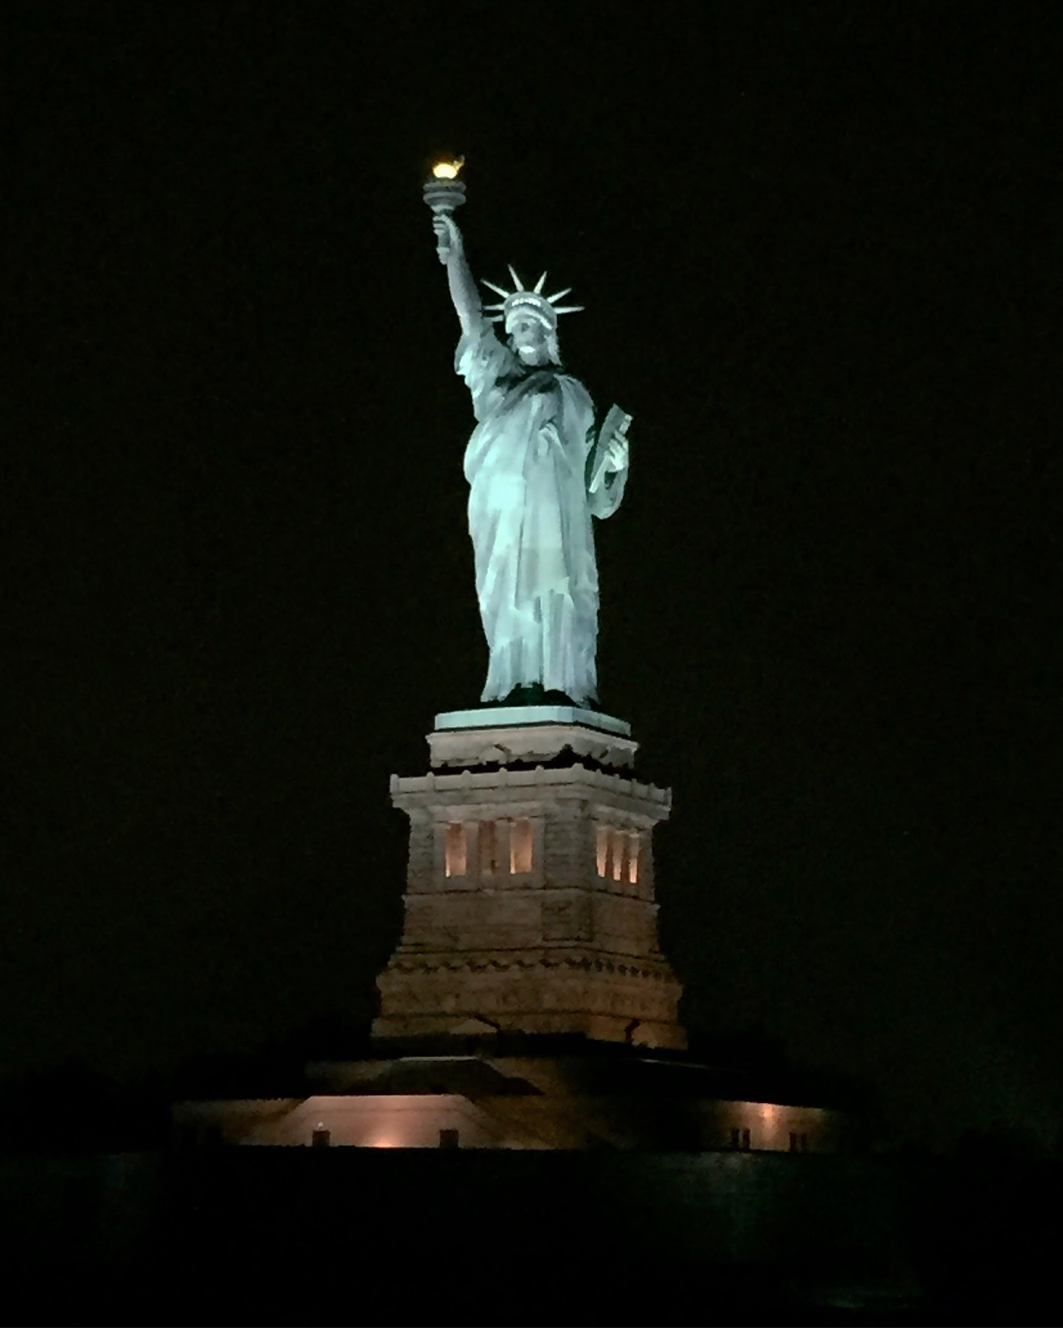
Notes:
Yay! We have worked to resolve Lady Liberty’s torch issue. You are going to be great electrical engineers that NYPA needs. Have student clean up their workspace

Slide 14
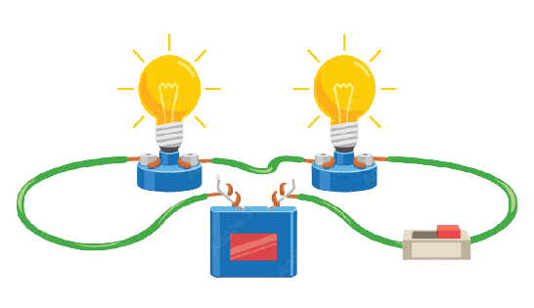
What parts are required to make an electrical circuit function?
Notes:
Ask student to point to the parts of the circuit on the project they made as you say each part.
Power source - battery, outlet, solar panel, generator
Load - light bulb, motor
Path - maker tape, wires, metal, water, humans

Slide 15
How does an electric circuit work?
Notes:
Ask students to describe how the electric circuit that they build works.
Electrons leave the battery and travel through the path pushing each other to the LED. They then turn the LED light on and then continue to travel through the Maker Tape back to the battery through the clip and around to the battery.

Slide 16

How do you think you could
MEASURE ELECTRICITY?
Notes:
Ask students what they think?

Slide 17

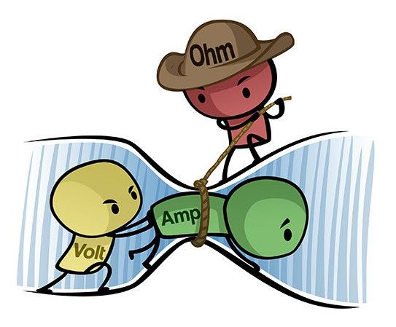
Measuring Electricity
Electricity is measured by the amount of pressure moving through a circuit and the amount of electrons in the circuit.
The pressure is called volts. The voltage pushes electrons.
The amount of electrons are called amps.
When you combine volts and amps you get watts.
Notes:
Electric circuits have pressure & flow.
Voltage is the pressure, the higher the voltage the more electrons are pushed to move.
The number of electrons flowing through the circuit are called amps. It is the amount of electrons in the circuit. The more amps the more electrons.
When you combine volts and amps you get watts or the measure of power. 100 watt lightbulb takes 100 watts of power.
Electrons are pushed by chemical reactions from batteries or pushed out from a generator.

Slide 18
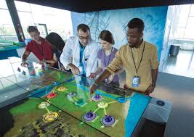

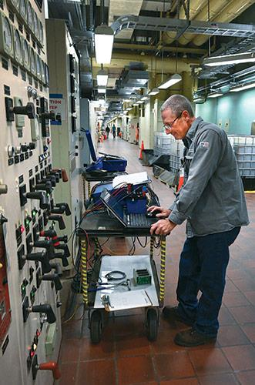
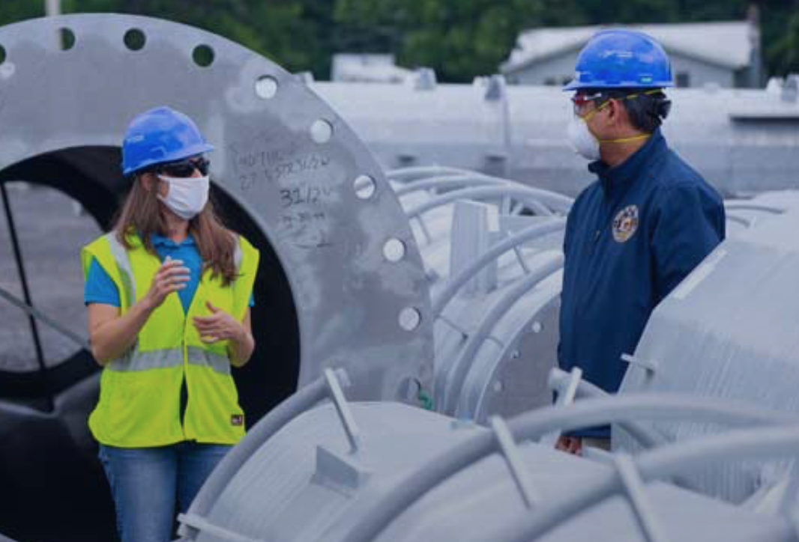

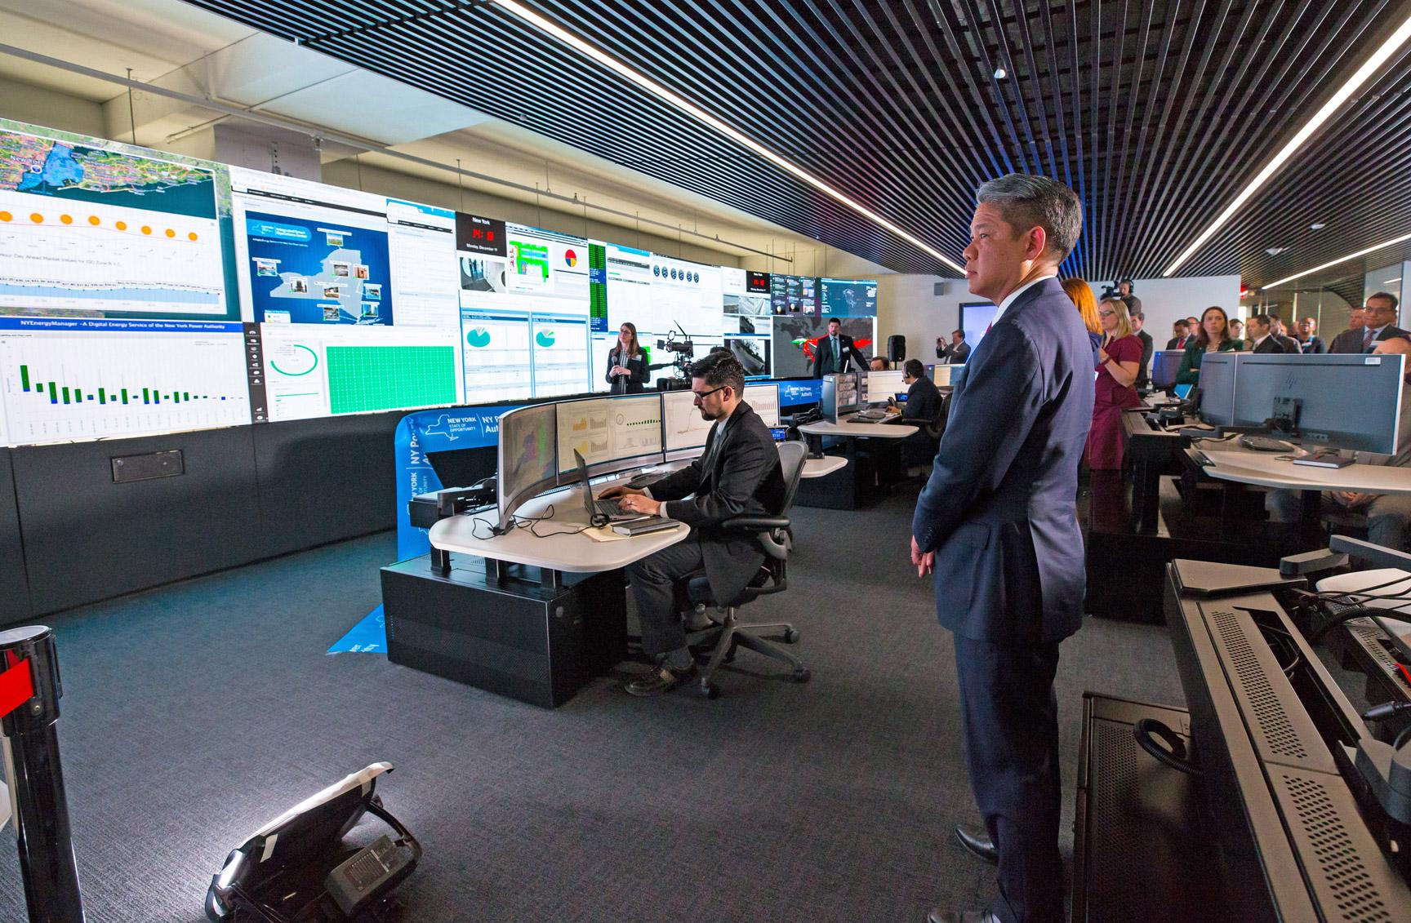
What careers do you think you could have with NYPA in the future?
What problems do you want to solve?
Notes:
Today you were NYPA engineers, you helped us to use both renewable and non-renewable energy to solve a problem and transmit electricity to a city building. NYPA has thousands of electricians, engineers and others that keep all of our lights on day to day. Everyday the citizens of New York State use more and more electricity in different ways, we need your great minds to keep the lights on and design solutions for our communities now and in the future. What careers do you think you could have with NYPA in the future? What problems do you want to solve?
We really enjoyed being with you today, if you have questions, we can answer them as we wrap up our time together today.

