Slide 1
Electricity Generation and Transmission
Where does it come from? How does it get to us?
Notes:
Objective

Slide 2
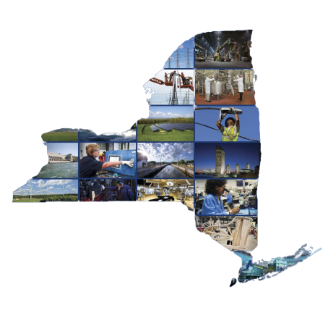
Who and What is
New York Power Authority?
Notes:
Introduce NYPA and yourself, get to know students.

Slide 3
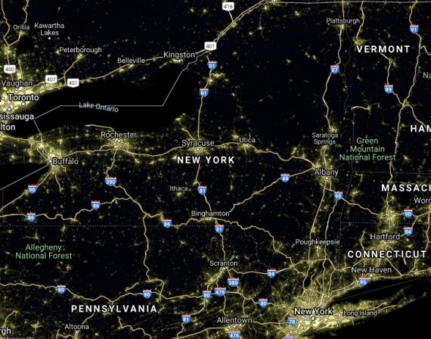
Notes:
Electricity is important to our community, and how it is generated is important to NYPA. In activity 1 you used a battery, which generates a little bit of power where they need it. Think about all of the things in our community that use electricity, where does the electricity to power all of those buildings and trains and microwaves and cell phones and lights come from? Where does electricity come from? How does it get to us?

Slide 4
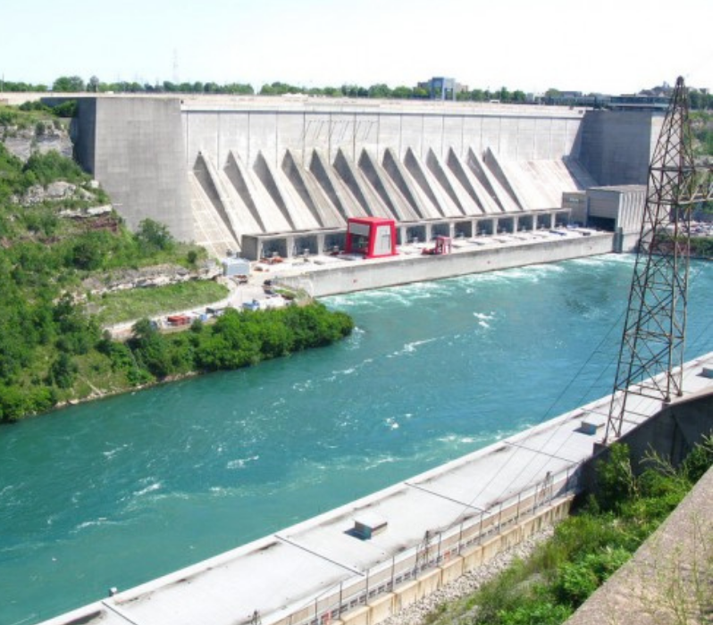
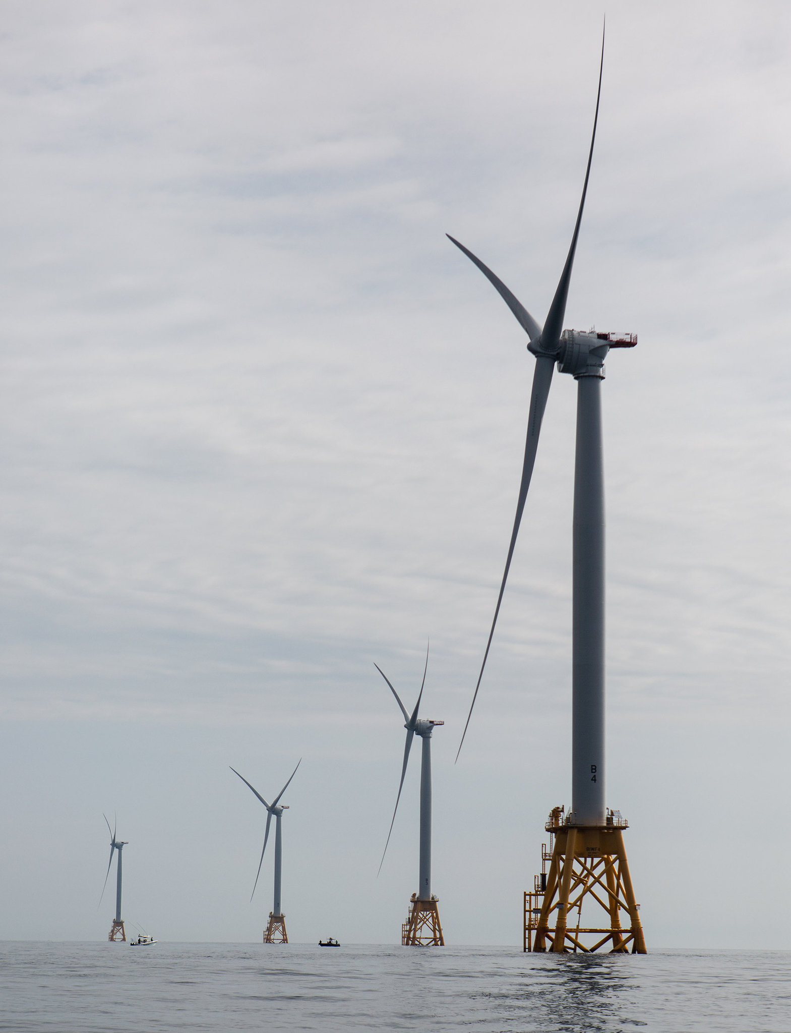
Power Source
WIND TURBINES
in South Fork
NIAGARA HYDROPOWER PLANT
in Lewiston
Notes:
Electricity is generated or made in a Power Plant. There are many different types of Power Plants around New York State. We have small clean energy plants and hydroelectric plants and solar panel farms and wind turbine farms. If it is made in those places, how does it get to our home?

Slide 5
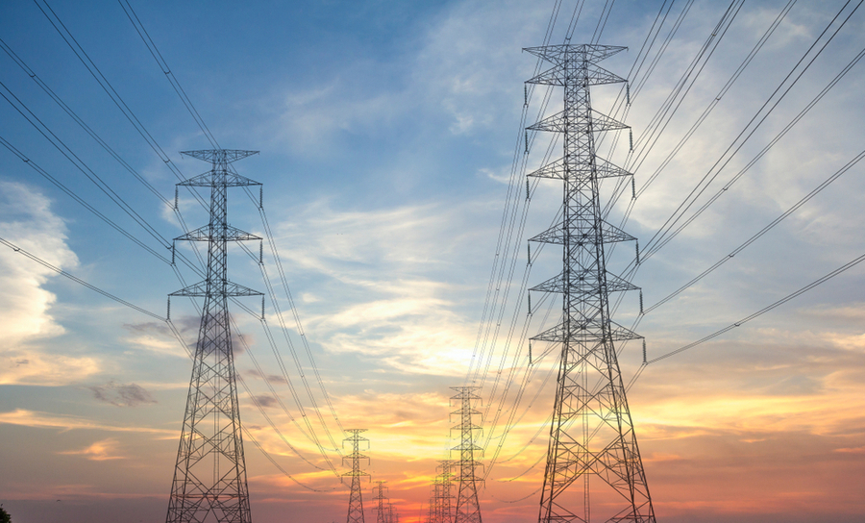
Transmission Lines
Notes:
If electricity is generated in a power plant, how does it get to us in our home? It travels along big transmission lines and smaller power lines. Sometimes stopping at energy storage facilities and substations to hold the electricity.

Slide 6
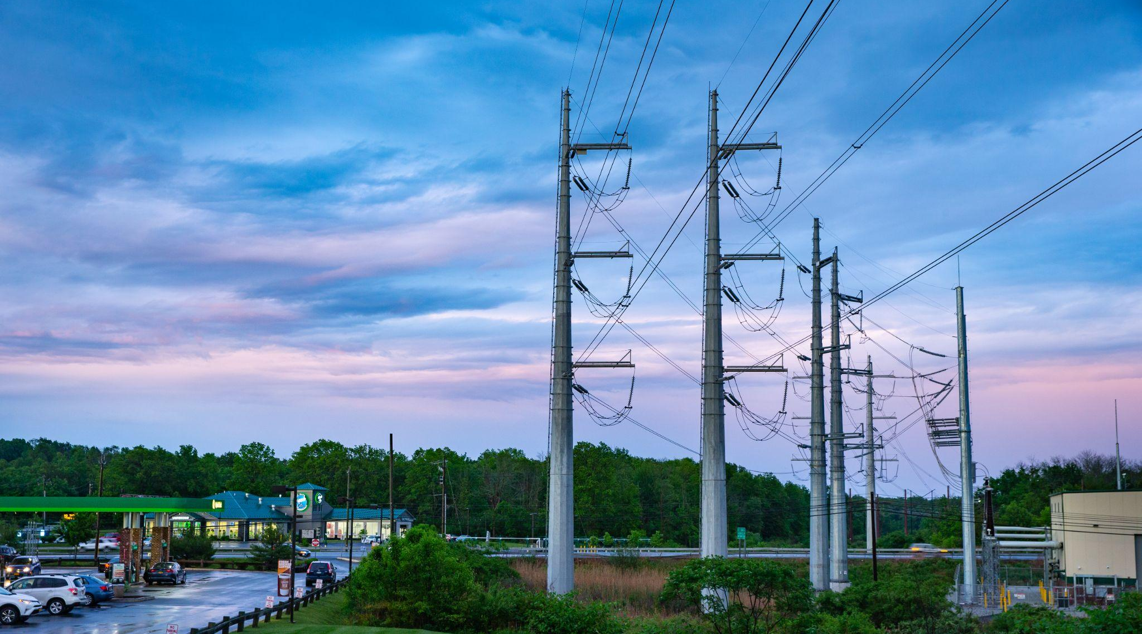
Transmission Lines
Notes:
Electricity comes through big transmission lines and smaller power lines often stopping at energy storage facilities to be stored for when electricity use is in high demand. And it goes to substations and transformers which step-down the power to the right voltage to be used in our homes.

Slide 7
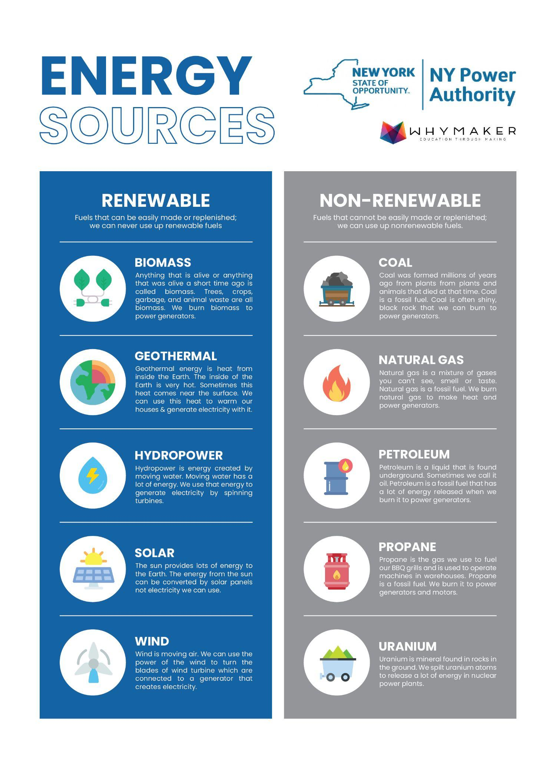
RENEWABLE
NON-RENEWABLE
Fuels that can be easily made or replenished;
we can never use up renewable fuels
Fuels that cannot be easily made or replenished;
We can use up nonrenewable fuels
Notes:
There are two different sources that we get electrical energy from. Renewable and Nonrenewable. Non-renewable energy means there is a limited supply of that resource that makes the generator spin, like coal or natural gas, similar to the limited amount of resources in the battery.
Renewable energy means we will never run out of that resource that makes the generator spin, like falling water at a hydroelectric plant.

Slide 8
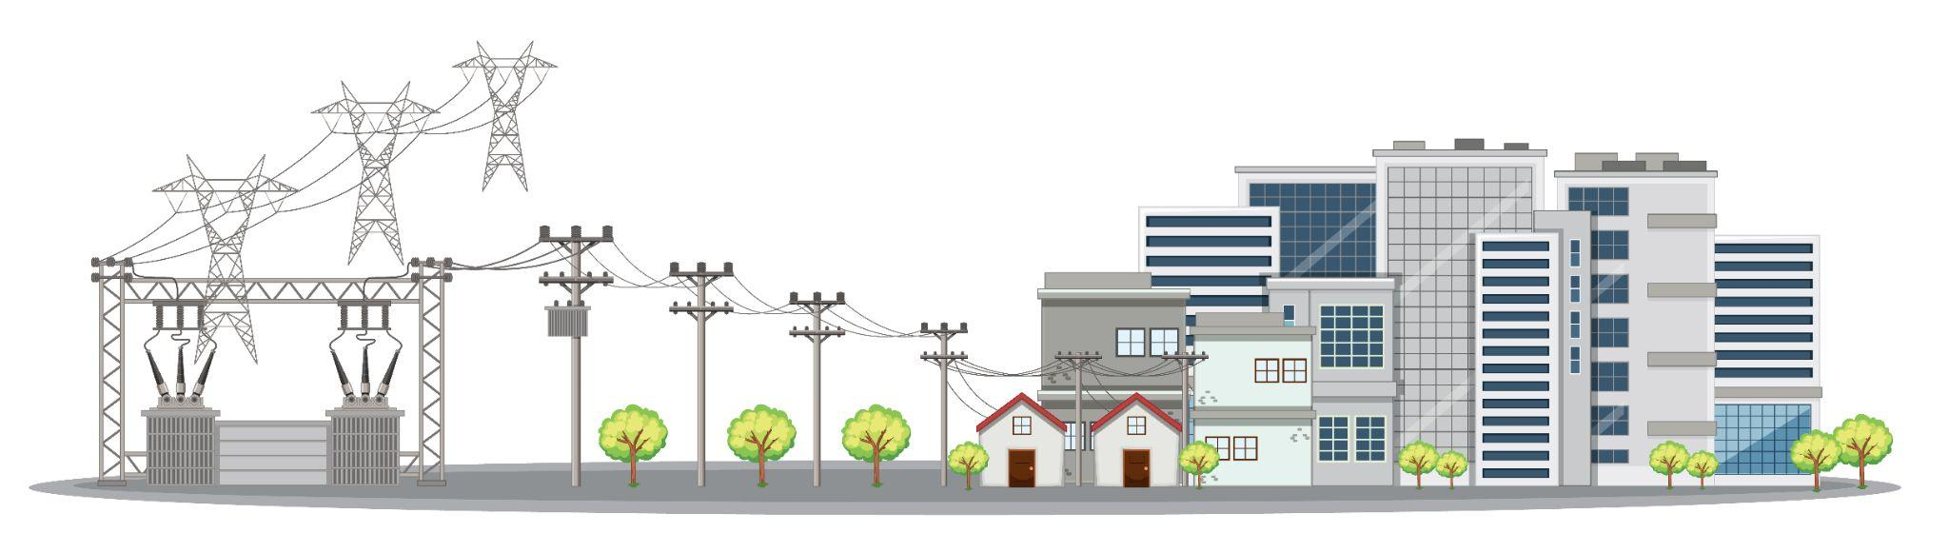
Let’s model electricity generation and transmission through our state
Notes:
In Activity 2 we will model electricity generation and transmission.

Slide 9

Safety
Do not put electrical
components in your mouth.
Always have a load
in the circuit.
Never run the path directly from the battery, back to the battery.
If anything get hots,
call over the teacher.
Notes:
Review Safety Notes

Slide 10
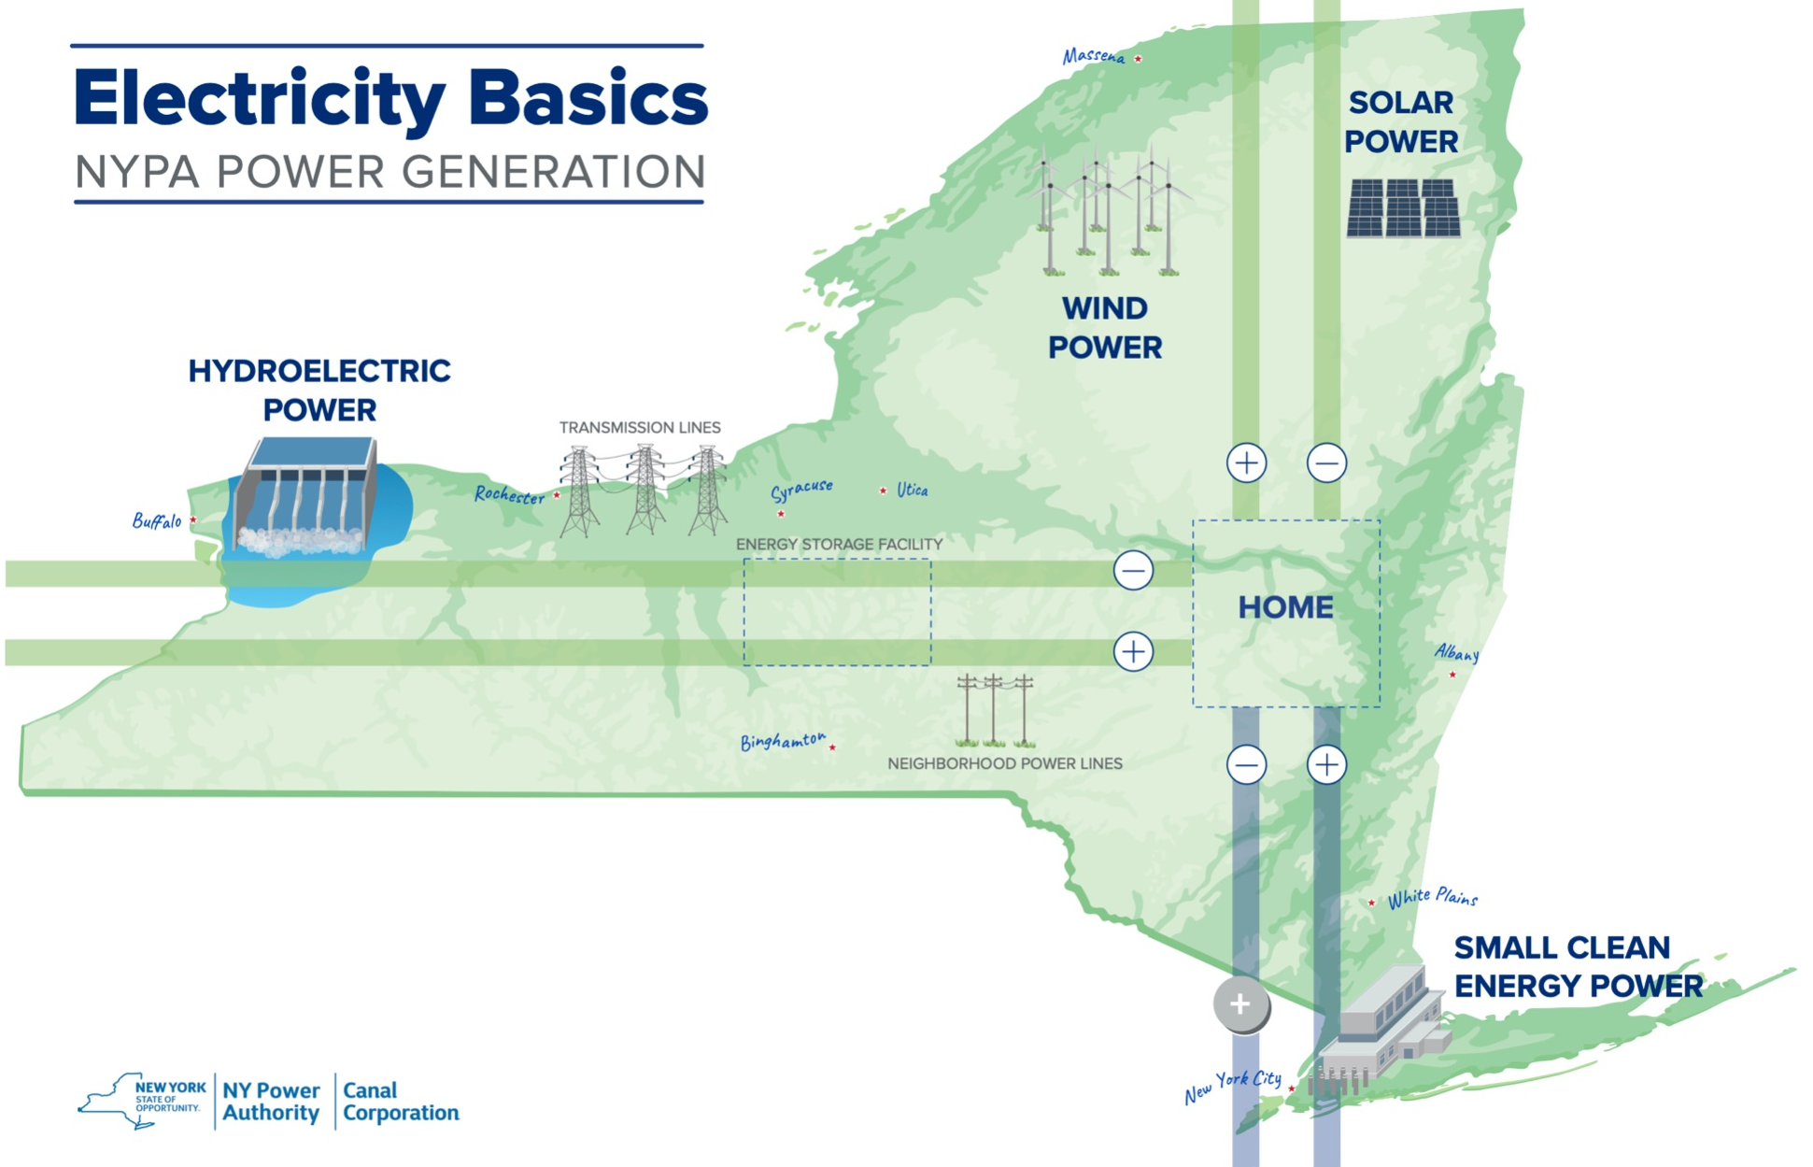
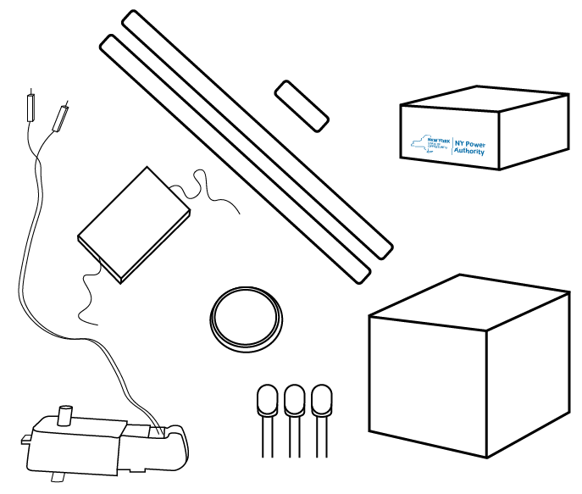
Build Activity 2: Electricity Transmission
Notes:
We will model generation and transmission of electricity across New York State. There is a very simplified map of the state. What electricity generation plants do you see?
There is a block that will represent a home.
There is Maker Tape and LEDs and a battery like last time, the battery represents the non-renewable energy source.
The yellow motor is going to represent the hydropower plant. You are going to attach the handle to the side and when you crank it, it will generate electricity. This represents a renewable energy source.
The little solar panel goes to the north of your circuit and that will generate electricity too. This represents a renewable energy source
Instructions from Student Guide
Home: Cube & LEDs
Remember the longer leg of the LED is positive (+), the shorter leg is negative (-). The cube symbolizes your home.
Separate the legs of all 3 LEDs. Bend the LED legs to create “knees” so the LED can “sit” on top of the cube with the legs hanging off the side of the cube. Sit 1 LED on each colored side of the cube. The negative side of the LED always is on the right.
Use 2 small strips of Maker Tape to secure the legs of the LED by sticking the tape vertically along the side of the cube - one strip per leg, do not let tape overlap.
Repeat with the other 2 LEDs on the other two green sides.
Place the cube on the map where it says “home.” Be sure to match the green sides of the cube with the green pathways and the blue side of the cube with the blue pathway.
You can use the stickers to decorate your home later.
Transmission Lines: Maker Tape
Place Energy Storage facility on designated map location, secure the box by following the next step.
Create the transmission lines by following the pathways on the map for the non-renewable and renewable power sources. Make sure none of the transmission lines cross or overlap!
Non-Renewable Energy Source (blue pathway)
The 2 medium size strips of Maker Tape will be used to connect the LED to the non renewable transmission lines. Start by sticking the Maker Tape to cover some of the smaller tape on the cube, making a connection. Then continue down the cube and along the blue transmission line. This will secure the cube to the paper and build the path for the circuit. Do this for both blue paths. Make sure the parallel paths do not touch each other.
Renewable Energy Source (green pathways)
Using the other 4 strips of Maker Tape, one for each path. Repeat the step above to create the pathways for the green transmission lines. Make sure the parallel paths do not touch each other. Do not secure the ends of the Maker Tape completely to paper on the green transmission lines - the loose ends of tape are needed to attach the hand crank.
Power Sources: Battery, Hand Crank, Solar Panels
Non-Renewable Power Source (Battery)
Use the last small strip of Maker Tape to create the switch for the battery.
Place battery negative (-) side down, on top of the pathway extending from the negative (-) or shorter leg of the LED.
Complete this circuit by sticking Maker Tape across the top of the positive side (+) of the battery and running it across to the positive pathway.
The battery will not be fully attached to the paper and that’s okay.
Renewable Power Source (Hand Crank Generator)
On the end of the western transmission lines, by the hydroelectric plant, secure the metal tip of the red wire from the hand crank to the positive (+) pathway of your green transmission line using the free end of the Maker Tape.
Repeat the step above for the black wire, on the negative (-) path.
Attach the handle to the white shaft coming out of the side of the yellow motor. This is just like how a hydroelectric plant uses flowing water to spin the blades of the generator and a wind turbine needs blowing wind to turn the blades and generate electricity. The motor is acting like a generator using the energy of movement into electrical energy.
Renewable Power Source (Solar Panel)
On the end of the northern transmission lines, the solar panels secure the metal tip of the red wire from the solar panel to the positive (+) pathway of the green transmission line using the end of tape left free along the pathway.
Repeat the step above for the black wire, on the negative (-) path. Unlike the battery and hand crank, the solar panel relies on light from the sun. Put your solar panel close to the window or use a flashlight to make your LED shine. It will be very dim and hard to see because it takes a lot of the sun's energy to make electricity.

Slide 11
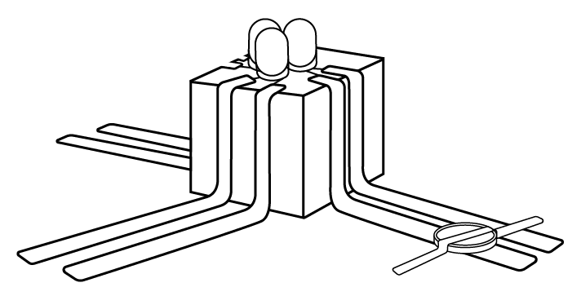
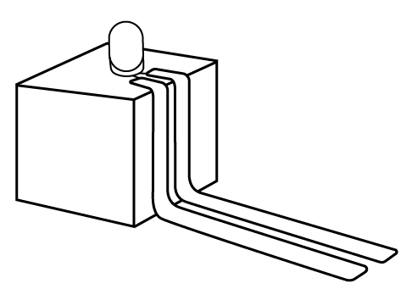
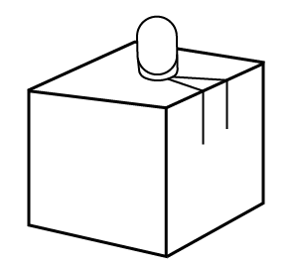
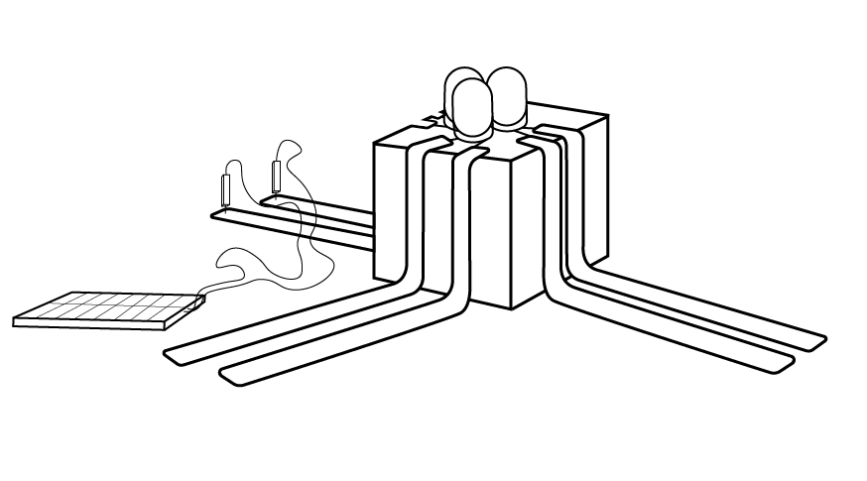
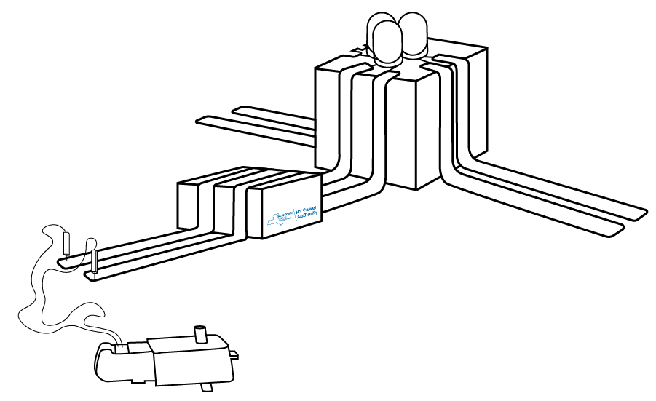
Let’s Build
1
2
3
5
4

Slide 12
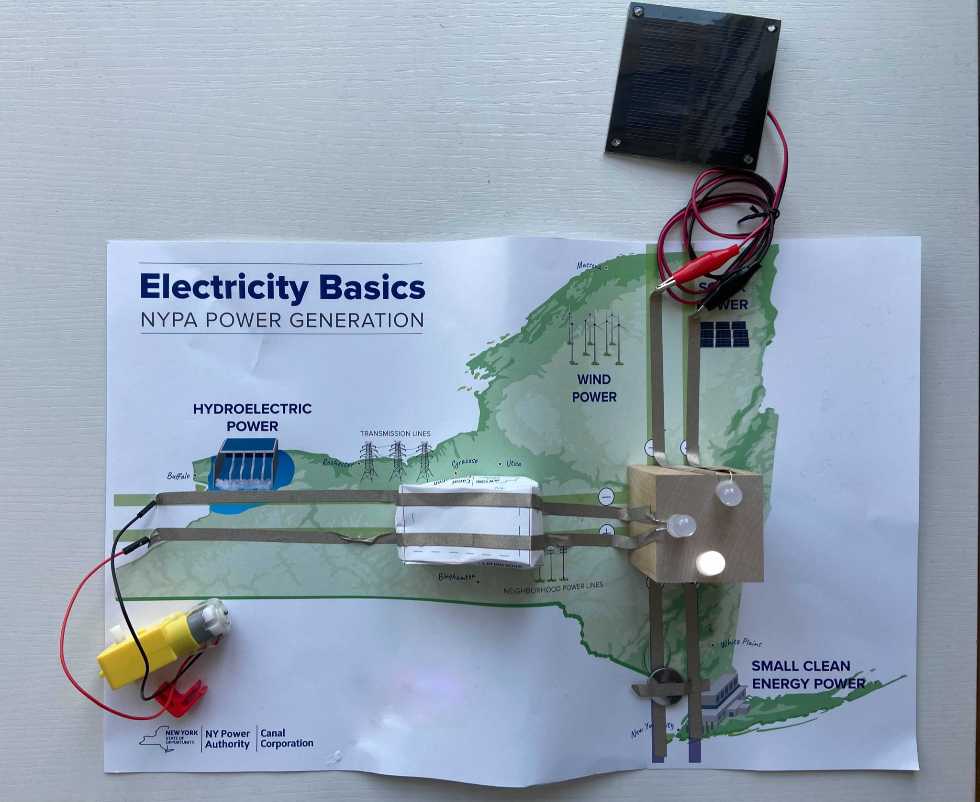
You generated electricity and transmitted to your home!

Slide 13

WONDER TIME
Notes:
Slide to be used to transition from building mode to reflection time.

Slide 14
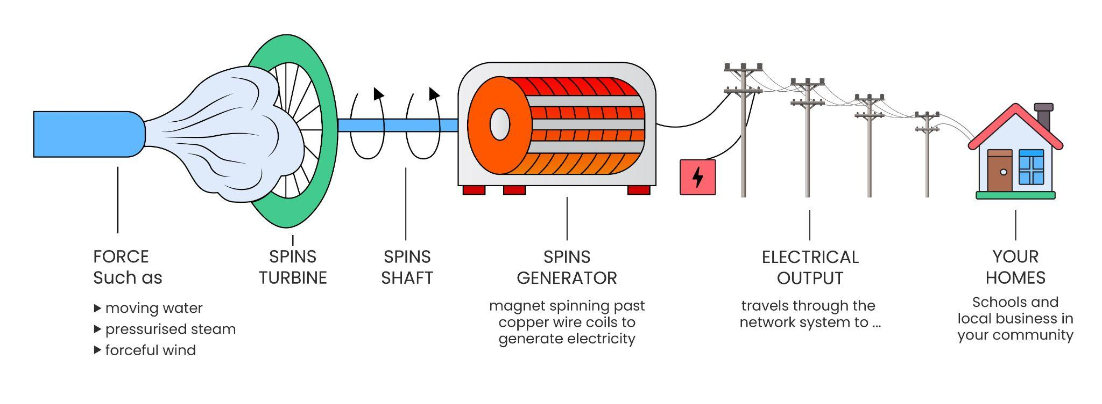
How is electrical power created?
Notes:
A physical force, steam, wind, water pushed a turbine with blades around in a circuit. This spins a shaft inside a generator that excites the electrons and makes them jump. The electrons push each other through transmission lines to substations and transformers then to your home.
The yellow hand crank motor represent the generation of power from the renewable resource - when you crank the handle of the motor around and around, electricity is being generated out of the wires. This cool device allows us to generate our own energy. In the real world, steam, wind or water is turning a turbine similar to our hand crank to generate electricity on a much bigger scale.

Slide 15
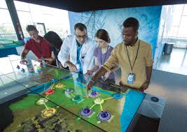
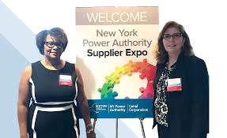
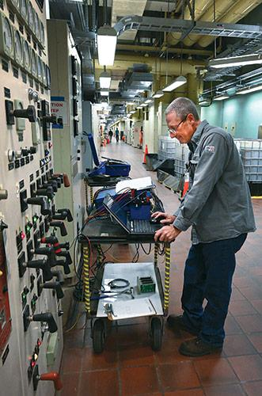
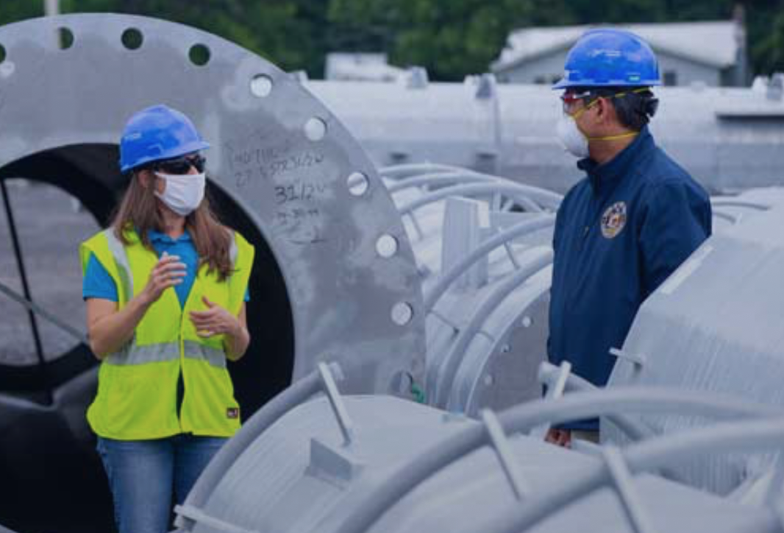
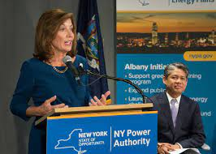
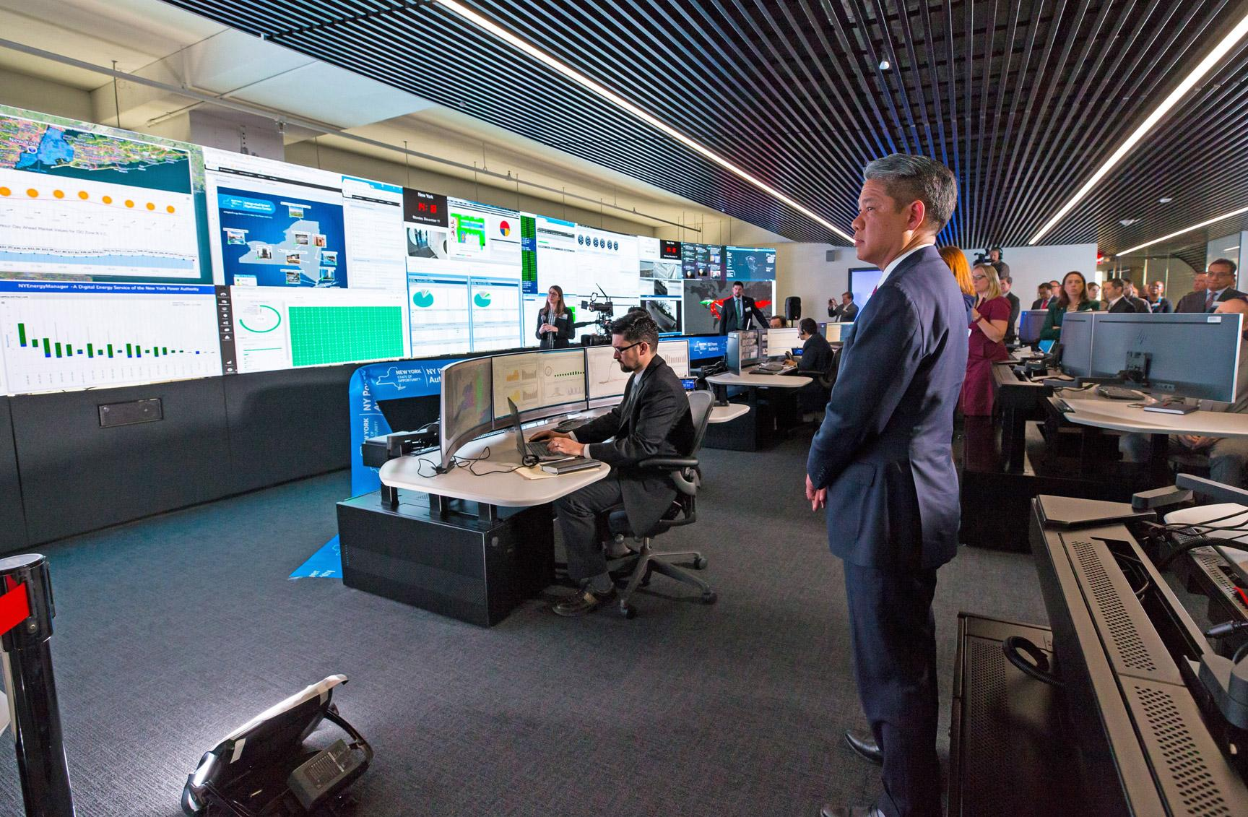
What careers do you think you could have with NYPA in the future?
What problems do you want to solve?
Notes:
Today you were NYPA engineers, you helped us to use both renewable and non-renewable energy to solve a problem and transmit electricity to a city building. NYPA has thousands of electricians, engineers and others that keep all of our lights on day to day. Everyday the citizens of New York State use more and more electricity in different ways, we need your great minds to keep the lights on and design solutions for our communities now and in the future. What careers do you think you could have with NYPA in the future? What problems do you want to solve?
We really enjoyed being with you today, if you have questions, we can answer them as we wrap up our time together today.

