Slide 1
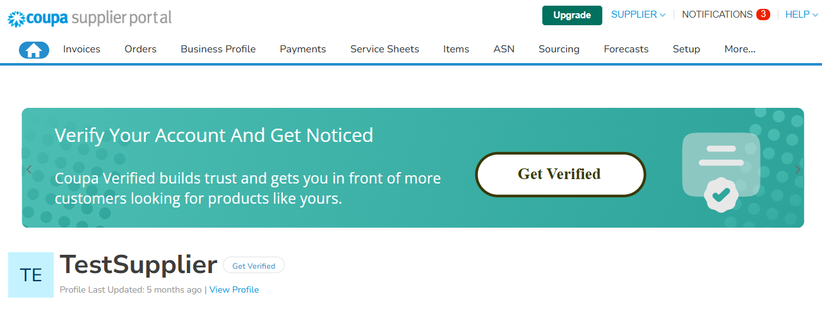
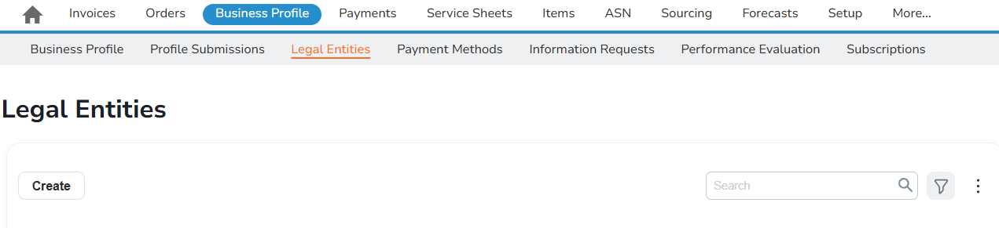
The aim of this document is to provide an overview of the creation and update process of a legal entity as part of the onboarding process to conduct business with Sasol. This document is only for Suppliers new to Coupa (no supplier profile available in CSP).
Getting started
You will log into the CSP with your Supplier Account.
From the top navigation bar, select Business Profile :
1
Select Legal Entities and then click on “Create” to add a new legal entity.
2

Slide 2
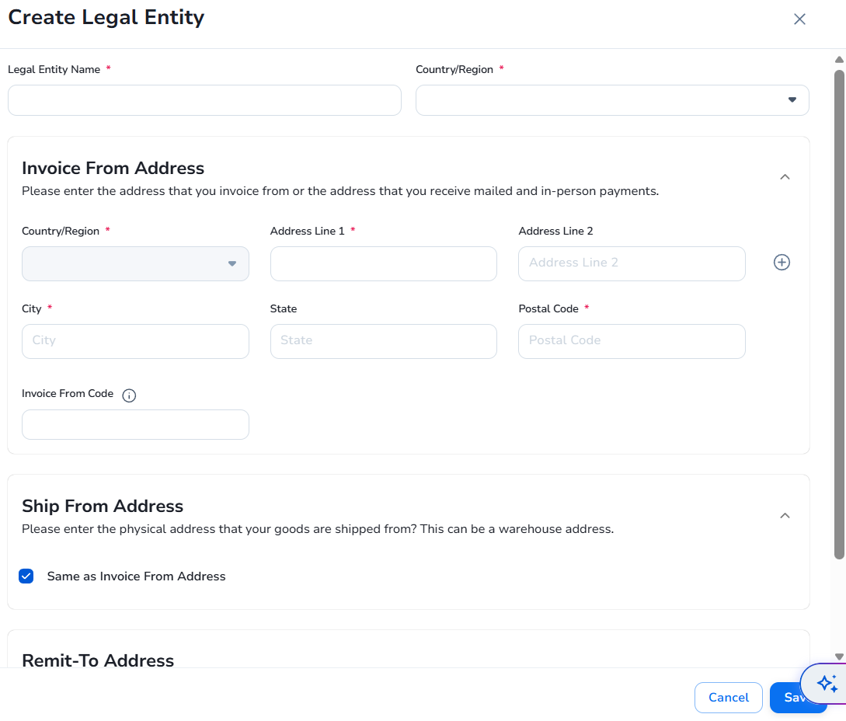

Once you click the “Create” button, an additional slide will appear in the right part of your screen.
3
a
b
c
d
Note:
Please note that the fields marked with “*” are mandatory.
e
Legal Entity Name: Official name of your business as it is registered with the local government.
Country or Region: Country or region where your business is located. You cannot change this field after you have saved the legal entity.
Invoice from Address: Address from where you send invoices to your customers. It can be the same as the “Remit-to Address” or a different one.
Ship from Address: Address from where you send products to your customer. It can be the same Invoice from Address or a different one.
Remit-to Address: The address where you receive payments. It can be the same as the “Invoice from Address” or a different one. When creating a payment method (bank transfer or virtual card), the system will pick up the latest version of the remit-to address of the legal entity

Slide 3
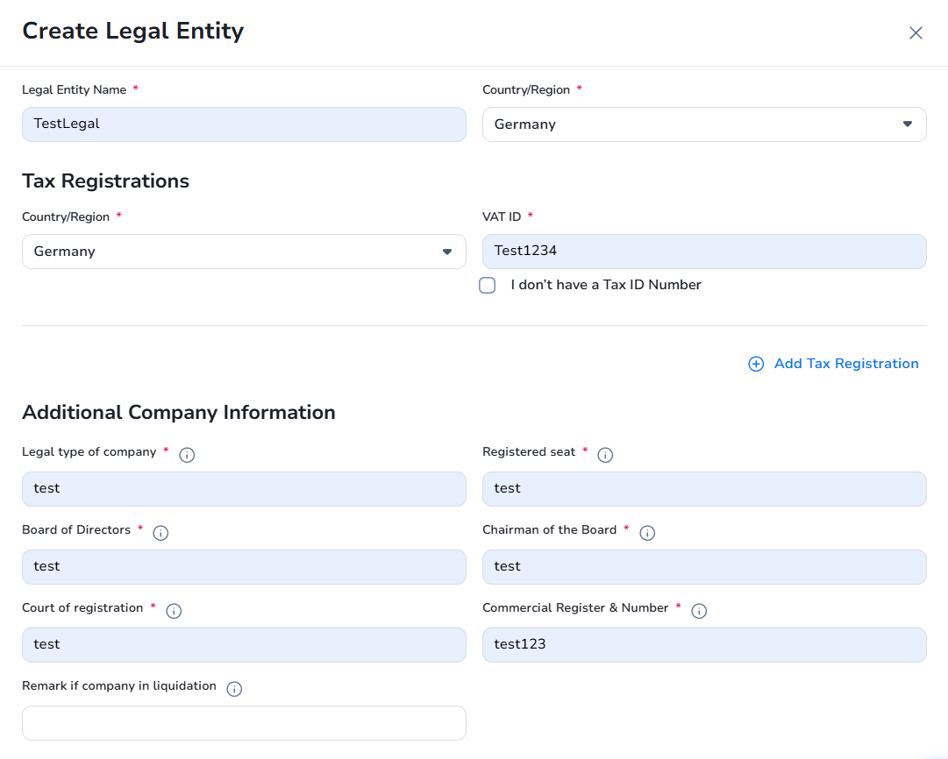
After completing the “Country/Region” section with Germany, two additional fields will appear
Tax Registrations.
Additional Company Information.
4
A
B
a
b
c
d
e
f
Additional Company Information mandatory fields :
Legal type of company : Include the type of company in relation to how your company is legally registered. For example, whether it is a limited company or not.
Registered seat : Include where you company's official seat is.
Board of Directors : Include the names of the Directors on the Board of your company.
Chairman of the Board : Include the name of the Chairman of your Board of Directors.
Court of registration : Include the name of the Court under which your company is registered.
Commercial Register & Number : Include the name of the commercial register with which your company is registered and the registration number of your company.

Slide 4

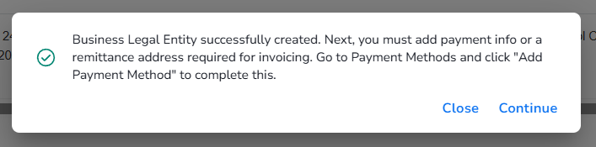
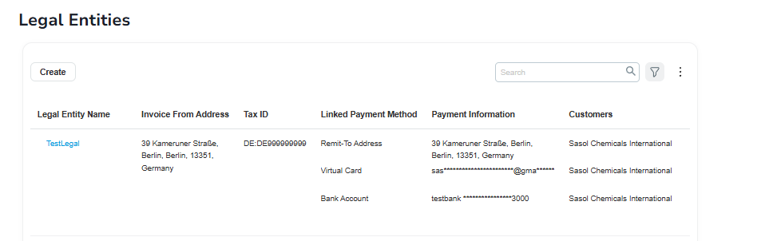
Select the Save button.
6
A confirmation message confirms that the action is successful:
8
7
Click Continue to add new payment methods to the legal entity or click Close to return to the Legal Entities page.
8

