Slide 1
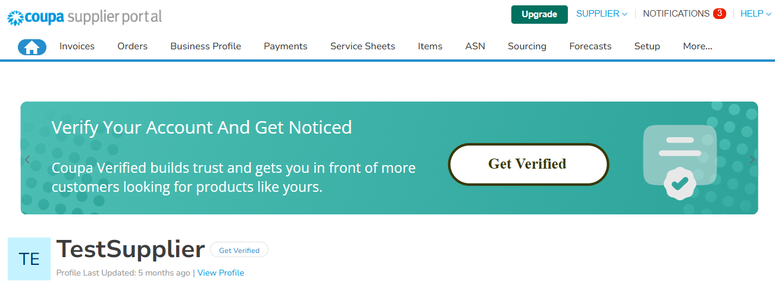
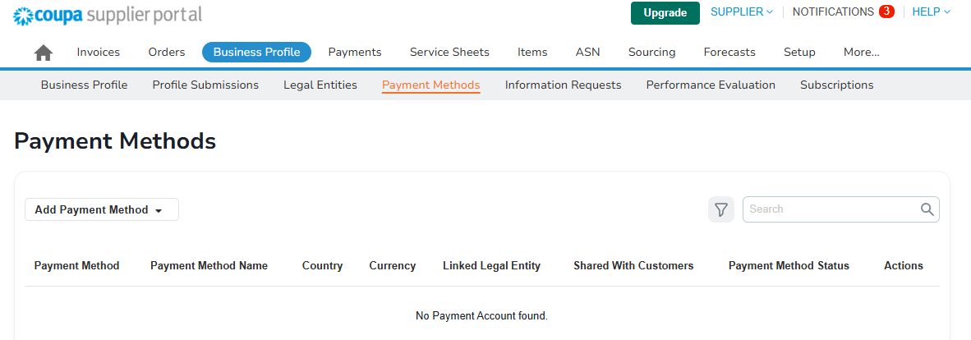

The aim of this document is to guide you through the Sasol specific requirements for adding a Payment method so you can finish your onboarding with Sasol.
This guide is for suppliers that already have a Coupa Supplier Profile created.
Getting started
You need to have added at least one legal entity before adding a payment method from the Payment Methods summary page.
From the top navigation bar, select Business Profile :
1
Select Payment Methods. This is the Payment Methods table view.
2
Note:
You can start to set up a new payment method after you finish to configure a legal entity by clicking “Continue” on the confirmation message .

Slide 2
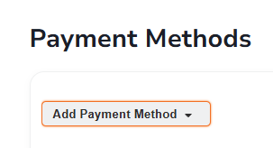
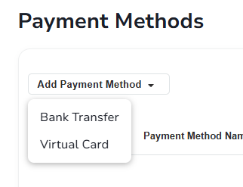
Select the Add Payment Method dropdown option on the top left corner of the page, underneath the Payment Methods header.
3
Select the Payment type of the new payment method. Options are:
  Bank Transfer
  Virtual card
3
A
B

Slide 3
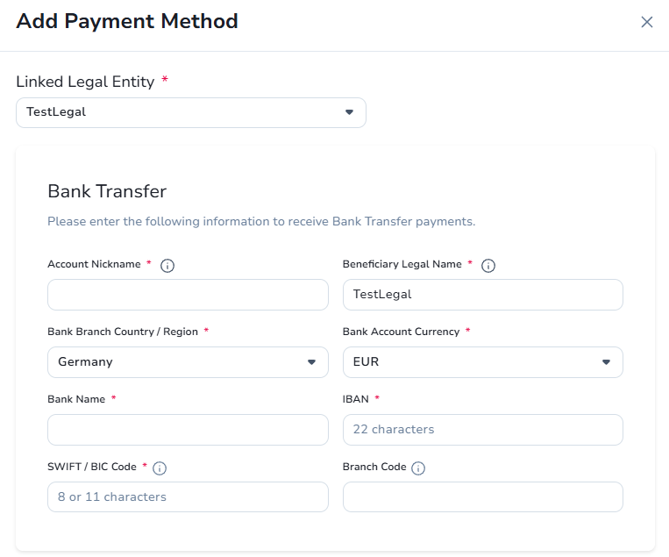
Bank Transfer
  Select the legal entity you want your payment method associated with from the dropdown list.
  For existing suppliers on the CSP, the Beneficiary Legal Name is pre-populated with your legal entity name when you add a Bank Transfer as payment method. This field is mandatory.
A
a
b
c
Beneficiary Legal Name : The legal name as it appears on the invoice
SWIFT / BIC Code : Required to receive International payments
Branch Code : Bank-defined internal branch identifier
Note: Please note that the fields marked with “*” are mandatory.

Slide 4
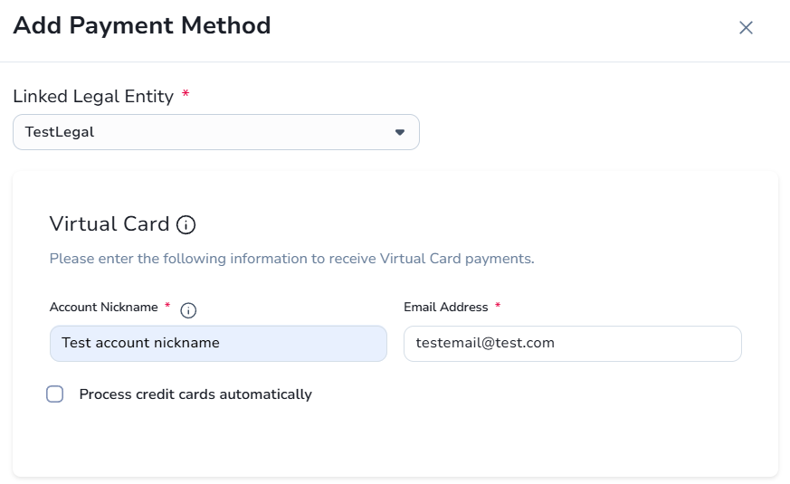
Virtual Card
  Select the legal entity you want your payment method associated with from the dropdown list.
B
a
Process credit cards automatically : You can now connect your Stripe account to process customer payment cards automatically. Once you click on 'Connect with Stripe', the Stripe authentication process will be initiated in a new browser tab or window. The window will automatically close as soon as the authentication process is completed

Slide 5
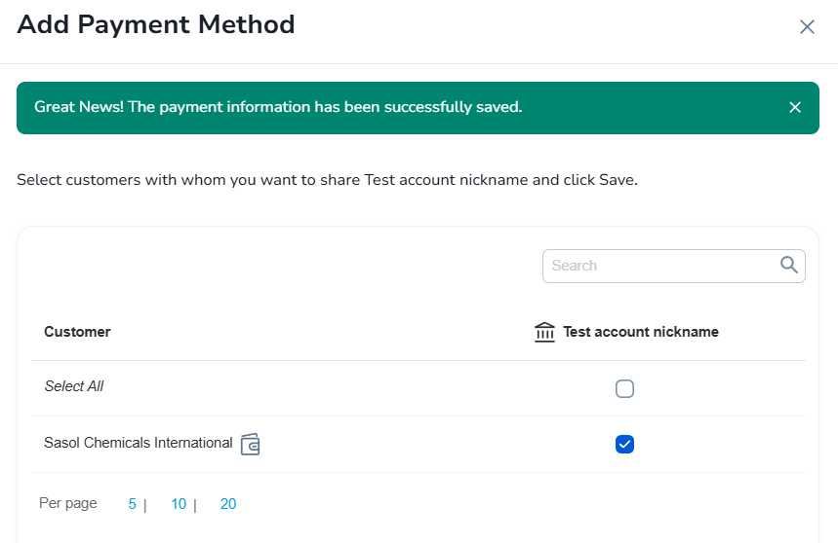
Create a payment method name:
  Choose a relevant and easy to remember Account nickname for this payment method. Avoid including customer names as you may want to share this with multiple customers. This field is mandatory.
5
Complete the fields shown in the window :
  Fields will vary depending on your payment method type. The fields marked with a red asterisk are mandatory.
6
Share payment methods with customers :
  Find the customer you want to share the payment method with. It can be listed underneath, or you can use the search bar.
7

Slide 6
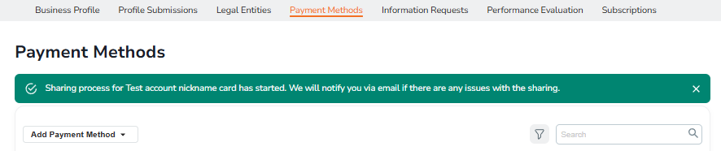
Select the checkmark next to the customer's name you want to share the payment method with.
8
Select the Save button on the lower right side of the window. If successful, this action displays a green banner with the message confirming the creating process of the payment method has begun. CSP notifies you by email if there are any issues.
9
Note:
If you see an error message while saving a payment method, do not ignore the errors and save the account. Ignoring the error message may result in delayed processing for the affected customers.
You can save an invalid payment method only once. Later you are required to correct the invalid fields.
If you get a warning that a payment method failed to share with a customer, you can create or edit the payment method directly from the red warning banner. After you successfully update and submit the payment method, you are redirected to the Payment Methods screen with a green success banner.

Slide 7
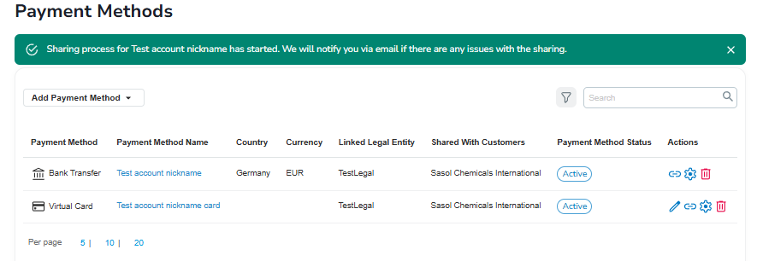
Payment Methods page
After confirming the new payment method, you will be redirected to the Payment Methods page. You see your newly created payment method in the list.
10

