Slide 1

The aim of this document is to outline the invoice creation process from a Purchase Order (PO) directly in the Coupa Supplier Portal (CSP), as well as how to submit an invoice from the PO email notification without needing to create a CSP account.
Create Invoice from Coupa PO
Note:
All invoices from Italian suppliers that include Italian VAT must be submitted through the SDI system. Suppliers attempting to submit these invoices via the CSP will encounter errors. This requirement also applies to suppliers from other countries submitting invoices to SASOL Italy or any other country.
Coupa Supplier Portal
(CSP)
Supplier Actionable Notifications (SAN)
Suppliers can accept Sasol's invitation to join Coupa Supplier Portal and submit invoices through the platform. Once an account is created, they can also view orders, invoices, payment statuses and create reports within a single free-of-charge platform.
Suppliers will be able to create their invoices directly from the email notification they receive from Coupa containing the purchase order (PO). For this step, they do not need to create a CSP account and can generate the invoice directly from the email.

Slide 2
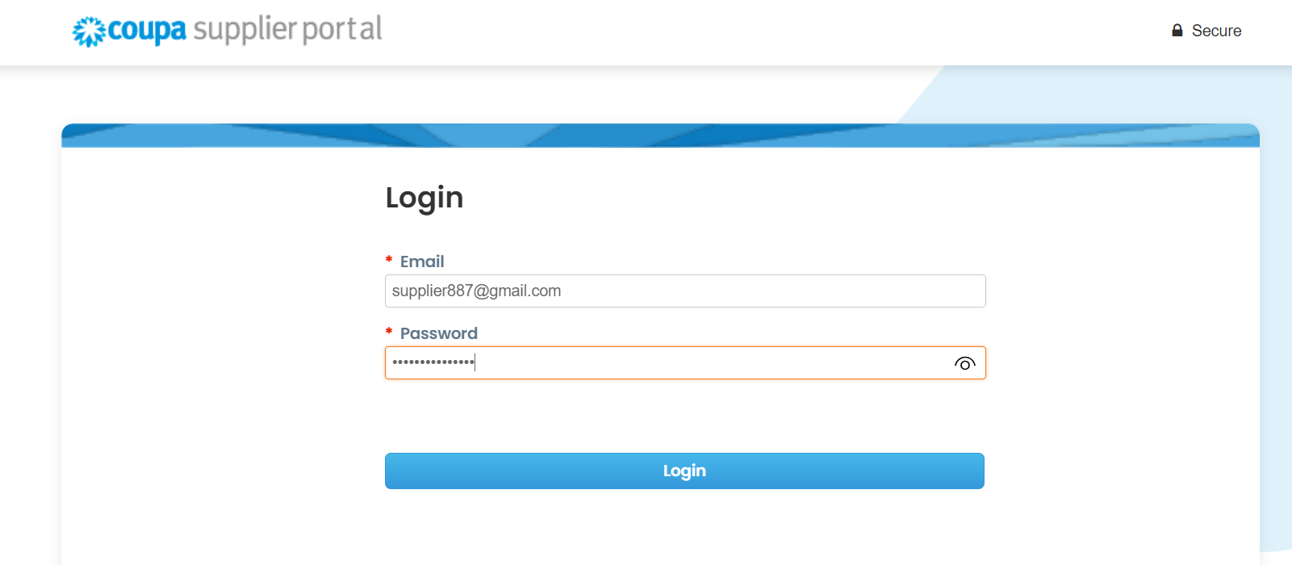
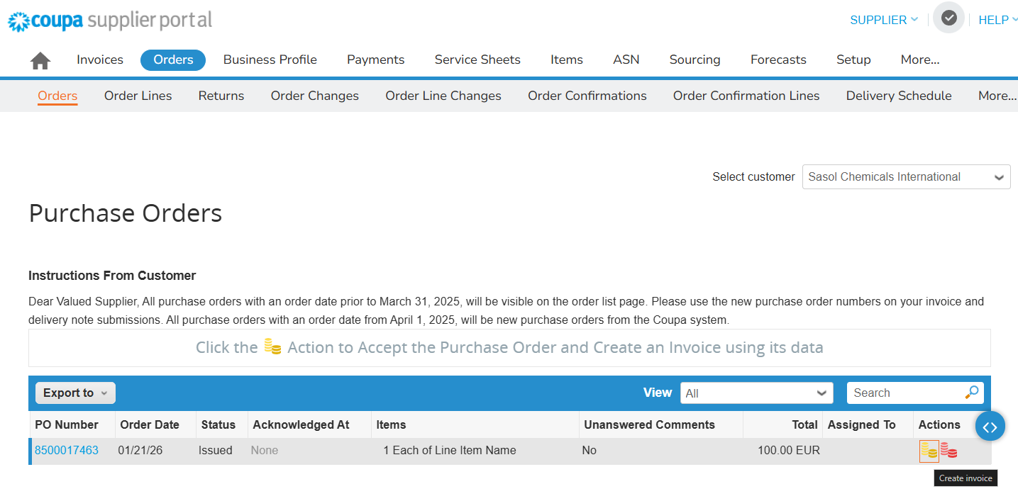
.
Create Invoice in CSP
Enter the Email ID and Password to log into CSP.
Click the Orders tab to view all orders created by Sasol.
Click on the gold Coins icon to create an invoice.
1
2
3
Note: The first time you create an invoice in CSP, the system will prompt you to enter legal entity details, such as VAT number, bank details, and more depicted in the following slides. These details may vary depending on the country legislation and Sasol requirements.

Slide 3
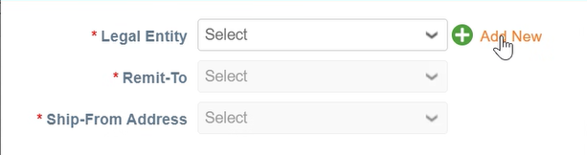
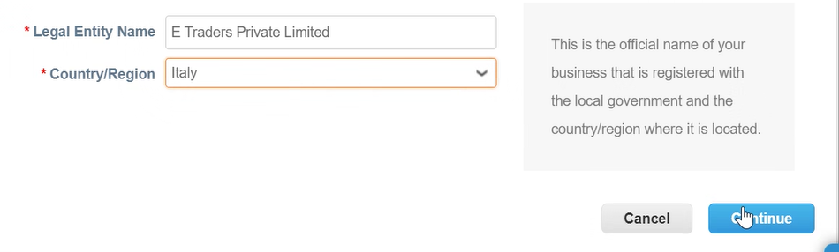
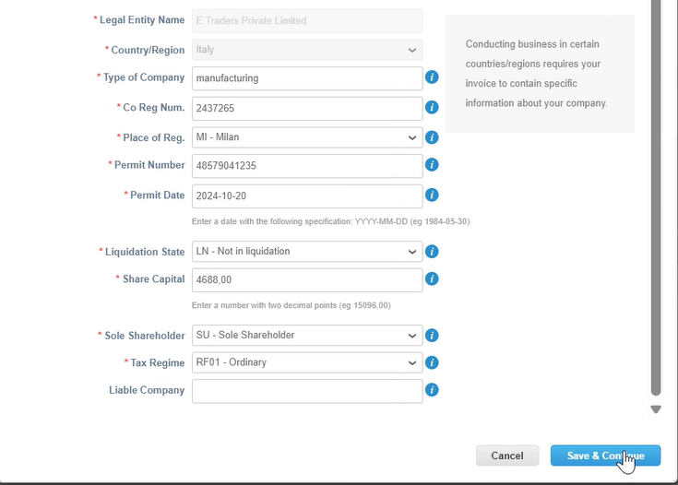
Create Invoice in CSP
Click the Add New option to create a new legal entity.
Enter the required details in the Legal Entity Name, Remit-To and Ship-From fields.
Once you fill in the Legal Entity Name and Country, you can click on Continue.
Enter the required details in the mandatory fields (*). Click Save & Continue.
5
4
6
7

Slide 4
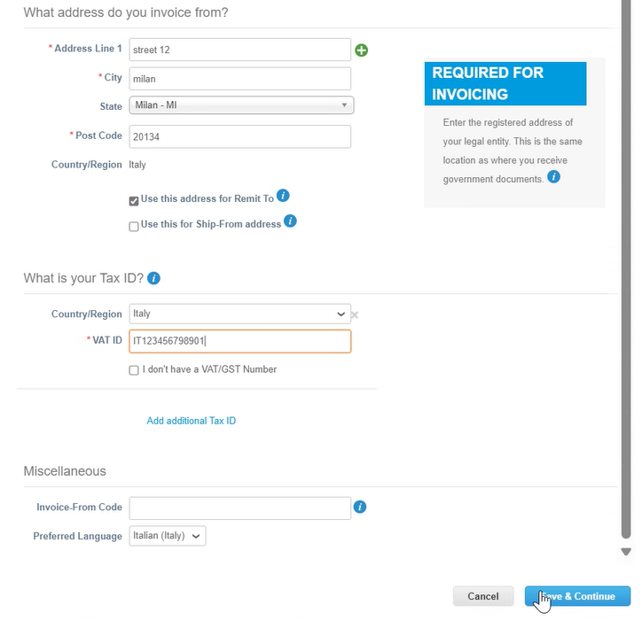
Create Invoice in CSP
Enter the required details in the Address and Tax section.
Click Save & Continue.
8
9

Slide 5
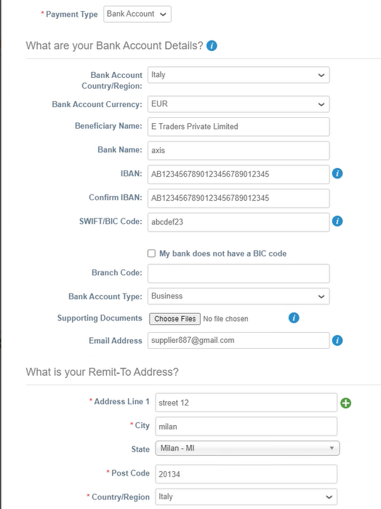
Create Invoice in CSP
Enter the required details in the Bank Account Details and Remit-To Address sections.
Click the Next button to save the Bank Account Details.
11

Slide 6
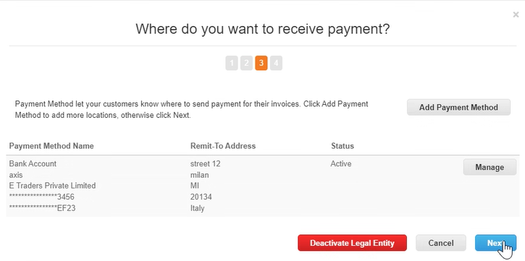
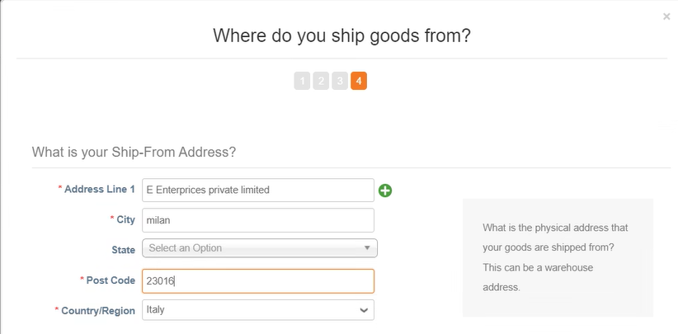
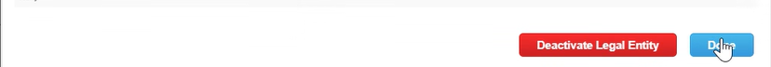
Create Invoice in CSP
Click the Next button to save the receiving Bank Account Details or Add Payment Method to create an additional one.
Enter the details in the mandatory fields from the Ship-From Address section.
Click the Done button to save the Ship-From Address details.
12
13
14

Slide 7
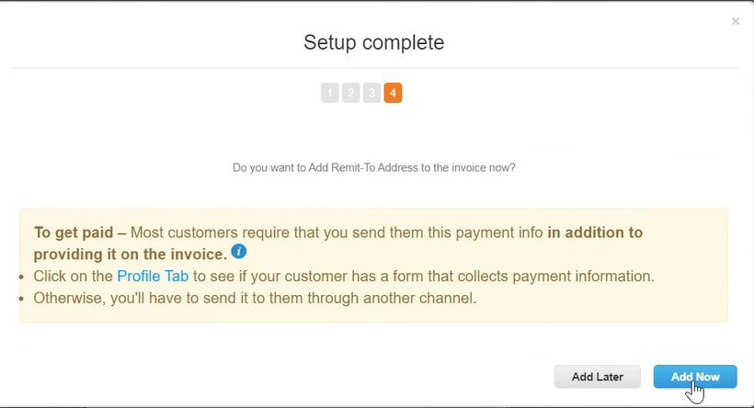
Create Invoice in CSP
Click the Add Now button to complete the creation of the legal entity.
15

Slide 8
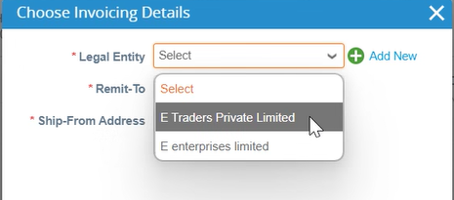
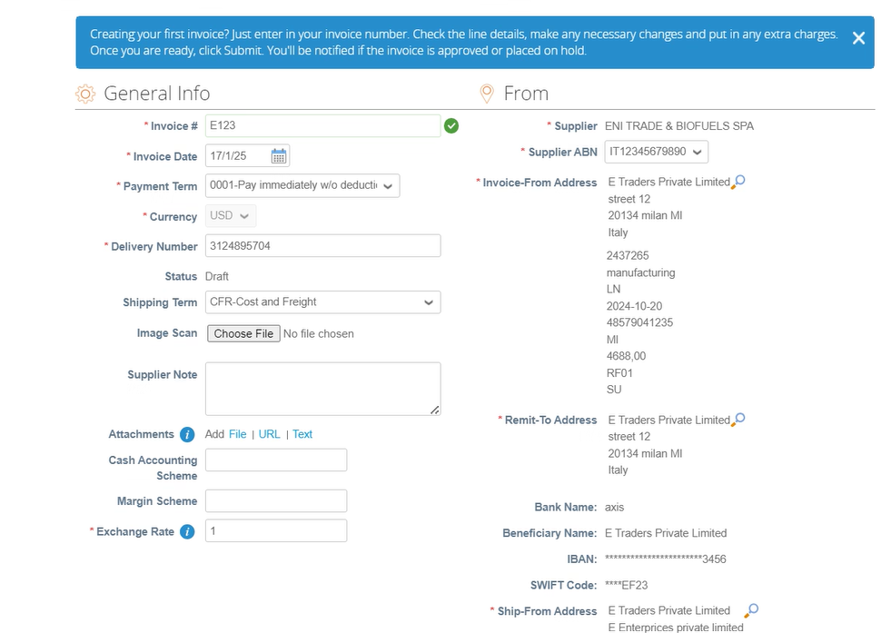
Create Invoice in CSP
Select the newly created Legal Entity from the dropdown.
Enter the required details (*) for invoice creation.
16
17

Slide 9
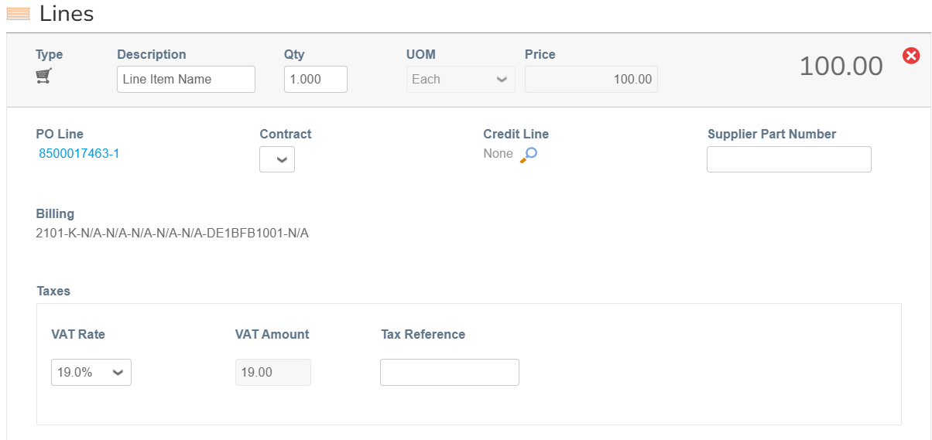
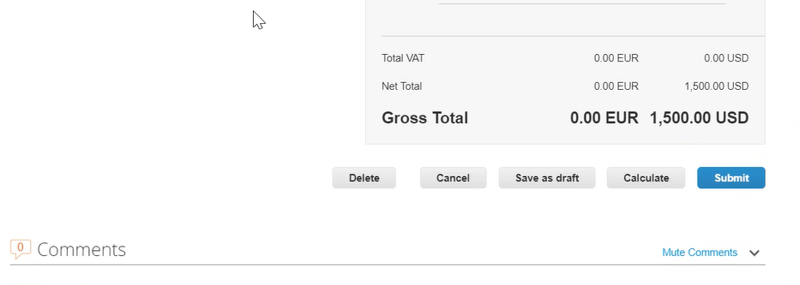
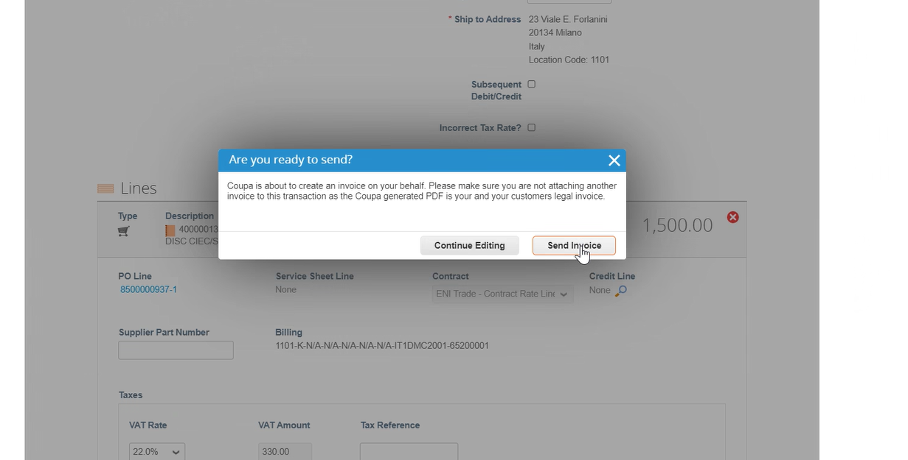
Create Invoice in CSP
Check the line details and adjust the VAT and quantity if required.
Check the total amount and then the Submit button. The draft can also be deleted or saved for further editing if needed.
Click on Send Invoice for the invoice to be submitted to Sasol for approval and to complete the invoice submission process in CSP.
18
19
20

Slide 10
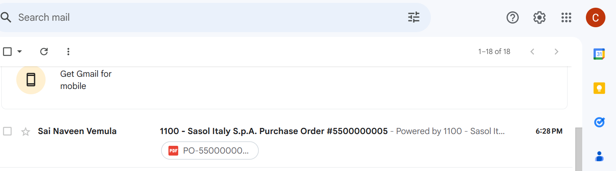
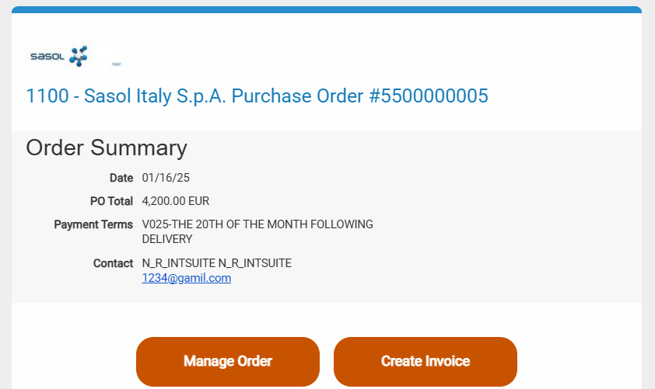
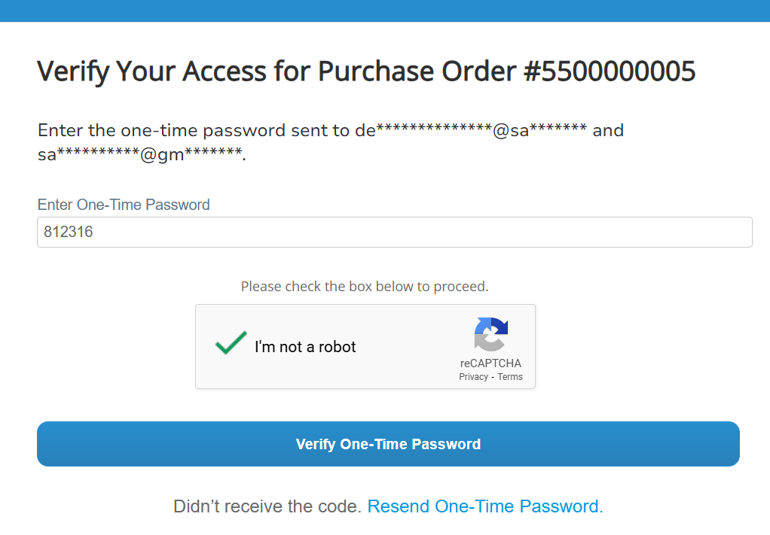
Create Invoice via Supplier Actionable Notification (SAN)
Click the mail to be redirected to the Sasol Portal.
Click on Create Invoice.
Complete the One Time Password verification process
1
2
3

Slide 11
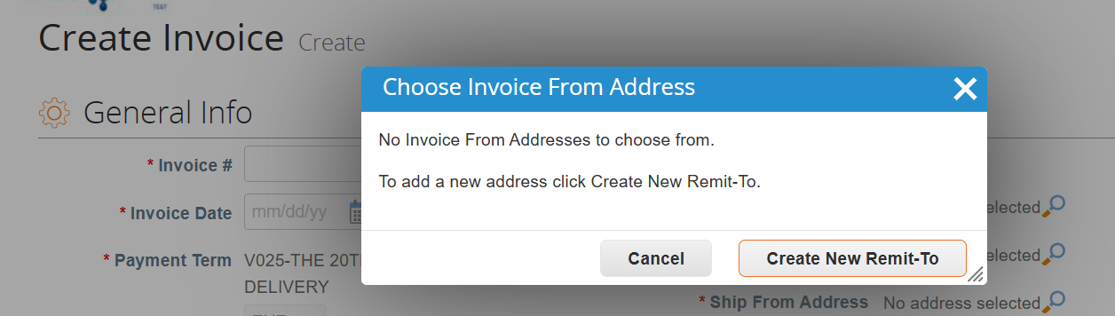
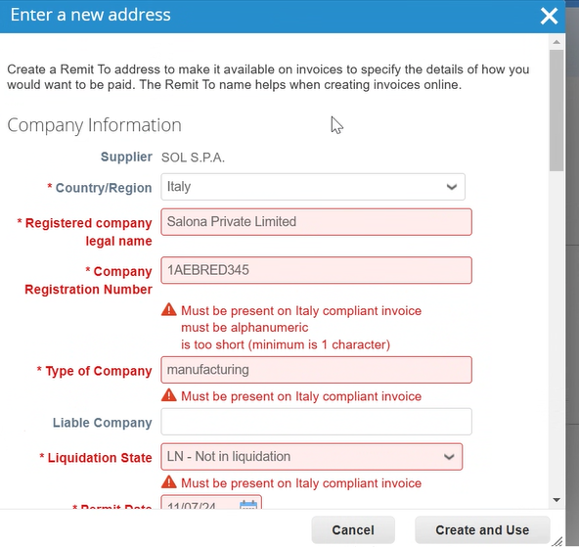
Create Invoice via Supplier Actionable Notification (SAN)
Click on Create New Remit-To button.
Add all the mandatory details for the chosen Country/Region and click Create and Use.
4
5

Slide 12
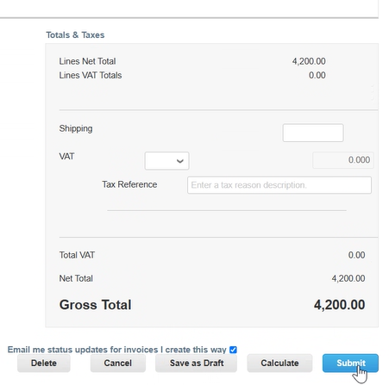
Create Invoice via Supplier Actionable Notification (SAN)
Enter all the required invoice details.
Click the Submit button.
6
5
7

Slide 13
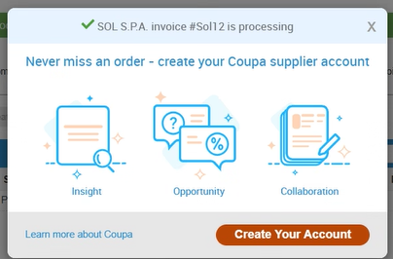
Create Invoice via Supplier Actionable Notification (SAN)
Click the Send Invoice button to submit the invoice to Sasol.
A confirmation message will be displayed.
8
9

