Slide 1

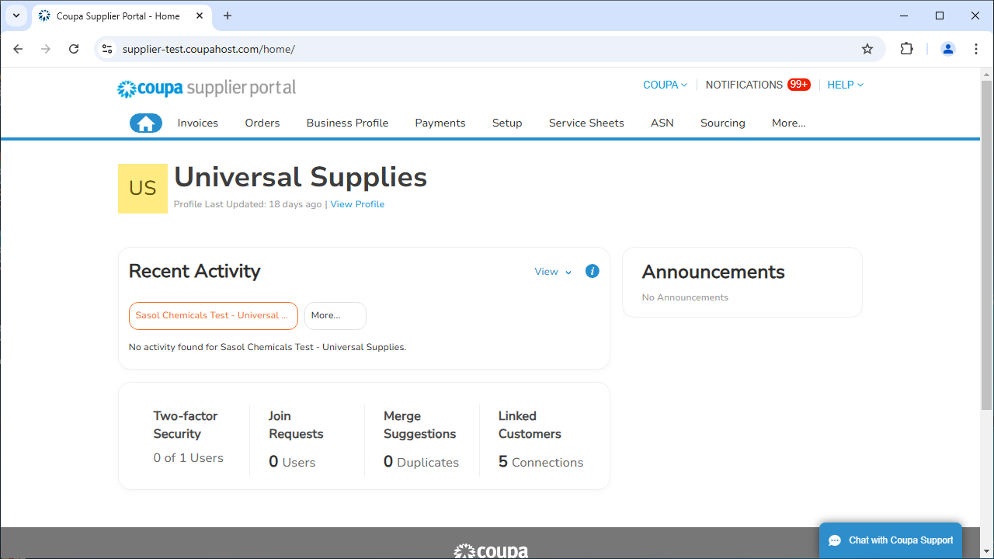
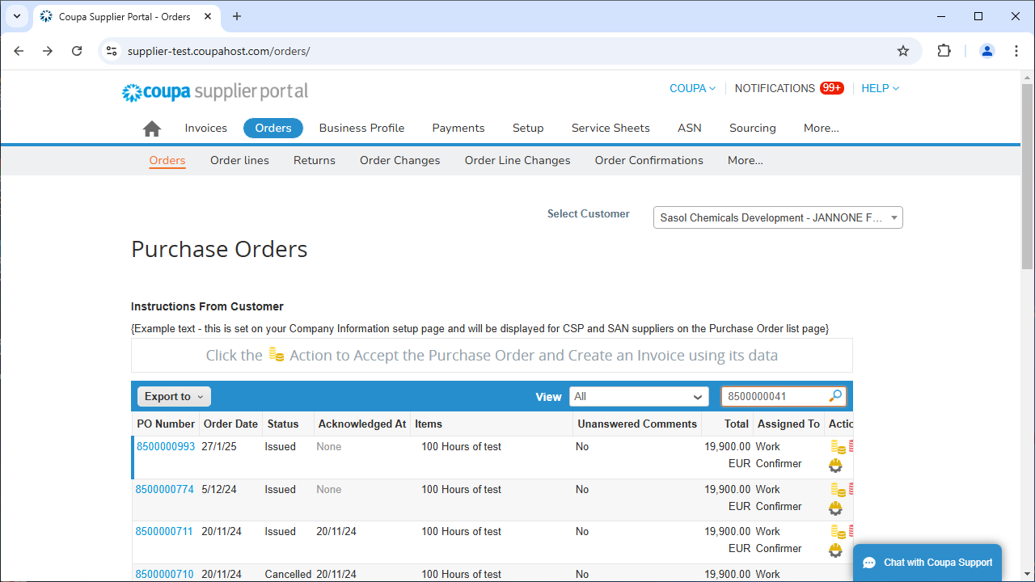
The aim of this document is to provide an overview of the Service Entry Sheet creation in the Coupa Supplier Portal.
Note:
The data used in this Quick Reference Guide is for learning purposes only. Please use data that is specific to the transaction you are executing when working in the live system.
Log into CSP and Locate Purchase Order
Log into the CSP and click on the Orders tab on the home screen.
Use the search field to enter the purchase order number.
1
2

Slide 2
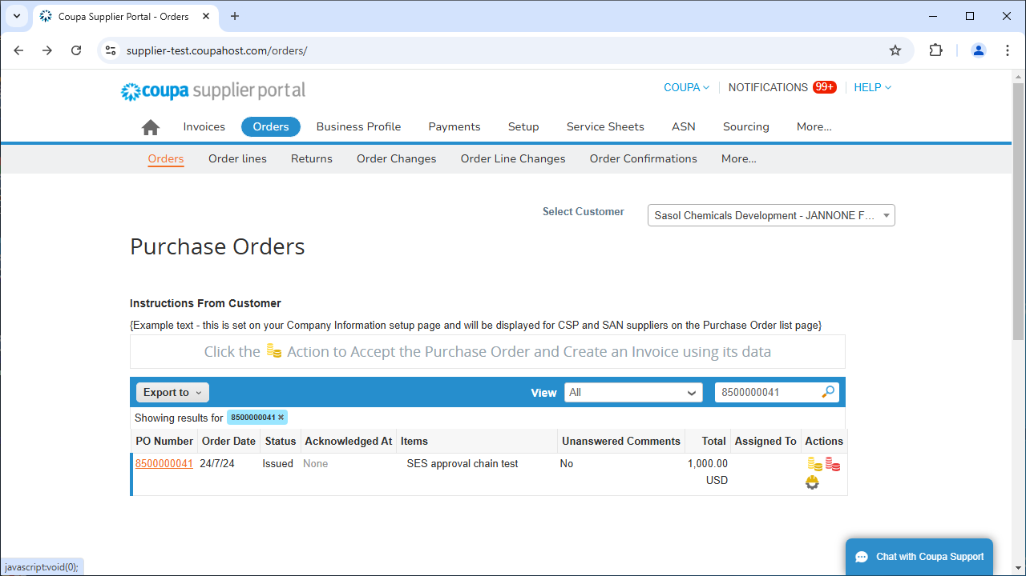
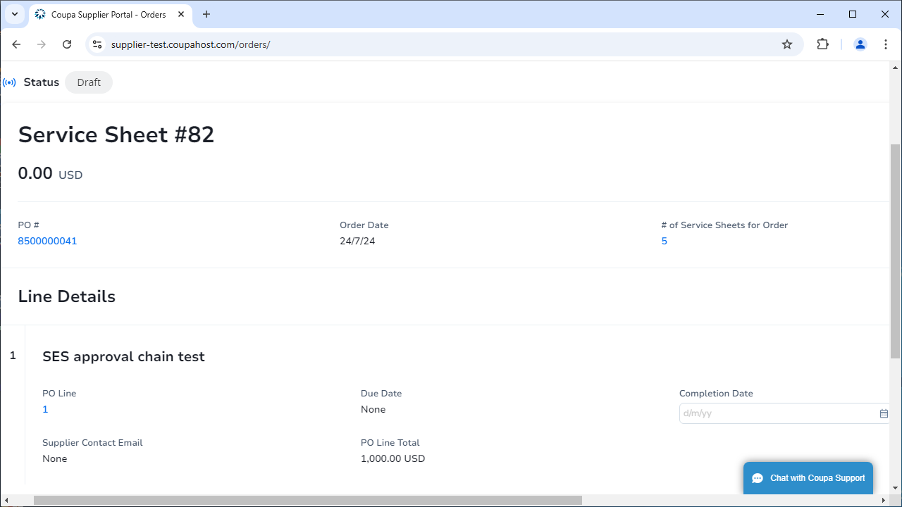
.
Log into CSP and Locate Purchase Order
Click the search icon to execute the search.
A draft service entry sheet opens. Click the Calendar icon to select the Completion Date.
3
4

Slide 3
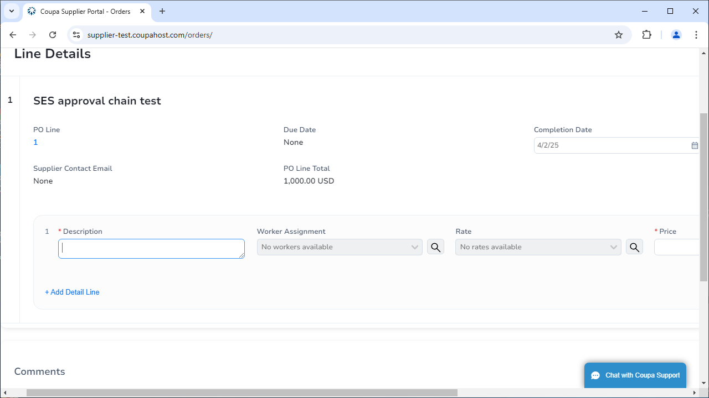
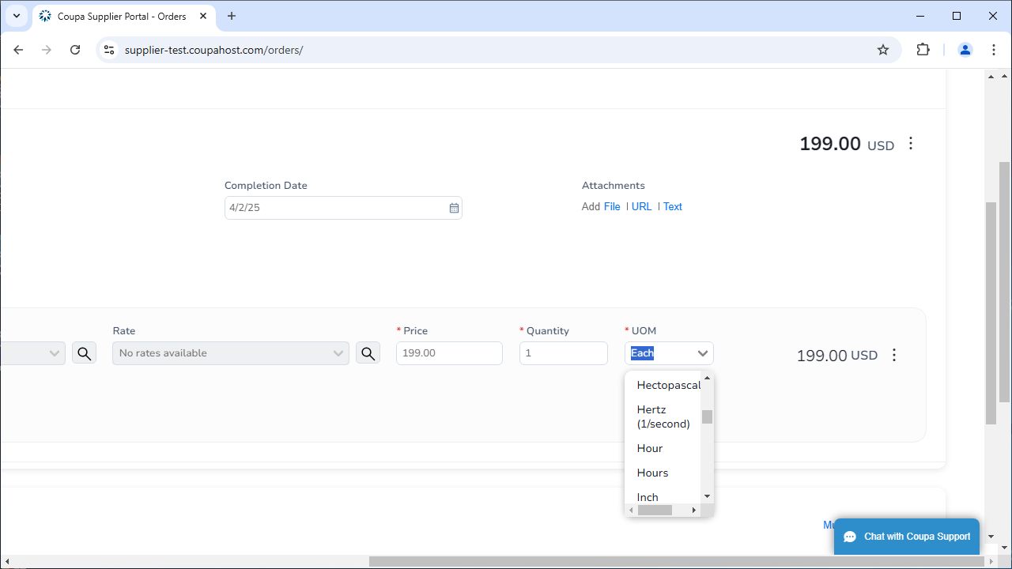
.
Enter Service Details
Enter a Description of the completed service.
Enter the Price, Quantity, and UOM.
5
6

Slide 4
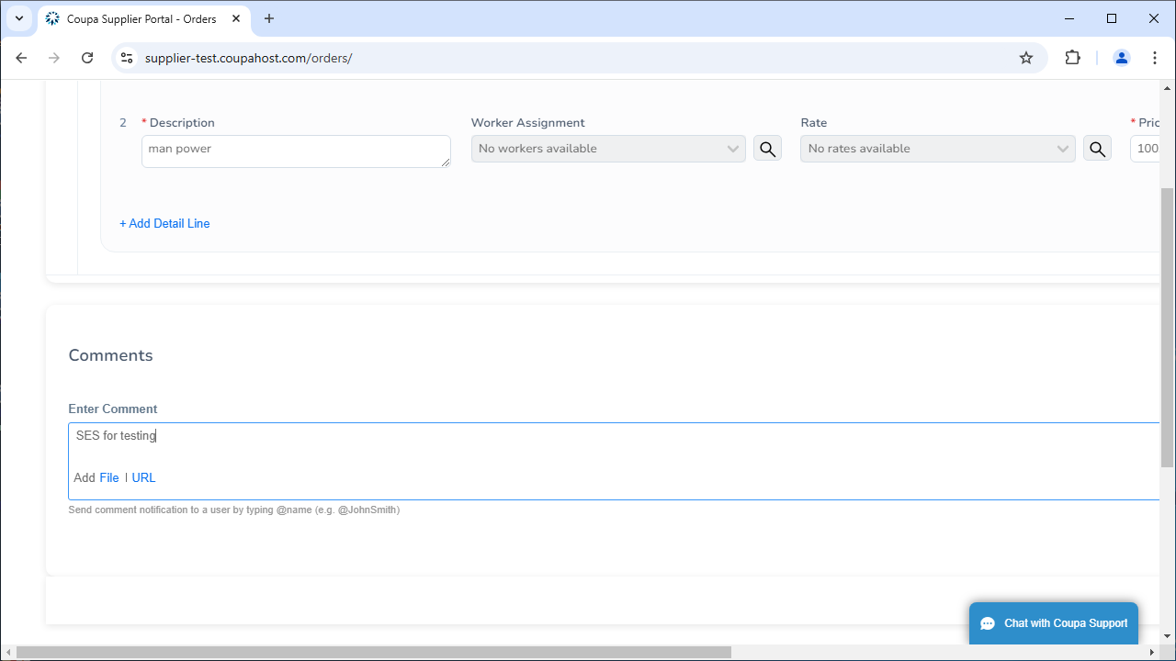
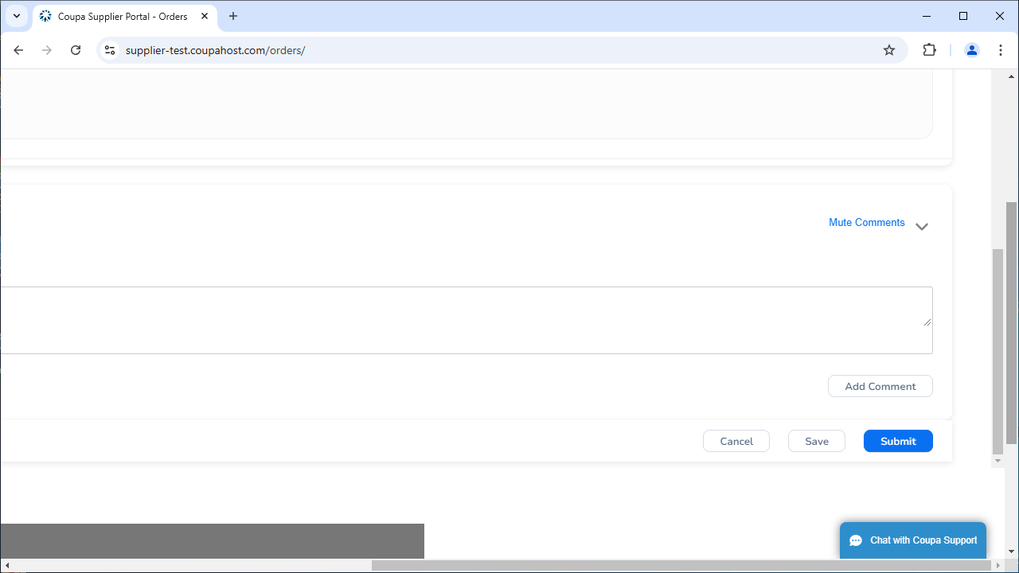
.
Submit Service Entry Sheet
Enter a Comment if you would like to send one to Sasol along with the service entry.
Click Submit.
7
6

Slide 5
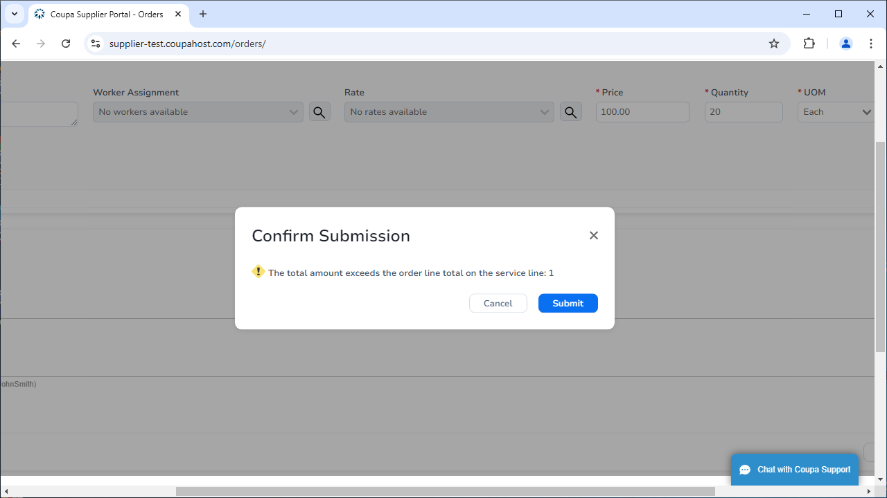
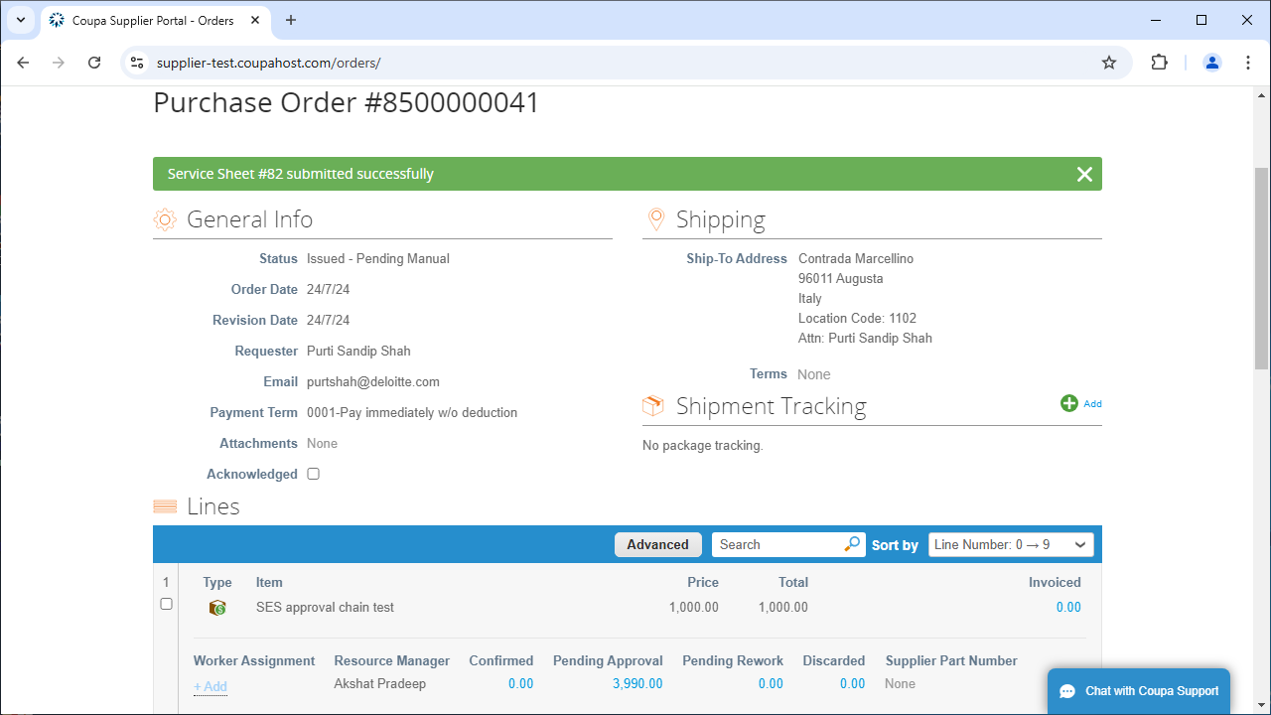
.
Submit Service Entry Sheet
Click Submit again on the pop-up to confirm submission.
Your Service Entry Sheet has been submitted in Coupa.
9

