Slide 1
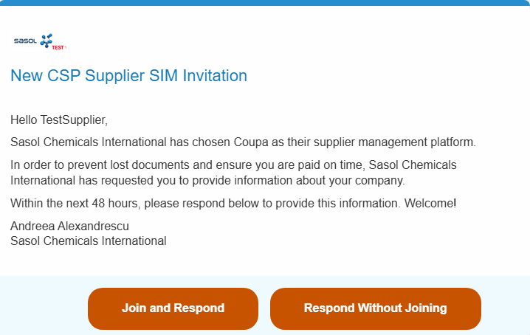

The aim of this document is to provide an overview of the creation and update process of your supplier account in CSP to conduct business with Sasol. This document is only for Suppliers new to Coupa (no supplier profile available in CSP).
Getting started
You will first receive an email notification from Sasol requesting you to create your Supplier Account.
Click Join and Respond to start setting up your company profile in CSP:
1
Note:
Please check your spam folder for this email and note that this invitation will expire in 48 hours. You won’t be able to use this link afterwards.

Slide 2
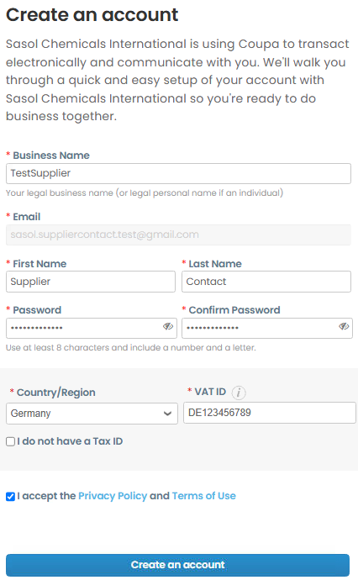
Once finished updating the information below, please click on “Create an account” to proceed to the next step.
Please note that the fields marked with “*” are mandatory.
Note:
Most of the details will already be migrated by Sasol from their ERP (such as Name, Country, etc.) but you can also overwrite whatever details are not accurate.
2

Slide 3
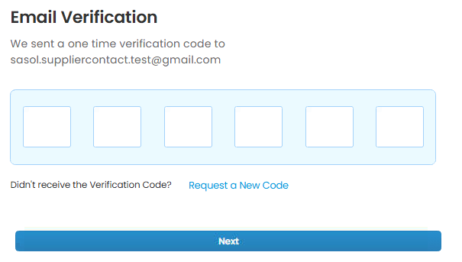
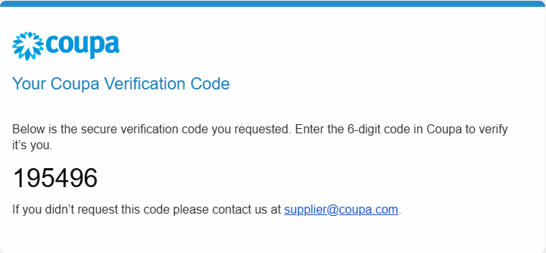
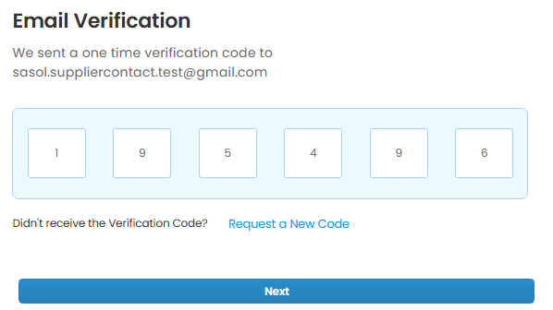
Once you click the “Create an account” button, you will receive a one-time verification code on the email address that you previously provided.
3
Enter the verification code to proceed to the next step. In case the code wasn’t received, you can also request a new one. Please make sure to check your Spam folders as well.
Click on “Next”.
4
5

Slide 4
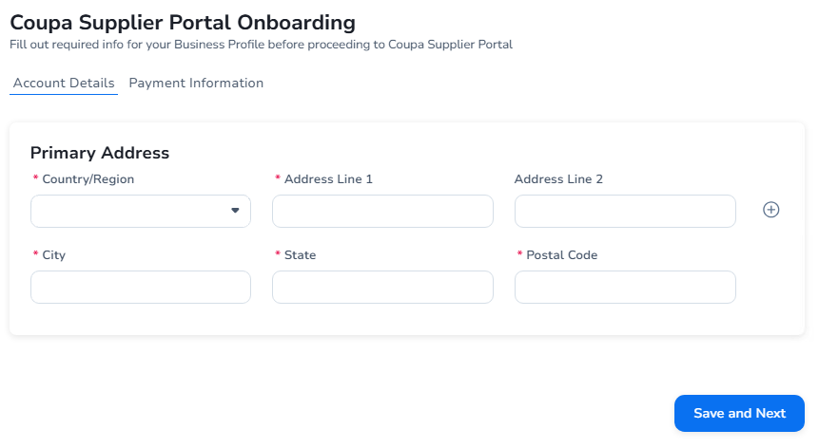
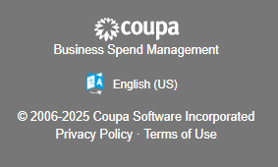
Updating the “Account Details” Section for Sasol
Verify the pre-populated information and make any required changes.
  Fill in the missing information including all mandatory fields marked with an (*).
  Click Save and Next to continue your onboarding.
6
Note:
Once the Country/Region is selected, additional fields with specific country requirements will be added to the form. Please make sure to update all these fields as well (next slide).
To change the language, please scroll to the bottom of the page and click on the region to select your desired language.

Slide 5
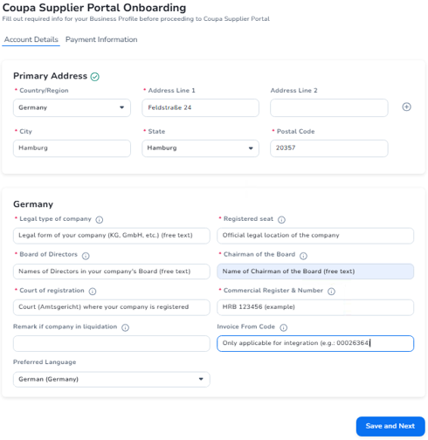
Account Details specific for Germany:
Legal Type of Company: Official legal form of your business entity as defined under German law (KG, GmbH, AG, etc.).
Registered Seat: Official legal location of the company as stated in its Articles of Association and recorded in the Commercial Register (Handelsregister).
Board of Directors: Individuals who are legally authorized to manage and represent the company, as recorded in the German Commercial Register (e.g.: for “GmbH” enter the names of the Managing Director/s – Geschäftsführer, for “AG” the names of Executive Board members, etc.)
Chairman of the Board: Refers to the head of the company’s supervisory or executive board, depending on the legal form of the company.
Court of Registration: Local commercial court (Amtsgericht) where your company is registered.
Commercial Register & Number: HRB 123456
Invoice From Code: This code is used to configure an integration between the CSP and your ERP system. If you are not creating an integration or aren’t sure at this time, you can leave it blank
6

Slide 6
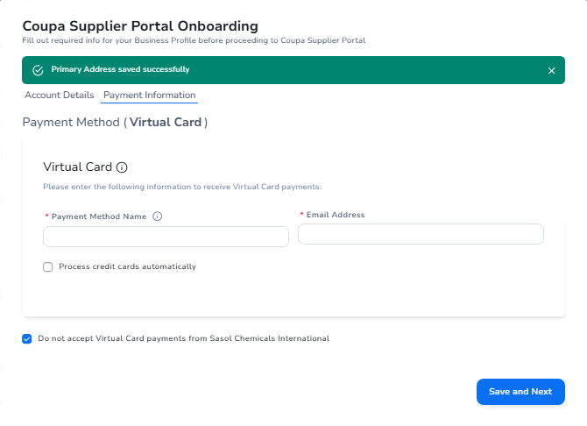
Updating the “Payment Information” Section for Sasol
Please select “Do not accept Virtual Card payments from Sasol” as shown below. This is only relevant for your public profile. You will need to confirm your payment details in the specific supplier onboarding form provided by Sasol Chemicals (detailed in the “QRG_Supplier Information Management_Update Company Info in CSP_EN” slides).​
Click “Save and Next”.
7
8

Slide 7
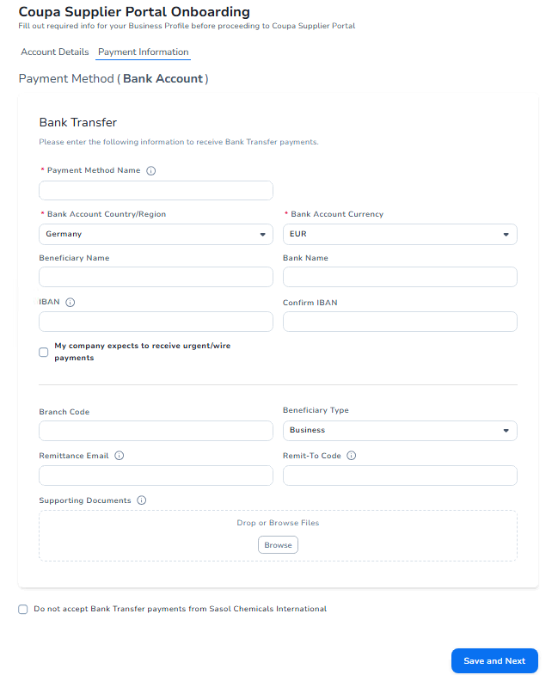
Verify the pre-populated Payment Information (for Bank Transfer details) and make any required changes. Fill in the missing information including all mandatory fields marked with an (*).
  Please ensure the Payment Method Name will be easy to remember and it will help you differentiate between all available payment methods on your account.
Click “Save and Next”.
9
10

Slide 8
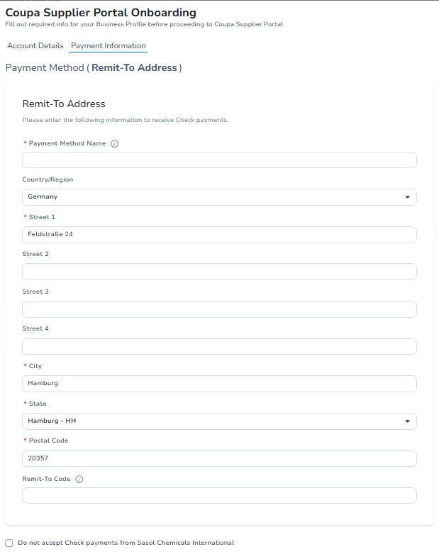

Verify the pre-populated Payment Information (Remit-To Address for check payments) and make any required changes. Fill in the missing information including all mandatory fields marked with (*).
  Choose a relevant and easy-to-remember name for this payment method. Avoid including customer names as you may want to share this with multiple customers.
Click “Save and Next”.
11
12

Slide 9
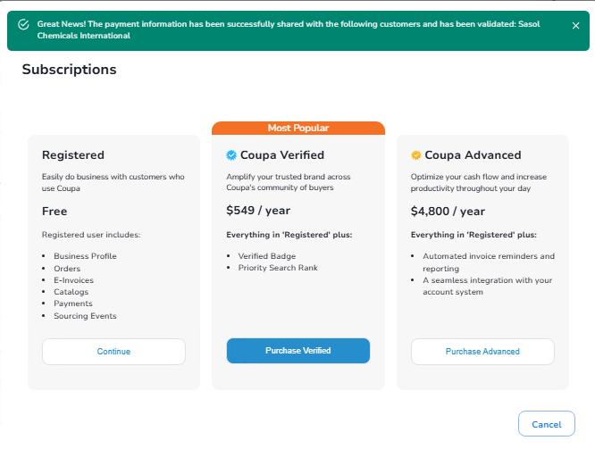
You have now reached the end of your onboarding, and you have created your Coupa Supplier Profile successfully.
From the options depicted below you can choose the “Registered” option and click “Continue”.

Slide 10
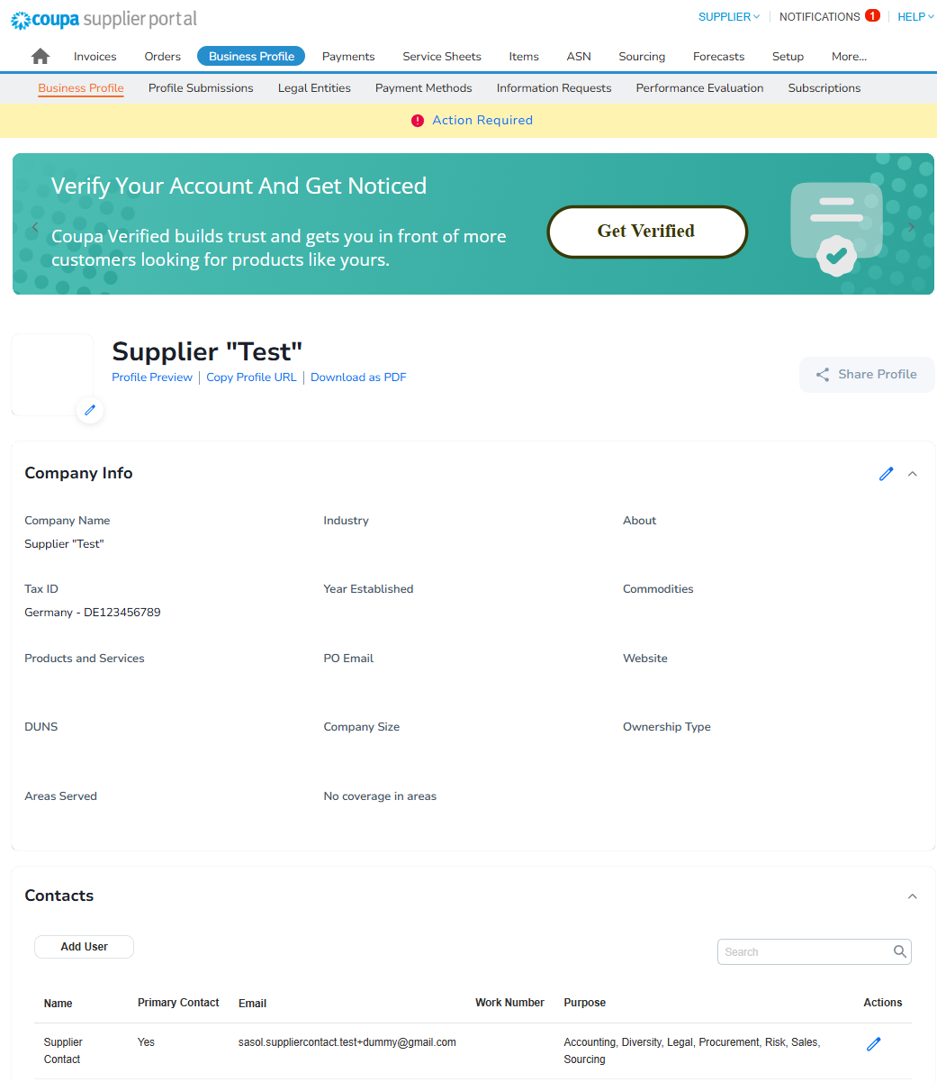
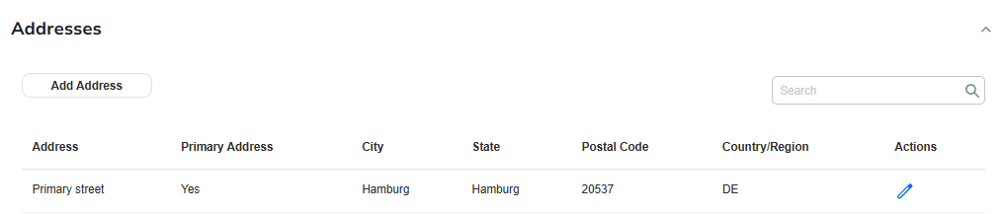
In case any of your company information (such as certificates, contact details, etc.) changes, please make sure to update your profile on CSP as soon as possible.
Updating your information
Log in to CSP and click the pen icon to edit the relevant details.

