Slide 1
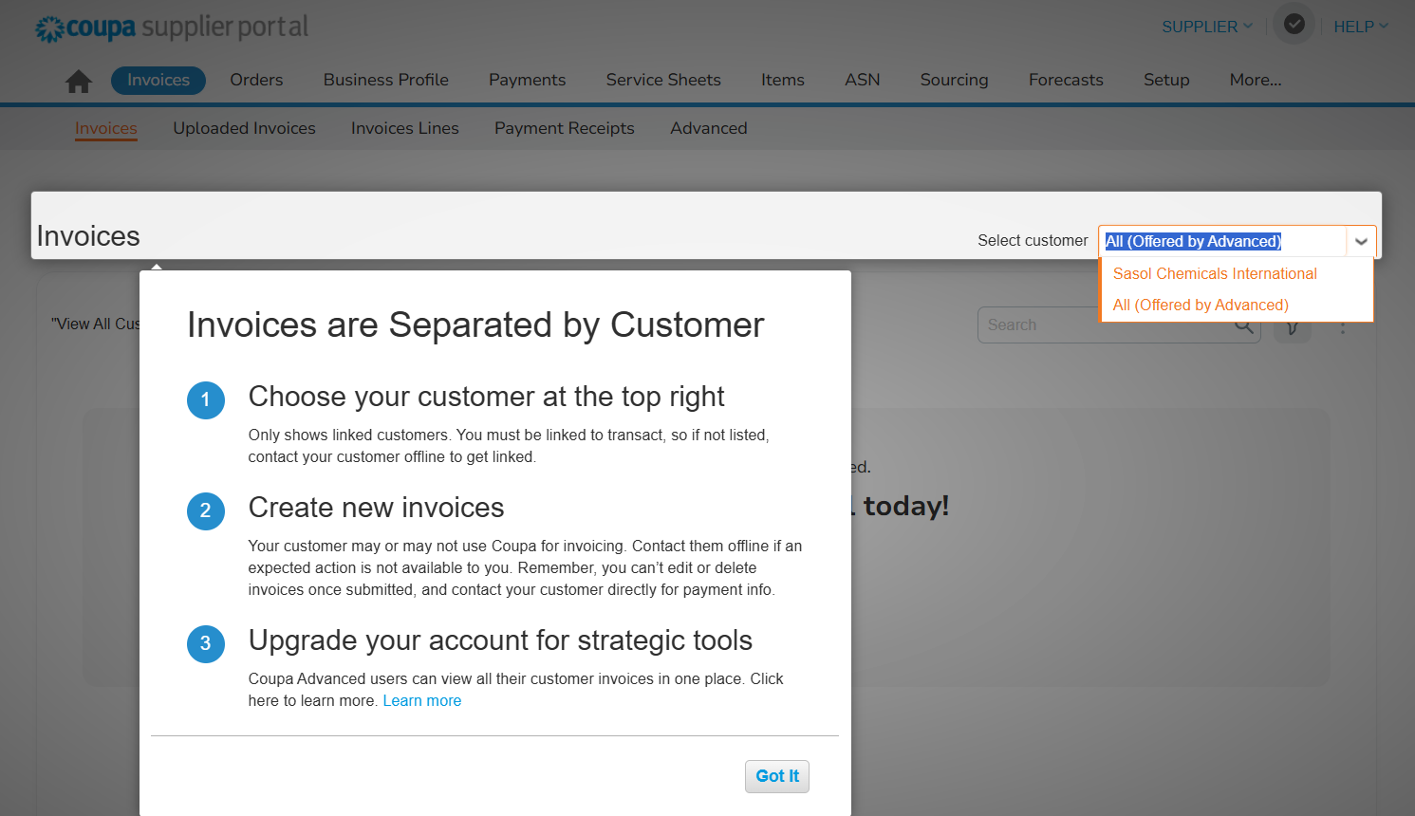
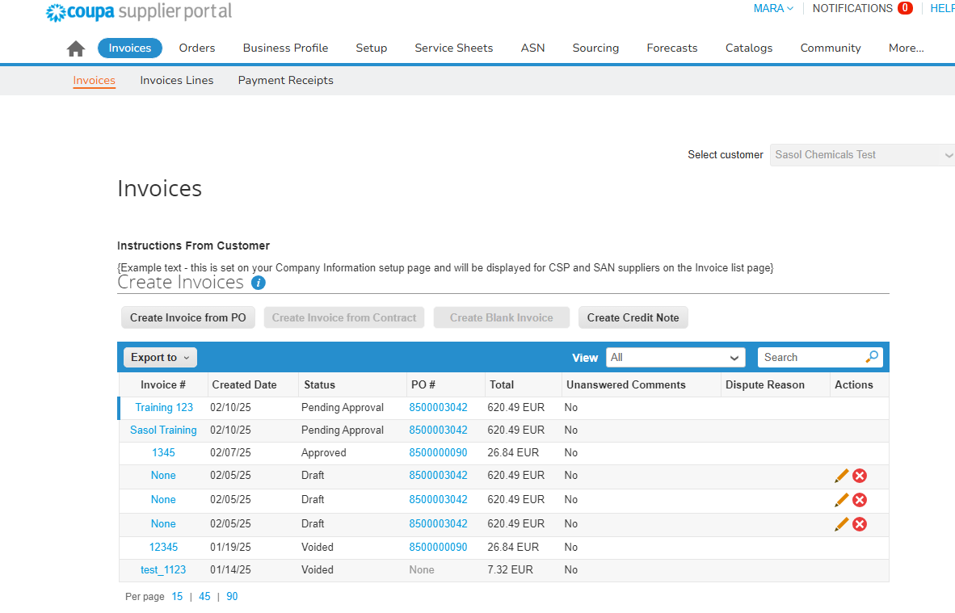
The aim of this document is to provide an overview of the process of monitoring payment status in the Coupa Supplier Portal (CSP).
Login to Coupa and navigate to the Invoice tab. Select Sasol as your customer.
1
Open the relevant invoice by clicking on the invoice number.
2

Slide 2
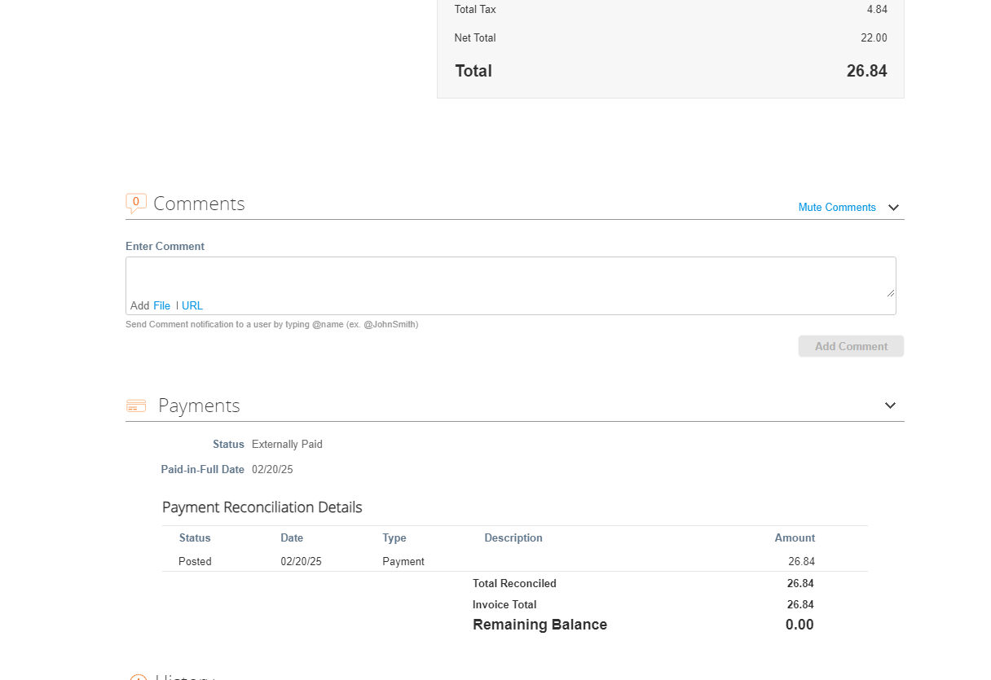
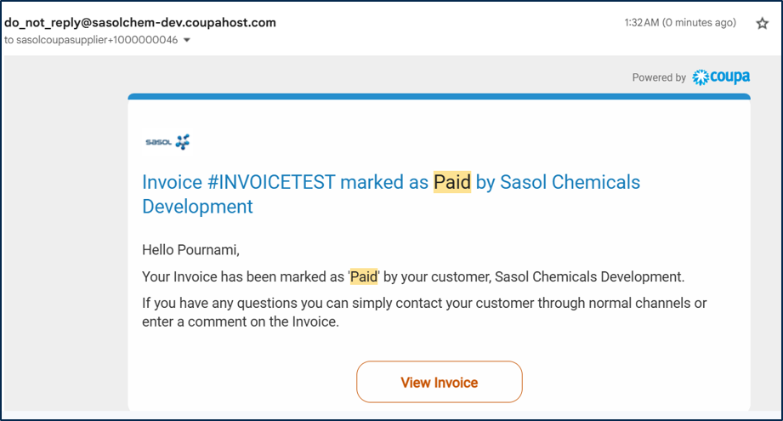
Once the Invoice is open, please navigate to the bottom of the page where you can see the Payment Status for that Invoice.
Once the invoice is marked as paid by Sasol, you will get an automated email notification from the system, as depicted below:
3
4

