Slide 1
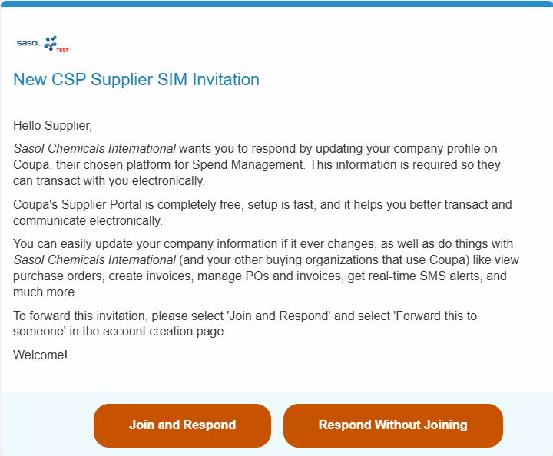

The aim of this document is to guide you through the Sasol specific SIM Form requirements (Supplier Information Management Form) so you can finish your onboarding with Sasol.
This guide is for suppliers that already have a Coupa Supplier Profile created.
Getting started
You will first receive an email notification from Sasol requesting you to complete the SIM Form (Supplier Information Management) in CSP.
Click “Join and Respond” to start.
1
Note:
Please check your spam folder for this email and note that this invitation will expire in 48 hours. This means that you won’t be able to use this link anymore.

Slide 2
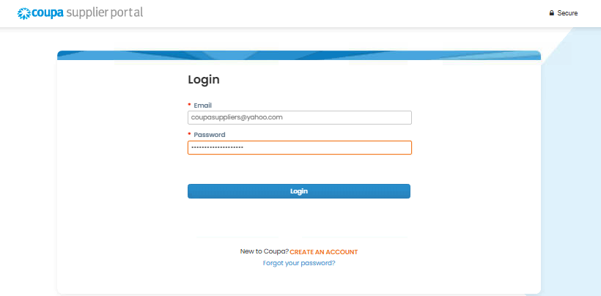
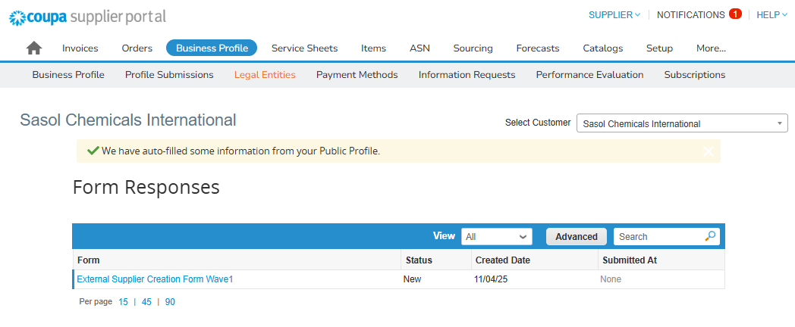
Log in to Coupa with your previously set credentials.
2
On your homepage you can find the form that is waiting for your input. To start providing the responses, click on the form name.
3

Slide 3
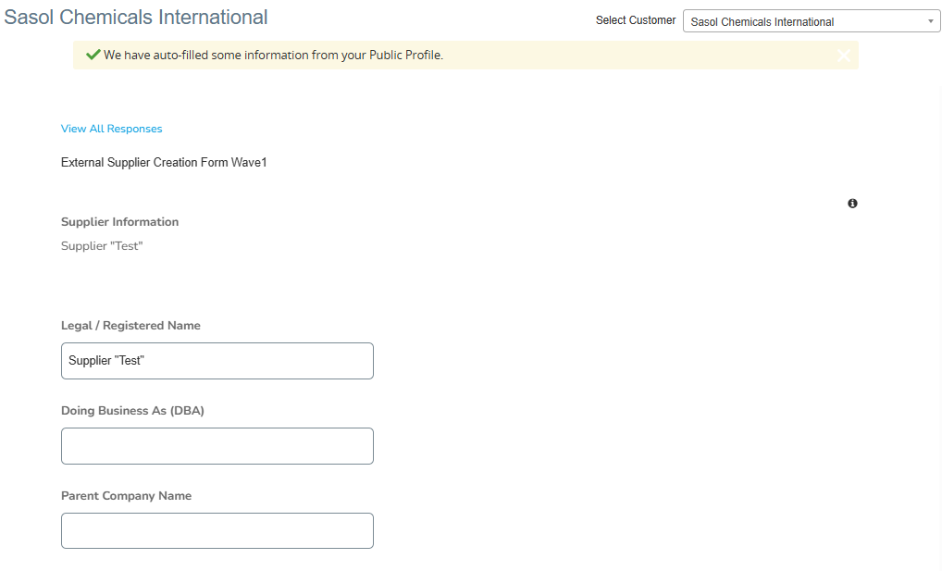
In case you have pending SIM Forms from multiple customers, please select Sasol from the Customer drop-down field.
  As mentioned below, some of the data will be pre-populated. In case there are any inconsistencies, please make sure to correct them.
4
Note:
Throughout this document, all fields marked with “*” are system mandatory. However, there might also be some fields required by Sasol, and Coupa won’t let you submit the form if these are not populated. Once you click on “Submit” they will become highlighted in red.

Slide 4
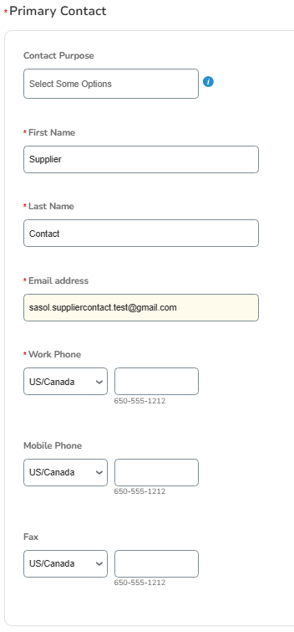
Primary Contact Information
The Coupa Primary Contact is the administrator and official representative of your supplier account, responsible for setup, user management, and being the main communication channel with buyers. Some of the data will be pre-populated based on your account. In case there are any inconsistencies, please make sure to correct them.
5

Slide 5
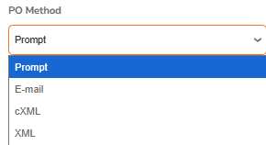
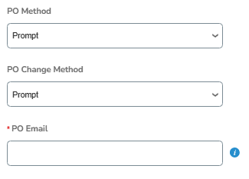
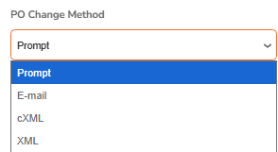
Order Transmission Method
The Order Transmission Methods define how purchase orders (POs) and purchase order changes are delivered to you. They control the communication channel (e.g., email, cXML, supplier portal) through which you will receive new POs and any subsequent updates or modifications. This is usually pre-populated based on your agreement with Sasol.
The PO Email field in Coupa is the specific email address where purchase orders (POs) and/or PO change notifications are sent. You can select the suitable option from each field’s drop-down list.
6
7
Note:
At the moment, Coupa only supports the following transmission methods for Sasol: Prompt (no output generated but PO is visible in CSP), E-mail, cXML.

Slide 6
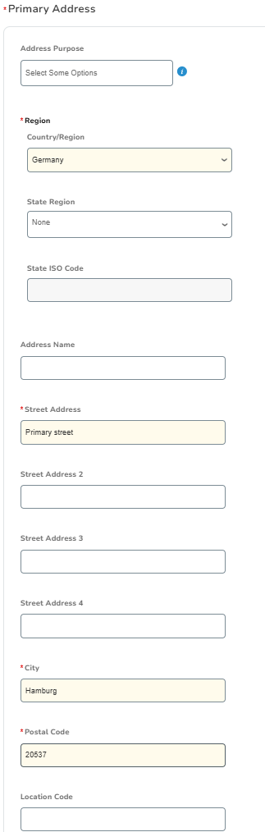
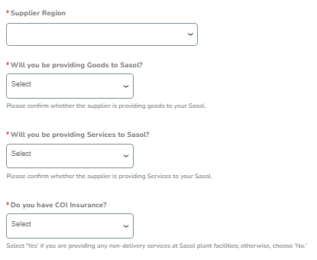
Primary Address
The Primary Address is the main business address for a supplier. It’s the official location that buyers associate with the supplier in the system and also with the Bank Transfer information.
8
Note:
Depending on your answers, more conditional questions will be displayed in the above section (depicted in the next slide).

Slide 7
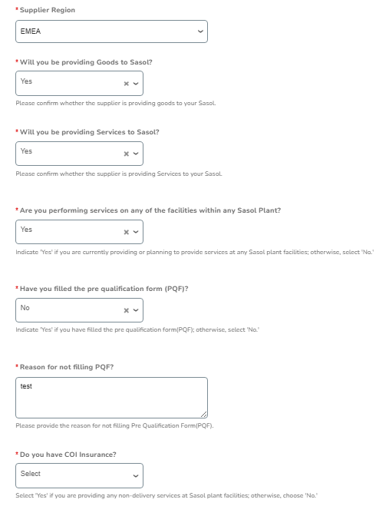
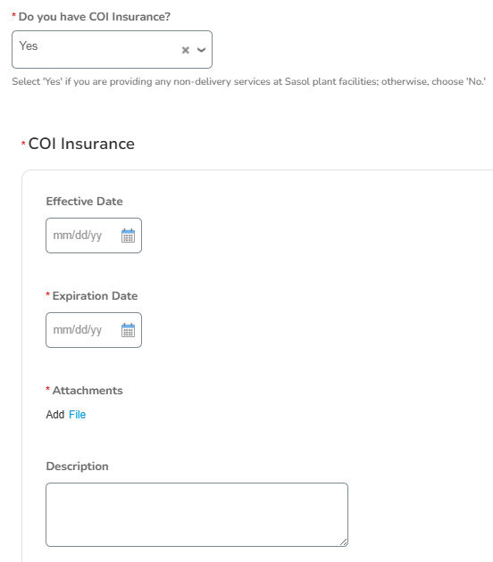
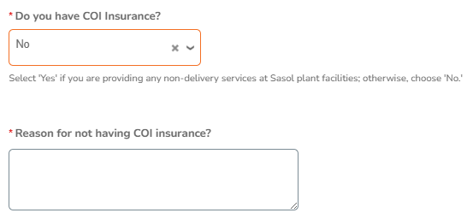
Additional Information
Each additional question will trigger helpful suggestions at the bottom of the answer field.

Slide 8
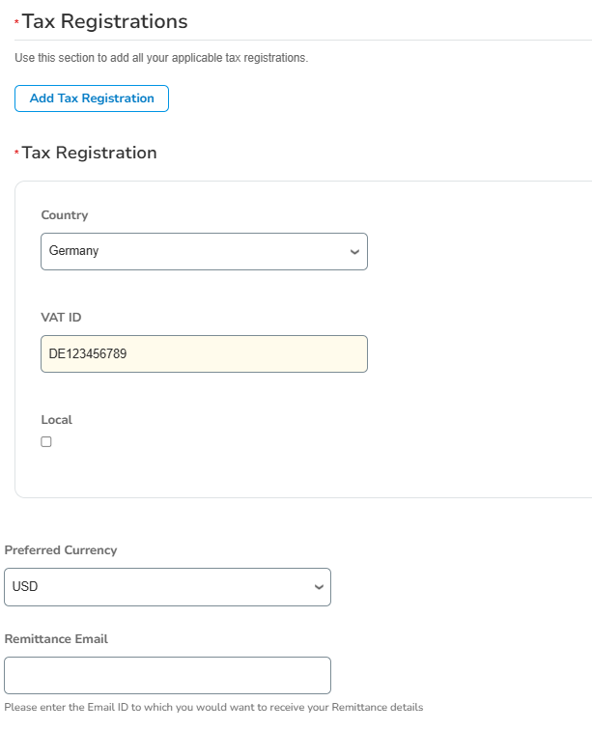
Tax Information
The Tax Registration segment will be pre-populated from your account. Please ensure the data is correct and can be used by Sasol in upcoming transactions.
In case additional Tax Registration details need to be added to your profile, please use the option below.
10
9

Slide 9
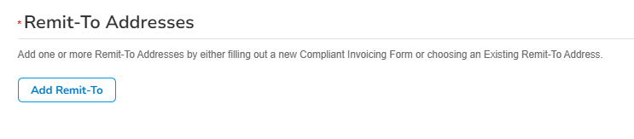
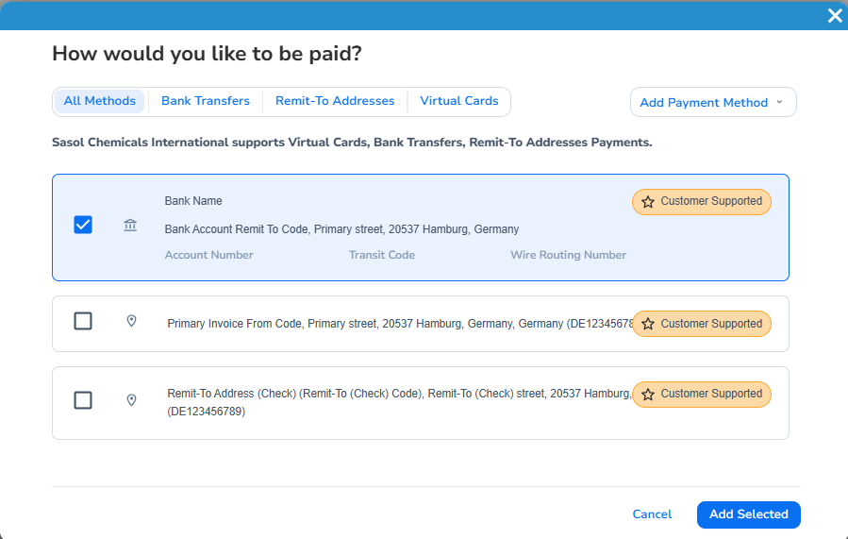
Remit-To Information
The Remit-To Address is critical because it tells Sasol where to send the payment for your invoices. Without it, invoices may be non-compliant, delayed, or even rejected, since most countries require a valid remit-to location for tax and legal purposes.
In case you already added a Remit-To Address to your profile, please use the “Add” option below to select the appropriate one. You can toggle between the different Payment Methods: Bank Transfers, Remit-To, Virtual Cards, as applicable to Sasol.
  Once added, you will have to add some additional information to the form (Sasol-specific).
In case a new address needs to be added, please follow the steps in Slides 13 & 14.
11a
12
11b

Slide 10
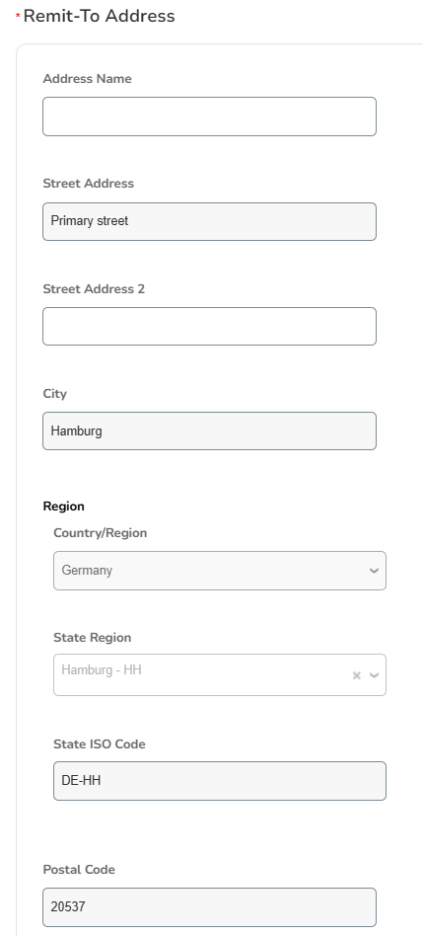
Remit-To Additional Information
Most of the information will already be previously populated from the Payment Information you provided when you created your Coupa Supplier Account.
Please make sure to check all this information and correct any inconsistencies.

Slide 11
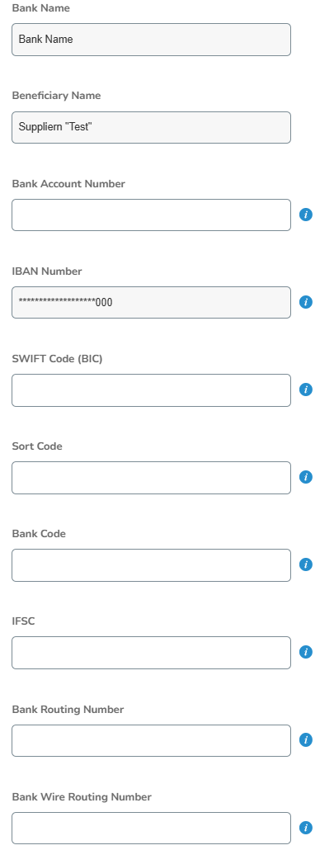
Remit-To Additional Information (1/2)
Note:
Fields marked with (*) are mandatory for Germany. The remaining fields might be needed for UK, NL, SK. Please check CoupaCompass.
(*) Needs to be between 1 and 34 characters without spaces (alphanumerical)
(*) Needs to be between 5 and 34 characters without spaces (alphanumerical)
(*) Must be 8 / 11 characters without spaces (alphanumerical and first 6 must be letters)
Must be 6 digits
Input between 1 and 20 characters without spaces (alphanumerical)
Must be 11 characters without spaces (alphanumerical)
Bank Routing Number must be 9 digits long
Bank Wire Routing Number must be 9 digits long

Slide 12
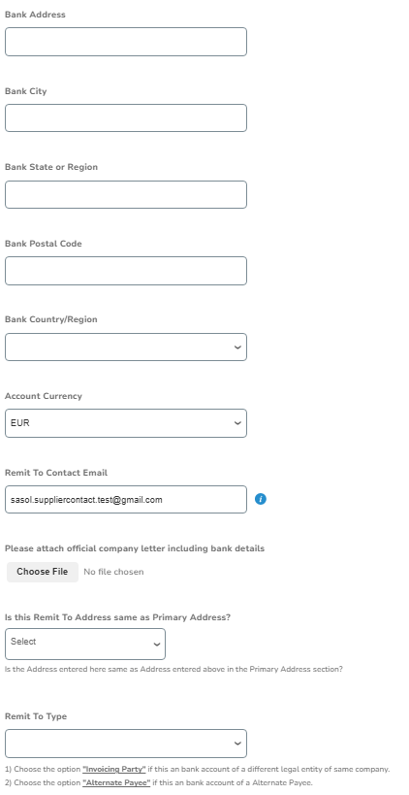
Remit-To Additional Information (2/2)

Slide 13
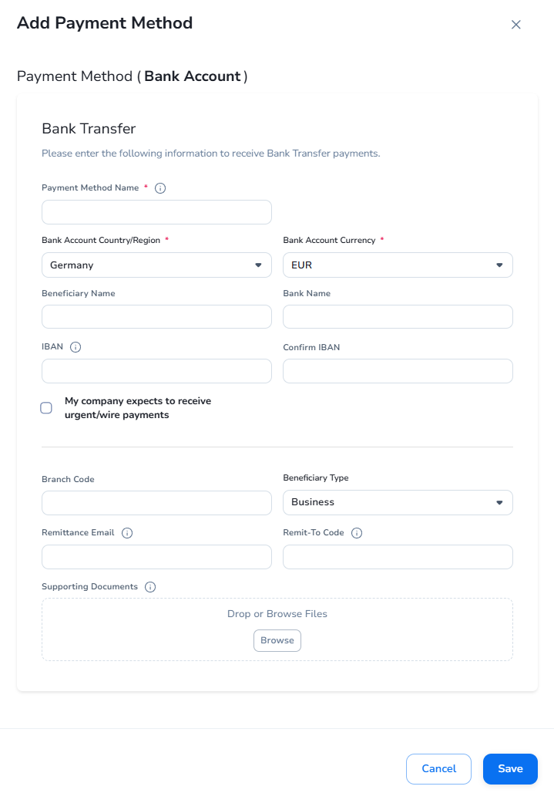
Adding a New Payment Method – Bank Account
If you would like to add a new Bank Account to your Payment Methods, please fill in the fields below (highlighted in yellow) and save the form.

Slide 14
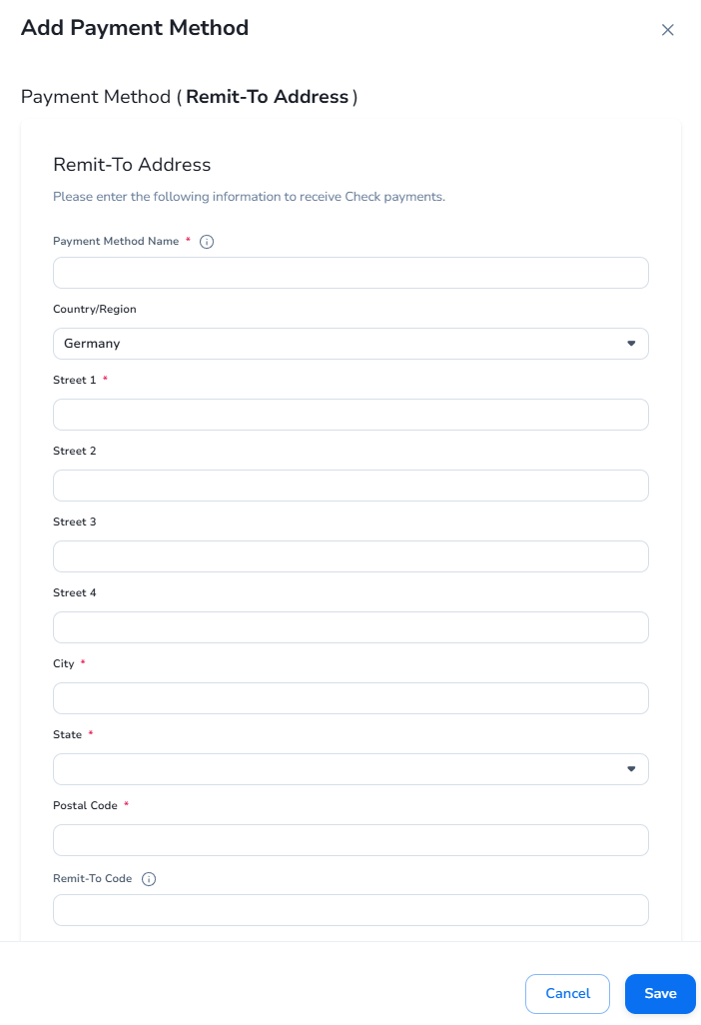
Adding a New Payment Method – Remit-To Address
If you would like to add a new Remit-To Address to your Payment Methods, please fill in the fields below (highlighted in yellow) and save the form.

Slide 15
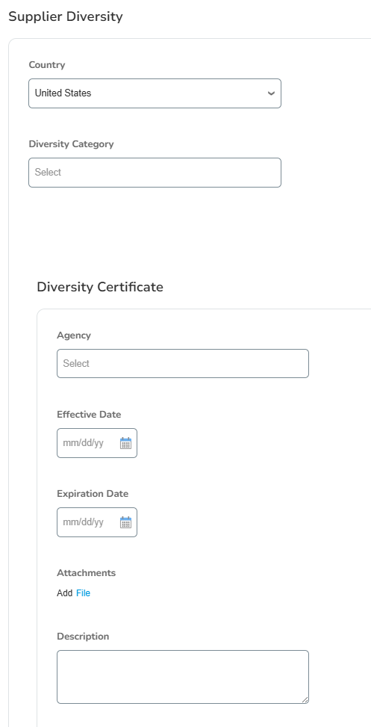
Supplier Diversity
This is not a mandatory section, but it is important because it enables Sasol to track, report, and promote supplier diversity, which supports inclusive procurement practices and compliance with diversity goals.

Slide 16
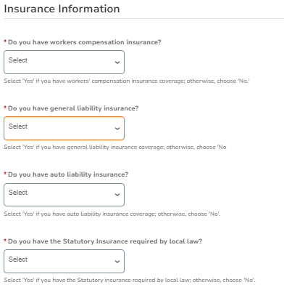
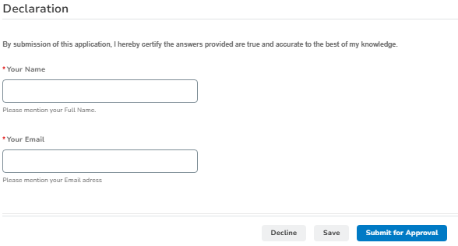
Insurance Information
The two sections below are mandatory. Please fill in the information and submit your form for Sasol Approval.

Slide 17
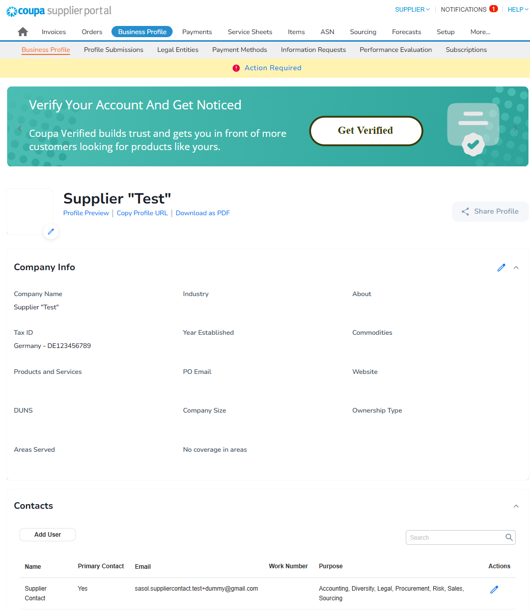
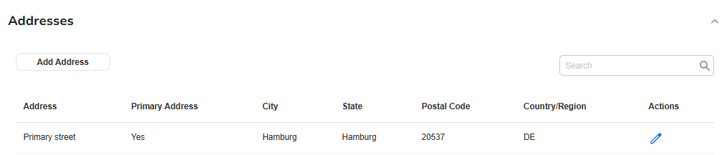
If case any of your company information (such as certificates, contact details, etc.) change, please make sure to update your profile on CSP as soon as possible.
Updating your information
Log in to CSP and click the pen icon to edit the relevant details

