Slide 1

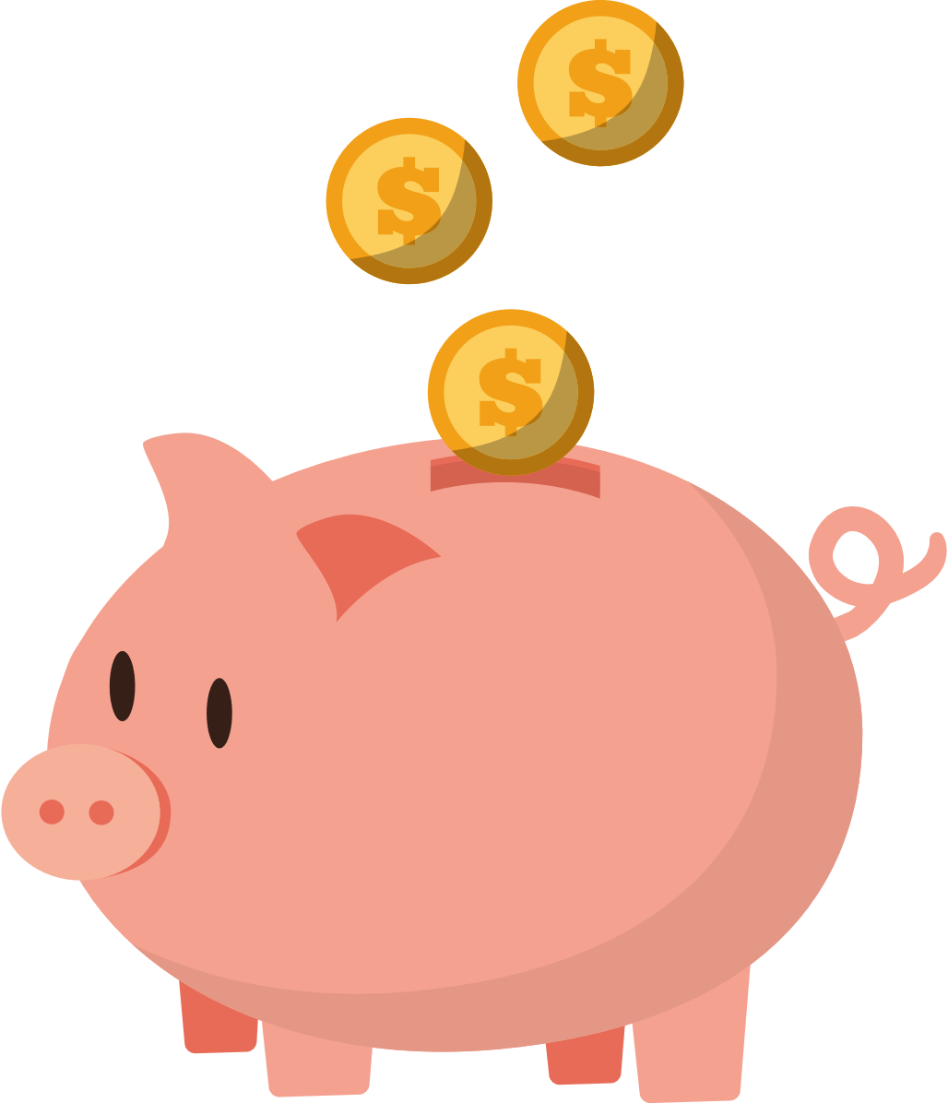
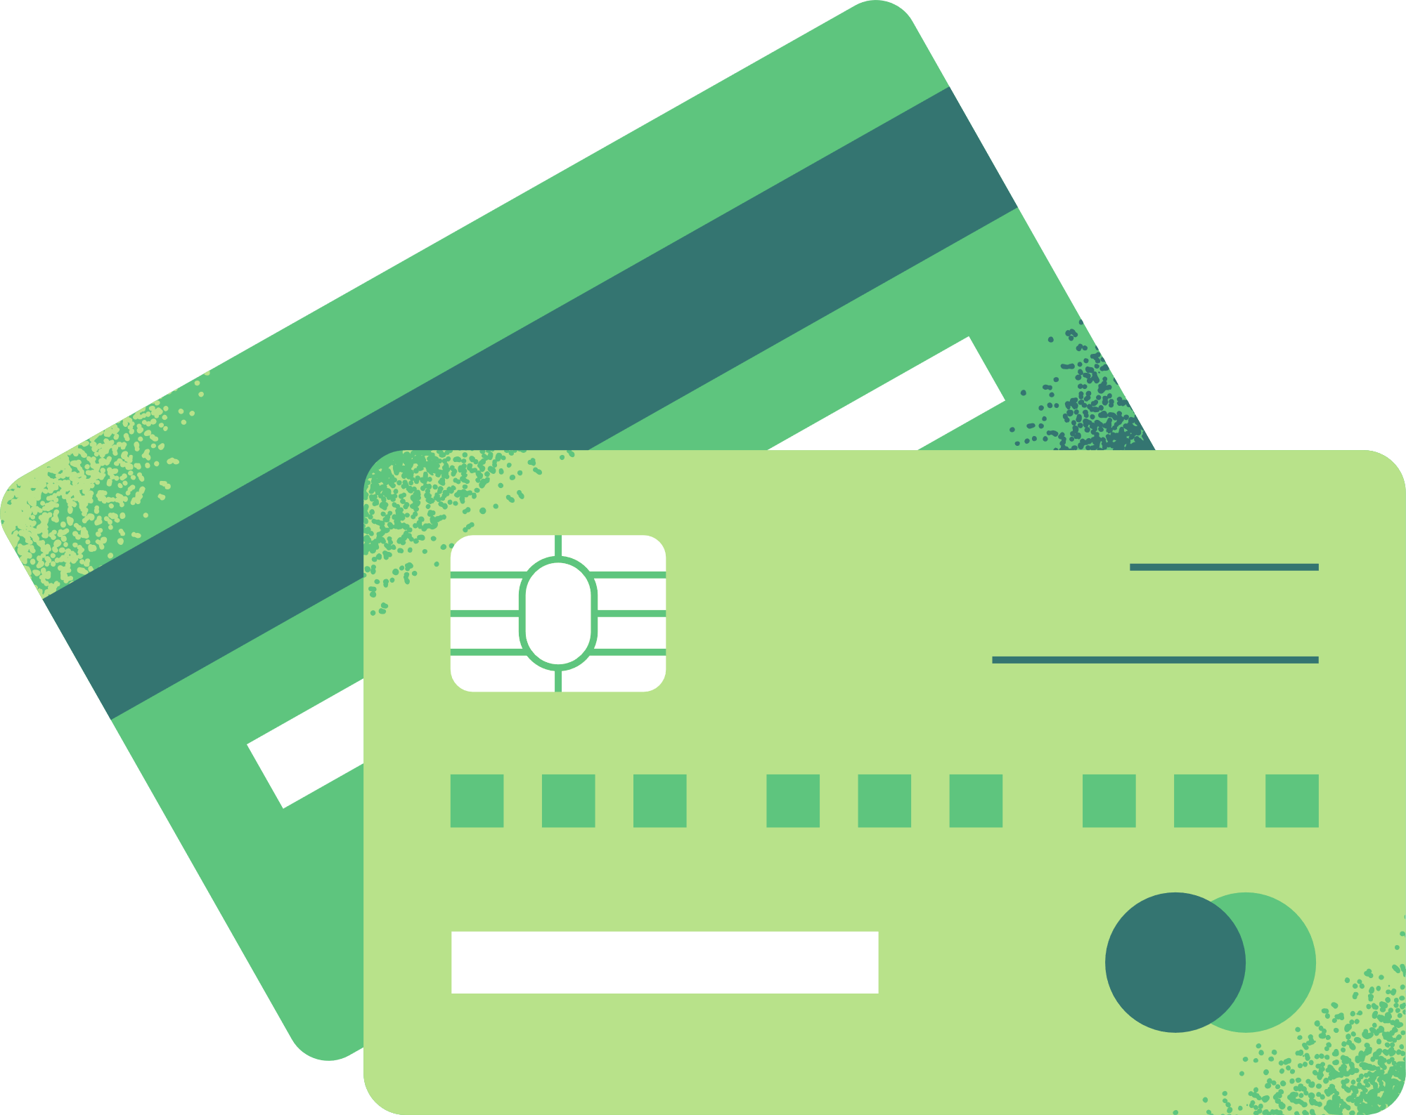



Great American Teach-In
Suncoast Credit Union

Slide 2


What is a
Credit Union
noun.
Financial institution where you are not just a customer but also a owner. People can save their money there and borrow money at a good rate when they need it. The goal of a credit union is to help its members instead of making a big profit.

Slide 3


OVER
$45 Million donated back to local communities since 1990
  Suncoast Credit Union gives back to the community
Foundation
SUNCOAST
Giving back to over
413,476
Children & Students
Notes:
An important part of Suncoast Credit Union DNA is giving back to our community and schools.

Slide 4


Who Am I?
Fun Fact about me?
What was my favorite subject in school?
What did I want to be when I grew up?
Notes:
Answer each question and have fun with it. Remember your audience.

Slide 5

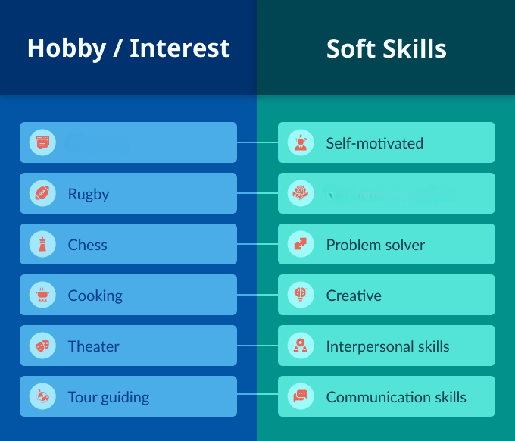


Interest
Skills
what you like or enjoy doing
Tools that allow you to do the work
Collaboration skills
Notes:
Interest - connects with what you want to do, builds motivation to work hard and do well.
Skills - these are the “tools” that allow you to do the work. Can be from education, training or from experience.
Those interest can help you cultivate the skills
Ask the class to tell you some of their interest.
Then use the interest and relate it to a skill. Explain that you need many of these skills when looking for a job/career.
Example-
Student says “Sports” that can translate to collaboration skill and problem solver. Players must utilize the team to be successful in a game and need good problem-solving skills to adapt to the changing situations.
Student says “Drawing or doing Make-up” that requires creativity and being self-motivated. The person needs to be self-motivated and know it will require lots of practice

Slide 6
My Job
What has been my career journey?
How long have I worked at Suncoast?
What does a day in my Job look like?
What is the coolest part of my work?
What was the hardest part of my job to learn?
Why is my job important?
Notes:
Answer each question and be creative. Remember your audience!

Slide 7


Why should YOU save?
Needs
and
Want/Goals
For Emergency
Notes:
It is important to save at all ages.
Saving allows you to have the necessary funds for the things you need to survive and fun things you want. Your wants may turn into a goal since it may require a little time to save of for that item.
Ex: You want to go to Bush Garden for your birthday. The tickets may cost way more than you receive from your allowance money, which means you’ll have to gather a few months of that money for when your birthday comes around. Which is savings!
You also need to save for emergencies. Life is unexpected, which means you should always have money put aside in case you need it.
Ex:
When you get older your car may have a flat tire one day, which will require you to take money from your emergency funds to pay for

Slide 8
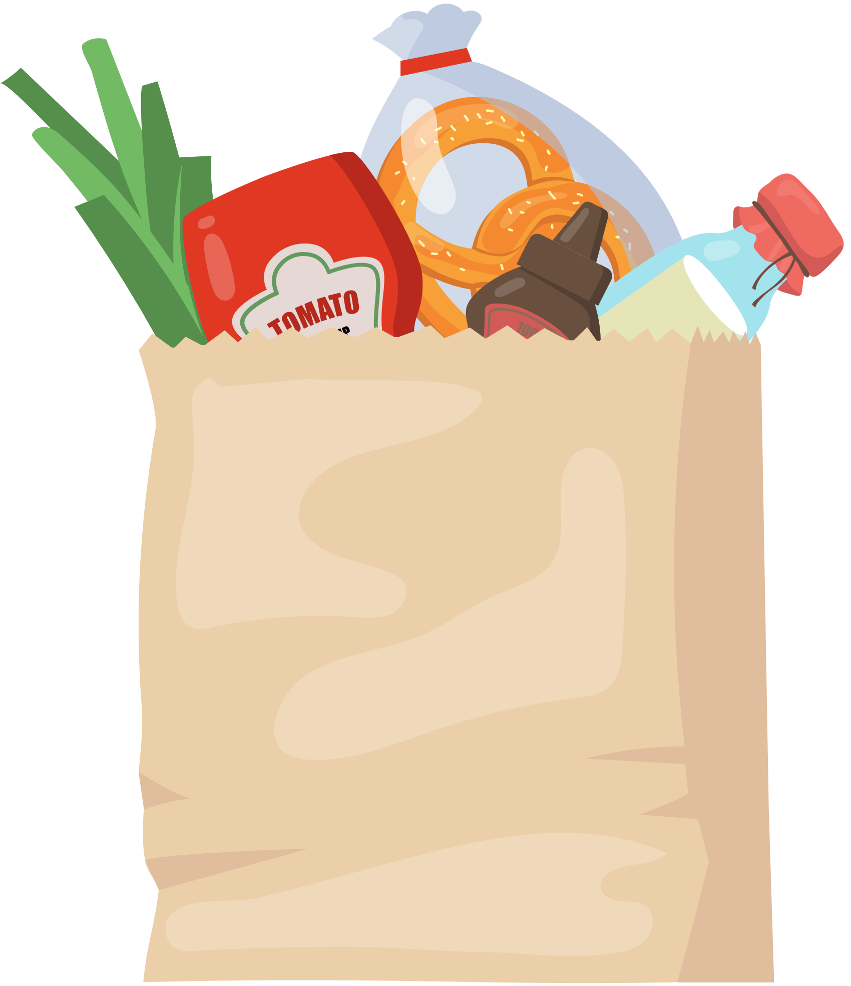
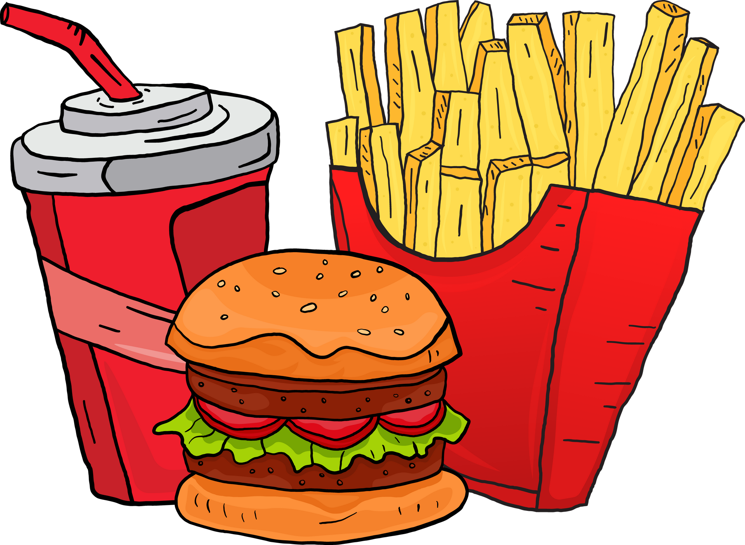


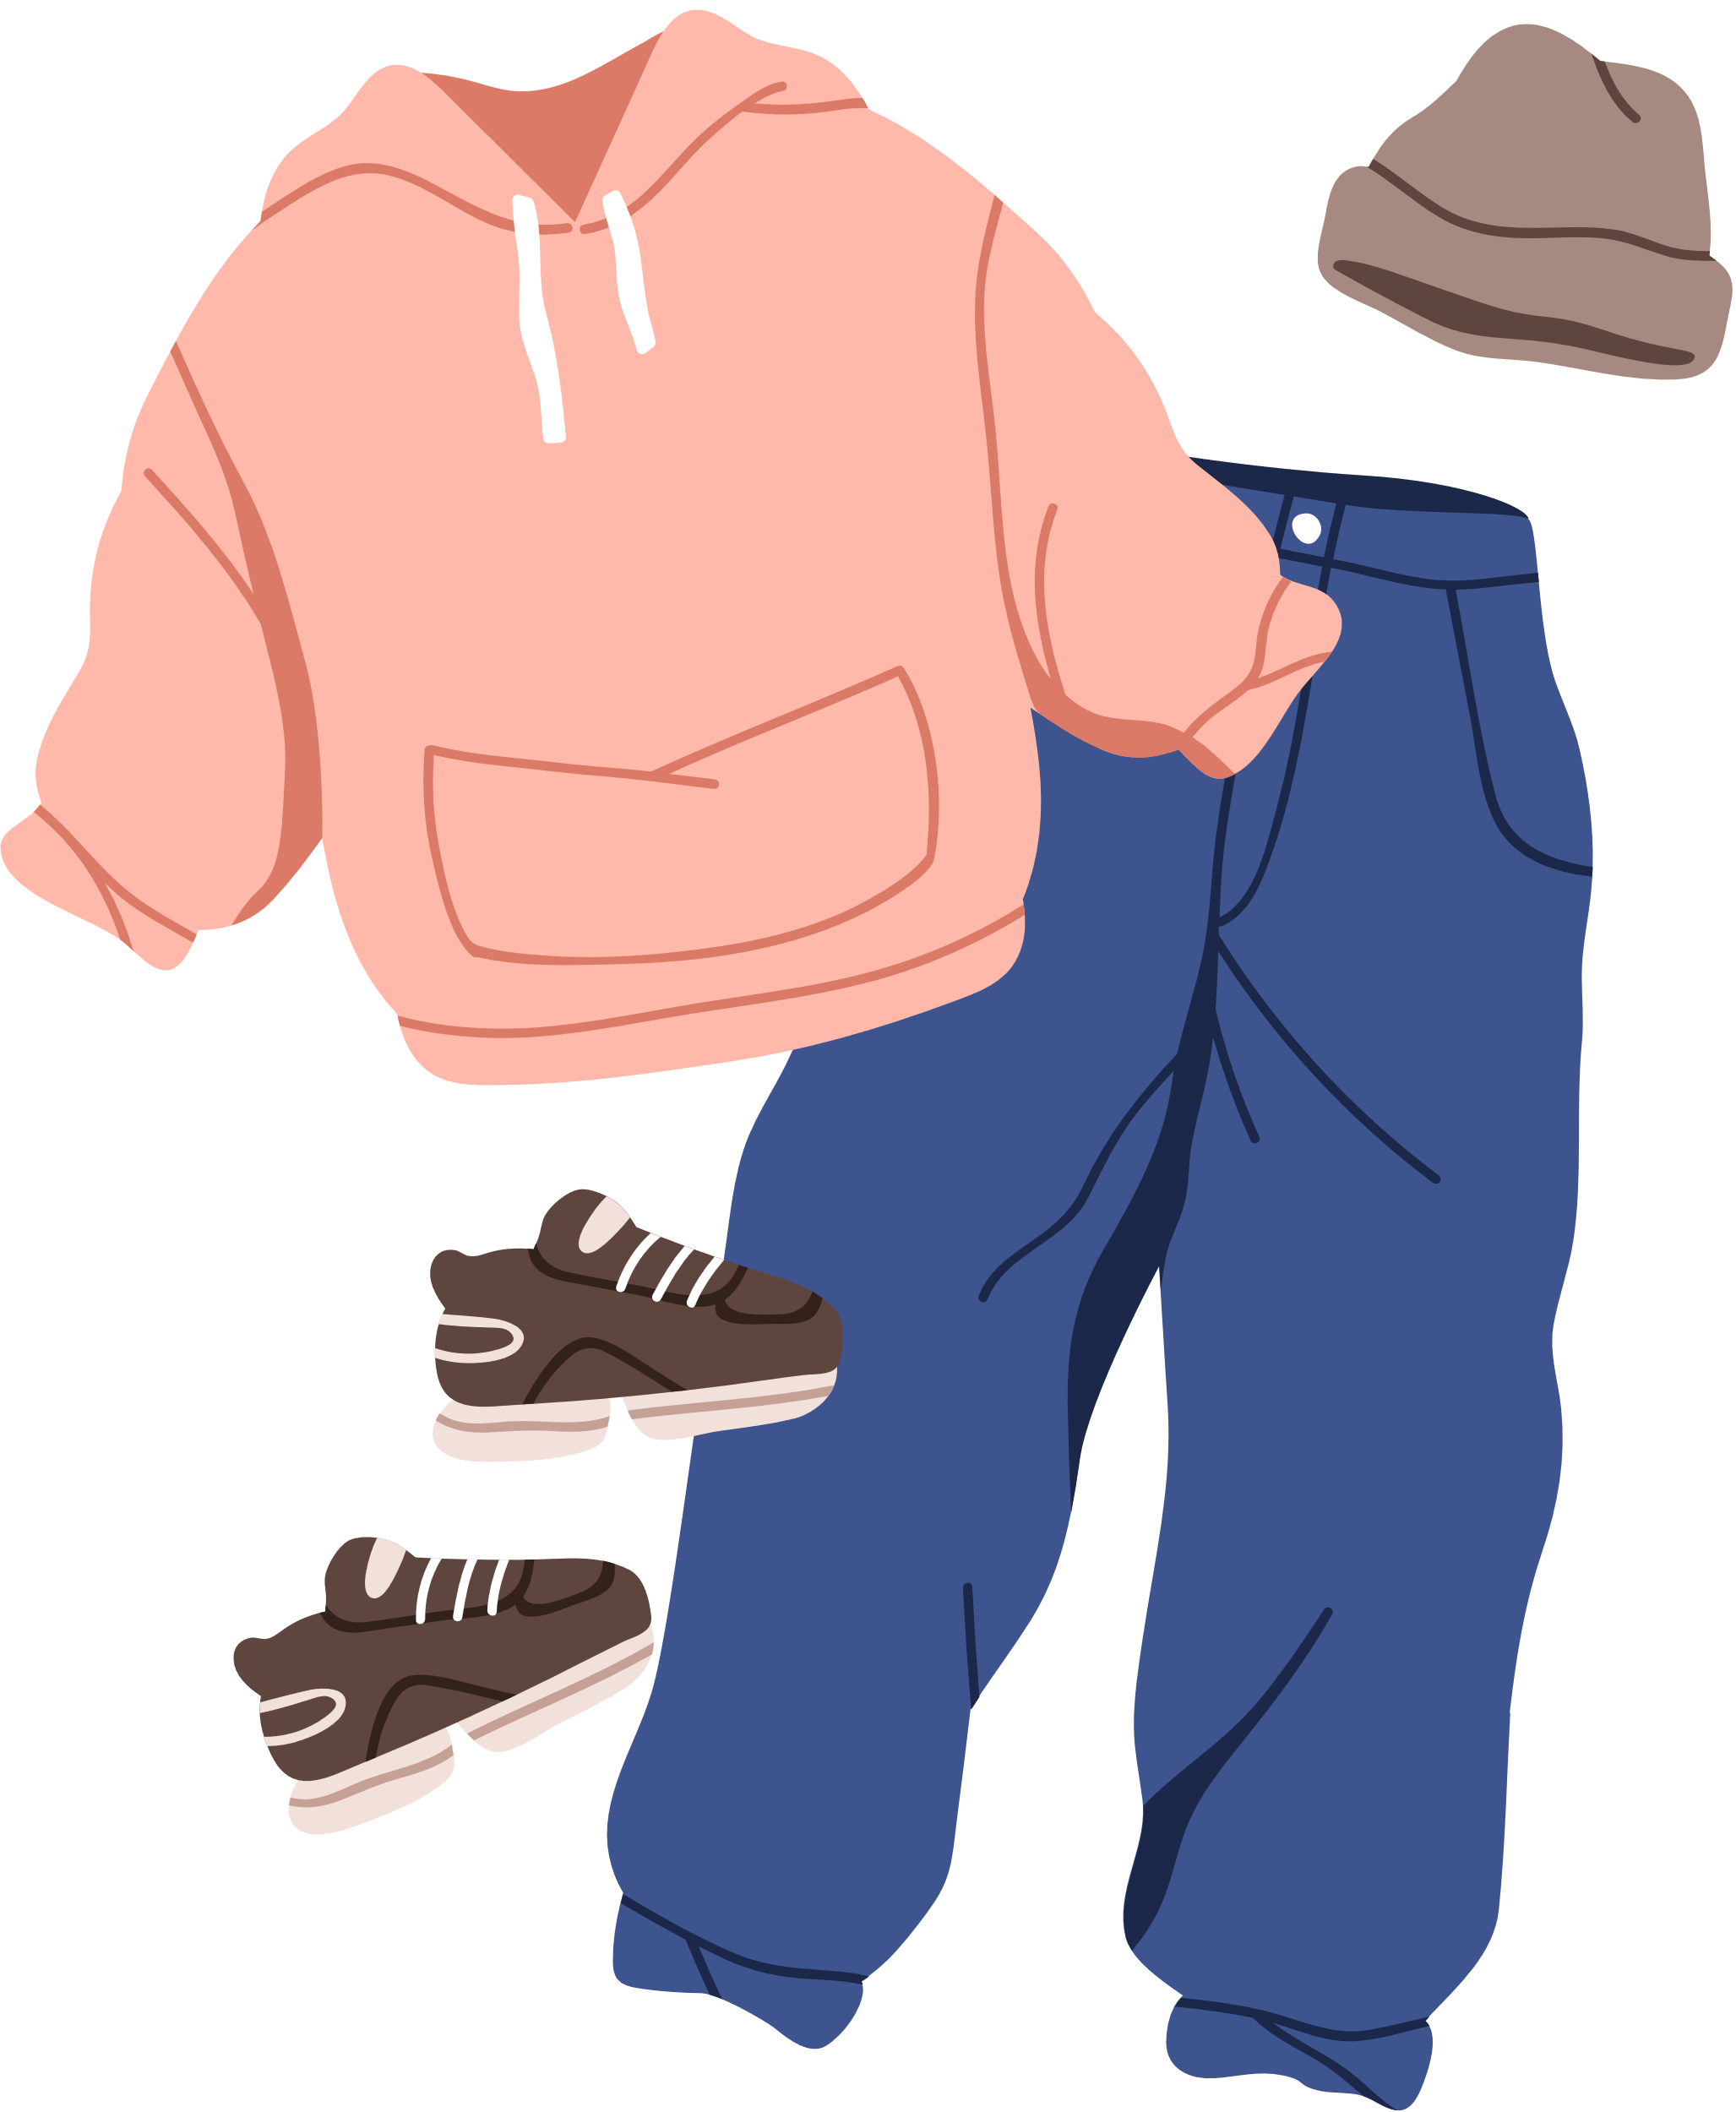
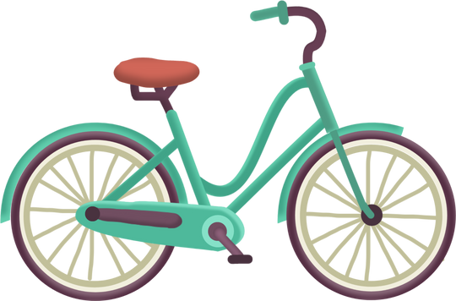

Wants vs. Needs
Review the images below and decided if it is a WANT or a NEED?
Notes:
Class Activity
Now that we talked about the importance of savings, lets test your knowledge
Ask the students to raise their hands to guess if the image below is a want or need?
Water- Need
A switch/ games- Want
Bike- Want
Groceries/ Food- Need
Clothes- Need: you need to have clothes- you don’t need to have expensive clothing brands
Fast Food (ex. McDonalds, Taco Bell)- Want: although food is a need you don’t need fast food to survive
House/ shelter- Need

Slide 9


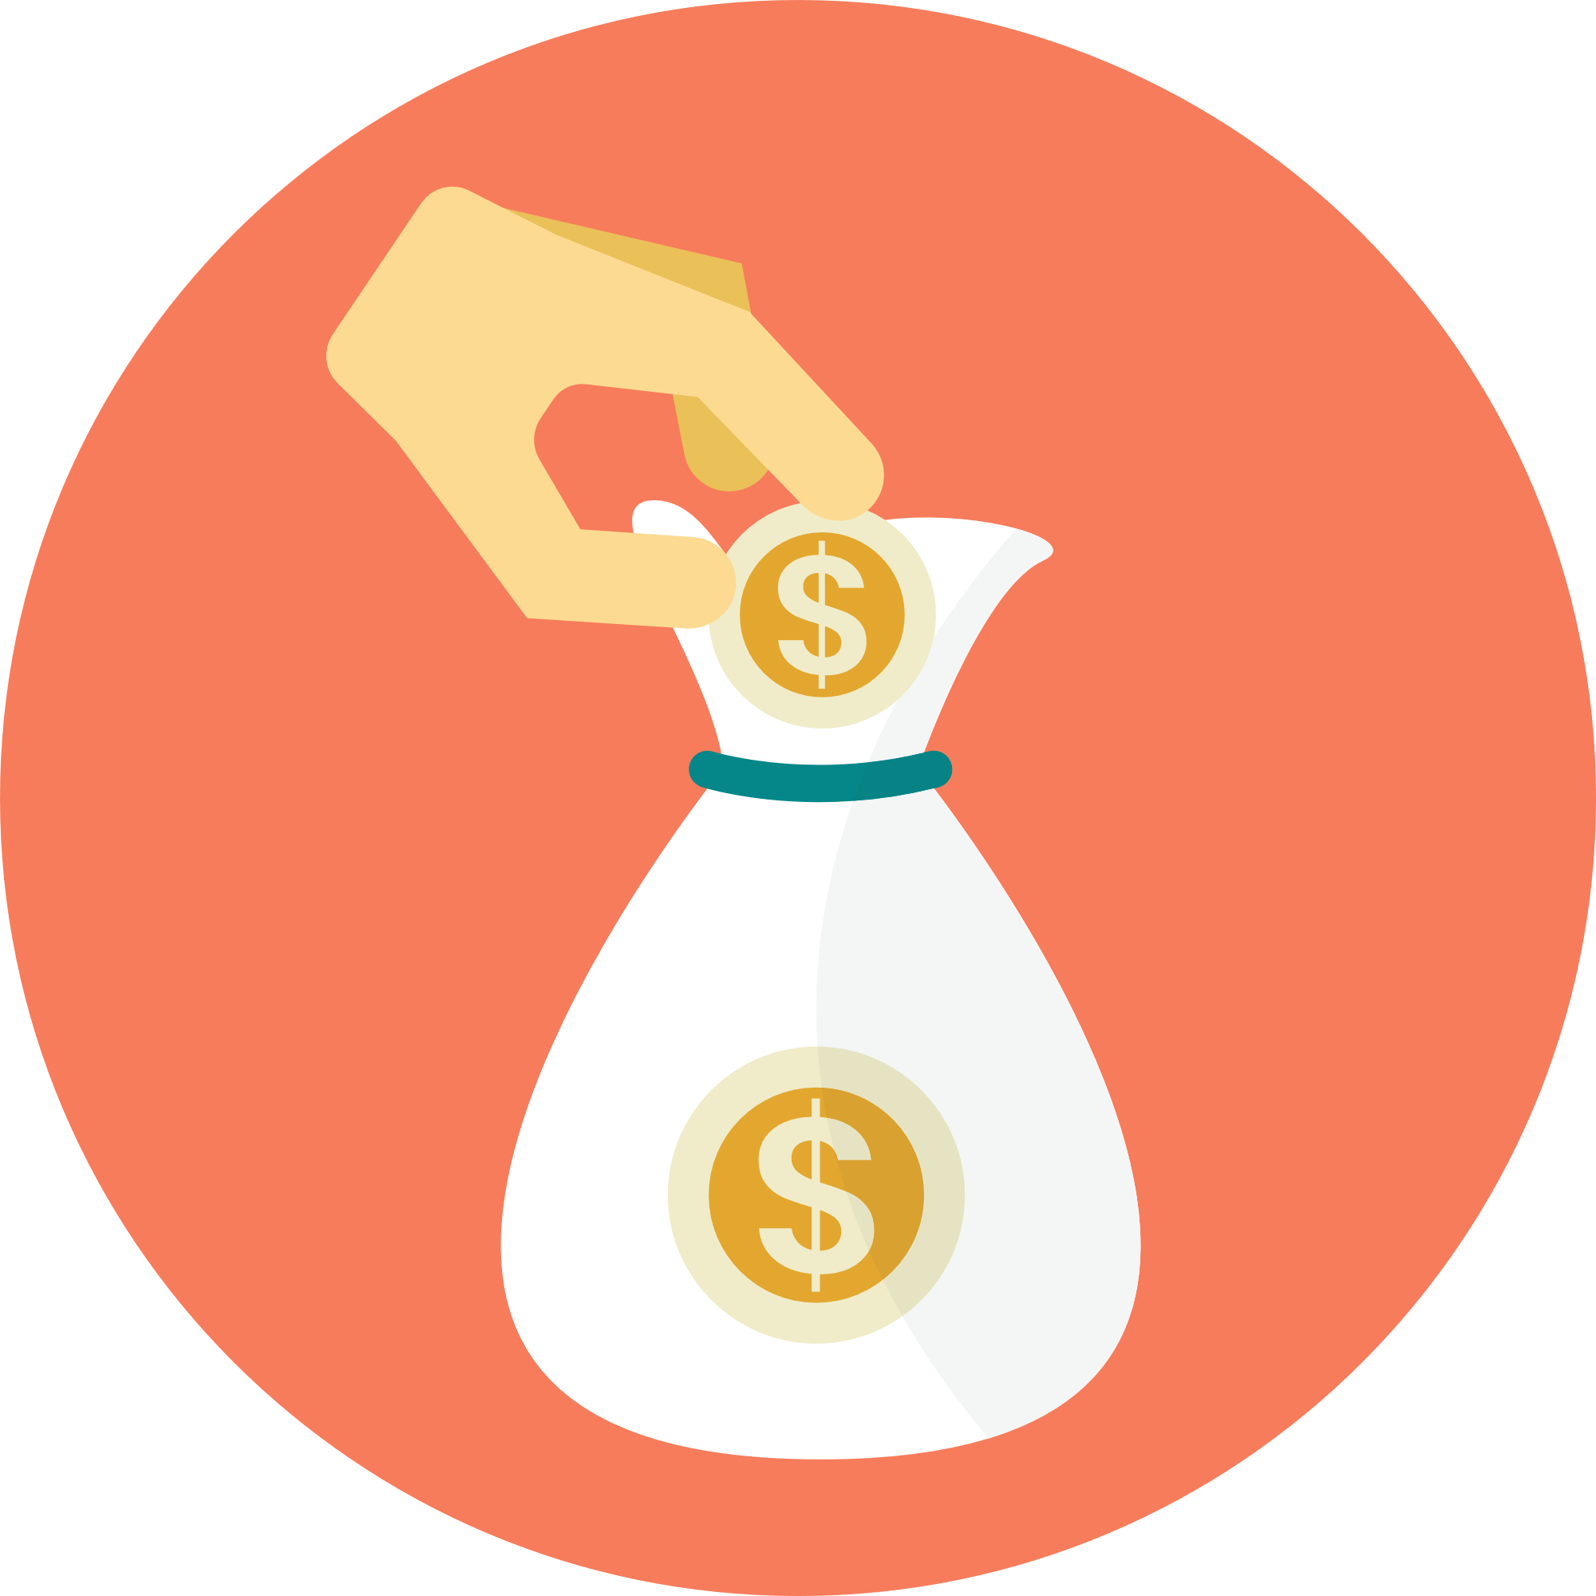
My Advice
Career
Education
Savings
Notes:
To wrap up the presentation, share with the students some personal advice about Careers, Education, and Savings

