Slide 1

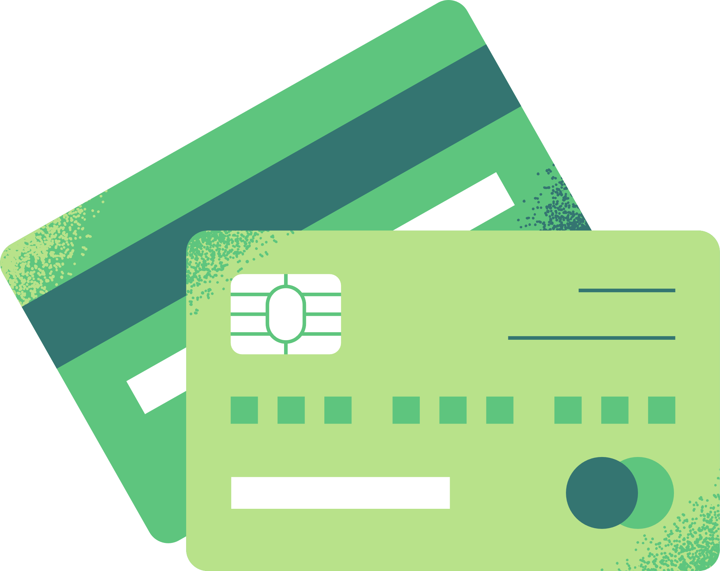




Great American Teach-In
Suncoast Credit Union

Slide 2



What is a
Credit Union
Noun.
  Credit Unions like Suncoast are not-for-profit, financial cooperatives owned by their members--and they exist specifically to help meet the financial needs of those members. Credit Union Profits go back to members, which is why they get lower rates on loans, higher earnings on deposits and more free services.
Notes:
Explain what a credit union is. Read the defination

Slide 3


  Our Suncoast Credit Union Foundation bridges the gap between us and our community to make a positive difference in the lives of those we serve.
OVER
$45 Million donated back to local communities since 1990
Foundation
SUNCOAST
Giving back to over
413,476
Children & Students
Notes:
An important part of Suncoast Credit Union DNA is giving back to our community and schools.

Slide 4


Who Am I?
Fun Fact about me?
What was my favorite subject in school?
What did I want to be when I grew up?
Notes:
Answer each question and have fun with it. Remember your audience.

Slide 5

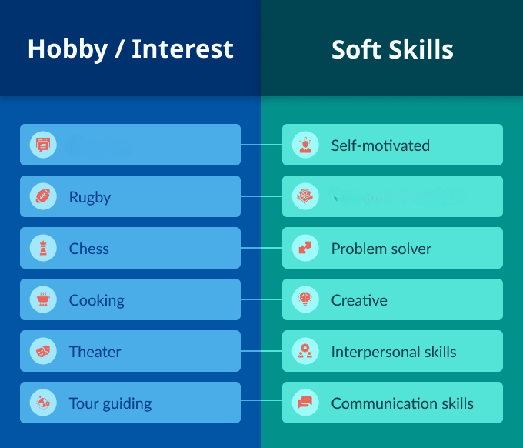


Interest
Skills
Connects with what you want to do, builds motivation to work hard and do well.
Tools that allow you to do the work. Can be from education, training, or experience.
Collaboration skills
Notes:
Interest - connects with what you want to do, builds motivation to work hard and do well.
Skills - these are the “tools” that allow you to do the work. Can be from education, training or from experience.
Those interest can help you cultivate the skills
Ask the class to tell you some of their interest.
Then use the interest and relate it to a skill. Explain that you need many of these skills when looking for a job/career.
Example-
Student says “Sports” that can translate to collaboration skill and problem solver. Players must utilize the team to be successful in a game and need good problem-solving skills to adapt to the changing situations.
Student says “Drawing or doing Make-up” that requires creativity and being self-motivated. The person needs to be self-motivated and know it will require lots of practice

Slide 6
My Job
What has been my career journey?
How long have I worked at Suncoast?
What does a day in my Job look like?
What is the favorite part of my work?
What was the hardest part of my job to learn?
Why is my job important?
Notes:
Answer each question and be creative. Remember your audience!

Slide 7



Why should YOU save?
Want and Goals
For Emergency
Needs
Notes:
It is important to save at all ages.
Saving allows you to have the necessary funds for basic needs of life (ex. food and water) and fun things you want. Your wants may turn into a goal since it may require a little time to save of for that item.
Ex: You want to go to Bush Garden for your birthday. The tickets may cost way more than you receive from your allowance or job, which means you’ll have to gather a few months of that money for when your birthday comes around. Which is savings!
You also need to save for emergencies. Life is unexpected, which means you should always have money put aside in case you need it.
Ex:
When you get your car, it may have a flat tire one day which will require you to take money from your emergency funds to pay for.

Slide 8





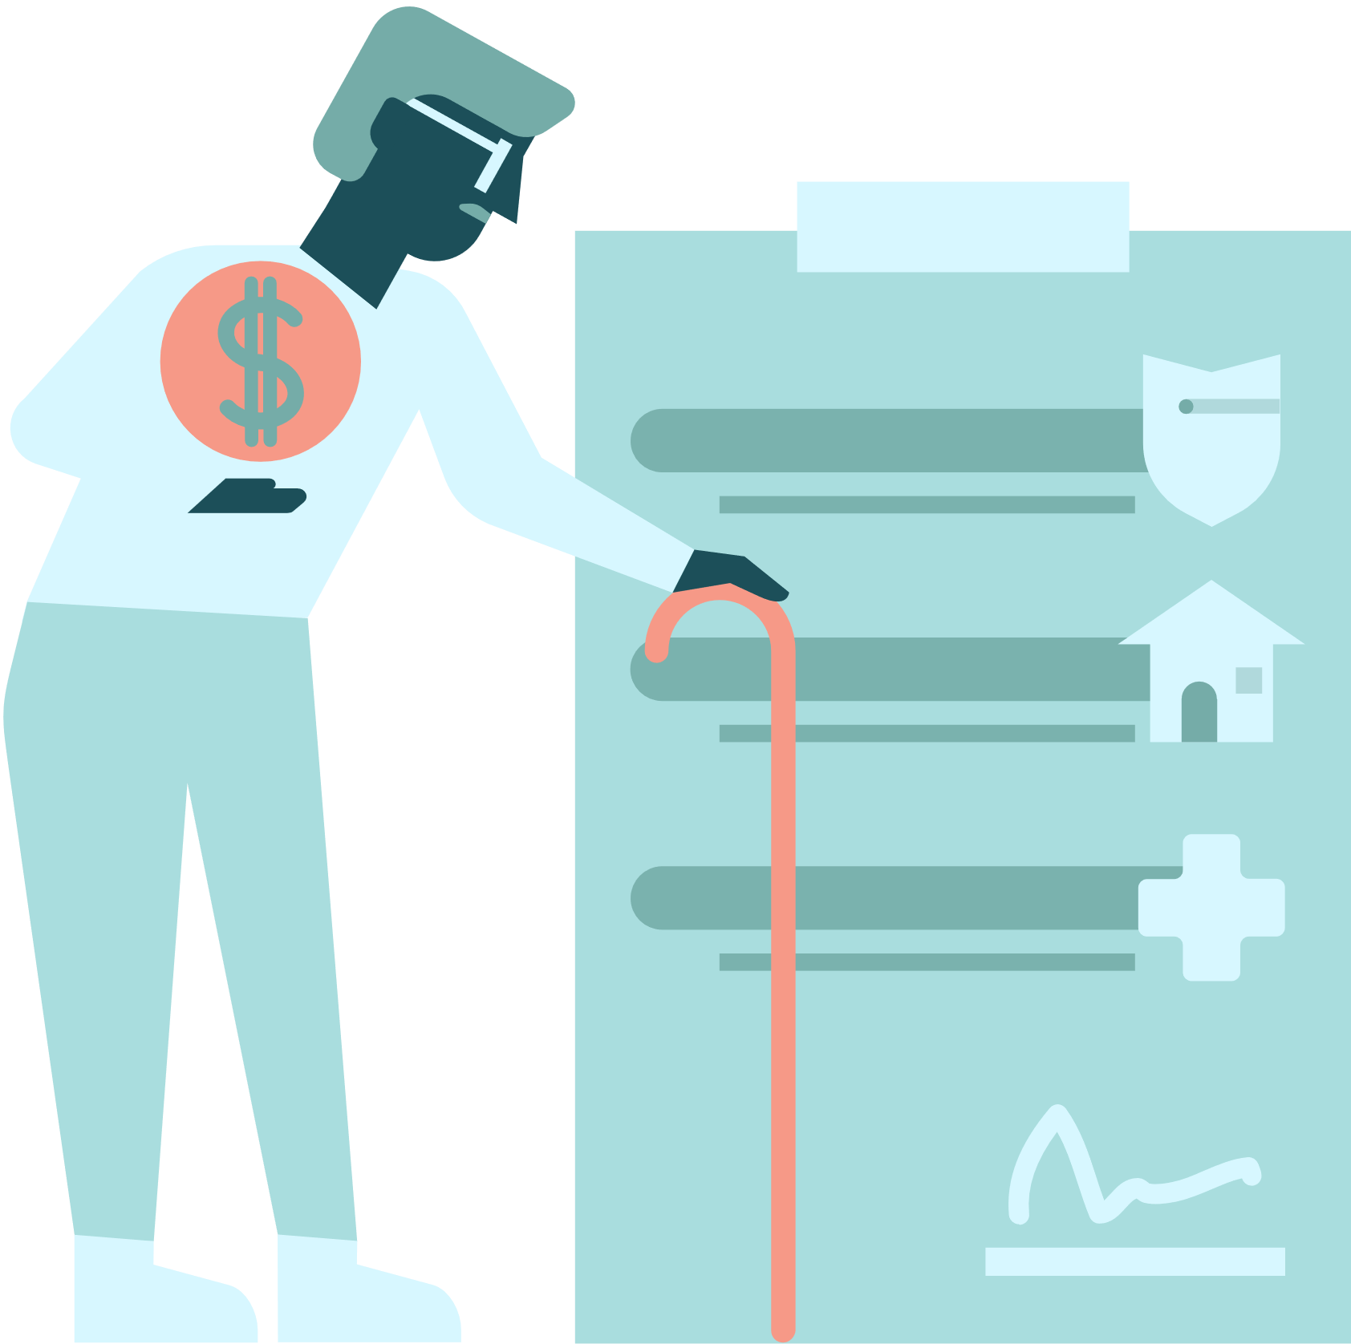
Save At Any Age
14-18 years old
13 years old
High school experience - Graduation cost, Grad Bash, yearbook, Homecoming, Prom.
Learners permit- Buying a car, which means having money for car payments, insurance, gas, and maintenance.
Life after High School - College? Technical career? Small business? Straight to the professional world?
Open a checking account - Helps you learn how to manage an account and debit card, building a budget, managing spending and saving habits, and checking transactions.
When you are born
Open a savings account - Starts building a habit of putting money away for your wants and goals.
18-21 years old
First job
As soon as you get a job you should start saving for retirement. If you don’t want to work for the rest of your life it is important to put money away for later life.
The door opens to credit. You can start building credit to achieve higher goals- Buying a car, better car, open a business
Notes:
Review each stage and explain why saving is important in all situations.

Slide 9



My Advice
Career
Education
Savings
Notes:
To wrap up the presentation, share with the students some personal advice about Careers, Education, and Savings

