Slide 1
2025 Supplier Conference
August 7, 2025

Slide 2
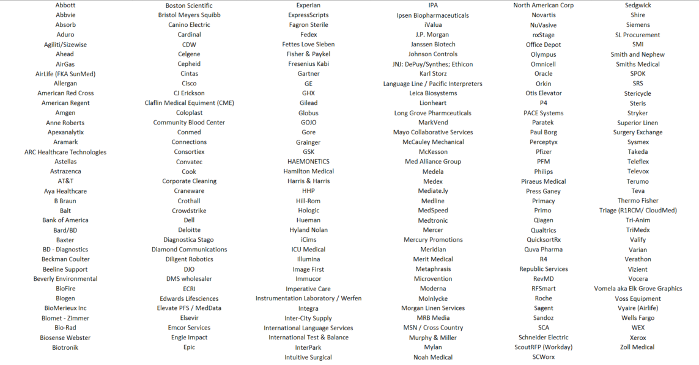
Invite List
Wifi: UChicago Guest Username: UCMEDCONF@uchicago.edu Pass: miy2y

Slide 3
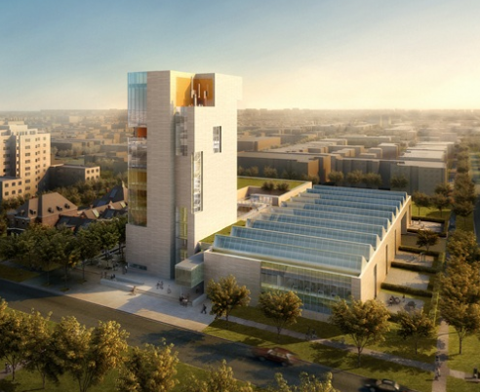
The Reva and David Logan Center For The Arts
Housekeeping
Housekeeping Items
Restrooms
Exits
Microphones
WIFI: UChicago Guest
User name: UCMEDCONF@uchicago.edu
Password: miy2y
How to access slides:
www.uchicagomedicine.org/about-us/supply-chain
Quick Links → 2025 Supplier Conference.

Slide 4
12th Annual UCM Supplier Conference
Purpose:
  Orient key supplier leadership to UCM critical business objectives, expectations, and distinct business practices.
  Update on progress and changes from last year’s conference.
  In order to ….
  Engage suppliers to work continually, passionately and collaboratively to deliver needed improvements and value to our patients.
Format:
Presentation with Q&A opportunities

Slide 5
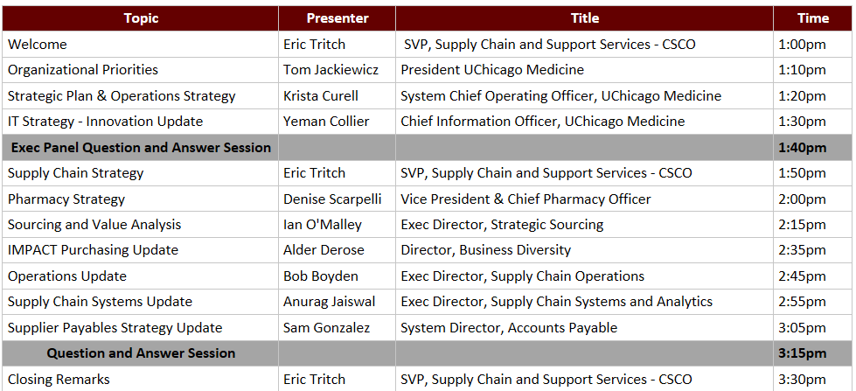
Agenda

Slide 6

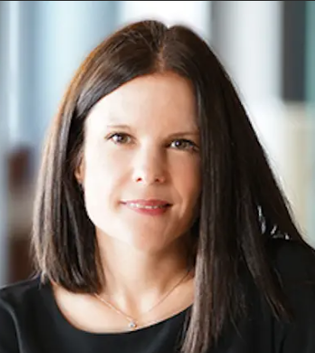
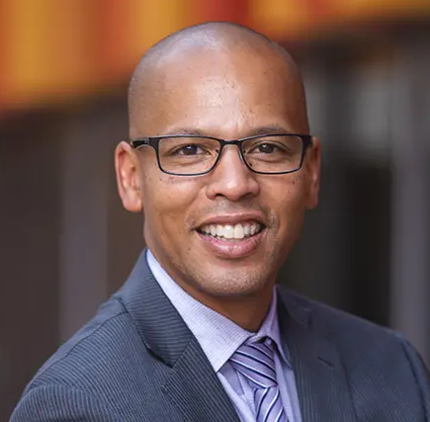
Executive Leadership Update
Tom Jackiewicz
President
UChicago Medicine
Krista Curell
System Chief Operating Officer
UChicago Medicine
Yeman Collier
Chief Information Officer
UChicago Medicine

Slide 7
Organizational Overview & Strategy
Tom Jackiewicz
President, UChicago Medicine

Slide 8

Who We Are:
An Academic Health System
The University of Chicago Medicine is a not-for-profit academic health system based on the University of Chicago campus on the city’s South Side. UChicago Medicine unites three organizations to fulfill its tripartite mission of patient care, research, and education.
University of Chicago Health System: The Health System is anchored by the University of Chicago Medical Center and spans hospitals, outpatient clinics, and physician practices across Chicagoland, its suburbs,
and Northwest Indiana.
Biological Sciences Division: UChicago’s largest academic division comprises 10 basic science and 14 clinical departments. Research and academic activities sit under the BSD.
Pritzker School of Medicine: UChicago’s medical school is co-located on campus, offering students a unique learning environment for education, research collaboration, and community service.

Slide 9
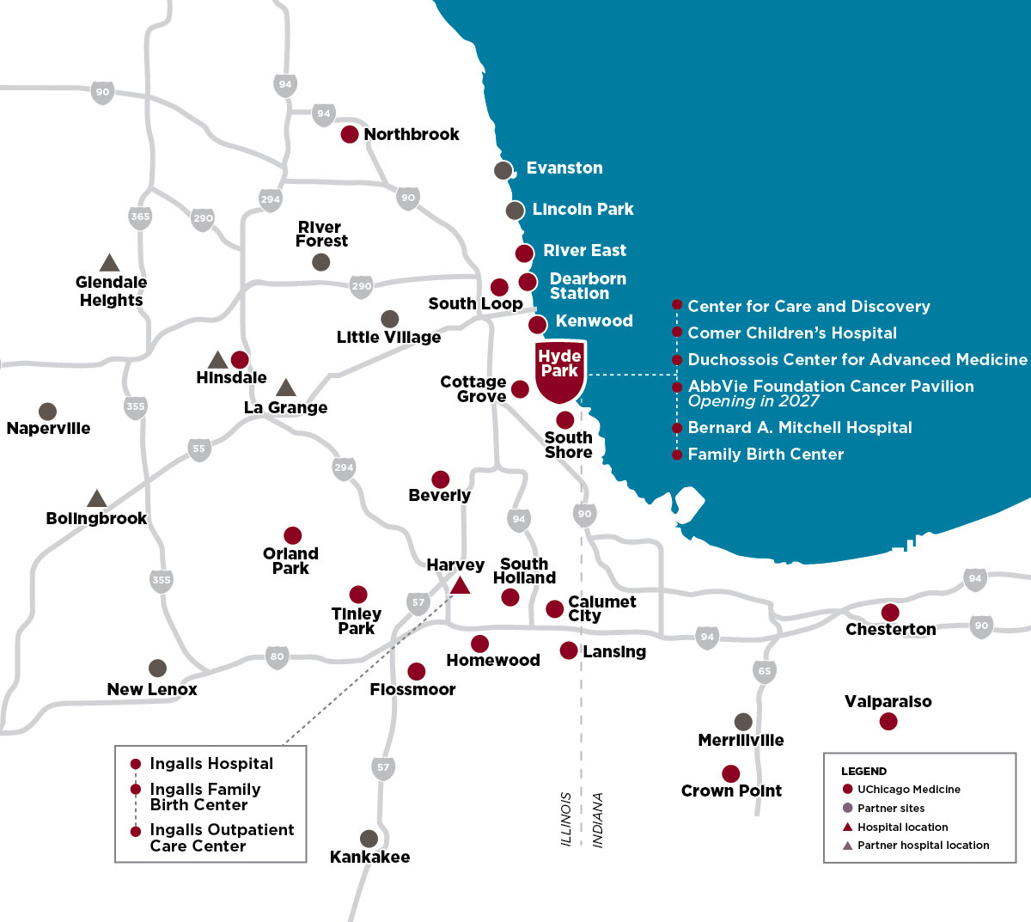
The Health System
The University of Chicago Health System has
a history dating back to 1927. It is known publicly as UChicago Medicine.
• University of Chicago Medical Center
Health System flagship in Hyde Park and serving South Side
• UChicago Medicine Ingalls Memorial
Serving the Southland & south suburbs
• UChicago Medicine AdventHealth
Joint venture serving the western suburbs
• UChicago Medicine Crown Point
Multispecialty center & micro-hospital in Northwest Indiana
• UChicago Medicine Care Network
A clinically integrated network of providers affiliated with
UChicago Medicine and independent community providers
University of Chicago Medical Center
Notes:
This map is of October 2024, and includes AbbVie Foundation CP

Slide 11


UChicago Medicine: the Health System
FACILITIES
PEOPLE *
1,304
14
Ambulatory
Care Facilities
8
~12,500
Inpatient Facilities
Licensed Beds*
4 in Chicago:
Hyde Park, River East, South Loop, Dearborn Station
4 in south suburbs
Harvey, Calumet City, Flossmoor and Tinley Park
4 in western suburbs: Hinsdale,
Bolingbrook, Glendale Heights, La Grange
Orland Park
Crown Point, Indiana
Center for Care and Discovery
Bernard M. Mitchell Hospital
Comer Children’s Hospital
Ingalls Memorial Hospital
UChicago Medicine AdventHealth (4)
Employees
829 Med-Surg
171 ICU
67 OB-GYN
60 General Pediatrics
53 NICU
78 Acute Mental Illness
46 Rehabilitation
Including:
2,388 Providers
1,680 Faculty Practice
142 Medical Group
566 Physician partners
4,021 Nurses
1,232 Residents & Fellows
57
Operating Rooms *
* Legacy UCM; Does not include UCM AdventHealth
† FY23 Legacy UCM and does not include UCM AdventHealth
**Appointments includes both onsite and telehealth
Business Entity | On-site | Video/Telephone | Total
UCMC | 897,330 | 108,202 | 1,005,532 | <---Inclusive of Care Network, UCMC appointments in Epic Departments with a functional mapping of Ambulatory.
Ingalls | 161,675 | 5,257 | 166,932 | <--- CHHD / PHA
NWI (Entity 105 only) | 4,869 | 161 | 5,030 | <--Northwest Indiana Business Entity. Excludes Oncology, which rolls up to UCMC
 | 1,063,874 | 113,620 | 1,177,494
Notes:
Notes:
What are our physicians doing at advent – ambulatory space with exception of cards surgery
Operating rooms – we have ~29 CDOR, 5 Comer, 8 DCAM, 9 Harvey, 4 Tinley ASC→ only include on this slide, and 2 Crown Point.

Slide 12
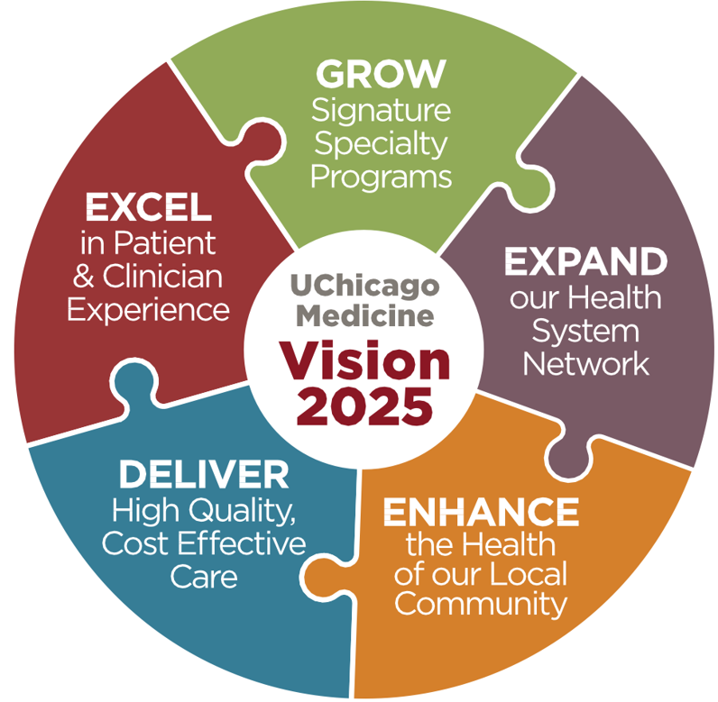
Over the Past 5+ Years, We’ve Successfully Executed On Our System’s Strategy for Growth & Excellence
Major Progress for the Health System
Recognition & Performance Growth
Financial Growth & Health
Geographic Growth
Programmatic, Partnership, & Infrastructure Growth
Vision 2025’s Major Priorities
(Our Previous Strategy)
¹Legacy UCM; Does not include U of C Faculty Practice
Notes:
Over the past 5+ years we’ve successfully executed on our system’s strategy for growth and excellence (highlighting data points including topline & EBIDA growth, major expansion, recognitions & awards), including the doubling of our system’s topline revenue
This is in spite of a long COVID recovery

Slide 13




Recognition & Performance Growth
Growing in National Excellence:
Success in Executing Locally in Chicagoland:
UCMC Nationally:
#12 Cancer
#20 GI / GI Surgery
#31 Ear Nose & Throat
#31 OB / GYN
#33 Cardiology / Cardiac Surgery
#34 Diabetes/Endocrine
#39 Pulmonology & Lung Surgery
#39 Urology
#40 Neurology / Neurosurgery
#44 Geriatrics
2019
Today
Nationally Ranked Specialties
29th
38th
2018
Today
2019
Today
Blue Ridge Medical School National Rankings
% of High Acuity Admissions in Chicagoland
1
¹Today’s Admissions Inclusive of AdventHealth Joint Venture High Acuity Volumes (High Acuity Defined as Top Decile of Complexity via MS-DRG Weight)
Notes:
Over the past 5+ years, we have seen success across various key dimensions:
National Excellence: our nationally ranked specialties continue to climb, and we are hopeful to be an honor roll hospital in the coming years (currently #28; top 20 for honor roll). Acknowledging the turbulence with NIH funding, we have seen our funding and ranking climb meaningfully
Key Recruitments: highlighting the importance of these recruits, in particular Bydon (recruited away from Mayo, helping launch the new department, international expertise to help boost our fast-growing international presence
Execution: we continue to increase our high acuity care in the market, bolstered in part by a very successful joint venture with AdventHealth

Slide 14
We Have Meaningfully Grown Over the Past 5 Years
OUR GROWTH & SUCCESS
Total UCM Revenue Over Time¹
FY20 to FY25
Growth Since FY20:
112% Overall (+$2.8B)
16% CAGR
+112%
FY20
FY21
FY22
FY23
FY24
FY25
¹Sources: UCM Financial Statements (note: does not include FPP)
Notes:
From a topline revenue growth perspective, our growth to $4.6B out achieved even our aggressive growth scenarios that we presented to the board back in the Fall of 2018
This was sustainable growth; our margin grew significantly (+25% over the past 5 years / +36% over the past 3) through thoughtful investments and financial stewardship
Most importantly, this was not growth just for growth’s sake; as you will see in the following slides, this was achieved by a wide range of “Firsts” – new partnerships, new markets, new program offerings – all while systematically making the necessary infrastructure investments and overhauls to pivot from a standalone hospital campus to a true health system.

Slide 15


Elevate 2035 Includes Ambitious and Important Goals for the Next Decade
The 5 Pillars of Our Plan
Healthcare, Research, Education, People, & Community
ASPIRATIONS
Be the eminent academic health system at the forefront of discovery, education and clinical innovation
Be the academic system of choice for patients, clinicians, researchers and team members
Provide the highest value care to all
Notes:
Over the past 18 months we’ve been building the next iteration of our clinical growth strategy in Elevate 2035 (Joint UCM/BSD/PSOM plan), which includes ambitious but important goals around our next decade (including top 10 in NIH funding, becoming the market leader for complex care, etc.). To accomplish these goals, we anticipate needing to double the size of our system again, to roughly $10B

Slide 16
Realizing Operational Efficiencies
Krista Curell
System Chief Operating Officer, UChicago Medicine

Slide 17
Academic Medical Centers Continue to Face Financial Headwinds
1.1%
AMC operating performance has deteriorated
median operating margin among U.S. AMCs in 2023 (down from 3% in 2019¹)
~130
bps
Cost pressures remain challenging, as inflation and labor shortages persist
headwind to acute care EBIDA margins expected from inflation and labor shortages between 2023-2028², with continued uncertainty on future outlook
-2%
Balance sheet outlook is becoming less favorable
per annum decrease in median days’ cash on hand for non-profit health systems between 2019 and 2023³
-2%
decline in hospital admissions in the U.S. between 2017 and 2022,⁶ which may disproportionately impact AMCs given reliance on tertiary and quaternary care
Revenue continues to be strained as care shifts away from acute
1. Becker’s Hospital Review, RBC Capital Markets NFP Healthcare Industry Financial Performance Report, CMS/KFF, Company 10Ks, Specialized press, Definitive Healthcare; 2. McKinsey profit pools model; 3. S&P Non-profit hospital medians; 4. Modern Healthcare; 5. Science; 6. American Hospital Association (January 12, 2024)
Source: Becker’s Hospital Review, RBC Capital Markets NFP Healthcare Industry Financial Performance Report, CMS/KFF, Company 10Ks , Specialized press, McKinsey profit pools model, S&P, Modern Healthcare, Science, AHA

Slide 18
Additionally, the South Side of Chicago is a More Fragile Ecosystem
Net Change in Licensed Beds 2012-2025: -661
LaRabida modernizes and expand OP facilities
MetroSouth starts IP AMI service + beds
Adv. Christ modernizes and expands ICU, OB and NICU
Trinity acquires Mercy
Franciscan Olympia Fields modernizes med/surg beds
Holy Cross merger with Sinai Health
Adv. Trinity adds 14 ICU beds
UCM adds 38 Med Surgs beds
UCM builds out 3rd and 4th Floor CCD and Orland Park CAC
Trinity acquires Mercy
Franciscan Olympia Fields modernizes med/surg beds
LaRabida modernizes and expand OP facilities
UCM builds out 3rd and 4th Floor CCD and Orland Park CAC
St. Bernard approved to build new Ambulatory Center
Provident discontinues OB services
Adv. Christ modernizes trauma, ED, and other services
UCM builds new ED and Trauma services and modernizes med/surg and ICU beds in Mitchell
UCM adds 6 Level III NICU beds
Ingalls/UCM merger
Franciscan Chicago Heights closes IP services
Mercy closes Pediatrics service
Adv. Christ modernizes Rad Onc
Holy Cross discontinues Rehab beds
Adv. South Suburban closes LTC and Pediatric Services
Palos closes Peds beds
Advocate S. Suburban modernizes surgical and procedural areas
LCMH modernizes ED
LCMH ends Peds Service
Franciscan Chicago Heights closes remaining services
MetroSouth Closure: -314 beds
Jackson Park closes OB services
Ingalls closes Peds Service
Metrosouth closes
St. Bernard closes Peds service
LCMH merges with OSF
Holy Cross suspends OB/GYN services and consolidates other units (16 beds)
Mercy announces closure in 2021 (later purchased by Insight, preventing closure)
St. Bernard suspends inpatient obstetrics unit (22 beds)
Advocate South Suburban closes obstetrics unit (16 beds)
UCM & AdventHealth Joint Venture Launch
Prime buys 9 Ascension Hospitals¹
Advocate to reduce programs at Trinity
UCM Medicaid Payer Mix vs. Market:
Today (2024): UCM 27% Medicaid (vs 21% Mkt. Avg.)
Pre-Advent Health JV (2022): UCM 36% (vs. 19% Mkt. Avg.)
Source: Census Bureau ACS estimates
1. Reduced beds on the North / West Side

Slide 19




Market Impact and our Response
1. Provider Expansion & Consolidation
2. Shifting Inpatient (IP) & Outpatient (OP) Landscape
3. Macro Financial Pressures
Continued Investment & Expansion in Key Markets, Including Our Backyard
Continued Provider Consolidation, Narrowing Key Care Continuum Channels
IP-to-OP Shifts Have Wide Swings by Service Line; High-Acuity Volumes Poised for Large Growth as Population Ages
Fewer Systems Seeing More & More High Acuity Volumes
Continued Financial Pressures for AMCs
Growing Medicare Advantage & South Side Ecosystem Will Strain Our Finances in Traditional Fee-for-Service Model
In Response To These Trends, Our Future Planning Needs To Be Focused On (Amongst Other Things):
Increase Our Own Primary Care & General Specialty Access, to meet increasing demand and counter a narrowing care continuum
Grow Outside Hyde Park Across Our Networks, to meet growing patient populations where they need care
More Efficient Use & Existing Space, & Build More Capacity to become a leader in high-acuity inpatient care

Slide 20
Impacts of Federal Funding
  Immediate Impacts
  Award Reductions / Terminations as awards are revised / put on hold / terminated (early targets included infectious disease related awards, diversity supplements, international grants and sub-contracts / sub-awards at DOJ targeted institutions)
  Delays in Grant Awarding decrease in rate of new awards / renewals / sub-awards, leading to delays and interruptions in research activities
  Bridge Funding Efforts The Division has allocated “bridge funding” to help labs survive immediate gaps; expected to rise with current pending requests
  International Recruitment Visa delays are creating challenges for recruitment of international faculty, postdocs and graduate students
  Long-Term Consequences
  Postdoctoral Researchers most at risk due to 1-year appts. & career progression highly sensitive to funding disruptions
  Junior Faculty dependent on securing 1st / 2nd major grant & impacts to faculty recruitment / retention
  Graduate Training Pipeline disruption to admissions / enrollment to top PhD programs with applicants on hold or rejected; impacting pipeline of future scientists for 4+ years
  Faculty Recruitment negotiations paused / offers rescinded leading to talent stuck in limbo

Slide 21
Macro Trends / Risks, & Recent Successes
  Macro Trends & Risks
  Erosion of Research Culture
  Growing anti-science rhetoric, propaganda, and deliberate misinformation are undermining scientific authority at the national level.
  Overreaching political interference risks further destabilizing research and impacting public health.
  Decreased support for research involving animal models.
  Operational & Strategic Shifts
  Watching for upcoming changes in indirect cost (IDC) models and how those alterations will affect institutional operations.
  Delays in the processing of funding due to staff terminations/ NIH restructuring.
  Changing focus in funding priorities and potential budget cuts from NIH and other agencies—remaining agile to pivot towards areas of sustained or increased emphasis.
  Recent Favorable Signs
  NIH action to cease terminating awards
  Favorable response to our first appeal.
  Certain Terminations have been deemed illegal and are being reinstated
  Indication some terminated programs will be funded for additional year
  Volume of new grant awards and continuations starting to pick up.

Slide 22
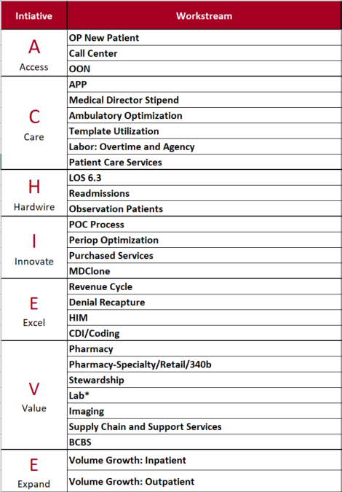
ACHIEVE
FY25 efforts performed above budget in aggregate; additional opportunities were implemented to help offset certain workstreams that fell short of plan: Length of stay, purchased service spend, premium pay and revenue cycle efforts are behind plan in FY2025
  Additional headwinds in the national payor landscape contributed to another $80M in reserves
  Constant focus on underperforming workstreams to understand operational change necessary to drive results.
Leadership and workstream owners represent the entire UCM system; this allows UCM to achieve results/understand barriers to success.

Slide 23
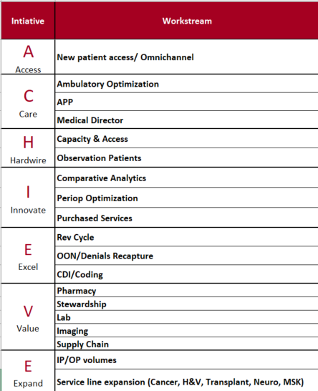
ACHIEVE 2.0
The foundation of ACHIEVE 2.0 is sustained improvements on prior opportunities and new opportunities identified for the 2026 financial plan.
Stretch targets are not part of the financial plan; these are identified to help escalate performance and/or offset financial hardships that were unknown.
Each month, we will reforecast all workstream outcomes against targets in order to address shortfalls and take action

Slide 24
Key Strategies and Risks Update
Revenue Cycle
Strategies | Risks
Identify and improve process issues causing payment delays such as workqueue management, coding, third-party audits, etc | Payers erroneously deny claims, and delays in review/appeal processes cause AR to significantly age
Procure resources to optimize technology, and address AR backlog | Ability to hire/deploy resources timely
Centralize all HMO referrals and all prior authorization workflows | Further realization erosion in current fiscal year
Purchased Services and Workforce Management
Strategies | Risks
Remove subjectivity and bias from decision making by utilizing benchmarking data to align targets (Comparative Analytics) | Automation doesn’t progress quickly enough or doesn’t prove as efficient/effective as expected
Embed benchmarking into Position Oversight Process | Lack of/delays in system adoption
Target areas with opportunities for improvement in purchased services and/or productivity performance | Ability to implement/execute upon identified opportunities: Immense Culture Change

Slide 25
Funding Key Strategic Initiatives: Cancer Pavilion
Krista Curell
System Chief Operating Officer, UChicago Medicine

Slide 26
Cancer Pavilion Mission
Mission: To discover the determinants of cancer, to develop novel therapies for cancer, and to prevent cancer through innovative and collaborative research, compassionate patient care, education, and community engagement.
Patient & Family First
1
Focus on full-service personalized patient experience
Multidisciplinary approach and one stop shop (all modalities on site)
We are at the forefront of comprehensive cancer care distinguished by eminence in patient-centered care delivery, research, discovery, and training the next generation of cancer leaders
2
THE Destination for Cancer Care
Consider cultures & communities beyond our current reach
Celebrate our diversity with our location as s source of strength.
3
Clinical Research & Innovation is Our Foundation
Put science on display and in play for patients
Digital innovation & technology to enhance patient experience

Slide 27

The cancer pavilion will be Chicago's first freestanding comprehensive cancer center.
The pavilion will reimagine cancer care and position UCM as the leader at the intersection of research and clinical activity through ⟶
Dedicated Space for Research & Clinical Trial Activation
A Unique Approach to Thinking & Caring About the Whole Person
A Fully Coordinated Patient-and Family-centric Experience
Multidisciplinary, Technologically Advanced Care
Deep Community Engagement
A Fully Coordinated Patient-and Family-centric Experience

Slide 28
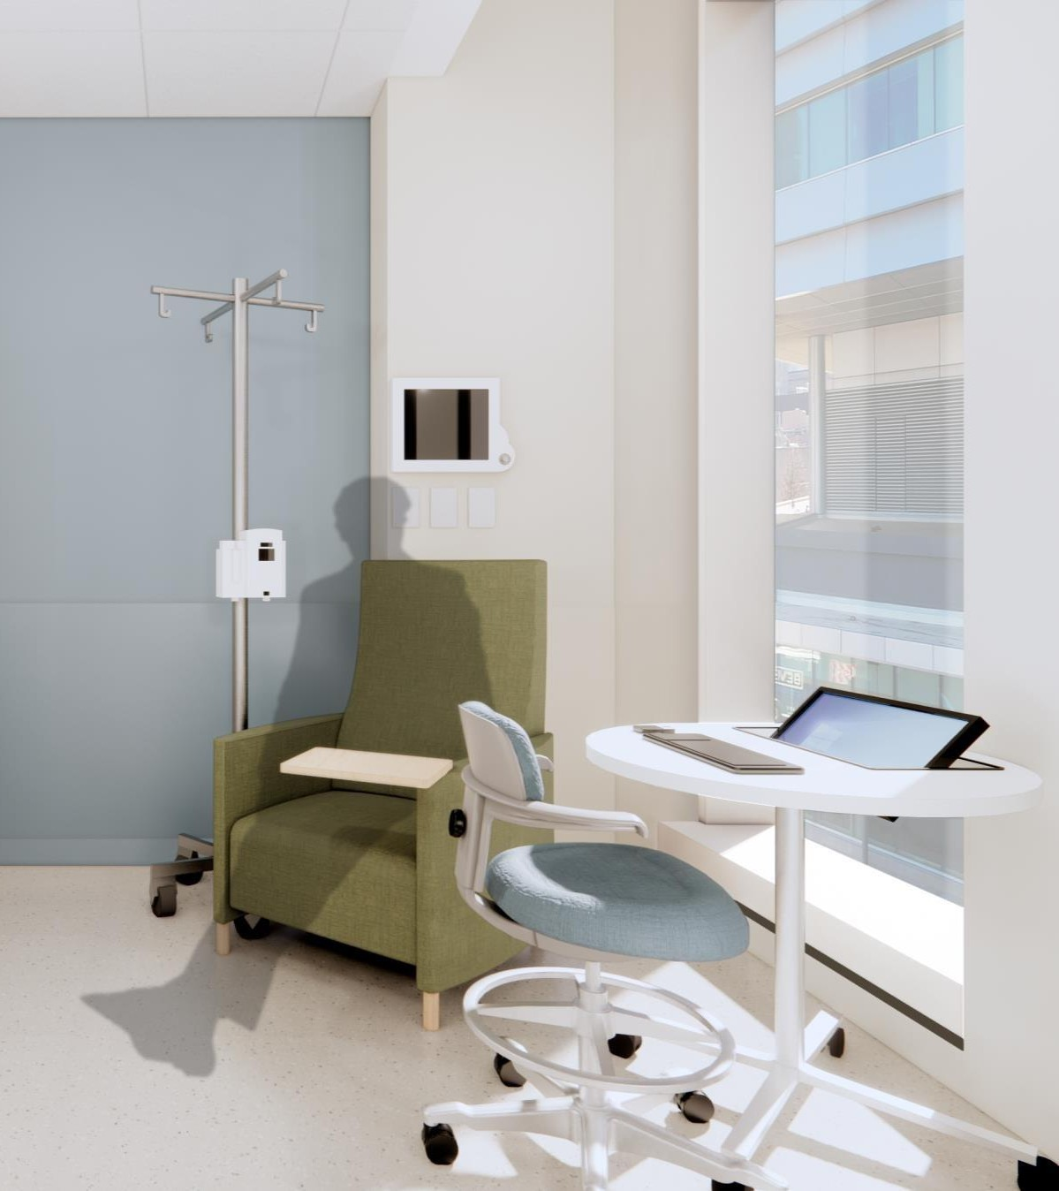
The cancer pavilion has the advancement of cancer care at the core of the
facilities’ design and layout.
The focus on cancer research will ⟶
Put Science on Display & in Play for Patients
Embed Research & Discovery in the Fabric of the Center
Foster Digital Innovation & Technology to Enhance Patient & Provider Experience

Slide 29
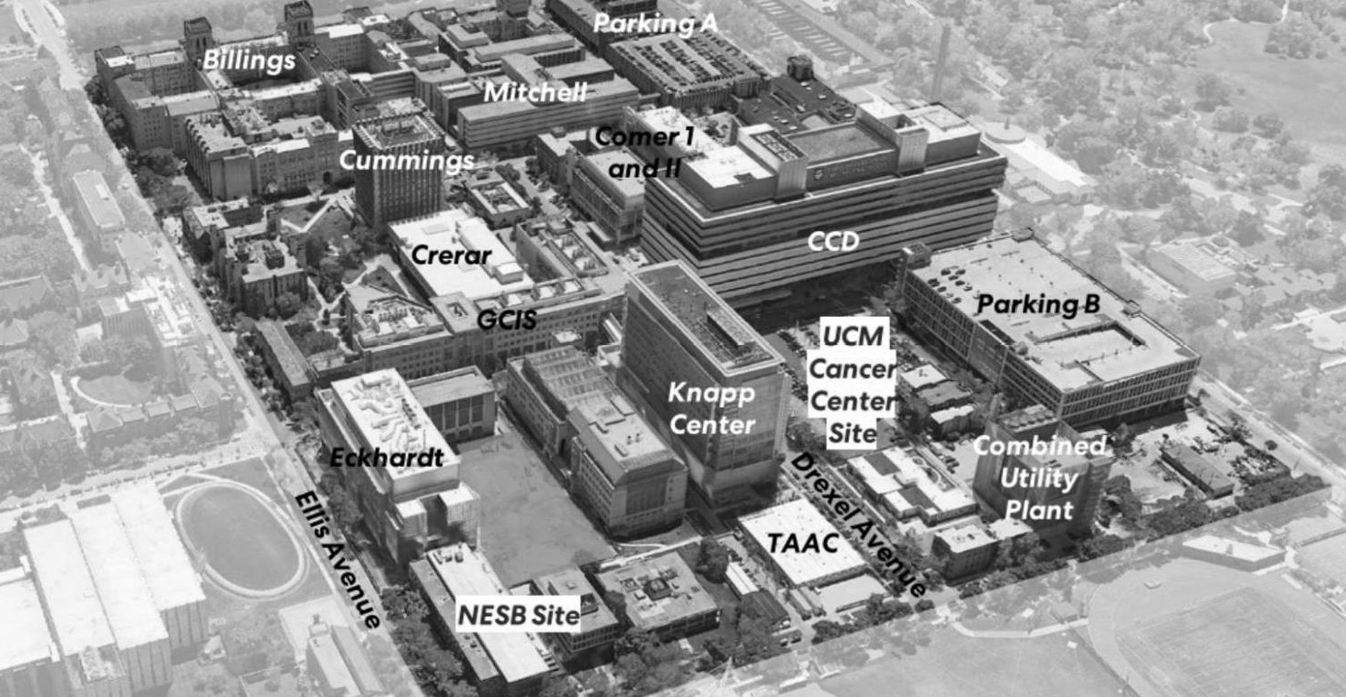




Project Site & Context
U C H I C A G O M E D I C I N E C A N C E R P A V I L I O N P R O J E C T T E A M O N B O A R D I N G 1 2
Washington Park
DuSable Museum
UCM Cancer Center Site
NESB Site
N
1 2

Slide 30
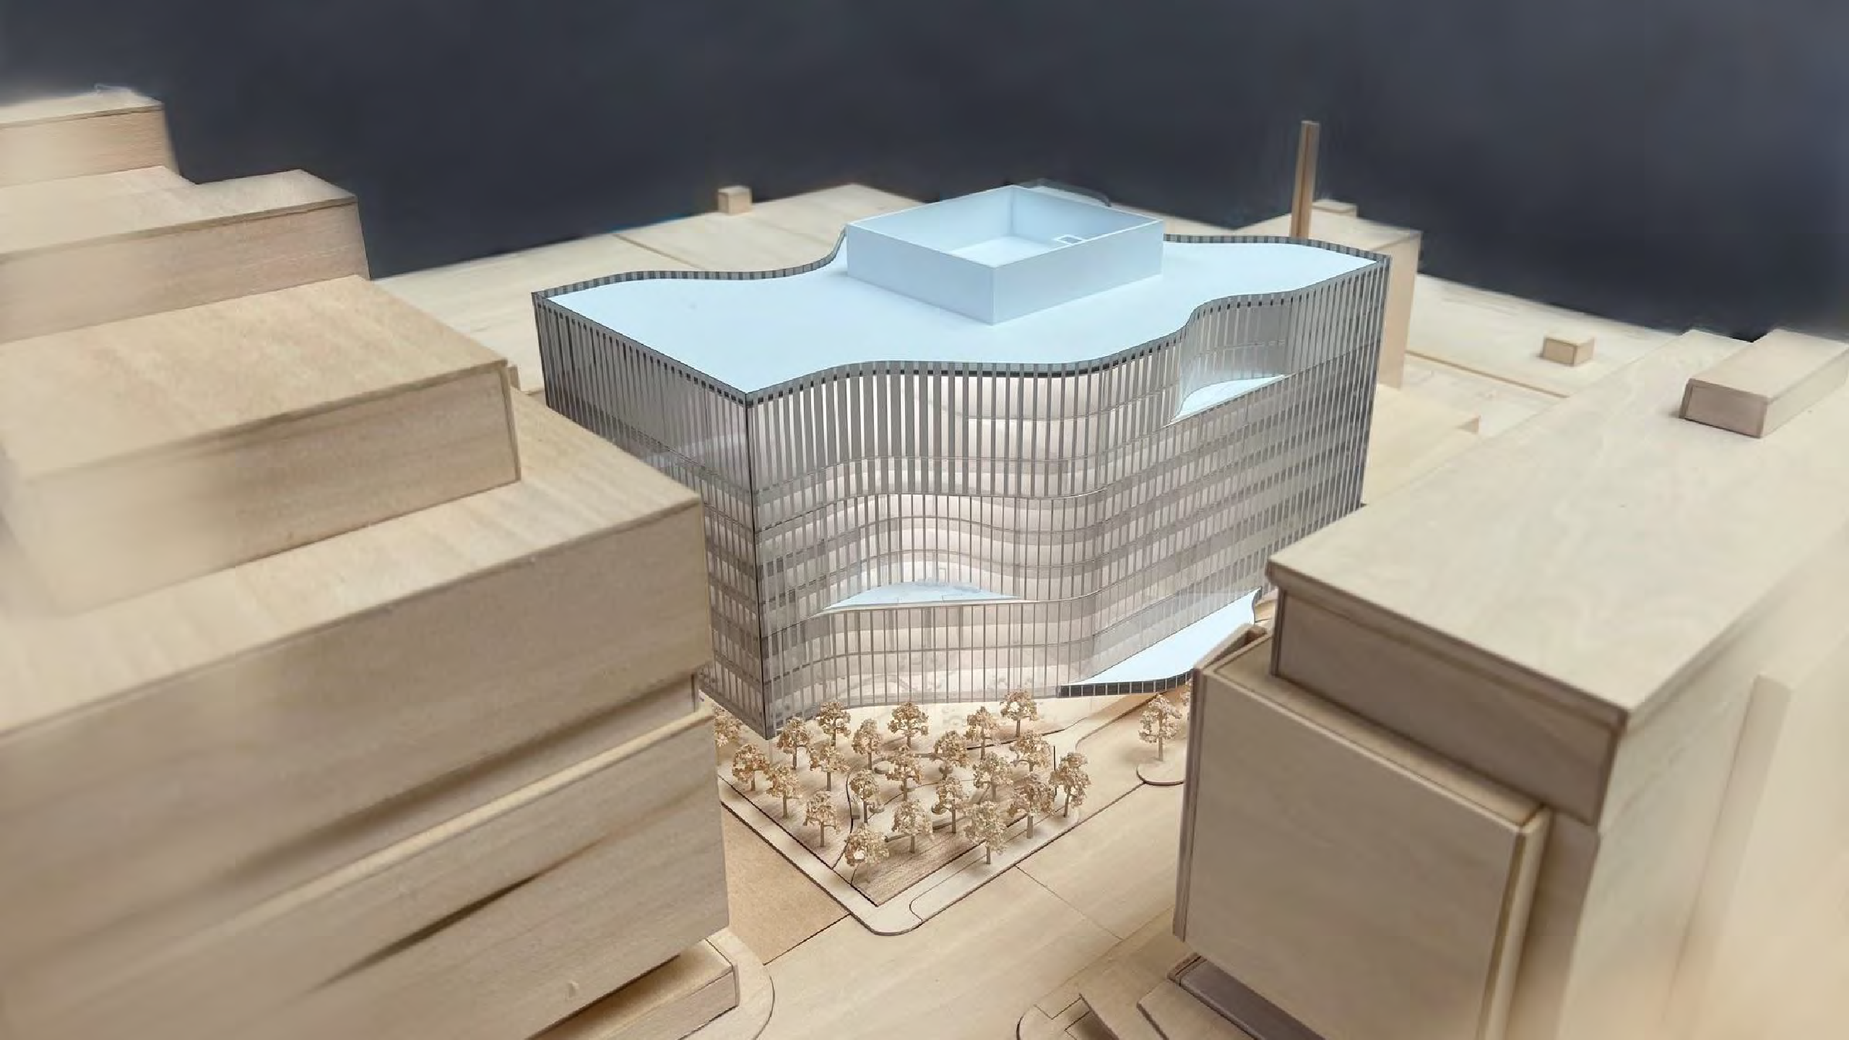
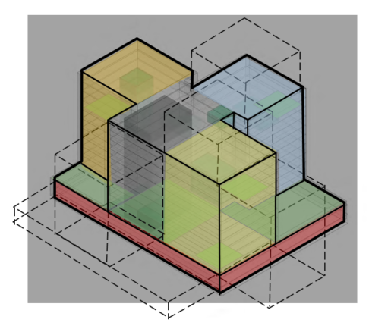

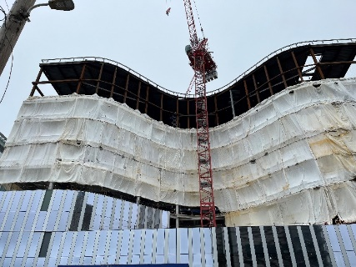

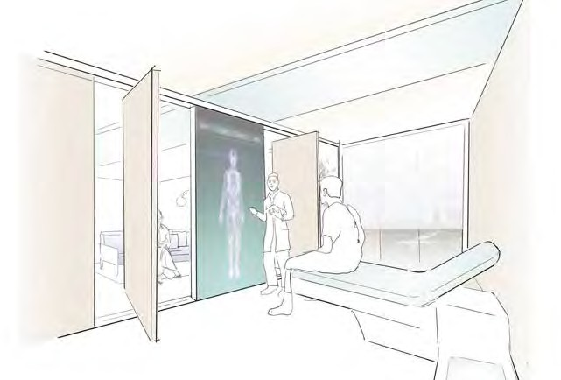
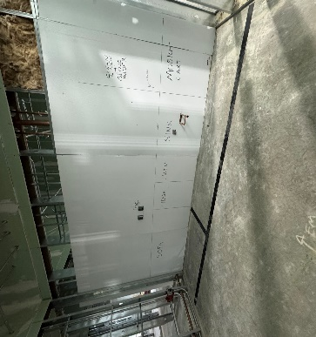
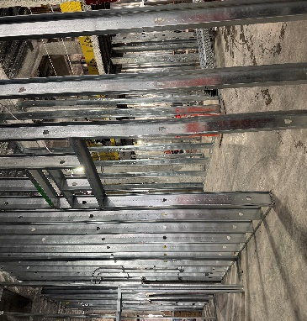
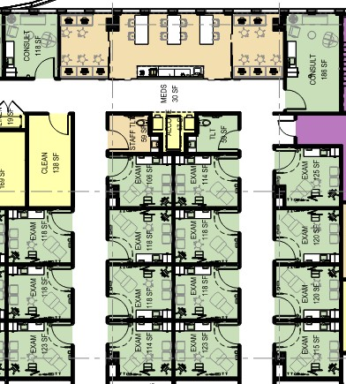
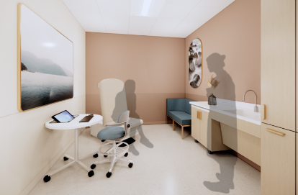
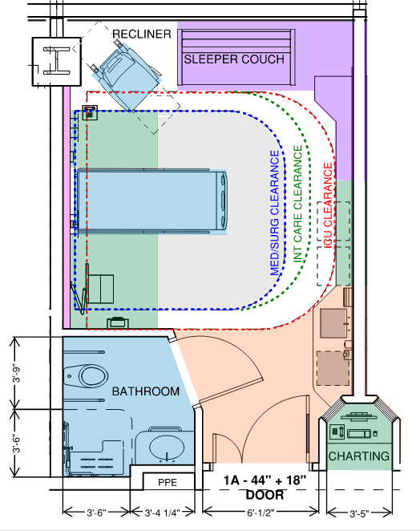
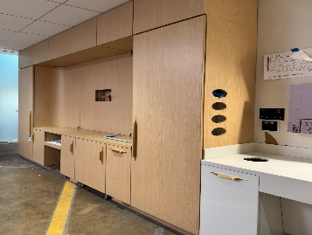
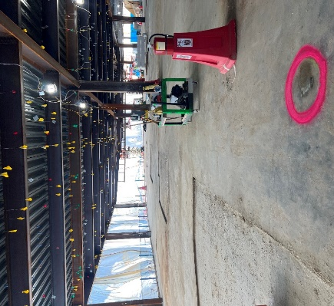
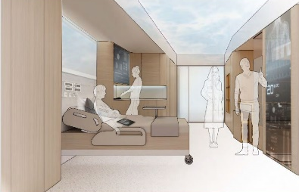
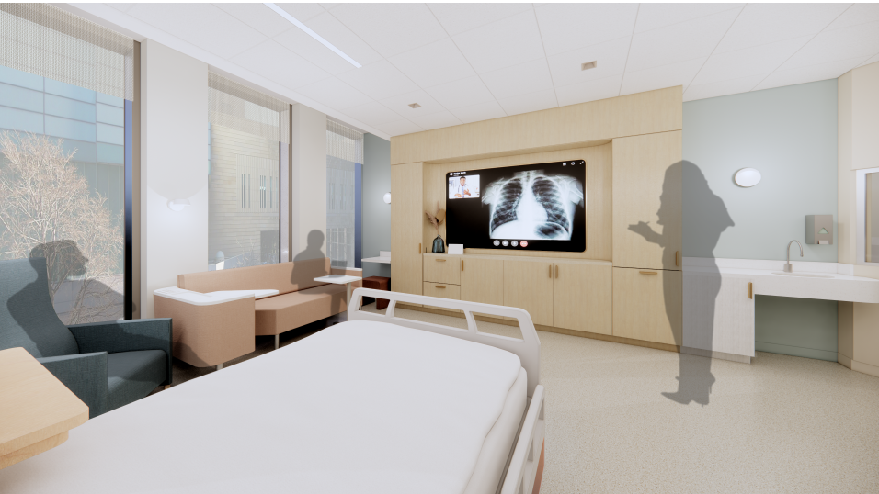
Our Process
CONCEPT
DEVELOP
DESIGN
TEST
BUILD
ACTIVATE
COMING
2027

Slide 31
Building Attributes
7 stories
plus one story below grade
575,000
total square feet
S H E L L S P A C E
161,000 SF
L7
L6
L5
L4
L3
L2
L1
LL

Slide 32
Building Program
80 | Inpatient Beds (16 ICU)
Radiology including MR, CT, Ultrasound & X-Ray
Breast Center
Oncology Rapid Response Clinic (ORAC)
Wellness Center
Pharmacy
Public / Waiting / Retail
Building Support Services
Mechanical Floor
Tunnel to Parking Garage B / Loading Dock
Utility Tunnel to existing University Steam Tunnel
Bridges to Parking Garage B & Center for Care & Discovery
Ambulatory Oncology Rapid Response Lab
 | OUTPATIENT ONCOLOGY CLINIC
90 | Exam Rooms
 | OUTPATIENT INFUSION SERVICES
67 | Infusion Rooms

Slide 33
IT Strategy & Innovation Update – Yeman Collier

Slide 34
Technology Innovation Guiding Principles
Meaningful enhancement of the patient and caregiver experience.
Foster interdisciplinary rounding to enhance safety, quality, and compliance.
Increase operational efficiency and automate repetitive, routine tasks.
Design and enhance clinical workflows / decision support to drive positive and consistent outcomes.
Spend more time directly with each patient to enable greater compassion in the provision of care.
Drive cost effectiveness, minimize waste, and strengthen financial stewardship.
Enhance timely access to real time information enabling more accurate clinical decision making.
Support clinical and translational research in accelerating discovery and evolved treatment protocols.

Slide 35
5 Themes
Innovative Care Model Enablement
Infrastructure and Process Modernization
OPEX Moderation and Fiscal Stewardship
IT Rebranding, Skills Enhancement, and Key Recruitments
Cybersecurity and Risk Management

Slide 36
Technology
Guiding Principles
Patient Experience | Caregiver Experience | Operational Efficiency | Foundational Technology
Patient Education/Infotainment | Virtual Nursing | Epic Command Center​ | Collaboration Rooms​
Wayfinding | Fusion Spaces | Smart Beds | Enhanced Cell Private LTE
Digital Pillow Speakers | Real Time Location Services (RTLS) | Room Scheduler | Network Review Cisco Assessment
Family Communications | Voice Integration | Service Now
Interpreter Services | UCM Mobile Applications
Financial Navigation
Enhanced Patient Experience
Patient Safety
Compassionate Care
Caregiver Experience
Automate Routine Tasks
Decision Support
Consistent Outcomes
Operational Efficiency
Financial Stewardship
Technologically Advanced

Slide 37
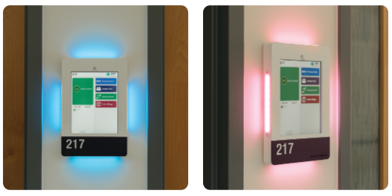
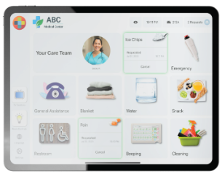
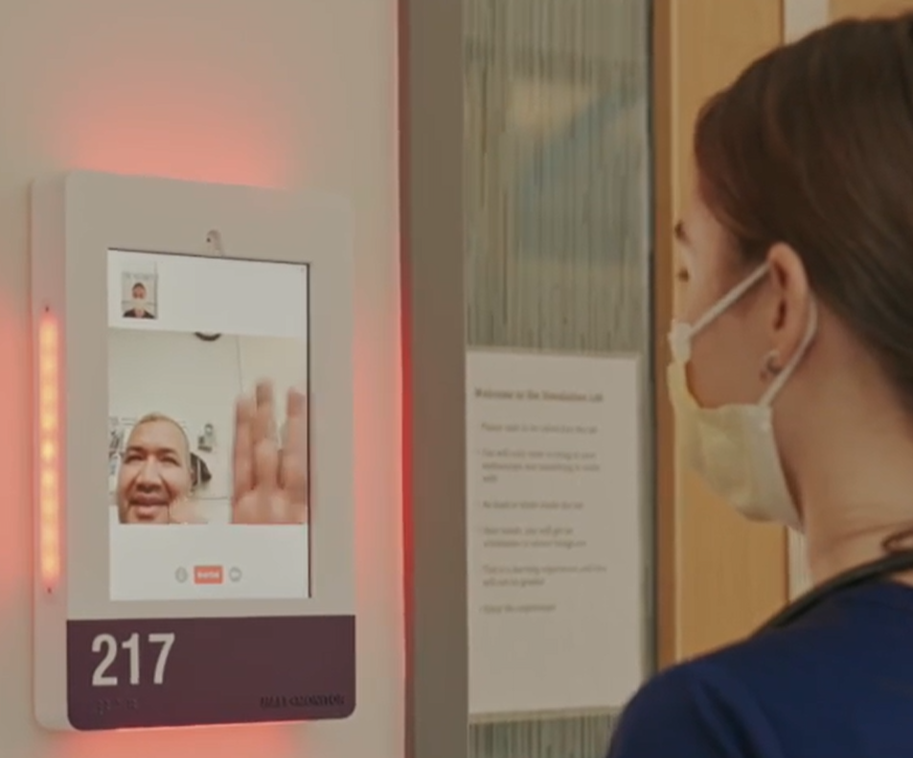
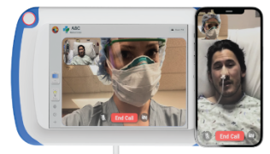
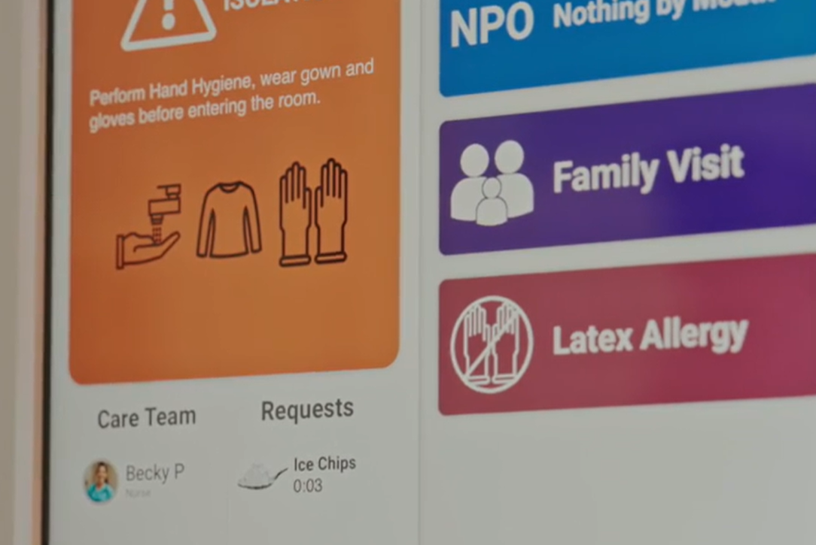
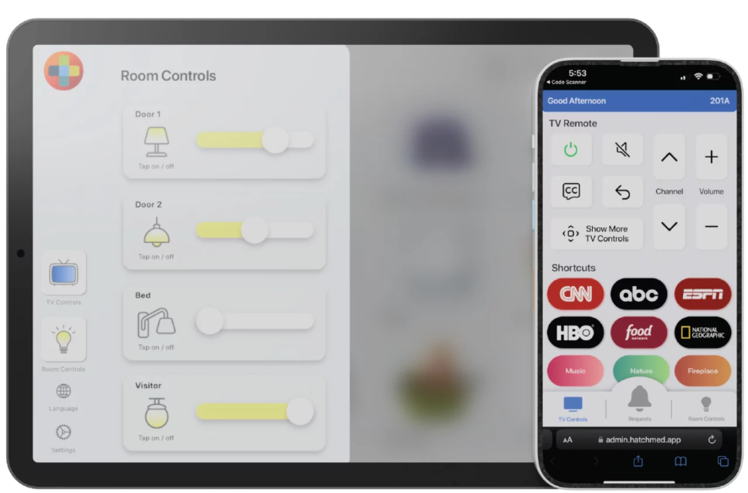
Digital Pillow Speaker and Hall Monitoring
Integration with both Epic EMR and Enterprise Nurse Call for more personalized, higher quality care
Built in 2-way video calling between patient and care team
Ability to use either the bedside tablet or patient/family member’s mobile device for room and TV controls
Hall monitor information is continuously updated via Epic during the patient’s stay and erased immediately after discharge
Epic EMR populated, color coded contextual illumination, displays care team, patient requests, and precautions

Slide 38

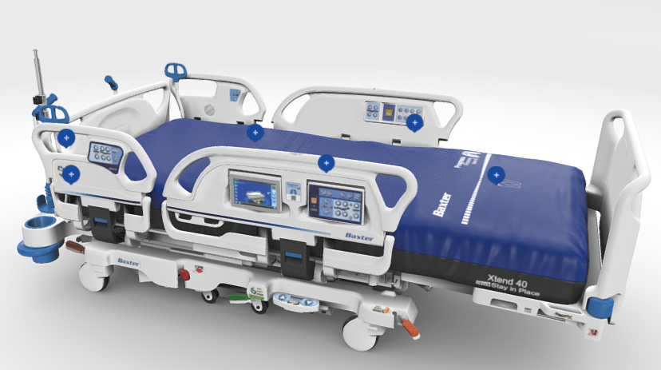

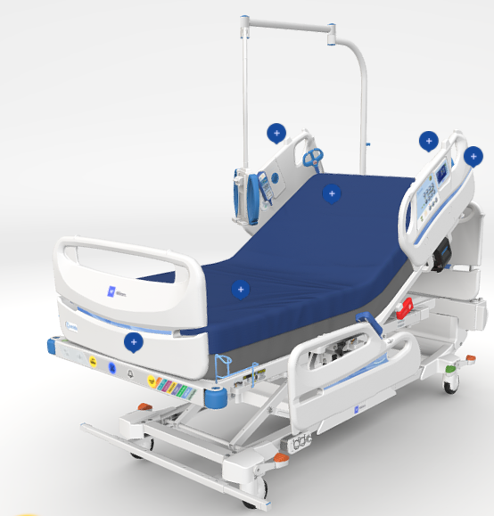
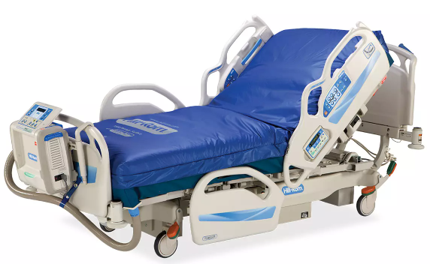
Smart Beds
Designed to help prevent hospital-acquired pressure injuries with advanced surfaces that manage heat, moisture, pressure, shear and friction
Simplifies patient positioning to help prevent sliding and adjusts for each patient’s height to helps clinicians turn patients with the press of a button
Deliver pulmonary therapies like chest physiotherapy and continuous lateral rotation in bed, with the press of a button.
Bed exit alarming to help support fall prevention protocols and verbal safety prompts to patients and caregivers.

Slide 39
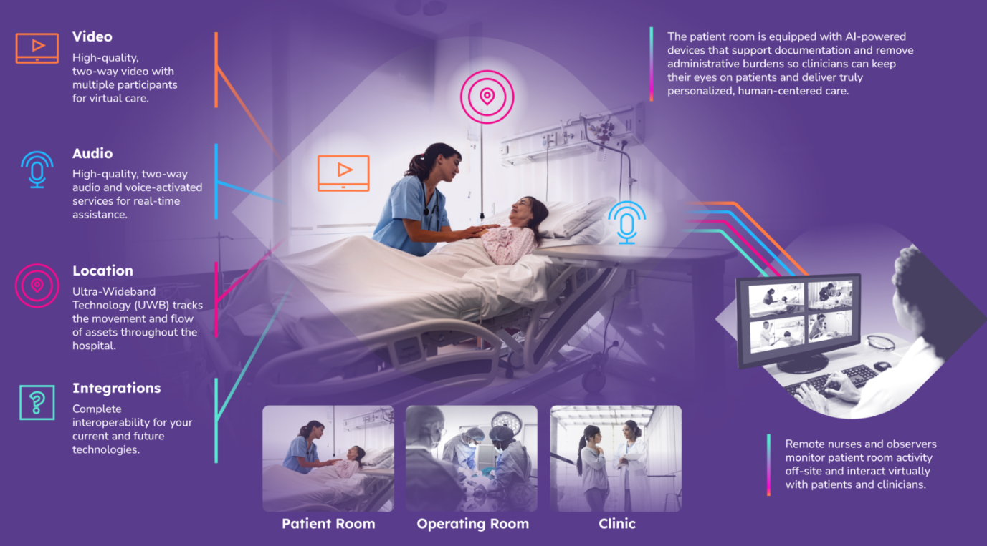
Virtual Nursing and Observer
Address nurse staff shortages, negative impact to productivity, and cumbersome fractured technology through Artificial Intelligence (AI) and automation
AI driven workflows audio-visual capabilities, ambient sensors, and real time live feed + documentation
Virtual nursing enables monitoring and interaction from nurses station or offsite location
Virtual observer monitors for fall risk or patient distress and drive intervention as appropriate

Slide 40



Elements of Success
Human centered
We incorporate the voice of the care team, patients, and end users, with equity at the forefront.
Discipline and Focus
We are uncompromisingly focused on solving problems. We are disciplined in our approach.
Implementation & Assessment
We are disciplined in the application and measurement of implementation strategies to maximize impact.
Innovation & Entrepreneurship
We are a dedicated partner for driving innovation in healthcare.
Science & Discovery
We approach digital health through a scientific lens and cultivate discovery in all that we do.
Ethics & Governance
We envelop all that we do with appropriate governance to ensure ethical deployment and development of digital solutions.

Slide 41
Executive Q&A Session
Tom Jackiewicz
President
UChicago Medicine
Krista Curell
System Chief Operating Officer
UChicago Medicine
Yeman Collier
Chief Information Officer
UChicago Medicine

Slide 42
Eric Tritch
SVP Supply Chain & Support Services

Slide 43

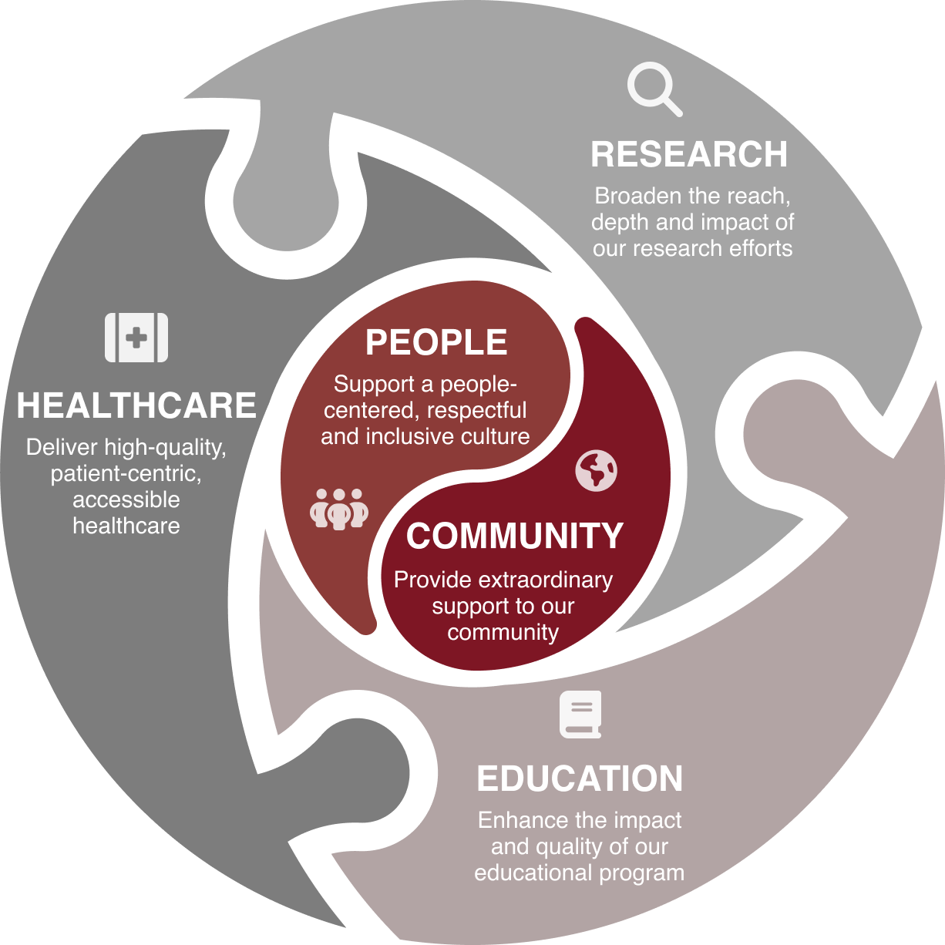

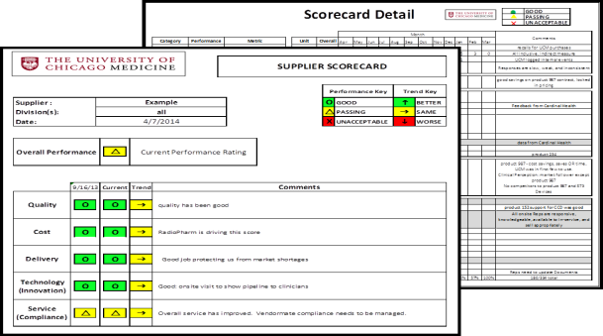




Commit to Excellence
Embrace Curiosity
Take Ownership
Make a Difference
Grow Together
Embody Equity
Notes:
Focus of remaining session:
Pharmacy cost management & growth
Sourcing, technology assessments, price competitiveness
Impact Purchasing
Operations resilience, leveraging technology to lower our cost to serve
Growing health system, efficient P2P processes leveraging people, process, and technology

Slide 44
Denise Scarpelli
VP & Chief Pharmacy Officer
Notes:
Invites Denise on Stage

Slide 45
Dominant Trends and Forecasts for 2025-2026
Drug shortages Continue > 200 drugs on shortage list
Greater Focus On spend Analytics
Inflation Drug Act- 10 drugs impacted Jan 2026
Growth in home delivery, Specialty, and Infusion
Growth in cell & gene therapies in the pipeline- 80 in the Pipeline- Hot Topic
Specialty drugs now account for 54% of the Pharmacy Market- immunology and oncology
Boom in Biosimilars- UCM Biosimilar Strategy Payer Adaptive Model
Surge in GLP1’s usage for Diabetes and Weight Loss
Site of Care Restrictions for Infusion- Infusion Strategy
340B Contract Pharmacy Restrictions- Rebate Model, HRSA->CMS
Growth of Artificial Intelligence technology
PBM reforms Bills passing in many states- Illinois being one
Growth of Pharmacy Deserts across the US

Slide 46
Pharmacy Challenges
Staffing shortages
Drug Shortages- Managing > 200 drug shortages
Payers shifting patients to lower sites of care or mandating white/clearing bagging
Payer access for Home Infusion
Payer decreasing reimbursements
340B challenges – Rebate Model, HRSA Moving under CMS, Contract Pharmacy Restrictions
Drug prices increasing and growth in expensive therapies
Impact of the Inflation Reduction Act – 10 drugs has ~ $11M impact to UCM starting Jan 26
Increase requirements for prior authorizations
Medicaid Cuts- enrollment down by 7%
Regulatory changes

Slide 47
Regulatory Changes Impacting Pharmacy
Tariffs
340B changes/reduction- Rebate Model, HRSA
Medicaid Cuts
Site Neutral Payments
Residency programs funding cut
Research funding cuts
PBM Reform Bills- Illinois just passed a new law
Most favored Nations Drug pricing program proposal- Reducing drug prices by 30-80%

Slide 48
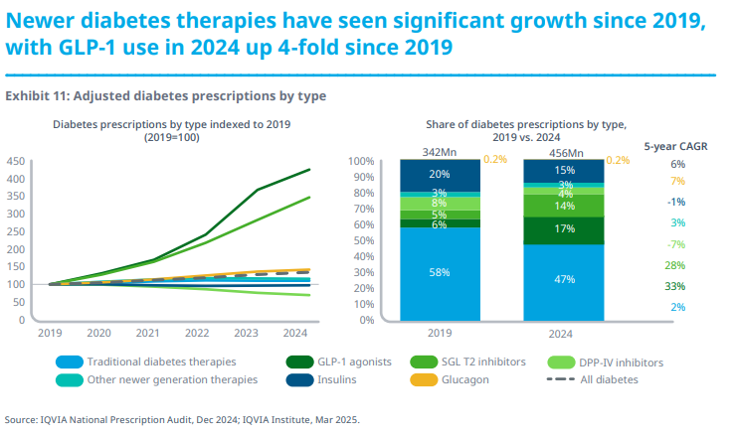

Slide 49
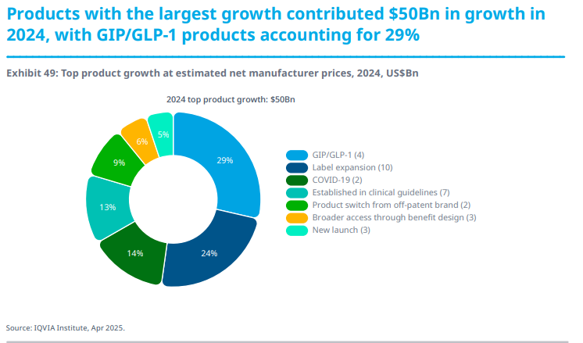

Slide 50
High-Cost Drug Committee
To address the surge in Gene/Cell Therapies and High Cost Drugs:
Establish a model workflow and process for operational and financial aspects of medications that cost (WAC) more than
  $25,000/dose per patient OR
  $100,000/year of therapy per patient
  $300,000/course of therapy per patient
Develop and maintain a detailed checklist of all elements to be considered when designing an operational and financial workflow for a specific medication
Engage individual department administrators to ensure that medication-specific workflows (covering operational and financial components) are developed for the requested drug
Approve workflows that have been developed and submitted by individual departments
Evaluate adherence to agree-upon workflows and escalate concerns to the P&T Committee
Report biannually to the P&T Committee

Slide 51
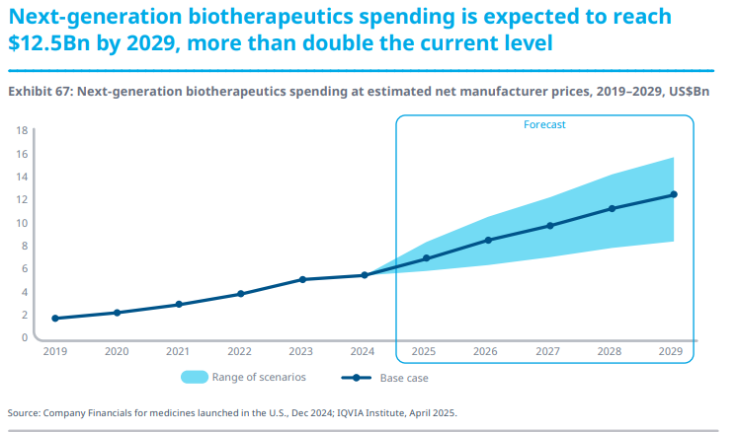

Slide 52
UCM Biosimilar Management
Payor Agnostic
Focus: Cost > Margin
Payor Adaptive
Focus: Margin > Cost
Payor preferences
Simplifies Inventory (?)
Complicates Inventory
Simplifies pre-authorization
Payor preferences
Complicates pre-authorization

Slide 53
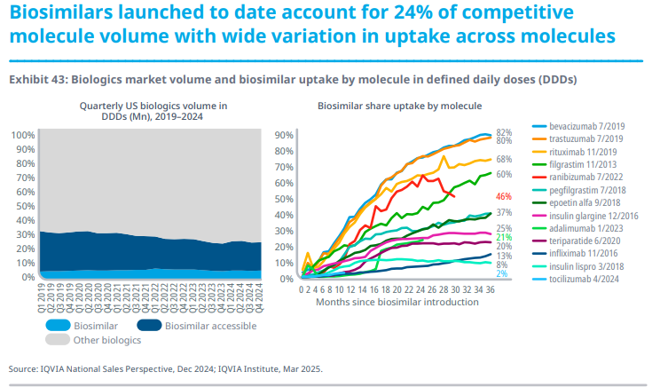

Slide 54
Pharmacy Department Plans FY26

Slide 55
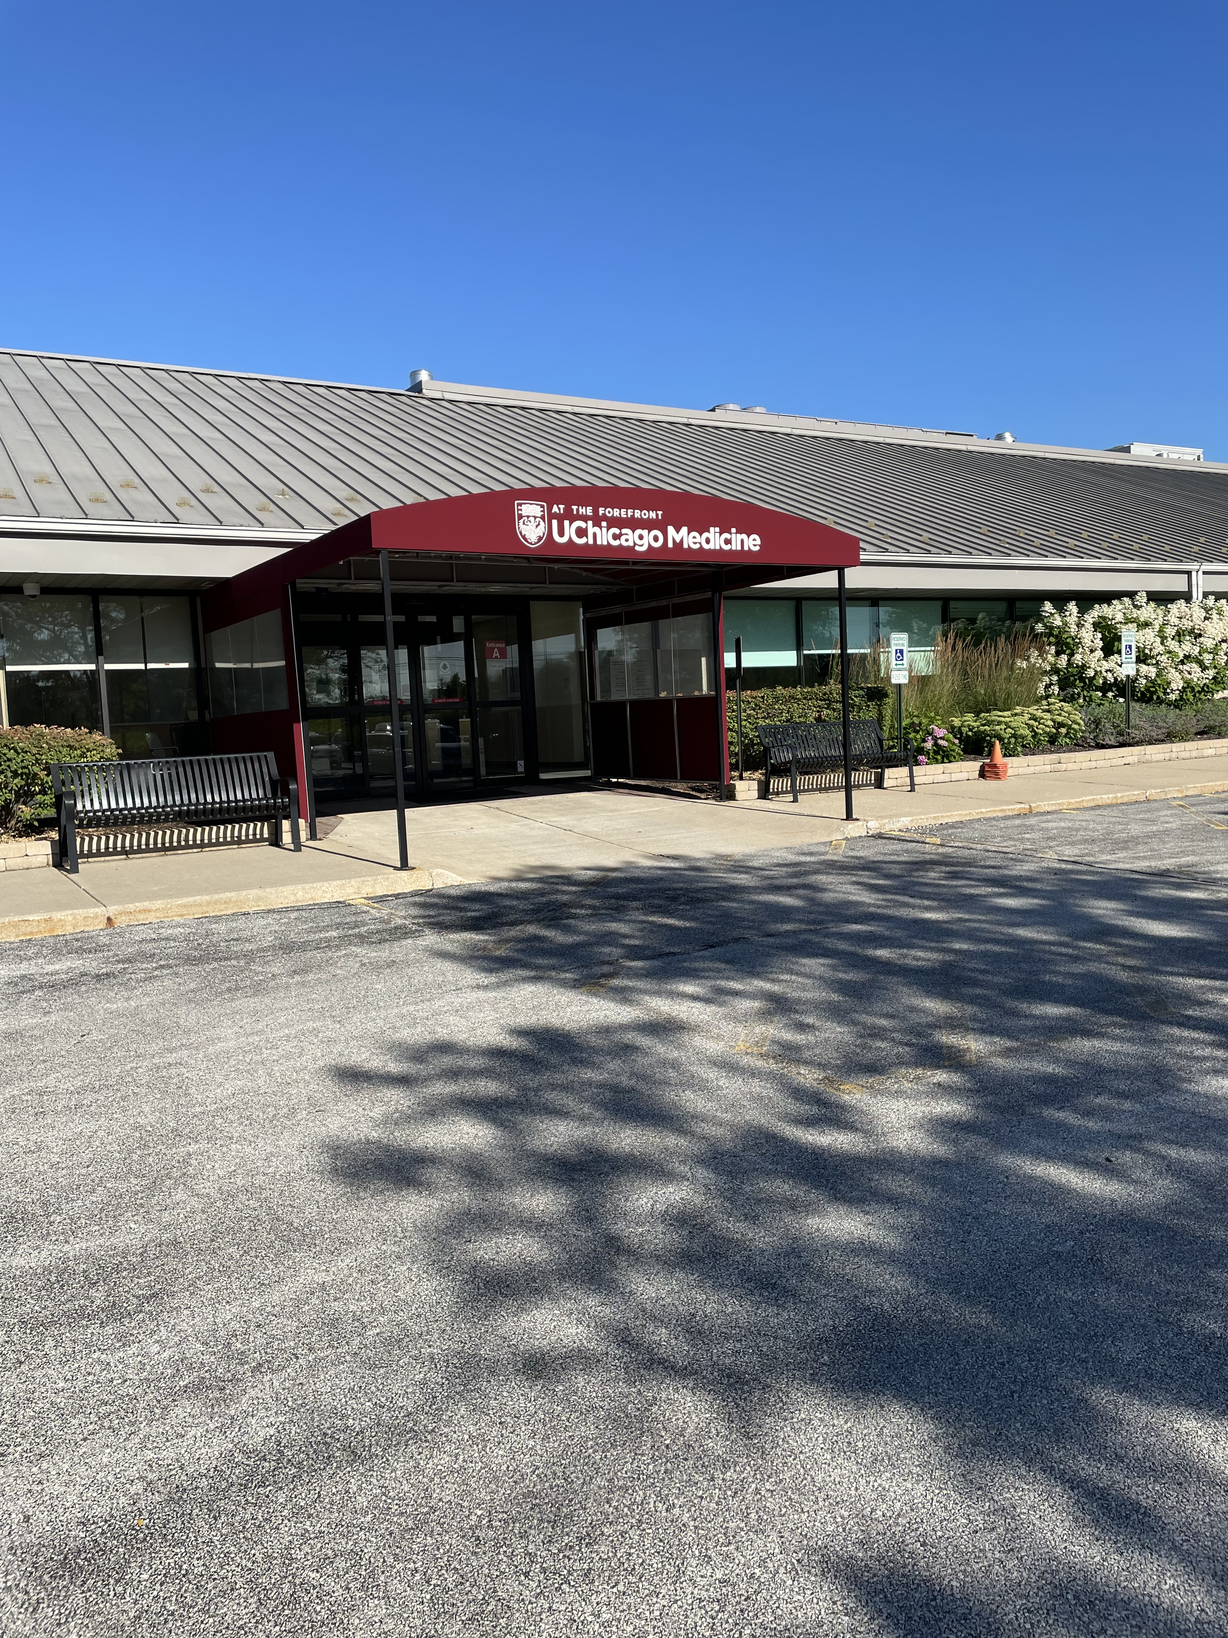
FY25 Pharmacy Accomplishments
Growth in Infusion, Mail, and Retail
Omnicell Upgrade at UCM
Roll-out of DSCSA software- 100% compliant
Dispense Prep Roll-out
Implementation of Compass Rose for Specialty
High-Cost Drug Committee
Biosimilar Payer Adaptive Model
PharmaFit- Support GLP-1’s
Spend Analytics Software

Slide 56
UCMC Inpatient Drug Cost / IP Admissions and Observations
The team focused on reducing drug spend on inpatient i.e. Vial-to-bag launch, Spend Analytics Software, Stewardship
Tracking high-cost utilization- New ad hoc committee

Slide 57
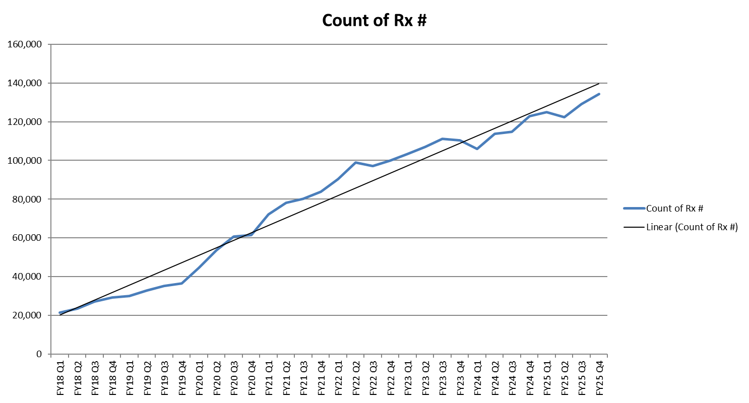
Outpatient Script Count- Growth Due to Mail Order

Slide 58

Key Pharmacy Strategies for FY26
Growth of outpatient scripts- Specialty, Retail, mail order
Expansion of Infusion services
Implementing a new Courier across the Enterprise, will help reduce mail order expenses and create standardization
Exploring AI technology to improve efficiencies
Hiring and Retention strategies
Focus on reducing drug spend- Spend Analytics
Launch of Omnicell Anesthesia Carts at Hyde Park
Execute Plans for New Cancer Center
Implement Process for IRA- 10 drugs
Expansion of Epic solutions with Epic inventory and Epic POS
Re-Accredit to be COE adding Ingalls

Slide 59
Summary
Many new government regulation impacting Pharmacy- Need to plan
Surge of Gene and Cell Therapies
Large growth in GLP-1’s
Outpatient script growth with more patients shifting to mail order
Home Infusion potential
Continue growth in Specialty Pharmacy with the new drugs hitting the market- oncology and autoimmune diseases
Drug shortages will be a challenge
340B Contract Pharmacy Business will be a challenge, focus on optimizing the program
Focus on Decrease drug spend
Using technology to create efficiencies across Pharmacy- especially help with Prior Auth’s

Slide 60
References
1. The Use of Medications in the US 2024. IQVIA. https: The Use of Medicines in the U.S. 2025 – IQVIA. Published April 2025.

Slide 61
Ian O’Malley
Exec Director of Strategic Sourcing

Slide 62

1
01
Strategic Sourcing Overview
2
02
Value Analysis & Category Management
3
03
Resiliency and Global Disruptions
4
04
Contracting Updates

Slide 63
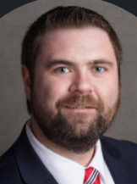
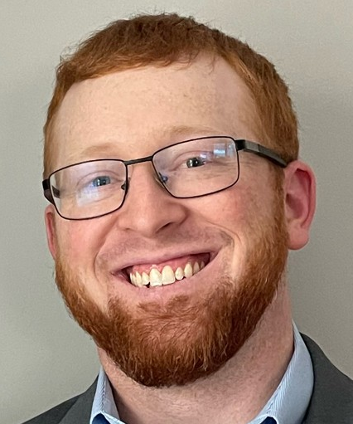

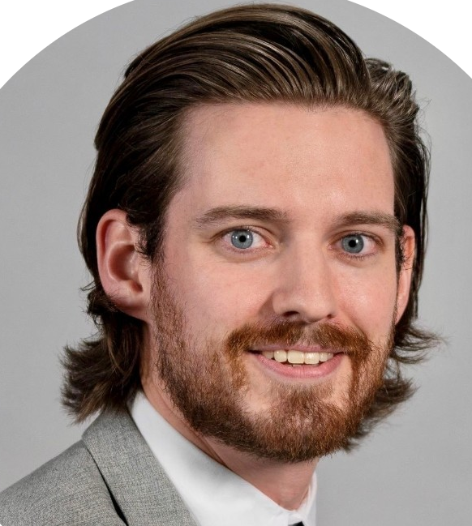

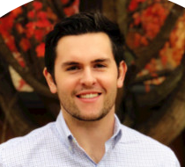
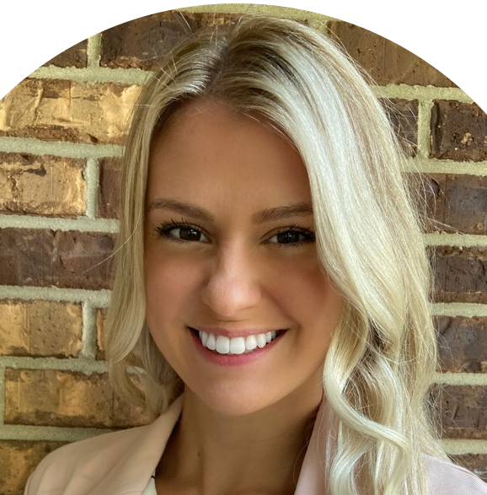
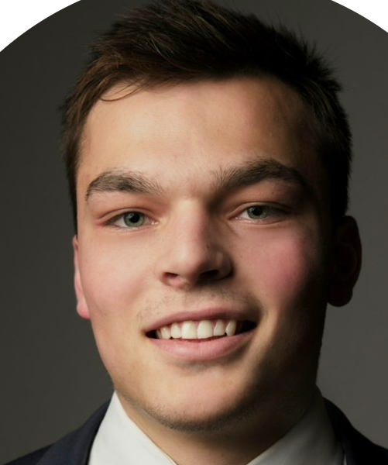
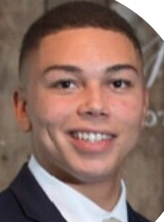
Clinical Strategic Sourcing
Ian O’Malley
Executive Director, Strategic Sourcing
John Mayer
Asst. Director, Strategic Sourcing
Cara Eason
Jordan Schleyer
Karen Cheung
Tim Garrett
Brooke Weese
Strategic Sourcing Manager-Perioperative Services
Strategic Sourcing Manager-Lab, Pharmacy, Ambulatory
Strategic Sourcing Category Leader-Ingalls Memorial Hospital
Strategic Sourcing Manager-Heart & Vascular
Construction Equipment Sourcing Manager-Radiology, Rad Onc, New Site Development
Open
Alan Holmgren
Peter Brewster
Strategic Sourcing Category Leader-Women’s & Childrens, Patient Care Services
Strategic Sourcing Category Leader
Digestive Diseases, Anesthesia
Strategic Sourcing Category Leader
Perioperative Services, Same Day Surgery Sites of Care

Slide 64
Robbie Brown
Director – Strategic Sourcing
OPEN - Recruiting
Strategic Sourcing Manager (Non-IT Categories)
Rick Zakowski
Sourcing Category Leader (FPDC & Support Services)
Melissa Wallace
Sourcing Analyst
Lara Christmann
Strategic Sourcing Manage (IT, HIM, Revenue Cycle)
New Team Member Starting 8/18
Sourcing Category Leader
Kyle Kaparos
Optifreight – Program Lead
Sydney Felty
Vizient – Sourcing Consultant
Non-Clinical Strategic Sourcing

Slide 65
Strategic Sourcing Overview
Strategic Sourcing is an organized and collaborative approach to leveraging targeted spend across a system with select suppliers that are best suited to optimize value for our patients and our organization.
Supplier Relationship Management
Category & Contract Management
Vendormate (GHX); Supplier Scorecarding, Supplier Onboarding (Oracle)
GHX, Oracle, Scout, Vizient, iValua, Surgery Exchange, Primrose, Valify
Value Analysis
Capital Equipment
Procedural Analytics, VAT Meetings
ECRI, Trimedx

Slide 66
What tasks are supported by Strategic Sourcing?
Category Assessment
Data Collection
Market Assessment
Market & Peer Review
ECRI
RFI/ RFP Execution
Scope Creation
Current Spend
Utilization
Contract Review
Price Benchmarks
Valify
Price model
Evaluation Criteria
RFI/ RFP
Workday/ ScoutRFP
New Suppliers
New Technology
Analysis & Selection
Initial Analysis
Price Review
Vendor present
Scoring
Supplier Selection
Contracting
Implement
Supplier Performance Management
Master Terms
SOW
BAA & SSA
Price Negotiation
KPI’s
Implementation timeline
Suppler Onboarding
Support Service/ Product Implementation
Financial Impact/ ROI & Savings
Vendor KPI review
Business Review & Scorecards

Slide 67

1
01
Strategic Sourcing Overview
2
02
Value Analysis & Category Management
3
03
Resiliency and Global Disruptions
4
04
Contracting Updates

Slide 68
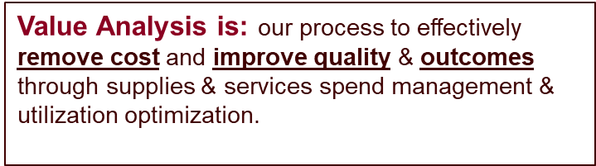




Driving Out Costs – Value Analysis

Slide 69

Value Analysis – Team Structure

Slide 70

Value Analysis– Procedural Analytics
Benchmark procedural costs across Vizient nationally
Includes quality metrics
Implemented across UCM System

Slide 71

Category Management-Sourcing Roadmap
01
Gather data
02
Internal stakeholder alignment
03
Go to market approach and strategy
05
RFI/RFP development and/or contract negotiations
06
Supplier selection and implementation plan
07
Implement & Monitor

Slide 72
Category Management-Off Cycle Projects
While we maintain a bid calendar tied to contract timelines there are many scenarios where a category may require off cycle assessment
Inflationary pressures are increasing this cadence and price increases are becoming the primary initiation for projects off cycle along with supplier performance due to disruption
01
02
03
04
Initiation
Planning
Execution
Control
Price Increase
Tech Change
Benchmark Alignment
New Service/Surgeon
Supplier Performance
VAT Review
Clinical Champion
Market Assessment
Bid/No Bid
Establish Timeline
Communicate to Market
Supplier Performance Data
Issue RFP
Negotiate Contract
Coordinate Trials
Clinician Support
Award Contract
Systems Updates
Operational Updates
Monitor Performance
Track qualitative data if available
VAT Updates

Slide 73
Capital Equipment Sourcing
Routine
148 Projects $54.5m
Strategic/Contingency
Est. $TBD
Construction/New Site Support
$TBD
Understand Stakeholder Need and Define Specs
System Standardization Assessment
Bid/RFQ
Negotiations
Legal Terms, IT review, Privacy Review, Service Coverage Post Warranty
Execute agreement
Coordinate delivery, training and implementation

Slide 74

1
01
Strategic Sourcing Overview
2
Value Analysis & Category Management
02
3
Resiliency and Global Disruptions
03
4
04
Contracting Updates

Slide 75
Building Resiliency: Supplier Expectations
1
Transparency
Our supplier representatives need to be prepared to answer and provide documentation on product/device origin
2
Proactive Communication
Sales needs direct lines of communication with their Operations teams and provide data with alternative options before disruption hits our shelves
Supply Chain Resilience
3
Suppliers need to invest in their resiliency plans. Diversify sites of production, invest in near/onshore capabilities, expand inventory positions and don’t outsell your operational capability. Work with our distributor (Cardinal) on communications and inventory.
Built in Resilience
4
We are partnering with Vizient on a Supply Risk Solutions tool. We expect our suppliers to be able to provide the data needed to get us line item level manufacturing information.
Resiliency Tools

Slide 76

Vizient and Supply Risk Solutions (SRS)
Disruption awareness: increase mitigation options by knowing immediately about impacted products.
Business reviews: discuss risk management deficiencies and ask suppliers to address them.
Scorecards: add risk to internal supplier scorecards by importing risks from SRS automatically via our API
Contracts: Negotiate Terms & Conditions using quantified supplier and product category risks.
Include risk in Sourcing decisions: a) Choose low risk supplier if pricing is similar b) Seasonally adjust safety stock for critical products made in hurricane areas. c) Consider single sourcing if low risk. d) Identify single points of failure such as products made in just one site.

Slide 77


Healthcare Industry Resilience Collaborative (HIRC)

Slide 78



Tariffs
Tariff impacts to UCM will be met with a market assessment to shift business and avoid these where possible
Providers are not able to pass along increased costs so this is direct loss to UCM
Suppliers have a shared responsibility to absorb and offset these impacts

Slide 79
1
01
Strategic Sourcing Overview
2
Value Analysis & Category Management
02
3
03
Resiliency and Global Disruptions
4
Contracting Updates
04

Slide 80

Medical Device, Clinical Software Solutions & Equipment IT Contracting
The MDS2 is intended to be used as part of the security procurement process. The MDS2 clarifies roles and responsibilities of manufacturers and healthcare delivery organizations for the upkeep and maintenance of a connected device security posture. The form is manufacturer-completed and provided to healthcare delivery organizations upon request
PHI Determination and BAA need
Security Standards Addendum
IT Security Risk Assessment
Artificial Intelligence
  Innovation Intake Process -> AI Committee Review
  Any digital solution or integrated technology (new not enhancements)
Medical Device Connectivity Market

Slide 81

Purchased Service Contracts
We have a process for Purchased Service Spend Management to balance expenses while providing the highest quality of care to our patients. This approach focuses to ensure resources are available for organization priorities:
Requester submits PSC form
Department
VP Approval
Y
Supply Chain
VP Approval
Y
Finance VP Approval
Y
Contract Approved
N
N
N

Slide 82





Supply Chain Affiliate Program
AdventHealth’s Great Lakes Region: Bolingbrook, Glendale Heights, Hinsdale and La Grange hospitals along with a network of nearly 50 locations in western suburbs
Advent Health contract portfolio in place
Expectation is that all of our supplier partners are providing a similar level of support to our affiliate partners that UCM is receiving

Slide 83

Finally-Thank You To Our Supplier Partners

Slide 84
IMPACT Purchasing – Alder Derose

Slide 85
UChicago Medicine Equity Plan
Domains and Goals
Workforce | Climate | Health Care Delivery and Services | Community Engagement and Outreach
Build an organization at all levels that reflects the demographics of our patients and the communities we serve. Ensure equity in our workforce processes to: Foster productivity Stimulate creativity and innovation Reduce disparities and disengagement | Enable each person to fully participate and belong as a valued member of our community. Build and sustain a culture that promotes: Wellness Equity Inclusion Justice | Enhance and strengthen the South Side, Southland Region, and other system-wide ecosystems. Use a multifaceted strategy to: Increase access to quality care Reduce healthcare inequities, and Improve health outcomes | Advance an Asset-Based Community Development approach for authentic and effective engagement. Leverage partnerships and stakeholder collaboration to: Achieve health equity Improve the health of the community Hire and buy from target system-wide service area zip codes. Increase utilization of local, minority-and-women-owned businesses, and promote supplier workforce goals
UCM IMPACT Purchasing embedded here
Equity Action Plan Objective: Leverage UCM’s non-labor spend strategically to invest in the communities that we serve as a key element of the total health & wellness of our patients and their families

Slide 86


IMPACT Purchasing Programs
Objective
Leverage UCM’s non-labor spend strategically to invest in the communities that we serve as a key element of the total health & wellness of our patients and their families
Continuous Improvement
Increase % of spend every year
Local Business Investment
Chicago United, HEAL and UChicago Local
Supply Chain is Executive Sponsor of team focused on sustainability initiatives at UCM

Slide 87
Business Diversity and Compliance
Purpose
Recognizing that diversity in construction can yield greater competition while enhancing quality, costs and performance the University of Chicago Medicine launched the Construction Initiative to encourage opportunities for women and minority-owned business enterprises and maintains a contractor base that reflects our diverse workforce and patient base.
Mission
To effectively utilize MWBE’s in construction projects and construction related professional service engagements
To integrate contractor diversity into daily work
To accelerate economic development in the community
To design and implement a process designed to maximize utilization of onsite construction workers that reside within an eight zip code area surrounding this campus and maximize apprenticeship opportunities
to create long-term career options for Chicago residents
Vision
The University of Chicago Medicine as a recognized leader among academic medical centers in the utilization of diverse firms and onsite workforce in its construction and construction related business opportunities.
UCM will create and maintain a level paying field for all bidders. Our contracting process will be transparent, and fair. UCM will be considered, by firms as the Owner of choice resulting in competitive pricing and a high level of creativity and quality.
The intentional utilization of diverse certified minority and woman owned firms cannot and should not remain within the walls of Facilities, Design and Construction. The effort must be expanded throughout the organization.
Minority Business Enterprise (MBE)
Woman Business Enterprise (WBE)
MWBE is Minority or Woman Owned

Slide 88
FY 2025 Highlights
FY2025 Year End Constructions Compliance Results
$57.4M in contracts awarded and paid to certified minority- and woman-owned firms
$9.6M in wages paid to minority and female onsite construction workers
$5.8M in wages earned by Chicago residents working on UChicago Medicine construction projects
From 2001 to 2024:
Certified minority and woman-owned firms (MWBE) achieved $643.5 Million in economic benefit from contracts awarded and paid on UChicago Medicine capital, renovation and plant expenditures.
Cancer Center Project
Over 90 MWBE subcontractors have been awarded contracts
To date over $45.M in contracts awarded and paid to certified minority- and woman-owned firms
$ 9.3M in wages paid to minority and female onsite construction workers
$ 5.8M in wages earned by Chicago residents working on Cancer Center project
Minority Business Enterprise (MBE)
Woman Business Enterprise (WBE)
MWBE is Minority or Woman Owned

Slide 89
UCM Community Impact – Supplier of the Year

Slide 90

UCM Community Impact – Supplier of the Year
PRESIDENT – COREY SMITH

Slide 91
Bob Boyden
Executive Director Supply Chain Operations

Slide 92
One Supply Chain
120,000 individual supply locations(bins)
23,000 individual skus managed
$40,000,000 in inventory managed
3,800 Lines per day
1,100 Packages(UPS/FedEx) per day
6,000,000 million pounds of linen per year
VOLUME
UCM Supply Chain
River East
Orland Park
Ingalls
South Loop
Hyde Park
Calumet City
Flossmoor
Tinley Park
Crown Point
Dearborn Station
Kenwood
Cottage Grove
Silver Cross
Chesterton
Valparaiso
PEOPLE
125 Supply Chain Professionals
Supply Chain people doing Supply Chain work

Slide 93


Where are we going?
Easy Street TBD
Source Tagging 2Yr
Auto Ordering 1.5 Yr
E-Labels 1Yr

Slide 94







Electronic Shelf Labels
ARC Healthcare Technology
Low Stock Press
AP Device
Information Transfer
Low Stock
Out of Stock
Full Stock
Device Status
Out of Stock Press
Ordering Information
Req
Order Qty
ESL
Vendor Order Sent
Oracle Cloud
Po orders created
Orders sent to Vendor
Replenishment Process

Slide 95
Electronic Shelf Label Performance – Results
Category | Criteria
Tag performance | Connectivity
Tag performance | Functional workflow performance
Conduciveness | Clinical team feedback
Conduciveness | Supply chain team feedback
Mounting and fit | Tags stay on the bin
STAT 0440 | DCAM 5748 | CCD 8480
Pass | Pass | Pass
Pass | Pass | Pass
N/A | Pass | Pass
Pass | Pass | Pass
Pass | Pass | Pass
Stockout Rate
Stockout Count
Avg SO Rate Before | 1.70%
Avg SO Rate After | 1.38%
Comparison Diff | -0.32%
Avg Sum SO Before | 189.9
Avg Sum SO After | 141.5
Comparison Diff | -48.4

Slide 96
Auto Ordering Pilot
Utilizing our data to predict supply orders in hospital units
Why Auto Order?
Free up labor for other activities
Reduce manual interventions-reduce chances for error
Reduced variability
Reduce overstock
Current Scope
Number of rooms: 12
Number of Items: 77 items
Started pilot in January of 2024

Slide 97
Auto Ordering-Results

Slide 98
Source Tagging-RFID
Partnership between UCM, ARC Healthcare Technologies, and Cook Medical
Current State
Inventory Planners within the medical center receive and RFID tag supplies to ensure traceability and expiration mitigation
Future State
Supplies are tagged at the manufacturer facility
Benefits
Cook Medical
Real-time stock level visibility
Real time product usage data
Consignment product visibility
Product movement metrics
Lot/Serial/Expiration tracking
UCM
Real-time visibility to product in the DC
Streamlined receiving process
Better product availability

Slide 99

How can you help?
Supply Resiliency – Proactive data sharing to allow for fast action. Build resiliency into the manufacturing process.
Transparency– We understand issues happen, the quicker we are informed, the quicker we can start working on the back-up plan to ensure patient care is uninterrupted
Innovation– How can you all make the supply chain more efficient for operations?

Slide 100
Anurag Jaiswal – Executive Director Supply Chain Systems & Analytics

Slide 101
Supply Chain Purchasing Team
Anurag Jaiswal
Executive Director Supply Chain Systems & Analytics
Nancy Olmos
Director, Purchasing
Keith Kissinger
Supervisor, Purchasing
Mike Lively
Supervisor, Purchasing
Edward Anderson
Specialty Buyer
Mark Lukasick
Specialty Buyer
Alberto Rocha
Specialty Buyer
Michelle Cox
Specialty Buyer
Byron Ealy
Purchasing Agent

Slide 102

Tasks Supported by Purchasing Team
Requisition Management
Purchase Order Management
Exception Management
Requisition Processing
User Training & Job Aides
PO Creation & Approvals
PO Supplier Communication
PO Confirmation
Quantity & Price Hold Resolution
Credit Hold Resolution
PO Change, Close/Cancel
Process Improvement
Improve Financial Forecast
Improve EDI Transactions
P2P Change Management
Procure –to- Pay (P2P) Optimization
Rush Order Management
Purchasing Policy Review
INR & RNI Reviews

Slide 103
Supply Chain Business Process Team
Anurag Jaiswal
Executive Director Supply Chain Systems & Analytics
Dhaneesh Sharma
Business Systems Analyst, Lead
Prashant Narayanan
Manager, Supply Chain Systems
Tierra Goldston
Business Systems Analyst, Intermediate
Kiersten Hardy
Business Systems Analyst, Senior
Michael Nava
Supply Chain Analyst
Open Position
Supply Chain Analyst

Slide 104

Tasks Supported by Business Process Team
Master Data Management
SCM DevOps
SCM Analytics
Supplier Master Add/Change
Item Master (ERP, Epic) Data
Monitor P2P Automations
SCM System User Access
Analytics ETL
Supply Spend Reports
Process Improvement
Improve Financial Forecast
Supply Charge Improvement
Requisition-to-Pay Optimization
Location Master Data
Location Chart of Accounts
Supplier-Ship-to GHX Registration
Distributor PO Jobs
Oracle SCM Release
SCM System Failure RCA
Procedural Analytics ETL
Master Data Quality
Technology Project Management
SCM Dashboards
Benchmarking API & ETL

Slide 105
FY25 Supply Chain System Priorities
Procure-to-Pay Optimization
AI / ML Driven Automations
Oracle Self Service Procurement Upgrade
Perfect PO

Slide 106
FY26 Supply Chain System Priorities
Procure-to-Pay Supplier Collaboration
AI & RPA
Automations
SCM
Analytics
Perfect
PO
Master Data Management
Improve
Bill Only PO
Charge Capture
Improvements
Increase GTIN
Utilization

Slide 107
Procure To Pay Supplier Collaboration
Build and strengthen strategic supplier relationships
Analyze scorecards for high-volume transactions
Identify opportunities for process improvement and automation
Lead Initiative to drive continuous improvement

Slide 108
How can your organization help us?
M&A Activity
Credit Warning
Purchasing Team
PO confirmations
Master Data Management
M&A Activity
Perfect PO
GHX Changes
New Site go-live
P2P Downtime
  Purchasing Contact: UCH_PURCH@uchicagomedicine.org

Slide 109
Sam Gonzalez
System Director Accounts Payable

Slide 110
Procure to Pay (P2P) Org & Key Contacts
Procurement Org
Accounts Payable Org
Eric Tritch
Senior Vice President – Supply Chain
Anurag Jaiswal
Executive Director –
Supply Chain Systems & Analytics
Nancy Olmos
Director, Supply Chain Purchasing
Edward Anderson
Specialty Buyer
Keith Kissinger
Supervisor, Purchasing
Mark Lukasick
Specialty Buyer
Mike Lively
Supervisor, Purchasing
Alberto Rocha-Perez
Specialty Buyer
Byron Ealy
Specialty Buyer
Michelle Cox
Specialty Buyer
Phil Kaufman
Vice President – Financial Services
Sam Gonzalez
System Director – Accounts Payable
Latonya Randle
Supervisor – Accounts Payable
Arieana Kelley
Accts Payable Specialist
Dinorah Jaquez
Accts Payable Specialist
Cheryl Dooley
Accts Payable Specialist
Michele Merino
Hayley Seiter
Yolanda Nalls
Cheryl Johnson
Accts Payable Specialist
Vickie Custodio
Accts Payable Specialist
Sarah Johnson
Linda Arceci
Accts Payable Specialist
Deatrice Tharpe
Accts Payable Specialist
Grishma Dangol
Accts Payable Compliance Specialist

Slide 111
P2P Key Contacts
Purchasing General Inquiries - UCH_PURCH@uchicagomedicine.org
Rush Order Process: UCMExpeditedOrders@uchicagomedicine.org
Purchasing Escalation Support
  Michael.Lively@uchicagomedicine.org
  Keith.Kissinger@uchicagomedicine.org
  Nancy.Olmos@uchicagomedicine.org
Accounts Payable & Invoicing Inquiries:
  UCM: accounts@uchicagomedicine.org
  Ingalls/CHHD: accountspayable@uchicagomedicine.org
  Payment Term & Method Updates: ProcureToPay@uchicagomedicine.org
AP Escalation Support
  latonya.randle@uchicagomedicine.org
  samuel.gonzalez@uchicagomedicine.org

Slide 112
Pillars of Excellence
Accounts Payable
Invoice Management
Invoice Processing Automation
Statement Reconciliation
Payment Optimization
Preferred Payment Methods
Payment Terms Improvement
Vendor Master Management
Data Repository Integrity
Life Cycle Management
Compliance
Expense Reporting
Fraud & Risk Mitigation
Process Improvement
Early Payment Discounts Utilization
Duplicate Payment Prevention
Duplicate Invoice Prevention
Exception Handling Workflow
Vendor Onboarding & Maintenance Standards
Policy Adherence & Audit Readiness
Regulatory & 1099 Tax Compliance Monitoring

Slide 113
Technology
Vendor Life Cycle Management
Automated Invoice & Vendor Validation: Enhance vendor verification protocols to ensure legitimacy before processing payments, reducing exposure to fraudulent actors.
Accounts Payable AI Roadmap
Vendor Statement Reconciliation – Utilizes AI to automatically analyze vendor statements for missing credits, unpaid invoices, or invoices not received.
Vendor Centralized Utility Management
Unified Utility Management Platform: Implement a centralized system to consolidate procurement, billing, and reporting for all utility and commodity services.
Automated Unclaimed Property Identification: Implement AI-powered reconciliation tools that continuously track and identify unclaimed funds across multiple states and entities.
Audit and Unclaimed Property Recovery
Payment Inquiry Helpdesk – Uses an Agentic AI SaaS to ingest and respond to internal/external queries for invoice and payment status, improving labor efficiency and SLA
Duplicate Payment Prevention - AI for real-time duplicate payment detection and prevention of overpayments
AP Analytics - Generative AI for predictive analysis and reporting dashboards to support strategic decision making and identifying improvement areas
Risk Monitoring - AI-driven anomaly detection in invoices and payments to identify unusual patterns in transactions and flag high-risk vendors or payments
Strengthened Internal Controls & Audits: Introduce regular AP audits and automated reconciliation tools to prevent unauthorized payments.
Vendor Onboarding - Reduces onboarding time while ensuring compliance and validation of procurement and organizational standards
Sustainability & Cost Reduction Initiatives: Establish data-driven programs to reduce energy consumption, implement renewable energy solutions, and achieve long-term operational savings.
Reduction in Administrative Overhead: Eliminates redundant processes across multiple business units, leading to significant time and cost savings.
Standardized Compliance & Filing Procedures: Establish a structured workflow to proactively claim property before state escheatment deadlines, avoiding unnecessary complexity in the recovery process.
Purchased Services Cost Avoidance: By reducing reliance on third-party services, the organization can save an estimated $500,000 in reclamation fees.

Slide 114
Process
Current Processes
Optimizations to Existing and Legacy Workflows
Interim Processes
Processes to bridge Current to Future State
ACH Banking Add and Update: Enhanced validation steps for secure and timely ACH setup
Future State Processes
Processes to support Long Term Strategic and Technological Vision
Strategic Card Programs – Ghost Cards: Virtual card issuance to reduce fraud risk and streamline low-dollar purchases
AP Production Standard Work: Documented procedures to standardize and streamline invoice and payment processing
AP Reporting: Standardized process to extract AP Reporting for Invoice, Payment, and Vendor data.
Invoice Spreadsheet Upload Template: Procedure to utilize Oracle template to upload bulk invoices into ERP
Payment Term Change Management: Controlled process to review and approve supplier term changes at scale
Vendor Life Cycle Management: Integrated system to manage vendor onboarding, performance, and offboarding
Supplier Add/Update: Workflow improvements for faster and compliant vendor onboarding
Check Production at Burr Ridge: Centralized and standardized check printing and distribution operations moved from Hyde Park to Burr Ridge
Master Data Clean & Enrichment: Efforts to ensure accuracy and completeness of vendor master data
Regulatory Reporting (1099): Compliance reporting for vendor payments to meet IRS regulations
Expense Policy Enforcement & Auditing: Routine audits to drive adherence to expense policies
Invoice Processing Policy at Sourcing: Alignment of invoice expectations at the time of contract or PO issuance
Outsource Payment Optimization: Partnership with third-party services to optimize payment mix, timing, and rebates

Slide 115


What’s Ahead: Upcoming Initiatives from Our AP Team

Slide 116
Strategic Roadmap
Technology
People & Talent
Process
FY 2026
July | Aug | Sept | Oct | Nov | Dec | Jan | Feb | Mar | Apr | May | June
P2P Pay Terms – Pay Term Updates and Change Management
Vendor Master Role - Onboarding
Vendor Master - Master Data Clean & Enrichment
AI - Onboarding/Scope
AI - Integration
AI – User Training
AI – Deployment in Production
AI – Sustainment Verification
Utility Services– Onboarding/Scope
Utility Services– Change Management
Utility Services– Sustainment Verification
Check Production at BR - Integration
Check Production at BR - Deployment
ACH Banking Add and Update – Process Refinement
Supplier Add/Update
– Process Refinement
OE Intern
Onboarding
AP Dash. Requirements
AP Tableau Dashboard - Buildout
Vendor Lifecycle Management Program- Onboard/Scope
VLM - Integration
VLM – User Training
VLM – Phase 1 Prod. Deployment
VLM P1– Sustainment Verification
VLM – Phase 2 Implementation
Accounts Payable Specialist/Manager Certification Program
Regulatory Reporting (1099):

Slide 117
Supply Chain Leadership
Q&A

Slide 118
This is a challenging time…but our core principles remain…
Quality – zero defects
Cost – best in market
Delivery – 100% on-time & complete
Technology – At The Forefront
Service – best in class

Slide 119
Thank You

